Slide 1

MOXy & SDO Architecture
Blaise Doughan (OXM/JAXB/SDO)

Slide 2
OXM High Level Architecture
If you simplify EclipseLink down to 2 layers persistence (data source to record) and binding (record to object), then OXM is built on the binding layer.
Objects
Binding Layer
Persistence Layer
XML
DB

Slide 3
Binding Layer – Object Builder
MOXy has two implementations of ObjectBuilder
  XMLObjectBuilder – DOM Platform
  TreeObjectBuilder – SAX Platform (below is an example)
XPathNode
XPathNode
“personal-info”
XPathNode
“contact-info”
XPathNode
“@first-name”
XPathNode
“@last-name”
XPathNode
“address”
XPathNode
“phone-number”
Direct Mapping
Direct Mapping
Comp. Object Mapping
Comp. Coll.
Mapping

Slide 4
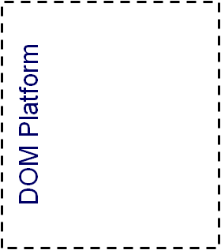
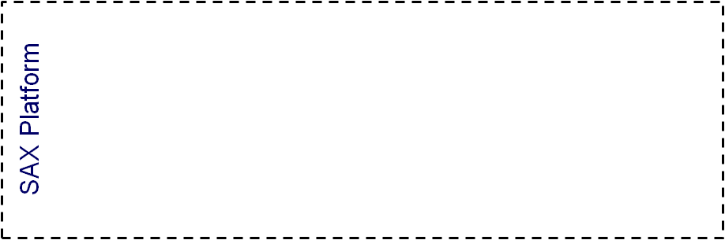
Binding Layer - Records
The Object Builder is responsible for converting objects to/from records. In MOXy we have XML technology specific sources/targets.
Abstract Record
XML Record
Database Record
DOM Record
Unmarshal Record
Marshal Record
Node Record
SAX Record
StAX Record
Stream Record

Slide 5
MOXy & SDO High Level Architecture
EclipseLink MOXy (JAXB) & SDO are a thin layers on our Object-to-XML(OXM) platform.
JAXB
SDO
OXM
Core – Binding Layer

Slide 6
MOXy (JAXB) Architecture
MOXy has been built from the ground up as a JAXB implementation. We have been heavily involved in the spec for many years.
JAXB Context
Unmarshaller
Marshaller
Binder
XML Context
XML
Unmarshaller
XML
Unmarshaller
XML
Binder

Slide 7
SDO Metadata Architecture
SDO has the concepts of Type & Property for representing the metadata for a DataObject. In EclipseLink SDO, these are simply wrappers for Descriptors and Mappings.
Type
XML
Descriptor
*
*
Property
Mapping

Slide 8
Using SDO in an Application Server
SDO has the concept of global & local helpers. The global helpers are available through static INSTANCE variables (i.e. XSDHelper.INSTANCE). EclipseLink SDO isolates these global helpers at the application level.
XSD Helper
XSD Helper Delegator
XSD Helper Delegate
When a call is made to a global helper a “delegator” determines which application space the call occurred in a relays the call to the appropriate “delegate”. We regularly test this behaviour in WebLogic, WebSphere, and JBoss.

Slide 9
Where to Find the MOXy/SDO Code
XML Platform (Core Component)
  org.eclipse.persistence.platform.xml.* (+ 1 sub package)
OXM (Core Component)
  org.eclipse.persistence.oxm.* (+11 sub packages)
  org.eclipse.persistence.internal.oxm.* (+10 sub packages)
JAXB (MOXy Component)
  org.eclipse.persistence.jaxb.* (+5 sub packages)
  org.eclipse.persistence.internal.jaxb.* (+1 sub package)
SDO (SDO Component)
  org.eclipse.persistence.sdo.* (+7 sub packages)

