Slide 1

EclipseLink Project
Component Overview
Peter Krogh, Blaise Doughan, Mike Norman

Slide 2
Components
Foundation (core)
  Includes core functionality with native ORM, OXM, and EIS support
JPA
  JPA 2.0 Reference Implementation
MOXy
  JAXB 2.1 Compliant – 2.2 Compliant for EclipseLink 2.1
SDO
  SDO 2.1.1 RI
DBWS
Utils
  Workbench, Package Rename, DBWS Builder
Documentation
Examples
Incubator

Slide 3


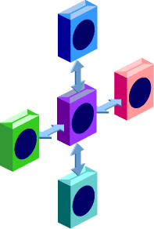






Eclipse Persistence Services “EclipseLink”
Java SE
Java EE
OSGi
Spring
Web
Container
Eclipse Persistence Services Project
(EclipseLink)‏
JPA
MOXy
EIS
SDO
DBWS
Databases
XML Data
Legacy Systems

Slide 4
Foundation Component
Bundles
  org.eclipse.persistence.core
Fragments
  org.eclipse.persistence.oracle
    extending org.eclipse.persistence.core
Testing
  eclipselink.core.test
  eclipselink.extension.oracle.test
/targets
  target.oracle - for Eclipse IDE to access optional Oracle JDBC
/plugins
  org.eclipse.persistence.oracle.jar
  org.eclipse.persistence.oracle.source.jar

Slide 5
JPA Component
Bundles
  org.eclipse.persistence.jpa
Fragments
  org.eclipse.persistence.jpa.equinox
    extending org.eclipse.persistence.jpa
  org.eclipse.persistence.jpa.weaving
    extending org.eclipse.osgi
Testing
  eclipselink.jpa.test
  eclipselink.jpa.spring.test
/plugins
  javax.persistence – 2.0 preview – current version: 1.99.5

Slide 6
MOXy Component
Bundles
  org.eclipse.persistence.moxy
  org.eclipse.persistence.moxy.dynamic
Testing
  eclipselink.test.moxy
/bin
  jaxb-compiler.cmd/sh
/plugins (only required for Java SE 5)
  javax.xml.bind_2.2.0.v201003241715.jar (with source)
  javax.xml.stream_1.0.1.v201001131653.jar
  javax.mail_1.4.0.v200804091730.jar
  javax.activation_1.1.0.v200906290531.jar

Slide 7
SDO Component
Bundles
  org.eclipse.persistence.sdo
Testing
  eclipselink.sdo.test
  eclipselink.sdo.test.server.wls
/bin
  sdo-compiler.cmd/sh
  sdo-jaxb-compiler.cmd/sh
/plugins
  commonj.sdo_2.1.1.v200905221342.jar
  commonj.sdo.source_2.1.1.v200905221342.zip

Slide 8
DBWS Component
Bundle
  org.eclipse.persistence.dbws
Testing
  eclipselink.dbws.test
  eclipselink.dbws.test.oracle
Utils
  DBWS Builder
/plugins

Slide 9
Utils Component
DBWS Builder
  eclipselink.utils.dbws
  eclipselink.utils.dbws.test
  eclipselink.utils.dbws.test.oracle
eclipselink.utils.jaxb
eclipselink.utils.rename
eclipselink.utils.webclient
Workbench
  eclipselink.utils.workbench
  eclipselink.utils.workbench.lib
  eclipselink.utils.workbench.test

Slide 10
Examples Component
Built and maintained by committers
  http://wiki.eclipse.org/EclipseLink/Examples
    http://wiki.eclipse.org/EclipseLink/Examples/JPA
Combination of how-to documents, simple downloadable examples, and more complete application tutorials
Examples exist within each branch of development

Slide 11
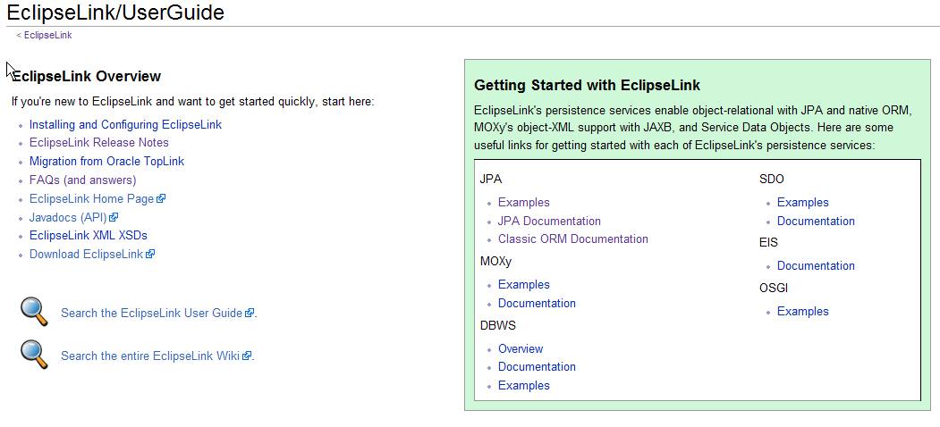
Documentation
Maintained on wiki
  http://wiki.eclipse.org/EclipseLink/UserGuide
  Converted from Oracle internal (Framemaker)

