Slide 1
New JPA 2.0 (JSR-317) API
Metamodel API

Slide 2
Agenda
1 - JEE standard for metadata view
2 - Mapping
3 - Architecture
4 - Initialization
5 - Demos
6 - Challenges
7 - Future

Slide 3
JSR 317 Standard metadata API
Introduced in EclipseLink 1.2 in SVN rev# 5088 in Aug 2009 matching the PFD2 spec
Key: Exposes the Java annotation API and the XML mapping API as one unified “Metadata” API
Typesafe and String based attribute access
The metamodel is a static state of the data model per persistence unit via the EntityManagerSetupImpl
The dynamic metamodel provides for criteria queries without using modelgen tool generated/manually created static metamodel classes – the “_” ones – we see these in the modelgen presentation (next)

Slide 4
Why use the Metamodel?
It is there by default – the developer gains a unified view of all XML and Java annotation markup
Practice (MAP) – Metamodel Aware Programming – mainly typesafe queries
An abstract view of the managed classes in a persistence unit
Criteria query type errors are picked up at design time and not runtime when using the typesafe API – IE: no un-executable queries
Results of Criteria queries can be typed (List<Person> instead of cast as just List) - (Object based queries) - Provides for a “typesafe” way to develop queries via the Criteria API using Java code instead JPQL Strings – Metamodel objects are passed to Queries and executed – but are design time verified via generics

Slide 5
Mapping native metadata classes
You may map everything in ORM and not use annotations
Part of consolidation of XML and Annotation mapping data
The metamodel is a kind of reflective API surrounding the metadata (wherever we get it from)
Introduces Types and Attributes as a wrapper for..
Types = Descriptors, Attributes = Mappings
Generics are used to represent the attribute return type as well as the containing type
Example:
EntityType Processor_ = metamodel.entity(Processor.class);
ListAttribute<HyperCube, Processor> processorsAttribute
= HyperCube_.getDeclaredList("processors", Processor_.getJavaType());

Slide 6
Example Mappings (Metamodel Attributes)
Singular (Basic, 1:1, M:1)
Plural (1:M, M:M, ElementCollection)
Collections (Map, Set, List)

Slide 7
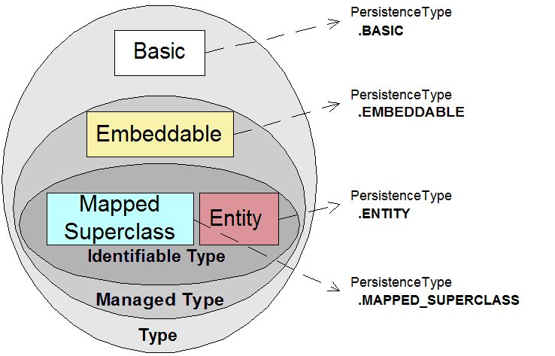
Metamodel Types: PersistenceType
We support the following hierarchy of
Entity, MappedSuperclass, Embeddable and Basic types

Slide 8
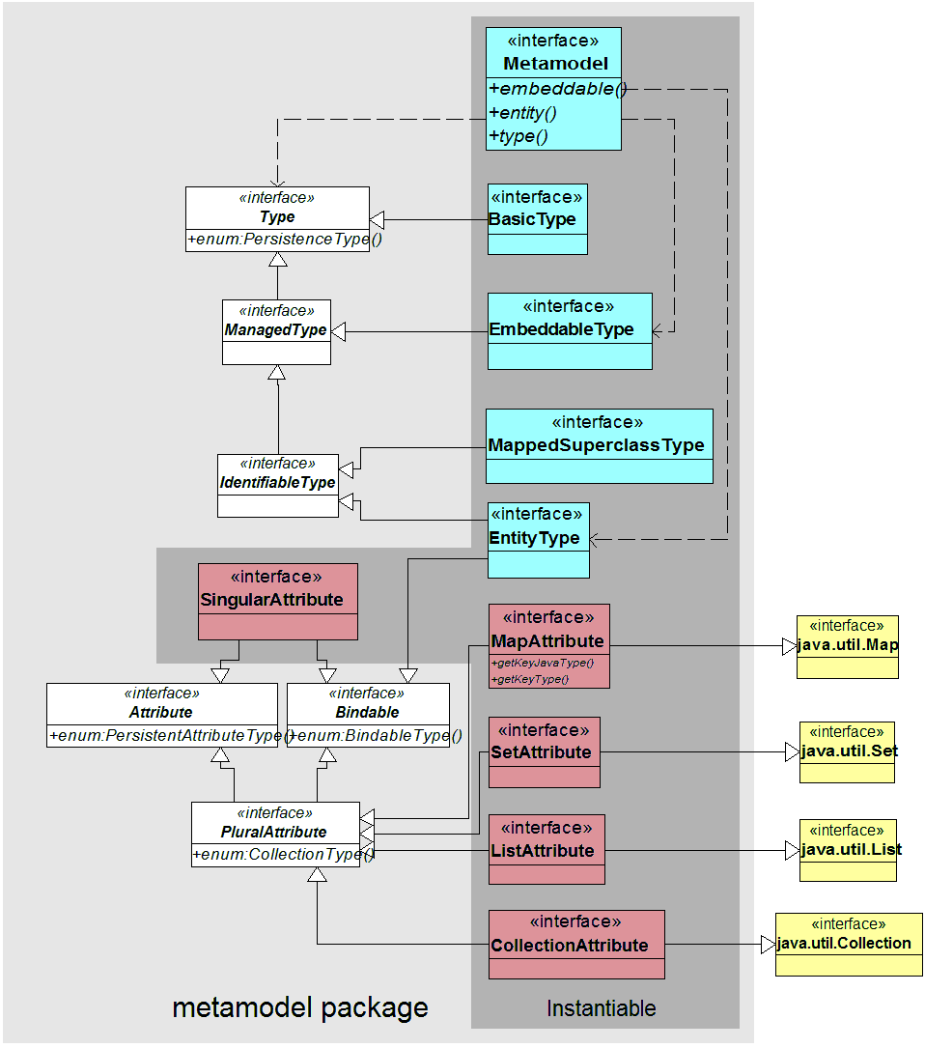
Interfaces Class Diagram – Types & Attributes
Types and Attributes
types = nodes
attributes = links
Types (Descriptors)
(Entity, MappedSuperclass,
Embeddable, Basic)
Attributes (Mappings)
(Singular: Basic)
(Plural: List,Map,Set,Collection)

Slide 9
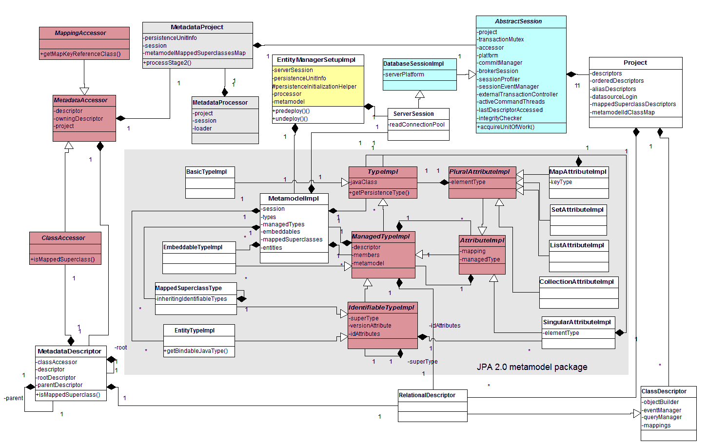
UML Class Diagram : Metamodel Integration
No BindableImpl (object or attribute type can be bound to a Criteria path) required

Slide 10
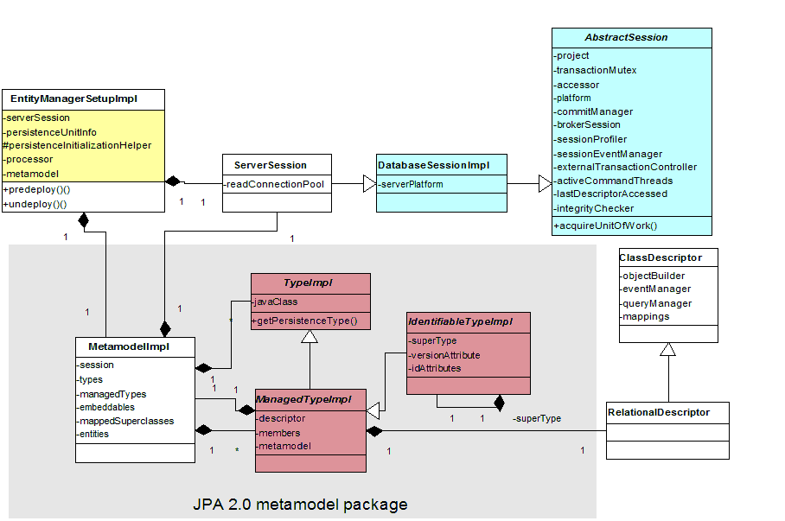
Metamodel Integration: API interfaces

Slide 11
Using the Metamodel – 3 ways
1) Dynamic metamodel class model for type safe queries - we use generics and pass in both the return type and the type containing the return type
2) Static metamodel class model for type safe queries - these are the _Underscore design time classes
3) String attribute references for non-type safe queries - see p.262 of the JPA 2.0 specification section 6.7

Slide 12
Metamodel Initialization
Metadata accessor preprocessing
- some additional processing and state storage is required for MappedSuperclass type and Map attribute processing
Metamodel creation of custom MappedSuperclass Descriptors
Metadata accessor processing
Metamodel post initialization of Types

Slide 13
Implementation Details
Metamodel lazy initialized at the end of deploy() on EntityManagerSetupImpl instead of EntityManagerFactory for GC performance

Slide 14
Activity Diagram: (flow)

Slide 15
State Transition Diagram

Slide 16
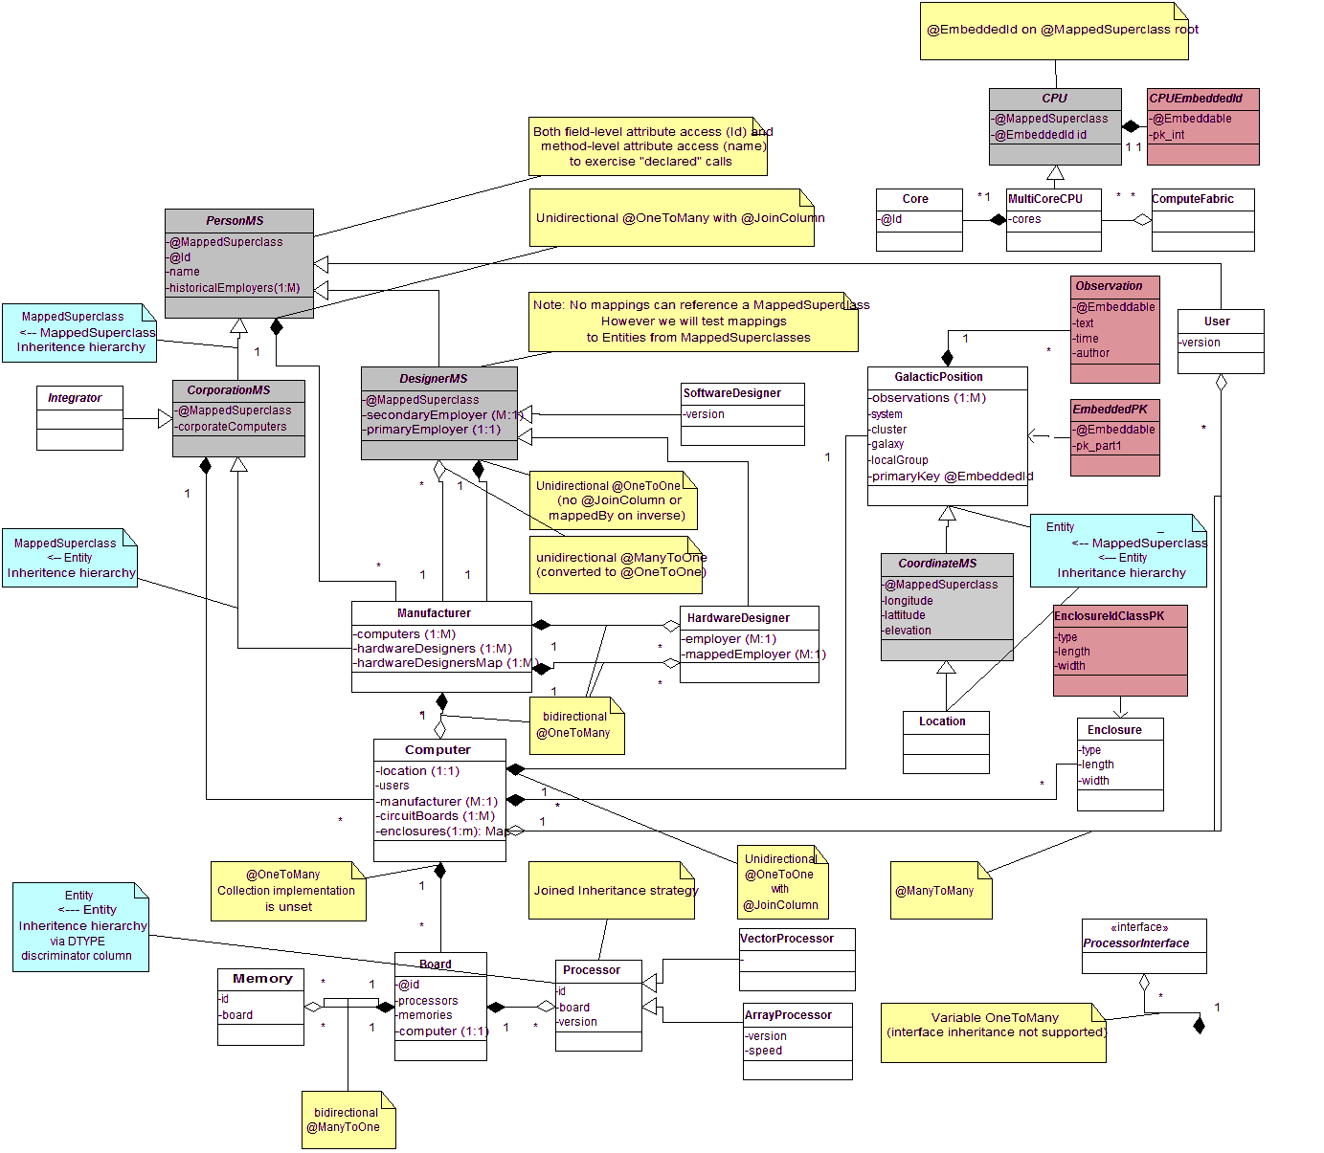
Metamodel JPA Test Suite Example

Slide 17
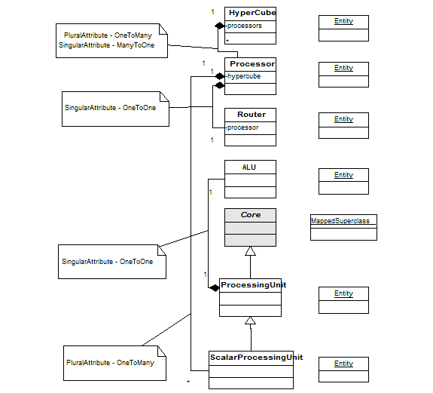
Metamodel Smaller Test Example
tributes Model Types

Slide 18
Application Walkthrough – Eclipse Debugger
The following [X] screens are used as a guide for the live debugging demo of an example Metamodel model
Each screen is a major breakpoint starting with
Predeploy and ending with creating an EM
The application is the standard SE testing browser - however all SE and EE applications will have the same predeploy behavior except that deploy will occur on first EntityManager create for EE applications

Slide 19
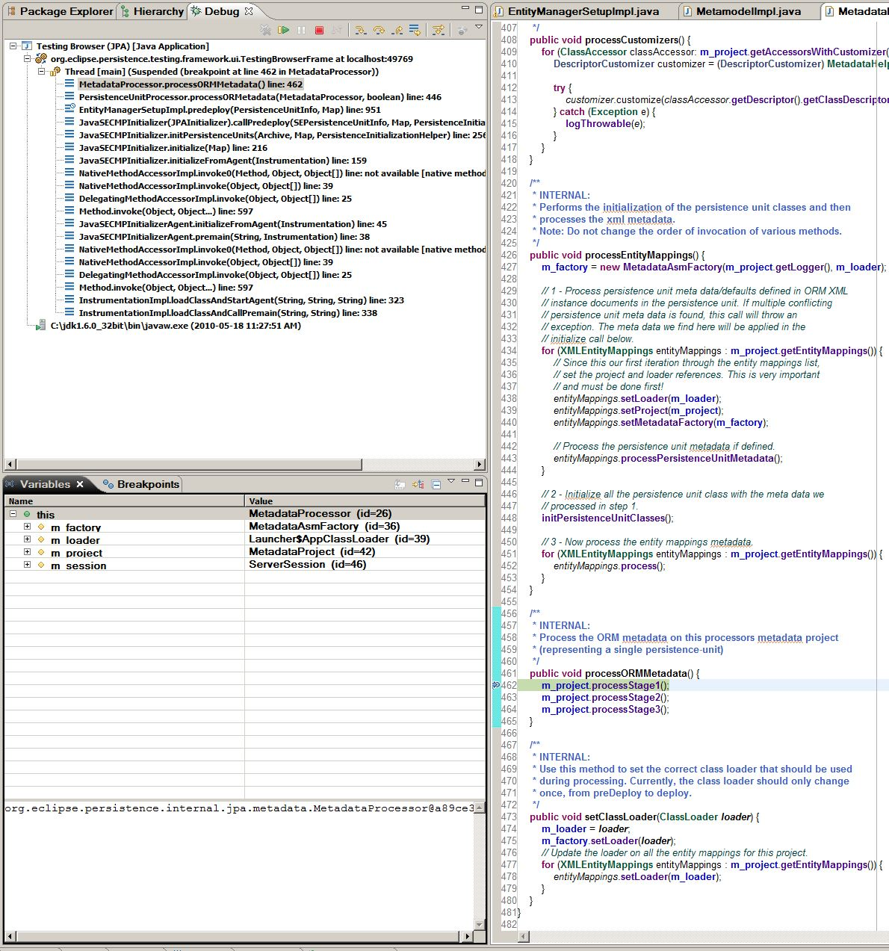
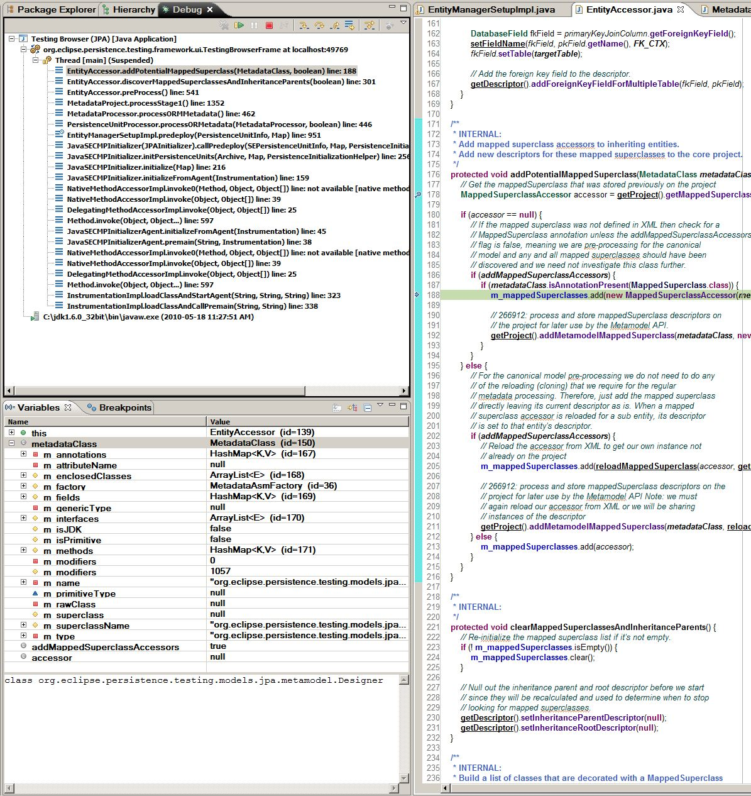
Application Walkthrough 1
MetadataProject.processStage1
(entities then embeddables)
Recursively check inheritance tree
addPotentialMappedSuperclass

Slide 20
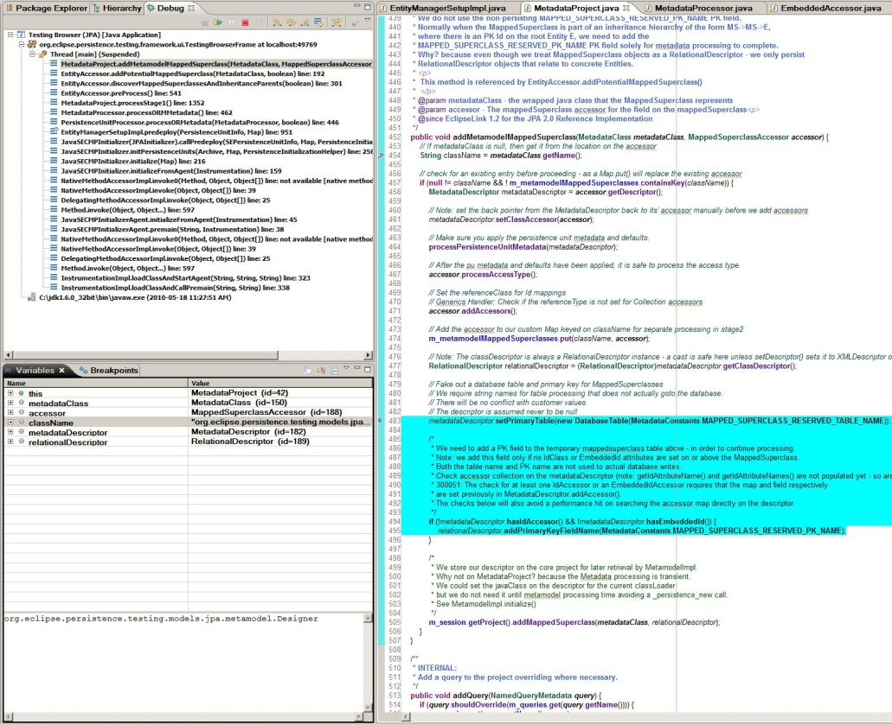
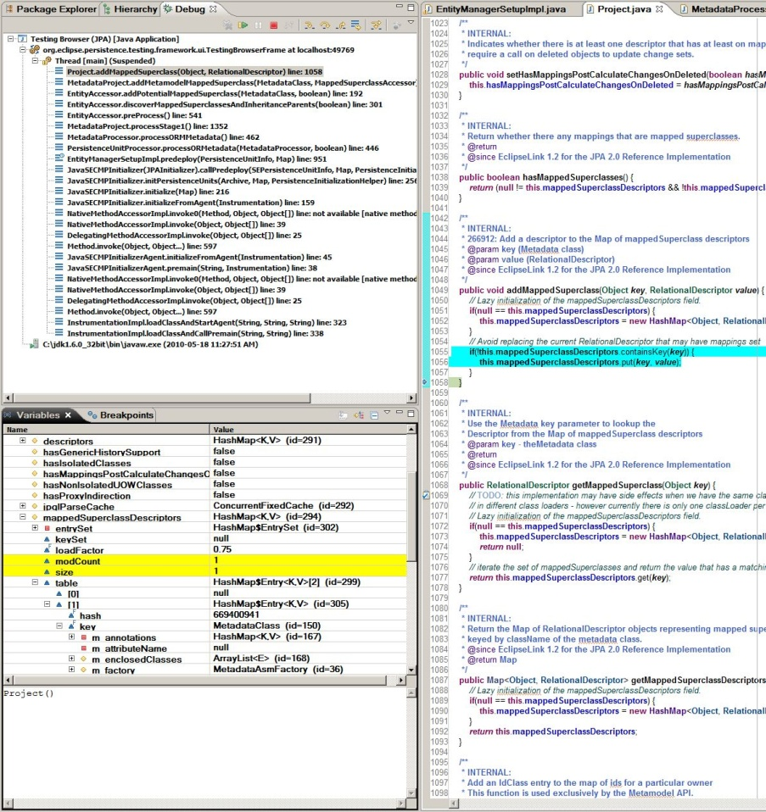
Application Walkthrough 2
Add fake Table and PK
for MappedSuperclass Descriptor
Add MappedSuperclass to
core (native) Project

Slide 21
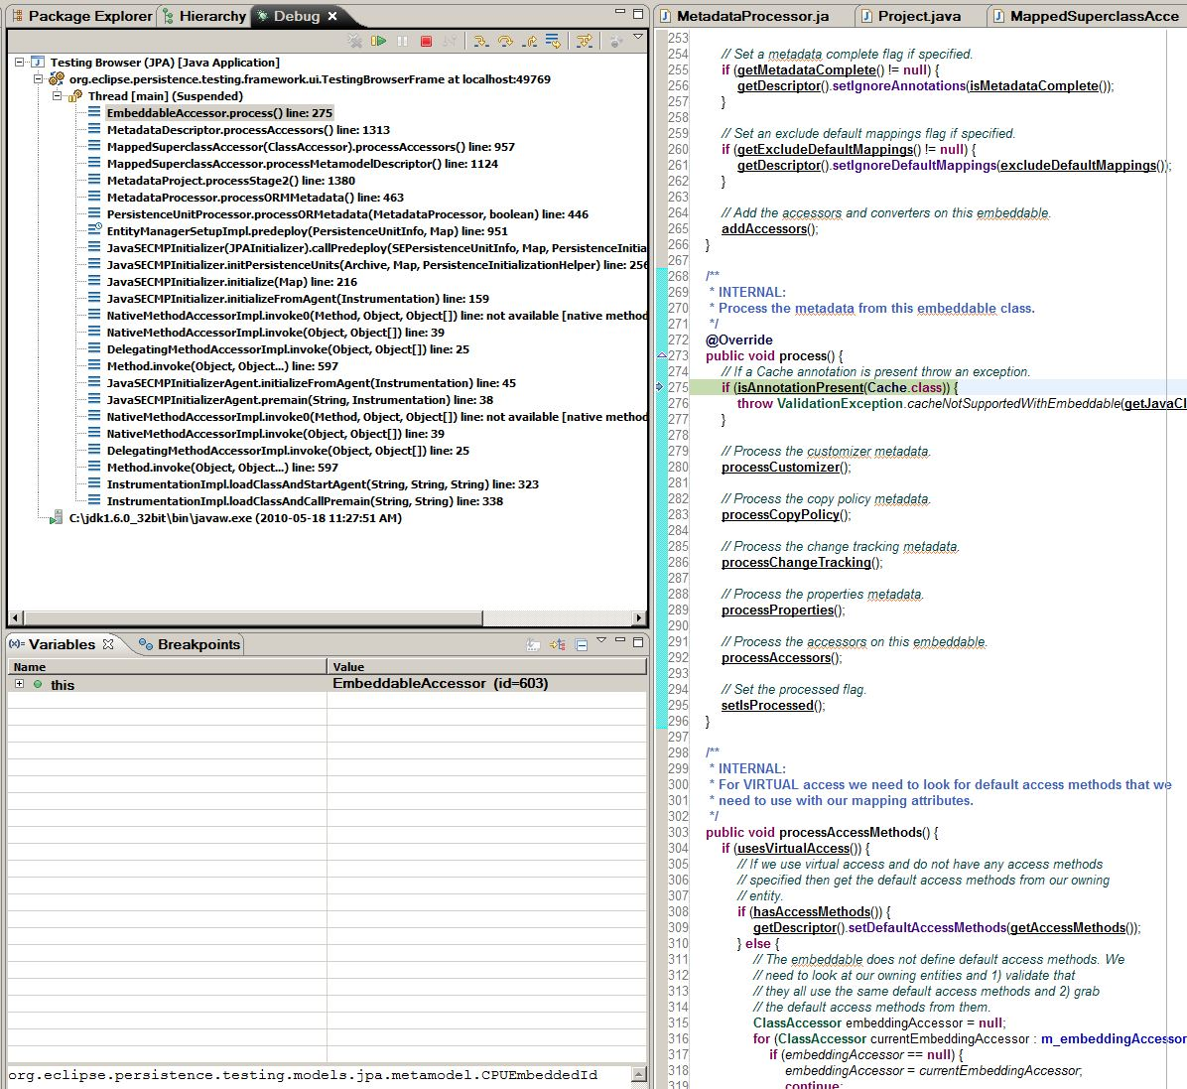
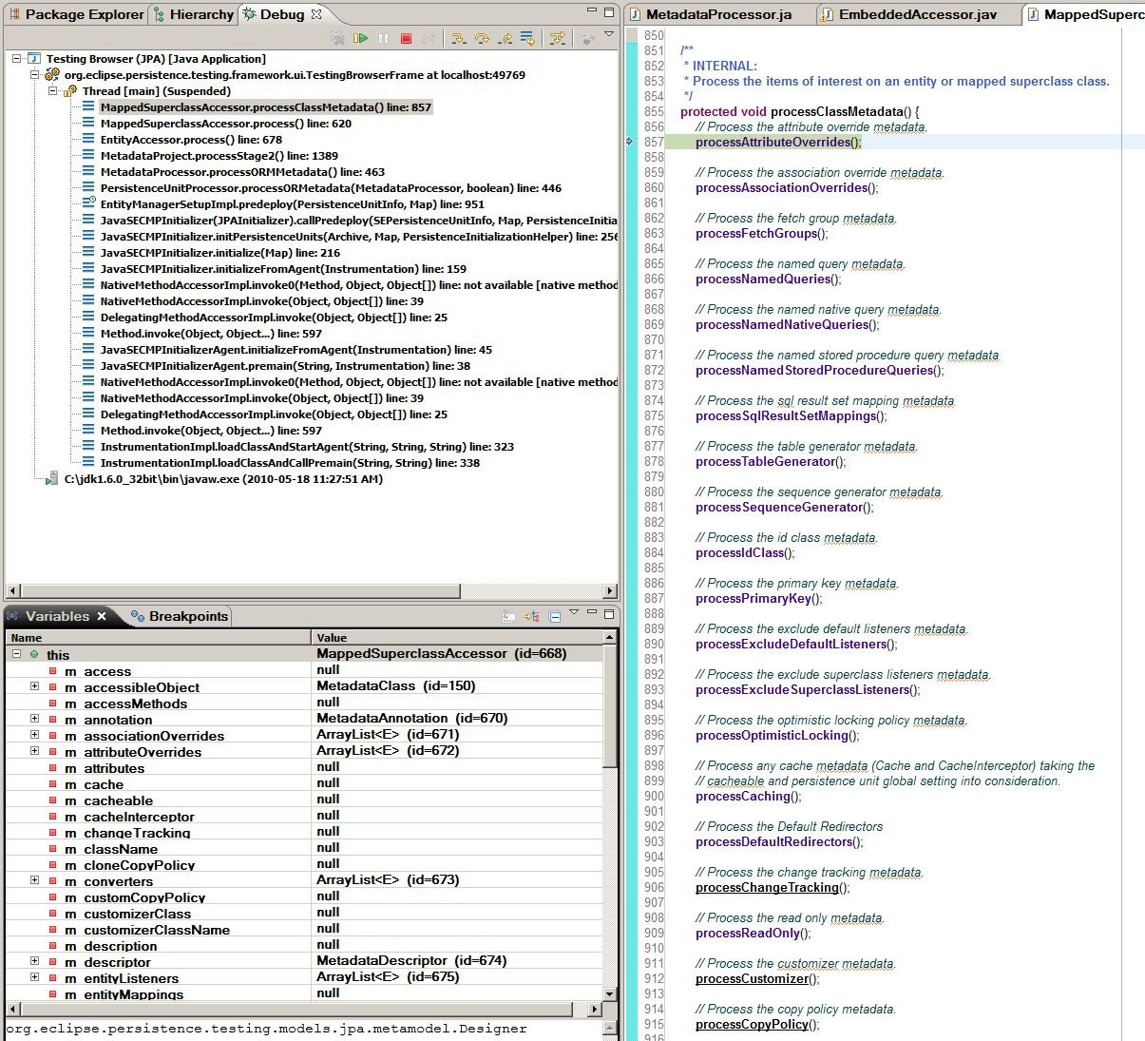
Application Walkthrough 3
processStage2
– process Accessors of
MappedSuperclasses
processStage2
process entities and
mappedSuperclass parents

Slide 22
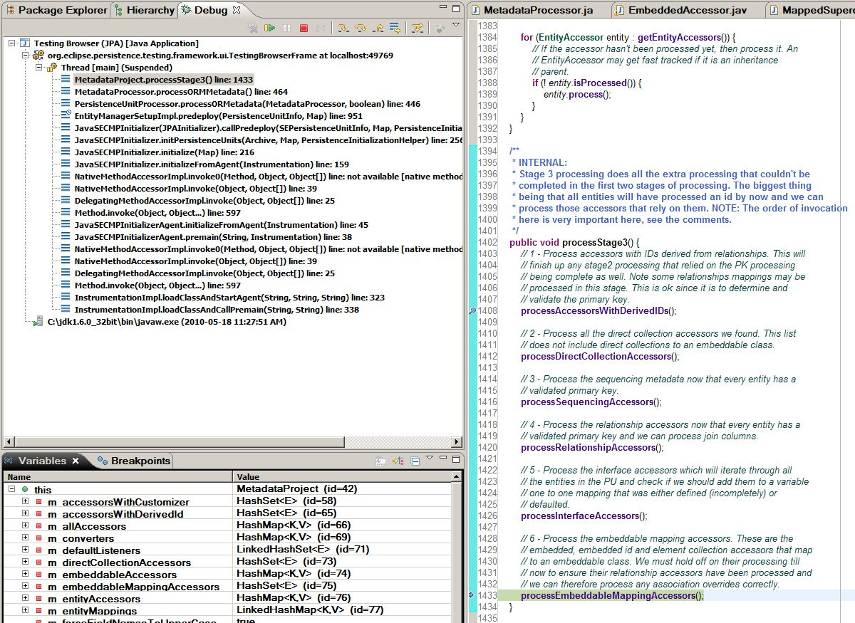
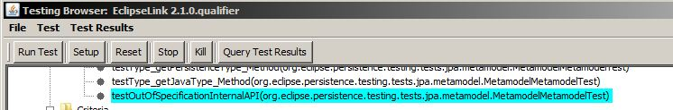
Application Walkthrough 4

Slide 23
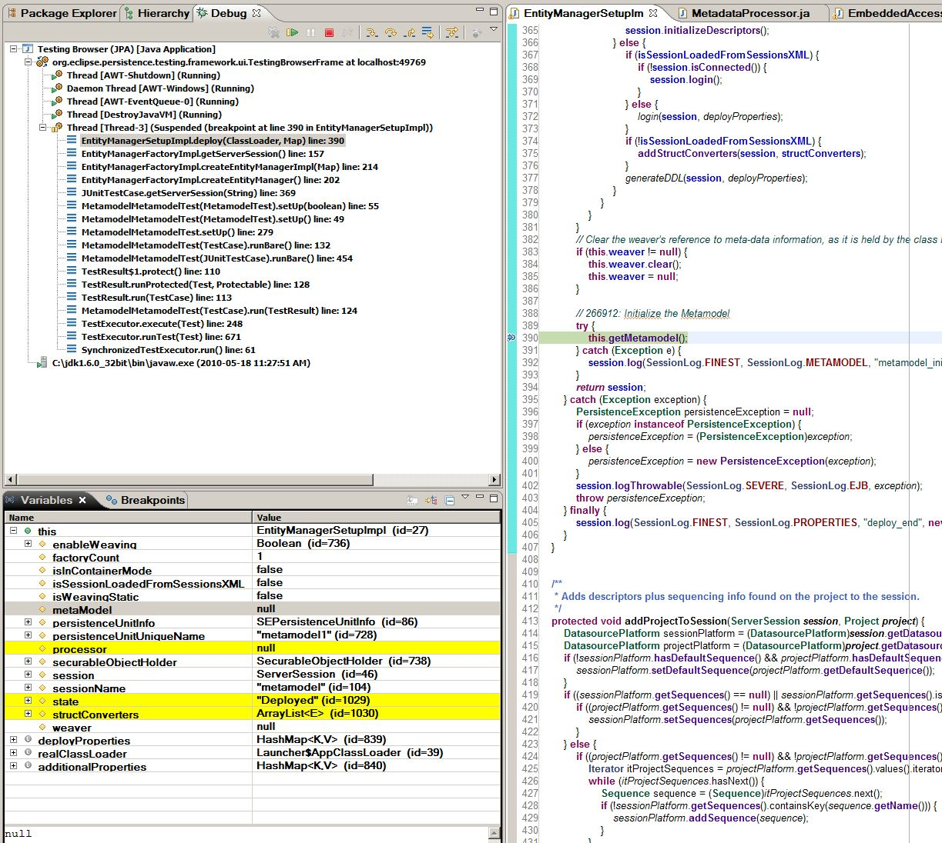
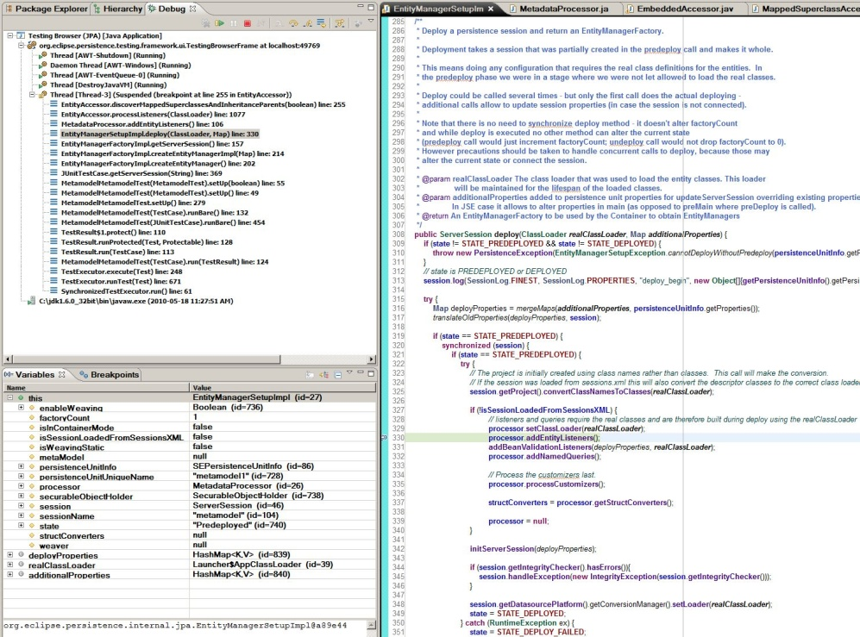
Application Walkthrough 5
EntityManagerSetupImpl.deploy
getMetamodel

Slide 24
Agenda
1 - JEE standard for metadata view
2 - Mapping
3 - Architecture
4 - Initialization
5 - Demos
6 - Challenges
7 - Future

Slide 25
Metamodel:Technical Challenges
RelationalDescriptor required without actual DB table (MappedSuperclass)
Decision: Real Descriptor or current special handling for MS
Criteria queries using Metamodel objects are less readable
No support for Interfaces or VariableOneToOneMapping (descriptorType INTERFACE) or TransformationMapping
Exceptions during metamodel creation must be ignored so predeploy() is not stopped
Manually (user) created canonical “_” classes may have omissions that cause corner case NPE’s like bug# 297928 (DI 99) – IE: a (K,V)=null,null causing a null ManagedType.javaType
Return void for undefined parameterized generic types for a MappedSuperclass defined map field

Slide 26
Criteria API use of the Metamodel

Slide 27
Canonical Generation use of the Metamodel
The canonical classes of the form “Class_.java” are generated by the APT wrapper described in the next session – these classes use the String based non-typesafe API part of the Metamodel API

Slide 28
Future: Extended Metamodel API
See open 283483: Extended ORM Functionality

Slide 29
Application Servers supporting JPA 2.0
The same demo app is available on 3-4 servers
WebLogic 10.3.3.0 (10.3.x with extensions)
WebSphere
Jboss 5.1.0
GlassFish V3
NetWeaver
Tomcat 6 (SE application managed WAR only)

Slide 30
References
http://wiki.eclipse.org/EclipseLink/Development/JPA_2.0/metamodel_api
http://wiki.eclipse.org/EclipseLink/Examples/JPA#Tutorials

