Slide 1

Transactions
Gordon Yorke

Slide 2
Native
Transaction control at the Session Level.
  Session.beginTransaction()
Can span multiple UnitOfWorks
For ClientSessions
  DatabaseAccessor (Connection) maintained for the life of the transaction

Slide 3
UnitOfWork
JPA’s Persistence Context
May span multiple transactions
Locally caches managed objects
Managed objects and changes are isolated from other clients and the shared cache.
  Supports Weak References through PU property
    “eclipselink.persistence-context.reference-mode"
Old pattern
  UOW was acquired from long lived Database/ClientSession
New pattern
  ClientSession is encapsulated in UOW
UnitOfWorks can be nested.
  Nested UnitsOfWorks are merged into a parent UOW
  When parent is committed union of changes are committed

Slide 4
UOW VS JPA (RepeatableWriteUnitOfWORK)
Persistence by reachability rules are different
  Like cascadeType=PERSIST
  UOW does not allow references to detached objects by default
UOW does not support multiple flushes.

Slide 5

Txn Cache Architecture
Client-1
Client-2
EntityManager -2
L1 Cache
EntityManager -1
EntityManagerFactory
L2 Cache
Read
Write
Notes:
Show JDBC Connections.
Cache contains objects, not rows
Show how write connection is obtained

Slide 6
Change Detection
Minimal Updates
  DeferredChangeDetectionPolicy
    Third clone created called ‘Backup clone’
    Backup compared against working copy to detect changes
    Comparison uses identity (==) for comparisons
  AttributeLevelChangeTrackingPolicy
    Uses weaving or customer implementation of interface
    Changes are recorded within the Entity as attributes are updated
    Extracted without comparison during write to Database
  ObjectChangePolicy
    Can be implemented by user
    Changes can be recorded as Entity Attributes are updated
    Not widely used.
Notes:
Show JDBC Connections.
Cache contains objects, not rows
Show how write connection is obtained

Slide 7
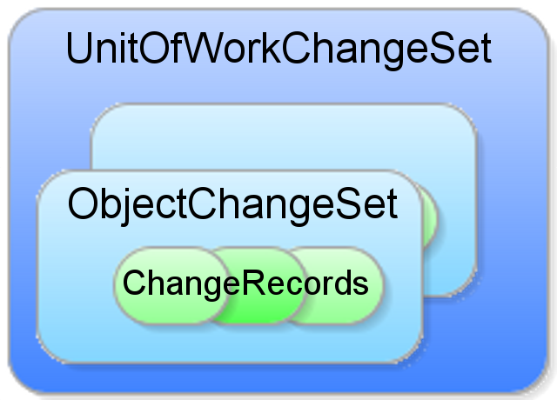
ObjectChangeSet
Changes to an Entity are normalized into ChangeSets and ChangeRecords.
These changes can then be used to
  generate SQL
  Merge into shared cache
  Merged into distributed cache
For flushes Changesets are merged into each other

Slide 8
Connection Management
UnitOfWork does not enter transaction on creation
  Forced by
    Pessimistic Locking
    Flush
    UOW.beginEarlyTransaction
    PU property
      “eclipselink.transaction.join-existing”
Non-transactional
  reads get connection on demand
  Cached/non-isolated objects loaded into shared cache
‘in transaction’
  write/transactional connection is maintained by UOW’s client session
  Read/refreshed object isolated to UOW/transactional cache

Slide 9
JTA synchronization
When configured UOW directly synchronized with JTA transaction creation.
Synchonized UOW ignores user calls only commits on JTA callbacks.
beforeCompletion == commit
afterCompletion == merge to shared cache

Slide 10
UOW tidbits
UOW not threadsafe
UOW’s identitymap does not use locking

