Slide 1
EclipseLink Development Process
Peter Krogh
  EclipseLink Project co-Lead

Slide 2
Overview
Eclipse Process
EclipseLink Process
  Code
  IP
  Reviews
  Testing
  Community
Future Direction

Slide 3
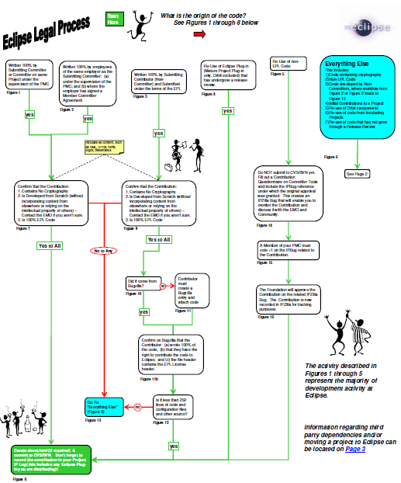
http://www.eclipse.org/legal/EclipseLegalProcessPoster.pdf

Slide 4
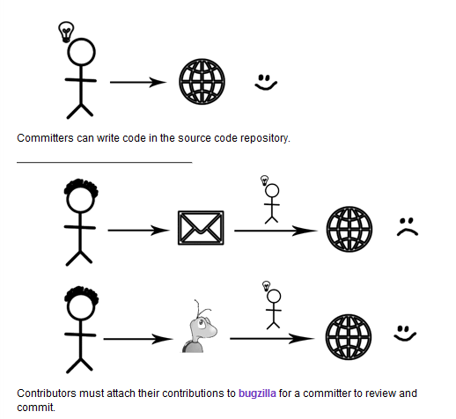
Committers and Contributors

Slide 5
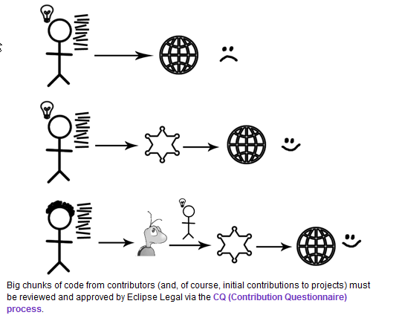
Initial Contributions

Slide 6
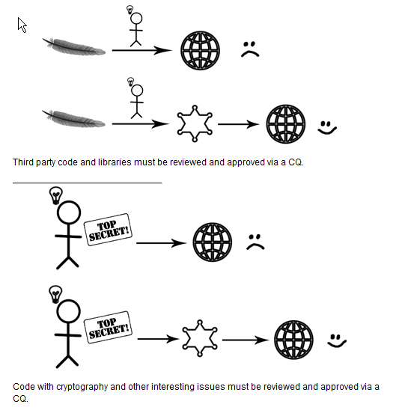
3rd Party Libraries

Slide 7
Code Process
Header for new files
  Copyright owner
  Copyright date
  Contribution log
/*******************************************************************************
* Copyright (c) 2010 <Company/individual>. All rights reserved.
* This program and the accompanying materials are made available under the
* terms of the Eclipse Public License v1.0 and Eclipse Distribution License v. 1.0
* which accompanies this distribution.
* The Eclipse Public License is available at http://www.eclipse.org/legal/epl-v10.html
* and the Eclipse Distribution License is available at
* http://www.eclipse.org/org/documents/edl-v10.php.
*
* Contributors:
* Joe Committer = 1.0 - Initial contribution
******************************************************************************/

Slide 8
IPLog
http://wiki.eclipse.org/EclipseLink/IPLog
Contributions
  All contributions require IP Log entry.
  Contributions require CQ if
    > 250 LOC (unless written by employees at the same company of the Submitting Committer, under review of PMC)
    Contains cryptography
Date | Bug # | Contrib Size | Committer | Description
May 13 2010 | 307497 | 12 files, 800 loc | Dminsky | Contributed fix and testing from Vikram Bhatia: fix to JoinedAttributeManager.addJoinedAttributeExpression to add the correct attribute expression to the joined attribute expressions

Slide 9
EclipseLink Committer Process
Write Code
  Include useful Java doc comments
  Include test case
Create Patch
Attach Patch to Bug
  If no bug exists, create one
Get code reviewed
Run Tests
  SRG, JPA + other pertinent tests.
Upon successful review, and test run – check in
  Notify

Slide 10
Code reviews
Implementation Code
  Method Names
  Comments
  Header
  Contribution Log
Test Case code
  Comments
  Database / Server agnostic?
  Negative test cases
Require Doc or Release Note?
CQ needed (>250loc, new dependency)
Schema change?

Slide 11
Testing
SRG – Short Regression
  Run hourly if new commits are present on build.eclipse.org
LRG – Long Regression
  Run nightly on build.eclipse.org
build.eclipse.org limitations
  Only has MySQL available
  No application server installs
Additional Oracle Testing
  Automated download of eclipselink.jar from nightly build
  Run through Oracle specific database tests

Slide 12
Community
Bugzilla
  Anyone can file bug/enhancement
  Contributions
    Submitted Patches
  Votes
Mailing Lists
  Eclipselink-users@eclipse.org
  Eclipselink-dev@eclipse.org
Committer Meeting

Slide 13
Future Direction
IPLog
  Auto IPLog
Utilities
  Auto Code coverage, Find Bugs, Copyright
Examples
  Like to be added to build
  Include in process
Incubator
  How to get out of incubation
  Process for Database platform
Community
  Bugs with votes
  Submitted patches

