Slide 1
RESOURCE MANGEMENT SYSTEM

Slide 2

TEAM : CODE KARMA
SLOGAN : BE GOOD… CODE GOOD
MEMBERS
SUBIN DONGOL
BIKASH BISHWAKARMA
SABIN KARKI
BINAY DESAR

Slide 3
OVERVIEW
INTRODUCTION
PURPOSE
TOOLS AND TECHNOLOGIES USED
USE CASE DIAGRAM
UML DIAGRAM
SEQUENCE DIAGRAM
DEMO
FUTURE ENHANCEMENT
QUESTIONS AND ANSWERS

Slide 4
INTRODUCTION
RESOURCE MANAGEMENT is the process of deploying resources in company in efficient and effective way.
Resources may be intangible like goods or substances and human resources.
RESOURCE MANAGEMENT SYSTEM helps to manage resources to the employees of a company dealing with resources

Slide 5
PURPOSE
The main purpose of application is to help the employees to assign the required resources easily and efficiently.

Slide 6
TOOLS AND TECHNOLOGIES USED
SPRING TOOL SUIT (STS)/ ECLIPSE
DATABASE : MySQL
VISUAL PARADIGM / ARGO UML

Slide 7
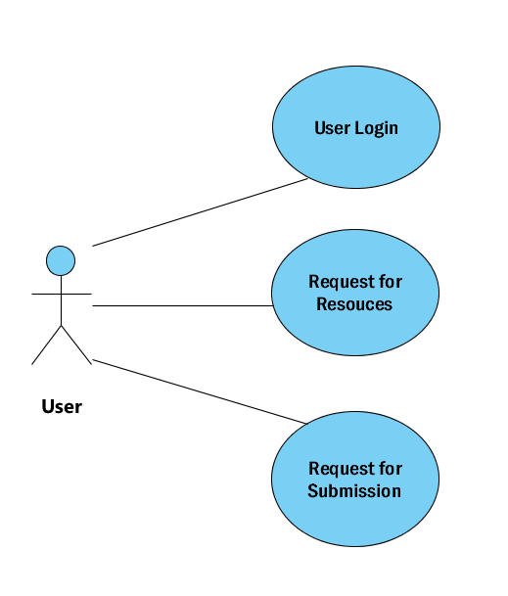
USE CASE DIAGRAM

Slide 8
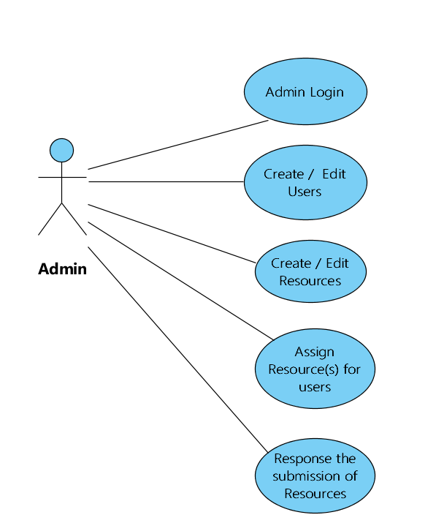
Use CASE DIAGRAM (contd…)

Slide 9
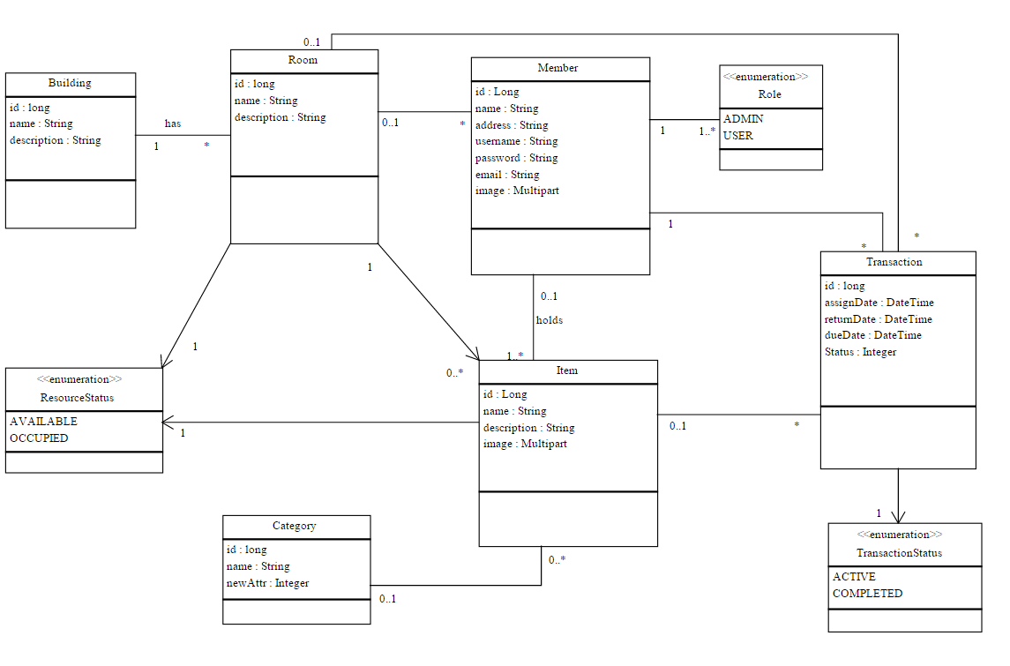
uml diagram

Slide 10
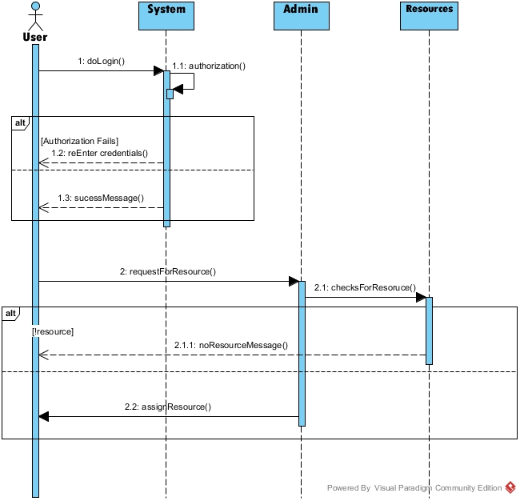
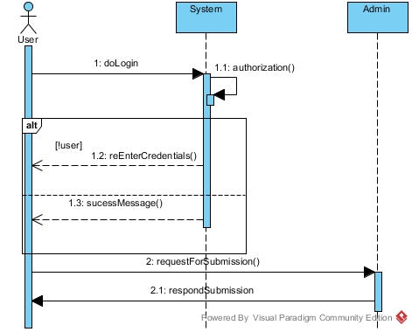
Sequence diagram

Slide 11
demo
Internationalization
Tiles
Image upload
Validation
AJAX [AJAJ] – RESTful Service
Security
Exception Handling

Slide 12
Future enhancements
Managing Human Resources too.

Slide 13
Any questions??

Slide 14
THANK YOU

