Slide 1
Introduction to Eclipse Rich Client Platform
Sabir Pasha

Slide 2
History of the Eclipse framework
The Eclipse IDE version 2.0 started as a modular and extensible IDE application. The Eclipse 3.0 version from 2004 allowed building stand-alone applications based on same framework.
At this point, the term Eclipse RCP (Eclipse Rich Client Platform) was coined. It means that the Eclipse framework is used to create feature-rich stand-alone desktop applications.
The release of Eclipse in version 4.x simplified and unified the Eclipse programming model. It is based on state-of-the-art technologies, like dependency injection and declarative styling via CSS files.
The Eclipse IDE can be viewed as a special Eclipse application with the focus on supporting software development. For example, the Java development tools (JDT) provide the functionality to develop Java applications.

Slide 3
What should you get out of this training?
Why should you use it?
Core technologies
Understand its structure
Plug-ins, Features and Products
IApplication and Co.
Extension Registry
Understand the makeup of the UI
Perspectives, Views, Editors and the Workbench
What you need to get started

Slide 4
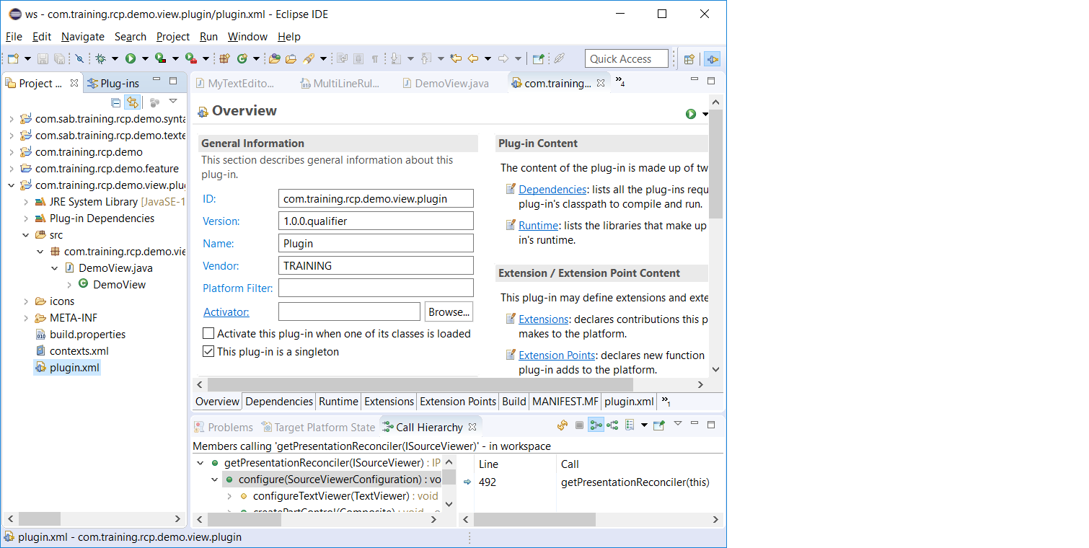
What is Eclipse RCP?
This is Eclipse, world famous Java IDE and generally cool tool.
This is Eclipse RCP, SPOT THE DIFFERENCE?

Slide 5
What is Eclipse RCP?
Can be though of as: stripping out the IDE specific components of Eclipse and reusing the generic components with your own custom plug-ins
Is in fact: A generic extensible scalable GUI(?) client that facilitates extremely rapid and sustainable development.
Translation: A set of generic components that can be customised to create your application.

Slide 6
Why Eclipse RCP?
» Very powerful platform for rich client applications
» Available for all major operating systems
» All sources provided
» Large and active community
» Commercial-friendly open source license: EPL

Slide 7










Why should you use it?
Well supported by industry with over 170 members

Slide 8
Why should you use it? – The good reasons
Branding
Splash screens, intro screen, icon sets, cheat sheets, No need to have anything “Eclipse” about it
Extensible help
Manages the mundane
Preference store, update manager, tips and tricks, navigation
Access to a world of plug-ins
Leverage other plug-ins, your application is improved as Eclipse improves (force multiplier!)
Much more, just ask, look and find; chances are if it is not application specific it is in Eclipse!

Slide 9
Core Technologies
OSGI
Provides the plug-in based environment for Eclipse
Is a standard of which Equinox is the implementation Eclipse uses
Permits lazy-loading of plug-ins
Permits multiple versions of the same plug-ins/packages to coexist
Every Eclipse Plug-in is an OSGI plug-in
Every OSGI plug-in can be treated as a standard JAR outside OSGI

Slide 10
Core Technologies
SWT/JFace
SWT is a Platform independent Widget toolkit that wraps native Widgets offering native feel and performance.
JFace provides Model-View-Controller wrapping for SWT widgets such as TreeViewer, TableViewer etc.
Swing is arguably the main competing framework with SWT. Many religious arguments with no clear winner in performance.
Widgets must be disposed – in practice not a big deal

Slide 11
Architecture and Components
» RCP Architecture and Bundles
» Extension Points and Views
» Bundle Dependencies
» Features

Slide 12
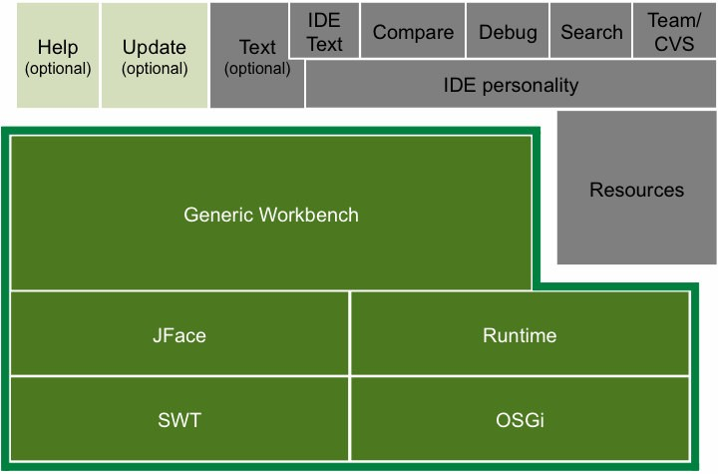
High Level Building blocks

Slide 13


Modular Architecture
» Eclipse is not a monolithic system but an open platform
» Eclipse is based on an modular and extensible architecture:
» Minimal runtime
» Applications are composed of modules called bundles or plug-ins
» Plug-ins can be added, updated or removed
Plug-in
Plug-in
Plug-in
Plug-in
Runtime

Slide 14

What is a Bundle/Plugin ?
» Bundles are components:
» Execution in a runtime container → Eclipse Equinox
» Well defined deployment format → JAR file
» Declared public API → exported packages
» Declared dependencies → imported packages or required bundles
» Well defined life cycle → installed, resolved, active, uninstalled
» Plug-ins may offer extension points
» RCP applications are built from plug-ins
-Extension point
Plug-in
Plug-in
Plug-in
Plug-in

Slide 15
Bundle Manifest (MANIFEST.MF)
» Located at : META-INF/MANIFEST.MF
» Text file with property-like syntax: Manifest headers with values
» Declares metadata, public API, dependencies etc.
Manifest-Version: 1.0
Bundle-ManifestVersion: 2
Bundle-Name: RCP Demo plugin
Bundle-SymbolicName: com.sab.eclipse.rcp.demo
Bundle-Version: 1.0.0
Bundle-Vendor: SAB
Bundle-RequiredExecutionEnvironment: J2SE-1.5
Export-Package: com.sab.eclipse.rcp.demo.util;version="1.0.0"

Slide 16
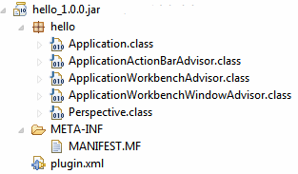
How does a plugin look-like?
» Plug-ins are common JAR archives,
» ... contain a bundle manifest (MANIFEST.MF) and
» ... may contain a plug-in manifest (plugin.xml).

Slide 17
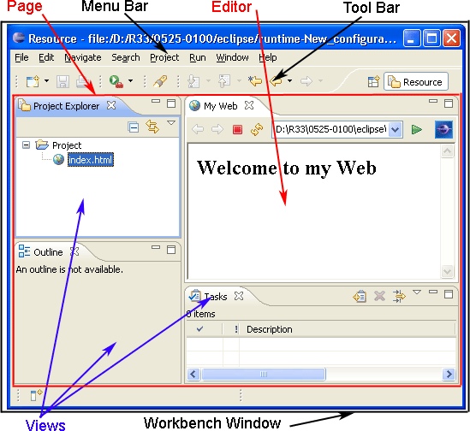
The Workbench Window
Source: Eclipse Help, Eclipse Public License Version 1.0

Slide 18
How can the Workbench be configured?
» The workbench is created internally by RCP
» You can advise this process
» Workbench advisor
» Workbench window advisor
» Action bar advisor: Since 3.3 better use commands!

Slide 19
IApplication and Workbench
Main program - A RCP main application class implements the interface "IApplication". This class can be viewed as the equivalent to the main method for standard Java application. Eclipse expects that the application class is defined via the extension point "org.eclipse.core.runtime.application".

Slide 20
Start and Stop method
The start () method in the Application class is where the eclipse / RCP application starts the execution .
The start method creates the Display Thread and calls the Platform API to create the Workbench.
The Workbench class calls the Workbench Advisor APIs to initialize the application

Slide 21
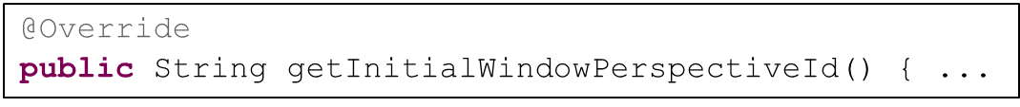
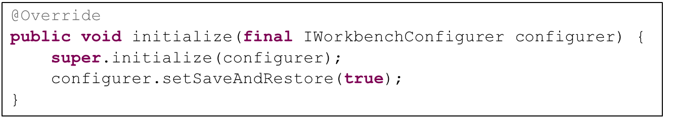
The Workbench Advisor ...
» ... defines the default perspective for the workbench:
» ... activates the save-and-restore behavior of the workbench:
» Window size, position etc. are restored on reopening
» The data is persisted between sessions in the applcation’s workspace data dir (see in run configuration, „Main“ tab)

Slide 22
The Workbench Window Advisor ...
» ... configures the workbench window:
» Window size
» Window title
» Visibility of menu bar, toolbars, status bar etc.
@Override
public void preWindowOpen() { getWindowConfigurer().setInitialSize(new Point(400, 300)); getWindowConfigurer().setShowCoolBar(false); getWindowConfigurer().setShowStatusLine(false); getWindowConfigurer().setTitle("Hello RCP");
}

Slide 23
Task to Create a Hello World RCP application
Demonstration

Slide 24
Create a Hello World Application
» Step 1:
» Use the “New” wizard to create a new “Plug-in Project”
» Enter “com.sabir.training.rcp.first” as project name
» Uncheck “Generate an activator ...”
» Select “Yes” for “Would you like ... rich client application?”
» Select the “Hello RCP” template
» Enter “Hello world!” as the “Application window title” and click “Finish”
» Step 2:
» The manifest editor will open: Click the icon or the link “Launch the Eclipse application”

Slide 25
Introduction to Extension Points
Extension-points define interfaces for other plug-ins to contribute functionality (code and non-code).
They are defined in the plugin.xml file, which must be in the root directory of your plug-in project.
Existing extensions (contributions) are collected during the start of an Eclipse application.

Slide 26
Extension Registry
The Extension registry is where the Platform keeps a description of the extensions defined by a plugin.
The extensions are internally loaded by the eclipse framework during the start of the application or on occurrence of an event , the PlatformUI api can be called to get the extensions and invoke the function attached to the extension.

Slide 27
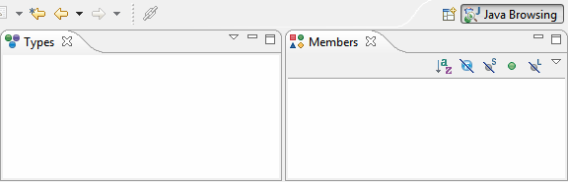
What is a Perspective?
» A Perspective arranges workbench parts (Views and Editors)
» Perspectives are typically used for "bundling" of role-specific functionalities, e.g. end user mode, administration mode etc.
» Perspectives can optionally be switched by the user
» There has to be a default perspective!

Slide 28
Perspective
A Perspective - defines the layout of your application. Must be declared via the extension point "org.eclipse.ui.perspective".
The WorkbenchParts which are part of a Perspective are either defined via a Java class defined in the extension point "org.eclipse.ui.perspectives" or via the "org.eclipse.ui.perspectiveExtensions".

Slide 29
Views
In an RCP applications Views are used to present information to the user. A viewer must implement the org.eclipse. ui.IViewPart interface, or subclass org.eclipse.ui.parts.ViewPart.
Views are defined via the extension point "org.eclipse.ui.views" .
Views must implement the createPartControl() and setFocus() methods.

Slide 30
CreatePartControl () method
createPartControl() is used to create the UI components of the View.
createPartControl() will get as parameter a Composite which can be used to construct the user interface. This composite has by default a FillLayout layout manager assigned to it. This layout manager assigns the same space to all components equally.
setFocus() must set the focus to a specific UI component.

Slide 31
Adding a view to perspective via Code.
A view can be added using the layout.addView() in the createInitialLayout() method.
public class Perspective implements IPerspectiveFactory
{ public void createInitialLayout(IPageLayout layout)
{ layout.addView(VIEW.ID, IPageLayout.TOP, IPageLayout.RATIO_MAX, IPageLayout.ID_EDITOR_AREA);
} }

Slide 32
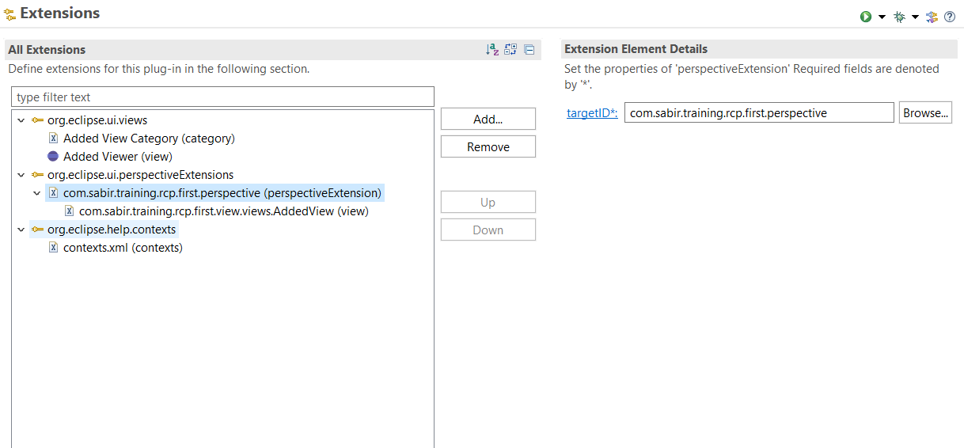
via Extension point

Slide 33
JFACE viewers
JFACE viewers are actually the wrappers on top of the SWT widgets
The most common of the JFACE viewers are the viewers for SWT table and Tree.
JFACE uses the concept of Databinding to bind the data and the widget and provides a viewer which can be used easily to display tabular or Structured data using the underlying SWT widgets for Table and Tree , without having to deal with the low level details of the table.

Slide 34
Structured Viewers
JFace includes the following basic types of viewers:
ListViewer connects to an SWT List widget.
TableViewer connects to an SWT Table widget.
TreeViewer connects to an SWT Tree widget.

Slide 35
Content Providers and Label Providers
In Eclipse the, JFACE viewers take care of data binding and the presentation of the data using two special interfaces called the IContentProvider and the ILabel provider.
The Content provider manages the data model for the view to be displayed in the viewer
The Label Provider manages how the data is presented on the viewer.

Slide 36
How does the content Provider work?
The content provider has few methods which are supposed to be implemented by the user.
These methods specify the structuring of the data.
The setInput() method of the viewer invokes the contentProvider APIs.

Slide 37
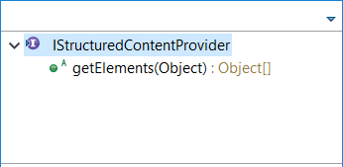
IStructuredContentProvider
The List viewer and the Tableviewer generally use an implementation of the IStructuredContent Provider like the ArrayContentProvider
Here the getElements () method is overridden by the ArrayContentProvider to provide the data as an array of the datamodel objects.

Slide 38
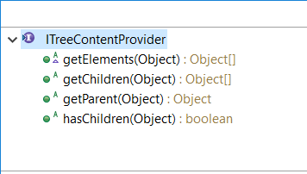
ITreeContentProvider
The Treeviewer uses an implementation of the ITreeContentProvider.
The ITreeContentProvider specifies APIs which help in determining the tree / parent-child structure of the tree items

Slide 39
ITreeContentProvider APIs
Apart from the getElements () method as in TableViewer and ListViewer the TreeViewer has methods to specify the
Parent of a given data model object.
The children of the data model object
A Boolean hasChildren which tells if a data model object is a leaf node in the tree.

Slide 40
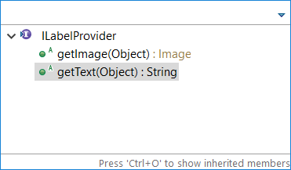
Label Provider
The Label provider is the interface to be implemented to specify how data to be displayed for the given data model object .
The Label Provider implementations have two methods
getImage() to Specify image to be displayed.
getText() to specify the Text to be displayed
in the viewer.

Slide 41
List Viewer
This is the simplest of all JFace viewers
The List viewer as the name suggested wraps up the List data and display as a List view with a single column.
The List uses ArrayContentProvider() as the ContentProvider.
Uses a Label provider for the text to be shown in the table.

Slide 42
TableViewer
This the viewer to display the SWT table.
The Table viewer uses ArrayContent Provider , It can one or more columns to display the different fields/properties of the datamodel object.
Each column can have its own label Provider.

Slide 43
TreeViewer
Used to display parent-child /Hierarchial data.
Uses an ITreeContentProvider for the ContentProvider.
A treeviewer like the TableViewer can have one or more columns and each of the columns can have its own LabelProvider.

Slide 44
Task to create a view with ListViewer
DEMONSTRATION

Slide 45
Task to create a view with TableViewer
DEMONSTRATION

Slide 46
Task to create a view with TreeViewer
DEMONSTRATION

Slide 47
Commands and Handlers
A command in Eclipse is a declarative description of a component and is independent from the implementation details
A command can be categorized, assigned to the user interface and a key binding can be defined for the command. The behavior of a command is defined via a handler.
Command is created using the “org.eclipse.ui.commands”
A command can be re-used by different menus without creating a new instance everytime a menu uses it.

Slide 48
Handlers
The org.eclipse.ui.handlers extension point connects the command to a certain class which is called once the command is executed.
The behavior of a command is defined via handlers. The handler is the class which is executed once the command is called. It must implement the IHandler interface from the org.eclipse.core.commands package.
You can extend the org.eclipse.core.commands.AbstractHandler class which provides a default implementation for the IHandler interface.

Slide 49
The execute() method
The execute() method is called, if the handler is executed.
In the execute(event) method you get access system values via the HandlerUtil class
The event object obtained as the parameter in the execute method contains the event object and can be used to get the event such as the active selection .

Slide 50
HandlerUtil
This is a Utility for the handlers available in eclipse platform .
The HandlerUtil has static methods to access various Platform APIs
The platform APIs help in getting the instances for the :
Active Page,
Active Selection
Active View
Active Error
… and many

Slide 51
Core Expressions
Core expression are special extensions which can be used to enable/disable a menu or a command using an expression
This expression evaluates to a true or false depending on the current selection or the state of the application.
The menus are then enabled /disabled based on the value of the expression.

Slide 52
Menus
Menus are added using the extension points “org.eclipse.ui.menus”
The location URI of the menu specifies the where in the UI the menu will be displayed. Uri fomat - [scheme]:[id]?[argument-list]
The menu contribution holds the value for the location URIs
Attribute Name | Required
menu:org.eclipse.ui.main. menu?after=window | Insert this contribution on the main menu bar after the Window menu
menu:file?after=additions | Inserts contribution in the File menu after the additions group
toolbar:org.eclipse.ui.main. toolbar?after=additions | Insert this contribution on the main toolbar
popup:org.eclipse.ui.popup. any?after=additions | Adds this contribution to any popup menu in the application

Slide 53
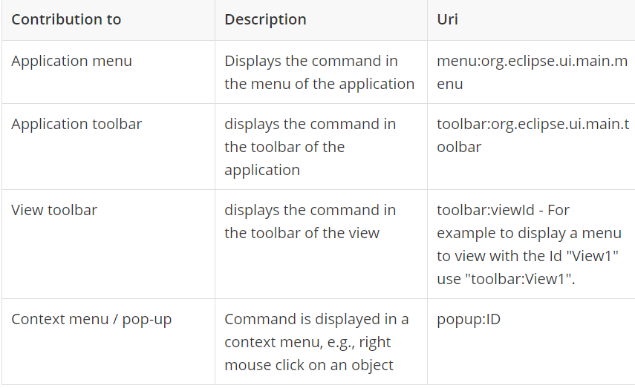
Location URIs

Slide 54
Menu Contribution
After adding the extension ‘org.eclipse.ui.menus’ the menu is added
using a Menu Contribution.
The menu contribution takes the input of the location URI
The menu are added to this menu contribution which are placed under a menu .

Slide 55
Menus and Commands
A menu can be associated with a command
On the click of the menu the handler associated with the Command for the menu is invoked.
The menu associated with the command can be enabled or disabled using core expressions.

Slide 56
ToolBar
Based on the location of the menu , the menu can appear on the Application toolbar or even on the view toolbar.
For the menu to be displayed on the toolbar we make sure that the configurer.setShowCoolBar(true); is set to true in the ApplicationWorkbenchAdvisor class.
For the toolbar to appear as a view menu
The location URI should be specified the viewID.

Slide 57
Pop-up Menus
Pop up menus also known as context menus are identified by the location URIs starting with ‘popup:’
The popup location URI specifies a id for the popup menu
The popup menu are linked to a UI control
For ex Table viewer.
The popup menu can be associated with a existing command

Slide 58
Registering a popup menu
The popup menu has to be registered with the UI control
MenuManager menuManager = new MenuManager();
Menu menu = menuManager.createContextMenu(viewer.getTable());
// set the menu on the SWT widget
viewer.getTable().setMenu(menu);
// register the menu with the framework
getSite().registerContextMenu(menuManager, viewer);

Slide 59
Selection Service
The selection Service in the eclipse platform is a global service which keeps the track of all the selection happening in the application.
The selection service gets the selection using classes called SelectionProvider
The SelectionProvider can be set using the getSite().setSelection () method where the classes implementing the ISelectionProvider register with the selection Service to communicate the selection happening in the widgets

Slide 60
Selection Providers
Most of the common UI elements like the viewer implement the ISelectionProvider interface.
On Registering of the selection providers the selection happening in the viewer is communicated to the selection service , which makes the selection to be listened by any class which implements selection Changed Listener
This helps the handler classes to know the current selection and perform any business logic accordingly.

Slide 61
Editors
Editors are used to create/modify workspace resources. As an Eclipse user you must have used editors all the time. Famous example of editor is the Java Editor. It provides many capabilities like Syntax check, color coding and so on. There is no specific implementation of an editor because editors essentially cater to application specific behavior.
Once the implementation model for an editor is determined, implementing the editor is much like programming a standalone JFace or SWT application.

Slide 62
Views vs Editors
Compared to views the Editors differ in that they have a dirty bit marker associated with it.
Any time any value is changed in the Editor , the Editor can be marked as dirty which means the values can be saved on dirty and can be reverted.
Editors have an area in the Workbenchpage reserved .
In the perspective this EditorArea has to enabled to be shown by using the showEditorArea(true)

Slide 63
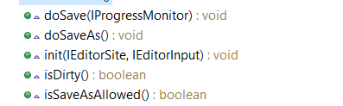
EditorPart
Editors are by implanted by using the ‘org.eclipe.ui.editor’ extension
The class which is sub-classed when an Editor is created from the extension is the EditorPart class.
The below methods are overridden for the Abstract EditorPart methods()

Slide 64
IEditorInput
The IEditorInput is the most important class of the Editor , it determines the input which is sent to the Editor.
An Editor opens up based on the EditorInput type , This EditorInput type is passed to the Editor class during the invocation of the Editor instance using the openEditor () call.
The openEditor() is a PlatformUI API call and can be invoked from a view, Handler , or on button Click events.
The openEditor takes two arguments EditorInput and the EditorID.

Slide 65
Init() method
The init() method is invoked right after the Editor instance is created and the IEditorInput instance and the IEditorSite
The IEditorInput is used to extract the data to be shown
in the editorand any change on the data can be used
to invoke the dirty bit for the editor

Slide 66
firePropertyChange()
The firePropertyChange(IEditorPart.PROP_DIRTY); method marks the editor as dirty.
The method can be invoked on a modify listener in an Editor.
We can also use isDirty() method to see if editor is marked as dirty at any point in editor.

Slide 67
doSave() and doSaveAll()
The doSave() method should mark the dirty bit to false so that the isDirty() method returns false.
The doSaveAll() is similar to the doSave() and is invoked when the saveAll() method is called.
The isSaveAllowed() method allows the save command to be enabled.

Slide 68
How to Open Editor ?
Editors can be opened using the Platform UI API s open Editor .
These APIs can be called from a view or from a menu/command using a Handler.
HandlerUtil.getActiveWorkbenchWindow(event).getActivePage().openEditor(input, FirstEditor.ID);

Slide 69
Demo Simple UI Editor

Slide 70
Text Editors
The text editors can be created using the in-built TextEditors in the Eclipse framework.
The text editor extends the ‘org.eclipse.ui.editors.text.TextEditor’ class
The text editors can be customized to open the editor for a specific type of file extensions .
The Syntax and the coloring of the text for different elements of the text like a comment or tag can be handled using the

Slide 71
SourceViewConfiguration
This class is implemented to override the presentation of the text editor to show the specific syntax coloring in the text Editor .
Uses a IPresentationReconciler implementation to set the Rules for the Text Editor using a RuleBasedScanner.

Slide 72
RuleBasedScanner
This class implements a method setRules() in its constructor method
The rules are formed using the Itoken
Each Token is associated with a Color and a text Attribute .
There are various in-built rules defined which can be used by providing the token to be associated with the Rule.
These set of rules are acted upon when a user edits the file in the Text Editor.

Slide 73
Text Editor Demo

Slide 74
MultiPageEditor
Multipage Editor , as the name suggests are used if we have to display the editor data in different ways in more than one editor.
The Multipage editor creates a Tabs like implementation for various pages of the Editor .
The addPages() method from the MultiPageEditorPart is implemented to provide the UI component for each of the editor in the multipage editor.

Slide 75
MultipageEditor Template
A multipage editor template example is provided in the framework .
Analysis of the Multipage Editor example.

Slide 76
Branding
In Eclipse branding an RCP application is done by providing the branding information in the .product file.
The branding information will inform the image to be used as splash and the launch of the product
The name of .exe generated when the product is exported
Icons for the .exe , shortcut and Task bar icon can be specified in the branding

Slide 77
Product file Changes
In the product file the values in the following tabs are changed
Launching:
Change the name of the Launcher , by default the .exe is named as eclipse.exe , name this to your application name.
Add a splash.bmp image to the plugin and make sure in the splash tab the reference for the plugin containing the splash image is given
Icons for each of the .exe, desktop and taskbar icon are specified

Slide 78
About Dialog
In the Product About Dialog , an Image and a text to describe the Product is added.
The About Dialog has to be added to the RCP application using the command for About Dialog
Create a menu in the plugin.xml and associate it with the standard command for About Dialog.

Slide 79
Branding & Licensing
The licensing information for the product can be added as part of the branding .
The license URL and the url for the update site can be provided.

Slide 80
Update URL
An update URL can be specified where the repository for the application is present .
The repository will have a plugins directory and artifacts.jar and content.jar

Slide 81
Features
A feature is component in eclipse RCP like the plugins , where in we group the related plugins into a single feature
A feature created will have a feature.xml which contains the information about the dependencies of the feature.
The feature can have another feature / plugins as it dependent features and plugins .

Slide 82
Features
The Eclipse RCP application can be configured to be exported using a feature project.
A features can have its own branding in terms of license information and update and can be added or removed from an eclipse RCP application to provide / remove a capability in the RCP application

Slide 83
Creating a Feature Project
Feature projects are created using the File-> New .. Feature project
An unique ID and a name and version is provided in the feature.
The dependencies for the feature are added as ‘Include features’ and ‘Included plugins’
The Product file can be configured to use the feature to run the eclipse application.

Slide 84
Exporting a product with feature
Change the product configuration selection in the product file editor
Click on the Export Product
Verify the product is exported and contains a feature directory.
The feature directory should have a feature.jar file
Run and verify the product is launched.

Slide 85
Exporting a feature
To export a feature , open the feature.xml in an editor
In the Exporting section , Selecting the Export Wizard.
Fill in the name and folder where the features has to be exported.
After export verify that a directory with features and plugins directory is created and it contains artifacts.jar and content.jar

Slide 86
Installing a feature
A feature can be installed into an Eclipse Application by Install as a new software and pointing to the directory where the feature was exported.
The eclipse framework will install this feature along with all the plugins the feature is composed of.

Slide 87
SWT Overview..
The purpose of SWT
The reasons for their creation
How the two libraries differ from Swing
Licensing and platform support

Slide 88
What exactly is SWT
Although we refer to SWT as a tools or toolset, it is essentially software library.
It consist of packages that contain Java classes and interfaces. But what makes these components so special is that you can combine them to form GUIs.
Can be independently run in a Java program independent of Eclipse Platform as a java library.
And not just any GUIs, either! Your applications will run quickly, make effective use of computer memory

Slide 89
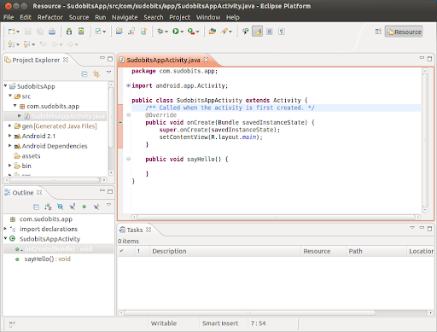
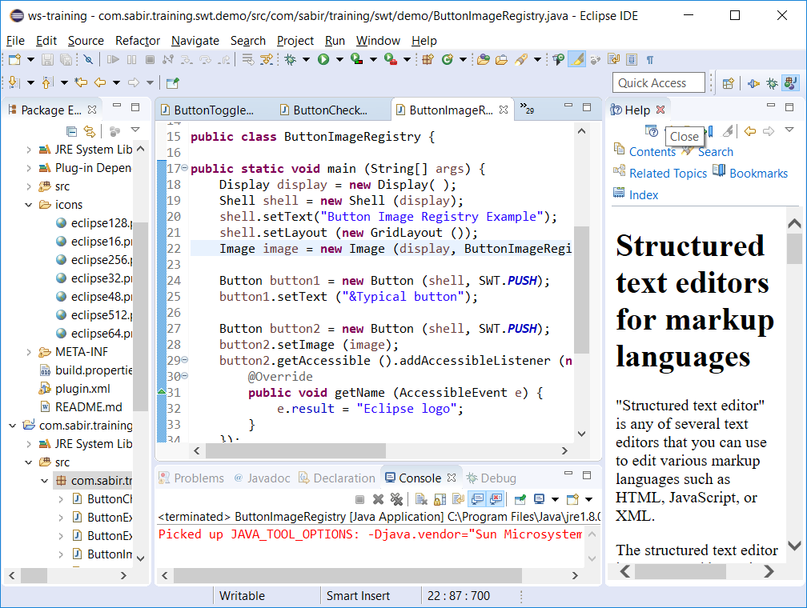
Native UI blending
Like chameleons, assume the look and feel of whichever Java-supported operating system they run on. No other GUI-building library can say that.
Windows
Ubuntu

Slide 90
Licensing and Platform Support
Comes under the Eclipse Public License which is free to use and is open source.
Supported by platforms:
Windows
Red hat Linux
SUSE Linux
Ubuntu
MacOS
Many others…

Slide 91
SWT / JFACE
The important classes of SWT: Display and Shell
An SWT programming example
The important class of JFace: ApplicationWindow
An SWT/JFace programming example

Slide 92
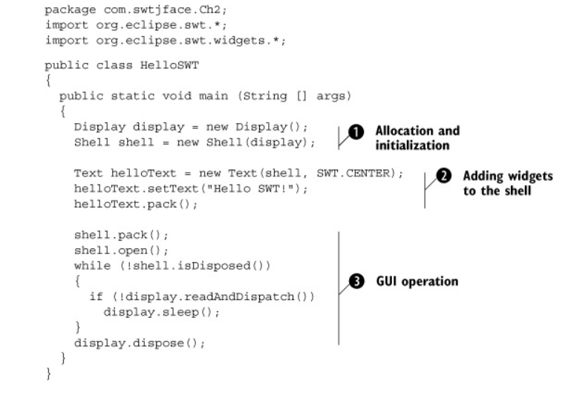
The Hello SWT program

Slide 93
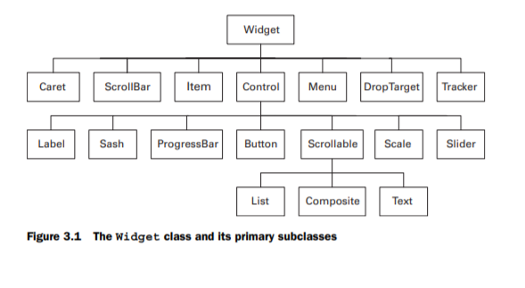
Widgets in SWT
SWT has a wide range of widgets to be used for the UI development in Eclipse RCP projects

Slide 94
SWT Widgets
Label
Shadow_Out
Seperator
BOLD
Italic
Button
SWT.Check
SWT.Radio
SWT.Toggle

Slide 95
SWT Widgets
Composite
Group
SashForm
TabFolder
TabItems
Text Widget
Text styles
Text Events

Slide 96
Graphics
Text Widget
Text styles
Text Events
Graphics
Rectangle
Oval

Slide 97
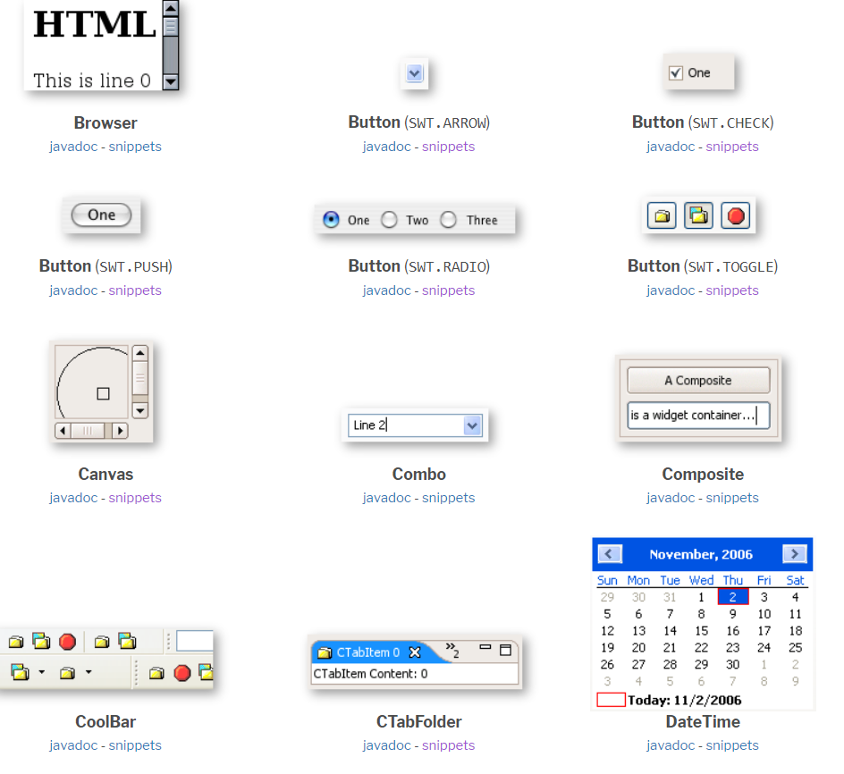
Common SWT Widgets
Source: https://www.eclipse.org/swt/widgets/

Slide 98
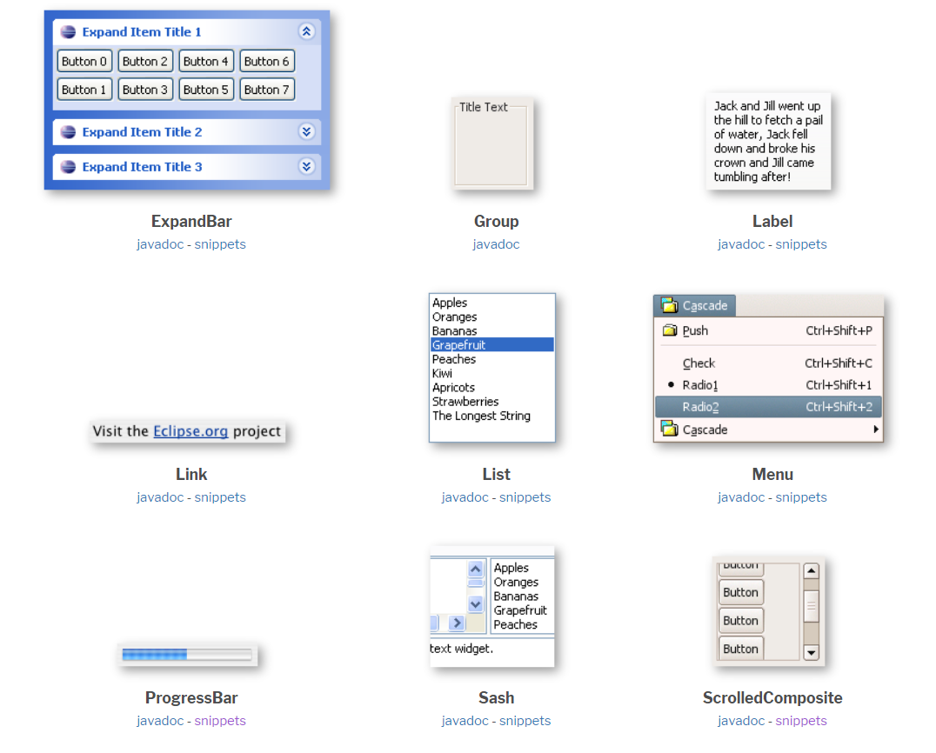
Common SWT Widgets
Source: https://www.eclipse.org/swt/widgets/

Slide 99
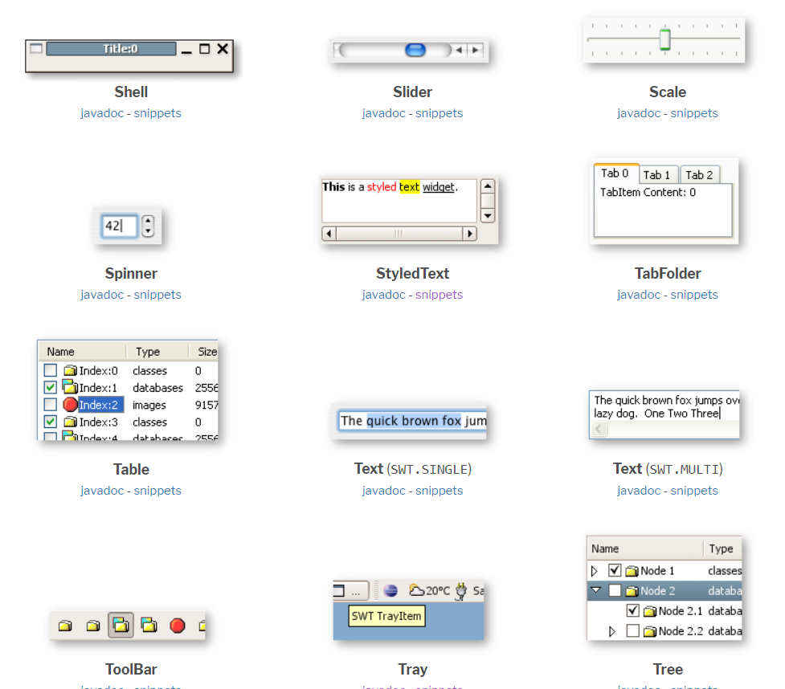
Common SWT Widgets
Source: https://www.eclipse.org/swt/widgets/

Slide 100
Composite
A composite is a special type of widget.
A composite doesn’t have any UI look and feel of its own , But it is own to form container like outline for the widgets
A composite is can have one or more widgets .
Inside the composite how the widgets are arranged depends upon the SWT layout set for the composite.

Slide 101
Group
Group is widget used to group one or more widgets based on some common functionality they are used for.
Group extends a composite and similar to they can have one or more widgets/composite as children under a group.
The group can have a heading associated with the composite.

Slide 102
Layouts
The Layout is a SWT class which manages the arrangement of the widgets in a Composite.
The layout is designed to arrange-rearrange the widgets as per the size of the Shell / Workbench and resize the widgets based on the expand or shrinking of the shell.
Layout may use a LayoutData to specify the parameters for each of the widgets in a composite.

Slide 103
Types of Layouts
There are 4 kinds of layouts which are commonly used
FillLayout
RowLayout
GridLayout
StackLayout

Slide 104
FillLayout
FillLayout is the simplest layout class.
It lays out widgets in a single row or column, forcing them to be the same size.
Initially, the widgets will all be as tall as the tallest widget, and as wide as the widest.
FillLayout does not wrap, and you cannot specify margins or spacing. You might use it to lay out buttons in a task bar or tool bar, or to stack checkboxes in a Group.

Slide 105
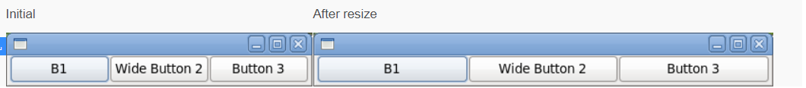
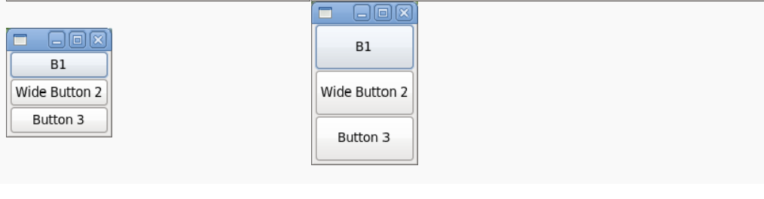
FillLayout types
fillLayout.type = SWT.HORIZONTAL
fillLayout.type = SWT.VERTICAL

Slide 106
Row Layout
It lays out widgets in a row or rows, with fill, wrap, and spacing options
rowLayout.wrap = true;
rowLayout.pack = true;
rowLayout.justify = false;
rowLayout.type = SWT.HORIZONTAL

Slide 107
Grid Layout
Arranges in a grid like format
The number of columns in a grid can be specified in the GridLayot , the widgets are layed out as the number of columns
Uses GridData to manage the widget level layout parameters

Slide 108
StackLayout
Used to flip – flop between two composites which can be shown in a
mutually exclusive way.

Slide 109
Custom Layout
Custom Layout used to have your own custom for a composite.
The computesize method computes size for each of the children of the composite
The layout method uses this size computed to render the widget with appropriate height and width.

Slide 110
RECAP

Slide 111
Help
Help in eclipse is accessed by using Help > Help Contents menu.
Once you done with development of your plug-in and before you are ready to ship it as a product, one thing which you would like to do is create help contents.
No matter how simple or complex your plugin is, users would like to see get started documents.
Also help provide us with opportunity to describe functionalities available with the plugin.

Slide 112
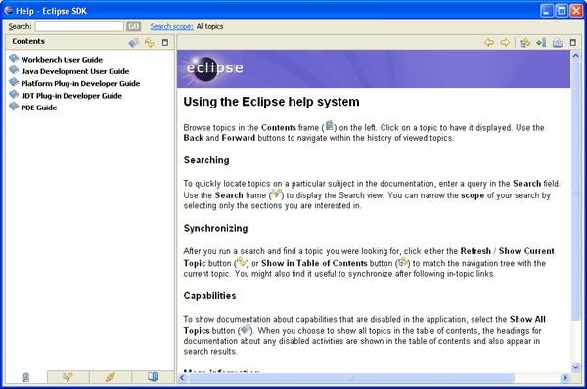

Slide 113
Overview
Eclipse has a build-in help system which allows to start and access the help system directly from your Eclipse RCP application.
The Eclipse help system is based on HTML, the "org.eclipse.help.toc" extension points and additional XML files called the context files which point to the HTML files.
Via the extension point you describe the first level structure and point to XML files. These XML files contain references to the relevant HTML files.

Slide 114
TOC files
The TOC files means Table of Content files for the Eclipse Help.
The toc entry which has the primary="true" flag set will be treated as a main entry in the help, all others will be treated as subtopics.
Topics not flagged as "primary" will not show up in the help hierarchy unless they are linked to from at least one primary toc file. The file attribute points to the XML file which describes the content.

Slide 115
Anchoring in toc files
The primary toc file defines anchor points to which other toc files can contribute content. For example the following "toc.xml" defines two anchor points "gettingstarted" and "samples".
<?xml version="1.0" encoding="utf-8"?>
<?NLS TYPE="org.eclipse.help.toc"?>
<toc label="Address Book Help" topic="html/toc.html”
<topic label="Getting Started">
<anchor id="gettingstarted"/>
</topic>
<topic label="Samples">
<anchor id="samples"/>
</topic>
</toc>

Slide 116
Generating Help Pages
Writing the HTML and XML files for the Eclipse help can be time consuming.
Documents for help are created and maintained usually with the Document teams

Slide 117
Creating help plugin
A help plugin can be created by using the Help plugin template and customizing the html and context file for the help
Create a new eclipse plugin com.sabir.training.rcp.demo.plugin with the “"Plug-in with sample help content".
Replace the toc.xml and .html pages with the appropriate help content

Slide 118
Eclipse Commands to invoke Help.
The Help page can be invoked by using the eclipse platform’s help command
"org.eclipse.ui.help.displayHelp" - Opens the help

Slide 119
Dynamic / Context Help
Dynamic or context help in eclipse are used to show the help related to the selected UI in the application .
Context Help changes the help as the selection changes in the RCP application.
The context help is created using the "org.eclipse.help.contexts“ extension , a context id and the reference for the html file is assigned.

Slide 120
Registering a control for Context Help
A UI Control / Widget has to be registered with a context help ID
The is done by using a Platform UI call
PlatformUI.getWorkbench().getHelpSystem().setHelp(control, “contextHelpID");

Slide 121
Invoking a Dynamic Help
To open the dynamic help the command "org.eclipse.ui.help.dynamicHelp" is used from the Help
Opens the Help specific for the current selection if this is configured in the application
Toggle between different views to see the help page content change.

Slide 122
Dynamic Help
DEMO

Slide 123
OSGI Overview
What is OSGi?
Why OSGi?
OSGi Architecture
Modular Layer
Lifecycle Layer
Service Layer
Bundles in depth
OSGi Service Registry

Slide 124
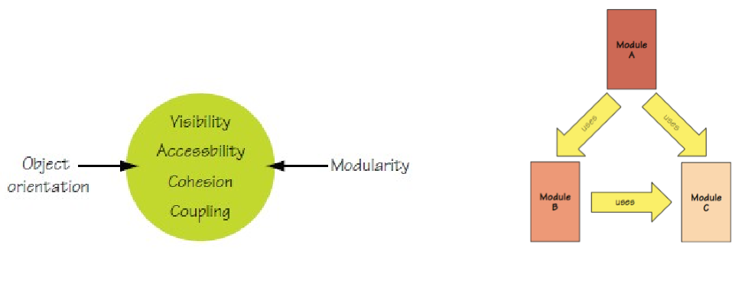
What is OSGi?
Modularity layer for the Java platform Modularity, where the code of application is divided into logical parts representing separate concerns
•From OSGi Alliance (http://www.osgi.org) standard for service-oriented, component-based Java applications

Slide 125
Why OSGI?
Reduced Complexity & Reuse - Developing with OSGi technology means developing bundles: the OSGi components. Bundles are modules. They hide their internals from other bundles and communicate through well defined services.
Dynamic Updates - The OSGi component model is a dynamic model. Bundles can be installed, started, stopped, updated, and uninstalled without bringing down the whole system.
Adaptive - The OSGi service registry is a dynamic registry where bundles can register, get, and listen to services. This dynamic service model allows bundles to find out what capabilities are available on the system and adapt the functionality they can provide. This makes code more flexible and resilient to changes.

Slide 126
Why OSGI?
Versioning - OSGi technology solves JAR hell. JAR hell is the problem that library A works with library B;version=2, but library C can only work with B;version=3. In standard Java, you're out of luck. In the OSGi environment, all bundles are carefully versioned and only bundles that can collaborate are wired together in the same class space. This allows both bundle A and C to function with their own library.
Small - The OSGi Release 4 Framework can be implemented in about a 300KB JAR file. This is a small overhead for the amount of functionality that is added to an application by including OSGi. OSGi therefore runs on a large range of devices: from very small, to small, to mainframes. It only asks for a minimal Java VM to run and adds very little on top of it.
Fast - One of the primary responsibilities of the OSGi framework is loading the classes from bundles. In traditional Java, the JARs are completely visible and placed on a linear list. Searching a class requires searching through this (often very long, 150 is not uncommon) list. In contrast, OSGi pre-wires bundles and knows for each bundle exactly which bundle provides the class. This lack of searching is a significant speed up factor at startup.

Slide 127
OSGI Architecture
Bundles - Bundles are the OSGi components made by the developers.
Services - The services layer connects bundles in a dynamic way by offering a publish-find-bind model for plain old Java objects. This layer concerned with interaction and communication among modules.
Life-Cycle - The API to install, start, stop, update, and uninstall bundles. This provides execution time module management and access to the underlying OSGi framework.
Modules - The layer that defines how a bundle can import and export code. Basically concerned with packaging and sharing the code. • Security - The layer that handles the security aspects. • Execution Environment - Defines what methods and classes are available in a specific platform.

Slide 128
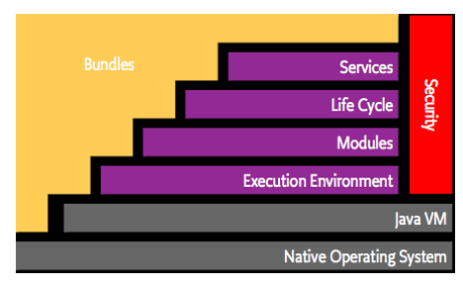
OSGI architecture

Slide 129
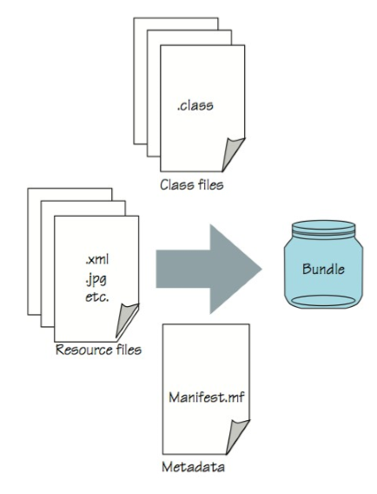
Modular Layer
The module layer defines the OSGi module concept, called a bundle, which is a JAR file with extra metadata and resources.
• Bundles typically aren’t an entire application packaged into a single JAR file; rather, they’re the logical modules that combine to form a given application.
• Bundles are more powerful than standard JAR files, because you can explicitly declare which contained packages are externally visible (that is, exported packages).
• Another important advantage of bundles over standard JAR files is the fact that you can explicitly declare on which external packages the bundles depend (that is, imported packages).
• The main benefit of explicitly declaring your bundles’ exported and imported packages is that the OSGi framework can manage and verify their consistency automatically.

Slide 130
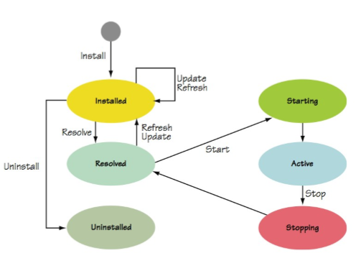
Lifecycle Layer
The lifecycle layer defines how bundles are dynamically installed and managed in the OSGi framework.
The lifecycle layer serves two different purposes. External to your application, the lifecycle layer precisely defines the bundle lifecycle operations (install, update, start, stop, and uninstall).
Internal to your application, the lifecycle layer defines how your bundles gain access to their execution context, which provides them with a way to interact with the OSGi framework and the facilities it provides during execution.
This overall approach to the lifecycle layer is powerful because it lets you create externally (and remotely) managed applications or completely selfmanaged applications (or any combination).

Slide 131
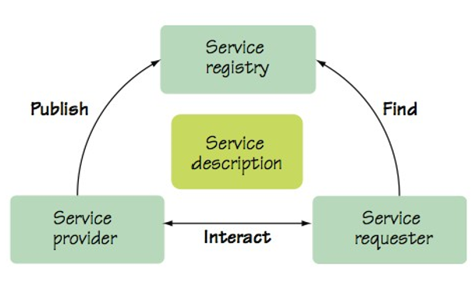
Service Layer
Service layer supports and promotes a flexible application programming model incorporating concepts popularized by service-oriented computing.
The main concepts revolve around the service-oriented publish, find, and bind interaction pattern: service providers publish their services into a service registry, while service clients search the registry to find available services to use.

Slide 132
Bundle Class-Search Order
If the class is from a package starting with java., the parent class loader is asked for the class. If the class is found, it’s used. If there is no such class, the search ends with an exception.
If the class is from a package imported by the bundle, the framework asks the exporting bundle for the class. If the class is found, it’s used. If there is no such class, the search ends with an exception.
At last the bundle class path is searched for the class. If it’s found, it’s used. If there is no such class, the search ends with an exception. Note : Each OSGi bundle has a class loader associated with it

Slide 133
OSGI Service Registry.
Provider Bundle
implement interface
register service
Client Bundle
find in registry
react when registered/unregistered
Core interfaces
ServiceRegistration
ServiceReference
ServiceTracker
Often registered/used
Spring DM
Declarative Services
Blueprint

Slide 134
Using OSGI console
The state of the running bundles can be viewed in Eclipse IDE using the OSGI console .
The osgi console gives a command line like interface to execute various commands on the OSGI container to know the state and to change the state of a bundle
A bundle can be started , stopped using the command line.

Slide 135
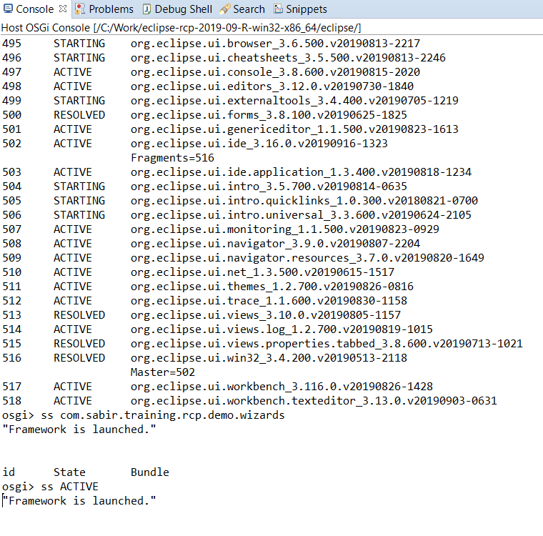


Slide 136
Command | Description
help | Lists the available commands.
ss | Lists the installed bundles and their status.
ss vogella | Lists bundles and their status that have vogella within their name.
start <bundle-id> | Starts the bundle with the <bundle-id> ID.
stop <bundle-id> | Stops the bundle with the <bundle-id> ID.
diag <bundle-id> | Diagnoses a particular bundle. It lists all missing dependencies.
install URL | Installs a bundle from a URL.
uninstall <bundle-id> | Uninstalls the bundle with the <bundle-id> ID.
bundle <bundle-id> | Shows information about the bundle with the <bundle-id> ID, including the registered and used services.
headers <bundle-id> | Shows the MANIFST.MF information for a bundle.
services filter | Shows all available services and their consumer. Filter is an optional LDAP filter, e.g., to see all services which provide a ManagedService implementation use the "services (objectclass=*ManagedService)" command.

Slide 137
Wizards
Often we need to get the input from a user which makes the user filling multiple pages or forms .
All the information filled in the form is collated as a single data input and is processed.
Basically , to perform a series of steps performed one at a time.
In Eclipse , The way we do it for such kind of input is Wizards.

Slide 138
How Wizards Work
For an implementation of a Wizard there are three main classes from the JFACE wizards framework
1) An abstract Wizard Class which implements Iwizard
2) A WizardPage class, one or more instances of this wizard page class is added to the wizard instance .
3) A shell or a Dialog which holds the wizard component and opens it.

Slide 139
Wizard Page
WizardPage implements the IWizardPage interface and provides much of the basic logic for a page. You need only implement createControl() from IDialogPage to
Build the controls appropriate to your page.
Has methods to decide the hasNext() page and to setError at the top of the wizard page using the showErrorMessage() method.

Slide 140
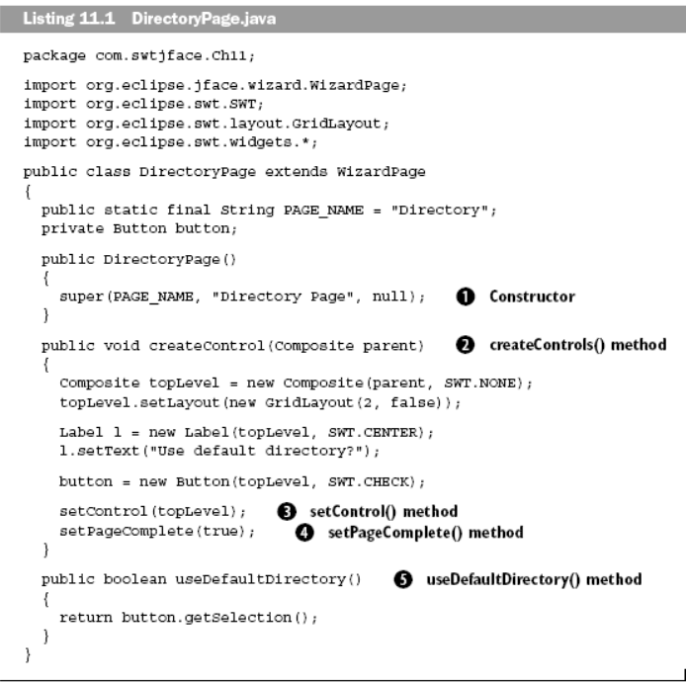
A sample WizardPage code.

Slide 141
Wizard Class
The Wizard class uses the method addPages () ,
addPage( wizardPage) adds the page to wizard.
All the instance of wizard pages are added to the Wizard class instance in the order they appear in the Wizard.
The performFinish() method is invoked in the method when the wizard Finish button is pressed.
This will immediately close the wizard even if there are several other wizard pages to be displayed.
To avoid this a canFinish() method canFinish() method can be used .

Slide 142
Wizard
CanFinish() will return a Boolean which on true will enable the Finish button and on false will keep the Finish button disabled.
PerformCancel() method is invoked when the wizard is cancelled.
getNextPage() method can be used to navigate the next page to be shown in the Wizard based on the currentPage or input.

Slide 143
Wizard Dialog
The Dialog instance which brings the Wizard pages as a modal dialog outside the RCP application.
The Dialog takes has two prominent method create() and open()
The create method invokes the createControl() and the open() method opens the dialog.

Slide 144
Wizard Dialog
As a wizard dialog takes the parent as the Shell object it doesn’t need any composite as a parent unlike any view or Editor or any UI widget control.
This makes the Dialog independent of from where the Dialog is invoked.
A wizardDialog can be invoked just by creating an instance and calling open() , It doesn’t need any PlatformUI calls or a HandlerUtil class for invocation.

Slide 145
Existing Wizard Commands
Several existing wizard commands are available in eclipse which can help the user to directly associate the opening of a wizard from a specific UI menu or Action.
For ex : org.eclipse.ui.newWizard extension will allow your wizard to be invoked from File New menu option.

Slide 146
DEMO

Slide 147
JFACE DataBinding

Slide 148
DataBinding
The JFace data binding framework allows to synchronize changes in properties of objects. Validation and conversion during the synchronization process is supported.
For example you could bind the String property called firstName of a Java object to a text property of the SWT Text widget. If the user changes the text in the user interface, the corresponding property in the Java object is updated.

Slide 149
Jface DataBinding
To observe changes in an attribute of a Java object, a data binding framework needs to be able to register itself as a listener to this attribute. JFace data binding provides API to register to changes in SWT widgets and JFace UI elements. Other Java object must implement this support.

Slide 150
Jface DataBinding
For example you can implement PropertyChangeSupport according to the Java Bean specification in these Java elements. Or you can use the WritableValue interface from JFace inside the model.

Slide 151
Factory | Description
PojoProperties | Used to create IObservableValue for Java objects. The term Pojo (Plain old Java object) is used to describe a Java object which does not implement a specific framework API.
BeanProperties | Used for Java Beans. A Java Bean is a Java object which follows the Java Bean specification. This specification requires that the class implements getter and setter methods for all its attributes. It must also implement property change support via the PropertyChangeSupport class and propagate changes to registered listeners.
WidgetProperties | Used for properties of SWT widgets.
ViewerProperties | Used for properties of JFace Viewer.
Properties | Used for properties of non specialized types, like Objects, Collections or Maps.
Observables | Used for properties of special Objects, Collections, Maps and Entries of an IObservableMap

Slide 152
Databinding context
DataBindingContext.bindValue()
Using the DataBindingContext.bindValue() method two IObservableValue objects are connected. The first parameter is the target and the second is the model. During the initial binding the value from the model is copied to the target. The initial copying from model to target is useful for the initial synchronization. For example, if you have an attribute of a Person p object and the text attribute of a Text txtName widget, you typically want to copy the value from p to txtName at the beginning.

Slide 153
Plugins Used
The following plug-ins are required to use JFace Data Binding.
org.eclipse.core.databinding
org.eclipse.core.databinding.beans
org.eclipse.core.databinding.property
org.eclipse.jface.databinding

Slide 154
Creating Binding Context
To Create a binding context we use the class
DataBindingContext ctx = new DataBindingContext();
To bind a UI control with a model the ctx.bind() method is used.

Slide 155
Observables
Different type of bindings is done by using the IObservable implementation.
The list of Observables implementation for different type of widgets and control is shown in the table.

Slide 156
Factory | Description
PojoProperties | Used to create IObservableValue for Java objects. The term Pojo (Plain old Java object) is used to describe a Java object which does not implement a specific framework API.
BeanProperties | Used for Java Beans. A Java Bean is a Java object which follows the Java Bean specification. This specification requires that the class implements getter and setter methods for all its attributes. It must also implement property change support via the PropertyChangeSupport class and propagate changes to registered listeners.
WidgetProperties | Used for properties of SWT widgets.
ViewerProperties | Used for properties of JFace Viewer.
Properties | Used for properties of non specialized types, like Objects, Collections or Maps.
Observables | Used for properties of special Objects, Collections, Maps and Entries of an IObservableMap.

Slide 157
PropertyChangeSupport
A PropertyChangeSupport instance is used to propagate the change by firing an event on add , remove or update call.
Model Classes implement this PropertyChange class and create an abstract model class from which the concrete data models are to be created.

Slide 158
WidgetProperties & BeanProperties
A widget like a text can be connected to the datamodel using a widget and a bean properties classes.
IObservableValue target = WidgetProperties.text(SWT.Modify). observe(firstName);
IObservableValue model= BeanProperties. value(Person.class,"firstName").observe(person);
ctx.bindValue(target, model);

Slide 159
UpdateValueStrategy
The bindValue() method from DataBindingContext allows you to specify UpdateValueStrategy objects as third and fourth parameters. These objects allow you to control the update of the values
If no UpdateValueStrategy is specified, the UpdateValueStrategy.POLICY_UPDATE is used by default. You can register converters and validators in the UpdateValueStrategy object.

Slide 160
Value | Description
UpdateValueStrategy.POLICY_NEVER | Policy constant denoting that the source observable’s state should not be tracked and that the destination observable’s value should never be updated.
UpdateValueStrategy.POLICY_ON_REQUEST | Policy constant denoting that the source observable’s state should not be tracked, but that validation, conversion and updating the destination observable’s value should be performed when explicitly requested. You can call DataBindingContext.updateModels() or DataBindingContext.updateTargets() to update all bindings at once. Or you can call Binding.updateTargetToModel() or Binding.updateModelToTarget() to update a single binding.
UpdateValueStrategy.POLICY_CONVERT | Policy constant denoting that the source observable’s state should be tracked, including Validate changes except for validateBeforeSet(Object), but that the destination observable’s value should only be updated on request.
UpdateValueStrategy.POLICY_UPDATE | Policy constant denoting that the source observable’s state should be tracked, and that validation, conversion and updating the destination observable’s value should be performed automatically on every change of the source observable value.

Slide 161
Validator
A validator allows you to implement validation of the data before it is propagated to the other connected property. A class which wants to provide this functionality must implement the org.eclipse.core.databinding.validation.IValidator interface
A validator can check in the setter methods where the value is valid before firing propertyChange Event .

Slide 162
Decorators
JFace Data Binding allows you to use icon decorators in the user interface which reflect the status of the field validation. This allows you to provide immediate feedback to the user. For the creation of the control decoration you use the return object from the bindvalue() method of DataBindingContext object.

Slide 163
Binding Viewers
JFace data binding provides functionality to bind the data of JFace viewers. Data binding for these viewers distinguish between changes in the collection and changes in the individual object.
In the case that data binding observes a collection, it requires a content provider which notifies the viewer, once the data in the collection changes.
The ObservableListContentProvider class is a content provider which requires a list implementing the IObservableList interface. The Properties class allows you to wrap another list with its selfList() method into an IObservableList

Slide 164
For List in ContentProviders
wrap the input into a writable list
IObservableList input = Properties.selfList(Person.class).observe(persons);
set the IObservableList as input for the viewer
viewer.setInput(input);

Slide 165
ObservableMapLabelProvider
You can also use the ObservableMapLabelProvider class to observe changes of the list elements.

Slide 166
ViewerSupport
Does Both
ViewerSupport simplifies the setup for JFace viewers in cases where selected columns should be displayed. It registers changes listeners on the collection as well as on the individual elements.
ViewerSupport creates via the bind() method the LabelProvider and ContentProvider for a viewer automatically.

Slide 167
JFACE Binding DEMO

Slide 168
Internationalization
Why ?
How?
Who ?

Slide 169
Locale?
A Locale defines the localization of a UI details in the language and the location
Commonly used locales are en_US , de_DE, en_UK,pt_BR
Internationalization makes the application to be used by others as per the locale in which the app is being viewed.

Slide 170
Internationalization in Eclipse
In Eclipse there is a framework inbuilt called the NLS
The NLS can generate the source files and the message.properties file for the plugin code.
The plugin UI can be internationalized by using a file for Bundle Localization by providing key value pairs in the plugin.properties file.

Slide 171
Messages.java and messages.properties
The class Messages.java and the properties file messages.properties are auto-generate by the NLS framework.
The strings which need to be translated are externalized
This can be done by selecting the file(.java) and using the source option in the Eclipse IDE menu.
It creates a Messages.java and a messages.properties file.

Slide 172
Locale files
The messages.properties are used for the default language of the system .
The messages.properties are copied and re-named as messages_locale.properties.
For ex: for locale de_DE , the properties would look like
messages_de_DE.properties.

Slide 173
DEMO
Internationalization

Slide 174
ExtensionPoint Creation

Slide 175
Want to create extension point?
In the application when we need to provide a functionalities so that others can use we create an extension point for it.
These extension points are available for a user to start contributing .
Making APIs public.

Slide 176
Extension point Schema
An extension point is created using the extension point tab from the Manifest file.
The extension-point should have a id, name and a schema defined.
The schema defines how the extension point should be used by the user and provides the extension point elements and attributes to which a contributor plugin specifies values

Slide 177
Plugin Registry
All plugins come for Extension Registry.
When a plugin is installed the plugin registry will have this plugin , and using the registry instance the extension-points exposed can be accessed in the application using the Platform APIs
The elements and attributes of the extension-points can be accessed and evaluate to call the appropriate method calls.

Slide 178
Executable Extension
A executable extension class is created which can be used to invoke the APIs of the class attribute of the extension .
The plugin extension point can be called by using a Handler instance on click of a command also .

Slide 179
DEMO
Creating extension-points

Slide 180
Introduction to E4

Slide 181
Eclipse E4
What ?
Why?
How?

Slide 182
What ?
Eclipse E4 is the latest eclipse framework where the eclipse applications can be designed and built by defining an Application Model.
Big change in the Eclipse world , where most of the existing 3.x concepts do not exist , the UI is built with POJO classes having special annotations.

Slide 183
How ?
E4 works by reading the model during startup and rendering the UI components as per the model hierarchy .
Makes use of DI framework to provide services and Eclipse Context across the parts in E4.
Uses @annotations to specify a behavior.

Slide 184
Why ?
Easier and faster to Design a RCP application.
No need to actually implement views /parts to just see the application design look.
Abstracts a lot of implementation from the User .
Gives the advantage of Dependency Injection
Behavior of simple POJO classes can be defined using simple annotations.
Arrangement of the views can be done using PartStack and PartContainers.

Slide 185
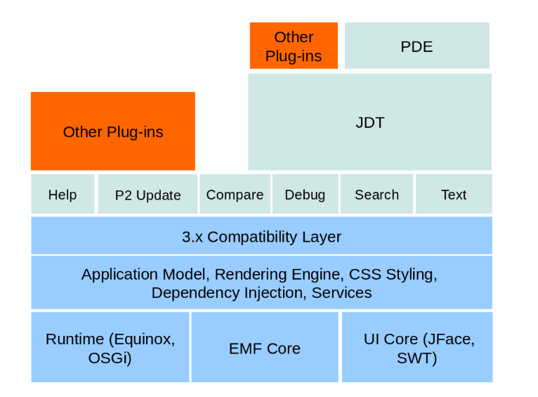
Architecture

Slide 186
Application Model
The foundation of every Eclipse 4 application, the application model.
In Eclipse 4, the workbench is defined in the so-called Application Model.
This includes windows, views, perspectives, menu contributions, handlers and key bindings.
Using the model you define the general design or “skeleton” of your application. Defining a model doesn’t already require that you implement the single components

Slide 187
Application Model vs. Views
For example, you can add a view to the model without implementing its contents. To show the resulting separation between the general workbench design and the implementation of single parts

Slide 188
Windows, Parts and PartContainers
The cornerstones of the application model are windows, parts and part containers.
Unlike in the eclipse 3.x platform, e4 has combined views and editors into the concept of Parts, which represent views inside a window.
If you add a part in the model, you can later connect it to your implementation of the selected view.

Slide 189
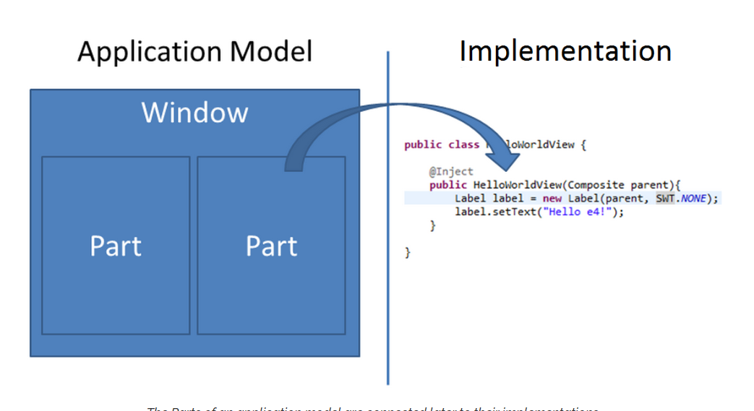
Application Model to Implementation

Slide 190
Part
In Eclipse E4 there is no separation between Views and Editors unlike the 3.x
Both are called a common UI element called the Part.
A part is a view in eclipse E4 , the parts can be created using Plain Java Classes with special annotations , No need to use an extension or to extend any Super class like ViewPart

Slide 191
@PostConstruct and @Focus
In Eclipse E4 the method which renders the view UI can be any method and need not be createPartControl () .
The method which is designated to be like the createPartControl() is invoked with the annotation @PostConstruct
The setFocus() method is also removed , any method can be used as setFocus method by using the annotation @Focus

Slide 192
No Editors Only Parts ?
In Eclipse there is no difference between views and editors both are as Parts , what makes a Part to be treated as a view or a editor like behavior is the ability to mark a part as dirty.
In E4 any Part can be marked dirty using the part.setDirty() method
MDirtyable and @Persist are treated like the dirty and doSave() method

Slide 193
PartContainer
As parts cannot exist on their own, they are always contained in PartContainers.
Those PartContainers create an application layout. Besides windows, there are two elements which can contain
Parts: PartSashes and PartStacks. A PartSash will arrange contained elements either vertically or horizontally.

Slide 194
PartStack
A PartStack adds an area, where the contained elements are stacked behind each other, only one element is shown on top.
PartSash and PartStack can contain each other to create any kind of layout within a window.

Slide 195
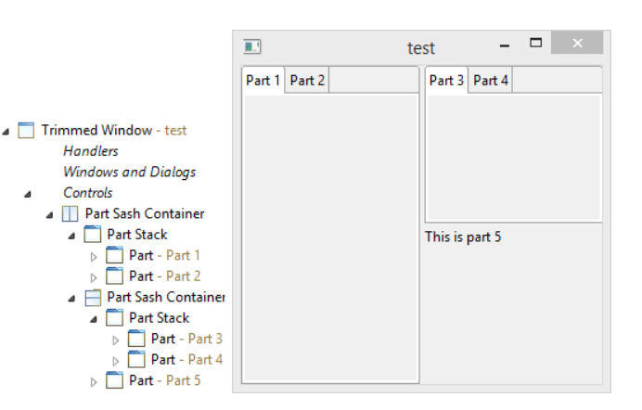
Arrangement of Parts / Views

Slide 196
Commands and Handlers.
Commands can be added to the application model
A command as in 3.x will take an id , name and a Handler class .
A Handler class here is any POJO class with a method having @Execute annotations.
A Handler can be created and added to the application model to be used by a command.

Slide 197
Menus and ToolBars
Menus can be handled using the HandledToolItem in the model
A HandledToolItem is like the menu Item or a Toolbar Item and it can be put under a menu or a toolbar .
For Parts a menu can be created under the hierarchy of the Part.

Slide 198
Dependency Injection
The DI is the most important aspect of Eclipse E4.
The application context , services and the model elements can be injected into the Parts using DI .
DI has three ways commonly
Field Injection.
Constructor Injection.
Method Injection.

Slide 199
Behavior annotations
Defines when a method will be invoked.
The most used are :
@Postconstruct
@Focus
@Persist
@Execute and @canExecute
@PreDestroy
@PersistedState

Slide 200
Services
No need of getting Platform class to invoke services
Services can be injected from an Eclipse Context using DI
Some of the common services used in Eclipse E4 are

Slide 201
Service | Description
EModelService | Used to search for elements in the model, create new model elements, clone existing snippets and insert new elements into the runtime application model.
ESelectionService | Used to retrieve and set the current active selection in the user interface.
ECommandService | Gives access to existing commands and allows you to create and change commands.
EHandlerService | Allows you to access, change and trigger handlers.
EPartService | Provides API to access and modify parts. It also allows you to switch perspectives and can be used to trigger that a method annotated with @Persist in dirty parts, i.e. if the corresponding part behaves like an editor.

Slide 202
Service | Description
EModelService | Used to search for elements in the model, create new model elements, clone existing snippets and insert new elements into the runtime application model.
ESelectionService | Used to retrieve and set the current active selection in the user interface.
ECommandService | Gives access to existing commands and allows you to create and change commands.
EHandlerService | Allows you to access, change and trigger handlers.
EPartService | Provides API to access and modify parts. It also allows you to switch perspectives and can be used to trigger that a method annotated with @Persist in dirty parts, i.e. if the corresponding part behaves like an editor.

Slide 203
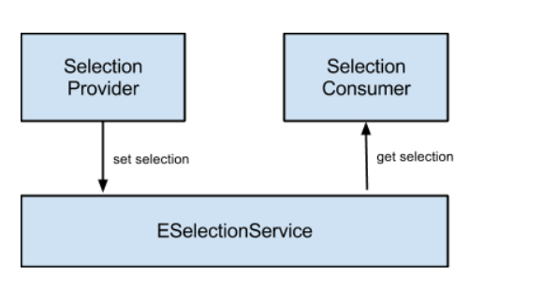
Selection Service
Provides the Application views with the selection happening in the application
Uses SelectionProviders to get the selections
Injectable through DI.
Consumers can do getSelection() on the SelectionService instance and get active selection.

Slide 204
3.X Compatibility Layer

Slide 205
3.x Compatibility Layer
The compatibility layer is used to provide functionality of the 3.x to the eclipse E4 application and also it connects a bridge between the E4 model and the 3.x implementation .
In a 3.x application the compatibility layer is used to create and show the Eclipse E4 view by making use of the e4 view option in the org.eclipse.ui.views extension.

Slide 206
SWT Advanced
Widgets and Layouts are the main /basic components of the SWT
In SWT we can have our own widgets designed and can create Layout to program how they react to re-size.

Slide 207
3.x Compatibility Layer
Helps the 3.x application to take advantage of E4 concepts and the Dependency Injection .
Use the services as Injectable in the E4 views.
Create an application with both 3.x and E4 functionality.

Slide 208
Designing a Custom Widget
This is done in two ways :
Canvas - to create basic widgets
Composite - to create compound widgets.

Slide 209
Basic Widgets
Basic widgets do not contain any other widgets, and are not built from any other widgets.
Basic widgets draw themselves. An example of a basic widget is Button. Another example is Text.
To create a custom basic widget, subclass Canvas.

Slide 210
Compound Widgets
Compound widgets contain other widgets, and/or are composed of other widgets.
An example of a compound widget is Combo. It contains a Text, a Button and a List. Another example is Group.
It can contain any number of children. To create a custom compound widget, subclass Composite.

Slide 211

Basic Widgets Example
a widget that displays an image with a line of text to the right.
Using Canvas we draw both image and text
The custom widgets extends Canvas.
public class PictureLabel extends Canvas {
Image image;
String text;
}

Slide 212
Methods to implement in Basic Widget
paintControl()
computeSize()
A dispose Listener which will inturn call the dispose on the widget.

Slide 213
Compound Widget Example
Uses two field a Image Label and a Text Label and a background color
to display a custom widget.
Extends a composite
Like the Basic widget need to layout the widget using computeSize() and a layout() method.
A disposeListener method is needed to dispose() the widget.

Slide 214
Custom Layout Managers
For custom widgets we may override how they are arranged in a standard layout by implementing our own custom Layout by extending the Layout class
The method computeSize() and layout() are implemented.

Slide 215
Custom Widget
Demo

Slide 217
SWT Events Model

Slide 218
Display
The org.eclipse.swt.widgets.Display class is responsible for managing event loops, fonts, colors.
The Display runs a Event loop.
The loop executes the readAndDispatch() method which reads events from the native OS event queue and dispatches them to the SWT event system.
The loop is executed until the main shell is closed. If this loop would be left out, the application would terminate immediately.

Slide 219
Event Object
Field | Description
display | the Display on which the event occurred
widget | the Widget that issued the event
type | the event type

Slide 220
Event Listeners
Can be :
Added - addListener(int event, Listener listener)
Removed - removeListener(int type, Listener listener)
Notified - notifyListeners(int type, Event event)

Slide 221
SWT Events
Event Type Constant | Description
SWT.KeyDown | A key was pressed
SWT.KeyUp | A key was released
SWT.MouseDown | A mouse button was pressed
SWT.MouseUp | A mouse button was released
SWT.MouseMove | The mouse was moved
SWT.MouseEnter | The mouse entered the client area of the control
SWT.MouseHover | The mouse lingered over a control
SWT.MouseExit | The mouse exited the client area of the control
SWT.MouseDoubleClick | A mouse button was pressed twice
SWT.Paint | A control was asked to draw
SWT.Move | The position of the control was changed
SWT.Resize | The size of the client area of the control changed
SWT.Dispose | The widget was disposed

Slide 222
SWT events
SWT.Selection | A selection occurred in the widget
SWT.DefaultSelection | The default selection occurred in the widget
SWT.FocusIn | Keyboard focus was given to the control
SWT.FocusOut | The control lost keyboard focus
SWT.Expand | A tree item was expanded
SWT.Collapse | A tree item was collapsed
SWT.Iconify | The shell was minimized
SWT.Deiconify | The shell is no longer minimized
SWT.Close | The shell is being closed
SWT.Show | The widget is becoming visible
SWT.Hide | The widget is being hidden
SWT.Modify | Text has changed in the control
SWT.Verify | Text is to be validated in the control
SWT.Activate | The control is being activated
SWT.Deactivate | The control is being deactivated
SWT.Help | The user requested help for the widget
SWT.DragDetect | A drag-and-drop user action occurred
SWT.MenuDetect | The user requested a context menu
SWT.Arm | The menu item is drawn in the armed state
SWT.Traverse | A keyboard navigation event occurred

Slide 223
Graphics
Graphics is SWT is way of drawing in the SWT UI.
The drawings are done on a component called Canvas and using the GC package classes
Using the paintControl() method the gc methods can be used to draw various components like the circle , rectangle oval.
It can also be used to draw Strings and Images to create custom widgets in SWT.

Slide 224
Colors
Can be created using the Color red = new Color (device, 255, 0, 0);
Uses the RGB values and the gradient constants to define a color look.
The Color is a special class and is not a widget but is associated with a widget as a background / foreground color if assigned.
Colors can be retrieved by Display object using
Display display = Display.getCurrent(); Color blue = display.getSystemColor(SWT.COLOR_BLUE);

Slide 225
SWT Threads
All SWT UI is rendered using a single Display thread .
Any UI operation in SWT has to happen on this thread also called Display thread only.
In case a UI operation is done on the non-UI thread a Display.async() runnable method is invoked.
A thread is always running and dispatches the event from the event loop.

Slide 226
SWT Dialogs
Dialogs are components which are created from a shell and appear outside the main window of the application .
Dialogs have two major methods called the createControl() and the open() method .
CreateControl() is where the UI of the dialog is created.
The open() method opens the dialog shell.

Slide 227
Eclipse in-built dialogs
There are many built-in dialogs an application can make use of
Font Dialog
Color Dialog
Directory Dialog
FileDialog
MessageDialog.
WizardDialog.

Slide 228
Creating a Custom Dialog
To create a custom Dialog we need to extend the Dialog instance.
The Custom Dialog should take input from the user for the Dialog shell title and any message to be shown in the Dialog.
The custom dialog should implement the createControl () and the open() method.

Slide 229
Dialog Examples Demo

Slide 230
Design patterns

Slide 231
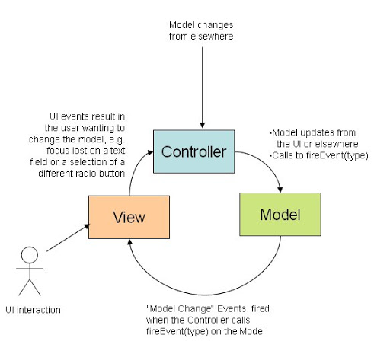
MVC

Slide 232
CellEditors
TextCellEditor
CheckBoxCellEditor
ColorCellEditor
ComboBoxCellEditor

Slide 233
Separation of Concerns
The MVC is designed to keep separation of model and view with a controller acting like intermediator
The controller is the common module to which both the view and model with talk to and exchange information.
The model and view will know the details about each other via the controller.
The changes in model should not affect or cause a break in the view.

Slide 234
MVC in JFACE
JFace viewers allow the creation of a model-view-controller (MVC) architecture
The view is the underlying SWT widget, the model is specified by the framework user, and the JFace viewer and its associated components form the controller.
The viewer input is a model element that seeds the population of the viewer.
JFace Text is a sophisticated framework which allows an Eclipse plug-in developer to build text editors with advanced features, such as syntax highlighting, basic content assistance and code formatting.

Slide 235
Command Pattern
the command pattern is a behavioral design pattern in which an object is used to encapsulate all information needed to perform an action or trigger an event at a later time.
This information includes the method name, the object that owns the method and values for the method parameters.
A command is basically a descriptor of how a functionality will be invoked which abstracts the Handler from the user.

Slide 236
Command Pattern in Eclipse Application
■ A command is an abstraction of some semantic behavior
■ A command is not an implementation of that behavior.
■ A command is not the visual presentation of the behavior.
Commands are executed by an external agent called the Handler.
A Handler is not aware of all the commands which use it in their description to execute the command.
It is independent of which commands invokes it.

Slide 237
Observable Pattern
There is observer and an observable in this Pattern.
A typical example is the jface data binding Iobservable interface .
The IObservables are created for each of the widget to be tracked and is binded with an observer using a binding Context.
The Observer is notified everytime there is any update / change of any properties in the Observer .

Slide 238
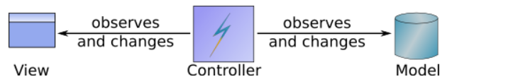
Jface Observerables

Slide 239
How it works?
The view observes (listens to) the model for changes and redraws itself when it detects a change.
The controller observes (listens to) the view for change events.
When the controller detects an event that needs to cause a change, it is responsible for mutating the model, which implicitly refreshes the view because the view is listening to the model for changes.

Slide 240
General Drawback
The view has to understand the model.
The controller has to understand both the view and the model.

Slide 241
Drag and Drop

Slide 242
SWT Drag and Drop
In SWT a drag and drop event is used when a data is sent to another widget by just dragging from a source to a target widget
The Drag and Drop is SWT is handled by using the SWT DnD package
SWT DND class provides a list of DND events which are used to indicate a drag or a drop on the widget.

Slide 243
DragSource and DropTarget
A DragSource instance has to be created , which is used to drag a selection from a widget
The DropTarget instance is what receives the selection from the drag source.
Both Drag Source and DropTarget communicate by setting a common Transfer Source Type.

Slide 244
The Transfer class
DND has this Transfer class which acts as a common class type which the source and target for the Drag and Drop has to agree to and set the transfer type to the same type of Transfer instances.
A drag and drop having different Transfer class instance set do not get paired up for a DND operation.

Slide 245
DND Listeners
For Source it’s the addDragListener () method which needs to be implemented
In this method the event data for the Drop Listener is prepared and assigned to the selection in the source.
The Target uses addDropTarget() listener which is used to receive the event from the source and set it to the receiving widget.

Slide 246
Transfer Types
Some of the inbuilt Transfer types in SWT DND package are :
Text Transfer
HTML Transfer
List Transfer
Image Transfer
URL Transfer
…. Many more

Slide 247
Custom Transfer Type
You can also create your own Transfer type for your model class type by extending the Transfer class.

Slide 248
DND DEMO

Slide 249
JFACE Resources

Slide 250
JFACE Resources
In Jface every widget and the resources created for the widget has to be disposed.
In case of SWT widgets the dispose mechanism of SWT takes care of the underlying widgets of JFACE .
But the resources like the Color , Font , Image which are used by the widget has to be disposed explicitly.

Slide 251
JFACE Resource Manager
JFACE Resource Manager takes care of handling all the resources for the jface widgets and controls.
JFace provides the ResourceManager and its derived classes for managing such resources automatically.
An instance of the LocalResourceManager class is created with a reference to a Control. If this Control is disposed, the resources created by the LocalResourceManager are also disposed.

Slide 252
Binding Resource Manager
A Resource is binded with a local Resource Manager of the JFACE framework.
// create the manager and bind to a widget ResourceManager resManager = new LocalResourceManager(JFaceResources.getResources(), composite);
// create resources
Color color = resManager.createColor(new RGB(200, 100, 0));

Slide 253
Use of Bundle to create Resources
Bundle bundle = FrameworkUtil.getBundle(this.getClass());
URL url = FileLocator.find(bundle, new Path("icons/alt_window_32.gif"), null);
ImageDescriptor imageDescriptor = ImageDescriptor.createFromURL(url);

Slide 254
Disposing
Having a resource manager to create Resources ensure that on dispose() just by disposing the localResource Manager all the widgets and their associated resources are also Disposed.

Slide 255
Progress Indicators
Used to show the progress of a task in UI
Used along with a non-UI thread performing a time consuming operation like File Read / Server Calls .
Can be used just like a UI widget by specifying the number of task and the monitor incremented as the tasks complete.

Slide 256
Jface Dialogs
Similar to Dialogs in the SWT .
With some additional functionality.
MessageDialog , similar to Message Box.
TitleAreaDialog , creates a Text Box to give a user feedback Dialog.

Slide 257
MessageDialog
MessageDialog has static apis which can be invoked to show a MessageDialog with the appropriate icon for the type of message
The type can be Info , warning , Error .
These are invoke like MessageDialog.openInfo() , MessageDialog.openError()

Slide 258
Custom Dialog
Created by extending the JFACE dialog.
The createDialogArea() is the method for the UI creation.
configureShell() method can be overridden to show custom title for the Dialog shell.

Slide 259
Selection Dialogs
ElementListSelectionDialog
ListDialog
ElementTreeSelectionDialog
CheckTreeSelectionDialog
For example ElementListSelectionDialog allows you to select elements from a list where the dialog provides a filter for the elements.

Slide 260
Non-Modal Dialog
Dialogs can be Non –Modal
setShellStyle(SWT.CLOSE | SWT.MODELESS | SWT.BORDER | SWT.TITLE);

Slide 261
SWT BOT

Slide 262
Testing UI Plugins with SWT Bot
Introduction to SWT Bot
SWT Bot Plugins Setup
SWT APIs
How it works

Slide 263
UI testing Challenges
It’s not easy, natural brittleness...
manual vs. automated testing
deciding what to test

Slide 264
Challenges
Identifying Controls
Similar looking controls
Moving Controls.
Sending “events” to controls

Slide 265
Managing SWT threads
Challenges in UI testing involves managing SWT thread

Slide 266
Installation and Setup
SWT Bot can be installed in eclipse using the update site
http://download.eclipse.org/technology/swtbot/releases/latest/

Slide 267
SWT BOT API Introduction

Slide 268
Finding Widgets
SWTWorkbenchBot bot = new SWTWorkbenchBot();
SWTBot[Widget] widget = bot.[widget][With][Matcher(s)]();
ex :SWTBotText text = bot.textWithLabel("Username:");
Think of the bot as something that can do tasks for you (e.g., ﬁnd widgets, click on them, etc.)

Slide 269
Finding obscure widgets
withLabel("Username:")
withMnemonic("Finish")
withText("&Finish") inGroup("Billing Address") widgetOfType(Button.class)
withStyle(SWT.RADIO)
withTooltip("Save All")
withRegex("Welcome, (.*)")

Slide 270
Performing actions
button.click() // click on a button
// chain methods to make them concise bot.menu("File").menu("New").menu("Project...").click();
tree.expand("Project").expand("src").expand("Foo.java").contextMenu("Delete").click(); // delete Foo.java
list.select("Orange", "Banana", "Mango"); // make a selection in a list.
list.select(2, 5, 6); // make a selection using indexes

Slide 271
Setup of Simple Test class
Create a plugin project “com.sabir.training.swtbot.demo” with a command template
Add Dependencies
org.eclipse.ui org.eclipse.core.runtime org.eclipse.swtbot.eclipse.ﬁnder
org.eclipse.swtbot.junit4_x
org.eclipse.swtbot.swt.ﬁnder
org.junit4

Slide 272
Run the Test class with Simple test
@Test
public void thisOneFails() throws Exception {
fail("this test fails");
}
@Test
public void thisOnePasses() throws Exception {
pass();} }

Slide 273
Launch SWT Bot
Using Run Configuration - > Swt bot
Run the Sample Test cases.
Verify there is one test case failing and one passing.

Slide 274
@BeforeClass
Used to make sure the eclipse is launched clean by getting the welcome page and closing it.

Slide 275
Find all widgets
Depth ﬁrst traversal of UI elements
1.Find top level widgets
2.Find children of each widget
For each child do (1) and (2)

Slide 276
Steps involved
For any SWT Bot Test
These 5 steps are involved ;
Before class to instantiate the initial Behavior
Preparation for the test (if any) like opening a specific perspective.
Identification of the widget by the SWT bot instance
Actions on the widgets
@Test passes if all the actions are performed .

Slide 277
Many more tests Example
The Sample view is tested in a similar way in the Eclipse UI.
Do not disturb the UI testing by manually interfering with the button clicks or using the mouse during testing.

Slide 278
Build

Slide 279
Build Units
In Eclipse the type of projects you can build are
Plugins
Features
Update Site
Product

Slide 280
Pre-requisite
Requires MAVEN to be installed.
M2e plugin to be installed ( by default it is installed ) in eclipse

Slide 281
Plugin Build
A plugin is built as a jar , a plugin can be independently built and a jar out of the eclipse plugin is created.

Slide 282
Features
A feature contains one or more features or plugins
A features is an Installable unit in eclipse.

Slide 283
Update Site / Repository
A repository contains one or more features which can be used as a Site for updates
It is described using a category definition in the category.xml file.

Slide 284
Tycho
Tycho is a build tool which is used for building eclipse components like the plugins , features , repositories and products
Tycho is basically a maven plugin , any project which is of maven type ie., has a pom.xml can be built with Tycho.
The Tycho plugin identifies the type of the project as plugin /feature or update site or product and builds it.

Slide 285
How Tycho works
Tycho has these build plugins
1) tycho-maven plugin
2) tycho-packaging-plugin
3) target-platform-configuration
4) tycho-p2-repository-plugin
5)tycho-p2-director-plugin

Slide 286
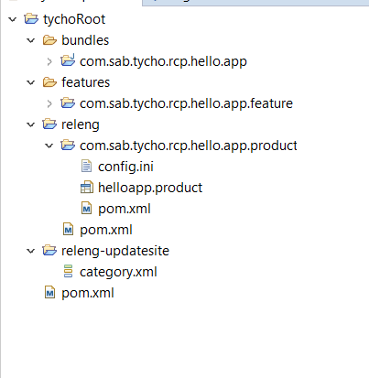
Tycho Build Project Structure

Slide 287
Advantages of using Tycho
Just runs like a maven build project
Easy to integrate any existing CI system supporting Maven ( like Jenkins)
Repository are downloaded from eclipse repos or from the maven central
Clean way of building

Slide 288
Hands on

Slide 289
JNA
Java Native Access

Slide 290
JNA library
Jna libraries makes it possible for Java to call native methods in Java programs.
System.load(dll) method is used to load a dll into runtime.
Once the dll is in runtime is methods can be accessed by using creating an instance for the DLL in java using the Native.loadLibrary

Slide 291
Demo

Slide 292
TreeViewer to Tableviewer
DEMO

Slide 293
CellEditors
DEMO

Slide 294
RCP best Practices

Slide 295
Best Practices
Define plugins with core, UI and services to be separated.
Follow the MVC pattern wherever applicable.
Use JFACE widgets for more abstraction of UI functionalities.
Create JFACE resource managers for managing resources.

Slide 296
Project, package and class names
Object | Description
Project Names | The plug-in project name is the same as the top-level package name.
Packages | Plug-ins which contain a lot of user interface components use sub-packages based on the primary purpose of the components. For example, the com.example package may have the com.example.parts and com.example.handler sub-package.
Class names for model elements | Use the primary purpose of the model element as a suffix in the class name. For example, a class used as a part implementation, should be called [PurposeDescription]Part.

Slide 297
Identifiers
Each of the UI component should have a ID , which tells the what the id is representing
Ex : for views have ids “com.sabir.training.rcp.myview.id”
For Commands “com.sabir.training.rcp.command.id”

Slide 298
Plugins
Maker sure there are no cyclic dependencies.
Use Import packages wherever possible.
Do not try to add the primary plugin as dependency to other plugin.
Update Plugin version when dependent plugins get updated.

Slide 299
Features.
Group plugins with a common functionality into a single feature.
Use nested features for complex implementations.
Have a basic Feature and a custom feature for any client features.
Use a feature based product over a plugin based product.

Slide 300
UI Layouts
Prepare a mockup of UI layout before implementation.
Use GridLayout for complex UI , Row or Fill Layout for simple UI
Use the appropritate GridData with the GridLayout.

Slide 301
Versioning
Maintain the OSGI versioning Major.Minor.Micro.Qualifier
Do not restrict version number unless a particular version is needed.
Update versions of features when plugin version changes.
Update version of product when features version changes.

Slide 302
Product
Create a feature based product over a plugin based.
Apply Branding , do not use standard eclipse icons in custom applications.
Provide update sites url and license url for each of the features and the product.
Create various versions of product by adding or removing features from product file and building.

Slide 303
Testing
Distinguish UI and non UI testing.
Use SWT bot for automating testing / Plain Junit for Non UI
Manual Test the UI in different Display resolutions whenever possible.
Export the product and test before building for faster product testing.

Slide 304
Build
Prepare the build structure like that of Tycho .
Use bundles directory to keep the plugins and features directory to keep the features.
Use a centralized pom.xml to build plugins.
Build Installable UI and test them independently for any feature implementations.

