Slide 1
Building new boxes

Slide 2

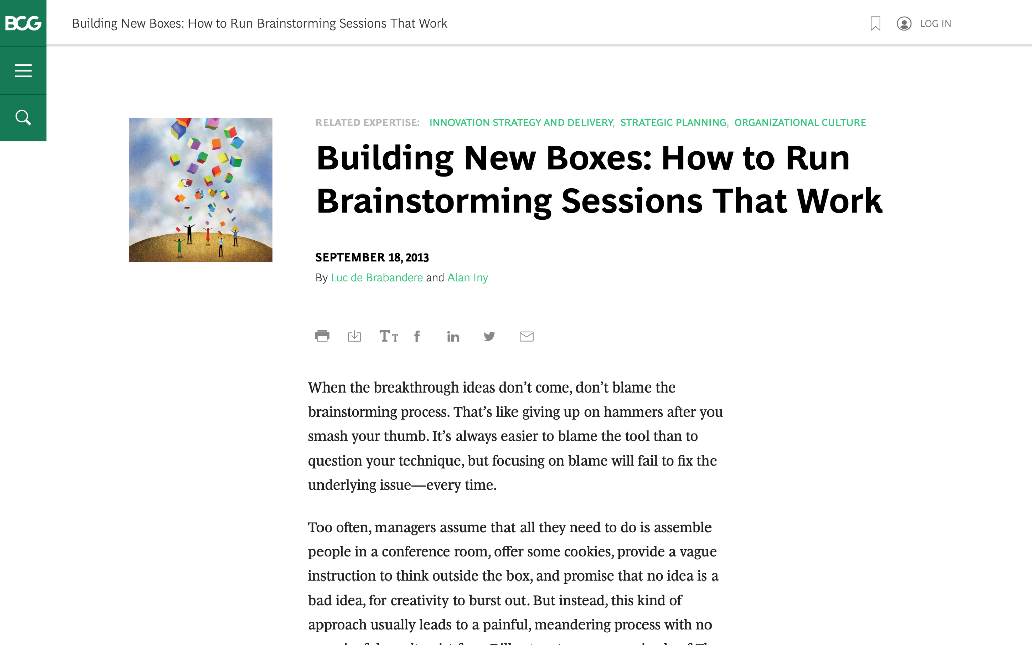
We are going to discuss effective brainstorming. Start by reviewing this article on the BCG website:
Building New Boxes: How to Run Brainstorming Sessions That Work

Slide 3

The article offers five suggestions to achieve real, valuable insights from brainstorming
We will focus on three of these in today’s task (as well as the brainstorming itself), highlighted in green
1.
Frame the question effectively
2.
Create creativity conditions
3.
Reveal and doubt your boxes
4.
Bring new boxes
5.
Follow up
Brainstorm

Slide 4
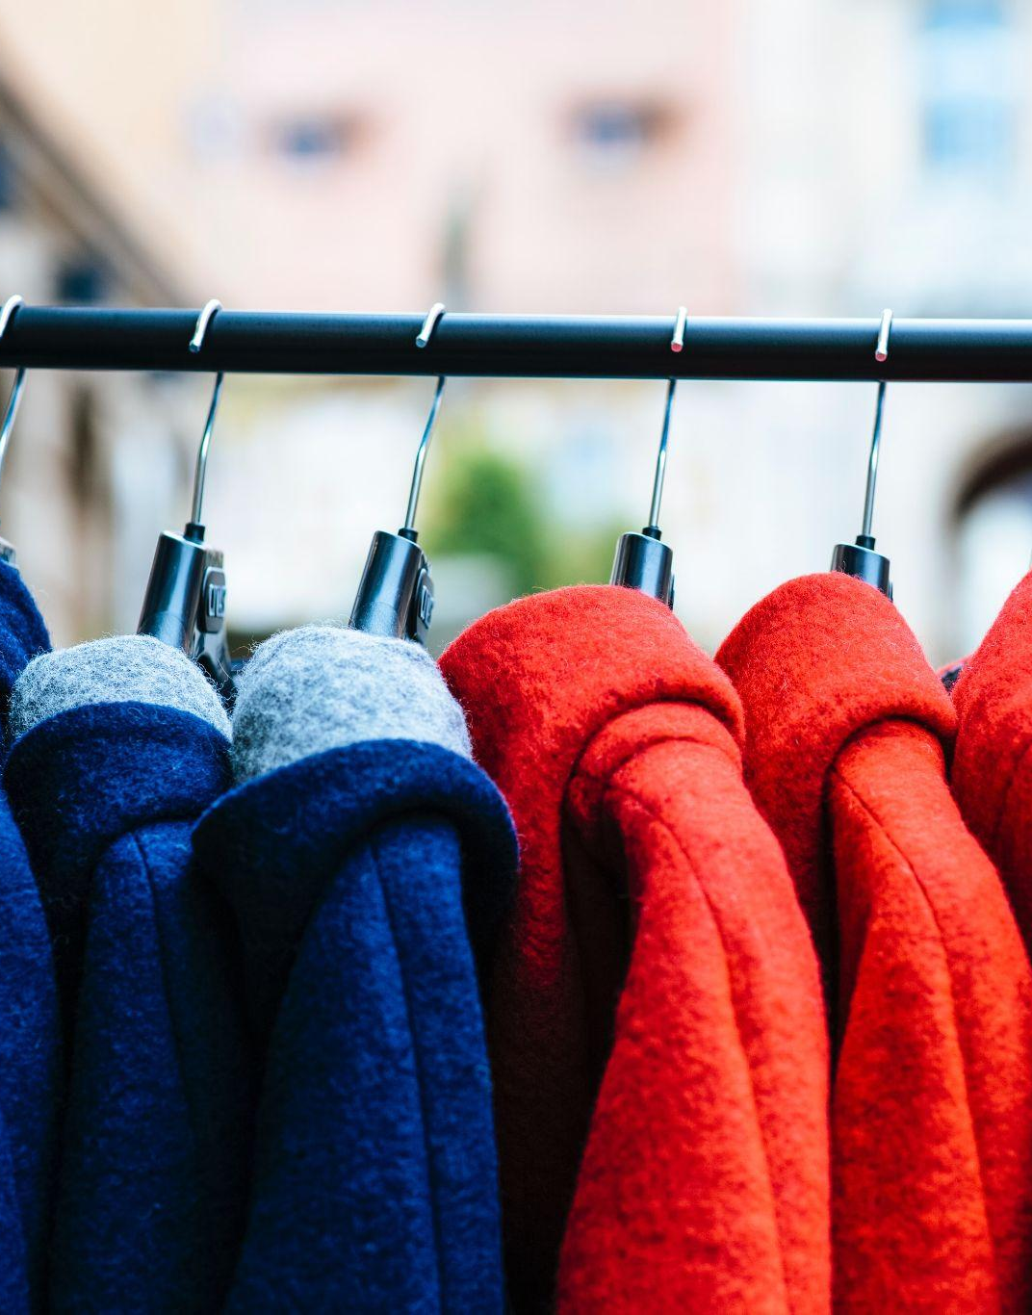
Your task
BCG has been brought in to help ClothingCo, a luxury clothing brand, grow their top line (i.e., increase revenue) after a period of declining sales.
The client is gearing up for the winter season. Imagine that you are a strategy consultant working on the project.
You will enter your responses in the green boxes throughout the remaining slides.

Slide 5
Frame the question effectively
Question to be reframed
How could we sell more outerwear this winter season?
Revised, effective questions:
How can we increase the appeal of our outerwear to attract a younger demographic?
What innovative marketing strategies can we implement to promote our outerwear as a must-have fashion trend?
In what ways can we leverage technology to enhance the functionality and style of our outerwear?
–
Remember: A good question for brainstorming will be narrow and concrete, so that people feel they know how to begin answering it.
“If I were given one hour to save the planet, I would spend fifty-nine minutes defining the problem and one minute resolving it.”
– Albert Einstein

Slide 6
Reveal and doubt your boxes
In this fictional scenario, make assumptions that seem reasonable
What boxes currently exist that are still relevant?
Customers value quality and durability in outerwear.
Winter weather conditions require functional and weather-resistant outerwear.
What boxes currently exist that need to be doubted?
The target market for outerwear is limited to a specific age group.
Traditional retail channels are the most effective way to reach customers.
Outerwear is primarily purchased for practical purposes rather than as a fashion statement.
The first step in the creative process entails identifying and doubting one’s current boxes and determining which ones require re-evaluation or replacement.
Make a short list of the shared beliefs and assumptions that likely prevail in ClothingCo. Determine which are still relevant and which need to be redefined.

Slide 7
Bring new boxes
New box #1
Fashion-forward
Sustainability
Customers are increasingly conscious of the environmental impact of their clothing choices.
There is a growing demand for sustainable and eco-friendly fashion.
Outerwear made from recycled materials or produced using sustainable manufacturing practices can appeal to environmentally-conscious consumers.
Collaborations with sustainable fashion influencers or organizations can enhance brand reputation and attract a new segment of customers.
New box #2
Technology-Driven
Outerwear
Technological advancements can be integrated into outerwear to provide enhanced functionality and convenience.
Smart features such as built-in heating, GPS tracking, or interactive interfaces can create a unique selling point for outerwear.
Targeting tech-savvy consumers who value innovation and connectivity can open up new market opportunities.
Partnering with technology companies or leveraging emerging technologies like wearable sensors or smart fabrics can differentiate the brand in the market.
Prepare for brainstorming by creating new boxes to bring to the session; new boxes will nurture ideation and can dramatically increase the odds of a useful result.
Remember: Defining new boxes requires a mixture of analysis and art. Boxes need to be grounded in fact. Different sectors will call for different inputs.

Slide 8
Brainstorm
Choose one of the effective questions you created on slide 5, and a new box from slide 7, and brainstorm potential ideas to address the question
Question | How can we increase the appeal of our outerwear to attract a younger demographic?
New box | Technology-Driven Outerwear
Integrate smart technology into our outerwear, such as built-in sensors for temperature control or activity tracking, appealing to tech-savvy younger consumers who value functionality and innovation.
Develop a mobile app that provides personalized style recommendations based on weather conditions, location, and the user's preferences, making our outerwear a convenient and fashionable choice for everyday wear.
Partner with popular fitness or wellness apps to offer exclusive promotions or incentives for users who incorporate our outerwear into their outdoor activities or exercise routines.
Create interactive and shareable content on social media platforms, showcasing the technological features of our outerwear through videos, tutorials, or user-generated content challenges.
Collaborate with tech companies to explore innovative materials or manufacturing techniques that enhance the performance and durability of our outerwear, positioning it as a cutting-edge choice for outdoor enthusiasts.

