Slide 1
A DEEP LEARNING APPROACH FOR EARLY SCREENING OF THYROID CANCER FROM ULTRASOUND IMAGE
PRESENTED BY
SABITA ADHIKARI
MIT-AI, Fourth Semester
Registration No. 024-1-06-2-009
SUPERVISED BY
Er. Mahesh Shakya

Slide 2
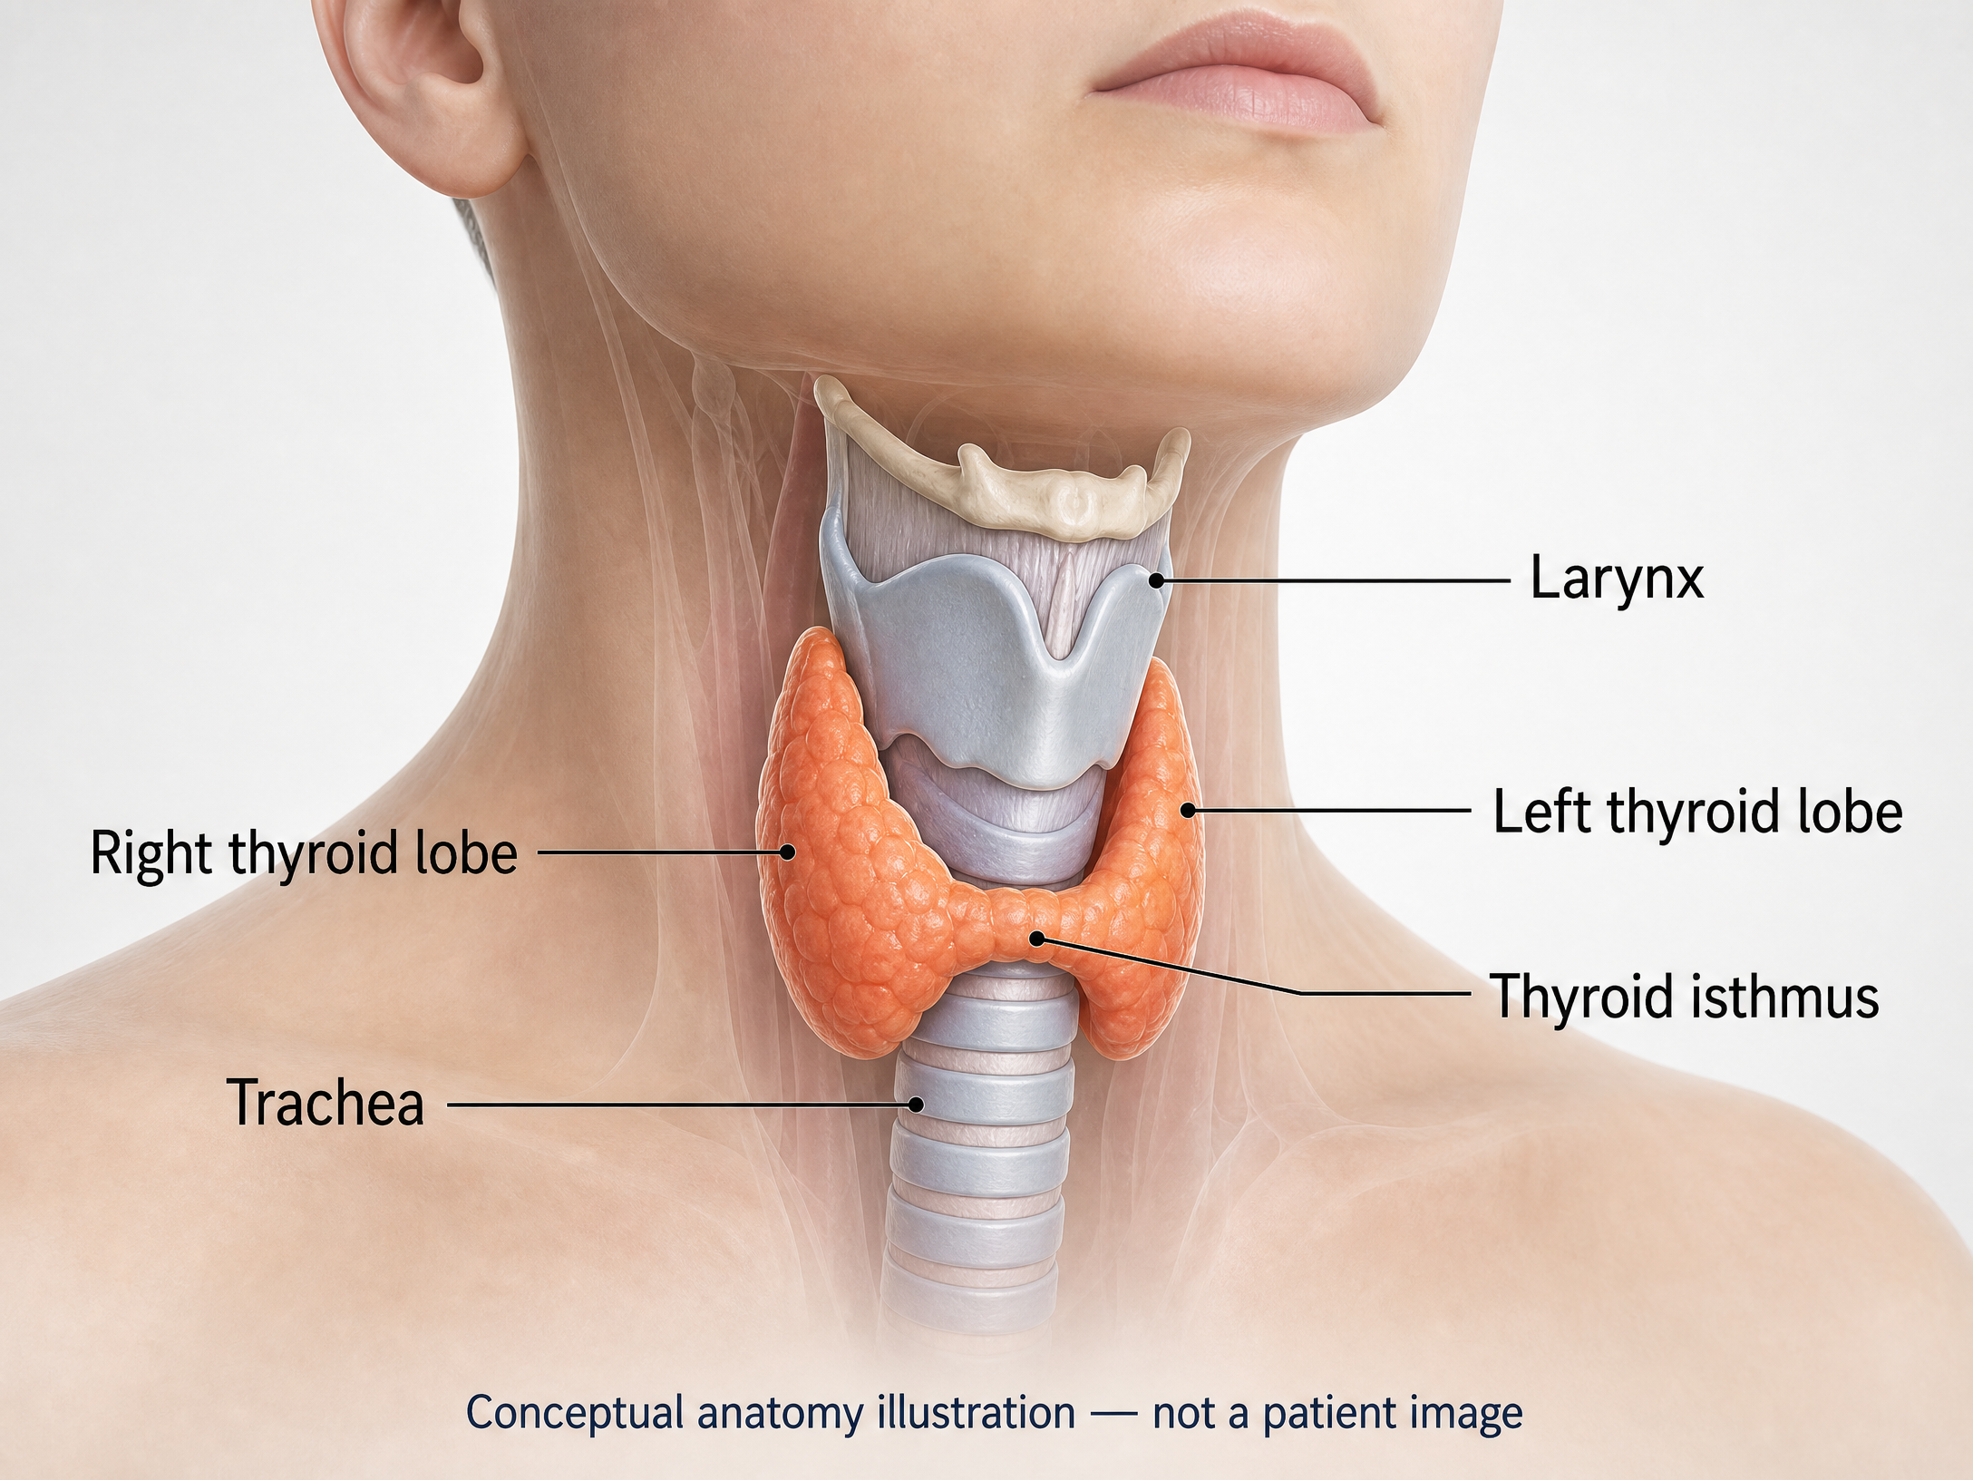
BACKGROUND AND RATIONALE OF STUDY
Thyroid Nodules Are Common
Thyroid nodules are lumps in the thyroid gland.
Ultrasound detects nodules in up to 60–68% of adults.
About 90–95% are benign.
Ultrasound is the main imaging method.
The main task is to identify suspicious nodules.

Slide 3
Why This Study Is Needed
The Study Focuses on Reliable Results
Ultrasound results can vary by machine, image quality, and user experience.
Images from one patient must not be placed in different data groups.
Patient-wise splitting reduces data leakage.
Accuracy alone is not enough.
The study also checks errors, calibration, and model speed.

Slide 4
Research Objectives
Prepare data: Check images, labels, and patient information.
Develop model: Adapt MobileNetV2 for thyroid ultrasound.
Evaluate model: Use several performance measures.
Check reliability: Study errors, speed, and model size.

Slide 5
Literature Review : Recent Lightweight CNN Research
Chen et al. compared MobileNetV3 with larger CNN models. [9]
Their multi-scale model achieved 85.3% accuracy and 84.8% AUC for a specific thyroid-tumor task. [9]
Kim et al. found that multiple ultrasound views can improve classification. [10]
Image quality and ultrasound equipment can affect model performance. [10]
MobileNet and EfficientNet are useful models for studying computer efficiency. [11]
References : Kingma, D. P., & Ba, J. (2014), Chen, W., Ni, X., Qian, C., et al. (2024 ), Kim, J., Kim, M. H., Lim, D. J., et al. (2025 )

Slide 6
LITERATURE REVIEW
Transfer learning helps when medical-image datasets are limited. [11] [12]
Class balancing can reduce unfair preference for one class. [12] [13]
Calibration checks whether predicted probabilities are trustworthy. [12]
TN5000 provides thyroid-ultrasound images with expert labels and biopsy information. [14]
GhostYOLO reported model size, computer cost, and external test results. [15]
References: Swan, K. Z., Thomas, J., Nielsen, V. E., Jespersen, M. L., & Bonnema, S. J. (2022), Tan, D., Cheng, C., Zheng, T., et al. (2026 ), Tejani, A. S., et al. (2024 ), Xu, Y., Xu, M., Geng, Z., Liu, J., & Meng, B. (2025 ), Zhang, H., Liu, Q., Han, X., Niu, L., et al. (2025 )

Slide 7
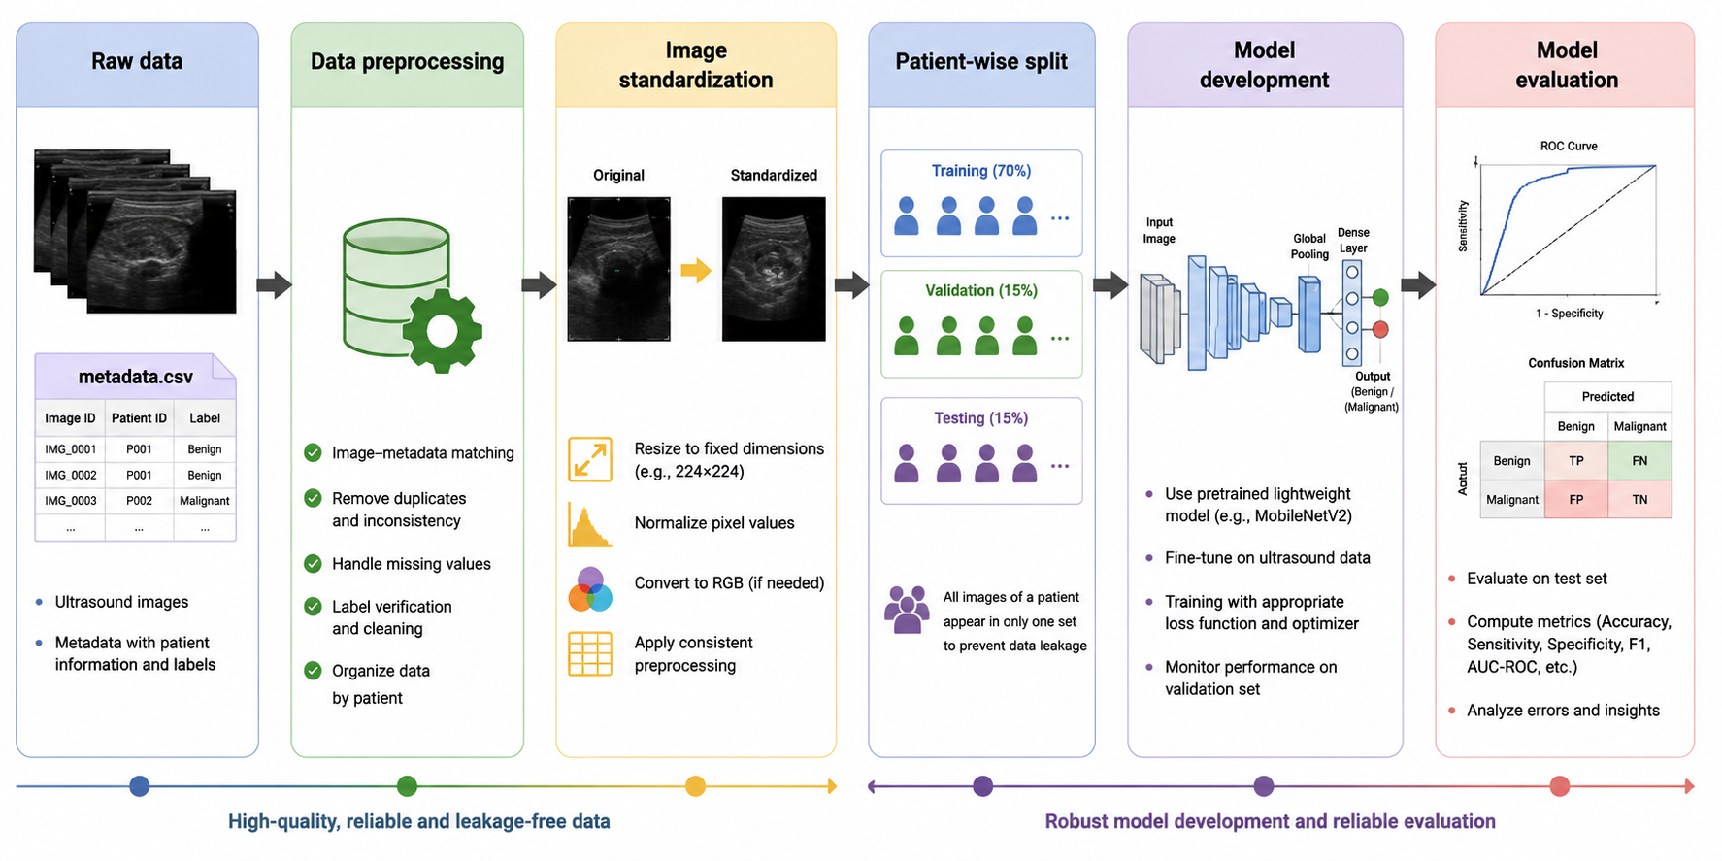
RESEARCH METHODOLOGY
Check and clean the data. [5] [6]
Prepare all images in the same format and size. [7]
Keep each patient in only one group. [5] [6]
Train and improve MobileNetV2. [7]
Evaluate performance, errors, reliability, and speed. [5] [6]

Slide 8
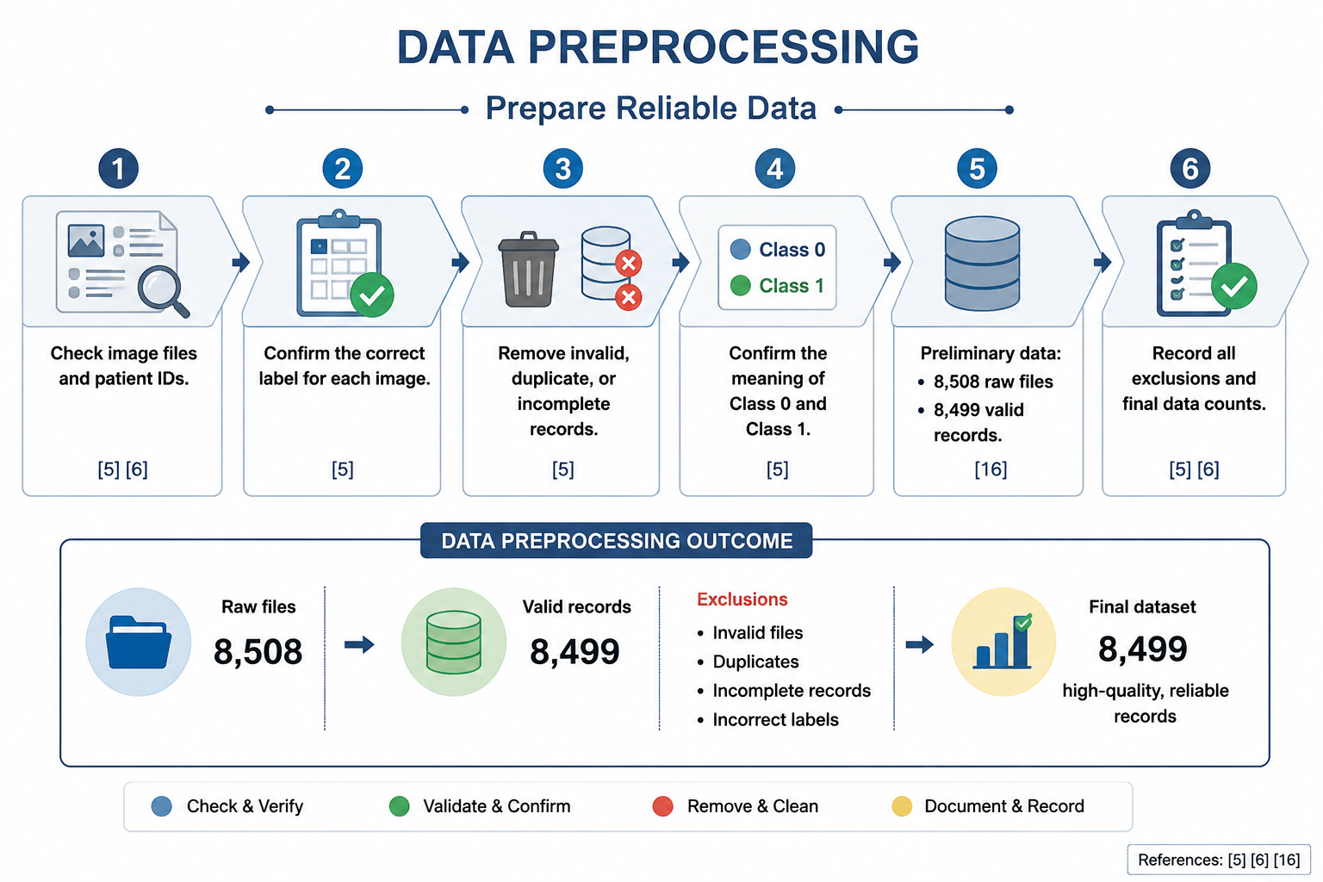
DATA PREPROCESSING
Prepare Reliable Data
Check image files and patient IDs. [5] [6]
Confirm the correct label for each image. [5]
Remove invalid, duplicate, or incomplete records. [5]
Confirm the meaning of Class 0 and Class 1. [5]
Preliminary data: 8,508 raw files and 8,499 valid records. [16]
Record all exclusions and final data counts. [5] [6]

Slide 9
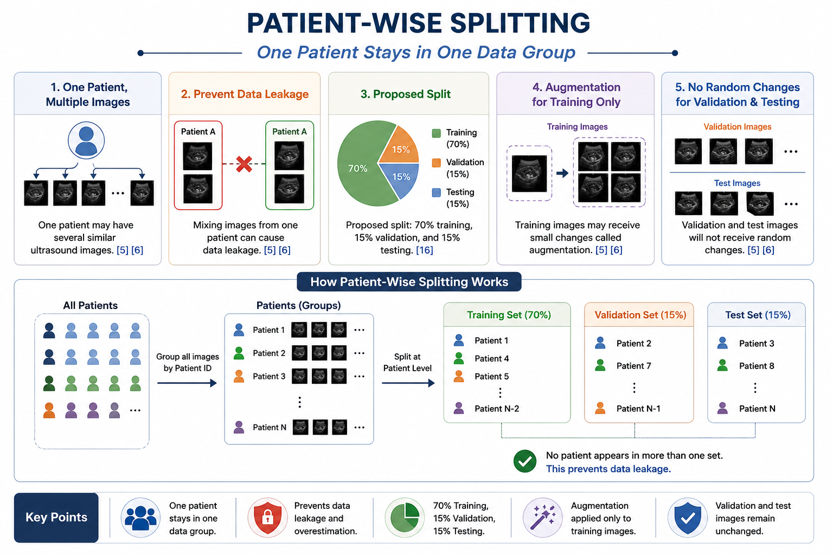
Patient-Wise Splitting
One Patient Stays in One Data Group
One patient may have several similar ultrasound images. [5] [6]
Mixing images from one patient can cause data leakage. [5] [6]
Proposed split: 70% training, 15% validation, and 15% testing. [16]
Training images may receive small changes called augmentation. [5] [6]
Validation and test images will not receive random changes. [5] [6]

Slide 10
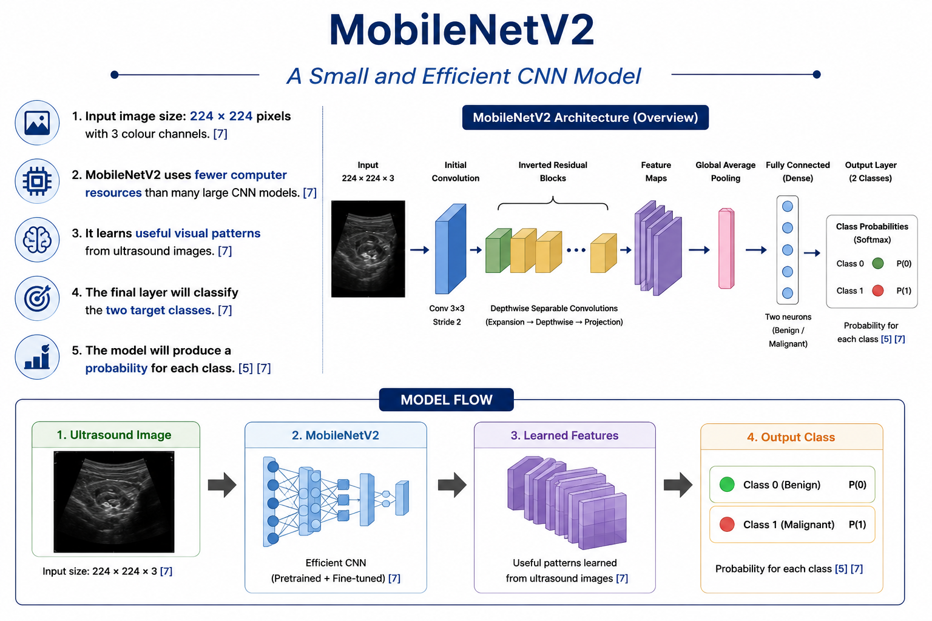
MobileNetV2
A Small and Efficient CNN Model
Input image size: 224 × 224 pixels with
3 colour channels. [7]
MobileNetV2 uses fewer computer resources
than many large CNN models. [7]
It learns useful visual patterns from ultrasound images. [7]
The final layer will classify the two target classes. [7]
The model will produce a probability for each class. [5] [7]
Model flow:
Ultrasound image → MobileNetV2 → Learned features → Output class

Slide 11
Model Development
Train the Model in Two Stages
Stage 1: Train the new output layer. [7]
Stage 2: Fine-tune selected MobileNetV2 layers. [7]
Use class weights if one class has fewer examples. [5] [6]
Compare training settings using validation data. [5] [6]
Save the best model using validation performance. [5] [6]
Preliminary settings: Adam optimizer, batch size 16, learning rate 0.0001, and weighted cross-entropy. [8] [16]

Slide 12
References
Bernet, V. J., & Chindris, A.-M. (2021). Update on the evaluation of thyroid nodules. Journal of Nuclear Medicine, 62(Supplement 2), 13S–19S. https://doi.org/10.2967/jnumed.120.246025
Chen, W., Ni, X., Qian, C., Yang, L., Zhang, Z., Li, M., Kong, F., Huang, M., He, M., & Yin, Y. (2024 ). The value of a neural network based on multi-scale feature fusion to ultrasound images for the differentiation in thyroid follicular neoplasms. BMC Medical Imaging, 24, Article 74. https://doi.org/10.1186/s12880-024-01244-1
Collins, G. S., Moons, K. G. M., Dhiman, P., Riley, R. D., Beam, A. L., Van Calster, B., Ghassemi, M., Liu, X., Reitsma, J. B., van Smeden, M., & TRIPOD+AI Steering Group. (2024 ). TRIPOD+AI statement: Updated guidance for reporting clinical prediction models that use regression or machine learning methods. BMJ, 385, e078378. https://doi.org/10.1136/bmj-2023-078378
Durante, C., Hegedüs, L., Czarniecka, A., Paschke, R., Russ, G., Schmitt, F., Soares, P., Solymosi, T., Papini, E., & European Thyroid Association. (2023 ). 2023 European Thyroid Association clinical practice guidelines for thyroid nodule management. European Thyroid Journal, 12(5), e230067. https://doi.org/10.1530/ETJ-23-0067
Kingma, D. P., & Ba, J. (2014 ). Adam: A method for stochastic optimization. arXiv. https://doi.org/10.48550/arXiv.1412.6980
Kim, J., Kim, M. H., Lim, D. J., Lee, H., Lee, J. J., Kwon, H. S., et al. (2025 ). Deep learning technology for classification of thyroid nodules using multi-view ultrasound images: Potential benefits and challenges in clinical application. Endocrinology and Metabolism, 40(2), 216–224. https://doi.org/10.3803/EnM.2024.2058
Kant, R., Davis, A., & Verma, V. (2020 ). Thyroid nodules: Advances in evaluation and management. American Family Physician, 102(5), 298–304. https://www.aafp.org/afp/2020/0901/p298

Slide 13
References
Rashed, A., Medhat, T., & Elgarayhi, A. (2025 ). Enhancing automatic diagnosis of thyroid nodules from ultrasound scans leveraging deep learning models. Scientific Reports, 15, Article 40364. https://doi.org/10.1038/s41598-025-25780-0
Sandler, M., Howard, A., Zhu, M., Zhmoginov, A., & Chen, L.-C. (2018 ). MobileNetV2: Inverted residuals and linear bottlenecks. In Proceedings of the IEEE Conference on Computer Vision and Pattern Recognition (pp. 4510–4520). https://doi.org/10.48550/arXiv.1801.04381
Savelonas, M. (2025 ). An overview of AI-guided thyroid ultrasound image segmentation and classification for nodule assessment. Big Data and Cognitive Computing, 9(10), Article 255. https://doi.org/10.3390/bdcc9100255
Swan, K. Z., Thomas, J., Nielsen, V. E., Jespersen, M. L., & Bonnema, S. J. (2022 ). External validation of AIBx, an artificial intelligence model for risk stratification, in thyroid nodules. European Thyroid Journal, 11(2), e210129. https://doi.org/10.1530/ETJ-21-0129
Tan, D., Cheng, C., Zheng, T., et al. (2026 ). A lightweight GhostYOLO framework with GhostDynamic Module and multi-scale attention for thyroid nodule diagnosis. Scientific Reports, 16, Article 19837. https://doi.org/10.1038/s41598-026-51141-6
Tejani, A. S., et al. (2024 ). Checklist for artificial intelligence in medical imaging (CLAIM): 2024 update. Radiology: Artificial Intelligence. https://doi.org/10.1148/ryai.240300
Xu, Y., Xu, M., Geng, Z., Liu, J., & Meng, B. (2025 ). Thyroid nodule classification in ultrasound imaging using deep transfer learning. BMC Cancer, 25, Article 544. https://doi.org/10.1186/s12885-025-13917-3
Zhang, H., Liu, Q., Han, X., Niu, L., et al. (2025 ). TN5000: An ultrasound image dataset for thyroid nodule detection and classification. Scientific Data, 12, Article 1437. https://doi.org/10.1038/s41597-025-05757-4

