Slide 1
Mutual Fund Analytics
Bluestock Fintech Capstone Project
By: Sabitha Saravanan

Slide 2
Problem Statement and Objectives
Problem Statement
The mutual fund industry generates large volumes of data related to fund performance, investor transactions and market benchmarks. Analyzing these datasets manually is difficult and time-consuming.
Objectives
Build an ETL pipeline for processing data.
Perform exploratory data analysis.
Study investor behavior and trends.
Develop interactive Power BI dashboards.
Generate useful insights and recommendations.

Slide 3
Data Sources
The project uses multiple datasets related to mutual funds and they are:
Fund Master Data
NAV History
AUM by Fund House
Monthly SIP Inflows
Category Inflows
Industry Folio Count
Scheme Performance
Investor Transactions
Portfolio Holdings
Benchmark Indices
These datasets provide information about fund performance, investor activity, and market trends from 2022 to 2026.

Slide 4
Project Architecture
Raw CSV Files
Data Cleaning and Validation
Processed Datasets
SQLite Database
EDA and Performance Analytics
Power BI Dashboard
Final Reports and Insights

Slide 5
EDA Highlights
Several visualizations were created to understand industry trends and several analyses have been done such as:
Daily NAV trend analysis for schemes.
AUM growth of different fund houses.
Monthly SIP inflow trends.
Category-wise inflow analysis.
Folio growth over time.
This EDA helped to understand that:
Industry AUM showed continuous growth.
SIP investments increased steadily.
Equity categories attracted higher inflows.

Slide 6
EDA Highlights
Investor transaction data was analyzed to understand investor behavior and the analyses performed include:
State-wise investment distribution.
Age group analysis.
Gender-wise participation.
City tier comparison.
Transaction volume trends.
This helped to understand that:
Younger investors actively participated in SIPs.
Major states contributed larger investments.
Monthly transaction volumes increased over time.

Slide 7
Performance Metrics
Several financial metrics were calculated to evaluate fund performance.
Metrics Used
CAGR
Sharpe Ratio
Sortino Ratio
Alpha
Beta
Maximum Drawdown
These metrics helped compare schemes based on return and risk characteristics and identify better-performing funds.

Slide 8
Performance Metrics
Risk analysis was performed using historical returns and various calculations include:
Daily Returns
Value at Risk (VaR)
Conditional VaR (CVaR)
Rolling 90-Day Sharpe Ratio
Additional analyses include:
Investor Cohort Analysis
SIP Continuity Analysis
Fund Recommendation System
These analyses provided deeper insights into portfolio risk and investor behavior.

Slide 9
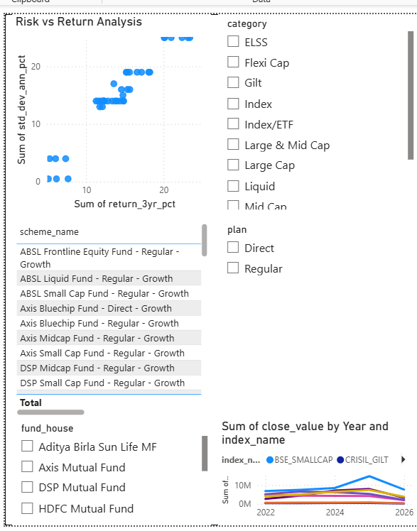
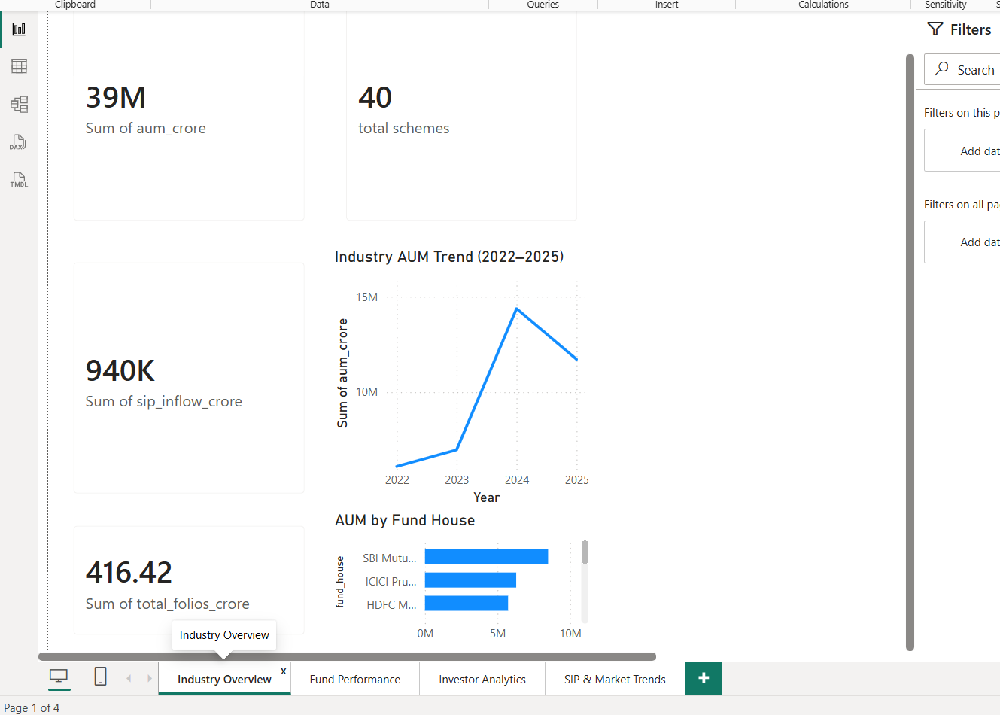
Dashboard Screenshots

Slide 10
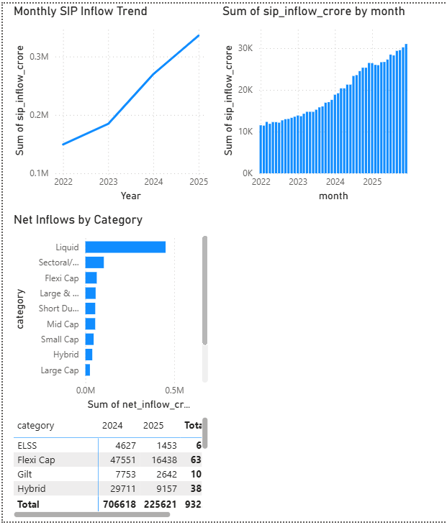
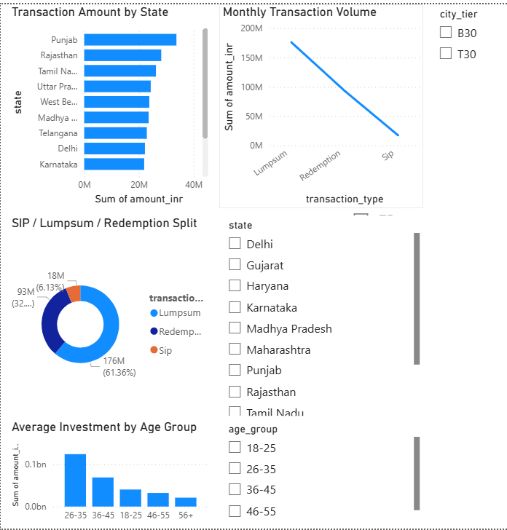
Dashboard Screenshots

Slide 11
Key Findings and Recommendations
Key Findings
Mutual fund industry AUM increased consistently.
SIP inflows reached record highs.
Some funds delivered superior risk-adjusted returns.
Recent investor cohorts contributed larger investments.
Diversified portfolios reduced concentration risk.
Recommendations
Encourage long-term SIP investments.
Focus on diversified portfolios.
Monitor downside risk regularly.
Use risk-adjusted metrics while selecting funds.

Slide 12
Conclusion
Successfully built an end-to-end Mutual Fund Analytics system using Python, SQLite, Jupyter Notebook, and Power BI.
Performed data cleaning, ETL, exploratory analysis, performance analysis, and risk analysis on multiple mutual fund datasets.
Calculated metrics such as CAGR, Sharpe Ratio, Sortino Ratio, Alpha, Beta, VaR, and Maximum Drawdown.
Developed an interactive Power BI dashboard to visualize industry trends, fund performance, investor behavior, and SIP patterns.
The project demonstrates practical applications of data engineering, financial analytics, and business intelligence.

Slide 13
Thank you

