Slide 1

Student Data Analysis
By Srikanth, Sabitha and Abhilash

Slide 2
What is it?

Slide 3
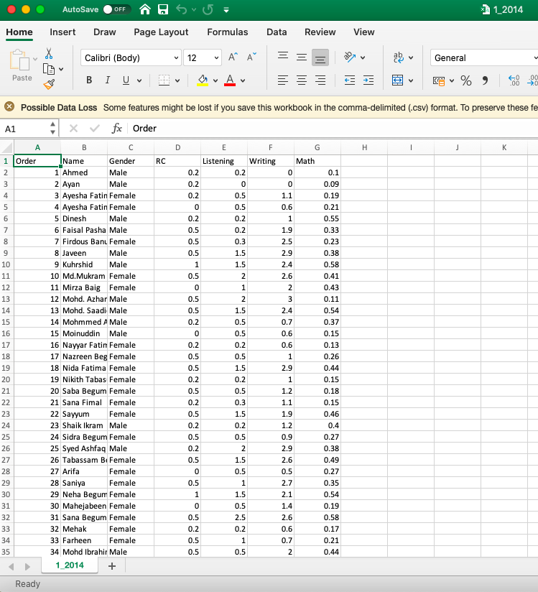
Data

Slide 4
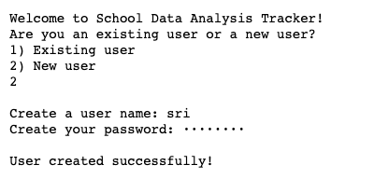
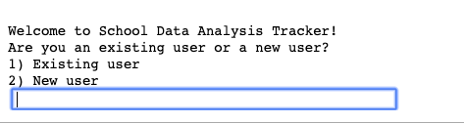
Features - Login

Slide 5

Fernet Key

Slide 6
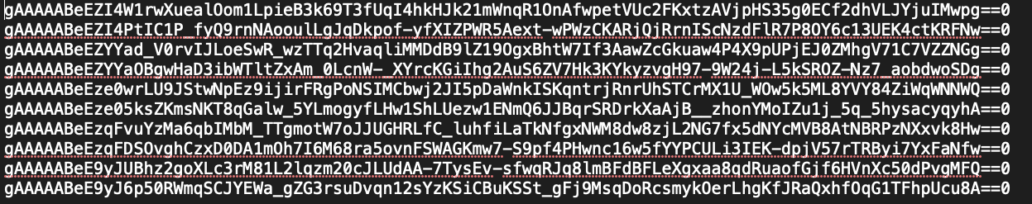
User data encryption

Slide 7
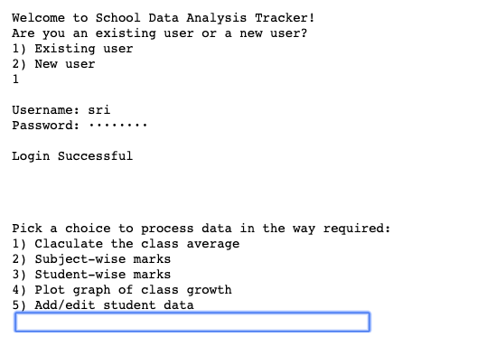
Options

Slide 8
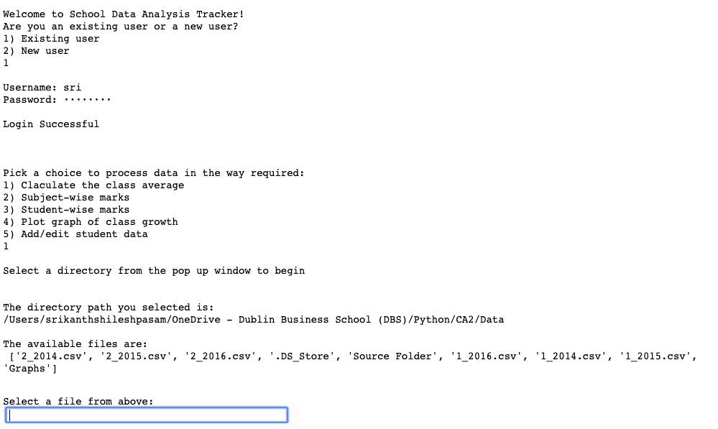
Choosing dir and file

Slide 9
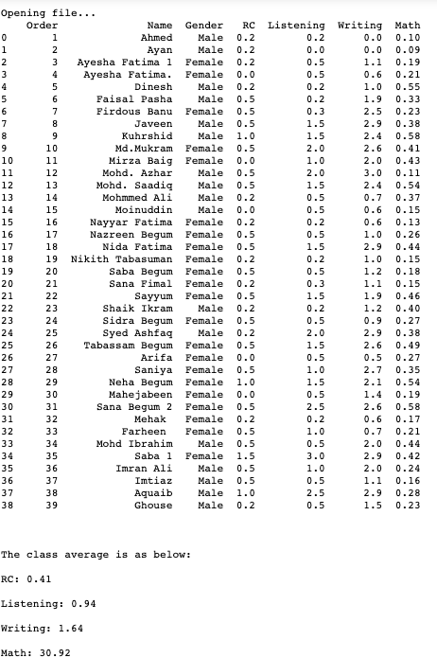
Class averages

Slide 10
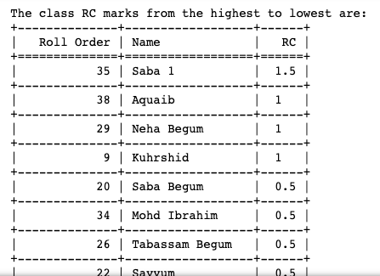
Subject-wise marks and sorting

Slide 11
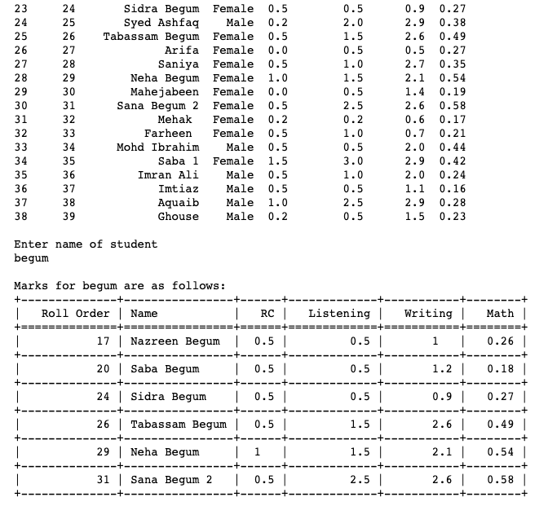
Student Search

Slide 12
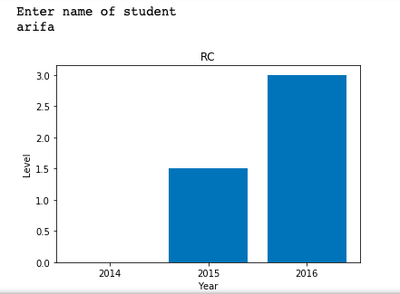
Student growth

Slide 13
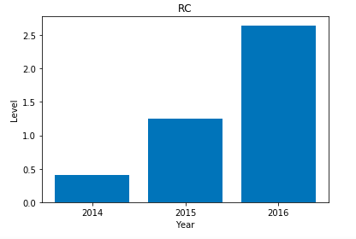
Class growth

Slide 14
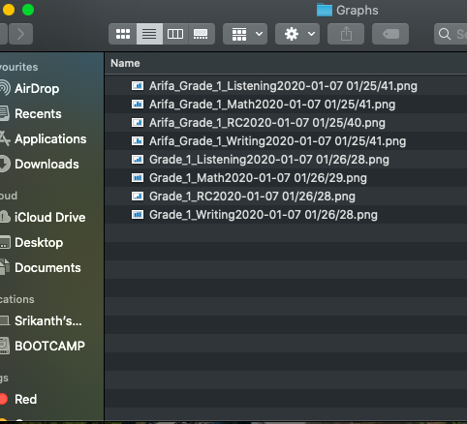
Saving graphs externally

Slide 15
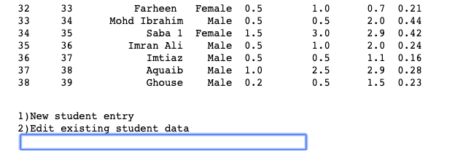
New student entry

Slide 16
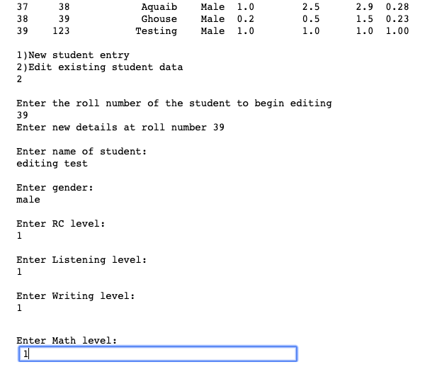
Editing existing details

