Slide 1
Artificial Bee Colony
MACHINE LEARNING · ASSIGNMENT
Finding the global minimum of the 2D Ackley function
Presented by
2107067 2107078 2107091
2107100 2107108 2107115
Notes:
Introduce the group and the task: we use the Artificial Bee Colony (ABC) algorithm to find the global minimum of the 2D Ackley function. About 8 minutes in total.

Slide 2
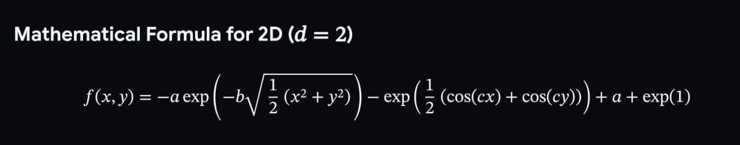
Minimize the 2D Ackley function
THE PROBLEM
f(0, 0) = 0
−5 ≤ x ≤ 5
a=20 b=0.2
The known global minimum
Search range for x1 and x2
and c = 2π
Many local minima around one global minimum: a classic test for optimizers.
Artificial Bee Colony · 2D Ackley
2
Notes:
The Ackley function is the fitness function. Recommended parameters a=20, b=0.2, c=2π. The global minimum is 0 at (0,0), and the search domain is -5 to 5 for both variables. The surface is full of local minima, so a method that only goes downhill gets stuck.

Slide 3
Three groups of bees
THE ALGORITHM
Employed bees
Onlooker bees
Scout bees
Stay on a food source and search the neighbourhood of that source.
Get food-source information from the employed bees and choose which sources to gather nectar from.
When a food source is abandoned, its bee becomes a scout and searches for a new source.
Food source = candidate solution [x1, x2] · Nectar quality = fitness
Artificial Bee Colony · 2D Ackley
3
Notes:
ABC was defined by Karaboga in 2005, inspired by how honey bees forage. A swarm-based metaheuristic with three kinds of bees. In our problem a food source is a point [x1, x2] and the nectar quality is its fitness from the Ackley function.

Slide 4
Four steps
THE ALGORITHM
STEP 1
STEP 2
STEP 3
STEP 4
Assign control parameters
Initialize solutions and calculate fitness
Repeat until the stopping criteria is met
Stop
Employed bees
Onlooker bees
Scout bees
Memorize the best
Artificial Bee Colony · 2D Ackley
4
Notes:
This is the flow from the lecture slides. Step 1 sets parameters. Step 2 creates the initial food sources and evaluates them. Step 3 is the loop: employed bees, onlooker bees, scout bees, then memorize the best solution. Step 4 stops. The next slides go through each step.

Slide 5
Parameters and initialization
STEPS 1 AND 2
Control parameter | Value
Swarm size | 100
Employed bees (50%) | 50
Onlooker bees (50%) | 50
Scouts | 1
Limit | 20 cycles
Dimension | 2
Max cycles | 100
Food source initialization
x(i,j) = x_min,j + rand(0,1) · (x_max,j − x_min,j)
i = 1…50 food sources (one per employed bee)
j = 1…2 dimensions (x1, x2)
x_min = −5 and x_max = +5
Artificial Bee Colony · 2D Ackley
5
Notes:
Control parameters from the lecture: swarm size, employed bees at 50 percent, onlookers at 50 percent, scouts, limit, and dimension. We use a swarm of 100, so 50 employed bees and 50 onlookers, one scout, limit 20, two dimensions. Each of the 50 food sources starts at a random point in the range using the initialization equation, and its fitness is calculated.

Slide 6
Employed and onlooker bees
STEP 3
Employed bee phase
Onlooker bee phase
v(i,j) = x(i,j) + φ · (x(i,j) − x(k,j))
P(x_i) = fit(x_i) / Σ fit(x_i)
φ = rand(−1, 1)
k = random source, k ≠ i
Keep the better of f(x_i) and f(v_i)
Roulette wheel picks a source by P
Evolve it exactly like an employed bee
fit = 1/(1+f): lower Ackley value, bigger slice
Artificial Bee Colony · 2D Ackley
6
Notes:
Employed bees: each bee evolves its own solution into a neighbour v by changing one dimension j using a random partner k and a random factor phi between minus one and one, then keeps whichever of x and v has the better value. Onlookers: each source gets a probability proportional to its fitness, and a roulette wheel decides which source each onlooker visits. Because we minimize, fitness is 1 over 1 plus f, so lower Ackley values get bigger slices. The chosen source is evolved the same way as in the employed phase.

Slide 7
Scouts, memory and stopping
STEPS 3 AND 4
Scout bee phase
Memorize and stop
x(i,j) = x_min,j + rand(0,1) · (x_max,j − x_min,j)
stop when f ≤ 1e-6 or cycle = 100
The best solution found so far is memorized every cycle
So the best value never gets worse
A source not improved for limit = 20 cycles is abandoned
Its bee becomes a scout and restarts at a random position
Artificial Bee Colony · 2D Ackley
7
Notes:
Scout phase: if a position cannot be improved for the limit number of cycles, here 20, that food source is abandoned and replaced by a random one using the same equation as initialization. This keeps exploring the search space. After each cycle the best solution is memorized. We stop after 100 cycles or when the best value is within 1e-6 of zero.

Slide 8
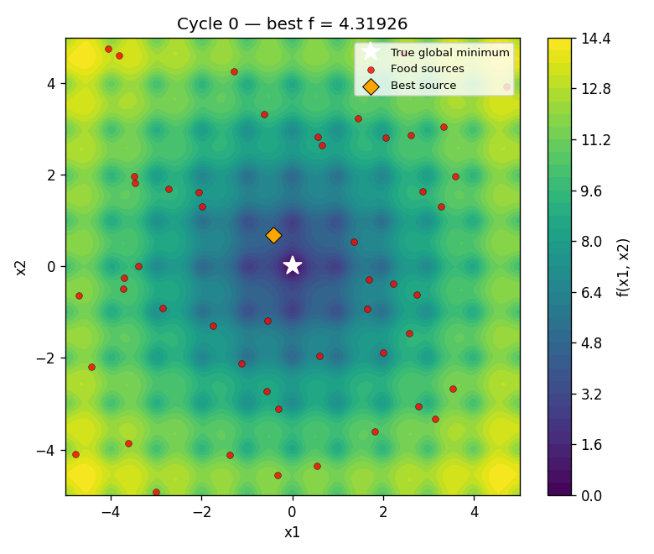
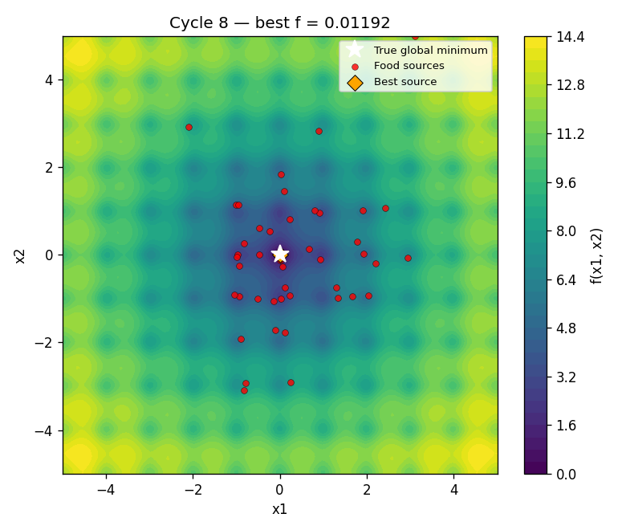

The swarm moves to (0, 0)
RESULTS
Cycle 0 · best f = 4.3193
Cycle 8 · best f = 0.0119
Cycle 25 · best f = 0.00013
Artificial Bee Colony · 2D Ackley
8
Notes:
Each dot is one food source on the Ackley surface; the orange diamond is the best one and the white star is the true minimum. At cycle 0 the sources are random. By cycle 8 they gather near the middle, and by cycle 25 the best value is about 0.00013. The generate_detailed_report script saves one plot and one table for every cycle if the instructor wants to see any single iteration.

Slide 9
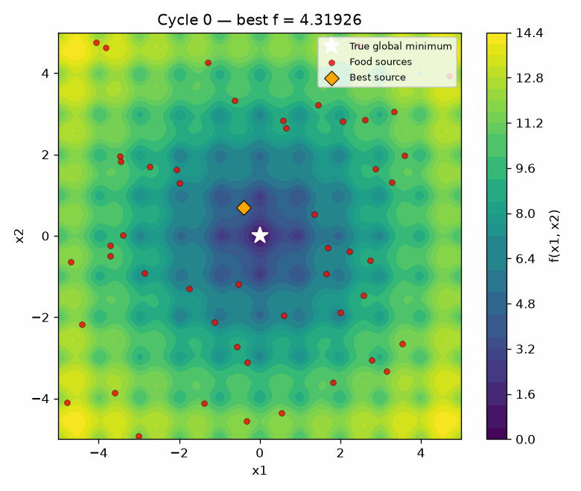
The swarm moves to (0, 0)
RESULTS
Artificial Bee Colony · 2D Ackley
9
Notes:
Each dot is one food source on the Ackley surface; the orange diamond is the best one and the white star is the true minimum. At cycle 0 the sources are random. By cycle 8 they gather near the middle, and by cycle 25 the best value is about 0.00013. The generate_detailed_report script saves one plot and one table for every cycle if the instructor wants to see any single iteration.

Slide 10
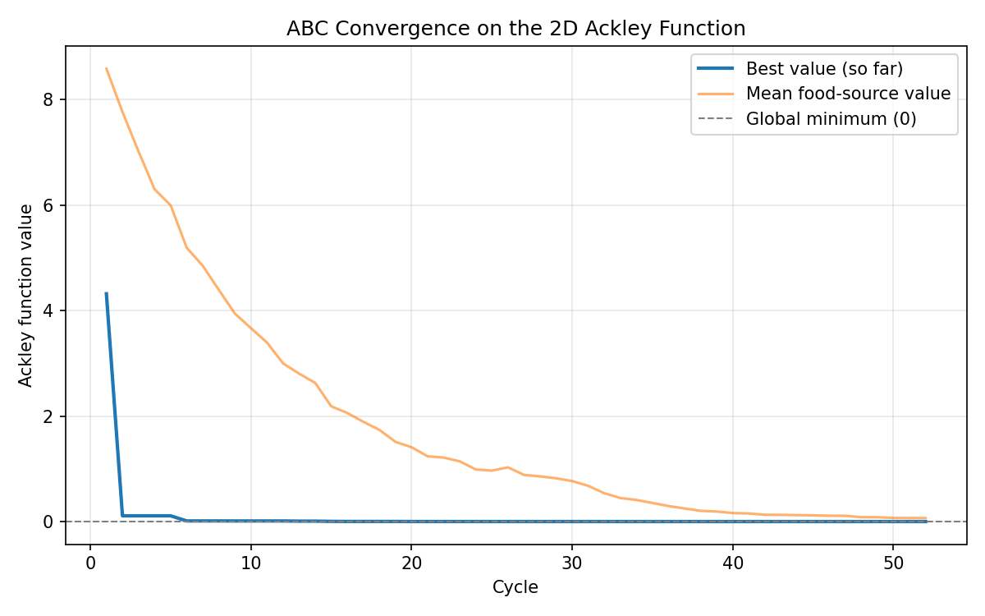
Convergence to the global minimum
RESULTS
52
cycles to reach f ≤ 1e-6
3.4e-7
best value found (true minimum is 0)
(0, 0)
x1 = 0.000000, x2 = −0.000000
Artificial Bee Colony · 2D Ackley · seed 42
10
Notes:
With the recommended settings and seed 42, the best value falls from 4.3 in the first cycle to below 1e-6 at cycle 52, and the best solution is x1 and x2 equal to zero. The mean value of the food sources also falls, which shows the whole swarm is converging, not just the best bee.

Slide 11
ABC against a classical optimizer
COMPARISON
Method | Best value f | Outcome
ABC, 20 cycles | 0.00049 | Very close to 0
ABC, 25 cycles | 0.00013 | Closer still
ABC, full run (52 cycles) | 0.00000034 | Converged
Nelder-Mead from (4, −4) | 10.998 | Stuck in a local minimum
Same Ackley function and seed 42. Nelder-Mead is a local method: it stays in the basin where it starts, while the bee colony explores the whole range.
Artificial Bee Colony · 2D Ackley
11
Notes:
The assignment asks for a classical algorithm and for runs with about 20 and 25 iterations. ABC at 20 cycles is already at 0.0005 and at 25 cycles at 0.00013. The classical Nelder-Mead method started at (4, -4) gets stuck at about 11 because it only follows the local slope.

Slide 12
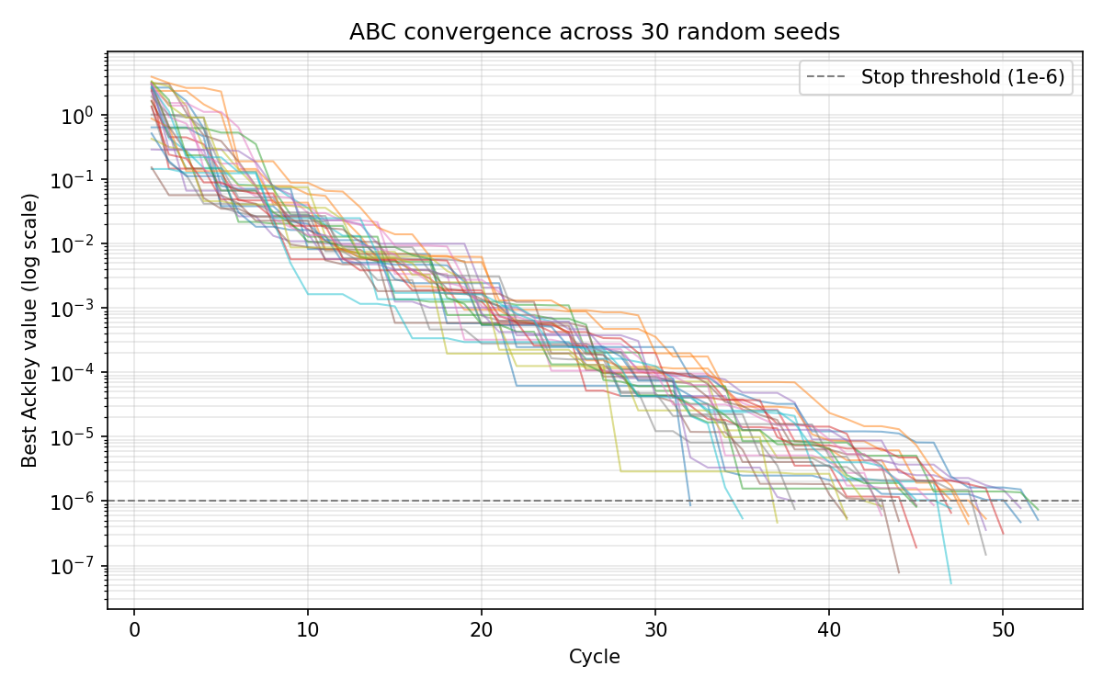
Not just a lucky seed
ROBUSTNESS
30 / 30
seeds converged to f ≤ 1e-6
44.8
mean cycles used (range 32 to 52)
9.9e-7
worst final value over all seeds
Artificial Bee Colony · 2D Ackley · seeds 0 to 29
12
Notes:
To check that the result is not luck, we ran ABC with 30 different random seeds and the same settings. All 30 runs reached the stop threshold within 32 to 52 cycles, and the worst final value was below 1e-6.

Slide 13
Strengths, limits and uses
WRAP-UP
Advantages
Limitation
Applications
Few control parameters
Fast convergence
Both exploration and exploitation
Search space is limited by the initial solutions
Welded beam and coil spring design
Digital filter optimization
Fuzzy control design
K-means data clustering
Robot control
Artificial Bee Colony · 2D Ackley
13
Notes:
Summary: ABC found the global minimum of the Ackley function with a swarm of 50 employed and 50 onlooker bees. It has few parameters, converges quickly and balances exploration through scouts with exploitation through employed and onlooker bees. A limitation from the lecture is that the search space depends on the initial solutions. Applications include mechanical design such as welded beams and coil springs, digital filters, fuzzy control, clustering, and robot control. Thank you, questions?

Slide 14
Thank you
for
your attention
Notes:
Summary: ABC found the global minimum of the Ackley function with a swarm of 50 employed and 50 onlooker bees. It has few parameters, converges quickly and balances exploration through scouts with exploitation through employed and onlooker bees. A limitation from the lecture is that the search space depends on the initial solutions. Applications include mechanical design such as welded beams and coil springs, digital filters, fuzzy control, clustering, and robot control. Thank you, questions?

