Slide 1

Zooming and shrinking images by Pixel Replication and Bicubic Interpolation
Digital Image Processing-Project
Team: Raluca Nelega
Elena-Sabina Onuț
Diana-Elena Mircea
31th October, 2022

Slide 2

REQUIREMENTS
input
01
-Grey-level image
-Scaling factor on horizontal axis
-Scaling Factor on vertical axis
-Interpolation Function
OUTCOME
02
PROJECT
HIGHLIGHTS
-Original Image & its histogram
-Processed Image & its histogram.
output
PLOT
results
03
-Shrink an image by 10 times
-Bring back the image to the original dimension
DISSCUTION
04
debate
-Differences between images
-Mean square error

Slide 3
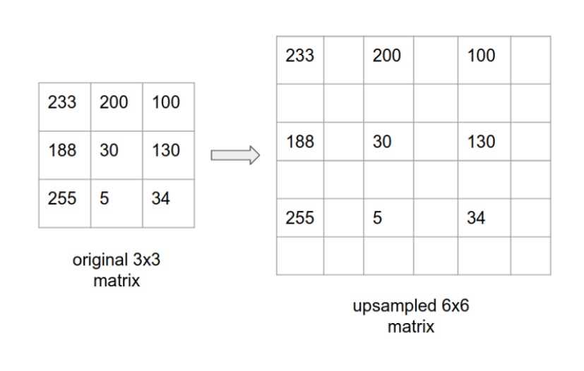
ZOOMING-SCALE UP
Method 1: Pixel Replication
Increase the size of an image by an integer number of times
Particular case of nearest neighbor interpolation
look for the closest pixel in the original image
assign its gray level to the new pixel in the grid
expand the overlay grid to the original specified size to obtain the zoomed image
Make new pixel locations to fill in the matrix
fill up the missing pixel values in this bigger matrix

Slide 4

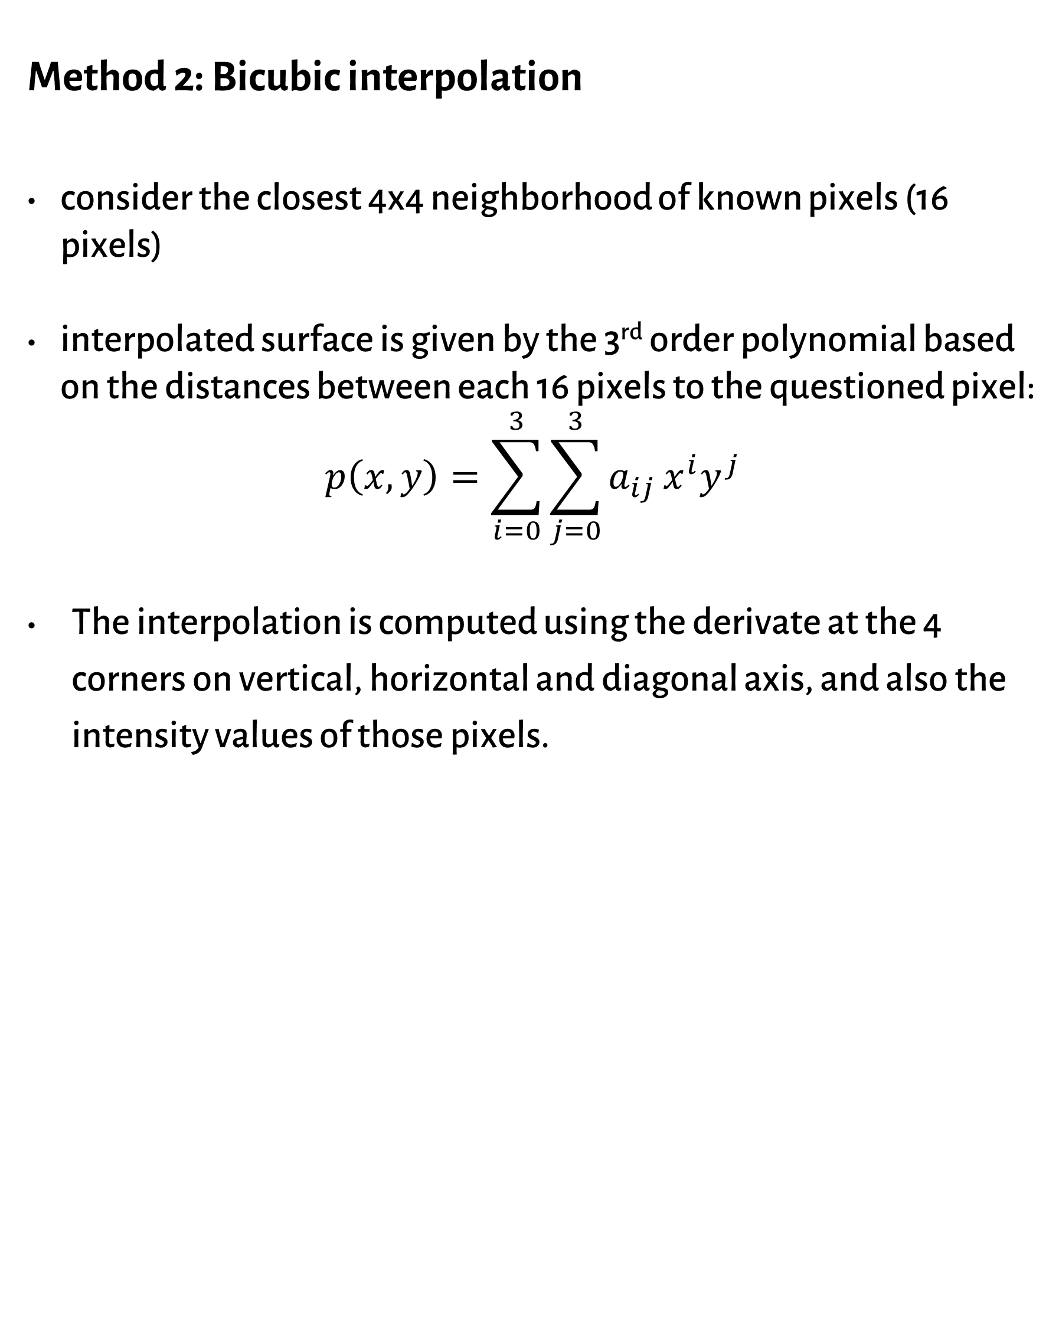
ZOOMING-SCALE UP
Method 2: Bicubic interpolation
consider the closest 4x4 neighborhood of known pixels (16 pixels)
interpolated surface is given by the 3rd order polynomial based on the distances between each 16 pixels to the questioned pixel:
$$p\left(x,y\right)=\sum_{i=0}^{3}{\sum_{j=0}^{3}{a_{ij}}x^{i}y^{j}}$$
The interpolation is computed using the derivate at the 4 corners on vertical, horizontal and diagonal axis, and also the intensity values of those pixels.

Slide 5
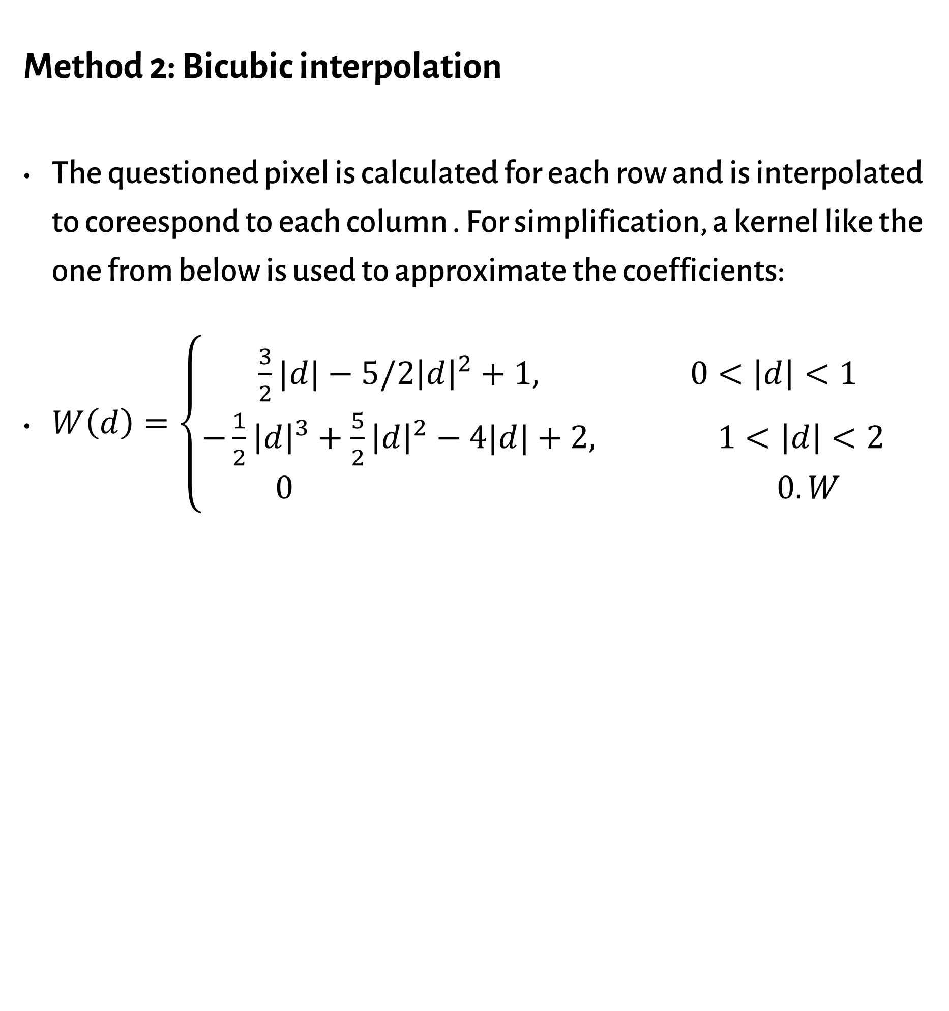
ZOOMING-SCALE UP
Method 2: Bicubic interpolation
The questioned pixel is calculated for each row and is interpolated to coreespond to each column . For simplification, a kernel like the one from below is used to approximate the coefficients:
$W\left(d\right)=\left\{\begin{aligned}\frac{3}{2}|d|−5/2{\left|d\right|}^{2}+1, 0<\left|d\right|<1 \\ −\frac{1}{2}{\left|d\right|}^{3}+\frac{5}{2}{\left|d\right|}^{2}−4|d|+2, 1<\left|d\right|<2 \\ 0 0.W\end{aligned}\right.$

Slide 6



SHRINKING
row-column deletion
expand the grid to fit over the original image
do bicubic interpolation
shrink the grid back to its original specified size
blur an image slightly before shrinking it

Slide 7
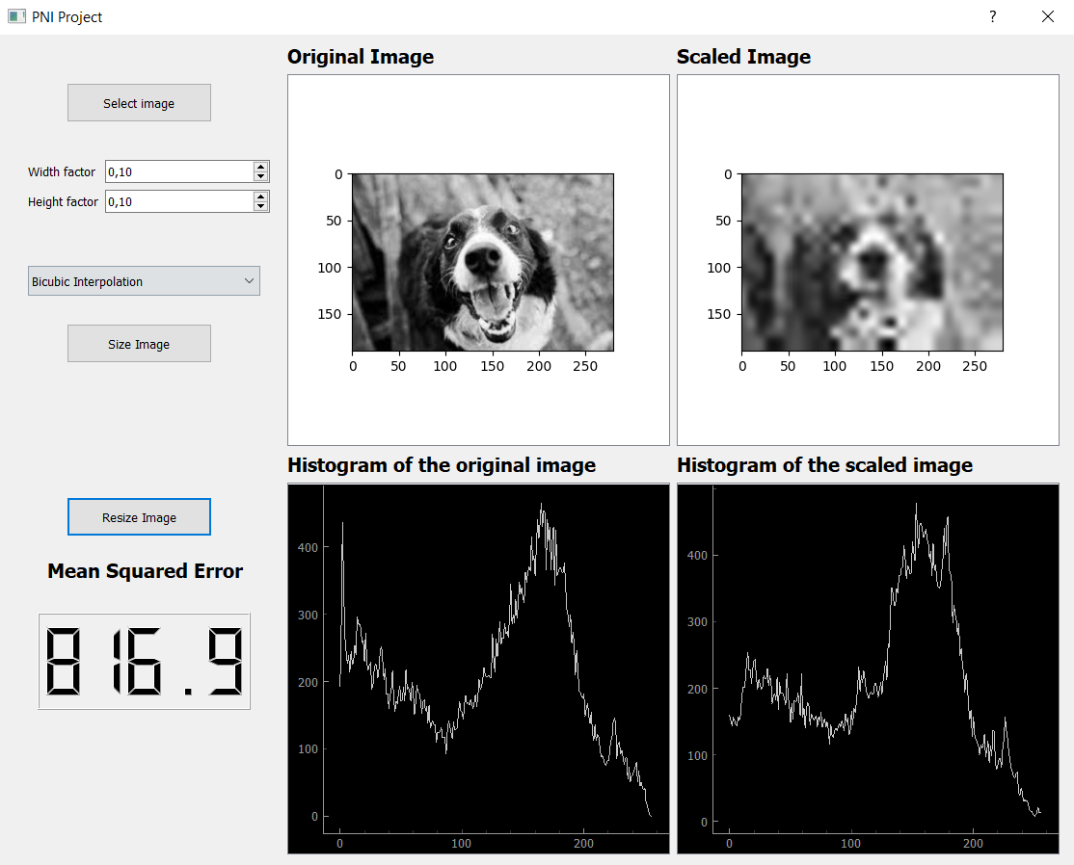
IMPLEMENTATION
~ Everything in Python ~
Make a function for each algorithm that will need to be called in the main function
Create an interface that calls the main function, allowing the user to select the scaling factors and the desired method to process the image it uploads in.
Introduce the function that computes the Mean Square Error between the input and the output images

Slide 8
TESTING-RESULTS
The smaller was the sizing factor, the greater was the MSE
If there are chosen different sizing factors for weight and height, the MSE is smaller compared to when both of them have the same value
BI provided a smaller MSE and better quality images. Pixel Replication requires a significant shorter time to be executed than BI, that has more complex computations to perform
Width | Height | MSE Pixel Replication | MSE Bicubic interpolation
0.1 | 0.2 | 927.1 | 1.587
0.1 | 0.1 | 1536 | 0.513
0.05 | 0.05 | 2773 | 1278

Slide 9
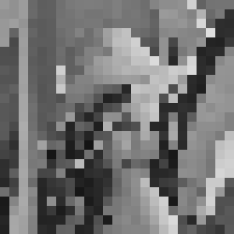
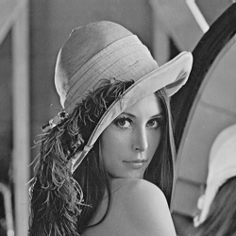

TESTING-Conclusions
bigger images, a higher MSE is obtained
images with similar dimensions, but with different white and black grading, MSE is bigger for those containing more white than black.
When an image is minimized, its resolution is poorer and its grid has to encapsulate more information
in a smaller place, therefore it loses its quality when someone tries to bring it to its original size.

Slide 10
Bibliography
1. R. Gonzalez and P. Wintz Digital Image Processing, 2nd edition, Addison-Wesley Publishing Company, 1987, pp 22 – 26
2. A. Jain Fundamentals of Digital Image Processing, Prentice-Hall, 1986, Chap. 4, pp 94
3. E. Davies Machine Vision: Theory, Algorithms and Practicalities, Academic Press, 1990
4. A. Marion An Introduction to Image Processing, Chapman and Hall, 1991
5. Bilal Himite, Aug 16, 2021, https://towardsdatascience.com/image-processing-image-scaling-algorithms-ae29aaa6b36c, 29.10.2022
6. Vincent Tabora, 3Mar, 2020 https://medium.com/hd-pro/bicubic-interpolation-techniques-for-digital-imaging-7c6d86dc35dc, 29.10.2022

