Slide 1
Katalon
Clue Webapp Test automation

Slide 2
Why Katalon?
Built on selenium
Technical debt/no big learning curves
Continuous product development
User forum & support
Record & play
Licencing was more affordable/less complicated back then

Slide 3
What we use in katalon
Object repository – Store all test objects
Keywords – inbuilt or custom keywords to aid automation
Test data – Mainly excel files at the moment
Test cases – Steps detailing the scenario
Test suites - Group of test cases
Execution Profiles – used to define various test environments

Slide 4
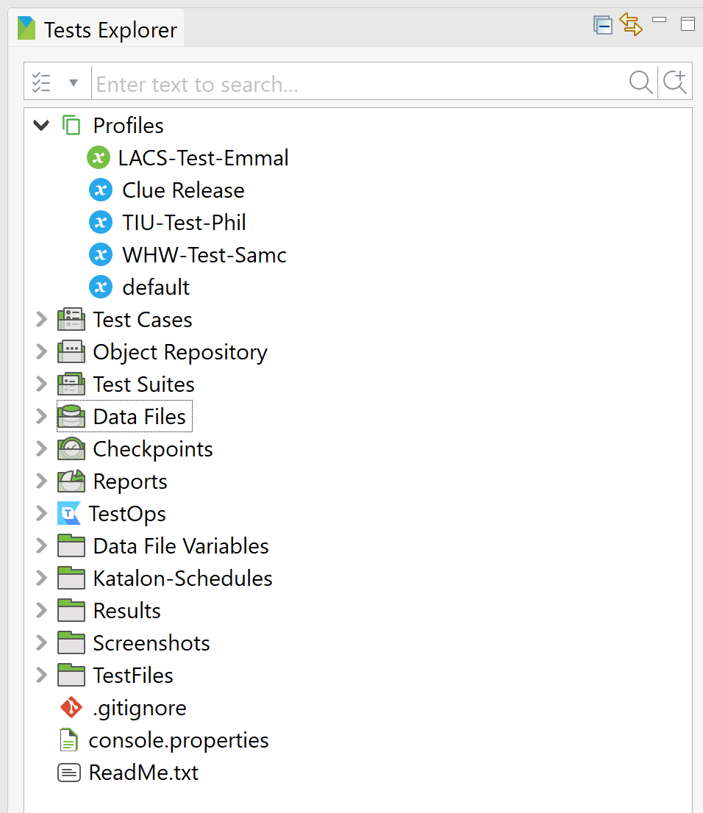
Katalon

Slide 5
How do we write/add tests?
Record & play
Manually identify objects – SpyObject
Developer tools to identify the attributes correctly
Using third party plugins like Firepath etc

Slide 6
What do we have right now?
Test cases: 145
Test suites: 173
Pls find the list here - https://dev.azure.com/ClueComputing/Clue/_git/Testing?path=/Clue%20Test%20Cases.xlsx

Slide 7
What would we like?
ID’s where possible so we can identify objects consistently. Popups especially as it makes it makes testing life a lot easer as Katalon knows what element it is looking for.
Technical Support with how we can connect Katalon to the SQL test database so we can incorporate turning settings on and off in the test cases instead of having to turn them on and off manual.

