Slide 1

BDD – A Practicable Approach for Computerised System Validation?
Sabrina Leuenberger
Bachelor Thesis SF2020 FHNW
30th of July 2020

Slide 2
Agenda
1 | GAMP5 with BDD for OQ
2 | Feature Files: Specification and Testscript
3 | GxP Compliant OQ Automation with BDD
4 | Towards a Fully Automated Validation Process?
5 | Some More Questions?

Slide 3

GAMP5 with BDD for OQ

Slide 4
Computerised System Validation in the Pharmaceutical Industry
GAMP5
A Guide
Covers Validation of Computerised Systems during the whole life cycle of a product in a risk based approach.
Fitness for Intended Use
Compliance to Regulation
Patient Safety

Slide 5
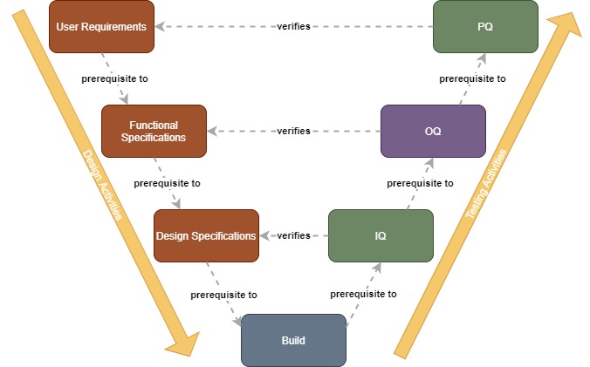
CSV needs Testing – Let’s Automate!
Software Verification Steps After Build:
OQs → often done manually: checking activities based on test script → Time consuming, error prone and expensive. --> Automation would be nice

Slide 6

In Four Steps to Our Results
Evaluation of a test automation for OQs based on BDD for a custom application during the project phase according to GAMP5.

Slide 7
OQ = Formal Proof for Functional Specs (FS)
Testing
Test
Specifications
Test
Scripts
Test
Results
Test
Report
writes
Test Analyst
Test Analyst
Tester
Tester
Test Reviewer
reviews
SME
SME
Test Reviewer
Quality Unit
approves
Process Owner
Process Owner
Quality Unit
Quality Unit

Slide 8
Important: Traceability & Risks
R
User
Requirements
Traceability
R
Functional
Specifications
Traceability
R
Testing
Test
Specifica-
tions
Test
Scripts
Test
Results
Test
Report

Slide 9


BDD can Automate FS-Testing…
R
User
Requirements
Traceability
R
Functional
Specifications
Traceability
R
Testing
Test
Specifica-
tions
Test
Scripts
Test
Results
Test
Report

Slide 10
… and Much More!
R
User
Requirements
Feature Files
Gherkin
Traceability
R
Functional
Specifications
Traceability
R
Testing
Test
Specifica-
tions
Test
Scripts
Test
Results
Test
Report

Slide 11
Feature Files: Specification and Testscript in One

Slide 12
BDD Practices
Discovery
Rules
Formulation
Feature Files
Automation
Cucumber Test Report
Examples

Slide 13
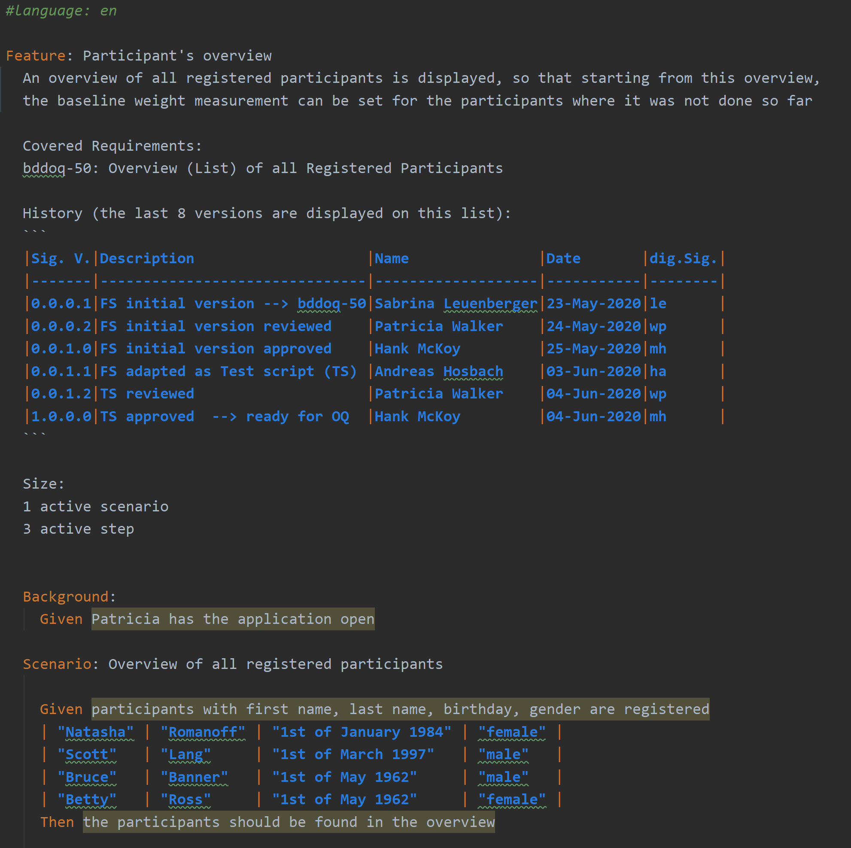
A Feature File

Slide 14
BDD With Risk Management
Discovery
Rules
Formulation
Feature Files
Automation
Cucumber Test Report
Examples
R

Slide 15
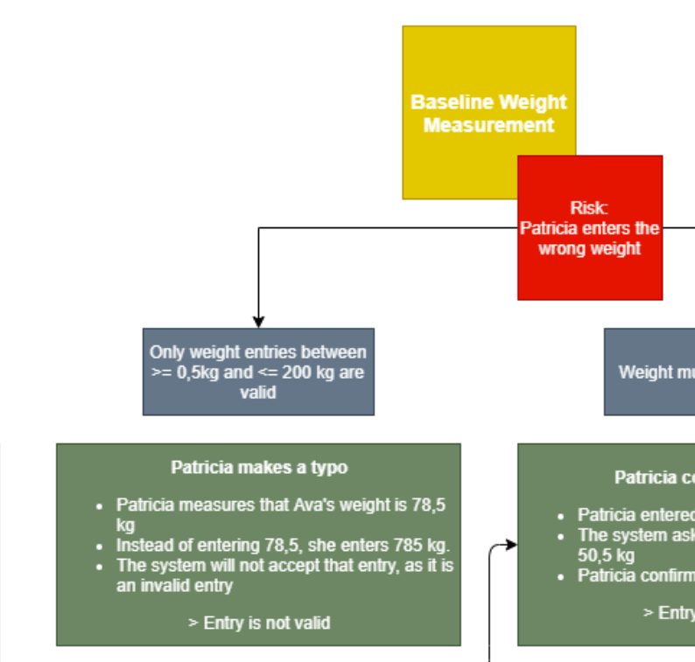
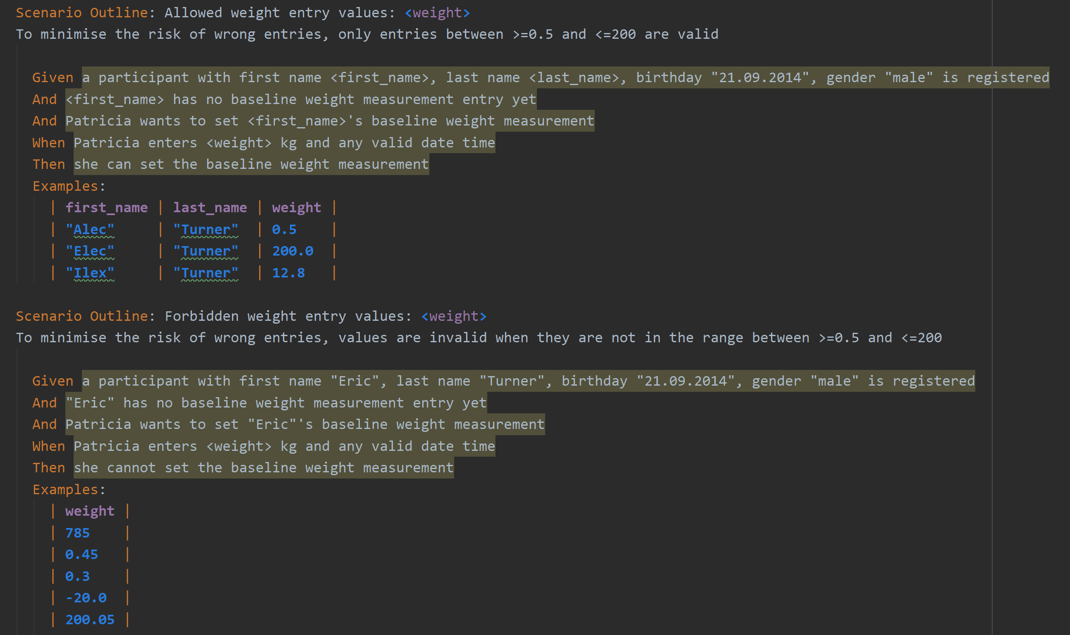
Feature File: Risk Management

Slide 16

Feature File: Single Source of Truth
User
Requirements
Feature 3
User Stories
FS
Test Scripts
Feature 2
User Stories
FS
Test Scripts
Functional
Specifications
Feature 1
User Stories
FS
Test Scripts
Traceability
Test
Scripts

Slide 17
GxP Compliant OQ Automation with BDD
Notes:
In Bezug Auf Bild in slide 7 mit Architektur

Slide 18
OQ
Testing
Test
Specifications
Test
Scripts
Test
Results
Test
Report
writes
Test Analyst
Test Analyst
Tester
Tester
Test Reviewer
reviews
SME
SME
Test Reviewer
Quality Unit
approves
Process Owner
Process Owner
Quality Unit
Quality Unit

Slide 19
Automated OQ
Testing
Test
Specifications
Test
Scripts
Test
Results
Test
Report
writes
Test Analyst
Team
Cucumber
Cucumber & Tester
Test Reviewer
reviews
SME
SME
Test Reviewer
Quality Unit
approves
Process Owner
Process Owner
Quality Unit
Quality Unit

Slide 20
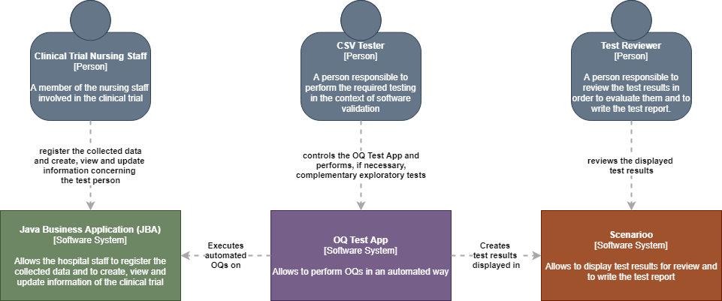
Architectural Needs

Slide 21
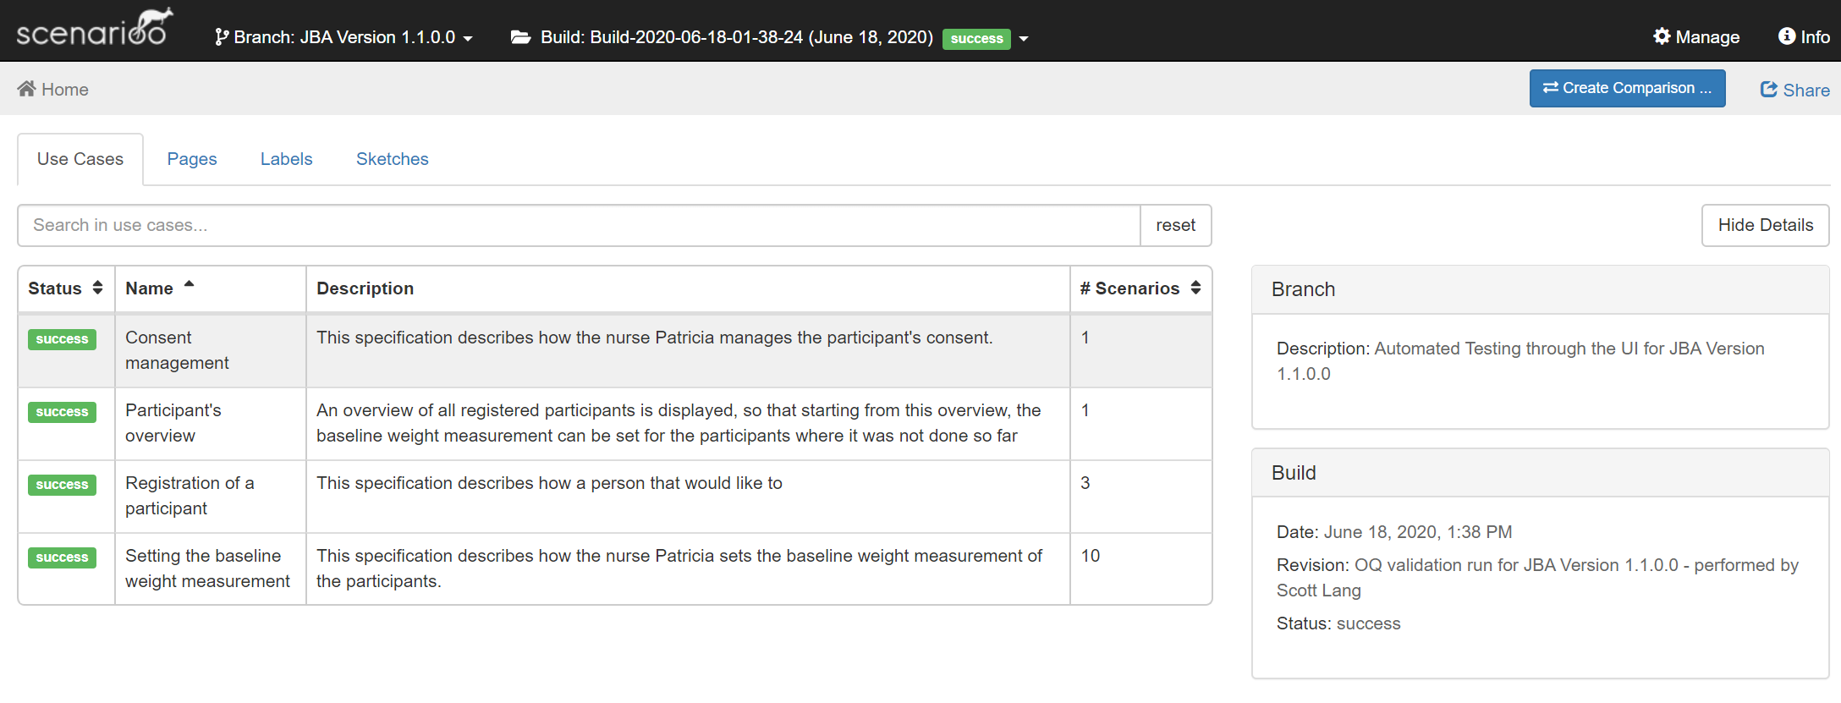
OQ Test Results: In an Overview...

Slide 22
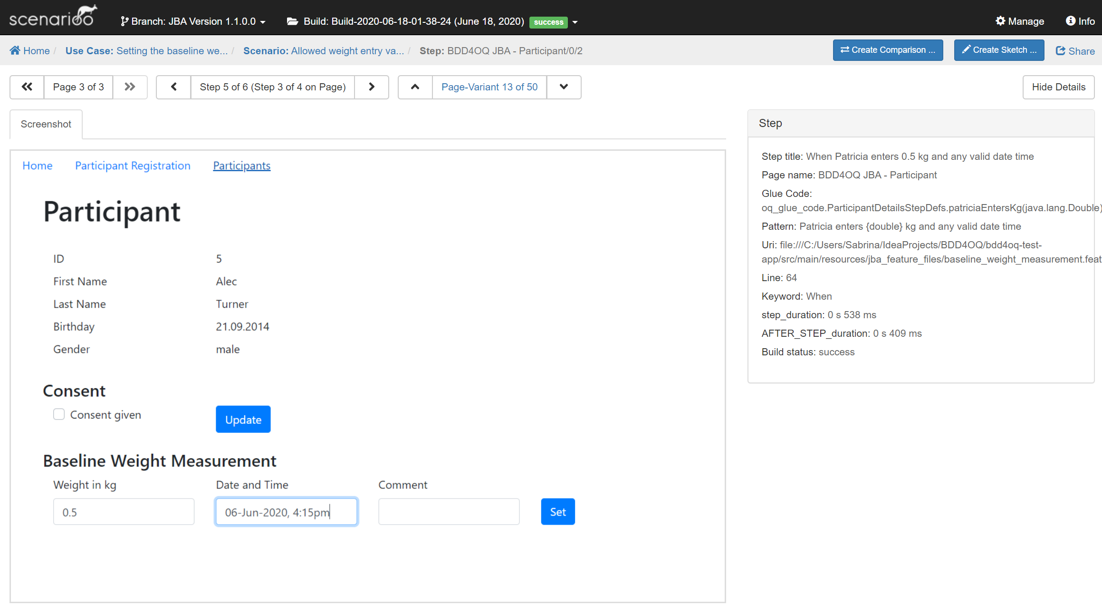


OQ Results: ... But also Detailed

Slide 23
Automated OQ
Testing
Test
Specifications
Test
Scripts
Test
Results
Test
Report
writes
Test Analyst
Team
Cucumber
Cucumber & Tester
Test Reviewer
reviews
SME
SME
Test Reviewer
Quality Unit
approves
Process Owner
Process Owner
Quality Unit
Quality Unit

Slide 24
The Audit: We Are on the Right Way!

Slide 25
ToDo: Evaluation of BDD for OQs with a Prototype
Evaluation of a test automation for OQs based on BDD for a custom application during the project phase according to GAMP5.

Slide 26
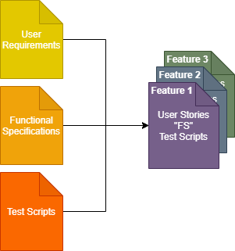
Learnings
We did not find anything that would prevent the use of BDD for OQ test automation
Opportunity that OQs could be automated (theoretically), but not only:
The FS process is (partially) fused with the test script generation part of the OQ process → Less redundancy
It will change the documentation system
Traceability is inherently included in the feature files
A tester will need to have other competencies → basics in coding required
Notes:
…That means, it gives us the opportunity……
Architecutal needs due to the fact, that the OQ is performed on the deployed application (IQ): It must use the interfaces of the deployed application

Slide 27
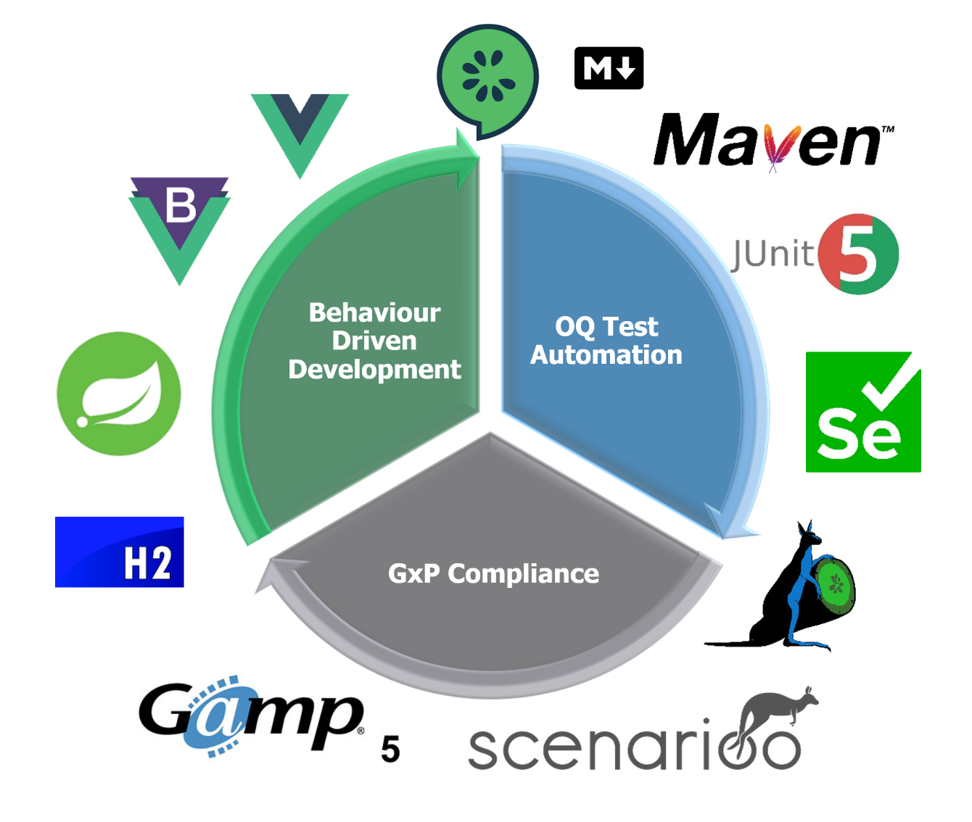


Many Thanks!!!

Slide 28
Acknowledgements
Wega
FHNW
Mathias Fuchs
Evelyne Daniel
Andreas Hosbach
It would not have been possible without you!

Slide 29











Many Thanks for Your Attention!
?
?
OQ Test Automation
GxP Compliance
Behaviour Driven Development
?
?
?
?

Slide 30






OQ Test Automation
GxP Compliance
Behaviour Driven Development

