Slide 1

BDD – A Practicable Approach for Computerised System Validation?
Sabrina Leuenberger
Bachelor Thesis SF2020 FHNW
30th of July 2020

Slide 2
Agenda
1 | GAMP5 with BDD for OQ
2 | Feature Files: Specification and Testscript
3 | GxP Compliant OQ Automation with BDD
4 | Towards a Fully Automated Validation Process?
5 | Some More Questions?

Slide 3

GAMP5 with BDD for OQ

Slide 4
Computerised System Validation in the Pharmaceutical Industry
GAMP5
A Guide
Covers Validation of Computerised Systems during the whole life cycle of a product in a risk based approach.
Fitness for Intended Use
Compliance to Regulation
Patient Safety

Slide 5
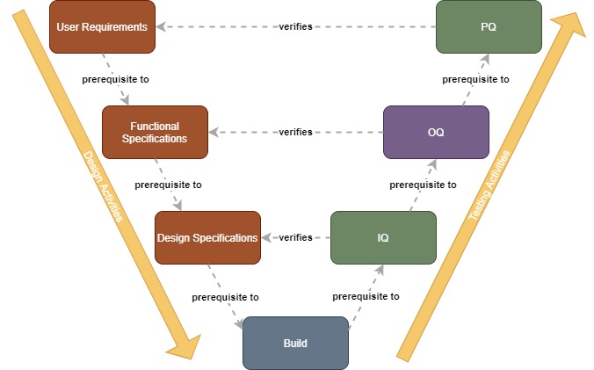
CSV needs Testing – Let’s Automate!
Software Verification Steps After Build:
OQs → often done manually: checking activities based on test script → Time consuming, error prone and expensive. --> Automation would be nice

Slide 6

In Four Steps to Our Results
Evaluation of a test automation for OQs based on BDD for a custom application during the project phase according to GAMP5.

Slide 7
OQ = Formal Proof for FS
Testing
Test
Specifications
Test
Scripts
Test
Results
Test
Report
writes
Test Analyst
Test Analyst
Tester
Tester
Test Reviewer
reviews
SME
SME
Test Reviewer
Quality Unit
approves
Process Owner
Process Owner
Quality Unit
Quality Unit

Slide 8
Important: Traceability & FRA
R
User
Requirements
Traceability
R
Functional
Specifications
Traceability
R
Testing
Test
Specifica-
tions
Test
Scripts
Test
Results
Test
Report

Slide 9


BDD can Automate FS-Testing…
R
User
Requirements
Traceability
R
Functional
Specifications
Traceability
R
Testing
Test
Specifica-
tions
Test
Scripts
Test
Results
Test
Report

Slide 10
… and Much More!
R
User
Requirements
Feature Files
Gherkin
Traceability
R
Functional
Specifications
Traceability
R
Testing
Test
Specifica-
tions
Test
Scripts
Test
Results
Test
Report

Slide 11
Feature Files: Specification and Testscript in One

Slide 12
BDD Practices
Discovery
Rules
Formulation
Feature Files
Automation
Cucumber Test Report
Examples
R

Slide 13
Feature File: Single Source of Truth
User
Requirements
Feature 3
User Stories
FS
Test Scripts
Feature 2
User Stories
FS
Test Scripts
Feature 1
User Stories
FS
Test Scripts
Traceability
Functional
Specifications
Test
Scripts

Slide 14
GxP Compliant OQ Automation with BDD
Notes:
In Bezug Auf Bild in slide 7 mit Architektur

Slide 15
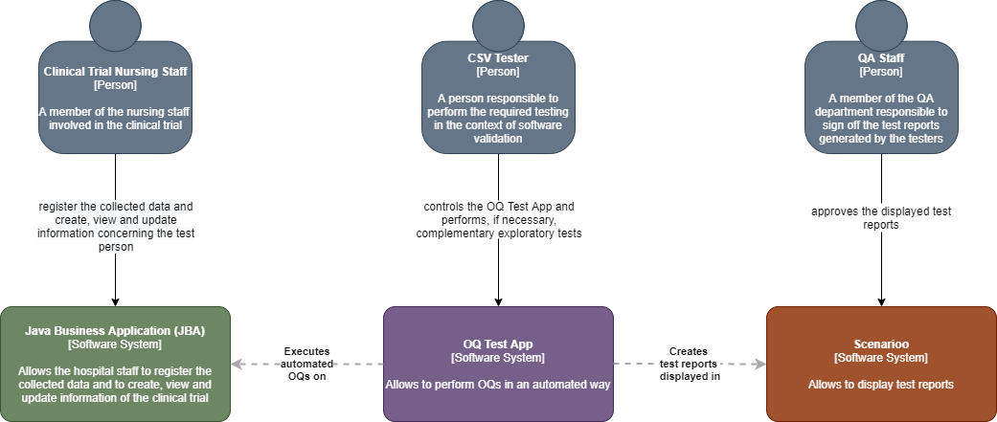
Architectural Needs
Notes:
C4: 1. System Context – 2. Container – 3. Component – 4. Code (e.g. UML class)
As I quickly mentionned earlier, there are some requirements about the documentation of the test results.
Documentation of Test Results:
Metadata (When, Environment, ID)
Passed/Failed
Screenshots required for important steps e.g. business critical or risk relevant steps
In order to make a quick check, if this could in principle be possible → Pre-Prototype of the OQ Test App.
It will test a wikipedia site.

Slide 16
ToDo: Evaluation of BDD for OQs with a Prototype
Evaluation of a test automation for OQs based on BDD for a custom application during the project phase according to GAMP5.

Slide 17
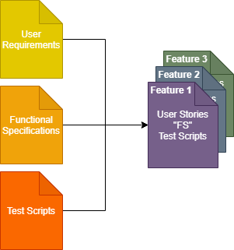
Learnings
We did not find anything that would prevent the use of BDD for OQ test automation
Opportunity that OQs could be automated (theoretically), but not only:
The FS process is (partially) fused with the test script generation part of the OQ process → Less redundancy
It will change the documentation system
Traceability is inherently included in the feature files
A tester will need to have other competencies → basics in coding required
Notes:
…That means, it gives us the opportunity……
Architecutal needs due to the fact, that the OQ is performed on the deployed application (IQ): It must use the interfaces of the deployed application

Slide 18
The Audit: We Are on the Right Way!

Slide 19
ToDo: Evaluation of BDD for OQs with a Prototype
Evaluation of a test automation for OQs based on BDD for a custom application during the project phase according to GAMP5.

Slide 20
Learnings
We did not find anything that would prevent the use of BDD for OQ test automation
Opportunity that OQs could be automated (theoretically), but not only:
The FS process is (partially) fused with the test script generation part of the OQ process → Less redundancy
It will change the documentation system
Traceability is inherently included in the feature files
A tester will need to have other competencies → basics in coding required
Notes:
…That means, it gives us the opportunity……
Architecutal needs due to the fact, that the OQ is performed on the deployed application (IQ): It must use the interfaces of the deployed application

Slide 21

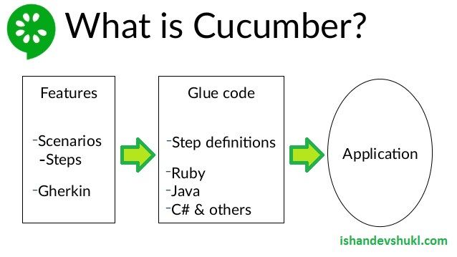
Engineering the OQ Test App
Tools:
Cucumber/Gherkin
And Selenium
With the results displayed in Scenarioo
Using a Cucumber-Scenarioo plugin

Slide 22
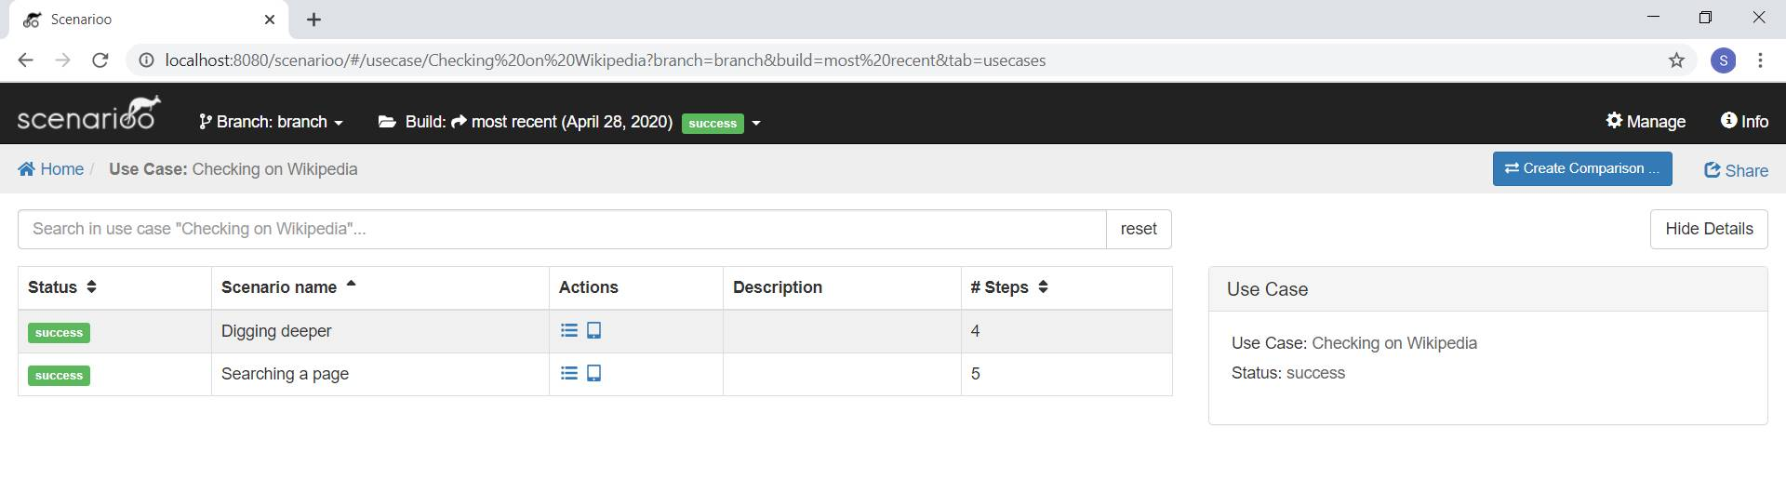
The Pre-Prototpe

Slide 23
The Pre-Prototpe

Slide 24
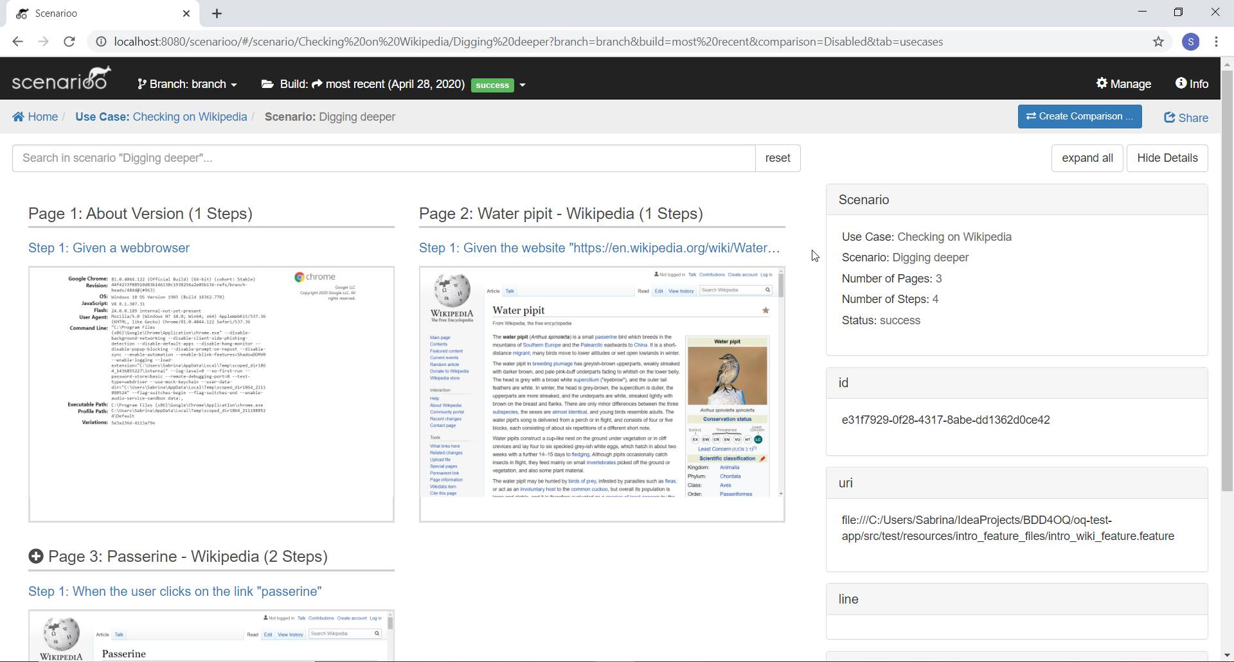
The Pre-Prototpe

Slide 25
Implemetation of the Prototype
Define User Stories
Define Test Specification
Create Feature Files and Glue Code
Create the Java Business Application App → Weighing Management App for Clinical Trials
Create the OQ Test App
Output of Interest: Test Specification, Feature Files, Glue Code, Test Results, Test Report → To be audited

Slide 26
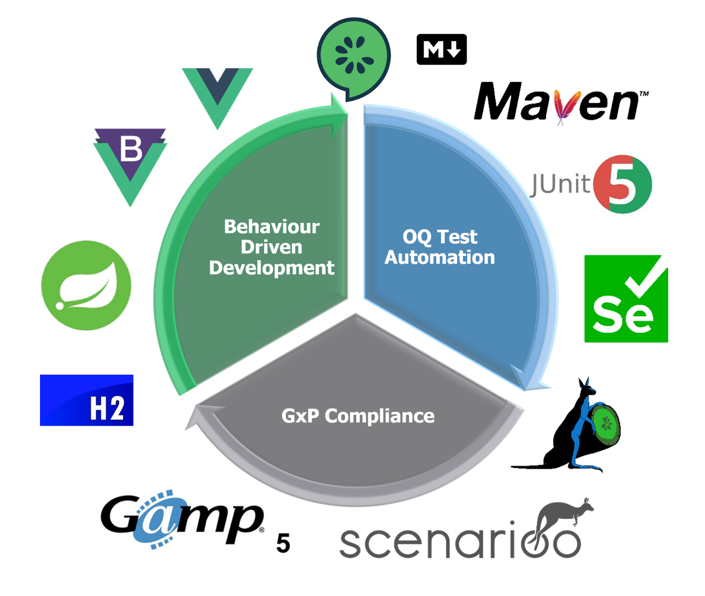


Many Thanks!!!

Slide 27
Acknowledgements
Wega
FHNW
Mathias Fuchs
Evelyne Daniel
Andreas Hosbach
It would not have been possible without you!

Slide 28











Many Thanks for Your Attention!
?
?
OQ Test Automation
GxP Compliance
Behaviour Driven Development
?
?
?
?

Slide 29






OQ Test Automation
GxP Compliance
Behaviour Driven Development

