Slide 1

BDD – A Practicable Approach for Computerised System Validation?
Sabrina Leuenberger
Bachelor Thesis SF2020 FHNW
30th of July 2020

Slide 2
Agenda
1 | GAMP5 with BDD for OQ
2 | Feature Files: Specification and Testscript
3 | GxP Compliant OQ Automation with BDD
4 | Towards a Fully Automated Validation Process?
5 | Some More Questions?

Slide 3

GAMP5 with BDD for OQ

Slide 4
Computerised System Validation in the Pharmaceutical Industry
GAMP5
A Guide
Covers Validation of Computerised Systems during the whole life cycle of a product in a risk based approach.
Fitness for Intended Use
Compliance
Patient Safety

Slide 5
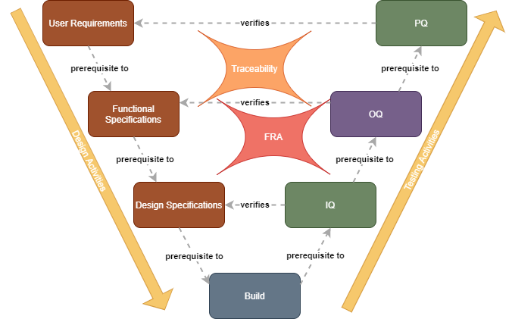
Verification in the Project Phase
Notes:
OQ is done on deployed software
Test Strategy / Test Plan
Functional Risk Assessment
Traceability
OQs → often done manually: checking activities based on test script → Time consuming, error prone and expensive. --> Automation would be nice

Slide 6
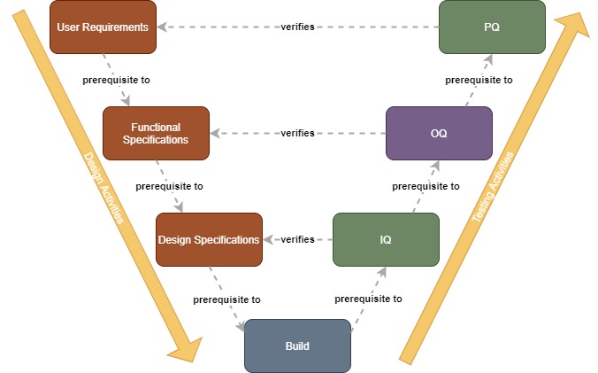
Custom Software Project Phase According to GAMP5
Software Verification Steps After Build:
OQs → often done manually: checking activities based on test script → Time consuming, error prone and expensive. --> Automation would be nice

Slide 7

ToDo: Evaluation of BDD for OQs with a Prototype
Evaluation of a test automation for OQs based on BDD for a custom application during the project phase according to GAMP5.

Slide 8
Feature Files: Specification and Testscript

Slide 9
ToDo: Evaluation of BDD for OQs with a Prototype
Evaluation of a test automation for OQs based on BDD for a custom application during the project phase according to GAMP5.

Slide 10
GxP Compliant OQ Automation with BDD

Slide 11
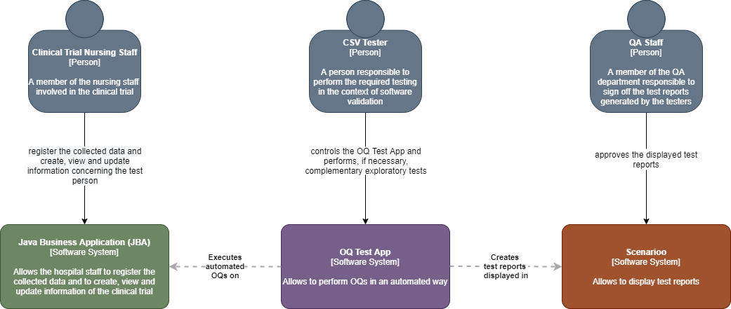
Architectural Needs
Notes:
C4: 1. System Context – 2. Container – 3. Component – 4. Code (e.g. UML class)
As I quickly mentionned earlier, there are some requirements about the documentation of the test results.
Documentation of Test Results:
Metadata (When, Environment, ID)
Passed/Failed
Screenshots required for important steps e.g. business critical or risk relevant steps
In order to make a quick check, if this could in principle be possible → Pre-Prototype of the OQ Test App.
It will test a wikipedia site.

Slide 12
ToDo: Evaluation of BDD for OQs with a Prototype
Evaluation of a test automation for OQs based on BDD for a custom application during the project phase according to GAMP5.

Slide 13
Towards a Fully Automated Validation Process?

Slide 14
ToDo: Evaluation of BDD for OQs with a Prototype
Evaluation of a test automation for OQs based on BDD for a custom application during the project phase according to GAMP5.

Slide 15
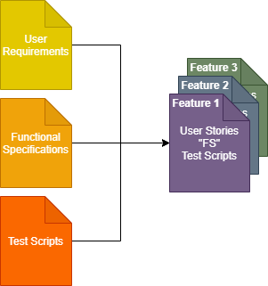
Learnings
We did not find anything that would prevent the use of BDD for OQ test automation
Opportunity that OQs could be automated (theoretically), but not only:
The FS process is (partially) fused with the test script generation part of the OQ process → Less redundancy
It will change the documentation system
Traceability is inherently included in the feature files
A tester will need to have other competencies → basics in coding required
Notes:
…That means, it gives us the opportunity……
Architecutal needs due to the fact, that the OQ is performed on the deployed application (IQ): It must use the interfaces of the deployed application

Slide 16
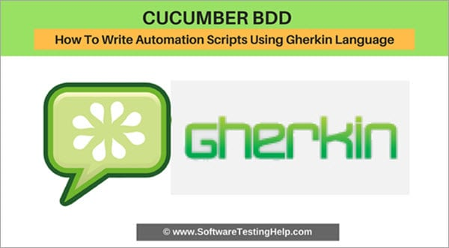
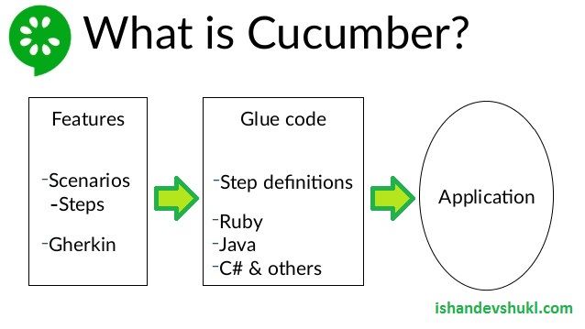
Engineering the OQ Test App
Tools:
Cucumber/Gherkin
And Selenium
With the results displayed in Scenarioo
Using a Cucumber-Scenarioo plugin

Slide 17
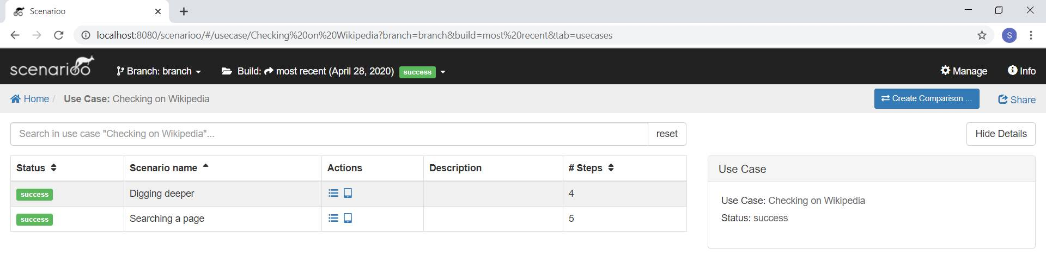
The Pre-Prototpe

Slide 18
The Pre-Prototpe

Slide 19
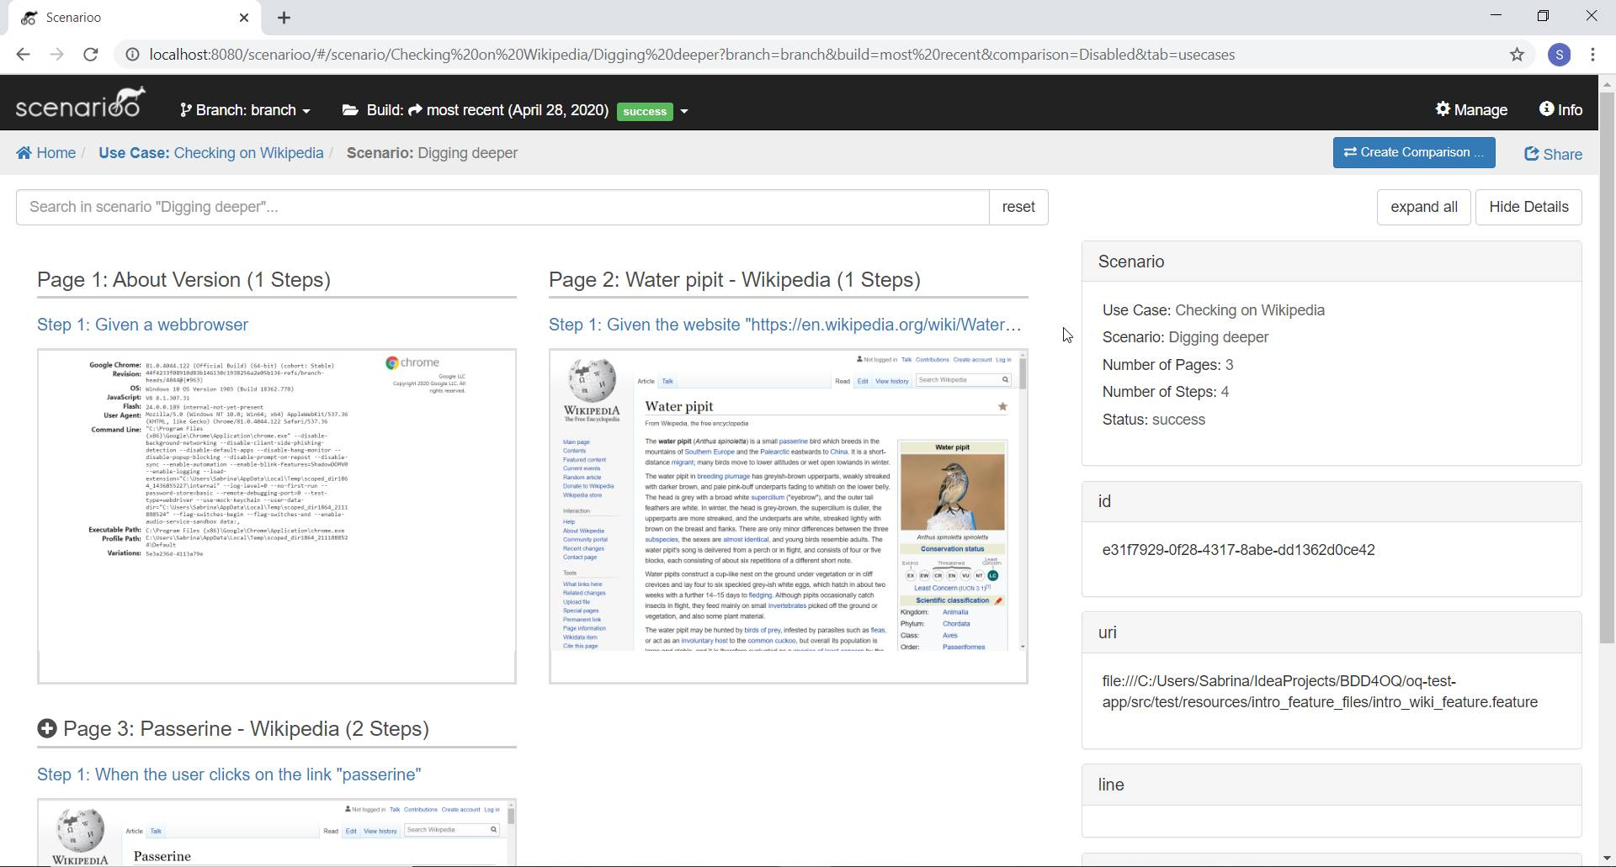
The Pre-Prototpe

Slide 20
Implemetation of the Prototype
Define User Stories
Define Test Specification
Create Feature Files and Glue Code
Create the Java Business Application App → Weighing Management App for Clinical Trials
Create the OQ Test App
Output of Interest: Test Specification, Feature Files, Glue Code, Test Results, Test Report → To be audited

Slide 21
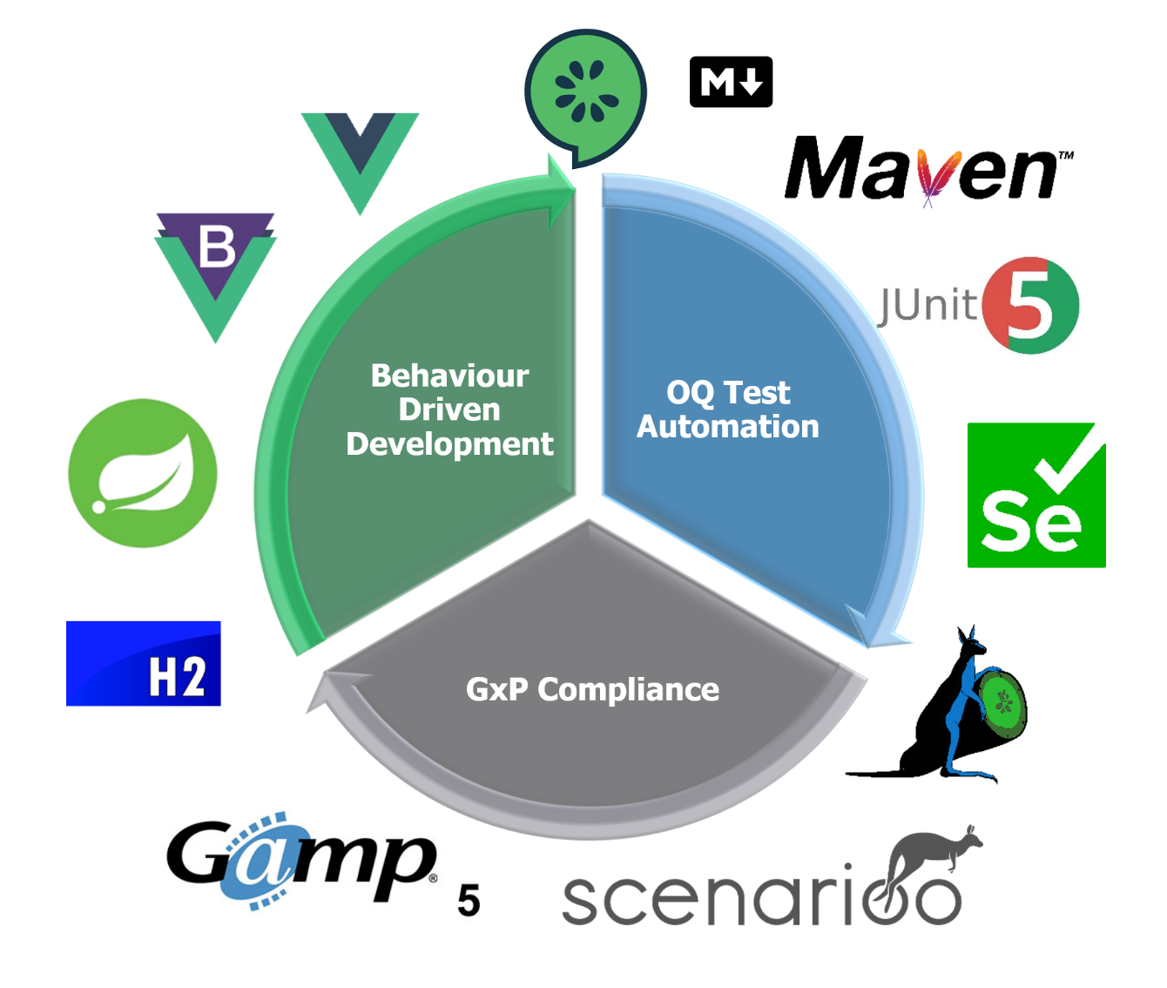

Next Step: Prototyping

Slide 22

Some More Questions? Happy to Discuss it!
Graphik von Sandra Schön, pixabay.com

Slide 23












OQ Test Automation
GxP Compliance
Behaviour Driven Development

