Slide 1

BDD – A Practicable Approach for Computerised System Validation?
Sabrina Leuenberger
Bachelor Thesis SF2020 FHNW
30th of July 2020

Slide 2
Agenda
1 | GAMP5 with BDD for OQ
2 | Feature Files: Specification and Testscript in One
3 | OQ Automation with BDD
4 | The Audit: We Are on the Right Way!
5 | Questions & Answers

Slide 3

GAMP5 with BDD for OQ

Slide 4
Computerised System Validation in the Pharmaceutical Industry
GAMP5
A Guide
Covers Validation of Computerised Systems during the whole life cycle of a product in a risk based approach.
Fitness for Intended Use
Compliance to Regulation
Patient Safety

Slide 5
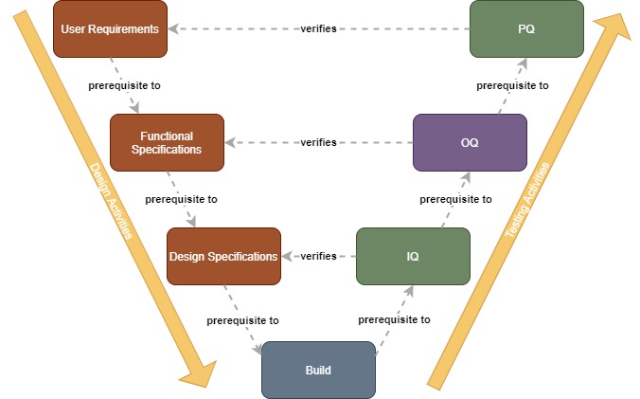
CSV needs Testing...

Slide 6

... a lot of Testing
OQs → often done manually: checking activities based on test script → time consuming, error prone and expensive.
https://commons.wikimedia.org/wiki/File:Panicking_Cartoon_Guy_Working_Overtime_With_A_Lot_Of_Paperwork.svg

Slide 7
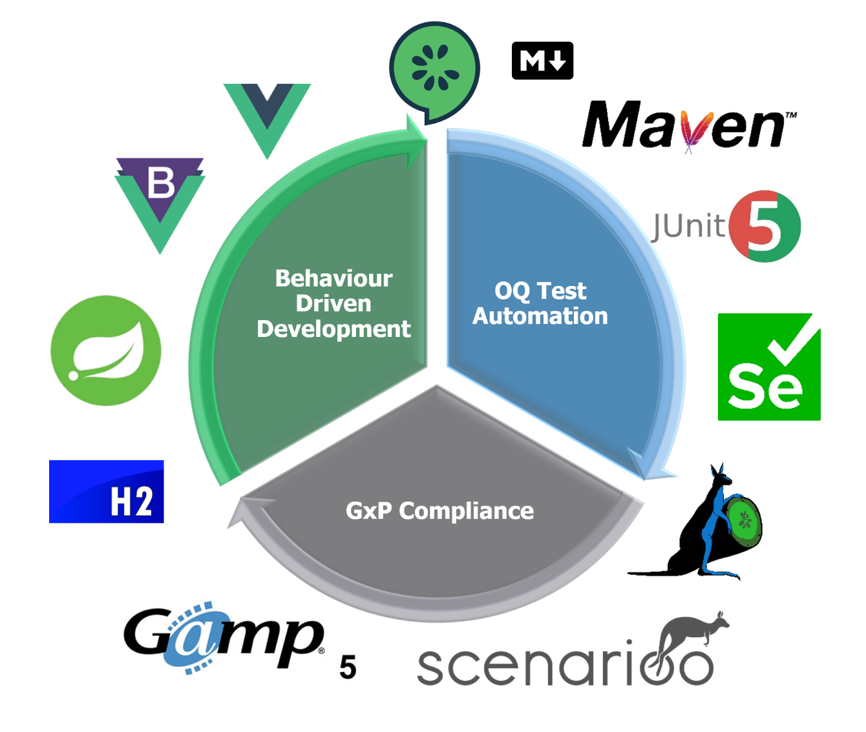
Let’s Automate!

Slide 8
Our Questions
Do the artefacts from the BDD-OQ process satisfy the GAMP5 OQ requirements?
How can the executable requirement suite be adapted to the evolving nature of the application?
Can automation tools like Cucumber/Gherkin, Selenium and Scenarioo be used together in validated environments?
And how could be dealt with new versions of the automation tools in terms of validation?

Slide 9
In Four Steps to Our Results
BDD/GAMP5 Process
Prototype
Audit
Final Evaluation

Slide 10
OQ = Formal Proof for Functional Specs (FS)
Testing
Test
Specifications
Test
Scripts
Test
Results
Test
Report
writes
Test Analyst
Test Analyst
Tester
Tester
Test Reviewer
reviews
SME
SME
Test Reviewer
Quality Unit
approves
Process Owner
Process Owner
Quality Unit
Quality Unit

Slide 11
Important: Traceability............
User
Requirements
Traceability
Functional
Specifications
Traceability
Testing
Test
Specifica-
tions
Test
Scripts
Test
Results
Test
Report
Notes:
Other considerations from which dependencies will arise

Slide 12
Important: Traceability & Risks
R
User
Requirements
Traceability
R
Functional
Specifications
Traceability
R
Testing
Test
Specifica-
tions
Test
Scripts
Test
Results
Test
Report

Slide 13


BDD can Automate FS-Testing…
R
User
Requirements
Traceability
R
Functional
Specifications
Traceability
R
Testing
Test
Specifica-
tions
Test
Scripts
Test
Results
Test
Report

Slide 14
… and Much More!
R
User
Requirements
Feature Files
Gherkin
Traceability
R
Functional
Specifications
Traceability
R
Testing
Test
Specifica-
tions
Test
Scripts
Test
Results
Test
Report

Slide 15
Feature Files: Specification and Testscript in One

Slide 16
From Specification to Test Results with BDD
Discovery
Rules
Formulation
Feature Files
Automation
Cucumber Test Report
Examples

Slide 17
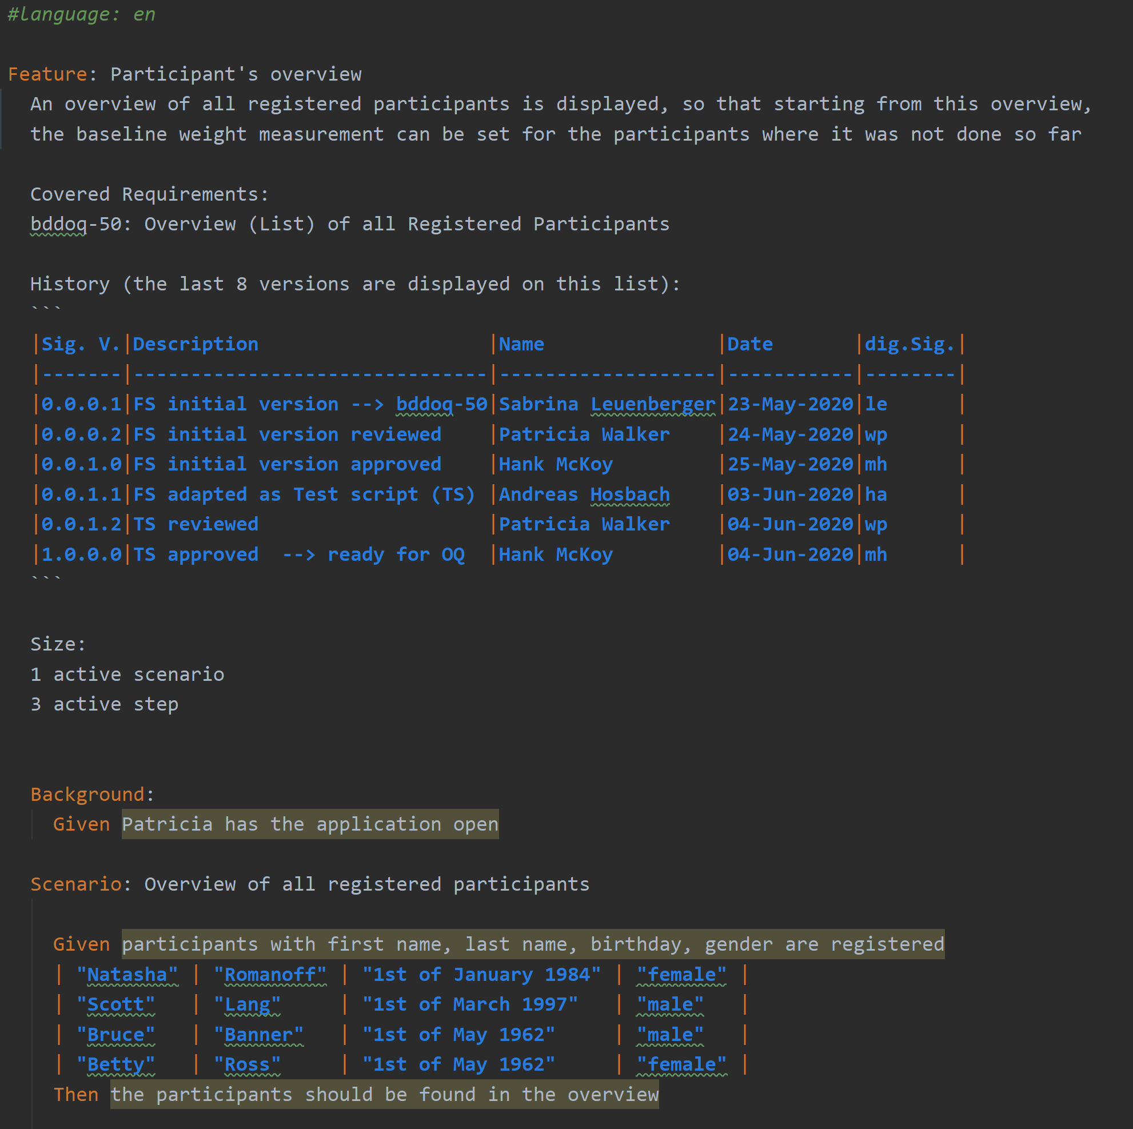
The Feature File as Key Element
Title / ID
Specification brief
Document History &
Signatures
Step
Scenario
Test Data

Slide 18
BDD With Risk Management
Discovery
Rules
Formulation
Feature Files
Automation
Cucumber Test Report
Examples
R

Slide 19
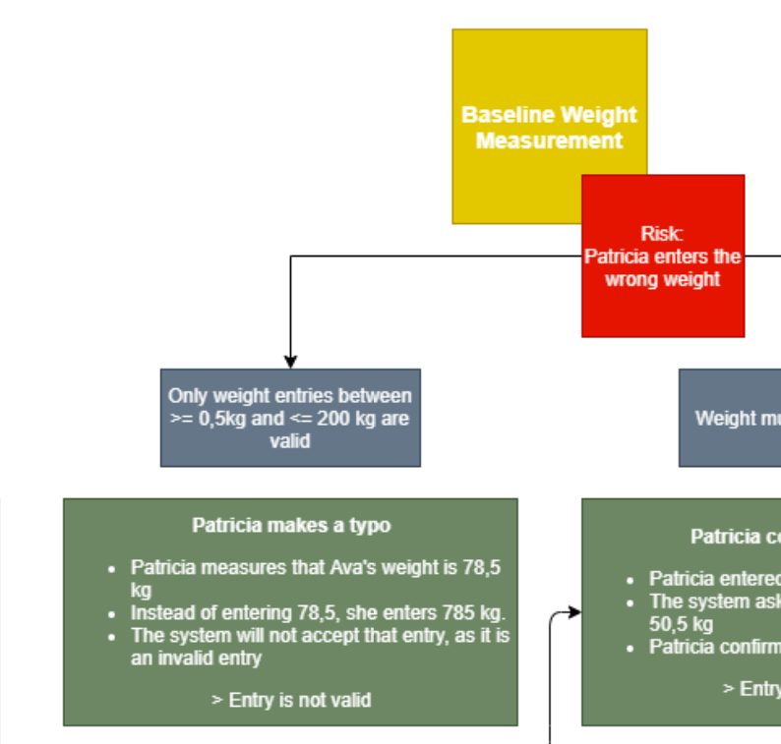
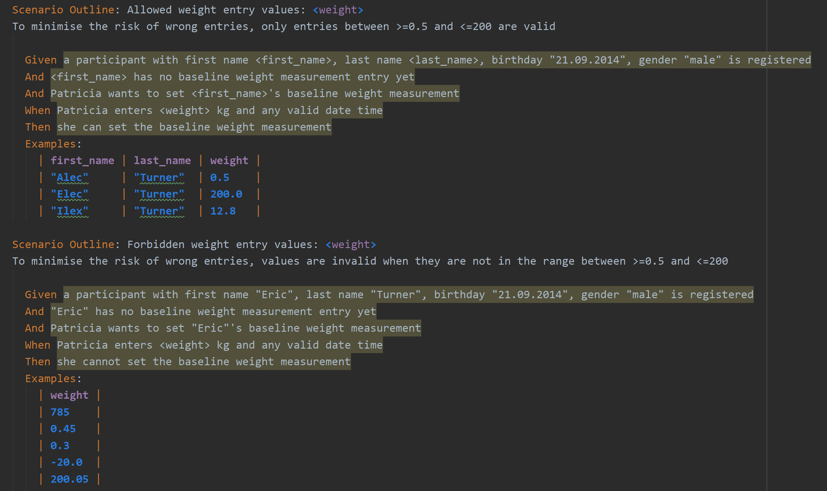
Feature File With Risk Management

Slide 20

Feature File as Single Source of Truth
User
Requirements
Feature 3
User Stories
FS
Test Scripts
Feature 2
User Stories
FS
Test Scripts
Functional
Specifications
Feature 1
User Stories
FS
Test Scripts
Traceability
Test
Scripts

Slide 21
OQ Automation with BDD
Notes:
In Bezug Auf Bild in slide 7 mit Architektur

Slide 22
OQ
Testing
Test
Specifications
Test
Scripts
Test
Results
Test
Report
writes
Test Analyst
Test Analyst
Tester
Tester
Test Reviewer
reviews
SME
SME
Test Reviewer
Quality Unit
approves
Process Owner
Process Owner
Quality Unit
Quality Unit

Slide 23
Automated OQ
Testing
Test
Specifications
Test
Scripts
Test
Results
Test
Report
writes
Test Analyst
Team
Cucumber
Cucumber & Tester
Test Reviewer
reviews
SME
SME
Test Reviewer
Quality Unit
approves
Process Owner
Process Owner
Quality Unit
Quality Unit

Slide 24
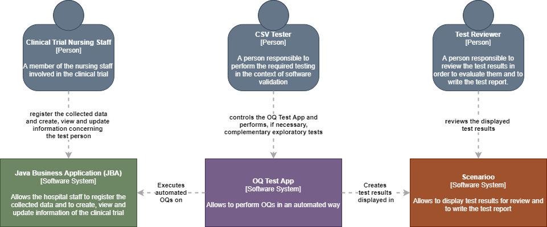
Architectural Needs

Slide 25
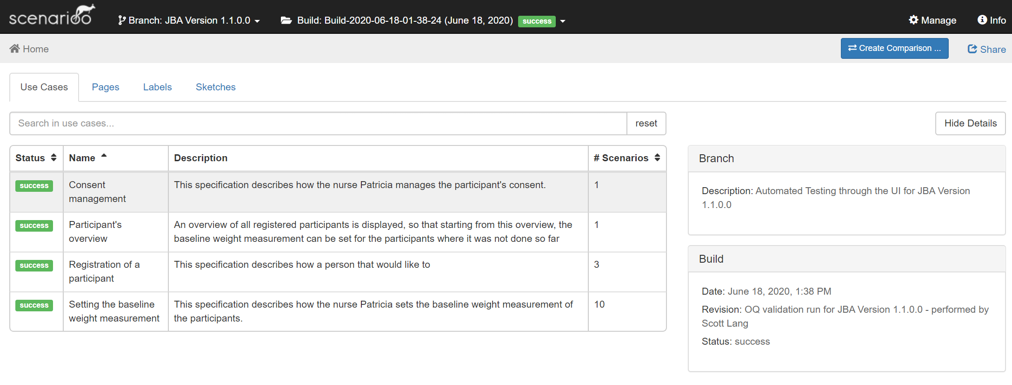
OQ Test Results: In an Overview...

Slide 26
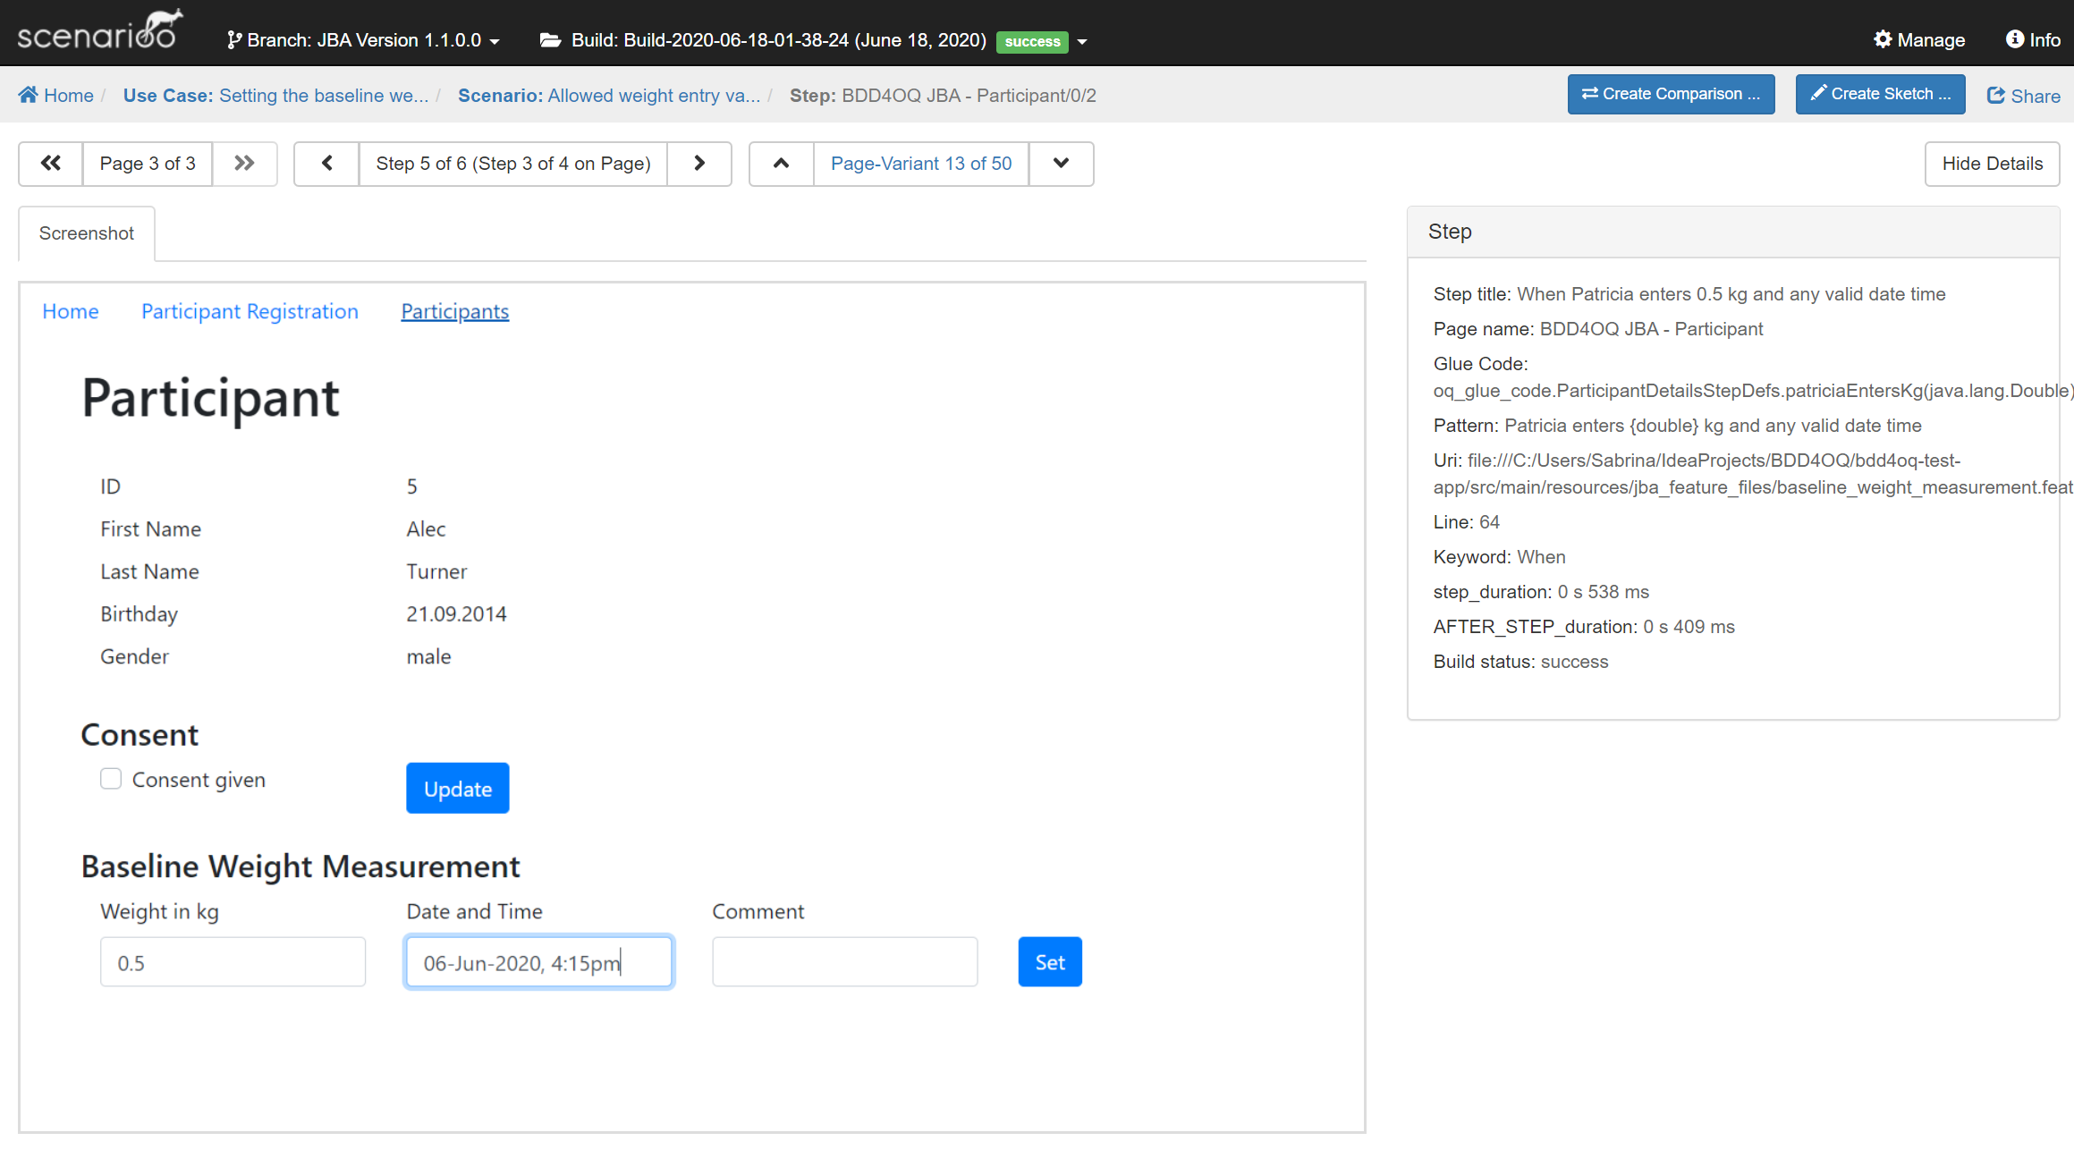


... But also in Detail

Slide 27
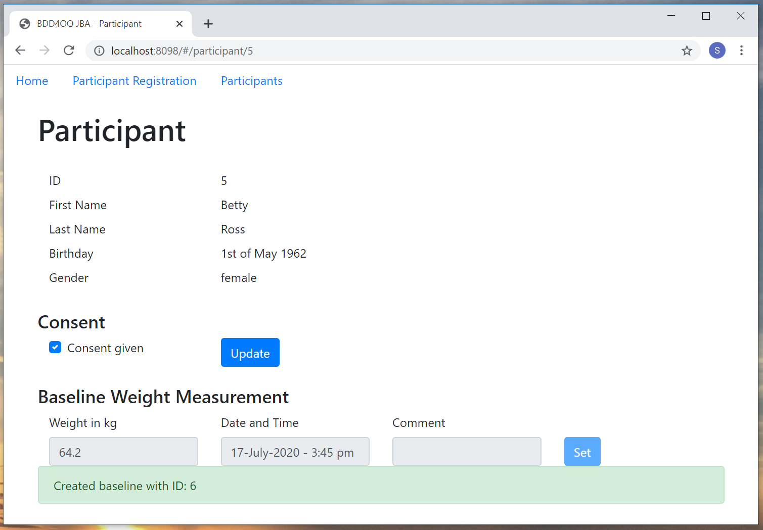

And Your Application is Documented!
Cucumber-Scenarioo-plugin

Slide 28
The Audit: We Are on the Right Way!

Slide 29
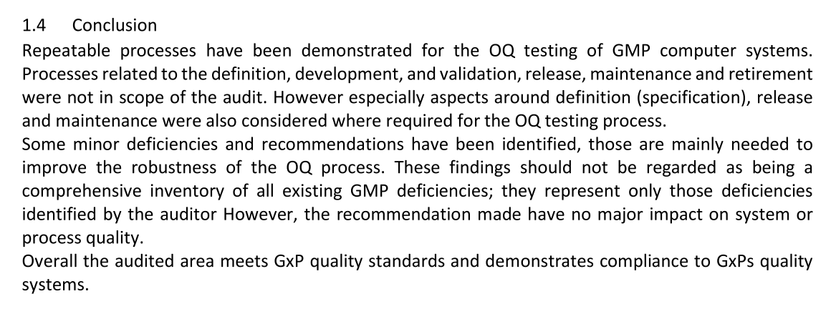
The Prototype Is Compliant to GxP...
Overall the audited area meets GxP quality standards and
demonstrates compliance to GxPs quality systems.

Slide 30
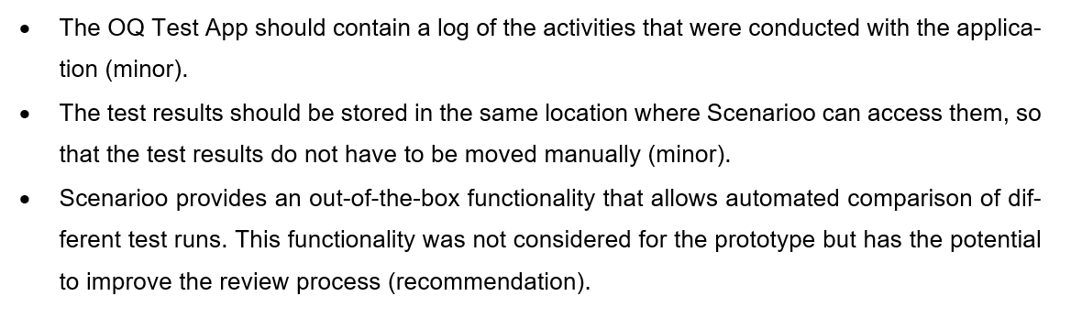
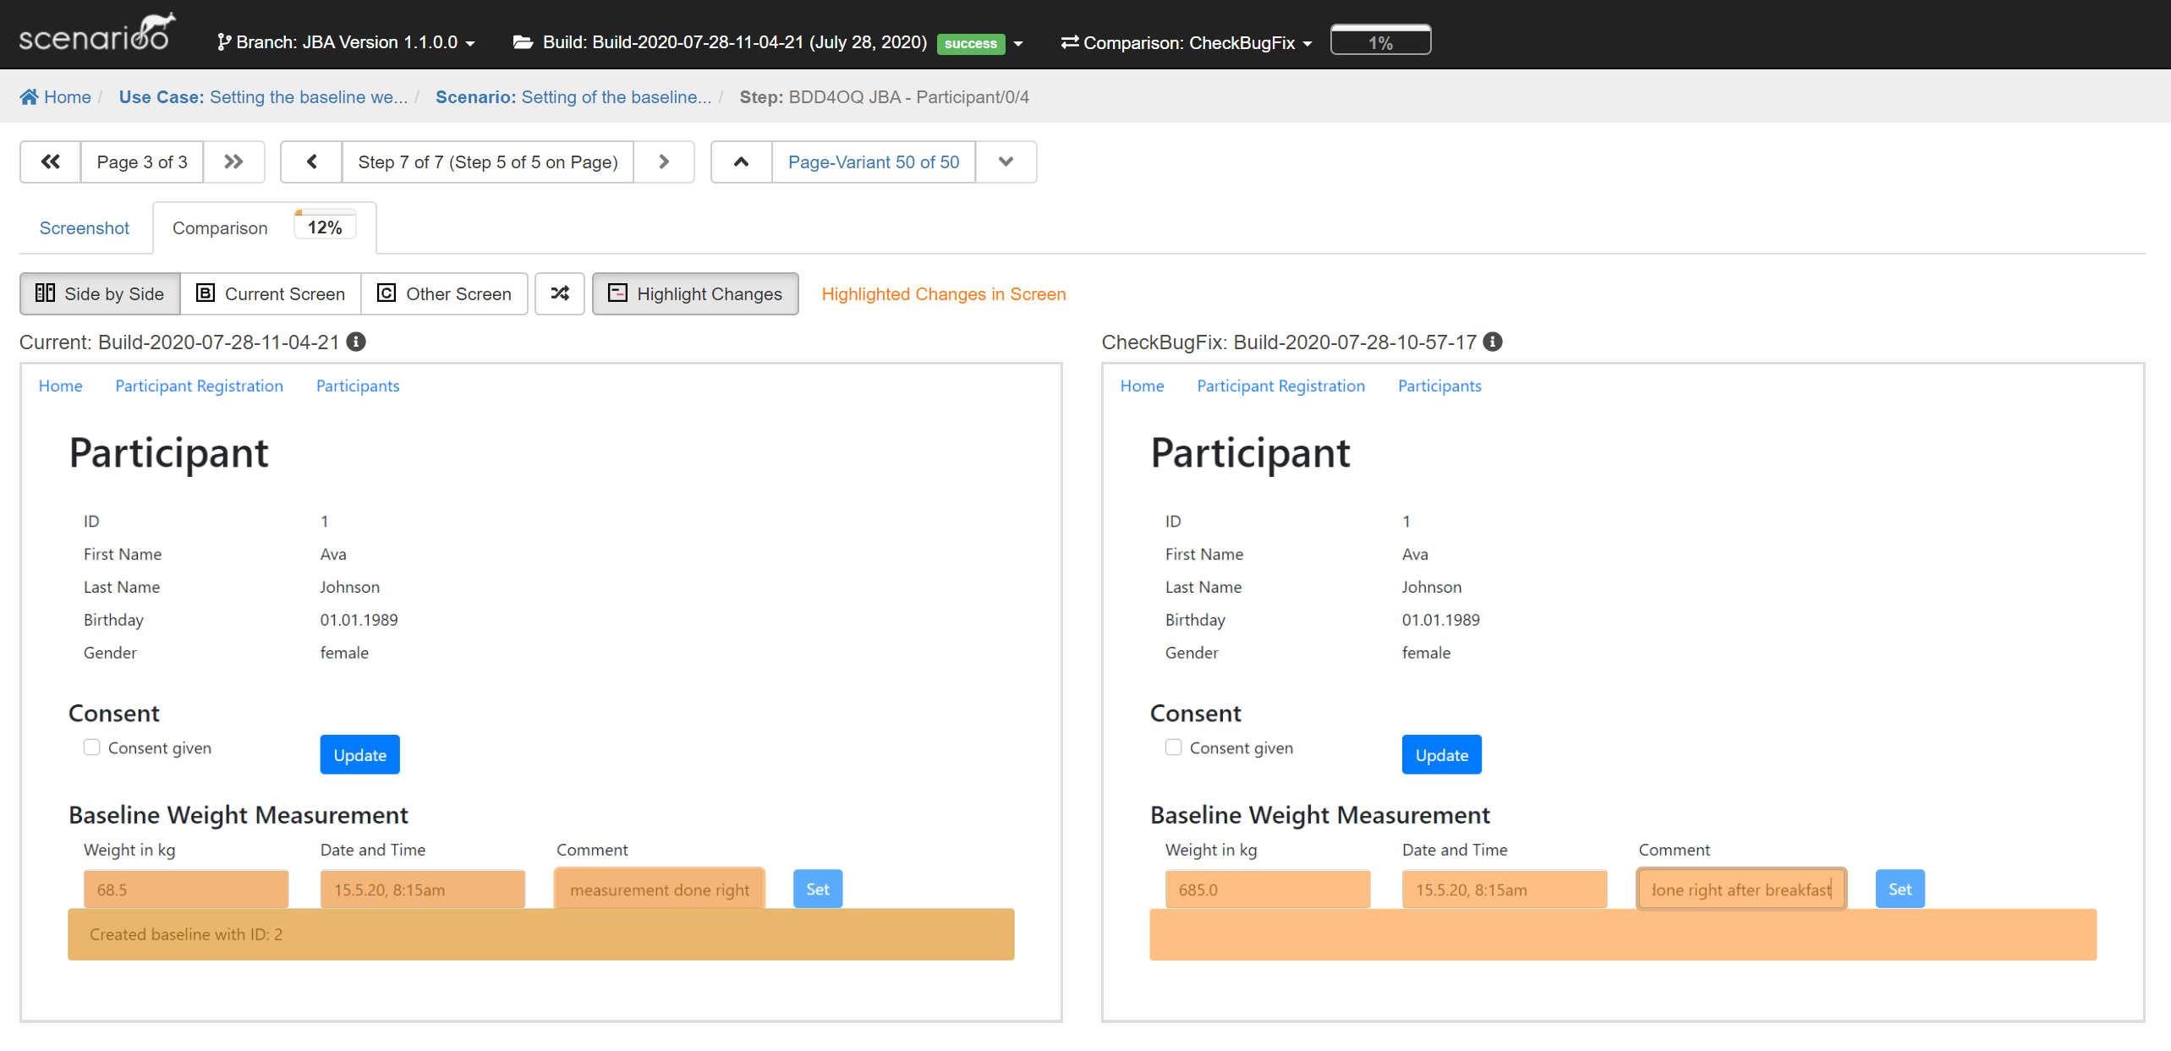
... But Can Be Improved

Slide 31
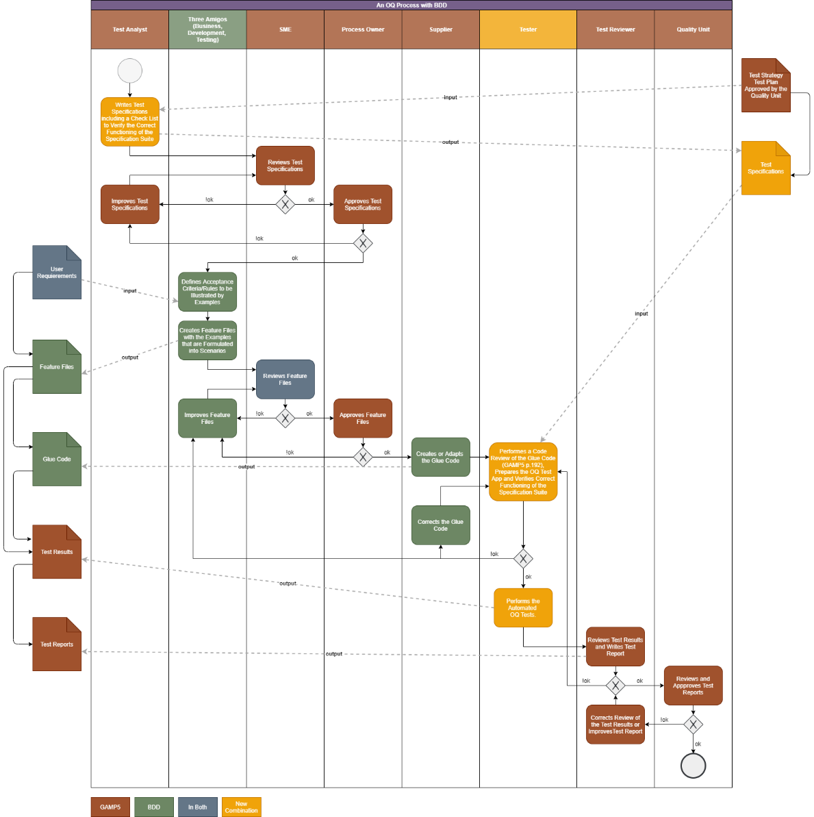
The Answers to Our Initial Questions
Do the artefacts from the BDD-OQ process satisfy the GAMP5 OQ requirements? YES
How can the executable requirement suite be adapted to the evolving nature of the application? Feature File & Agile
Can automation tools like Cucumber/Gherkin, Selenium and Scenarioo be used together in validated environments? YES with high Probability
And how could be dealt with new versions of the automation tools in terms of validation? On Premise & Maven

Slide 32
To Make a Long Story Short...
Feature File: A Valuable Artefact
Single source of Truth: Requirements/Specifications/Tests
English or any other Language
Machine Readable AND Business Specific
Automated Testing (Regressentesting!)
= Automated Documentation
Transparent and Traceable

Slide 33
But Most Importantly: Let’s Continue!
Real Added Value
Test Automation for
Device Integration
Full Automation:
IQ – OQ – PQ
Artificial Intelligence

Slide 34


Many Thanks!!!

Slide 35

Many Thanks for Your Support!
Wega: Daniel Juchli
FHNW: Stephan Jüngling
Mathias Fuchs
Evelyne Daniel
Andreas Hosbach
It would not have been possible without you!

Slide 36











Many Thanks for Your Attention!
?
?
OQ Test Automation
GxP Compliance
Behaviour Driven Development
?
?
?
?

Slide 37
?
?

Slide 38






OQ Test Automation
GxP Compliance
Behaviour Driven Development

