Slide 1

BDD – A Practicable Approach for Computerised System Validation?
Sabrina Leuenberger
Bachelor Thesis SF2020 FHNW
30th of July 2020

Slide 2
Agenda
1 | The Topic of the Bachelor Project: BDD4OQ According to GAMP5
2 | A GAMP5 OQ Process
3 | The BDD Process
4 | A Combined Process
5 | Conclusions: It looks promissing ☺
6 | Next Steps: We go for prototyping
7 | Questions & Discussion

Slide 3

Reminder of the Topic of the Bachelor Thesis

Slide 4
Computerised System Validation in the Pharmaceutical Industry
GAMP5
A Guide
Covers Validation of Computerised Systems during the whole life cycle of a product in a risk based approach.
Fitness for Intended Use
Compliance
Patient Safety

Slide 5
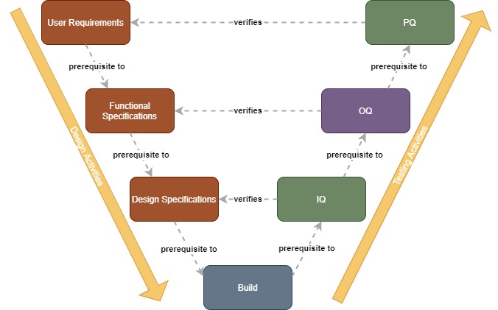
Custom Software Project Phase According to GAMP5
Software Verification Steps After Build:
OQs → often done manually: checking activities based on test script → Time consuming, error prone and expensive. --> Automation would be nice

Slide 6
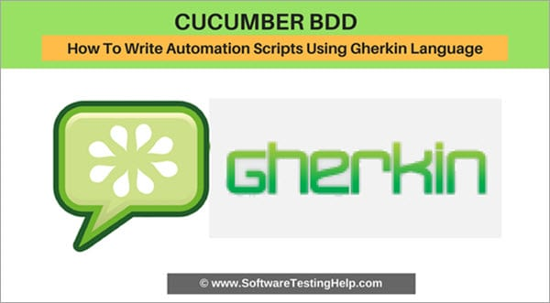
BDD could be a solution
BDD provides a language based on Business Terminology that facilitate communication between Business and Software Engineers based on examples.
Used for Specification AND as Test Script for automation
It will be examined whether BDD could be an effective solution to the problem described above.
Notes:
Purpose of software development: Deliver solutions to business problems --> fitness for intended use
Challenge: Verify that the software acutally satisfies the requirements
Solution: BDD
(G. Nagy & S. Rose, 2018: The BDD Books – Discovery, pp. 9-11)

Slide 7
Specification and Test Script in One Document
User story
As a scientist
I want to know how much of a specific substance is left
So that I do not run out of that substance when I need it
Find examples
Scenario ‘On demand checking of the available amount‘:
Given that 2 labwareitems with 6mg of substance Ba00312 are registered
When a scientist asks for the available amount of substance Ba00312
Then she/he should be told that there are 2 labwareitems with total 6mg available
Formulate

Slide 8
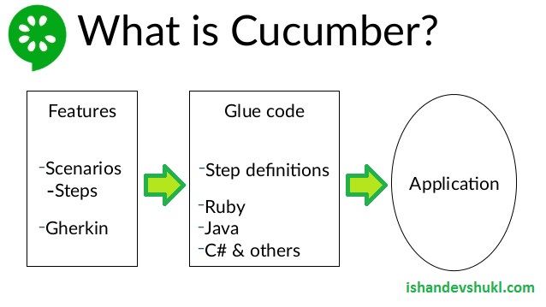
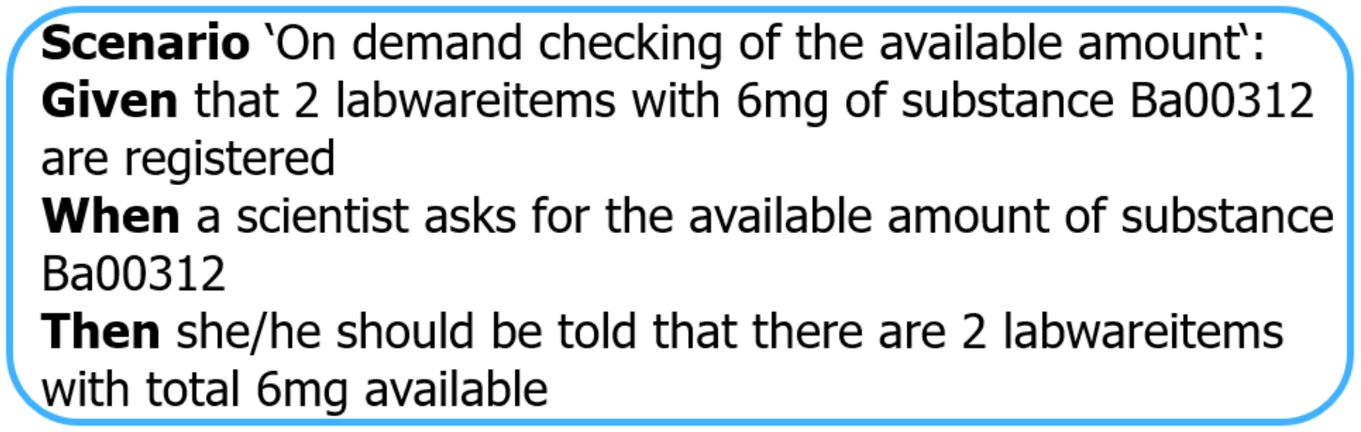
Cucumber/Gherkin will be used

Slide 9

ToDo: Evaluation of BDD for OQs with a Prototype
Evaluation of a test automation for OQs based on BDD for a custom application during the project phase according to GAMP5.

Slide 10
A GAMP5 OQ Process

Slide 11
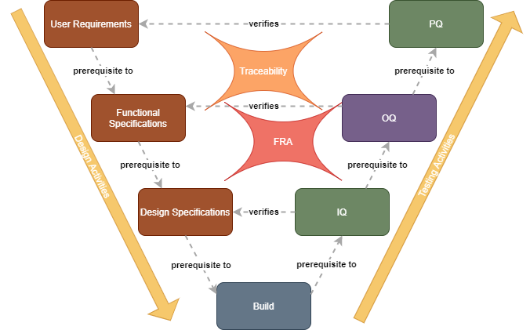
Verification in the Project Phase
Notes:
OQ is done on deployed software
Test Strategy / Test Plan
Functional Risk Assessment
Traceability

Slide 12
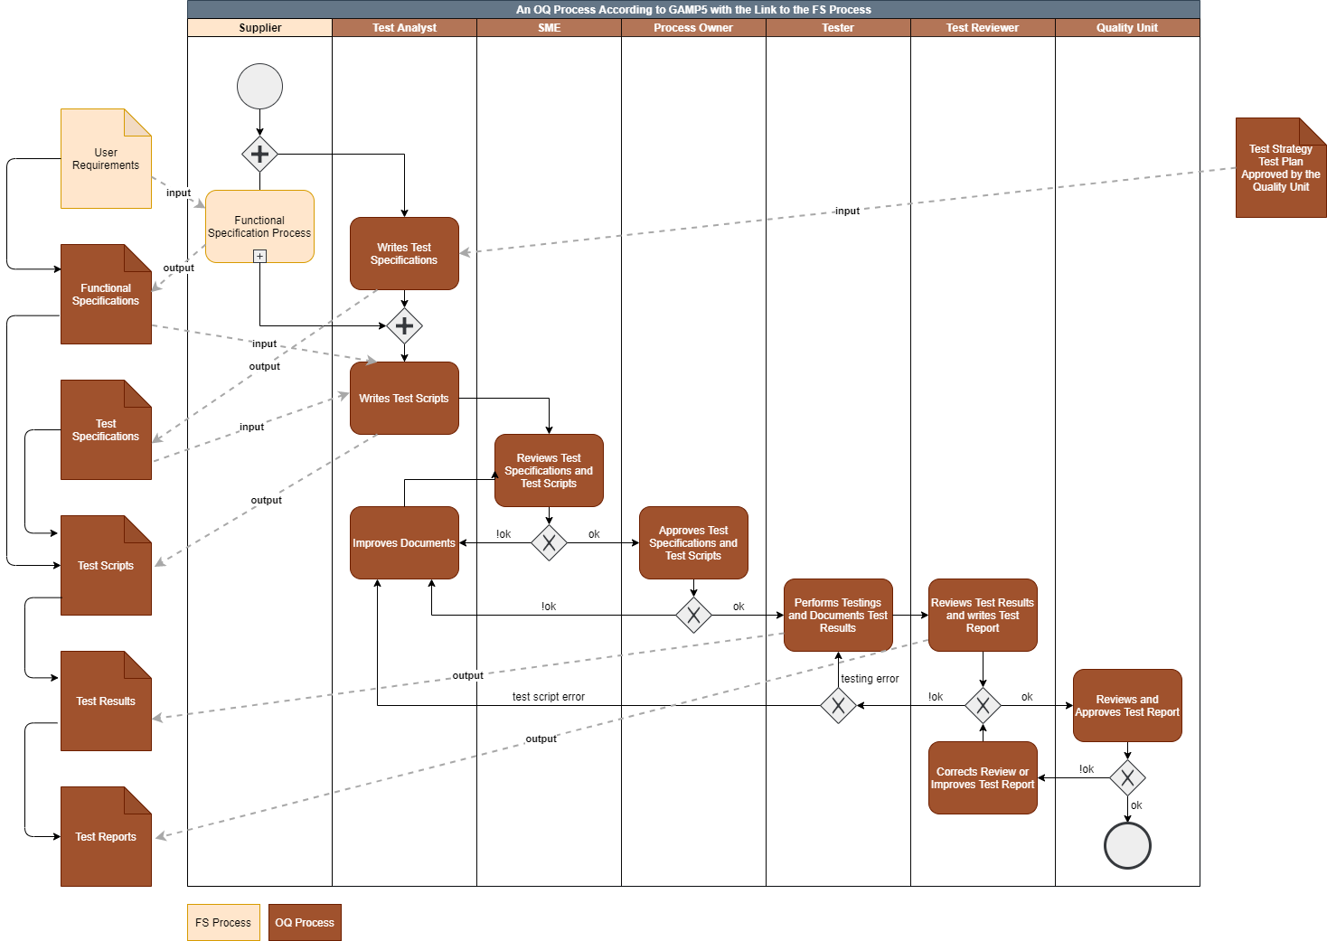
The OQ Process
Notes:
Test Specifications:
Metadata (When, Environment, ID)
Relationship to other documents
Scope: How it fits within the overall test strategy
Those test scripts/cases to be carried out
Version of software under test
Methods
Tools
Reviews and Approvals needed
Documentation of Test Results:
Metadata (When, Environment, ID, Titel of test)
Passed/Failed
Screenshots, Description of the test specific data to be collected and recorded
Test Report
Introduction
Scope of testing
Organisation of testing
Who performed and who reviewed the testing
Summary of test failures
Conclusion

Slide 13
The BDD Process

Slide 14
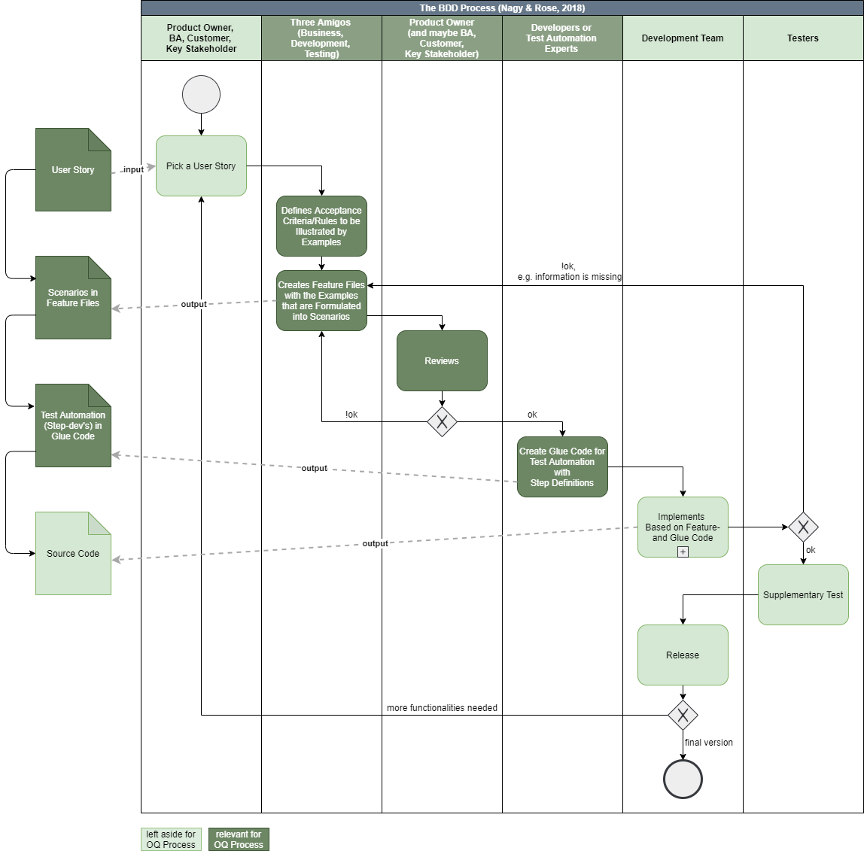
The BDD Process
Notes:
Approach for Software Development:
Get Software that realy does what it should by focusing on a common language between Business and IT → one element of it is Gherkin
Fitness for Intended Use

Slide 15
A Combined Process

Slide 16
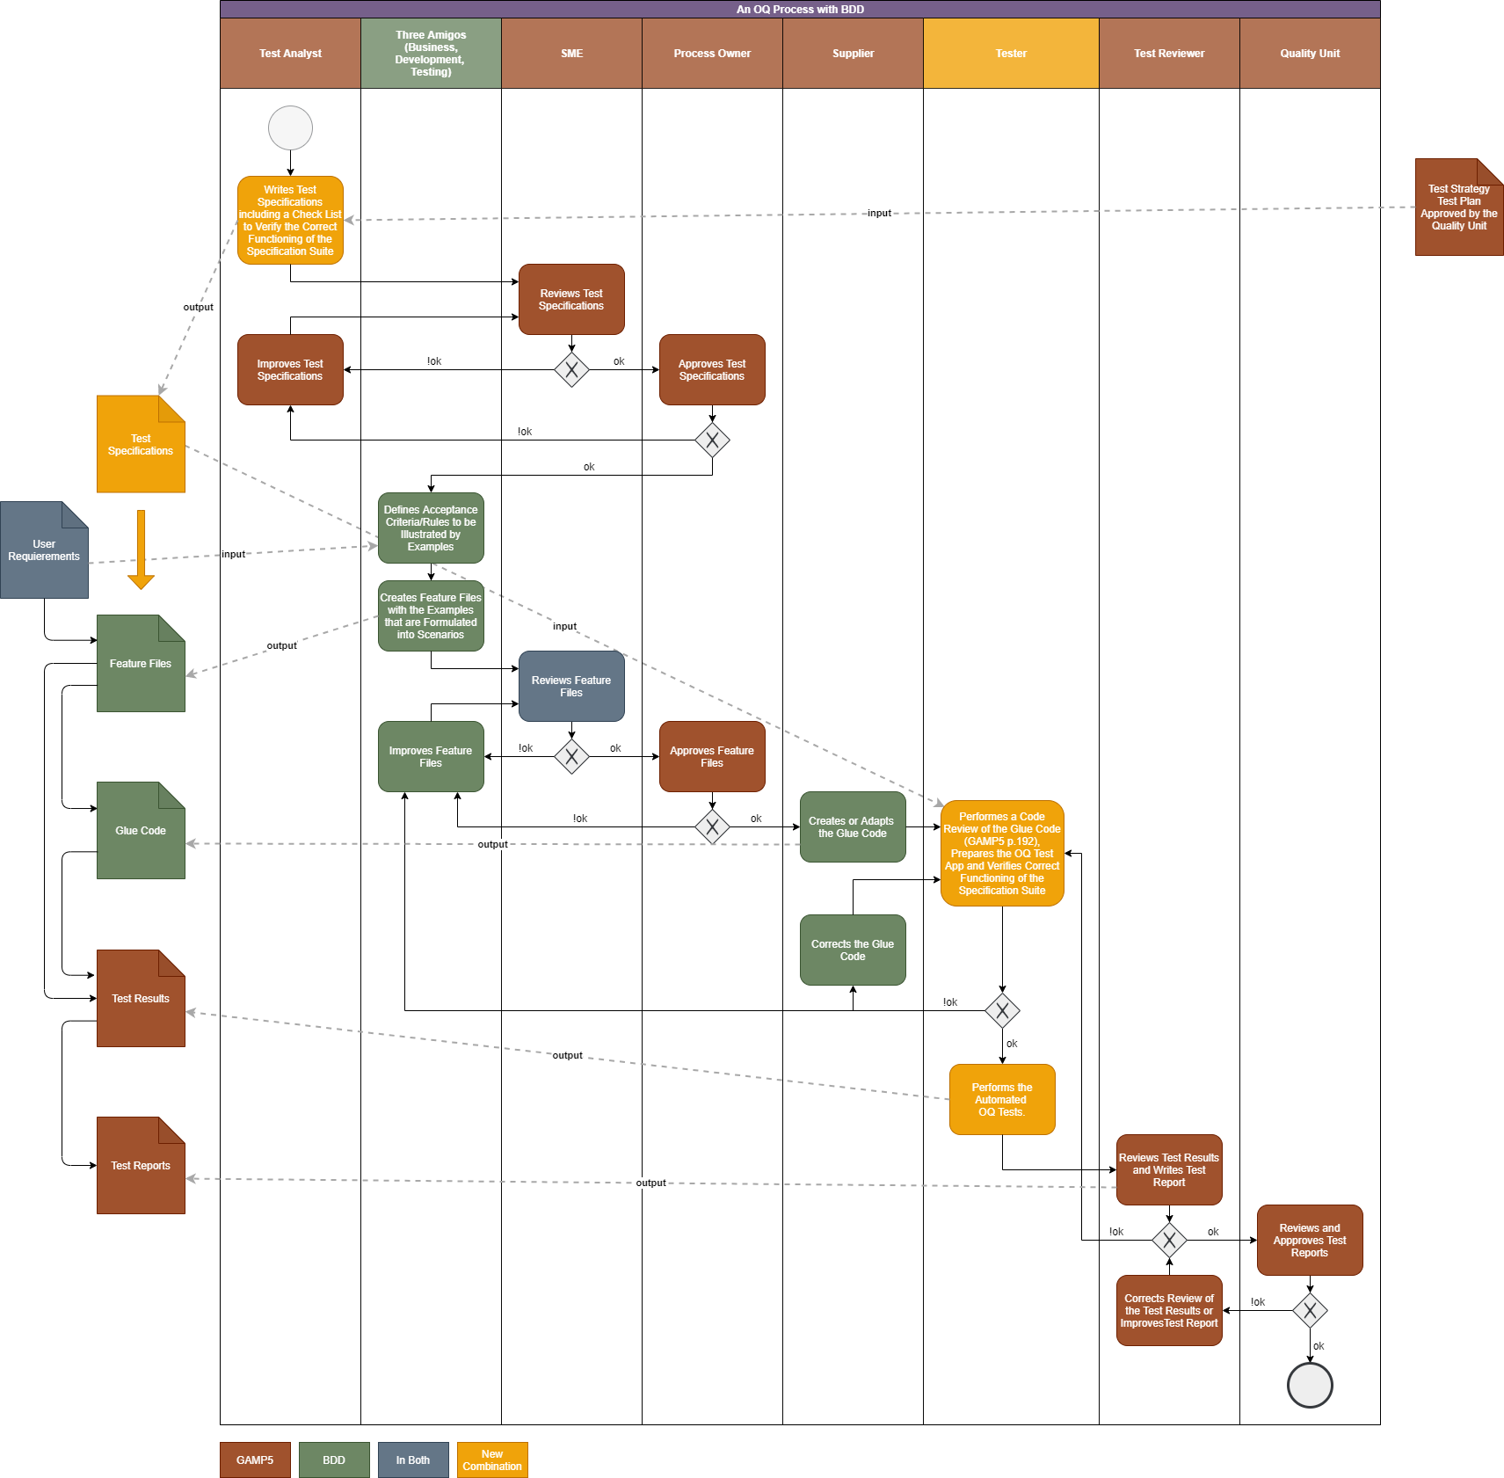
Combined Process
Notes:
Grösserer Prozess als beide anderen → Es fällt auf, dass das Dokument Functional Specifications nicht mehr vorkommt → Dieser FS-Prozess ist nun durch das Vorgehen nach BDD mit dem Teil des Verfassens des Test Script fusioniert. → Das bedingte von dem her auch noch eine Überprüfung des FS-Prozesses, ob es mit dem hier dargestellten Prozess kombinierbar ist und effektiv, ohne jetzt näher darauf einzugehen, es spricht aus GAMP5 nichts dagegen, ihn so zu fusionieren.
Es gibt Teile die in beiden Prozessen gleich sind → blau
Es gibt neue Teile, die vorher in dieser Art, in keinem der beiden Teile vorhanden waren
Dann gibt es Elemente die ohne Abwandlung entweder aus dem einen oder aus dem anderen Prozess kommen.

Slide 17
Conclusions

Slide 18
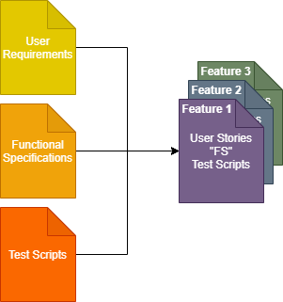
Learnings
We did not find anything that would prevent the use of BDD for OQ test automation
Opportunity that OQs could be automated (theoretically), but not only:
The FS process is (partially) fused with the test script generation part of the OQ process → Less redundancy
It will change the documentation system
Traceability is inherently included in the feature files
A tester will need to have other competencies → basics in coding required
Notes:
…That means, it gives us the opportunity……
Architecutal needs due to the fact, that the OQ is performed on the deployed application (IQ): It must use the interfaces of the deployed application

Slide 19
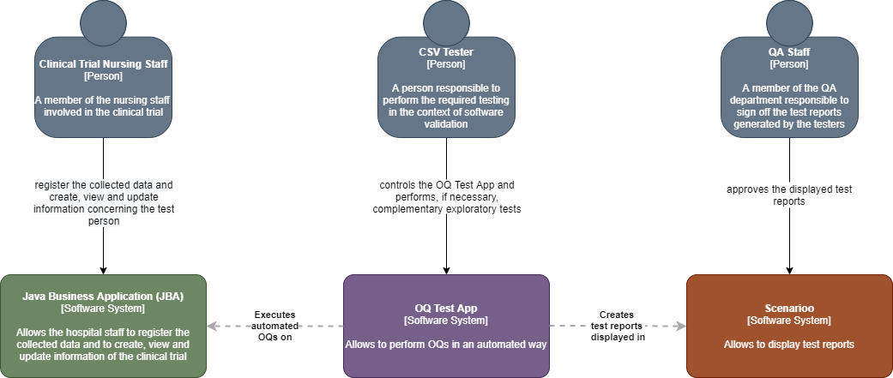
Architectural Needs
Notes:
C4: 1. System Context – 2. Container – 3. Component – 4. Code (e.g. UML class)
As I quickly mentionned earlier, there are some requirements about the documentation of the test results.
Documentation of Test Results:
Metadata (When, Environment, ID)
Passed/Failed
Screenshots required for important steps e.g. business critical or risk relevant steps
In order to make a quick check, if this could in principle be possible → Pre-Prototype of the OQ Test App.
It will test a wikipedia site.

Slide 20
Engineering the OQ Test App
Tools:
Cucumber/Gherkin
And Selenium
With the results displayed in Scenarioo
Using a Cucumber-Scenarioo plugin

Slide 21
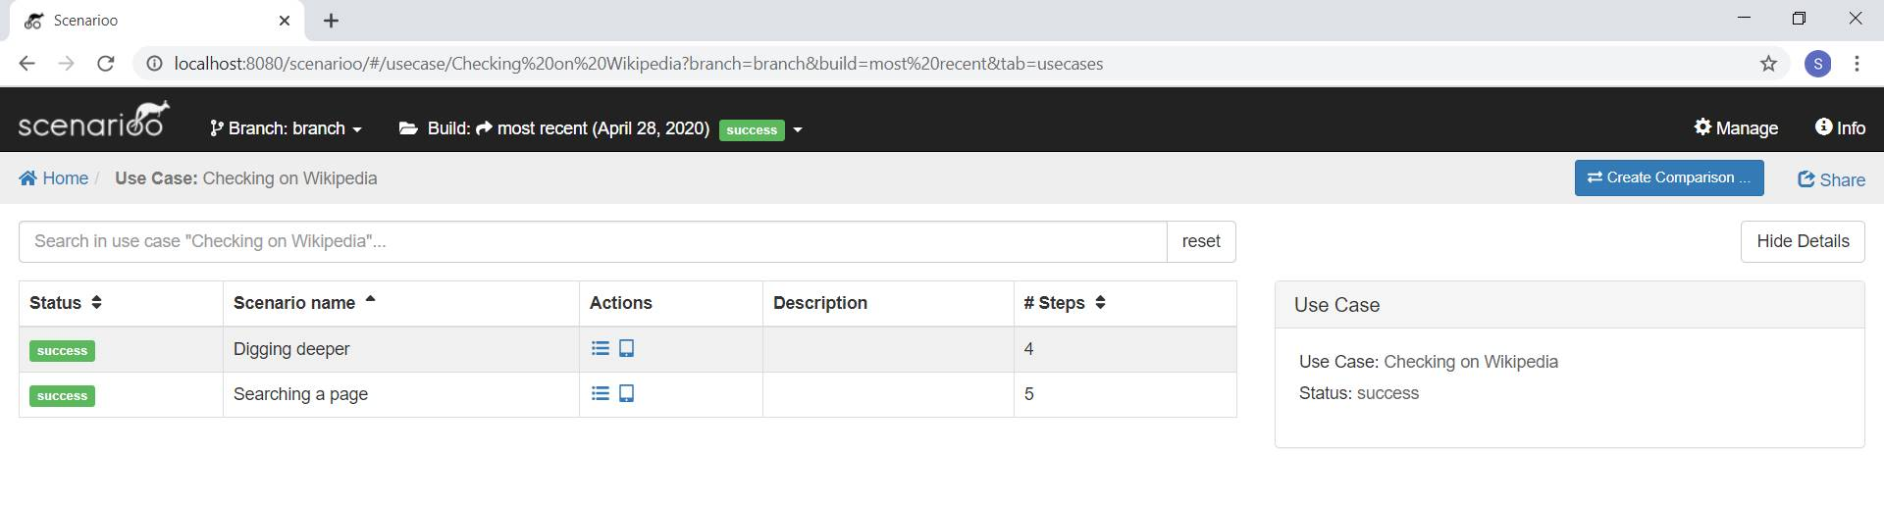
The Pre-Prototpe

Slide 22
The Pre-Prototpe

Slide 23
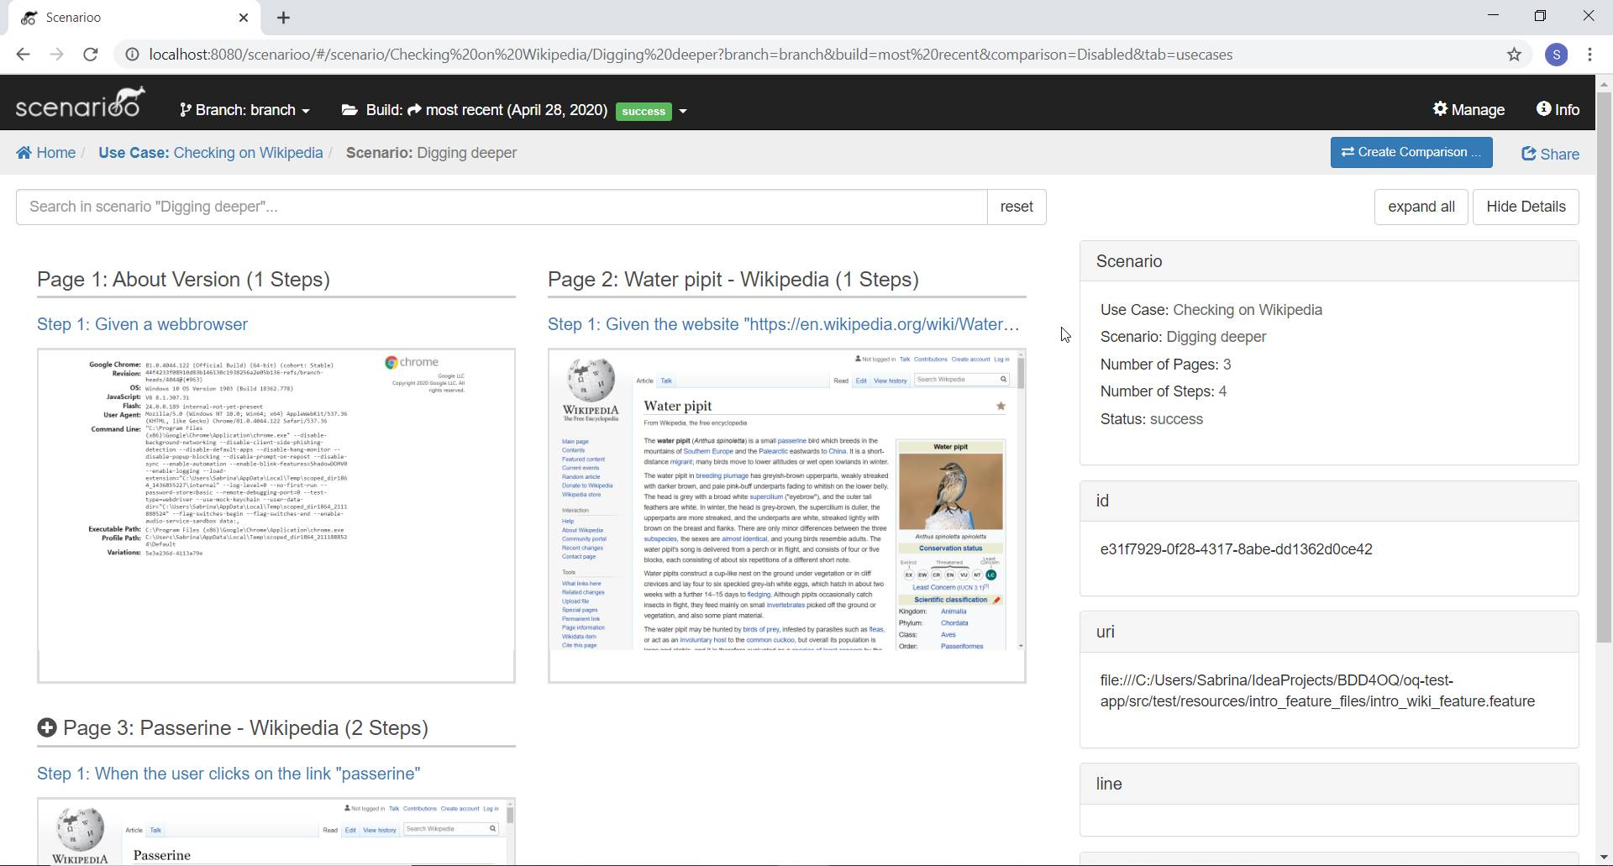
The Pre-Prototpe

Slide 24
Next Step: Prototyping

Slide 25
Implemetation of the Prototype
Define User Stories
Define Test Specification
Create Feature Files and Glue Code
Create the Java Business Application App → Weighing Management App for Clinical Trials
Create the OQ Test App
Output of Interest: Test Specification, Feature Files, Glue Code, Test Results, Test Report → To be audited

Slide 26

Questions & Discussions
Graphik von Sandra Schön, pixabay.com

