Slide 1
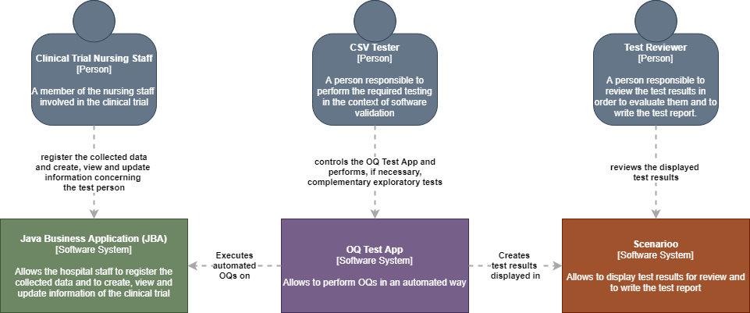













Placeholder logo cucumber-schenarioo plugin
Placeholder logo cucumber-schenarioo plugin

Slide 2









BDD4GxP
Test Automation
GxP Compliance
Behavior Driven Development

