Slide 1




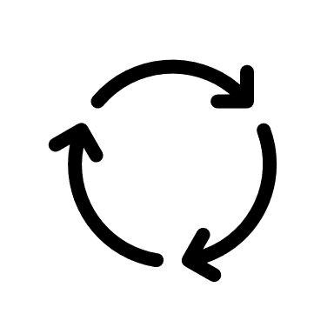
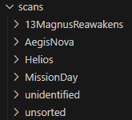


Machine Learning
Patches Recognition
Incorrect
?
Notes:
The Python web app runs with Flask, and https is needed.
When an image is scanned / uploaded it is
2) Class is predicted
Unsure
Correct
1) Take / upload
picture of a patch
3) Confirm prediction
Continuous learning
6) New model is generated and in use
5) Re-train model via admin panel
4) New image
is sorted in corresponding folder

