Slide 1
DEEP LEARNING • SEMESTER PROJECT
01
SkinSight AI
HAM10000
7-class image
classification
Deep Learning-Based Skin Lesion
Image Classification
Abdul Saboor
BS Computer Science • 7th Semester
Roll No: SU92-BSCSM-F23-216
MobileNetV2
Transfer Learning
TensorFlow / Keras
Submitted to: Dr Munir Ahmad
Superior University • Computer Science
ACADEMIC PROTOTYPE ONLY

Slide 2
Project Overview
What SkinSight AI demonstrates
PROJECT IDEA
CORE APPROACH
USER EXPERIENCE
A deep learning prototype that classifies dermatoscopic skin-lesion images into seven HAM10000 label categories.
Transfer learning with an ImageNet-pretrained MobileNetV2 backbone and a seven-unit softmax classification head.
A Streamlit app for image upload, top-3 model outputs, class descriptions and evaluation visualizations.
Project scope
• Study multi-class classification on the HAM10000 dermatoscopic image dataset.
• Evaluate validation performance using accuracy, macro precision, macro recall and macro F1-score.
• Demonstrate an end-to-end workflow from data preparation to a web-based prototype.
2

Slide 3
Problem Statement & Objectives
The project is an educational research exercise—not a clinical product
PROBLEM
PROJECT OBJECTIVES
Interpreting skin-lesion images requires specialist expertise. This project investigates whether transfer learning can distinguish seven labelled categories in a research dataset.
• Build a seven-class image classifier.
• Use MobileNetV2 transfer learning to reduce training cost.
• Prepare images, labels and metadata for supervised learning.
• Reduce lesion-level data leakage with grouped splitting.
• Evaluate class-wise and aggregate performance.
• Create a Streamlit demonstration interface.
Expected outcome: a reproducible academic workflow and working demonstration interface, with limitations clearly documented.
3

Slide 4
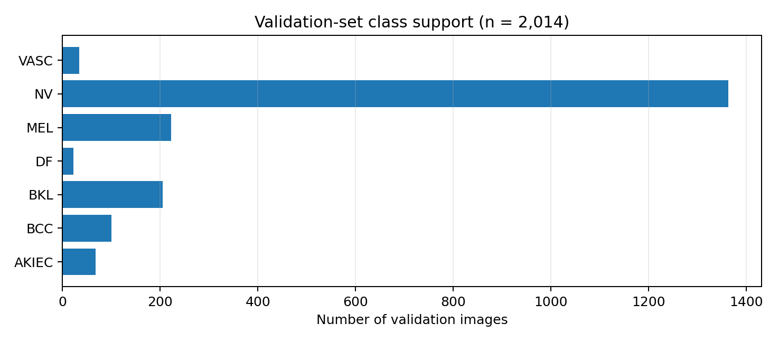
Dataset: HAM10000
Dermatoscopic images • seven diagnostic labels
DATASET
LABELS
VALIDATION SET
INPUT SIZE
HAM10000
7
2,014
160×160
Public research dataset
Multi-class classification
Support total from metrics.json
RGB images
Seven label categories
• AKIEC — Actinic keratoses and intraepithelial carcinoma
• BCC — Basal cell carcinoma
• BKL — Benign keratosis-like lesions
• DF — Dermatofibroma
• MEL — Melanoma
• NV — Melanocytic nevi
• VASC — Vascular lesions
Counts are validation-set supports, not full-dataset totals.
4

Slide 5
Methodology & Workflow
From raw dataset to an interactive inference interface
01 Dataset & metadata
02 Preprocessing
03 Split strategy
HAM10000 images + metadata CSV
RGB • resize 160×160 • MobileNetV2 preprocessing
StratifiedGroupKFold grouped by lesion_id
04 Training
05 Evaluation
06 Deployment demo
MobileNetV2 transfer learning + classification head
Validation metrics + class-wise report
Streamlit upload, prediction and visualizations
Grouped splitting keeps images associated with the same lesion in one subset to reduce leakage risk.
5

Slide 6
Model Architecture
MobileNetV2 transfer learning
Input
Augmentation
MobileNetV2
Global Average Pooling
Dropout
Dense + Softmax
›
›
›
›
›
160 × 160 × 3 RGB
Random flip, rotation, zoom
ImageNet pretrained • include_top=False
Feature vector
0.3 regularization
7 class scores
WHY TRANSFER LEARNING?
OUTPUT
Reuses pretrained visual features rather than learning all image features from random initialization.
Seven softmax scores; these are model outputs, not calibrated disease probabilities.
6

Slide 7
Training Configuration
Configuration documented in the project report
Image dimensions
Batch size
160 × 160
32
Maximum epochs
Optimizer
8 (early stopping may stop sooner)
Adam
Initial learning rate
Loss function
0.001
Sparse categorical cross-entropy
Class imbalance
Callbacks
Balanced class weights
EarlyStopping + ReduceLROnPlateau
7

Slide 8
Experimental Results
Actual validation metrics extracted from the supplied metrics.json
VALIDATION ACCURACY
VALIDATION LOSS
MACRO PRECISION
MACRO RECALL
56.65%
1.1396
38.01%
50.53%
Overall correct predictions
Sparse categorical cross-entropy
Equal class weighting
Equal class weighting
MACRO F1-SCORE
40.89%
Harmonic mean of precision and recall
Interpretation: the overall validation accuracy is 56.65%, while macro F1 is 40.89%. The gap indicates that performance is uneven across the seven categories, so accuracy alone does not describe class-wise behaviour.
8

Slide 9
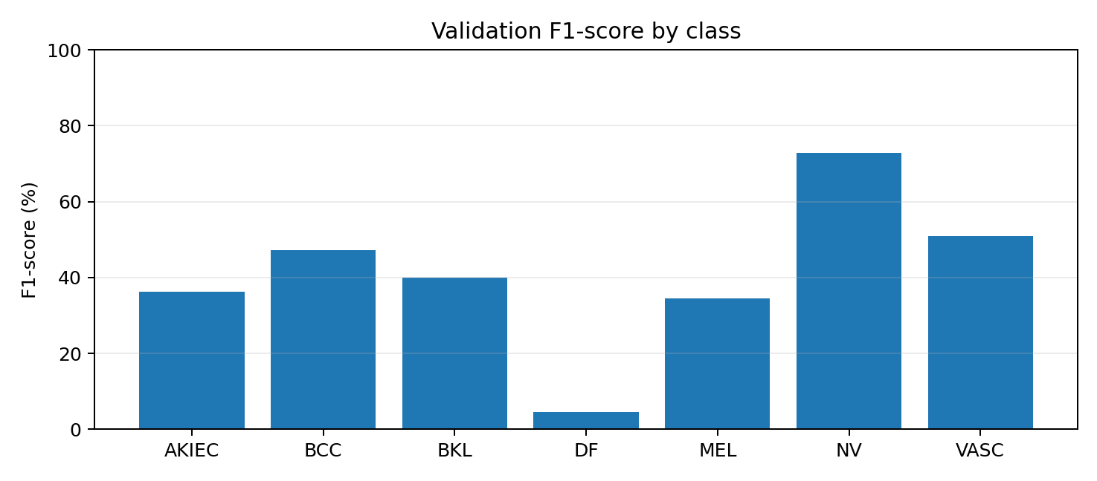
Class-wise Validation Performance
Per-class precision, recall, F1-score and support from metrics.json
Class | Precision | Recall | F1-score | Support
AKIEC | 31.5% | 42.6% | 36.2% | 68
BCC | 41.9% | 54.0% | 47.2% | 100
BKL | 32.7% | 51.2% | 39.9% | 205
DF | 2.8% | 13.6% | 4.6% | 22
MEL | 26.2% | 50.5% | 34.5% | 222
NV | 94.2% | 59.4% | 72.9% | 1363
VASC | 36.8% | 82.4% | 50.9% | 34
NV has the highest F1-score (72.9%); DF is the weakest class (4.6% F1) and has only 22 validation examples.
9

Slide 10
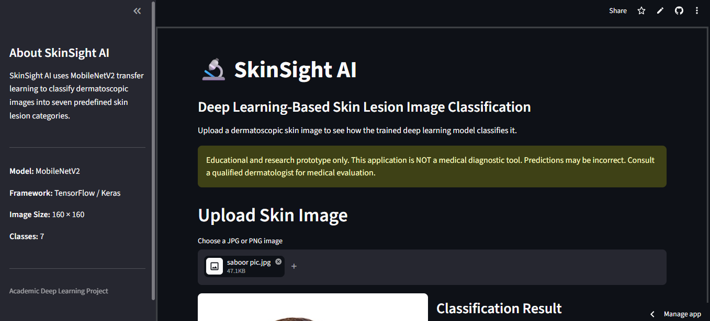
Streamlit Application
Current application interface screenshot supplied for the project
Interface includes project information, image upload, classification panel and medical-use disclaimer.
10

Slide 11
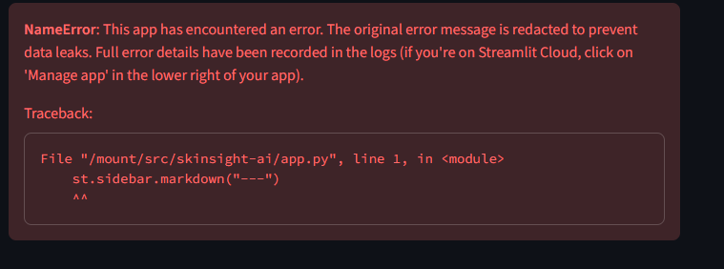
Deployment Debugging: Streamlit NameError
Issue observed after committing the updated app.py
ROOT CAUSE
The traceback points to line 1: st.sidebar.markdown(...). The sidebar snippet was placed before `import streamlit as st`, so `st` did not yet exist.
CORRECT PLACEMENT
Keep all imports at the top. Add the Project Resources block inside the existing SIDEBAR section, after the sidebar model/framework details—not at the beginning of app.py.
This is a code-order / placement error, not evidence of a failed model training run.
11

Slide 12
Correct Project Resources Block
Paste this within the existing SIDEBAR section only
st.sidebar.markdown("---")
st.sidebar.subheader("📚 Project Resources")
st.sidebar.markdown(
"""
**📄 Project Report**
[Open Word Report](YOUR_WORD_DOC_LINK)
**📊 Project Presentation**
[View PPT Slides](YOUR_PPT_LINK)
**💻 GitHub Repository**
[View Source Code](YOUR_GITHUB_REPO_LINK)
"""
)
st.sidebar.markdown("---")
st.sidebar.caption("Developed as an Academic Deep Learning Project")
Replace the three placeholder URLs with shareable Word, PPT and GitHub links before committing.
12

Slide 13
Limitations & Future Enhancements
Responsible interpretation of the experimental results
CURRENT LIMITATIONS
FUTURE WORK
• Dermatoscopic images only; ordinary phone-photo performance is unknown.
• Imbalanced classes lead to uneven performance.
• Validation results do not establish clinical safety.
• Softmax scores are not calibrated disease probabilities.
• Evaluate on an independent lesion/patient-level test set.
• Investigate imbalance handling and alternative architectures.
• Assess calibration and uncertainty.
• Add explainability research and improve privacy guidance.
Ethical boundary
SkinSight AI must not be used for self-diagnosis, treatment selection, triage or reassurance that a lesion is harmless. Medical evaluation should be provided by a qualified professional.
13

Slide 14
Conclusion & References
Project summary
CONCLUSION
KEY REFERENCES
SkinSight AI combines HAM10000 data preparation, lesion-grouped validation, MobileNetV2 transfer learning, model evaluation and a Streamlit demonstration. The observed validation accuracy is 56.65% and macro F1 is 40.89%, showing that further class-wise improvement and independent validation are needed.
• Tschandl, Rosendahl & Kittler (2018), HAM10000 dataset, Scientific Data, 5, 180161.
• Sandler et al. (2018), MobileNetV2: Inverted Residuals and Linear Bottlenecks, CVPR.
• HAM10000 dataset: kaggle.com/datasets/kmader/skin-cancer-mnist-ham10000
• TensorFlow: tensorflow.org
• Streamlit: docs.streamlit.io
• scikit-learn: scikit-learn.org
Thank you
14

