Slide 1

Breaking Bad API
The Chefs
Abbey Guilliat, Sargis Abrahamyan, Daniel Brickman

Slide 2
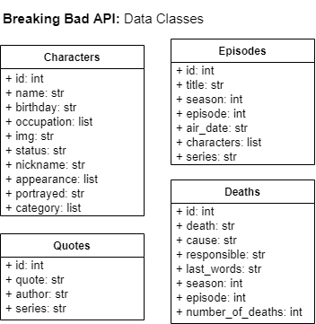
Data Classes

Slide 3
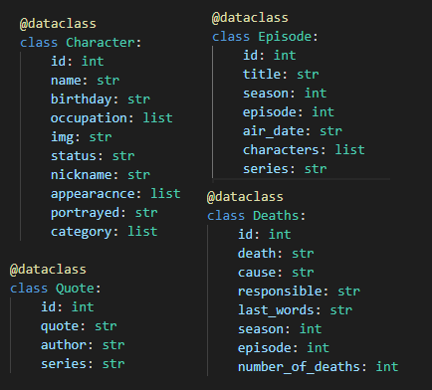
Data Classes Code

Slide 4
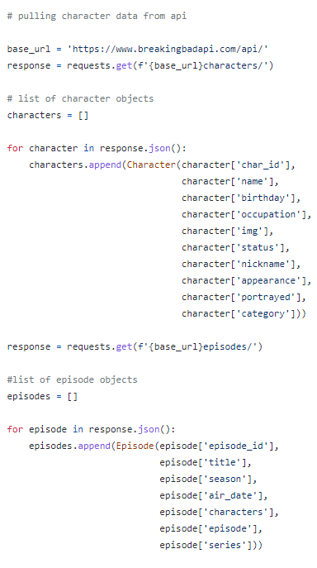
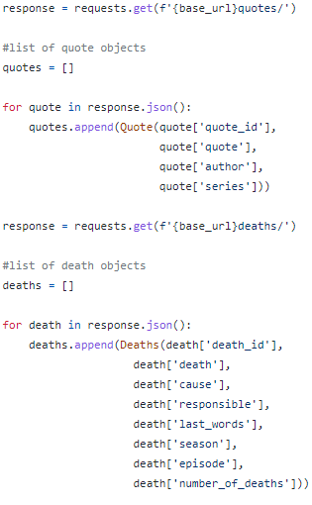
Loading Data Code

Slide 5
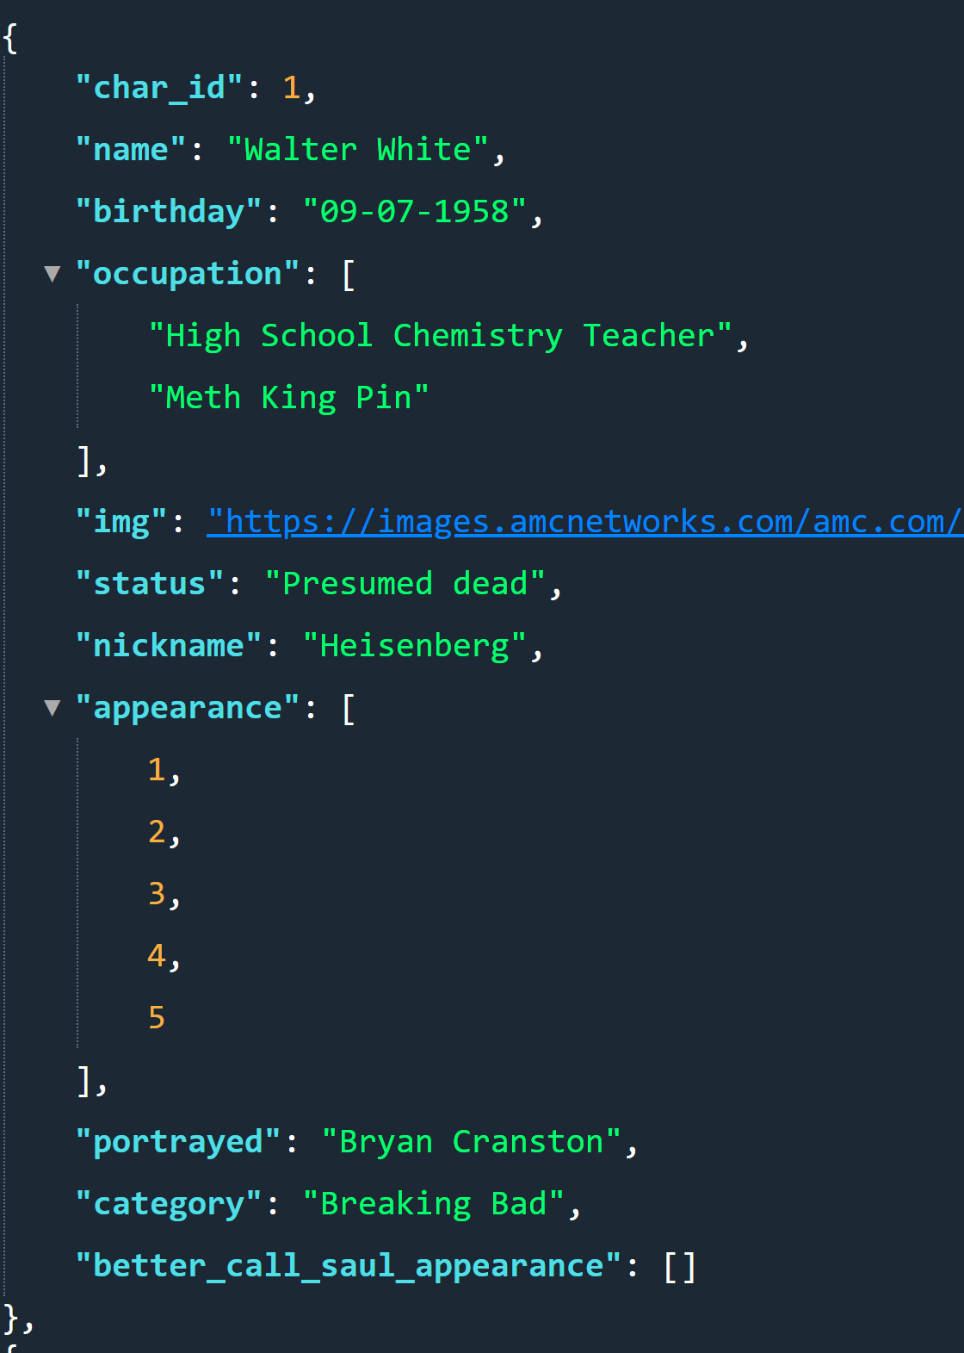
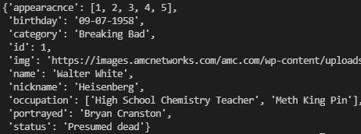
API vs. The Chefs

Slide 6
Differences Challenges Takeaways
Differences
Search for things using the URL in the API
Search through a table in our code
Challenges
Finding a suitable API
Takeaways
How to model data classes based on API output
How to pull data from an API

