Slide 1

G2M Case Study
Virtual Internship
21 July 2022

Slide 2
Background –G2M(cab industry) case study
Objective : XYZ is a private firm in US. Due to remarkable growth in the Cab Industry in last few years and multiple key players in the market, it is planning for an investment in Cab industry and as per their Go-to-Market(G2M) strategy they want to understand the market before taking final decision.
Throughout this presentation, we will analyze the performance of both companies in order to advise XYZ .

Slide 3
Data Exploration
24 Features( including 9 derived features)
Timeframe of the data: 2016-01-31 to 2018-12-31
Total data points :355,032
Assumptions:
All data sets have been merged into one main data set.
The data does not contain null values and/or erroneous values.

Slide 4
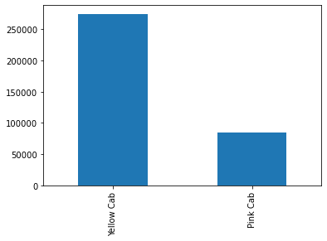
Number Of Transactions
If we compare the total number of transactions of both companies we can find that Yellow Cab (274681) is ahead of Pink Cab (84711).
Yellow Cab has a significantly higher Total number of transactions, the difference between both is 189970 or 224% of Pink Cab’s Total approx.
Yellow Cab’s number of Transactions is approximetly x3 larger than Pink Cab’s.

Slide 5
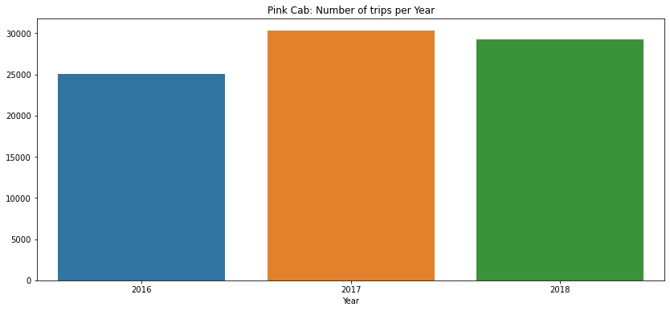
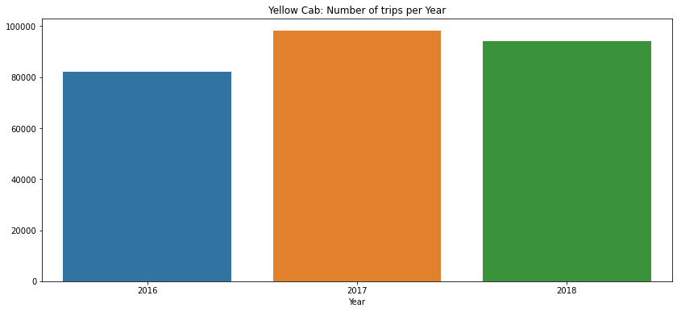
Total Trips per year
We can find that both companies’ total number of trips has increased from 2016 to 2017 but also slightly decreased in 2018.
As expected from the first slide, Yellow Cab’s total number of trips is also significantly higher than Pink Cab’s total in all three years.

Slide 6
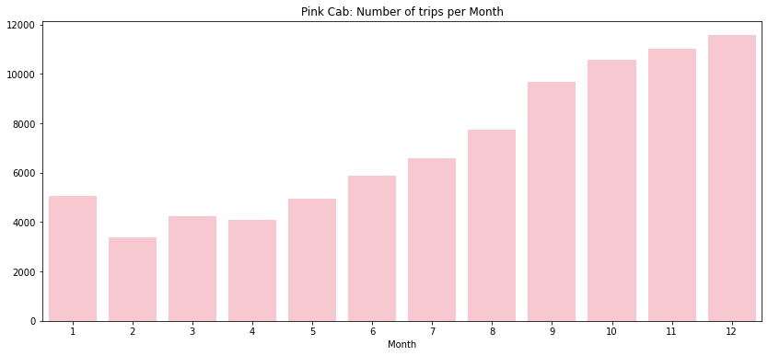
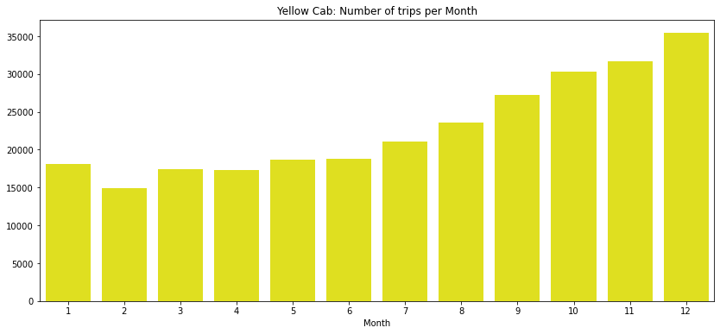
Total Trips Per Month
Both Cab companies’ Total number of Trips per Month follow the same trend. The volume of trips is lowest during the beginning of the year, with the lowest month being February. From June onward, the volume increases gradually each month reaching its peak during December.

Slide 7
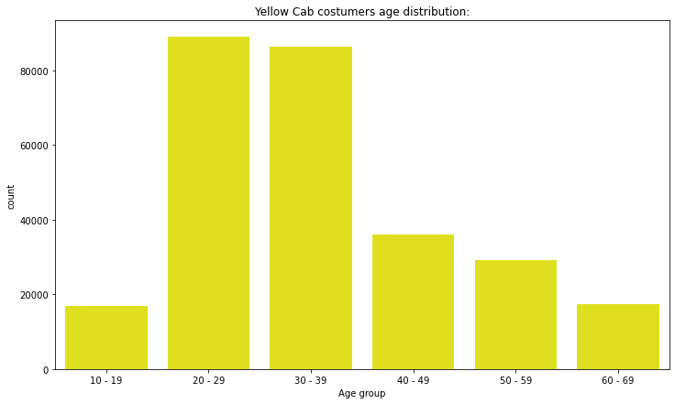
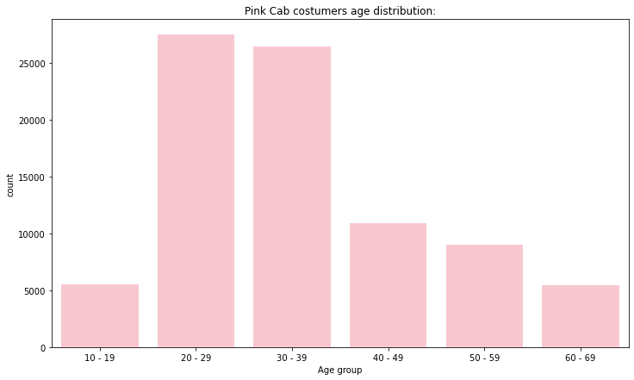
Age Distribution of Customers
Both companies’ customers are mostly aged between 20 and 39. The age range of the customers almost follows a Gaussian distribution (Bell Curve).

Slide 8
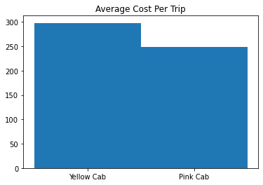
Cost Per Trip
Yellow Cab’s average cost per trip (300$ approx) is 21% higher than Pink Cab’s (248$ approx).
This means that the cost of operations of Yellow Cab is higher than Pink Cab in Total.

Slide 9
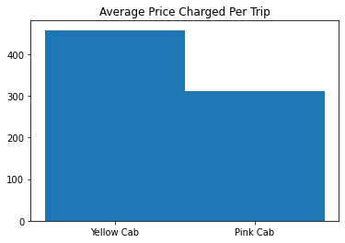
Price Charged per Trip
As expected, since Yellow Cab’s trips cost more for the company, they are more expensive on average ( 460$ approx.) than Pink Cab’s (310$ approx.)

Slide 10
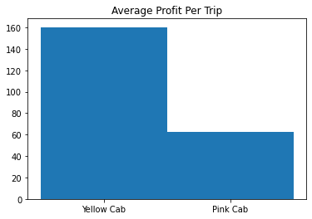
Profit Per Trip
Although Yellow Cab’s average cost per trip is higher than Pink Cab’s, its Average Profit Per Trip (160$ approx.) is higher as well (62$ approx.) .
This is explained by the high price charged per trip by Yellow Cab as we’ve seen from the previous slide.

Slide 11
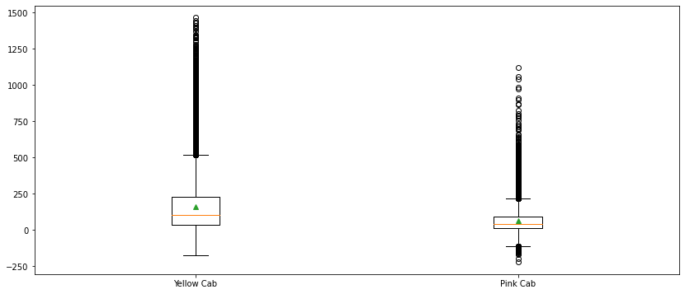
Profits per Company
Fig: profits per company
If we observe the box plot showing the distribution of profits per company, we can see that Pink Cab has more outliers in the negative than Yellow Cab.
In addition to that, Yellow Cab has significantly more trips with profits above 1000$

Slide 12
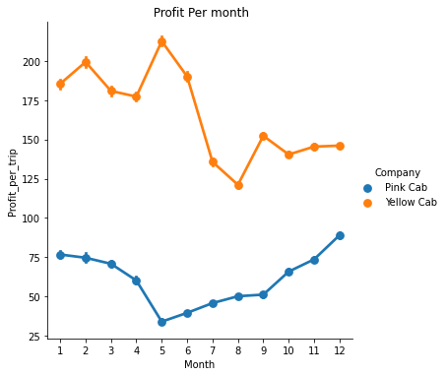
Profits per month
Although Yellow Cab’s profits are higher than Pink Cab’s throughout the whole year, there is a sharp downwards change in its profits from May to September. This trend is not apparent in Pink Cab’s profits throughout the year.

Slide 13
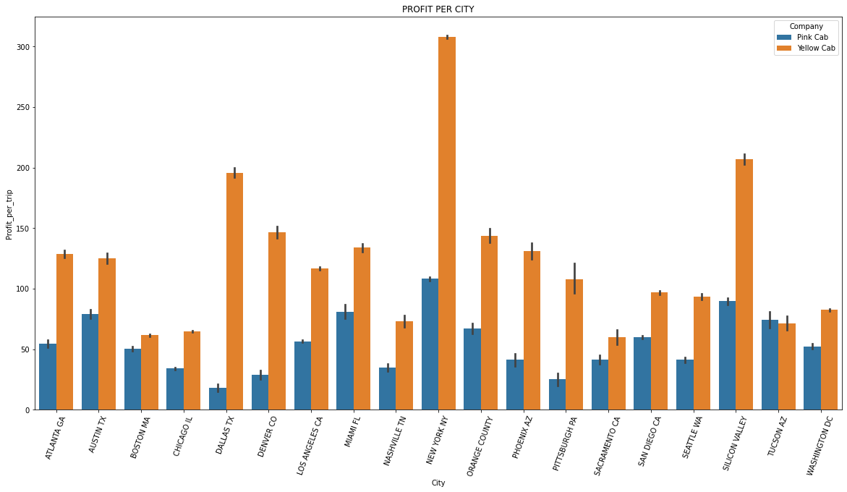
Profit per city
If we observe the profits per city for both company we can see as well that Yellow Cab has higher profits in all the cities both companies operate in.
The difference is vast in some cities that house higher income costumers such as New York, Silicon Valley, and Dallas TX

Slide 14
Recommendations
After the analysis we made based on the data that we have on Yellow Cab and Pink Cab, We arrive to the conclusion that Yellow Cab seems like the better option for investment. Since it has the higher number of costumers, trips and profits as well. It appears that Yellow Cab has a significantly bigger share in the market than Pink Cab, this applies to all cities where both Cab companies operate and throughout the whole period contained in the data set available.

Slide 15
Thank You

