Slide 1
Let’s simulate audio electronics
Introduction to electronic circuit simulation

Slide 2
Agenda
Introduction to electronics
What’s Spice simulation
Simulation examples
What’s next

Slide 3
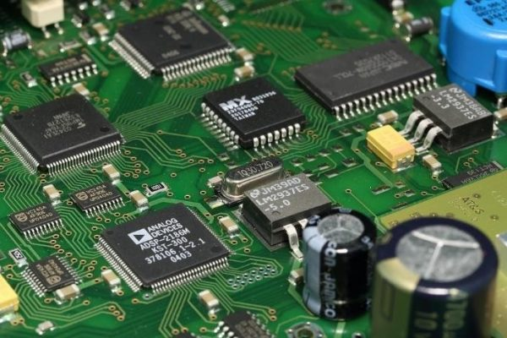
Electronics
The study and use of electrical devices that operate by controlling the flow of electrons or other electrically charged particles.

Slide 4
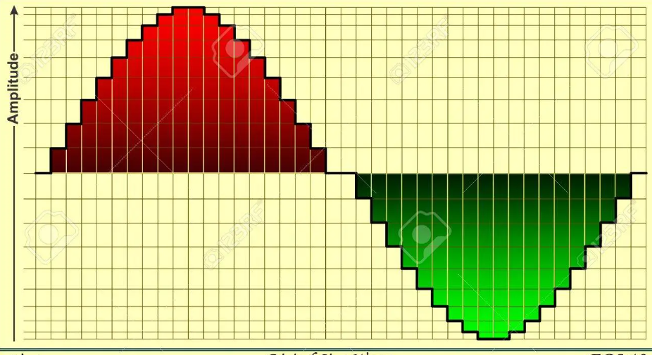
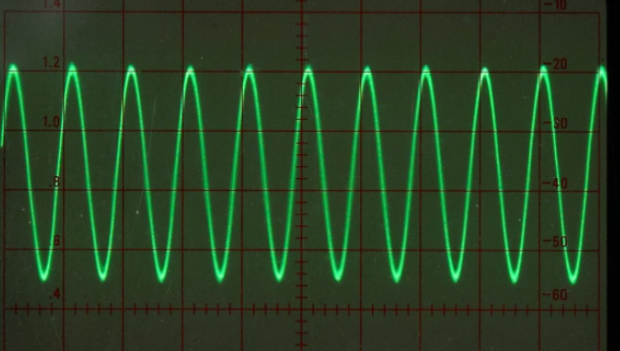
Classification
electronics
analog
digital

Slide 5

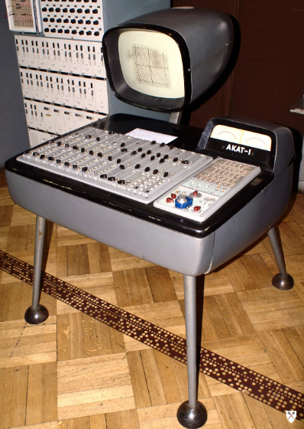
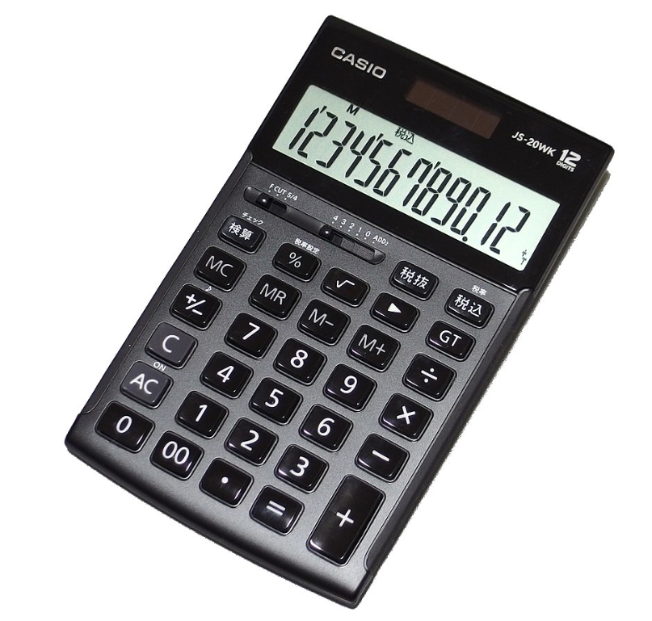
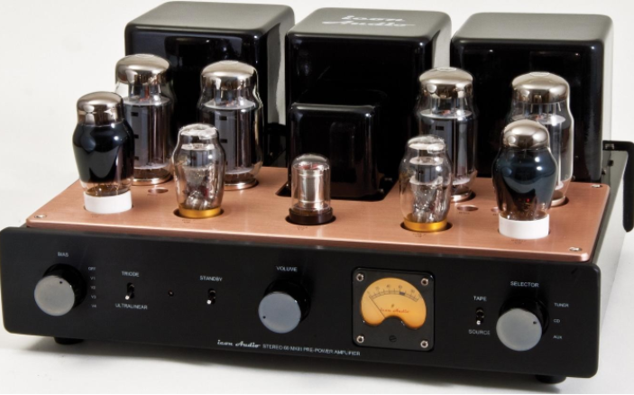
Examples
Analog
Digital

Slide 6
Types of electronics
Power electronics
RF electronics
Microelectronics
Audio electronics
Optoelectronics
Embedded systems
Aerospace and defense electronics
Automotive electronics
...

Slide 7
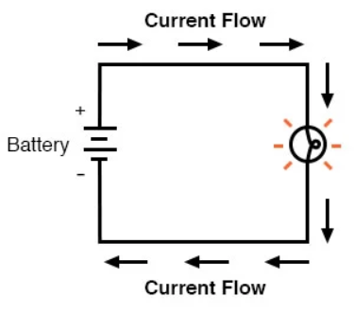
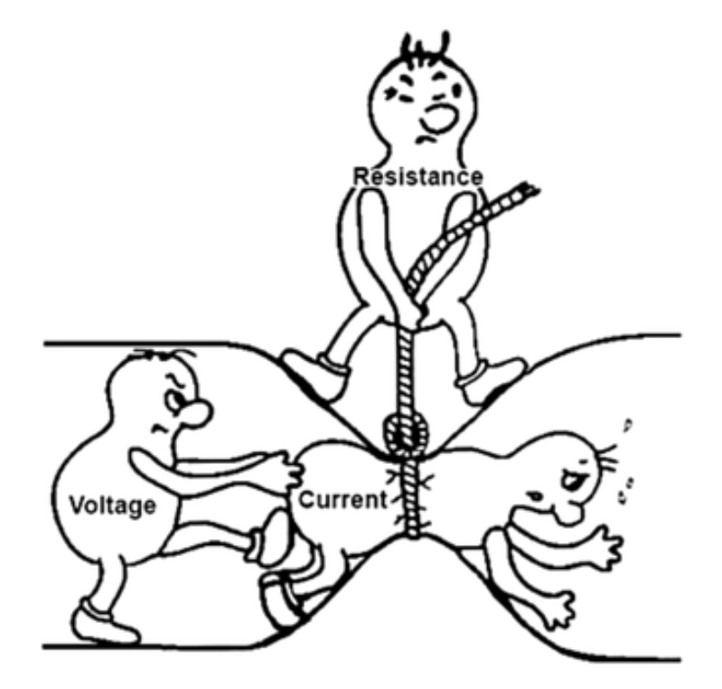
Ohm’s law
U = I * R , where
U – voltage
I – current
R – resistance

Slide 8
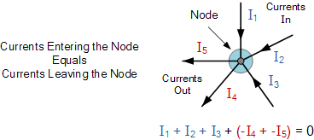
Kirchhoff's circuit laws
Algebraic sum of ALL the currents entering and leaving a node must be equal to zero, I(exiting) + I(entering) = 0

Slide 9
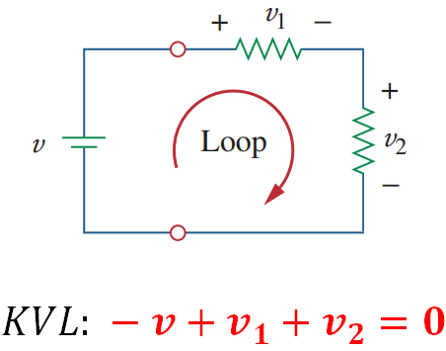
Kirchhoff's circuit laws
Algebraic sum of ALL voltages within the loop must be equal to zero

Slide 10
Electronics building blocks
components
resistor
diode
integrated circuits
capacitor
transistor
active
passive
coil
operational amplifier
transformer
vacuum tube
antenna

Slide 11
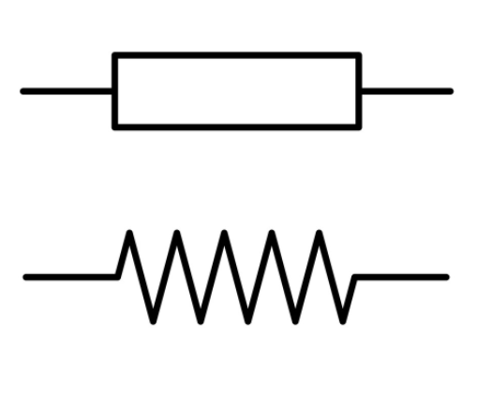
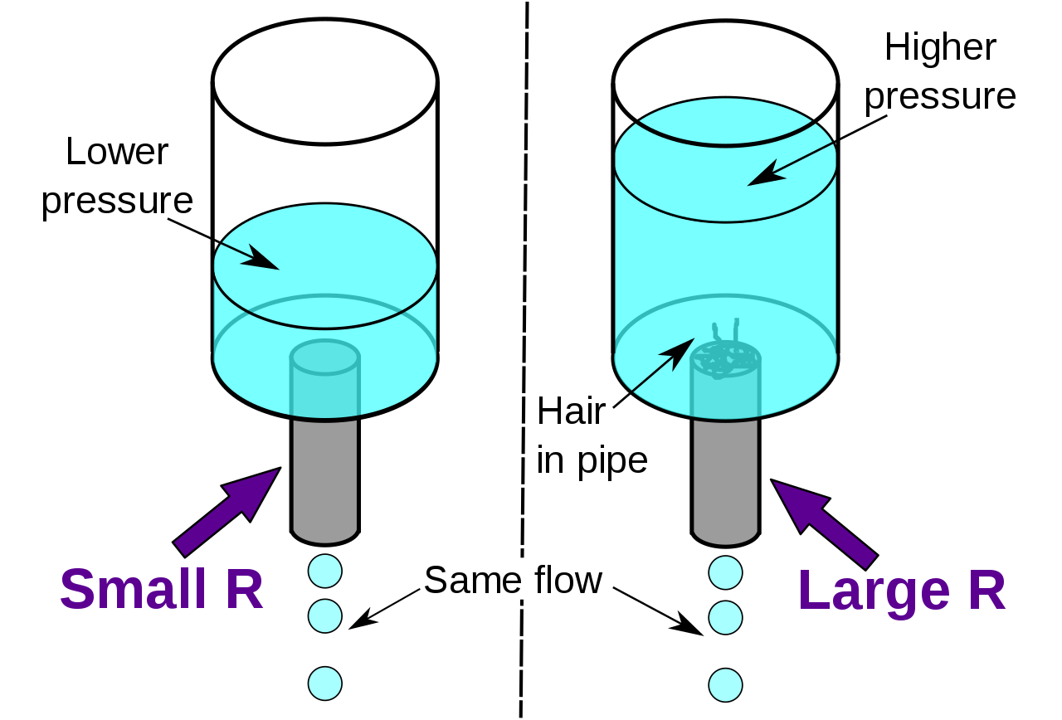
Resistor
Implements electrical resistance
Resistance measured in Ohms
Limits current, voltage divider

Slide 12
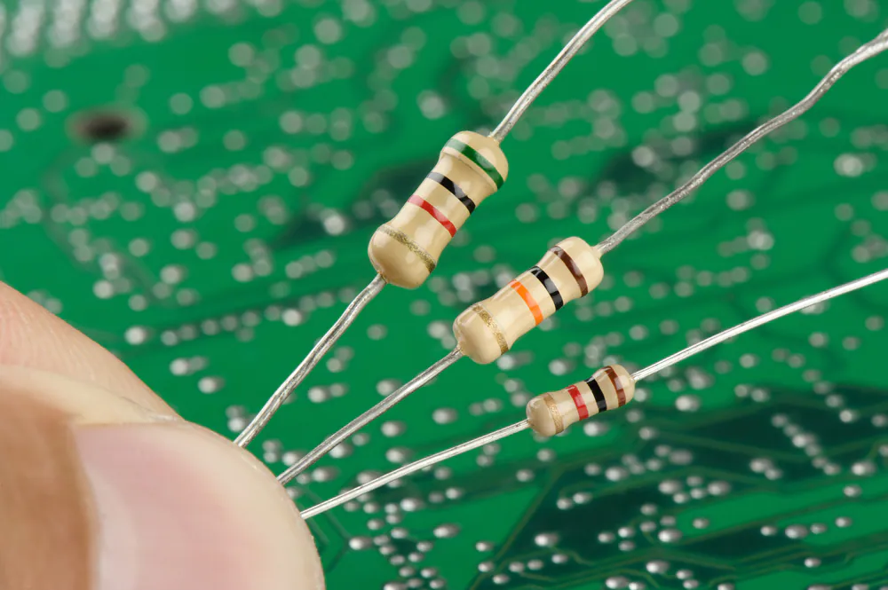
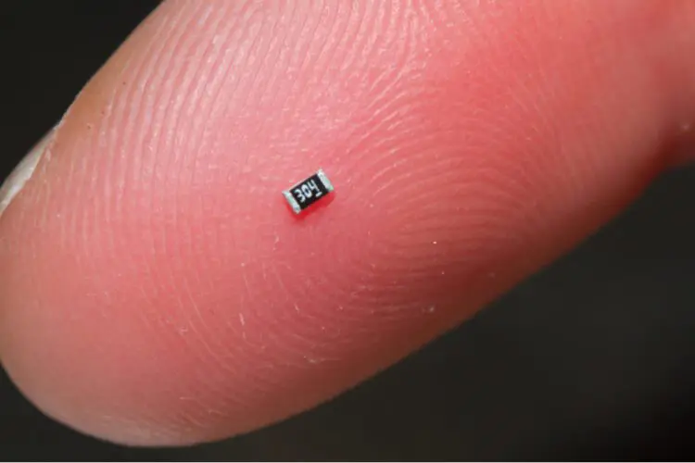
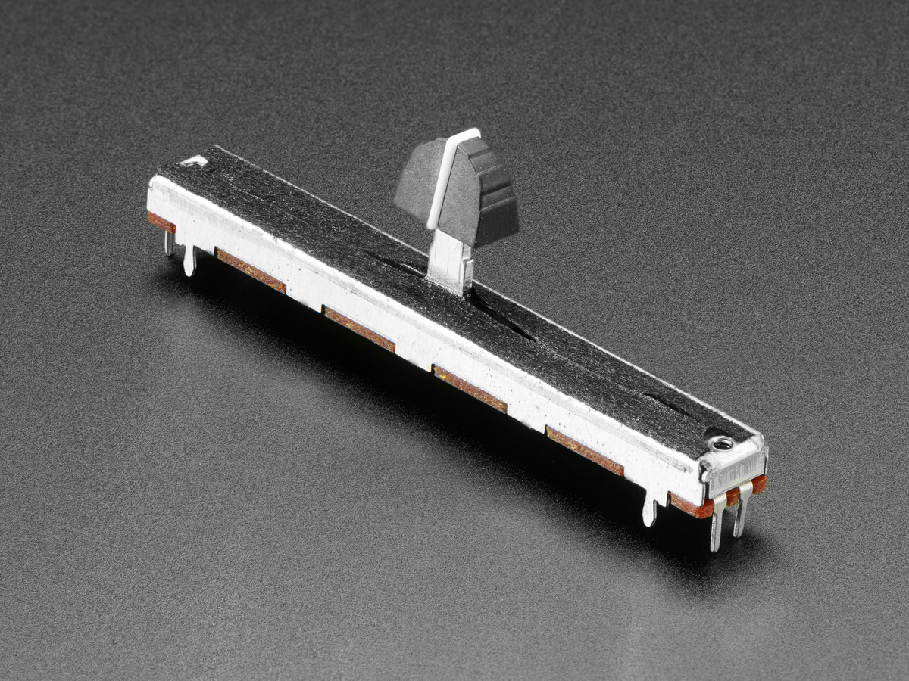
Resistor

Slide 13

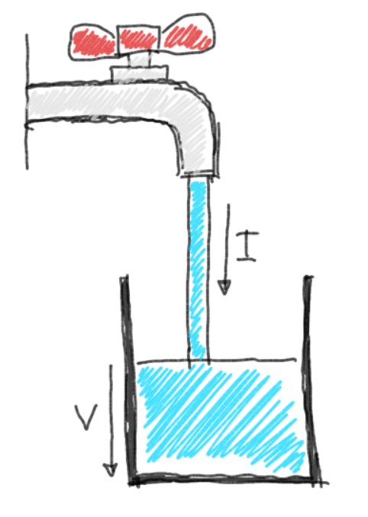
Capacitor
Stores energy in electrical field
Capacitance measured in Farads (F)

Slide 14
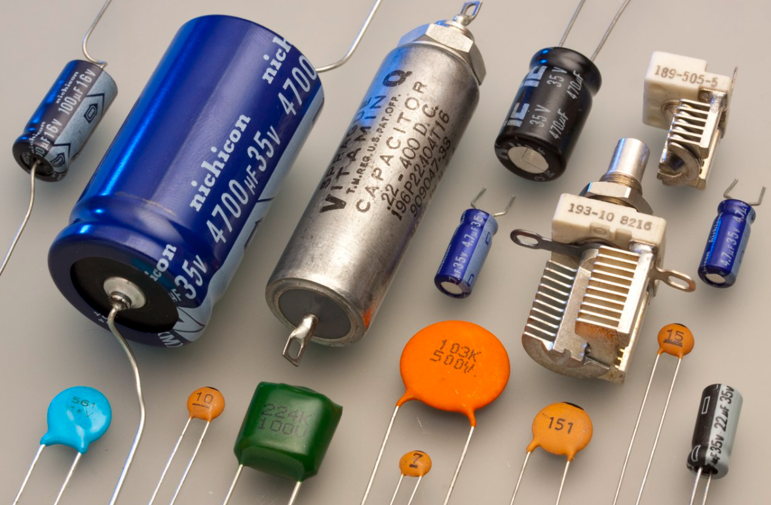

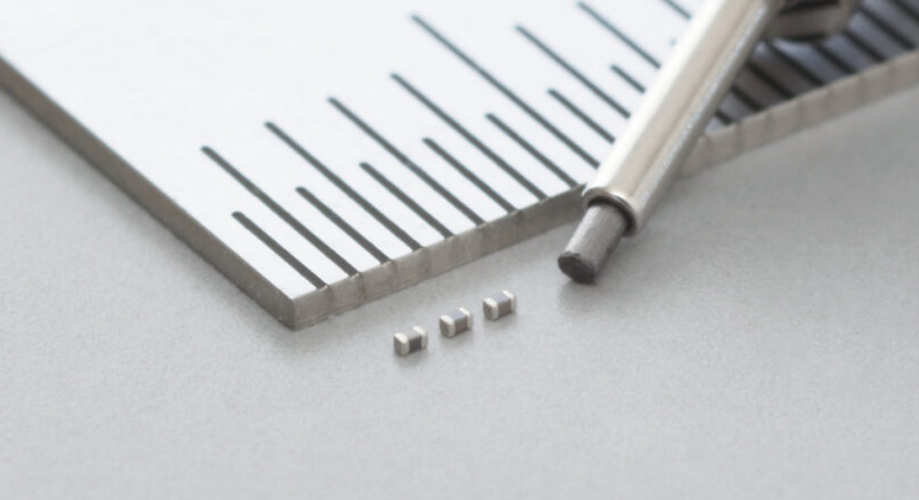
Capacitor

Slide 15
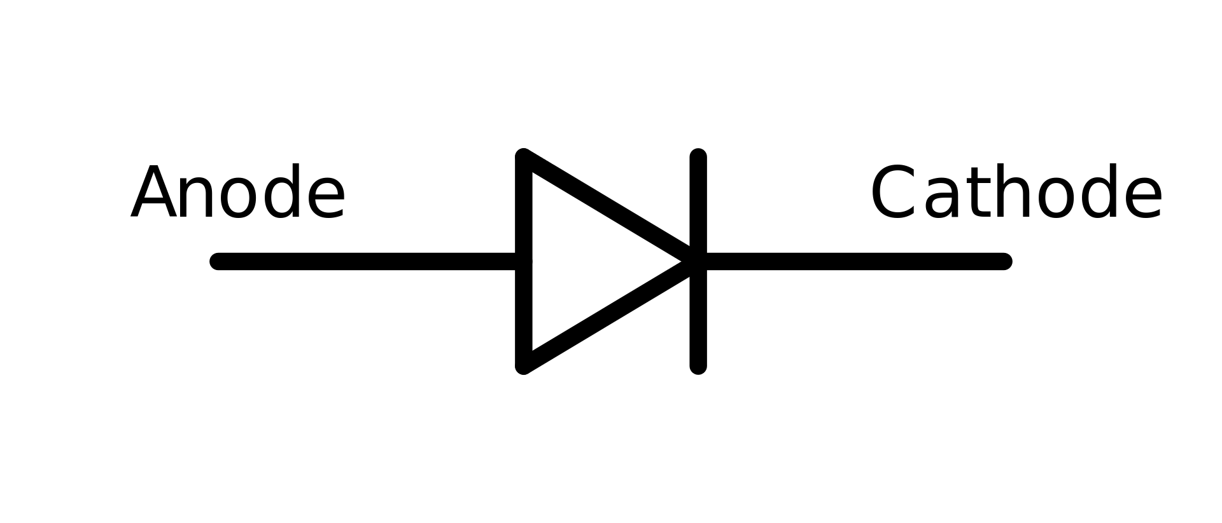
Diode
Semiconductor device, which conducts current only in one direction
LEDs are also diodes
Widely used in everyday power supplies to convert AC to DC

Slide 16

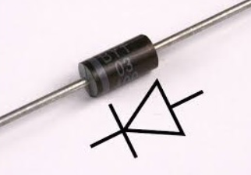
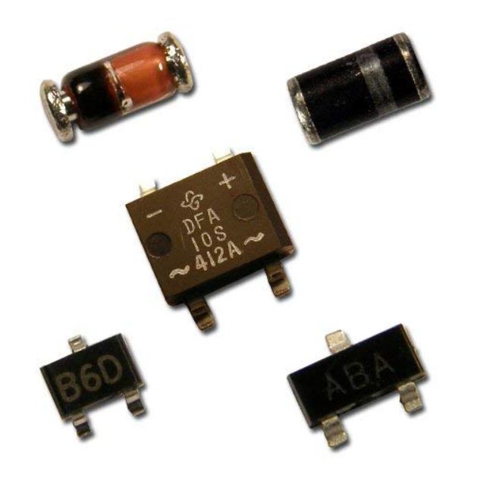
Diode

Slide 17
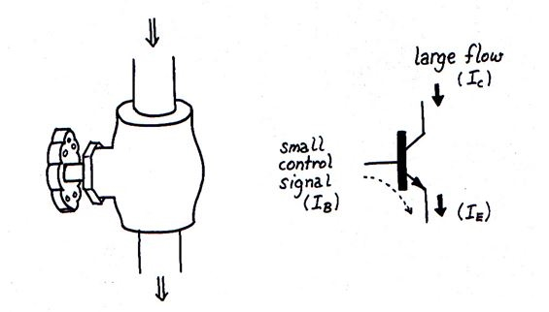
Transistor
Semiconductor device used to amplify signals
Bipolar transistor controlled by current
Three modes: active region, saturation, cut-off

Slide 18
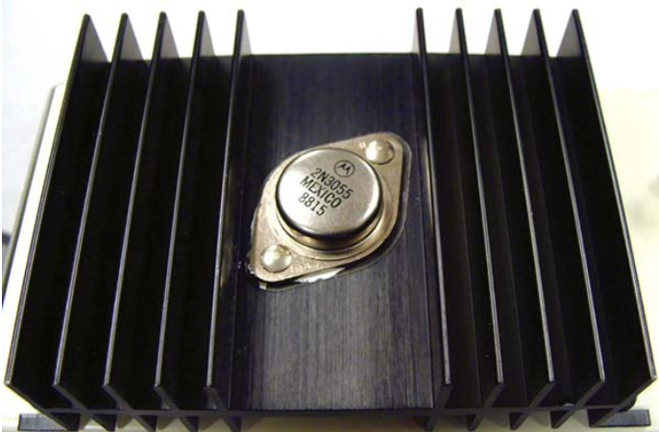
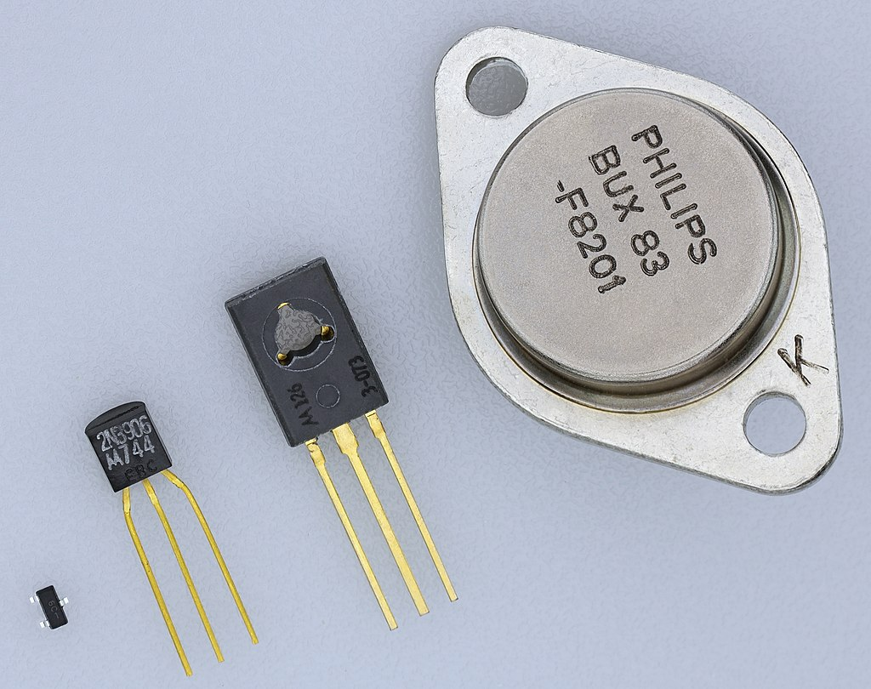
Transistor

Slide 19
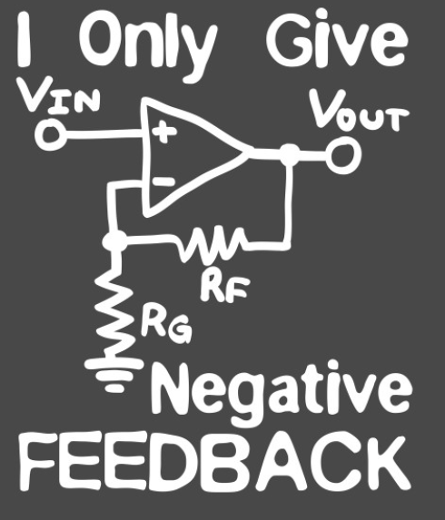
Operational amplifier
An operational amplifier is an integrated circuit that can amplify weak electric signals.
An operational amplifier has two input pins and one output pin. Its basic role is to amplify and output the voltage difference between the two input pins.

Slide 20
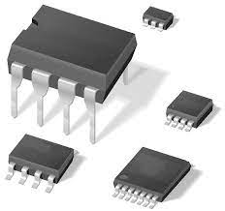
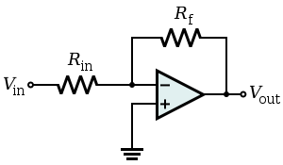
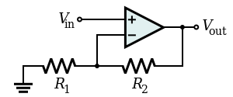
Operational amplifier

Slide 21
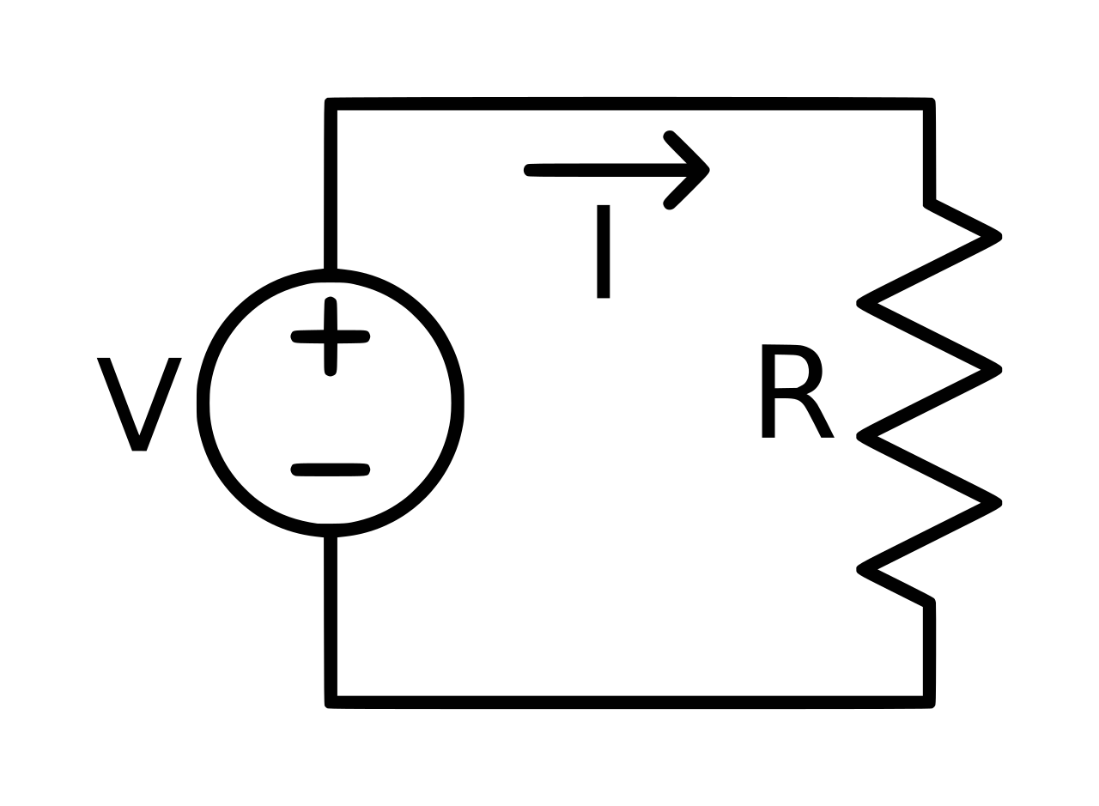
Voltage source
A voltage source is a two-terminal device which can maintain a fixed voltage
An ideal voltage source can maintain the fixed voltage independent of the load resistance or the output current.

Slide 22
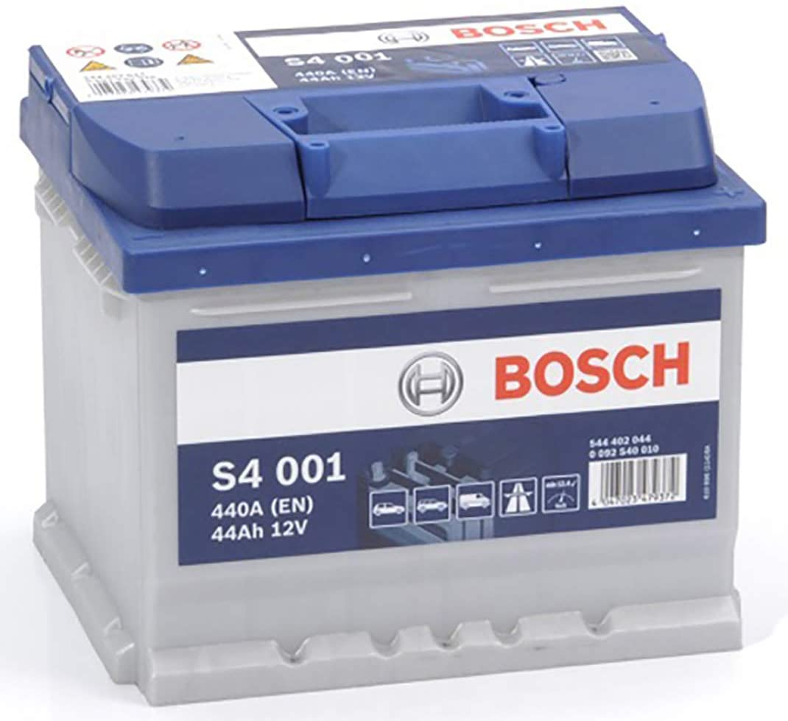
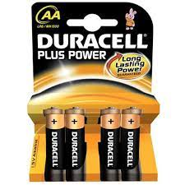
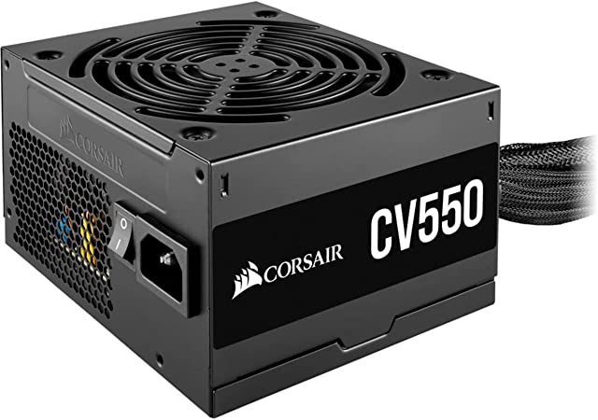
Voltage source

Slide 23
Spice simulation
General-purpose, open-source analog electronic circuit simulator. It is a program used in integrated circuit and board-level design to check the integrity of circuit designs and to predict circuit behavior.

Slide 24

Let’s simulate

Slide 25
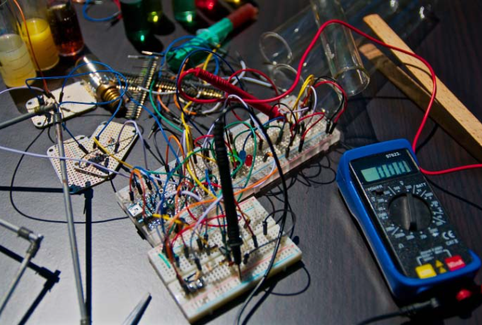
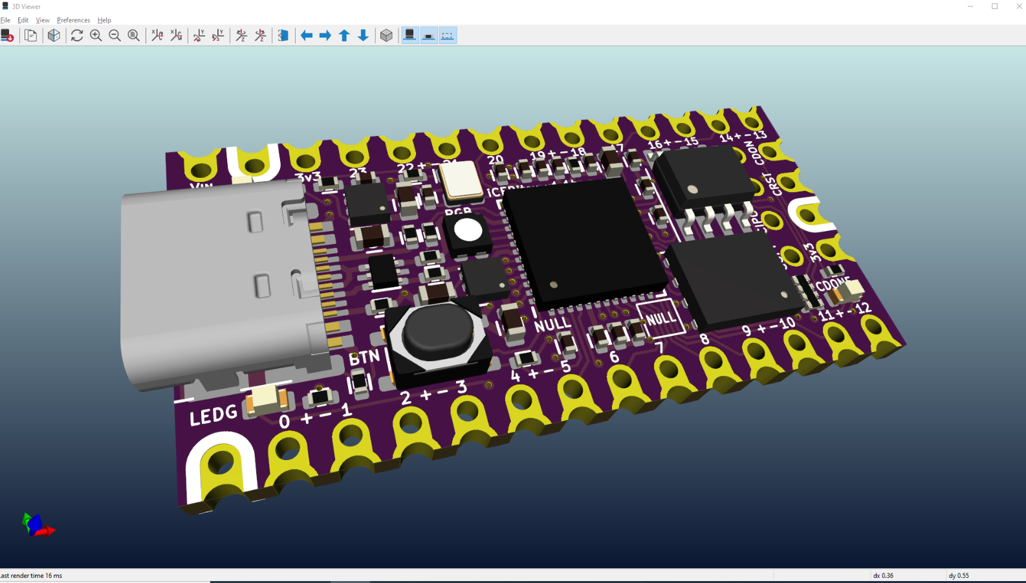
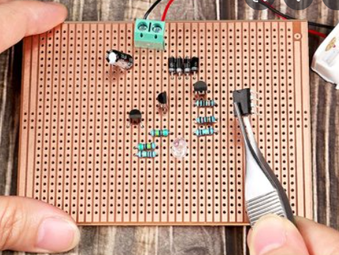
What’s next

