Slide 1
Group Assignment 2: User Interface Design of DIY Home Climate Monitoring and Control System
Greg Gerling

Slide 2
DIY Home Monitoring System
The client has set up an array of sensors to monitor the climate within his home and live streams the data to a UI on a website
The data visualized on the UI requires significant cognitive effort and prior technological knowledge make sense of overall status
Your task is to redesign the UI so an average person can understand and take advantage of all the benefits it can provide

Slide 3
Basic System Design
Sensors monitor indoor and outdoor temperature and humidity along with the supply air temperature and return air temperature coming from/going to the A/C unit
Indoor control panel for A/C unit
Live data reported to website
Indoor & Outdoor Temp + Humidity Sensors
Return & Supply Air Temp Sensors
House
A/C Unit

Slide 4
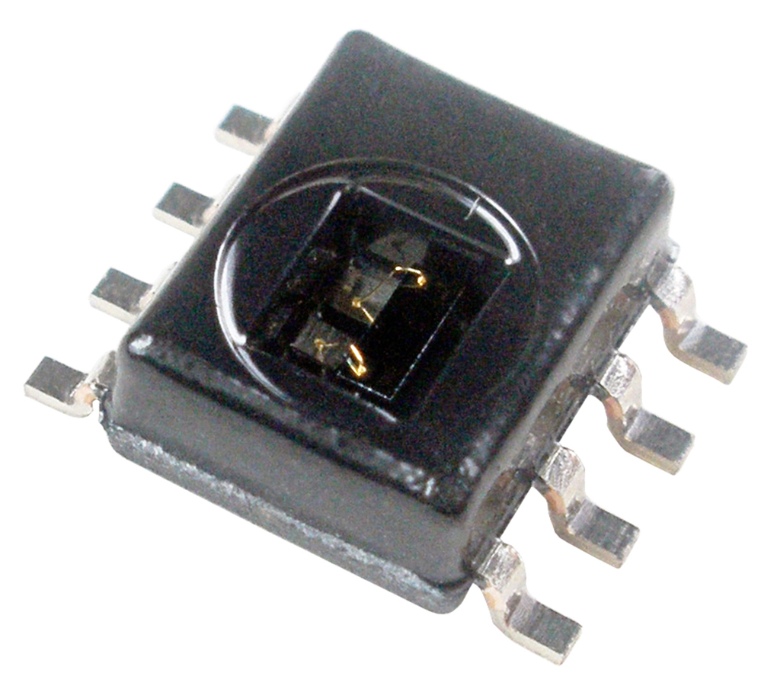
Sensors
Indoor/Outdoor Temperature/Relative Humidity sensors: Honeywell HIH6130
Air supply/return temperature sensors: Analog Devices AD-22100

Slide 5
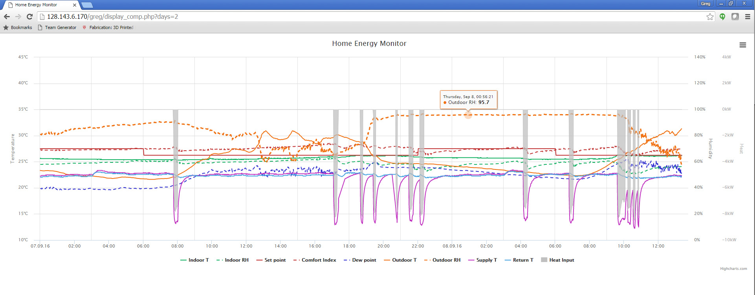
User Interface
http://128.143.6.170/greg/display_comp.php?days=2

Slide 7
Variables (Monitored and Controlled)
Indoor Measurements
Temperature
Relative humidity
Outdoor Measurements
Temperature
Relative humidity
Dew point (calculated from temp & humidity)
Equipment Measurements
Supply temperature (coming out of the furnace)
Return temperature (going into the furnace)
Heat added to the space (negative means the AC is running) (calculated value)
User controls: Set-point (control)
Derived “Comfort Index”: Composite custom index (next slide)

Slide 8
Derived “Comfort Index”
Say you’re comfortable at 28 C at 50% RH or below in the summertime. Do you ever notice that on some days 28 C just feels a little too warm? It could be because it is more humid!
What would the temperature have to be at 50% RH to feel the same?
28 C at 50% RH
25 C and 70% RH

Slide 9
Derived “Comfort Index” (2)
In the words of the client, “For the given indoor temperature and humidity, I calculate the enthalpy. Then I move along a line of constant enthalpy until I get to 50% relative humidity, and the resultant temperature is the “comfort index”. It’s kind of like “heat index” except that the latter is derived from human trials (“How uncomfortable are you?) and mine is based on the idea that enthalpy is a good surrogate of the air’s ability to cool you (which is debatable).”

Slide 10
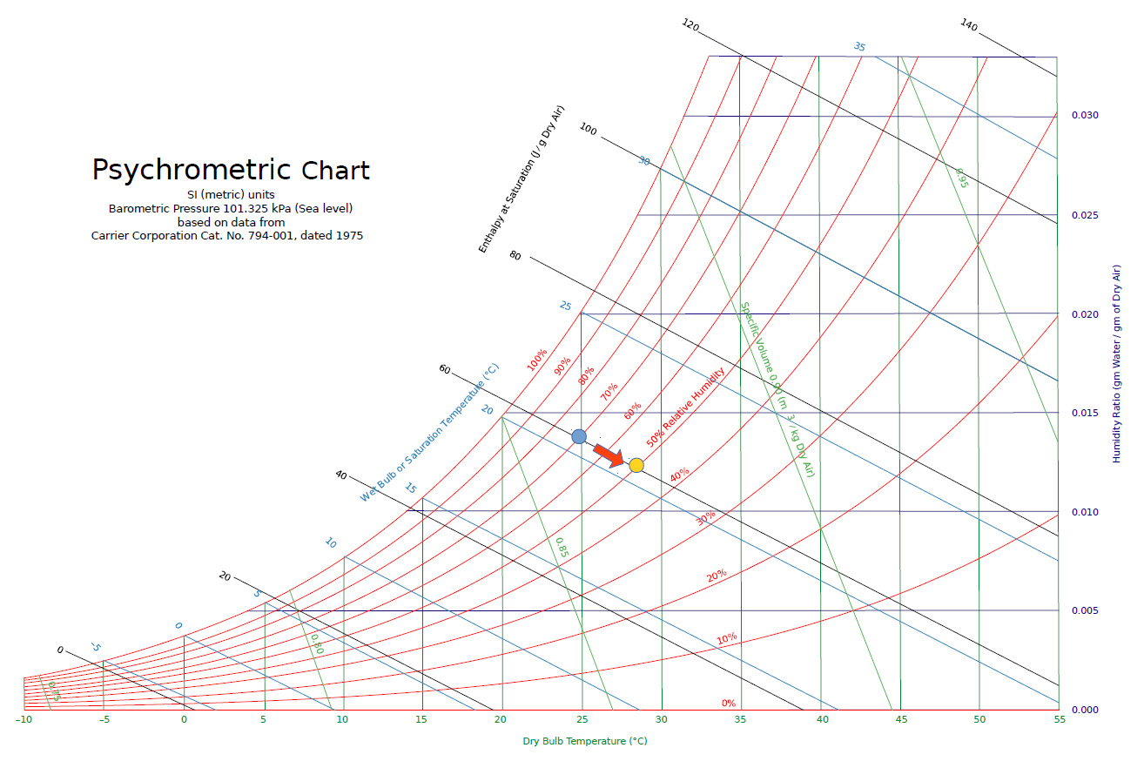

Slide 12
Two dots as an example: Say it is 25C and 70% humidity (blue dot). You would follow a line of constant enthalpy (black lines) until you reach 50% RH (yellow dot). You then read the “comfort index” as 28C. In other words, because it is so humid, even though it’s relatively cool (25C is not bad), it feels like it would if it were 28C at 50% RH.

Slide 13
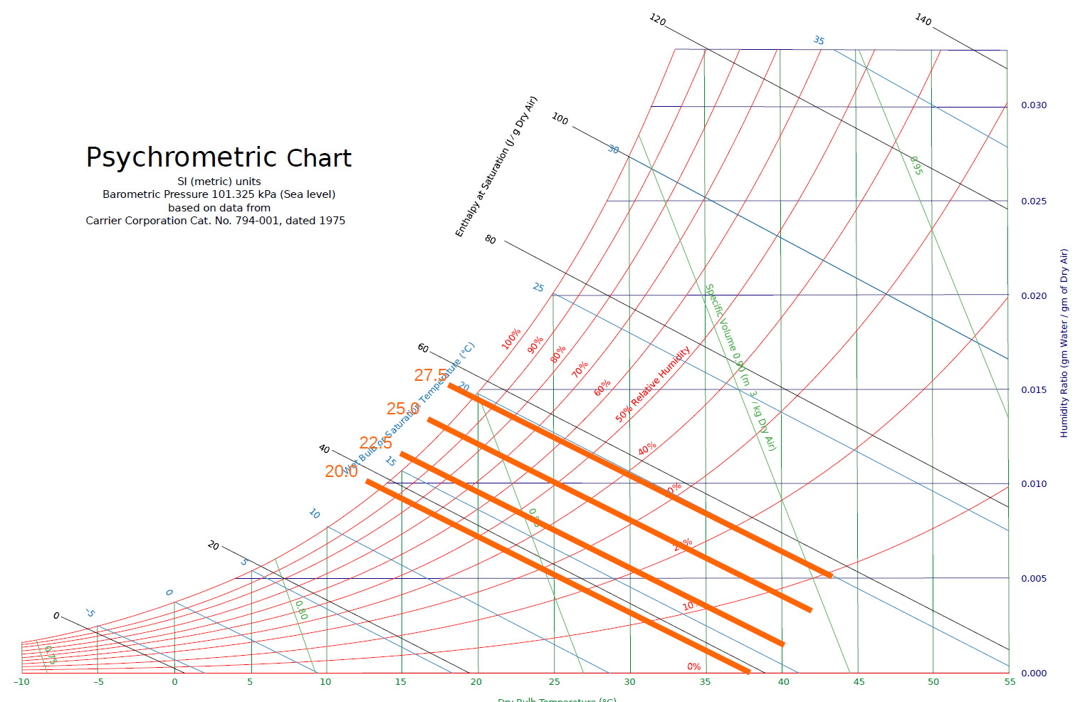
Lines of constant comfort index are lines of constant enthalpy (case of 50% relative humidity

Slide 15
Notes on FAQs
It’s not “if you like 50% humidity”, but what temperature it would have to be at 50% to feel the same.
When controlling by “comfort index” you’re essentially controlling on enthalpy. If you want your house to be 25C/50%RH, then you start there and draw a line of constant enthalpy. If the temperature/humidity combination — any combination — is to the upper right, the AC will come on. Anything to the lower left, the AC goes off (less a small dead-band). So 23C/70% would be right on the line, as would 20C/90%. The trouble is that the way the AC works, as it comes on, the point will move down and to the left, so saying that you’d “follow the line back up to 70%” doesn’t really make sense.

Slide 16
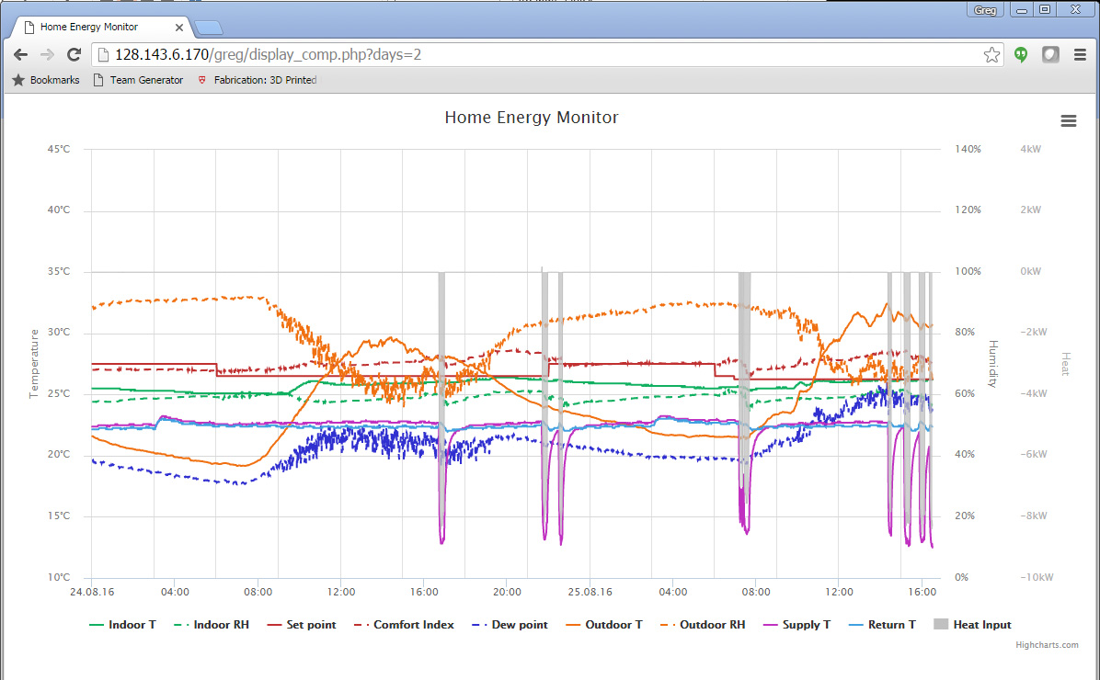
Ideal Case (in box) where temperature and comfort index match well
Set-point and comfort index really close

Slide 17
Your Task
Create/re- design in storyboard format
the monitoring interface/s
the control interface so that the user can set a desired temperature, humidity, or comfort index (explained later)
Justify the design by connecting specific design principles, navigation strategies, information resolution, etc. to specific information requirements of this domain.

Slide 18
Demonstrate that new UI will help user in three distinct use cases
Urgent issue
Less urgent issue, yet must be detected and dealt with
Controlling comfort index rather than temperature
Note that the first two are monitoring functions related, third is both control and monitoring functions related.

