Slide 1






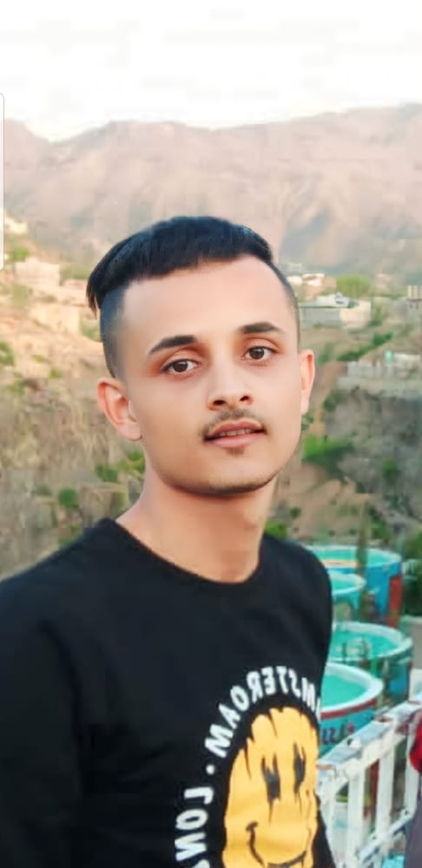







SABRI DERHIM
ABOUT ME
HOBBIES
I am a professional web designer,graduating from the college of Engineering and IT.I prossess strong technical skills in website design and development.I have a strong passion for developing applications using flutter
UI/UX&WEB DESIGNER
EDUCATION
2020-2025
2024-2024
2023-2023
ENGINEERING&IT
MESHKAT EDUCATION
EDRAAK PLATFORM
Bachelor of information technology – Taiz University,college of Engineering and IT
Diploma in Web Design at Mishkat Distance Learning Institute for 40 hours
I completed a course in User interface design principles UI/UX
EXPERIENCE
2023-2023
2023-2023
2023-2023
CYPER SECURITY
NETWORKING
PYTHON
EDRAAK PLATFORM
EDRAAK PLATFORM
EDRAAK PLATFORM
I completed a course in cyber security techniques attack for 3 hours
I completed an introduction to Networking course for 3 hours
I completed a course in introduction to python programming for 2 hours
SKILLS
SOFTWARES
CONTACT
+967 780840146
UI/UX Design
Sharaf.sabry18@gmail.com
Bootstrap / Taillwind css
Front-End Developer
VISUAL STUDIO CODE
GIT / GITHUB
YEMEN, TAIZ
HTML5 / CSS3
FIGMA / ADOBE XD
ANDROID STUDIO

