Slide 1
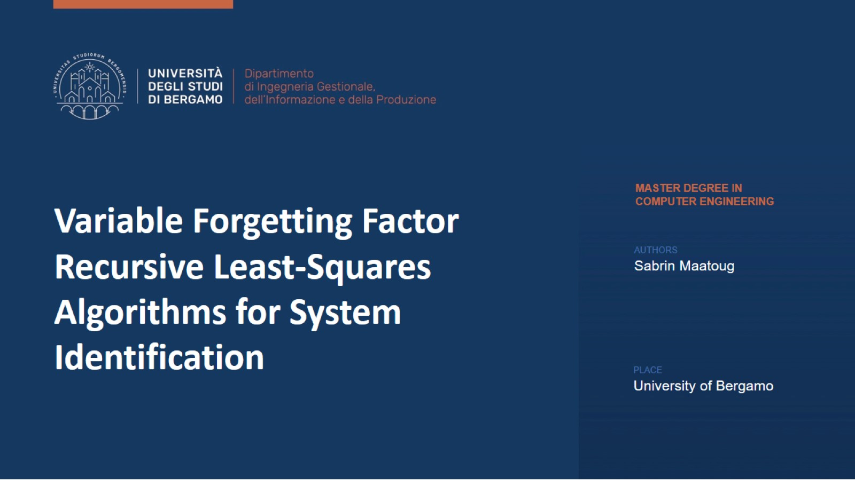

Slide 2
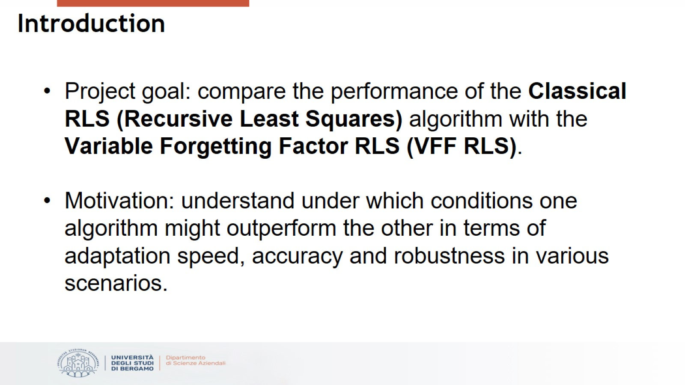
Introduction

Slide 3
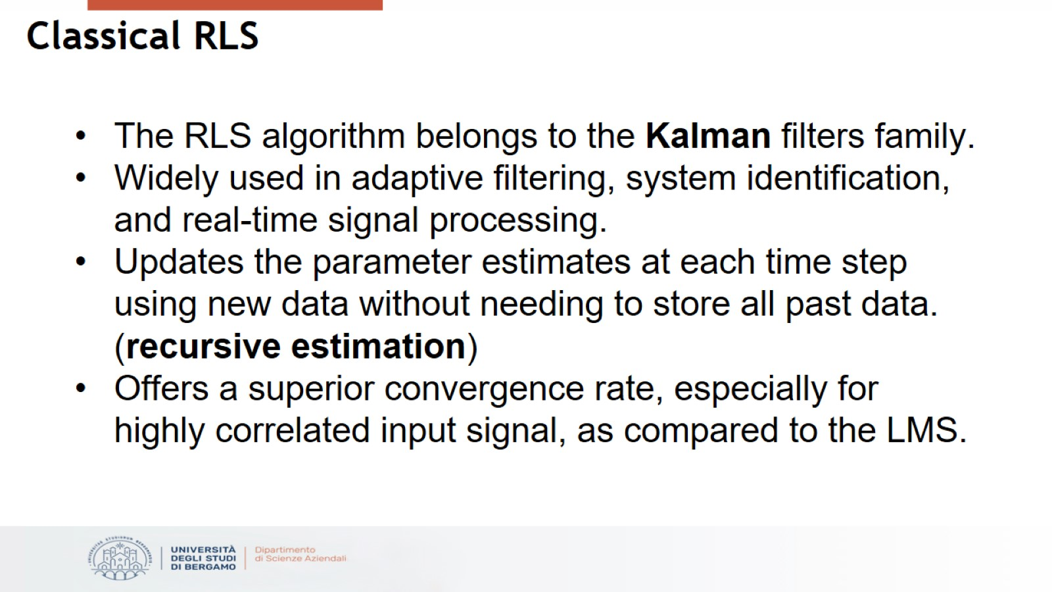
Classical RLS

Slide 4
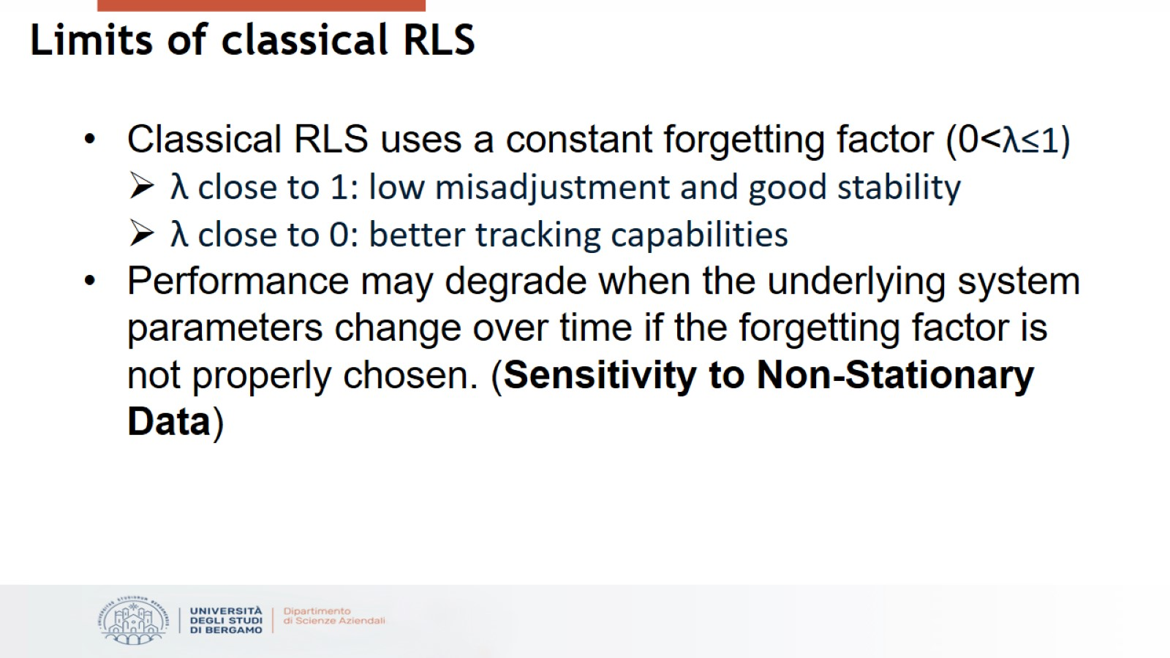
Limits of classical RLS

Slide 5
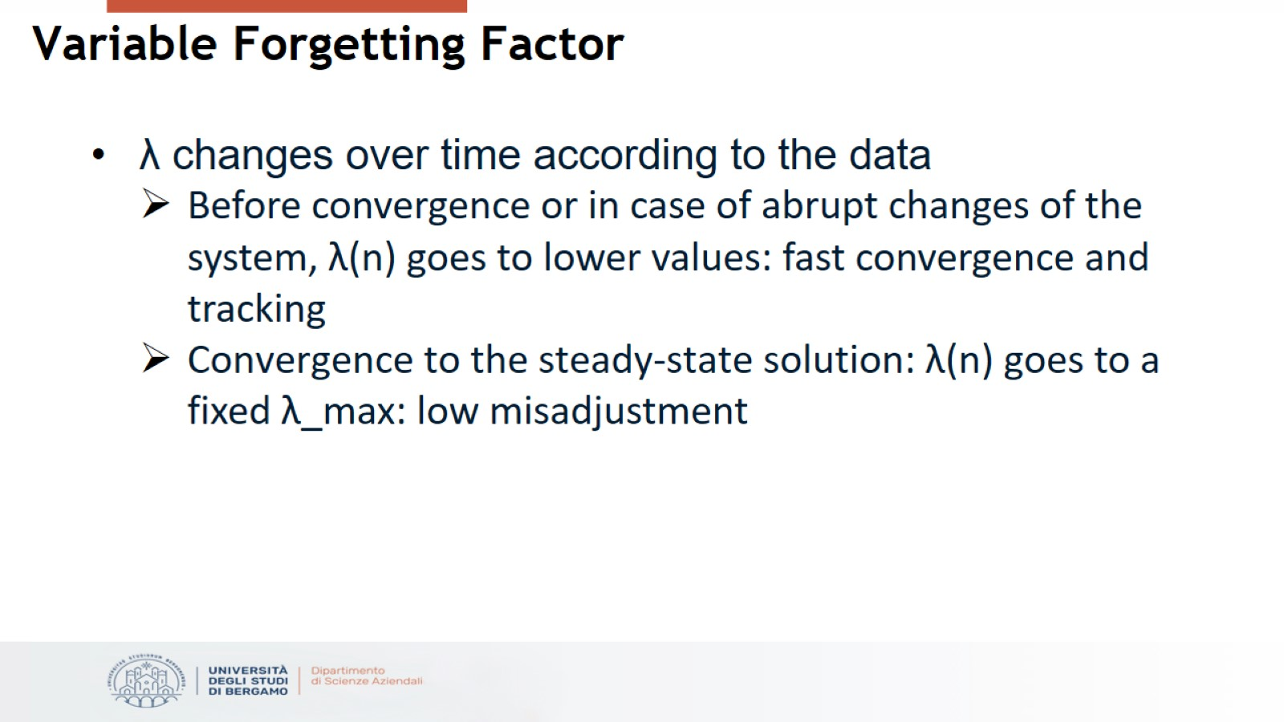
Variable Forgetting Factor

Slide 6
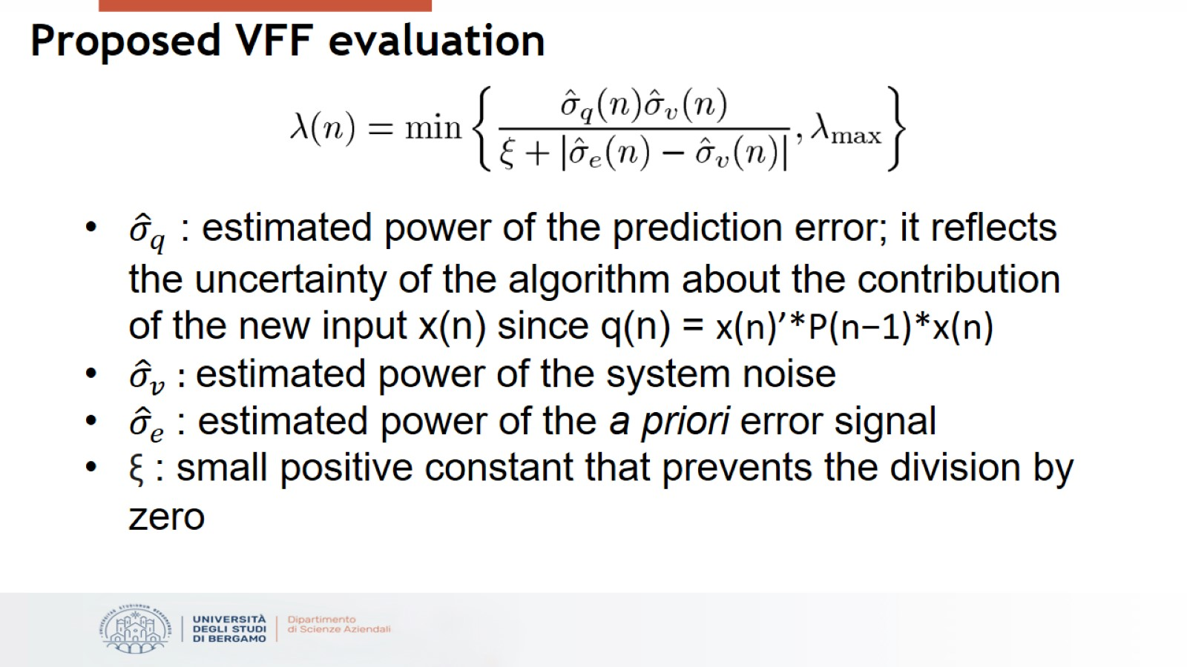
Proposed VFF evaluation

Slide 7
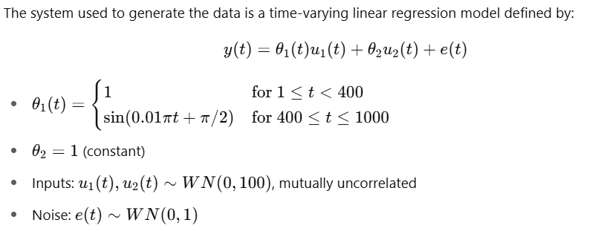
Data Generating System

Slide 8
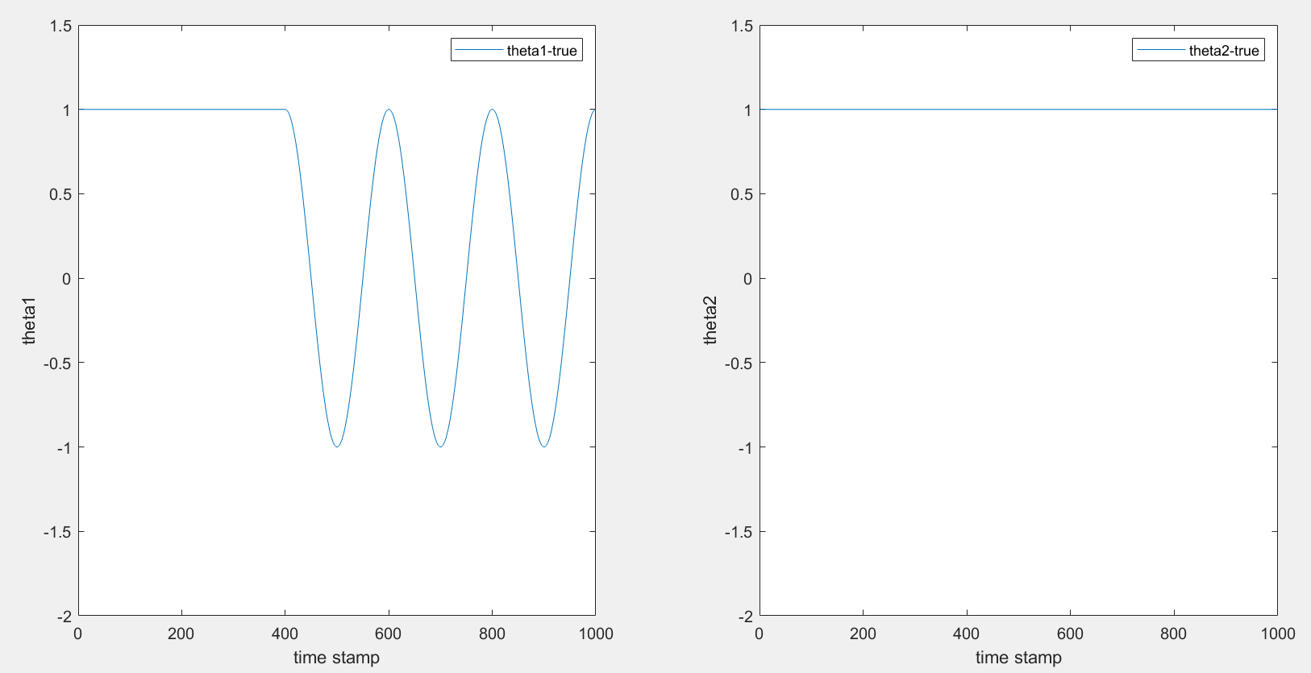
Data Generating System

Slide 9
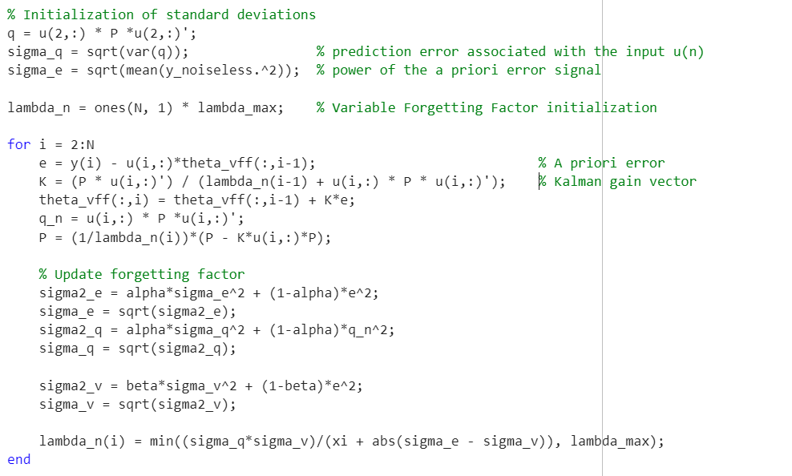
VFF-RLS Implementation

Slide 10
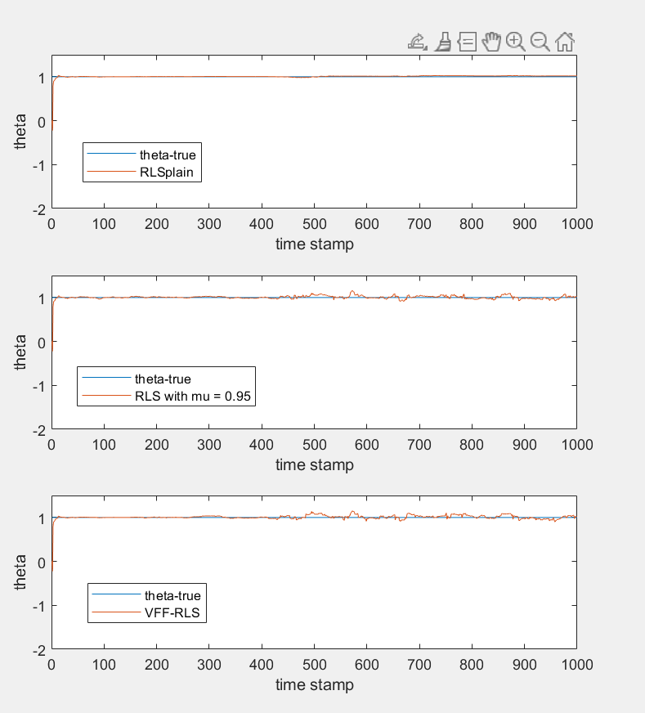
RLS vs. VFF RLS: Stationary Parameter Scenario

Slide 11
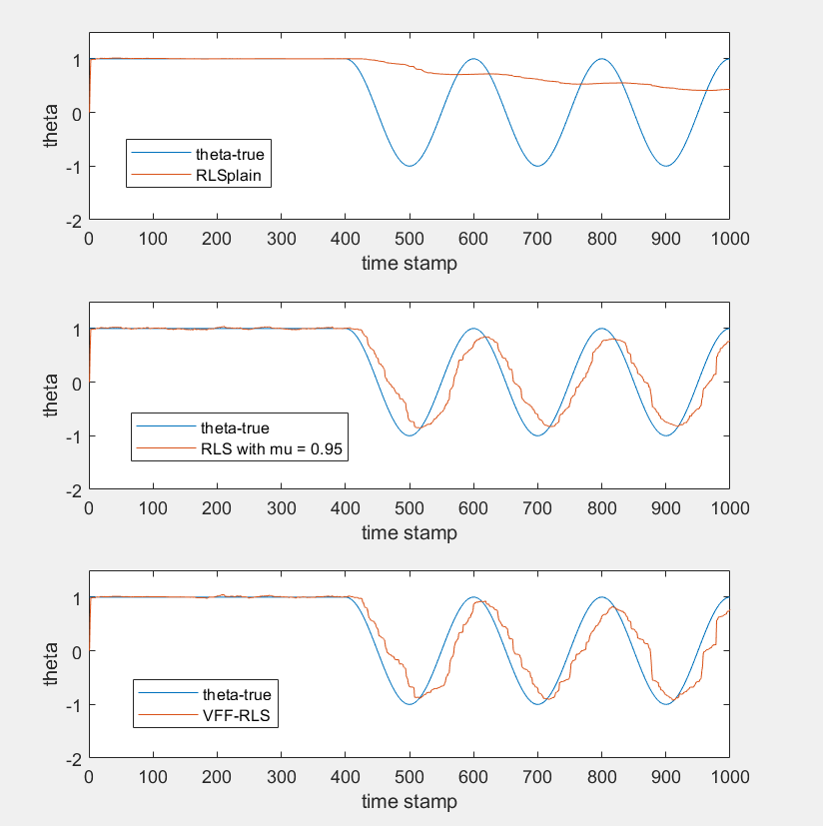
RLS vs. VFF RLS: Non−Stationary Parameter Scenario

Slide 12
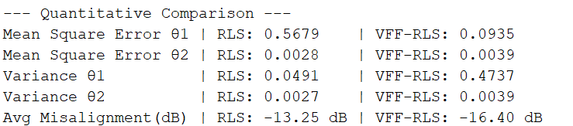
Evaluation metrics

Slide 13

Conclusions

Slide 14


