Slide 1
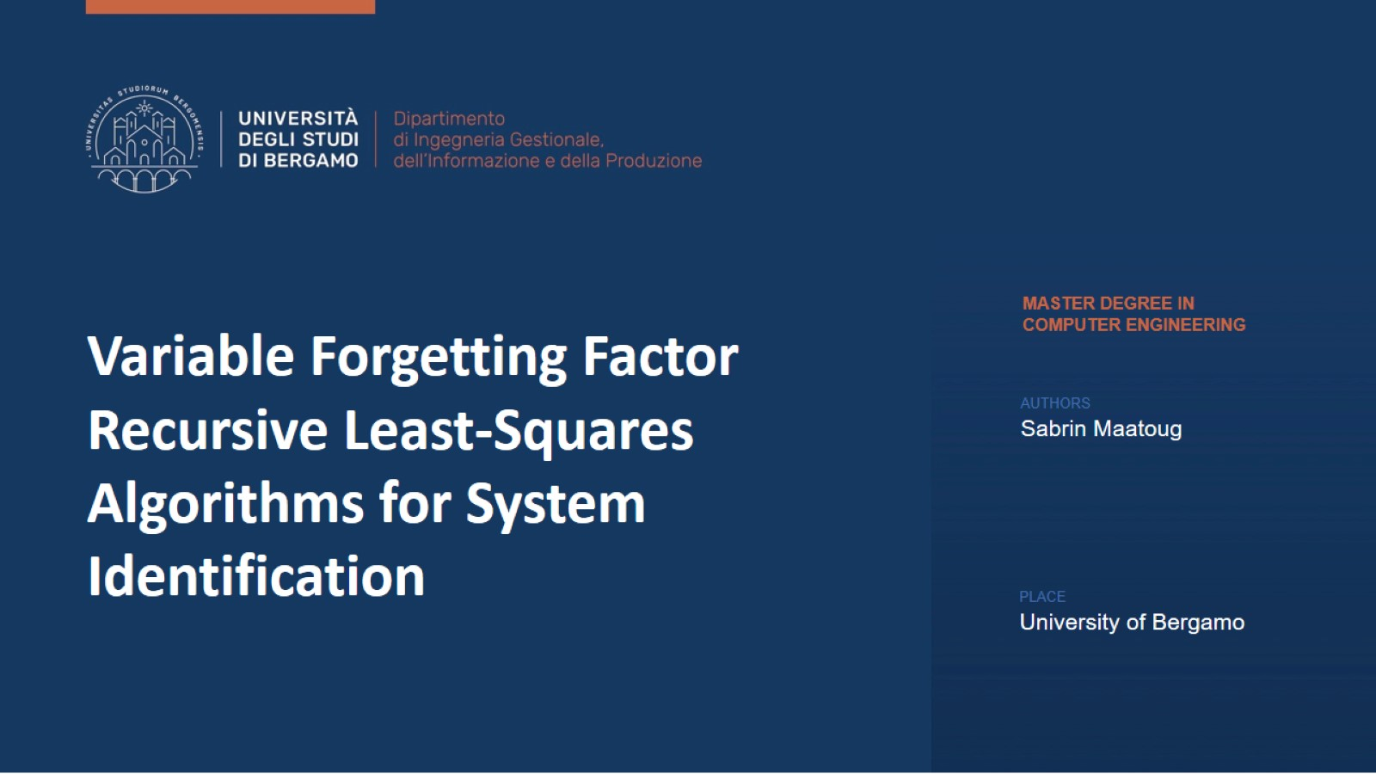

Slide 2
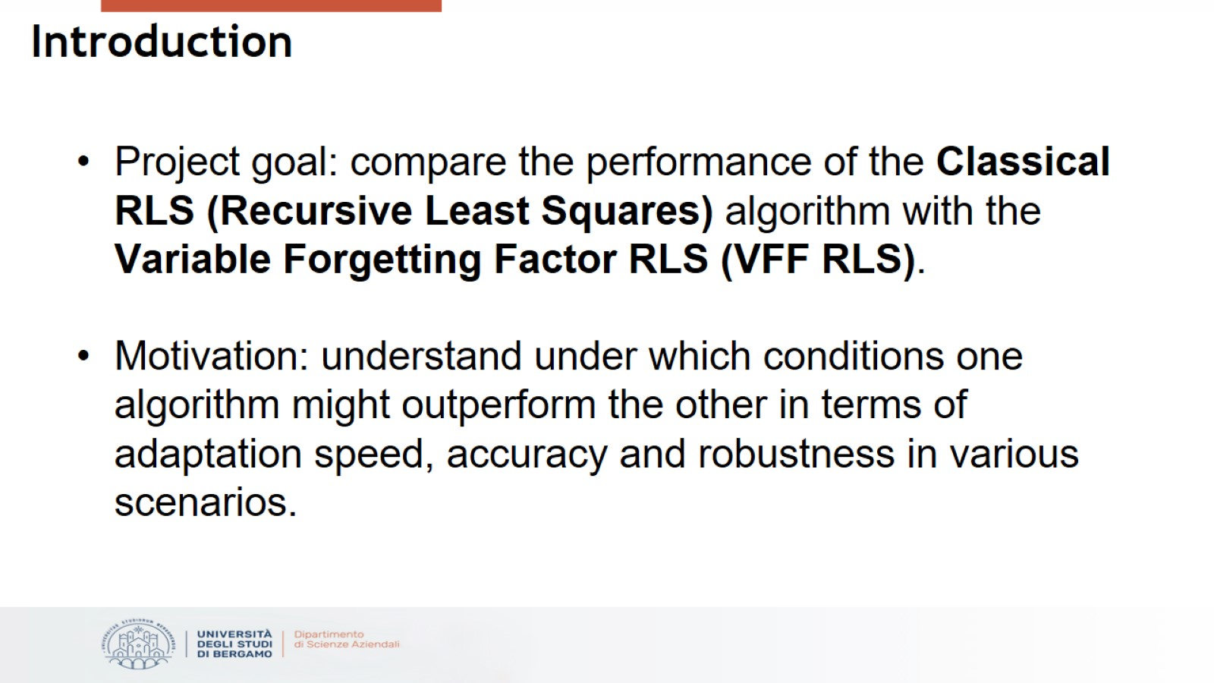
Introduction

Slide 3
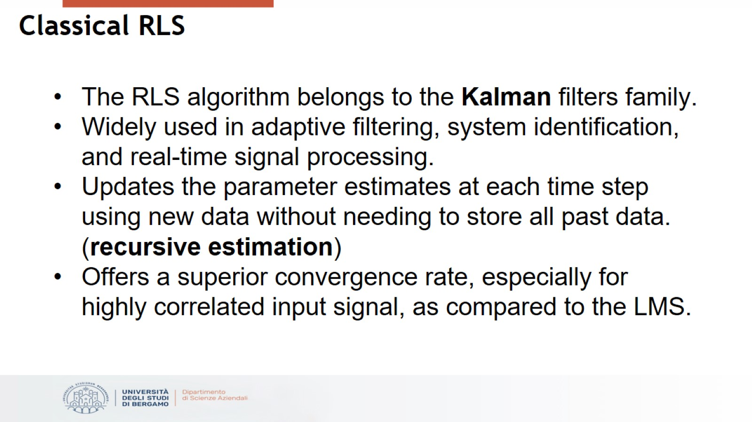
Classical RLS

Slide 4
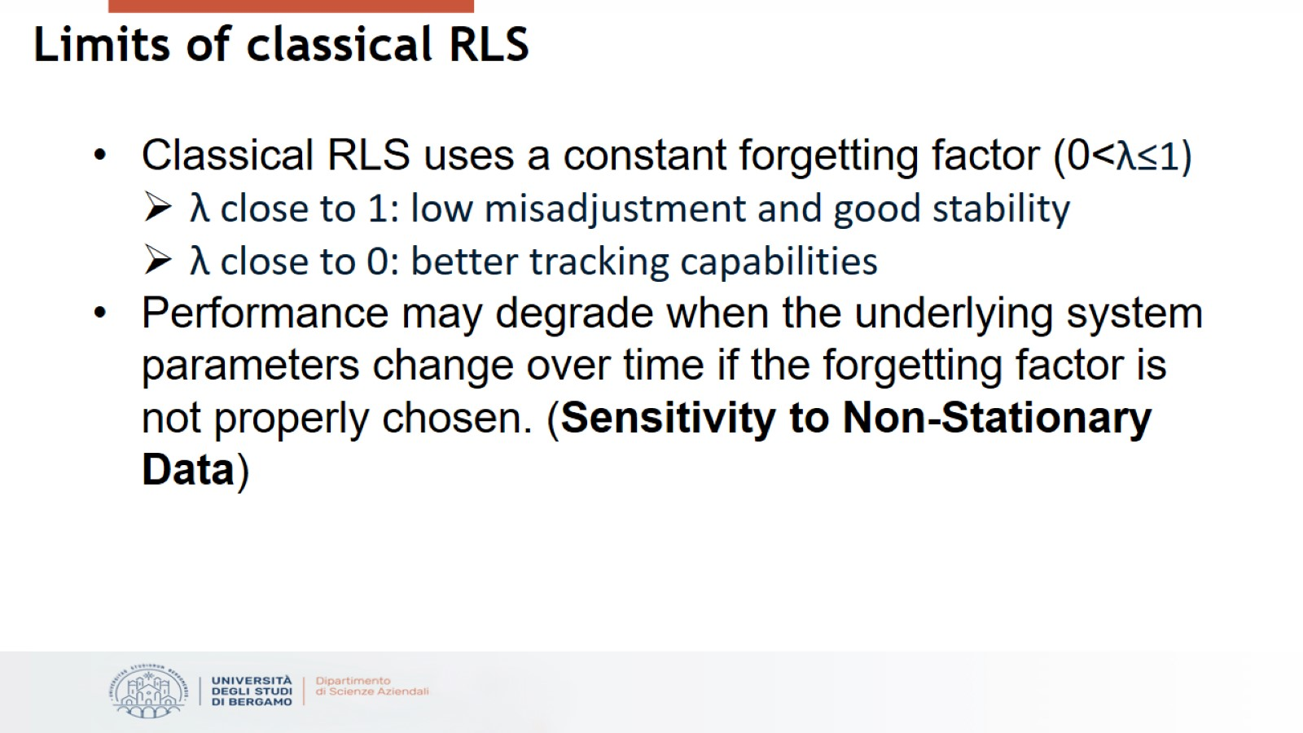
Limits of classical RLS

Slide 5
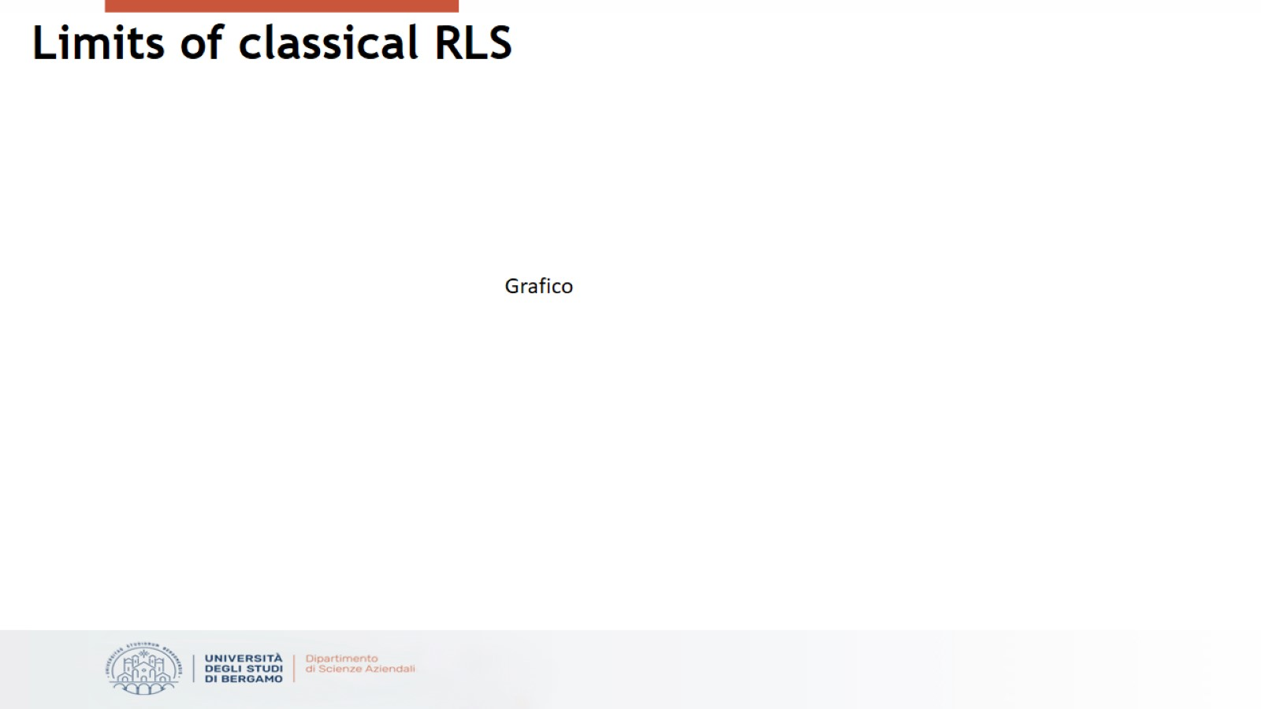
Limits of classical RLS

Slide 6
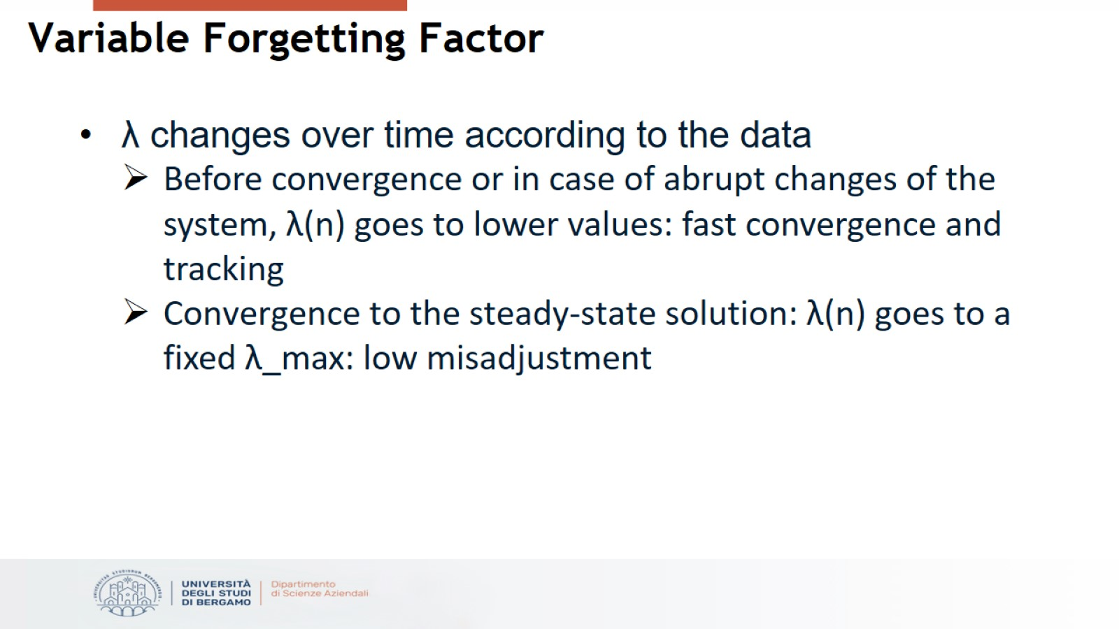
Variable Forgetting Factor

Slide 7
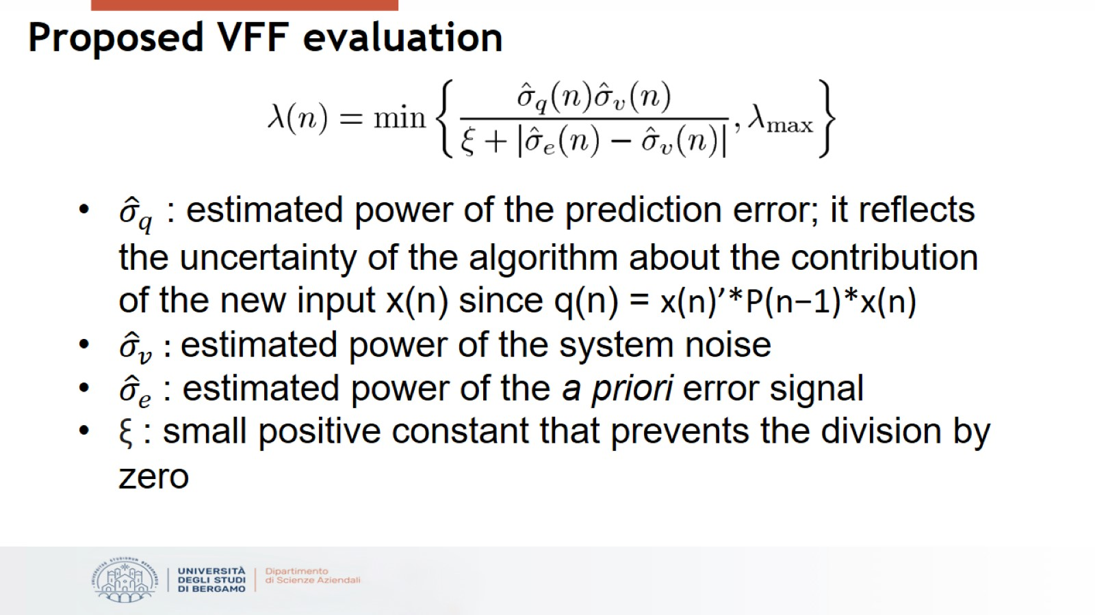
Proposed VFF evaluation

Slide 8
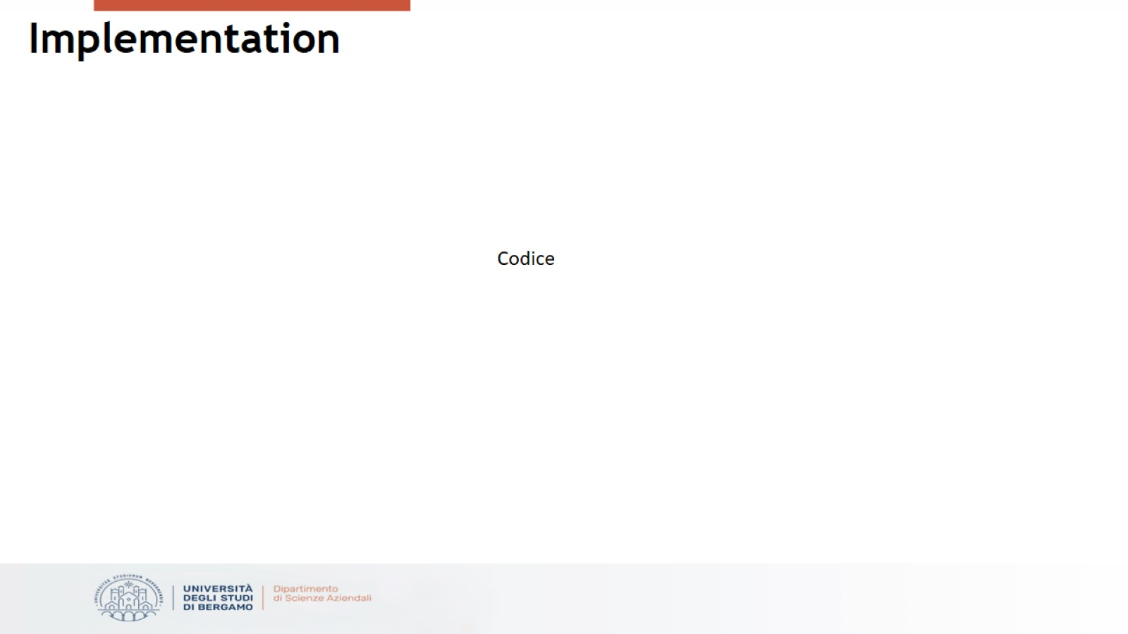
Implementation

Slide 9
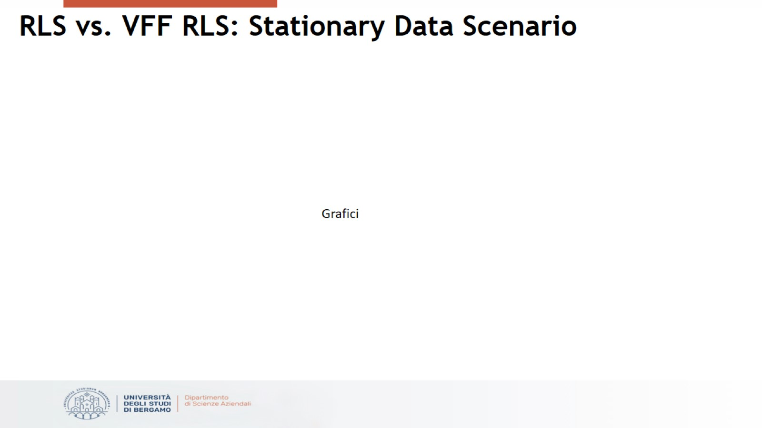
RLS vs. VFF RLS: Stationary Data Scenario

Slide 10
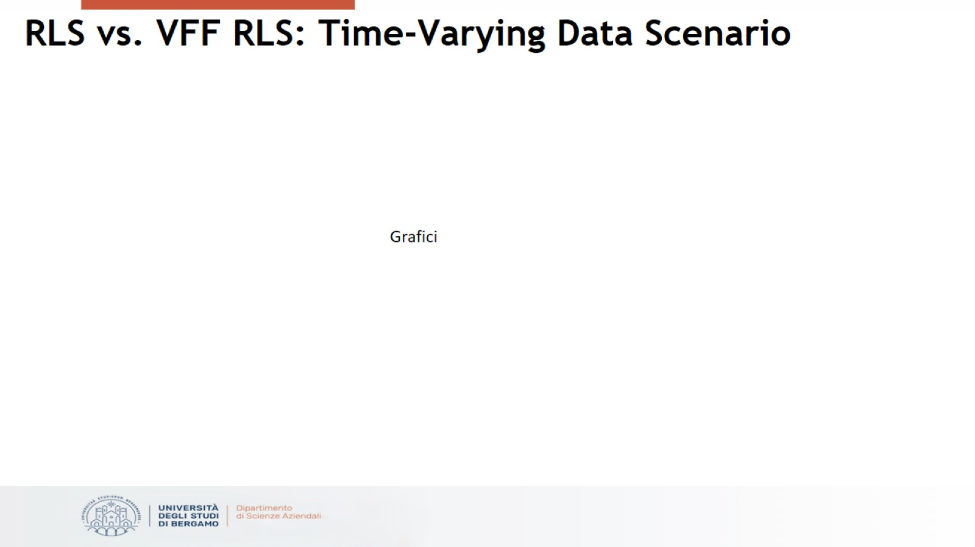
RLS vs. VFF RLS: Time-Varying Data Scenario

Slide 11

Conclusions

Slide 12
