Slide 1
WELCOME

Slide 2
A CLINICAL CASE PRESENTATION ON THYROTOXICOSIS
DR. A.N.M. GOLAM HAMEEM
DA TRAINEE
DEPARTMENT OF ANESTHESIOLOGY

Slide 3
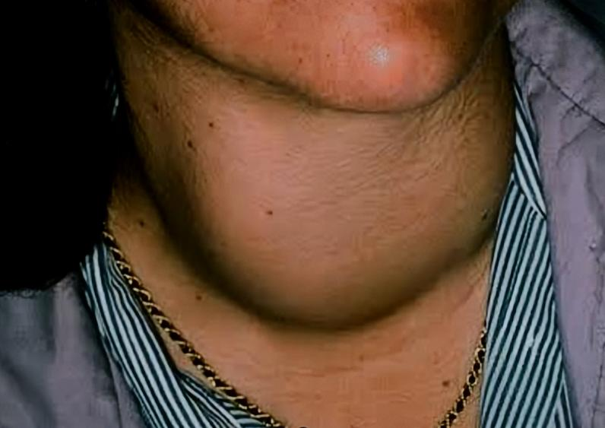
PARTICULARS OF THE PATIENT :
Name: Mrs. Tania Begum, W/O Lcpl MD MOHABBAT ALI
Age: 31Y
Sex: Female
Occupation: Housewife
Address: Narsingdi
Religion: Islam
Marital status: Married

Slide 4
CHIEF COMPLAINTS :
Swelling in front of the neck for last 06 months
Excessive sweating and heat intolerance for last 2 months
Palpitation, restlessness, insomnia, irritability for last 2 months
Weight loss for 6 months
Oligomenorrhoea for last 6 months

Slide 5
HISTORY OF PRESENT ILLNESS :
According to the statement of the patient she was reasonably well about 06 months back. Then she noticed a swelling in front of her neck. The swelling was insidious in onset, progressive in nature, not painful , not associated with difficulties in breathing or swallowing. There was no H/O of changes of her voice. She also complained of excessive palmar sweating and intolerance to heat for the last 02 months and felt comfortable in cold environment.

Slide 6
CONTINUE..
She experienced palpitation, even at rest which is more marked on exertion. She noticed significant weight loss despite of good appetite for the last 06 months. Her weight changes was gradual and not associated with cough, hemoptysis, breathlessness, dyspepsia, melena, haematochezia, chronic fever or any abdominal swelling. She also complaints of insomnia, irritability and restlessness for the last 02 months.

Slide 7
CONTINUE..
She experienced generalized weakness for the last 6 months period occasionally. Also gave H/O occasional loose stool, 3-4 times a day, which is not associated with mucous/blood or not related to intake of any food or milk. Besides all of these, on questioning, she disclosed that she has been experienced oligomaenorrhoea which was developed gradually over a period of last 6 months.

Slide 8
CONTINUE..
She have no H/O fever, joint swelling/pain, hoarseness of voice, excessive thirst or polyuria, abdominal or chest pain, cough, sputum, hemoptysis, jaundice, itching or oliguria. Her bladder habit is normal.

Slide 9
HISTORY OF PAST ILLNESS:
She is non diabetic and normotensive. Have no H/O TB, liver
disease, any cardiac or kidney disease.
Have H/O Covid 19 positive 1 year back which was resolved
without any complication. Now patient is immunized with 3
doses of Covid 19 vaccine.
There is nothing other significant H/O past illness
Have no H/O hospitalization before

Slide 10
Drug History: There is no history of
taking drugs that may cause these symptoms
Family history: No other family member is suffering from this
kind of illness.
Personal history: There is nothing significant personal history.
Allergic history: Have no significant H/O allergy to drugs or
diet.
Menstrual history:
Her menstruation was regular. But for last few months, she is oligomenorrheic.

Slide 11
GENERAL EXAMINATION :
Appearance: The patient is anxious, agitated, frightened,
restless with staring look and excessive sweating on palm
and hand.
Body built: emaciated(cachectic)
Co-operation: Cooperative
Decubitus: On choice
Nutritional state: Below average
Anemia: Absent
Jaundice: Absent

Slide 12
CONTINUE..
Cyanosis: Absent
Leukonychia: Absent
Koilonychia: Absent
Edema: Absent
Dehydration : Absent
Skin: Normal skin pigmentations but palm and hands are
warm and moist .
Fine tremor present on outstretched hands.
Dupuytren’s contracture: absent.
Hair Distribution: Hair is friable , fine and silky.

Slide 13
CONTINUE..
Palmar erythema: Absent
Gynecomastia: Absent
Lymph nodes: Not palpable
Parotid Gland: Not enlarged
Neck vein: Not engorged
BP-140/75 mm Hg.
Pulse: 105 beats/ min
Temperature: 99° F
Respiratory rate: 14-18 breaths/ min
BMI:16.4

Slide 14
SYSTEMIC EXAMINATION:
Thyroid Gland
Inspection:
Thyroid gland is diffusely enlarged, measuring 10 x 10 cm, right lobe is slightly larger than the left lobe. Which is moves with swallowing, but not with protrusion of tongue. overlying skin of the gland is normal, but have no scar mark or prominent veins.

Slide 15
CONTINUE..
Palpation:
The gland is soft, non tender, mobile, surface is smooth, not fixed With underlying structure or overlying skin. Not associated with lymphadenopathy. palpable thrill present.
Percussion:
Percussion note over the upper part of manubrium is resonant.so there is no retrosternal extension.
Auscultation:
There is bruit over the right lobe.

Slide 16
EYE :
Exophthalmos present in both eyes.
Lid retraction and lid lag present.
Joffroy's sign present.
Mobius' sign and Stellwag's sign are absent.
Movement of the eyeball-normal in all directions.
Conjunctival congestion present

Slide 17
CARDIOVASCULAR SYSTEM:
Pulse-105/min, regular, high volume.
BP-140/75 mm Hg.
Precordium- Apex beat is thrusting in nature . Both first
and second heart sounds are loud. No other abnormalities
are detected.

Slide 18
NERVOUS SYSTEM:
Higher psychic functions:
Speech-normal
Memory-intact
Abbreviated mental test: normal
Emotional status: normal
Illusion, delusion or hallucination: absent
Intelligence: normal

Slide 19
MOTOR FUNCTIONS :
Jerk: Exaggerated ( Ankle, Knee, Biceps, Triceps)
Involuntary movement: fine tremor present in both hand
Bulk of muscle: reduced
Tone of muscle: normal
MRC Power of the muscle: 5/5
Gait: normal
Plantar reflex: flexor

Slide 20
Sensory functions : Intact
Cranial nerve examination : Functions of all cranial
nerves are intact .

Slide 21
Examination of the other systems reveal No Abnormality

Slide 22
SALIENT FEATURES :
Mrs Tania Begum, 31Y old, housewife, normotensive,nondiabetic patient hailing from Narsingdi presented with the complaints of swelling in front of the neck for last 06 months.Also have excessive palmar sweating, heat intolerance ,palpitation, restlessness, insomnia, irritability for last 2 months with weight loss and Oligomenorrhoea for last 6 months. Patient gave H/O occasional loose stool, 3-4 times a day too.

Slide 23
CONTINUE..
Her thyroid swelling was insidious in onset, progressiv nature,not painful & not associated with difficulties in breathin or swallowing. On examination the patient is anxious, agitated, frightened, cachectic. Hair is friable ,fine and silky. Both hands are warm, moist and sweaty with fine tremor present on her outstretched hands. Pulse rate is 105/min, regular with high volume.

Slide 24
CONTINUE..
Her thyroid gland is diffusely enlarged, soft in consistency, non tender and mobile with palpable thrill and audible bruit on right lobe Bilateral exophthalmos,lid lag, lid retraction, Joffroy's sign and conjunctival congestion are present. Apex beat is thrusting in nature.First and second heart sounds are loud. All jerks are exaggerated but plantar response are bilaterally flexor. Functions of all cranial nerves remain intact.

Slide 25
PROVISIONAL DIAGNOSIS :
Thyrotoxicosis due to Graves diseases

Slide 26
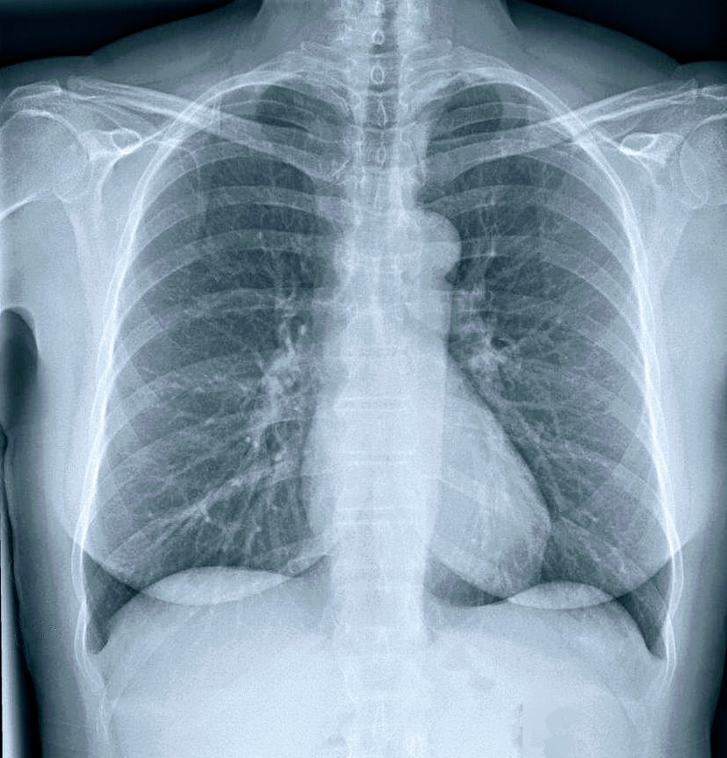
INVESTIGATIONS:
CBC: Hb 12g/dl, WBC-7000/cumm, Platelet-250k/cumm
RBS: 5.5 mmol/L.
Serum Electrolytes, Serum Creatinine: within Normal Range.
LFT: within normal range
S.Cholesterol : 100 mg/dl
Chest X ray: Normal Finding.

Slide 27
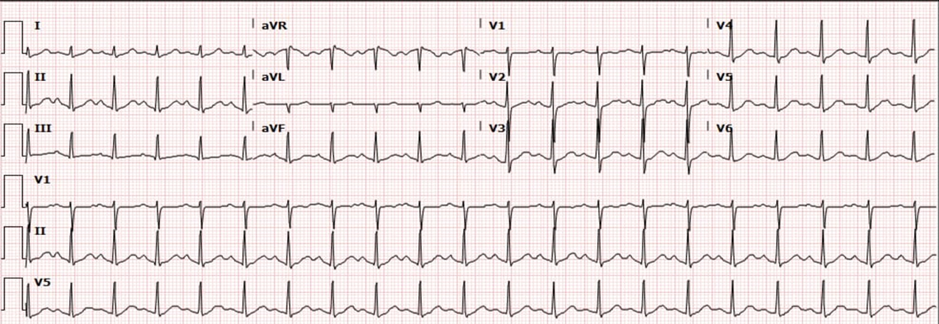
ECG: Sinus Tachycardia
Echocardiography :Normal,EF:72%

Slide 28
CONTINUE…
Thyroid Function test :
At 30/10/2023:
*Serum TSH < 0.01 microIU/ml
*Serum F-T3 = 37 pmol/l
*Serum F-T4 = 73.6 pmol/l
At 24/12/2023:
*Serum TSH = 0.01 microIU/ml
*Serum F-T3 = 22 pmol/l
*Serum F-T4 = 52 pmol/l
At 7/1/2024:
*Serum TSH = 0.01 microIU/l
*Serum F-T3 = 7.1 pmol/l
*Serum F-T4 = 19 pmol/l

Slide 29
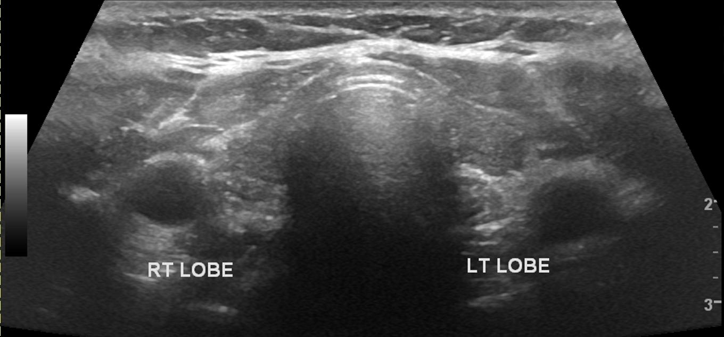
CONTINUE…
Anti Thyroglobulin antibody test: Positive.
USG of Thyroid gland:
*Left lobe: 52×18×16
*Right lobe: 55×20×18
*There is no retrosternal extension or tracheal
deviation.

Slide 30
DIFFERENTIAL DIAGNOSIS :
Toxic nodular goitre
Simple goitre with anxiety neurosis

Slide 31
CONFIRMATORY DIAGONOSIS:
Thyrotoxicosis due to Graves diseases

Slide 32
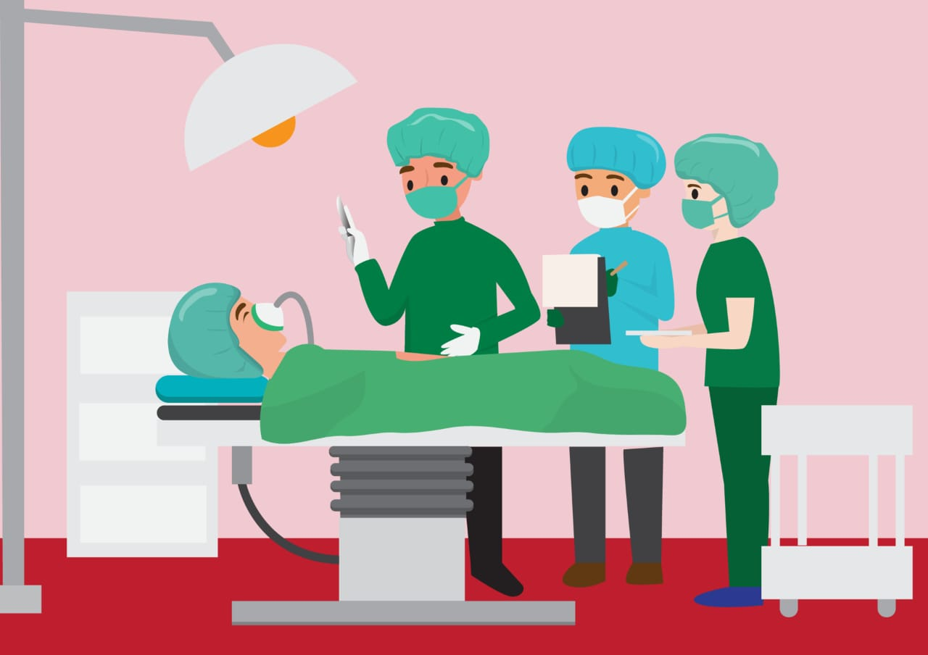
ANAESTHETIC MANAGEMENT OF A CASE OF THYROTOXICOSIS

Slide 33
PRE OP CHECKUP AND PREPARATION: All elective surgical procedures should be postponed until the patient is rendered clinically and biochemically euthyroid. It may require a substantial time (6 - 8 weeks) for the anti thyroid drugs to become effective.

Slide 34
CONTINUE
Assessment should include: - Normal TFTs - No resting tachycardia (HR < 90 bpm; sleeping HR) Evaluation of the upper airway for evidence of tracheal compression/deviation caused by a goiter.

Slide 35
CONTINUE…
CXR to look for Tracheal deviation or Xray of neck for Tracheal compression.
Optimization of cardiovascular status before surgery in hyperthyroid patients by:
-B-blockers or - Calcium channel blockers

Slide 36
CONTINUE…
If emergency surgery must to proceed despite clinical hyperthyroidism, hyper dynamic circulation can be controlled by titration of an Esmolol infusion (rapid distribution and hydrolyzed in the blood by RBC esterase).

Slide 37
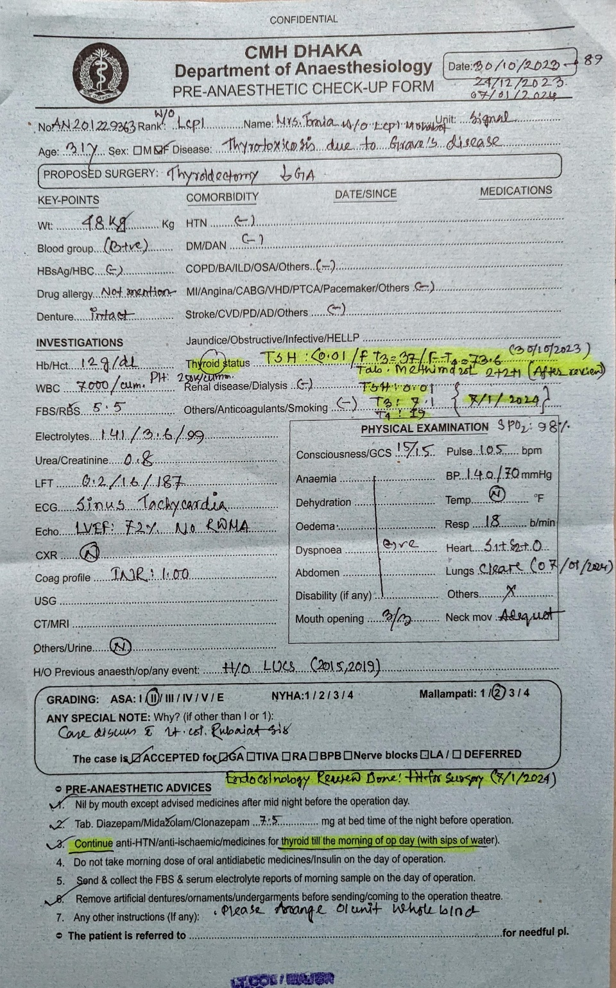

Slide 38
Patient was accepted operation with ASA grade II and Mallampati II

Slide 39
EMERGENCY CASE PREPARATION:
Intravenous B blocker
Ipodate
Dexamethason 2mg IV 6 hourly
PTU 200 -400mg 8 hourly

Slide 40
CONTINUE
Should always be prepared to manage thyroid storm (especially in patients with uncontrolled/poorly controlled disease) Regional anesthesia may be a preferred technique for pt with hyperthyroidism undergoing non-thyroid surgery. Epinephrine-containing LA solutions should be avoided

Slide 41
PREMEDICATION: -BDZs - Anti thyroid medications and Beta-blockers are continued through the morning of surgery. -Avoid Anti cholinergics
Induction: -Establishing adequate anaesthetic depth to avoid exaggerated sympathetic responses.

Slide 42
CONTINUE…
Avoid drugs that stimulate sympathetic nervous system.(e.g ketamine, pancuronium, atropine, ephedrine, epinephrine, norepinephrine, dopamine etc.) because of possibility of exaggerated elevations in BP and HR (or administer in extremely low doses, if needed)

Slide 43
CONTINUE
Thiopental sodium (TPS) possesses some anti thyroid activity at high doses, so it may be the agent of choice.(Thioureylene nucleus of TPS decreases peripheral conversion of T4 to T3).

Slide 44
TRACHEAL INTUBATION:
Adequate anaesthetize depth must be established before laryngoscopy to avoid exaggerated sympathetic responses(tachycardia, hypertension and ventricular arrhythmias).In case of very large thyroid gland, an assistant may elevate it to facilitate intubation.Armored tube is preferred to avoid kinking/obstruction.

Slide 45
POSITIONING AND PRECAUTION:
Head side can be raised 15-20° to aid venous drainage and reduce blood loss, though doing so increases the risk of venous air embolism. Eye protection (eye drops, lubricants, eye pads) as exophthalmos/proptosis increases the risk of corneal abrasion/ulceration.

Slide 46
Monitoring: The surgical procedure as well as the patient's general condition dictate monitoring requirements. Cardiovascular function (ECG, NIBP, Pulse oximetry) and body temperature should be closely monitored.

Slide 47
CONTINUE
Maintenance: No change in MAC. Volatile anesthetics, N2O, Propofol and opioids are generally regarded as safe & satisfactory.
Competitive NMBAs should be administered cautiously and carefully titrated, because hyperthyroid patients may have co-existing muscle disease (e.g. myopathies and myasthenia gravis).

Slide 48
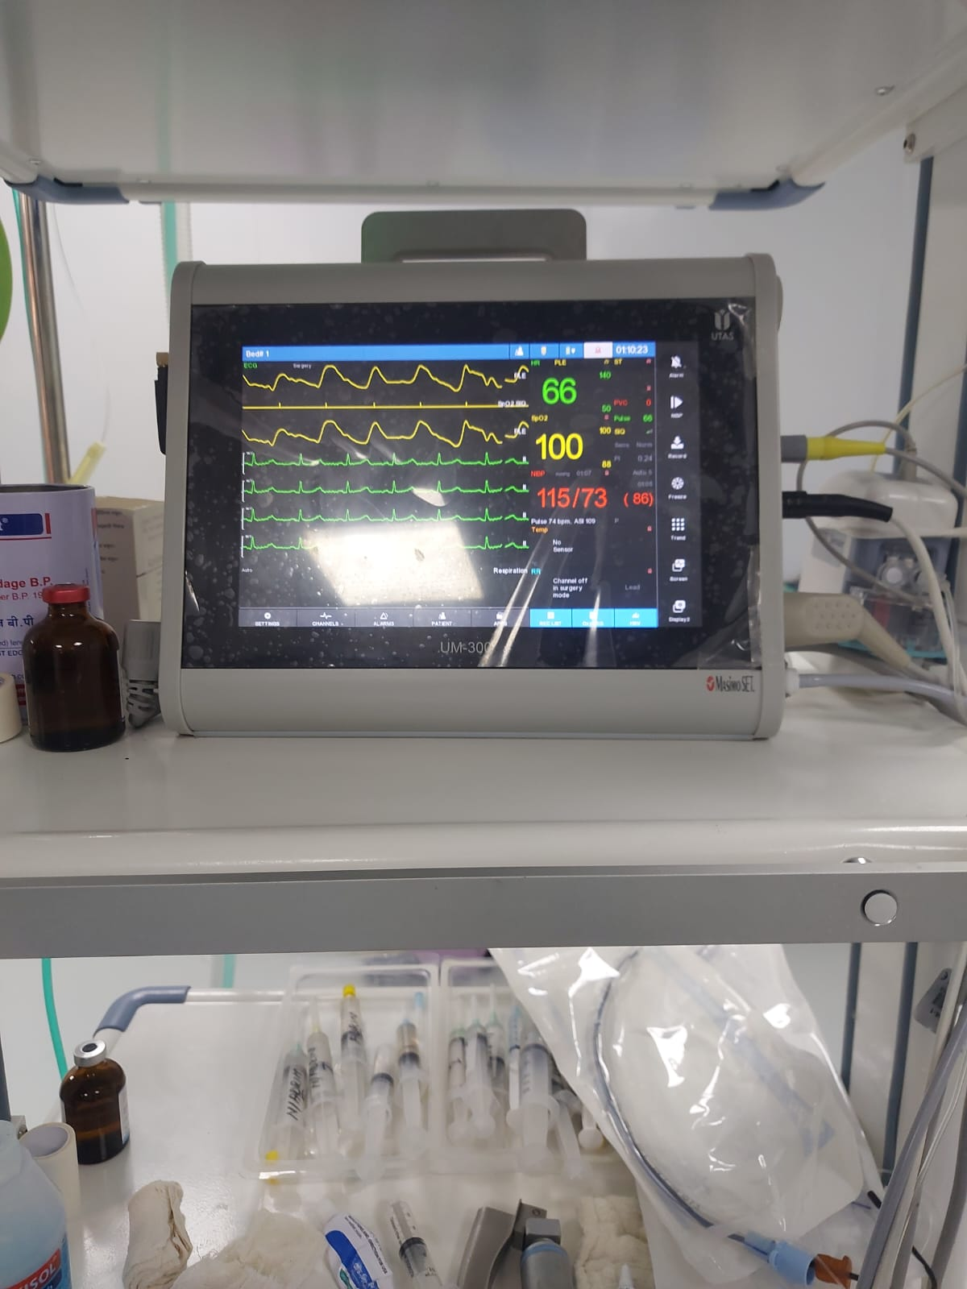
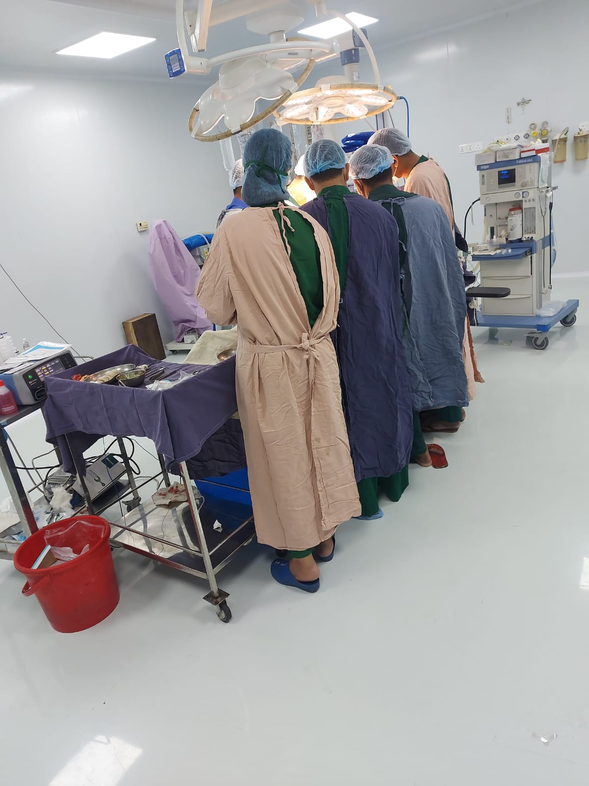

Slide 49
Treat intraoperative hypotension with intravenous fluid and direct acting vasopressor(e.g.phenylephrine) is preferred.
Reversal: Deep extubation may be a choice. Acetylcholinesterase inhibitor+Glycopyrrolate.

Slide 50
CONTINUE
Post-operative: Vocal cord function can be evaluated by laryngoscopy immediately following deep extubation, though rarely necessary. Failure of one or both cords to move may require re intubation and exploration of the wound.

Slide 51
CONTINUE…
Talking to the patient to check the voice. Immediate treatment of hematoma formation following thyroidectomy includes opening the neck wound and evacuating the clot, then reassessing the need for reintubation.

Slide 52
CONTINUE
Take into account thyroid storm and other complications. ß-blocker therapy may need to be continued in the postoperative period (because half life of T4 is 7- 8 days).

Slide 53
THANK YOU
ANY QUESTION?

