Slide 1


Slide 2
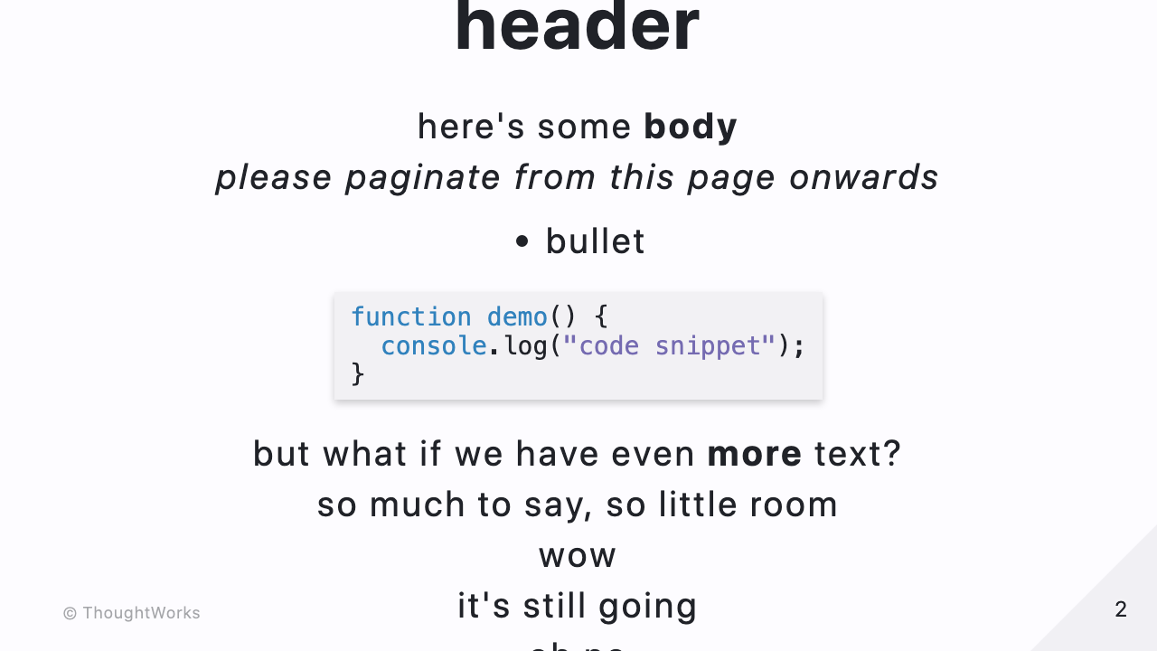

Slide 3
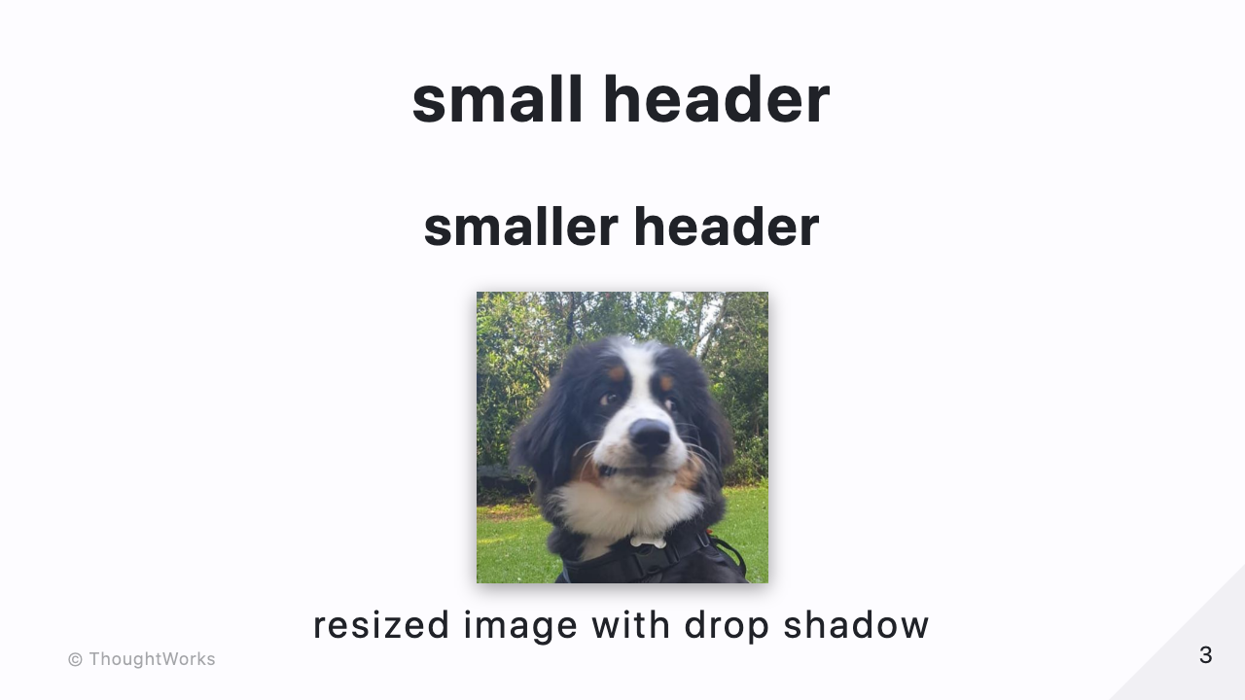

Slide 4


Slide 5


Slide 6

Notes:
these are supposed to be in the presenter notes.

Slide 7
