Slide 1

Defining a program in Lean
CS 4501, UVA
Sabrina Fuller

Slide 2


Defining a language
First, we need need to define
Variables
In this case we are defining basic arithmetic, so we are just defining a_var as a natural number
Binding values to our vars

Slide 3

Defining a language
Second, we need need to define
States
In this case we’ll define states as natural numbers. Where the basic constructor will begin at state 0

Slide 4
Defining a language
Third, we need need to define
States
In this case we’ll define states as natural numbers. Where the basic constructor will begin at state 0

Slide 5
Defining a language
Third, we need need to define
States
X = 4
(X, 0) st1
(X, 4) st2
Thus, a state is bounded to a variable
And every time a var is changed the state changes
X = 4
X = 0
(X, 0) (Y, 0) st1
(X, 4) (Y, 0) st2
(X, 0) (Y, 0) st3

Slide 6
Defining a language
Third, we need need to define
States
X = 4
(X, 0) st1
(X, 4) st2
Thus, a state is bounded to a variable
And every time a var is changed the state changes
X = 4
X = 0
(X, 0) (Y, 0) st1
(X, 4) (Y, 0) st2
(X, 0) (Y, 0) st3

Slide 7
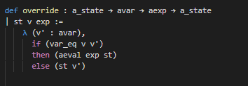

Defining override
If two variables are equal, then we don’t do anything. Else we override with new var
We bind a state to a variable
We override the current value with a new value
We return a new state

Slide 8

Defining how to evaluate our commands
Assign: Where we update the expression with an updated value and assign a new state
Sequence: Where we define how to sequence together two commands

Slide 9
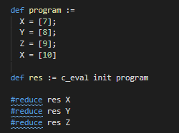
Defining a program
Create a program where we assign values to variables
We then revaluate the program with our evaluation method and initial state

