Slide 1
Car Sales Analysis
By Sabrina Harris

Slide 2
Car Sales Data
From Kaggle
Includes information about 550,000 used & new car sales from 2014 and 2015.
Variables used:
Odometer reading: mileage on the vehicle at the time of sale
Selling Price: the price at which the vehicle was sold (USD)
Body: the body type of the vehicle
Color: exterior color of the vehicle

Slide 3
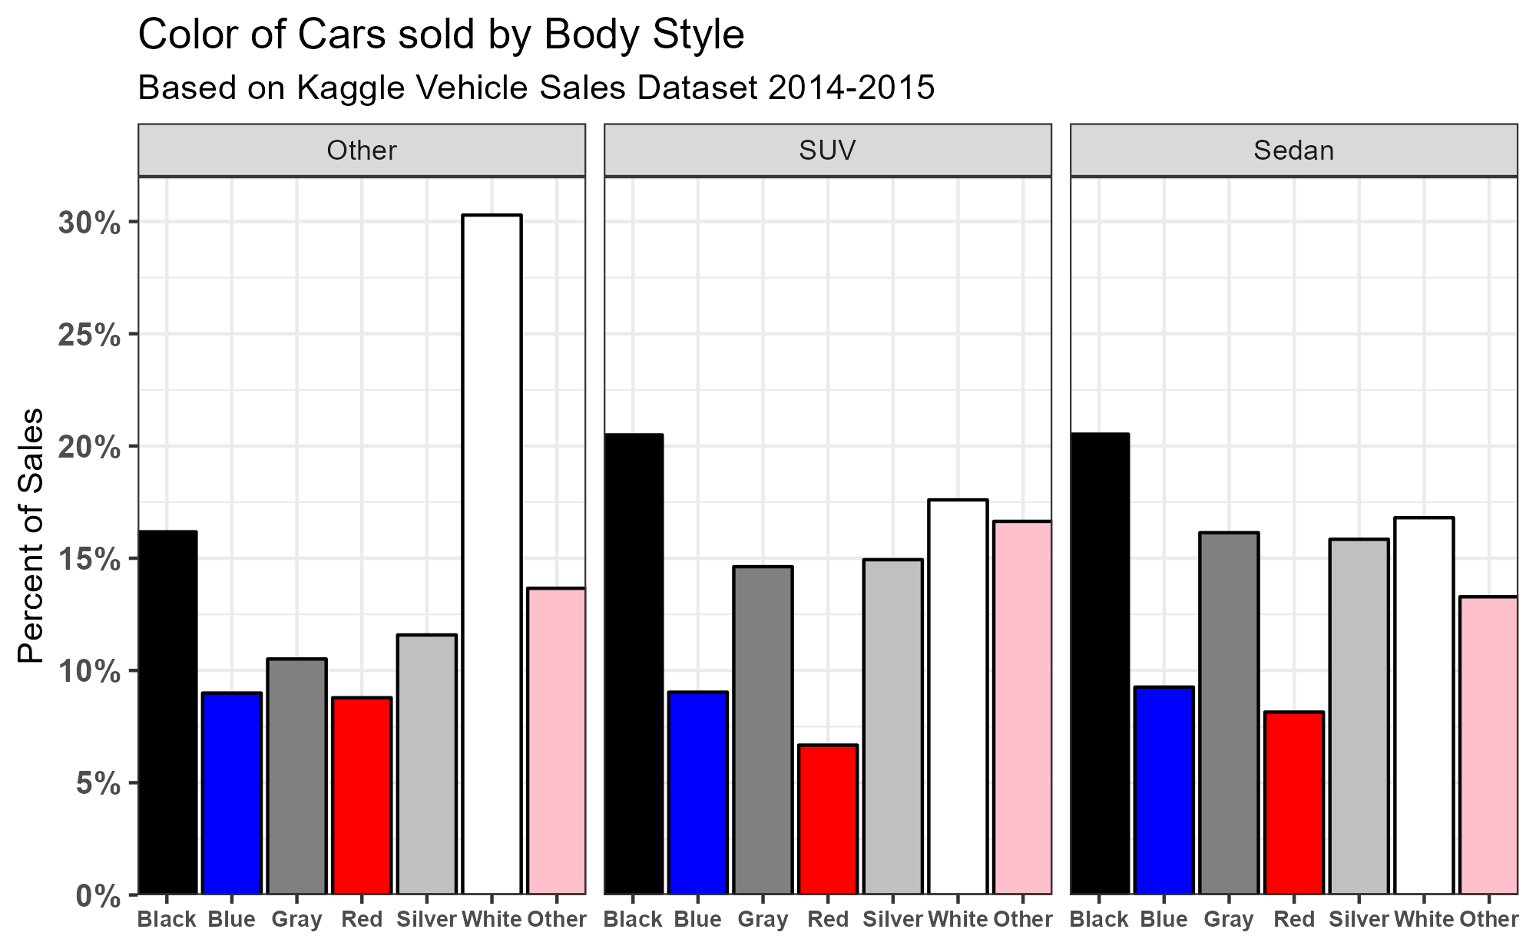

Slide 4
