Slide 1
Car Sales Analysis
By Sabrina Harris

Slide 2
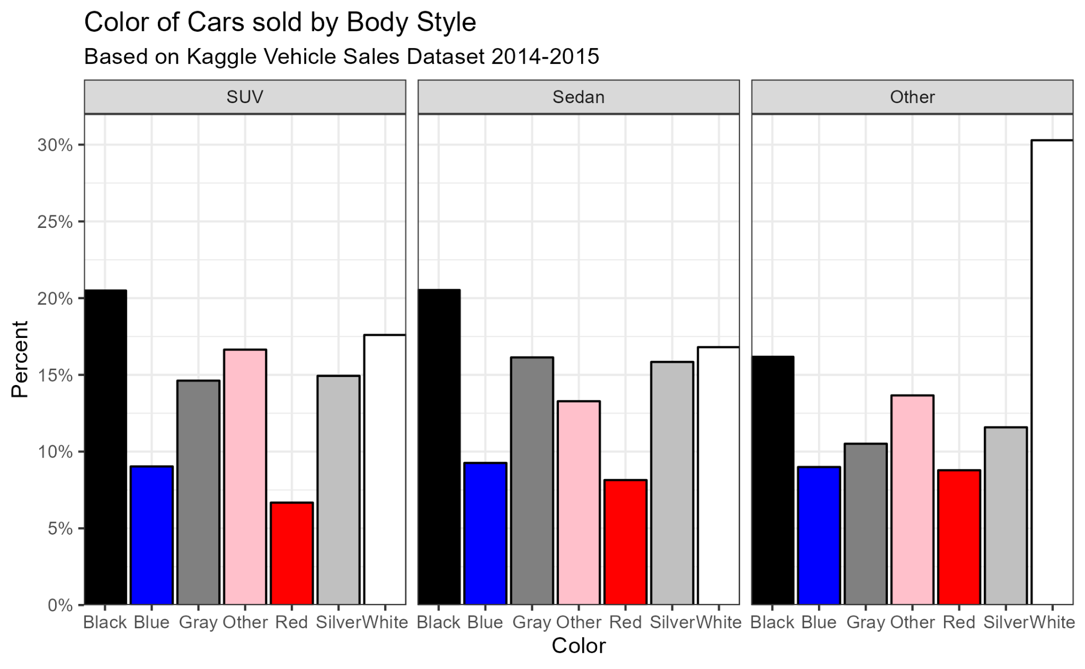

Slide 3
