Slide 1

SSF 2.0 App Architecture workshop

Slide 2
Agenda
SSF 2.0 App Architecture
SSF2.0 Architecture
SSF2.0 interaction with CRM backend
Development approach in SSF2.0
How developments can impact existing functions
2
Internal | RBVH/ETI4 | 2019-01-02
© Robert Bosch Engineering and Business Solutions Vietnam Company Limited 2019. All rights reserved, also regarding any disposal, exploitation, reproduction, editing, distribution, as well as in the event of applications for industrial property rights.

Slide 3
Architecture - IT System landscape – Current situation
SSF FI @ Bosch
Inside
Launchpad
DCZ
QCZ
PCZ
SAP Fiori
DXG
QXG
PXG
RDX
TDX
DDX
QDX
PDX
SSF FI
YDX
Sandbox
ERP
MDM
Others
ERP
MDM
Others
Test systems
Productive systems
3
Internal | Ho Quoc Vuong (RBVH/ETI4) | 2019-01-02
© Robert Bosch Engineering and Business Solutions Vietnam Company Limited 2019. All rights reserved, also regarding any disposal, exploitation, reproduction, editing, distribution, as well as in the event of applications for industrial property rights.

Slide 4
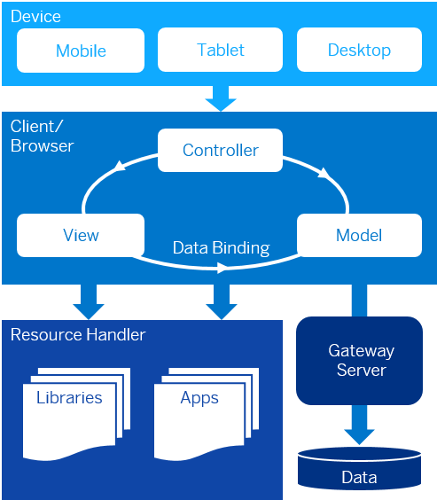
Architecture Overview
SSF 2.0 App Architecture
System
Responsible
xCZ (DCZ, QCZ, PCZ)
End User
xXG (DXG, QXG, PXG)
UI5 team
xDX (RDX, TDX, DDX, QDX, PDX)
CRM Team
4
Internal | RBVH/ETI4 | 2019-01-02
© Robert Bosch Engineering and Business Solutions Vietnam Company Limited 2019. All rights reserved, also regarding any disposal, exploitation, reproduction, editing, distribution, as well as in the event of applications for industrial property rights.
Notes:
SSF 2.0 portal: https://inside.bosch.com/irj/portal/fiori#MyAccSelfService-display&/
SAPUI5 framework:

Slide 5
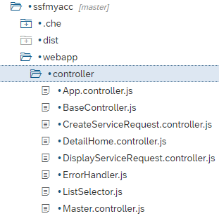
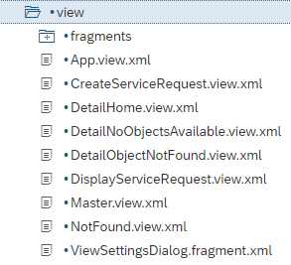
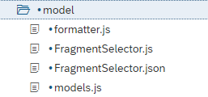
MVC Model
SSF 2.0 App Architecture
5
Internal | RBVH/ETI4 | 2019-01-02
© Robert Bosch Engineering and Business Solutions Vietnam Company Limited 2019. All rights reserved, also regarding any disposal, exploitation, reproduction, editing, distribution, as well as in the event of applications for industrial property rights.
Notes:
Many processes → many views & controller → get complicated over time with Model & controller cod twisted together.

Slide 6
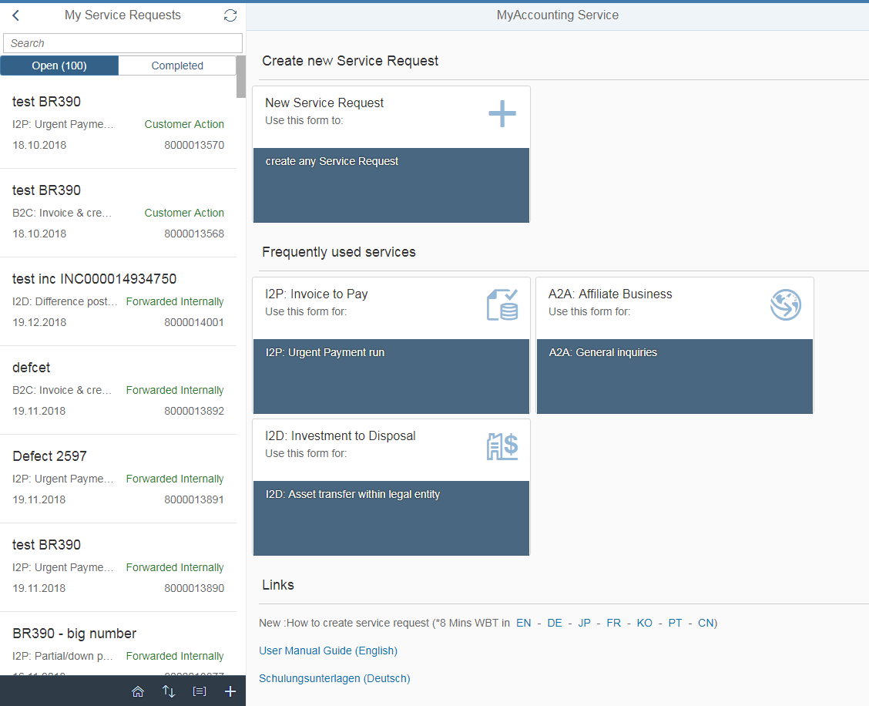
App layout - Home
SSF 2.0 App Architecture
Master
Home
6
Internal | RBVH/ETI4 | 2019-01-02
© Robert Bosch Engineering and Business Solutions Vietnam Company Limited 2019. All rights reserved, also regarding any disposal, exploitation, reproduction, editing, distribution, as well as in the event of applications for industrial property rights.

Slide 7
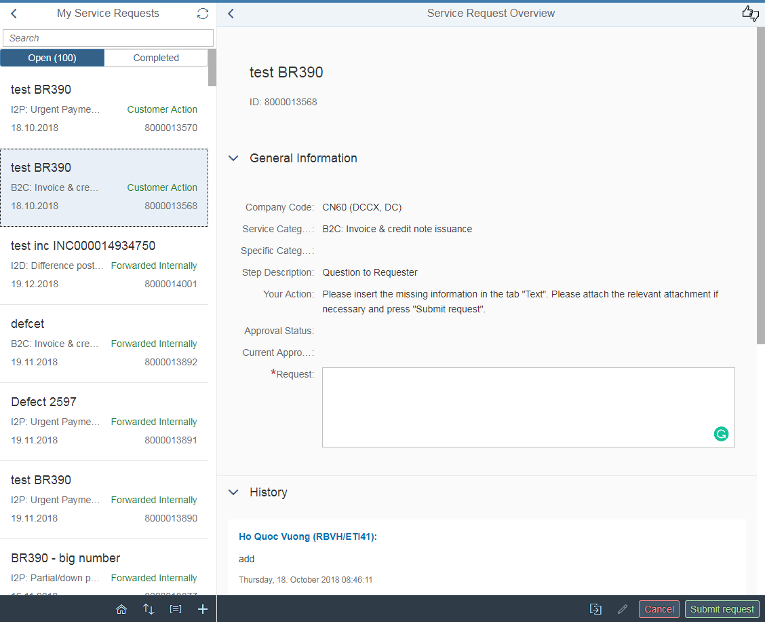
App layout – Display/Create Service Request
SSF 2.0 App Architecture
Master
Detail
7
Internal | RBVH/ETI4 | 2019-01-02
© Robert Bosch Engineering and Business Solutions Vietnam Company Limited 2019. All rights reserved, also regarding any disposal, exploitation, reproduction, editing, distribution, as well as in the event of applications for industrial property rights.

Slide 8
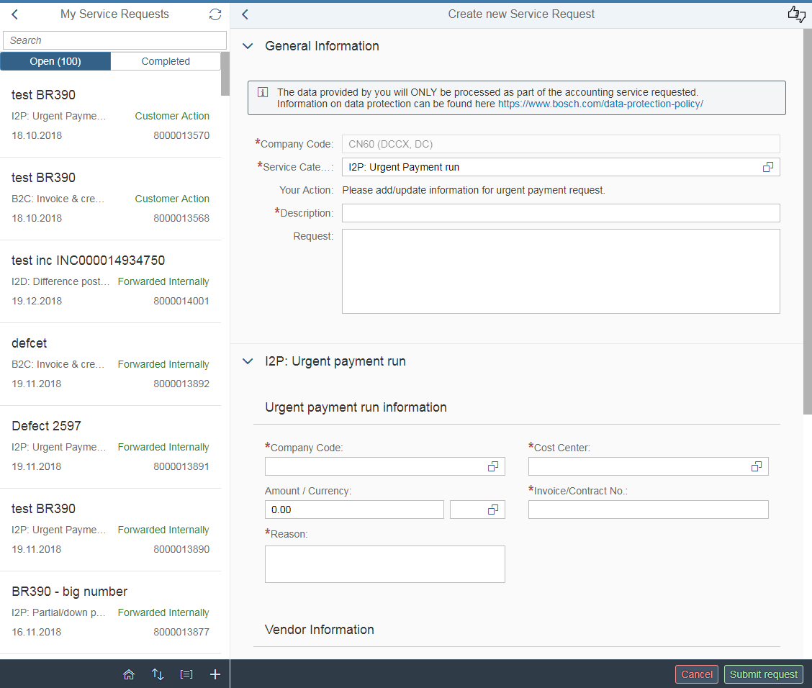
Multiple processes handled using Fragment
SSF 2.0 App Architecture
Selected Category
General fragment
Specific Category Fragment
- Based on selected category
Value will be loaded from Backend, using fields’ name.
8
Internal | RBVH/ETI4 | 2019-01-02
© Robert Bosch Engineering and Business Solutions Vietnam Company Limited 2019. All rights reserved, also regarding any disposal, exploitation, reproduction, editing, distribution, as well as in the event of applications for industrial property rights.

Slide 9



SSF2.0 interaction with CRM backend
SSF 2.0 App Architecture
OData entities example:
Entity Name | Usage
CompanyCodeDefaultSet | To set user company code as default
CostCenterSearchSet | F4 help for cost center
FrequentlyUsedServicesSet | Frequently used Process, add diamond process also
…
Diamond Process entity types
GetGLItems | Add Items in Account Posting and Cost Transfer process
GLAccountSearch | F4 help for GL account
…
Exposes as OData services
9
Internal | RBVH/ETI4 | 2019-01-02
© Robert Bosch Engineering and Business Solutions Vietnam Company Limited 2019. All rights reserved, also regarding any disposal, exploitation, reproduction, editing, distribution, as well as in the event of applications for industrial property rights.

Slide 10
SSF2.0 interaction with CRM backend - Details
SSF 2.0 App Architecture
ObjectId | CategoryId | YYAMT_DEC_55 | YYBUKRS_55 | YYCURRENCY_55
8000013570 |  | 123123.00 | CN60 | USD
{
"ObjectId": "8000013570",
"CategoryId": "",
"Mode": "",
"FieldName": "YYBUKRS_55",
"Index": "0 ",
"FieldValue": "CN60",
"Mandatory": "X",
"Hidden": "",
"Display": "",
"Update": ""
}
{ "ObjectId": "8000013570",
"CategoryId": "",
"Mode": "",
"FieldName": "YYAMT_DEC_55",
"Index": "0 ",
"FieldValue": "123123.00",
"Mandatory": "",
"Hidden": "",
"Display": "",
"Update": "" }
10
Internal | RBVH/ETI4 | 2019-01-02
© Robert Bosch Engineering and Business Solutions Vietnam Company Limited 2019. All rights reserved, also regarding any disposal, exploitation, reproduction, editing, distribution, as well as in the event of applications for industrial property rights.

Slide 11
Development approach in SSF2.0
SSF 2.0 App Architecture
LH Preparation.
UD & CI
Timeline Planning
PH preparation
CI & Dev Team discuss PH & estimate effort.
Open discussion with UD
Sprint Development
Dev Team develop based on PH
Test before delivery
Test phase
1 week for CI Test.
2 week for UD test.
GO-LIVE
If everything is OK.
11
Internal | RBVH/ETI4 | 2019-01-02
© Robert Bosch Engineering and Business Solutions Vietnam Company Limited 2019. All rights reserved, also regarding any disposal, exploitation, reproduction, editing, distribution, as well as in the event of applications for industrial property rights.

Slide 12
How developments can impact existing functions
SSF 2.0 App Architecture
Code is reused for all processes.
SR in different processes are loaded based on variant.
Other entities (Cost center, service category) are also loaded based on variant.
→ which is changed during Diamond processes → affect all processes
→ which is changed during Diamond processes → affect all processes
Reduce the complexity of the development, Improve the app-loading performance.
But affect multiple functions when changed.
Example Defects: 4610
Example Defects: 4628, 4593
Solution: Test carefully after development.
Solution: fixed in Sprint 11-2018
Solution: fixed in Sprint 11-2018
12
Internal | RBVH/ETI4 | 2019-01-02
© Robert Bosch Engineering and Business Solutions Vietnam Company Limited 2019. All rights reserved, also regarding any disposal, exploitation, reproduction, editing, distribution, as well as in the event of applications for industrial property rights.
Notes:
1. Defect 4628: No error message when request field is empty, Silver process
The variant ID from backend is returned incorrect. It should be '000002' instead of '000000'.Cost center loaded based on variant.
2. Defect 4637: buffer issues happened repeatedly during Sprint
The duplicated id error will appear if fragment is loaded again. We need to destroy fragment before reloading it.
3. Defect 4593: loading of cost center based on company code for gold process is gone.
- Previously, Frontend sent request to get full cost center but backend can not return all cost center because data is too big, that why there were some cost center missed.
- Now, Frontend only send request with specific company code and backend just returns cost center that belong to the company code.
One special reason that developer always try to utilize the old functions to avoid duplicating source code when implement new features that why the old features may be impacted. Developers need to carefully test before submit changed code.

Slide 13

Current MVC Model
SSF 2.0 App Architecture
Complicated code base
Develop over time
More features
More processes
Controller & Model
13
Internal | RBVH/ETI4 | 2019-01-02
© Robert Bosch Engineering and Business Solutions Vietnam Company Limited 2019. All rights reserved, also regarding any disposal, exploitation, reproduction, editing, distribution, as well as in the event of applications for industrial property rights.

Slide 14
Defects reason - communication gap (PH preparation)
SSF 2.0 App Architecture
Feature 1
BR-124
BR-123
Feature 2
Improvement
Old Feature 3
BR-1239
Feature 3
BR-123
BR-453
Feature 1
BR-124
BR-123
Feature 2
Improvement
Old Feature 3
BR-1239
Feature 3
BR-123
BR-453
Communication Gap
UD Point of view
Developers point of view
14
Internal | RBVH/ETI4 | 2019-01-02
© Robert Bosch Engineering and Business Solutions Vietnam Company Limited 2019. All rights reserved, also regarding any disposal, exploitation, reproduction, editing, distribution, as well as in the event of applications for industrial property rights.

Slide 15
Thank you
We are Bosch
SSF Team → FI SSF → Bosch users are happy with the new application.
15
Internal | RBVH/ETI4 | 2019-01-02
© Robert Bosch Engineering and Business Solutions Vietnam Company Limited 2019. All rights reserved, also regarding any disposal, exploitation, reproduction, editing, distribution, as well as in the event of applications for industrial property rights.

Slide 16
SSF 2.0 App Architecture
Device
Mobile
Tablet
Desktop
Device
Controller
View
Model
16
Internal | RBVH/ETI4 | 2019-01-02
© Robert Bosch Engineering and Business Solutions Vietnam Company Limited 2019. All rights reserved, also regarding any disposal, exploitation, reproduction, editing, distribution, as well as in the event of applications for industrial property rights.

