Slide 1








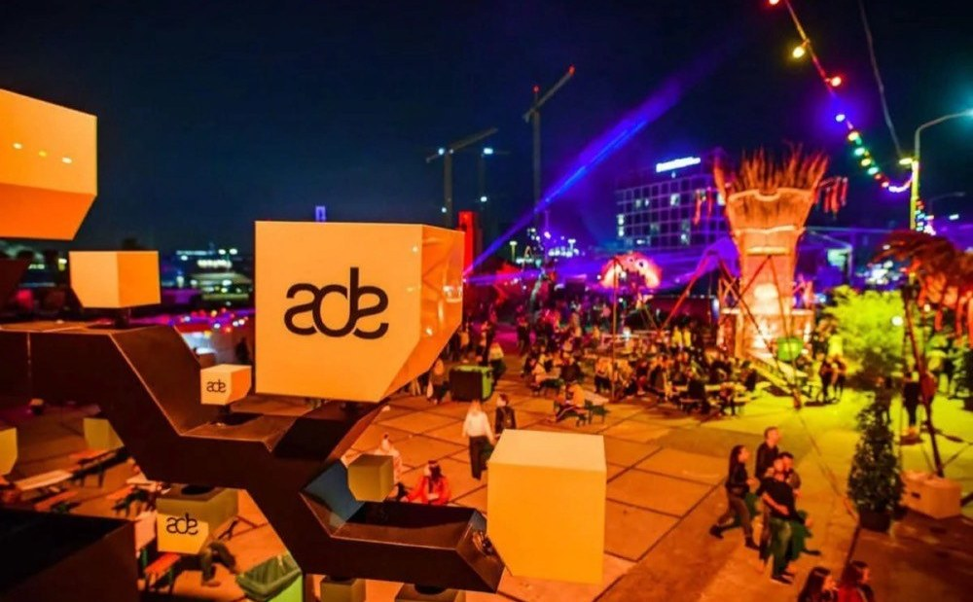
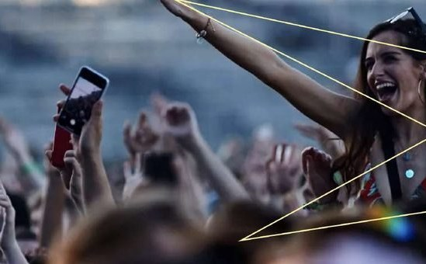
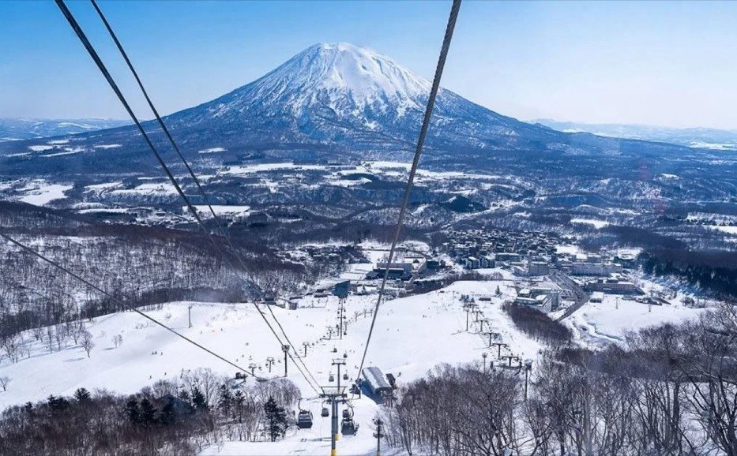
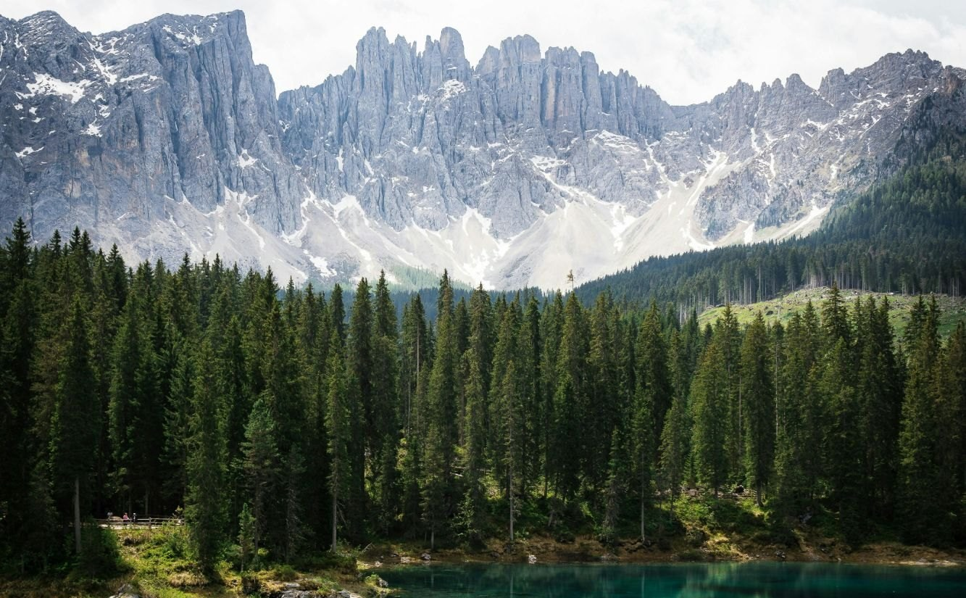






DAYS / PARTNER ONE-PAGER
JAKARTA · SINCE 2022
Experience-driven travel media
and global connector between
Indonesia and Europe.
Media perjalanan berbasis pengalaman dan penghubung global antara Indonesia dan Eropa.
It starts with the music. DAYS takes Indonesian travelers to Europe’s festivals, and no one else in Indonesia does it the way we do. Around that core, we plan cities, nature, sport and slow travel.
5×
2,000+
97–98%
Amsterdam Dance Event, every year 2022–2026
visa applications processed since 2022
visa approval rate
ONE BRAND. FIVE WAYS TO GO.
CITY
A city the way locals live it.
Seoul: Soft Days
MUSIC FESTIVAL
Europe’s festivals, planned around the lineup. Our core.
ADE 2022–2026 · Primavera Sound 2024–2026 · Dekmantel 2026
NATURE
Journeys where the landscape is the reason to go.
Dolomites · Positano · Sorrento, 2025
SPORTS
Formula 1, Grand Slams and active escapes.
Australian Open · Niseko 2024–25
CULINARY, LEISURE &
WELLBEING
Slow travel for food, wine and rest.
Tuscany · Florence · Bologna · Rome, 2025
OUR HIGHLIGHTS
ADE, Amsterdam
Primavera Sound
Niseko, Japan
Italy, 2025
Five editions in a row, 2022–2026, and the ADE 2026 Asia Hub panel.
Barcelona, with a DAYS group three years running, 2024–2026.
Ski open trip for all levels, winter 2024–25.
Seven places in one year, from the Dolomites and Positano to Florence and Rome.
TRUSTED BY
Let’s plan your next DAYS.
+62 812 2000 0185 lets@talkaboutdays.com @talkaboutdays talkaboutdays.com

