Slide 1
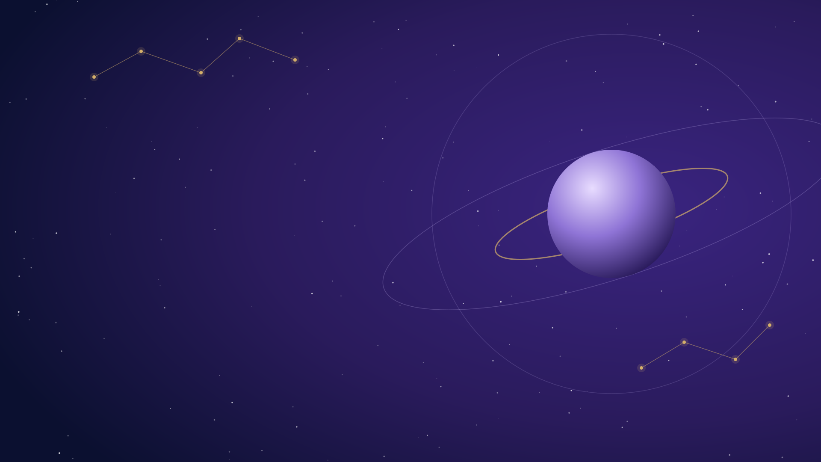


ASTROLUME
Your Personalized AI-Powered Podcast
From personal questions to meaningful conversations.
Astrology-inspired personal reflection, powered by AI
Two virtual podcast hosts: Alex and Sam
Team: Murat Comez – Max Kempa – Sabrina Urriola

Slide 2








The Problem & Our Solution
The Problem
Our Solution: Astrolume
Traditional podcasts give every listener the same content.
Turns personal questions into customized podcast conversations.
Mainstream astrology websites provide generic reviews, not personalized.
Grounded in a study of planetary positions, zodiac signs, houses, aspects, and planetary transits.
Finding audio that answers a specific personal question is hard.
Explores transformation, control and personal growth.

Slide 3
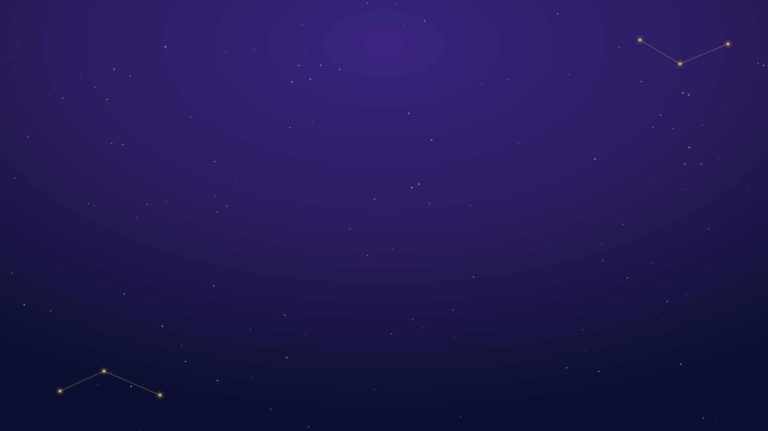




How Astrolume Works
1
2
3
4
5
User Input
PDF Processing
Script Generation
Text-to-Speech
Gradio Interface
Python · Gradio
PyMuPDF
OpenAI
OpenAI + Pydub + FFmpeg
Gradio
Personal question + birth information.
Extracts reference material on the Natal Pluto Complex.
A personalized Alex & Sam dialogue, grounded in the PDF and your question.
Two distinct voices, combined into a single MP3.
Shows the script and plays the audio.
Note: personalization comes primarily from the user's question.
Python | Gradio | OpenAI API | PyMuPDF | Pydub | FFmpeg

Slide 4








Key Learnings & Next Steps
Key Learnings
Possible Next Steps
Planning your project reduces mistakes
Improve personalization and user customization.
Teamwork & Communication
Enable adjustable podcast length for users.
Testing is important
Enter the discussion of the podcast.
Be adaptable

Slide 5
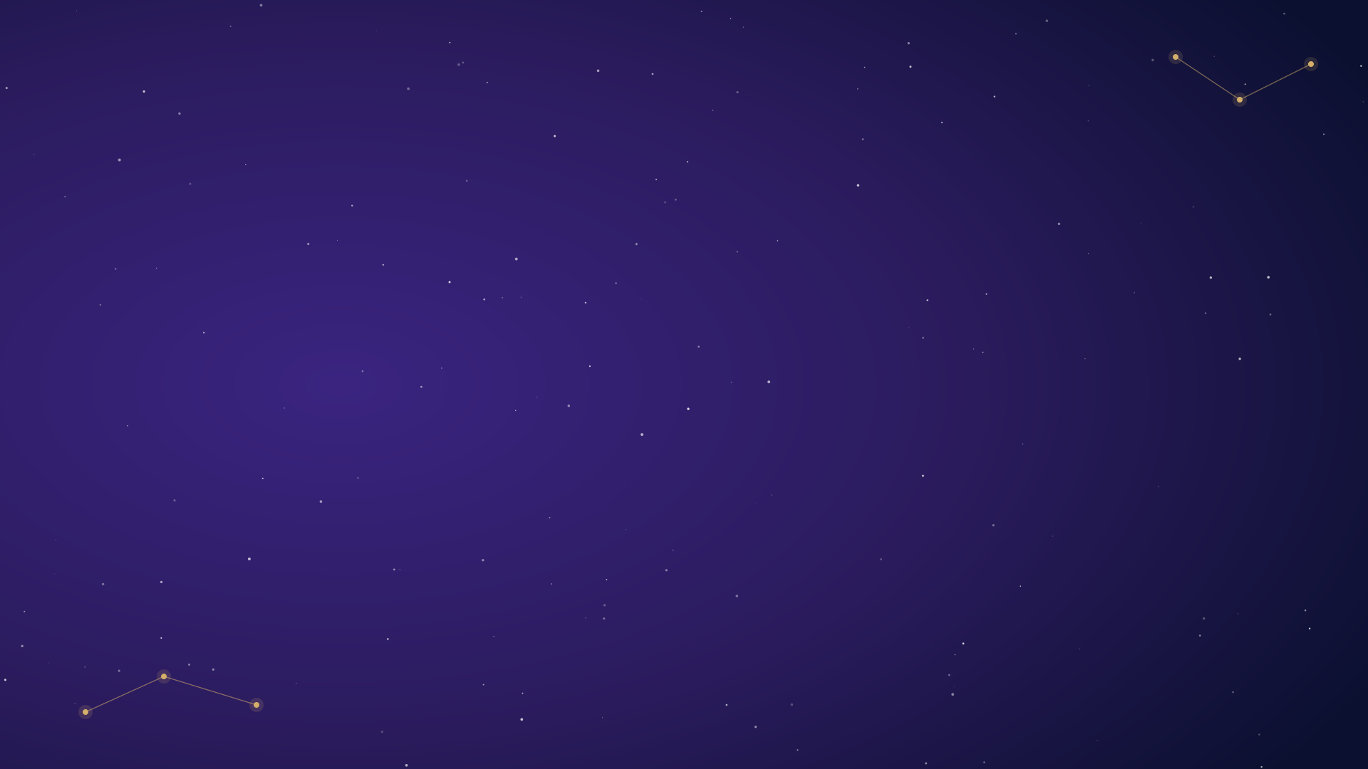
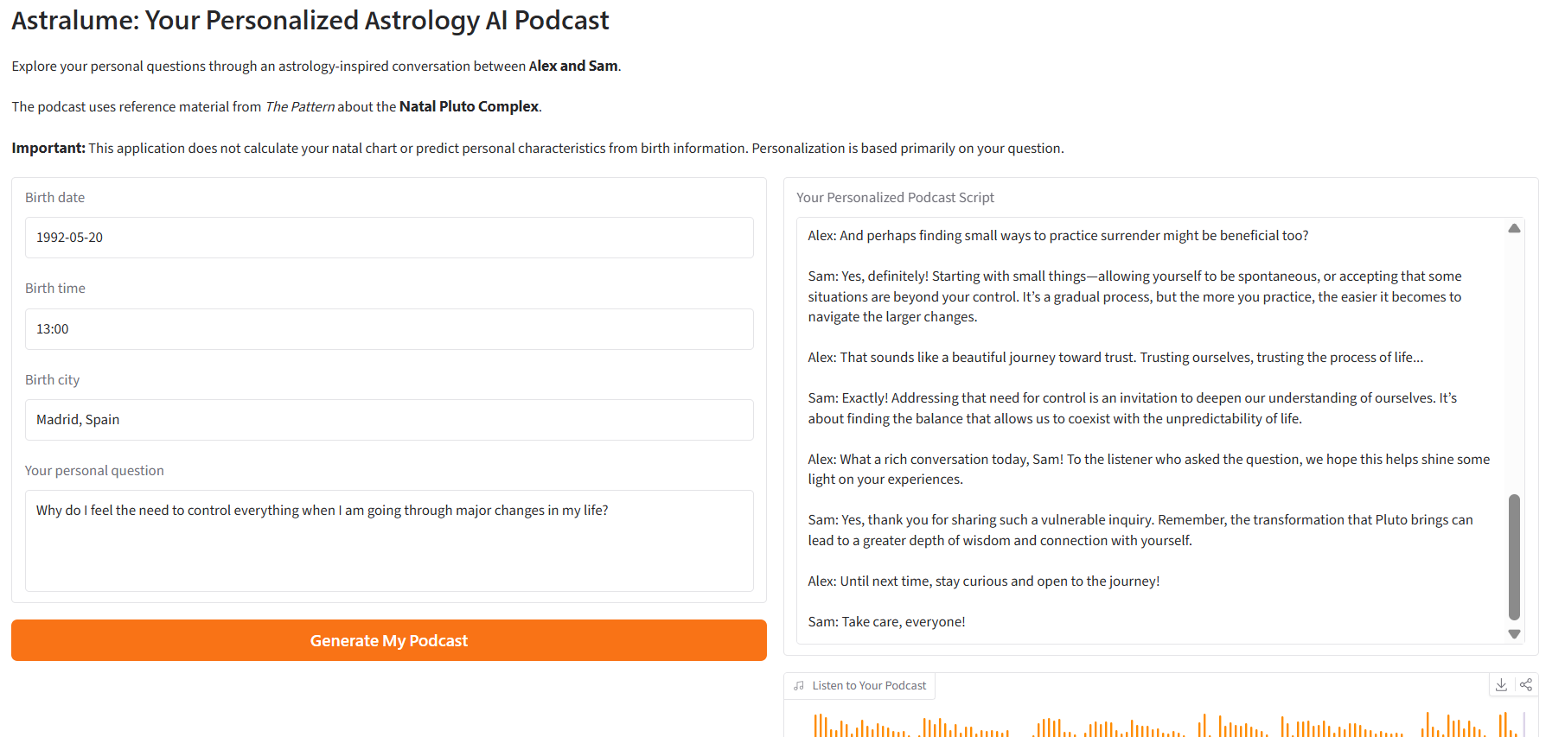

See Astrolume in Action
From a personal question to a two-host AI podcast.
Demo question
“Why do I feel the need to control everything when I'm going through major changes in my life, and how can I learn to let go?”
Click the player to hear the podcast
Watch the demo video: https://www.loom.com/share/c9b86a2c7ca44b299814c017e30b09c3
Generated podcast audio (embedded MP3)

