Slide 1
Procurement Risk & Mitigation Agent
PROJECT 3 · FINAL PRESENTATION
Market news + company contracts → a checked risk report
Sabrina Urriola · Food manufacturing · Built with LangGraph
Time: about 0:20

Slide 2
The problem, and who has it
WHY · THE PROBLEM
WHO
WHAT THEY DO TODAY
THE PAIN
Procurement manager at an industrial bakery
Reads news, then checks contracts by hand
Cost exposure and risk of production stops
Buys sunflower oil and wheat. Demo company: Bakery Foods Inc. (fictional).
Repeated before each buying decision.
Uncovered volume is bought at spot prices.
A missed signal can mean higher costs or a stopped line.
Project 3 · Sabrina Urriola
Time: about 0:45

Slide 3

How it works
HOW · THE DATA FLOW
Market news and company data go in; a risk report with sources comes out.
Step 1
Step 2
Step 3
Step 4
Step 5
Trigger
Collect
Check
Write
Deliver
A web form: commodity and months
Web search, news and EU price data
Our contracts, forecasts and policies
The AI drafts it; unsupported claims are removed
Saved in Notion; email on request
Every claim needs a quote from a source.
Project 3 · Sabrina Urriola
Time: about 0:30

Slide 4
See it work.
HOW · LIVE DEMO
Sunflower oil, 3 months → a risk report in Notion
1
2
3
4
Start it
Show it run
Open the report
Prove it
Sunflower oil, 3 months
Research, checks, then the draft
Click one source link
Exposure, risks, actions
Backup ready: a saved report and a screen recording.
Project 3 · Sabrina Urriola
Time: about 2:15

Slide 5
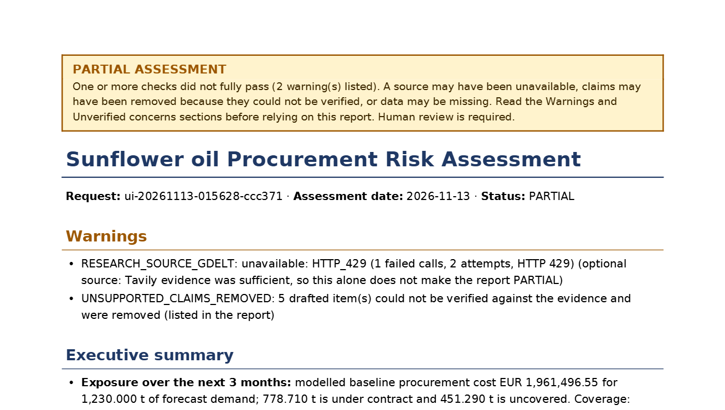
What the user gets
SO WHAT · THE RESULT
About 1 minute
per report (43–97 s in live runs)
Sources
Every key claim has a quote and a link
Honest
Unverified claims are removed and listed
Project 3 · Sabrina Urriola
Time: about 0:30

Slide 6
Under the hood
SO WHAT · TECHNICAL SPECIFICATIONS
Part | What we use | Its job
Orchestration | LangGraph (Python) | Runs every step after the trigger
AI model | OpenAI gpt-5.4-mini + embeddings | Reads, compares, writes the report
Data sources | Tavily · GDELT · EU oilseed prices | Live news and price facts
Grounding | Supabase (SQL + pgvector) | Checks facts against contracts and policies
Delivery | n8n → Notion · Gmail | Archives the report; email on request
Error handling | Budget limits + visible status | An API fails → the report says so, no guessing
Why LangGraph: the checks, maths and spending limits need real code.
COST PER REPORT
~$0.04
TIME PER RUN
43–97 seconds
Project 3 · Sabrina Urriola
Time: about 0:45

Slide 7
Under the hood
SO WHAT · TECHNICAL SPECIFICATIONS
Why LangGraph: the checks, maths and spending limits need real code.
COST PER REPORT
~$0.04
TIME PER RUN
43–97 seconds
Project 3 · Sabrina Urriola
Time: about 0:45

Slide 8
What’s next: go-to-market sprints
NEXT · GO-TO-MARKET
Sprint | Goal & audience | How we reach them | Deliverable | Success metric
1 | Learn: 12 buyer interviews at food makers in Spain | LinkedIn and industry groups | Sample report + findings note | 6 of 12 say it would change a decision
2 | Trust: 3 buyers share anonymised data | Follow-up calls with Sprint 1 leads | Report on their own data | 2 of 3 confirm the exposure figure
3 | Pilot: 1–2 teams for 6 weeks | Sponsors from Sprint 2 | Weekly report + one-page offer | 1 team stays; 1 names a price
All targets are hypotheses, not results.
Project 3 · Sabrina Urriola
Time: about 0:30

Slide 9
Thank you.
Questions?
github.com/sabrinaurriola/procurement-risk-and-mitigation-ai-agent
Sabrina Urriola
Time: about 0:15

