Slide 1
STLS HYBRID
SMART TRAFFIC LIGHT SYSTEM · ROYAUME DU MAROC
Traffic signal engineering,
control, and runtime — in one product.
A web dashboard, a desktop engineering + control tool, and a field controller runtime.
Internal project deck · Engineering + Operations

Slide 2
◆
STLS HYBRID
AGENDA
What this deck covers
01
Product & positioning
Why STLS exists and the three products that ship together.
02
Architecture
Operations dashboard, Desktop Studio, Controller runtime.
03
Engineering mode
Configure an intersection end-to-end: identity, approaches, signal groups, phases, detectors, controller, live schematic.
04
Control mode
SEA/TOPS-style operator console — diagram, timing strip, piano keys, keyboard shortcuts.
05
Theme architecture
Dark and light mode built on semantic tokens.
06
Stack & status
Technology choices and what comes next.

Slide 3
◆
STLS HYBRID
PRODUCT POSITIONING
What STLS is — and what it isn't
STLS IS
STLS IS NOT
▸ Traffic-signal engineering software
Configure phases, stages, signal groups, conflict matrix.
▸ An operator control room
Play traffic lights like a piano during incidents and peaks.
▸ A field controller runtime
Run the intersection 24/7 on the device in the cabinet.
▸ Not an AI research dashboard
No ML panels, no black-box decisions.
▸ Not a city analytics platform
No KPIs, no long-tail charts. Operators first.
▸ Not a replacement for SCADA monitoring
The Operations dashboard is for supervision, not control.

Slide 4
◆
STLS HYBRID
ARCHITECTURE
Three products, one system
Each surface is focused on the audience it serves.
Operations
Web dashboard for police, district supervisors, and C2.
Studio · Desktop
Engineering + Control tool — SEA/TOPS style.
Controller Runtime
Standalone Go process that runs in the field cabinet.
• Live map & alerts
• Hardware health
• Read-mostly view
• Intersection editor
• Apply / Pull to runtime
• Piano-key operator console
• Cycle simulator
• Socket.IO live state
• Offline fall-back

Slide 5
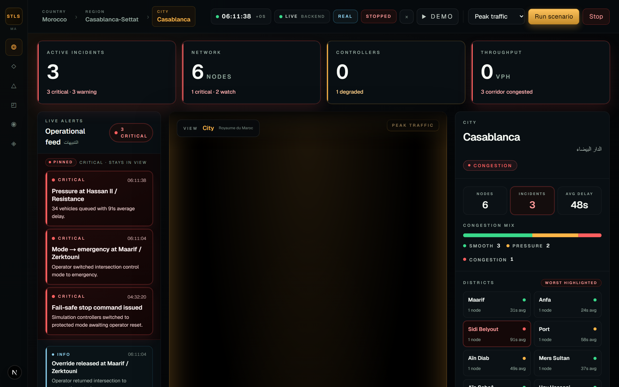
◆
STLS HYBRID
OPERATIONS DASHBOARD
City-wide supervision, not control
Read-mostly view for police, district supervisors, and the command centre.
▸ Live map
Morocco-wide intersection state.
▸ Alert feed
Hardware and operational alerts in one stream.
▸ Scenario runner
Trigger normal / peak / emergency demo scenarios.
▸ Strict supervision
Commands that change traffic stay in Studio.
STLS Hybrid · Smart Traffic Light System
05 / 22

Slide 6
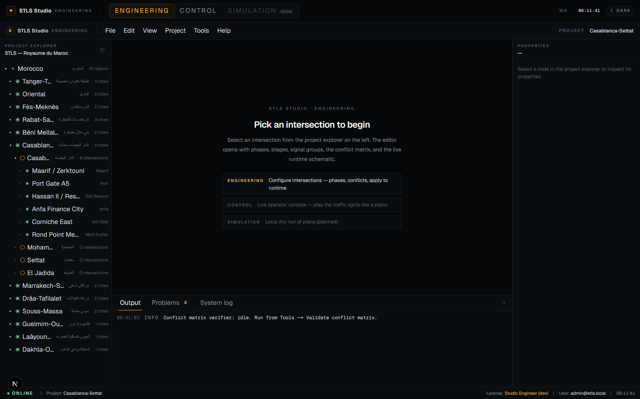
◆
STLS HYBRID
STUDIO · SPLASH
One intersection at a time
SEA/TOPS-style desktop — project tree on the left, workspace in the centre, control rail on the right.
▸ Project explorer
Country → region → city → intersection.
▸ Mode tabs
Engineering · Control · Simulation.
▸ Session memory
Reopens the last intersection you worked on.
▸ No dashboard noise
Every surface is engineer- or operator-focused.
STLS Hybrid · Smart Traffic Light System
06 / 22

Slide 7
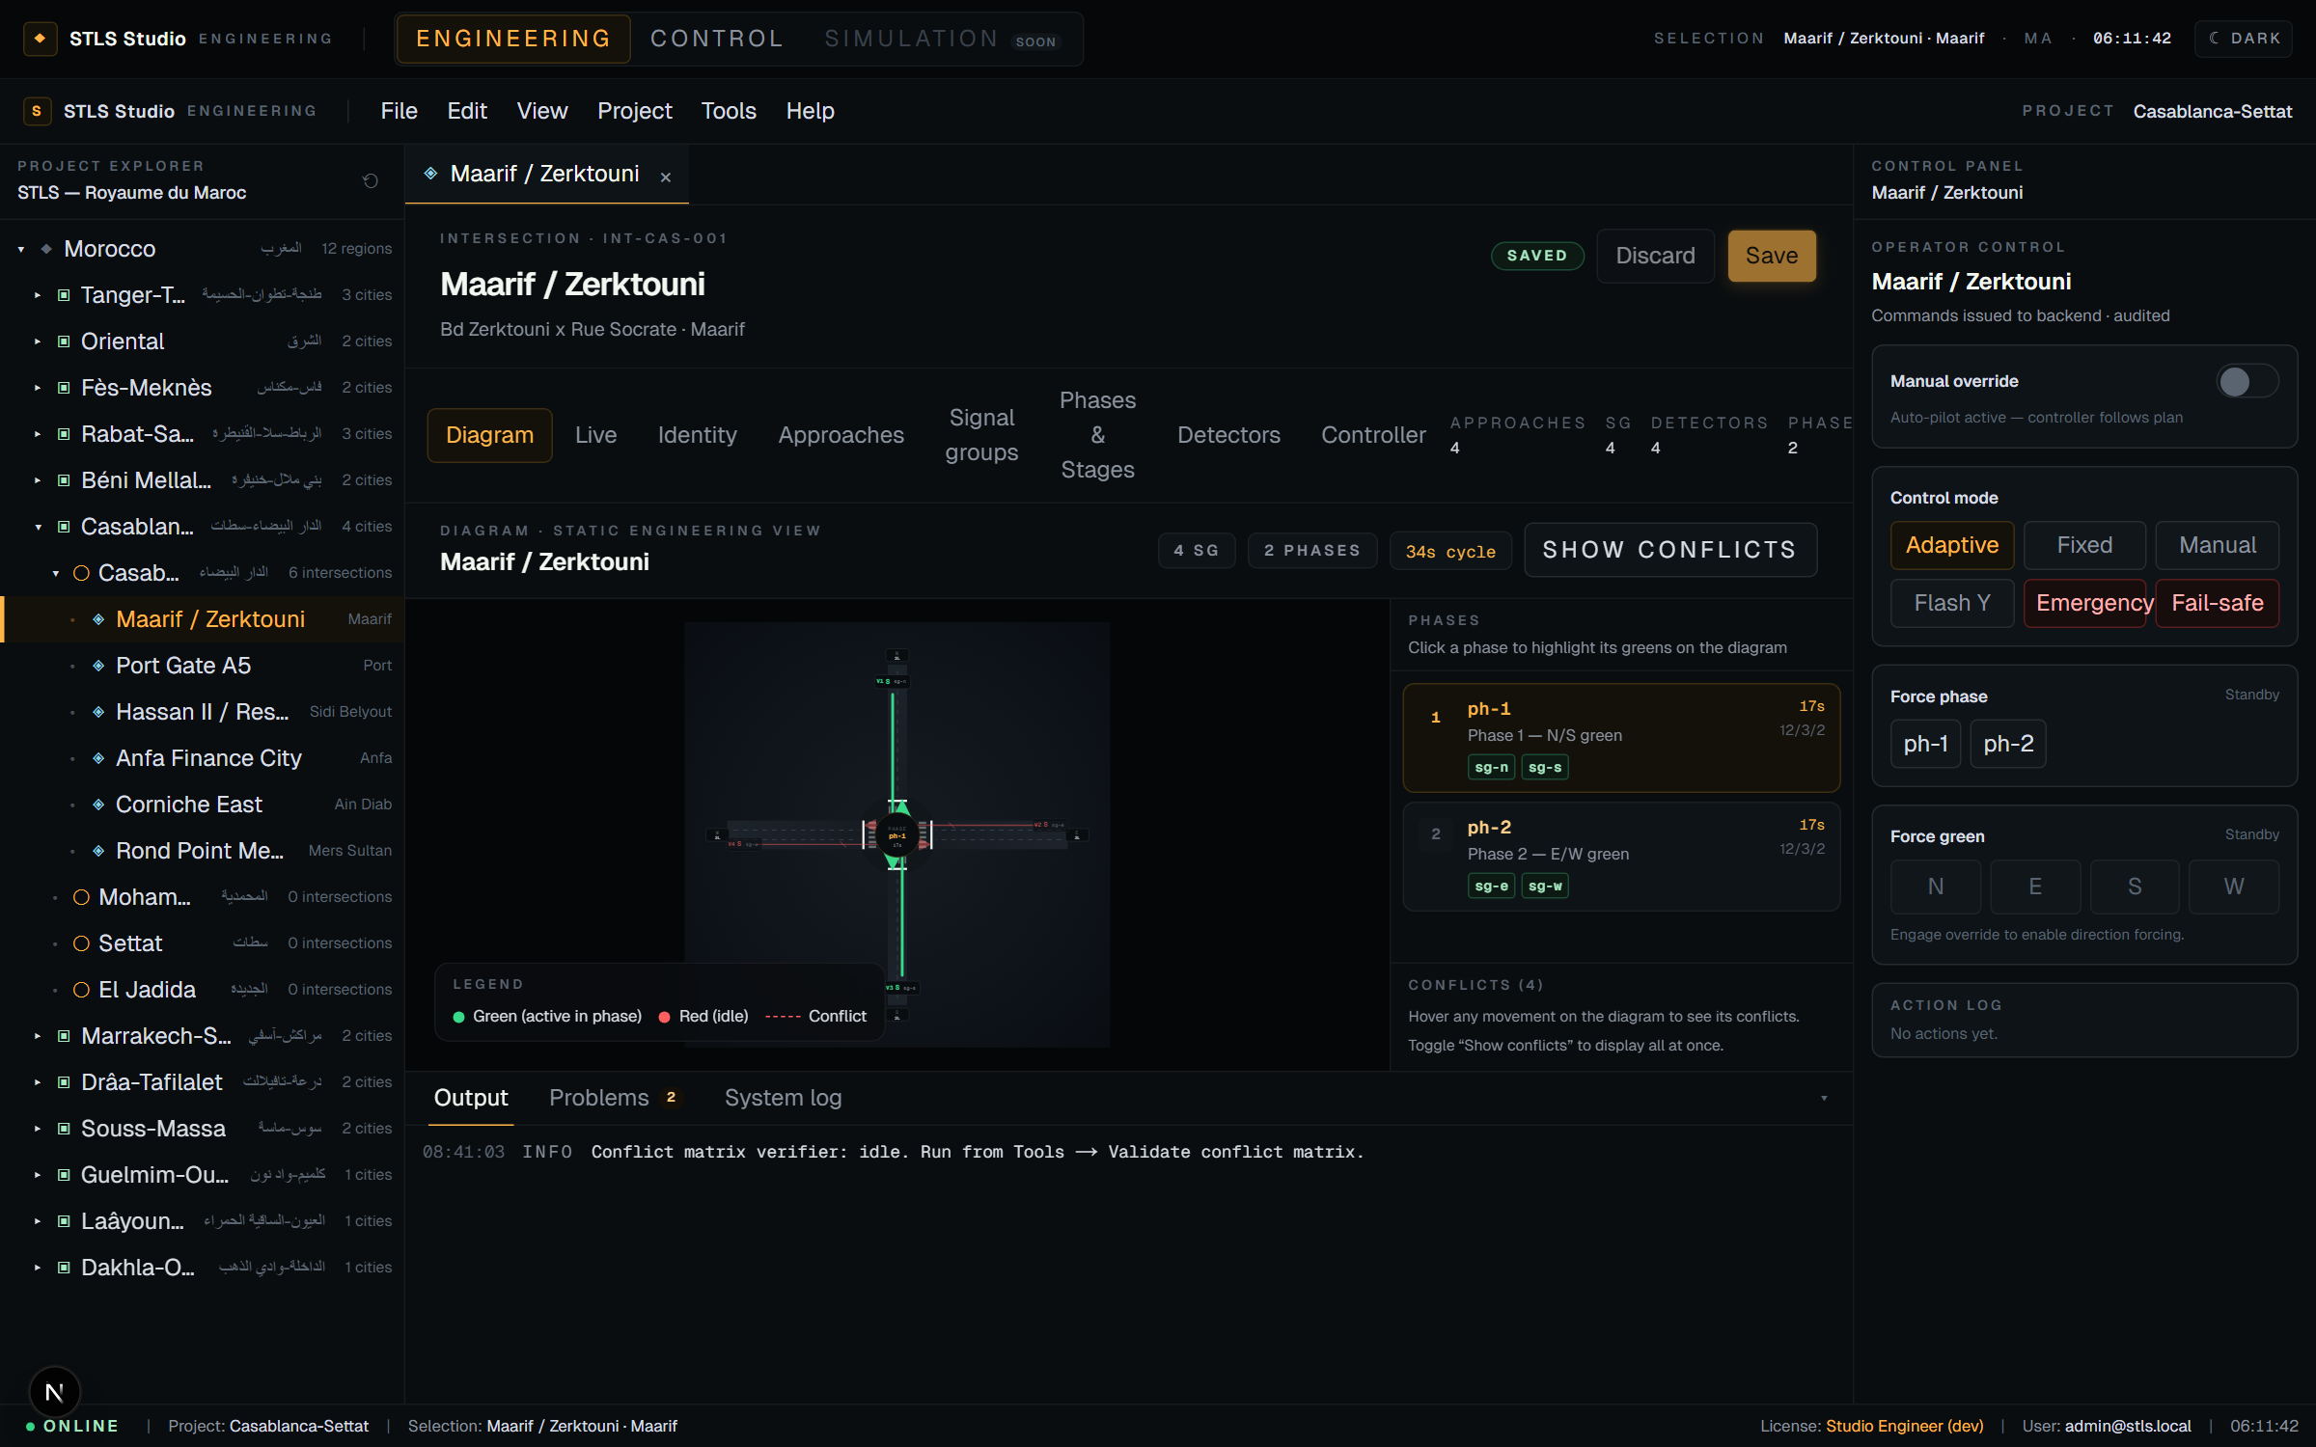
◆
STLS HYBRID
ENGINEERING · DIAGRAM
Static engineering view of the intersection
Multi-bearing, multi-lane, with turning movements and a per-phase phase panel.
▸ 8 cardinal bearings
N, NE, E, SE, S, SW, W, NW.
▸ Real lane geometry
Lane count per approach drives road width.
▸ Turning arrows
Left / straight / right per signal group.
▸ Conflict overlay
Toggle to see all incompatibility pairs at once.
STLS Hybrid · Smart Traffic Light System
07 / 22

Slide 8
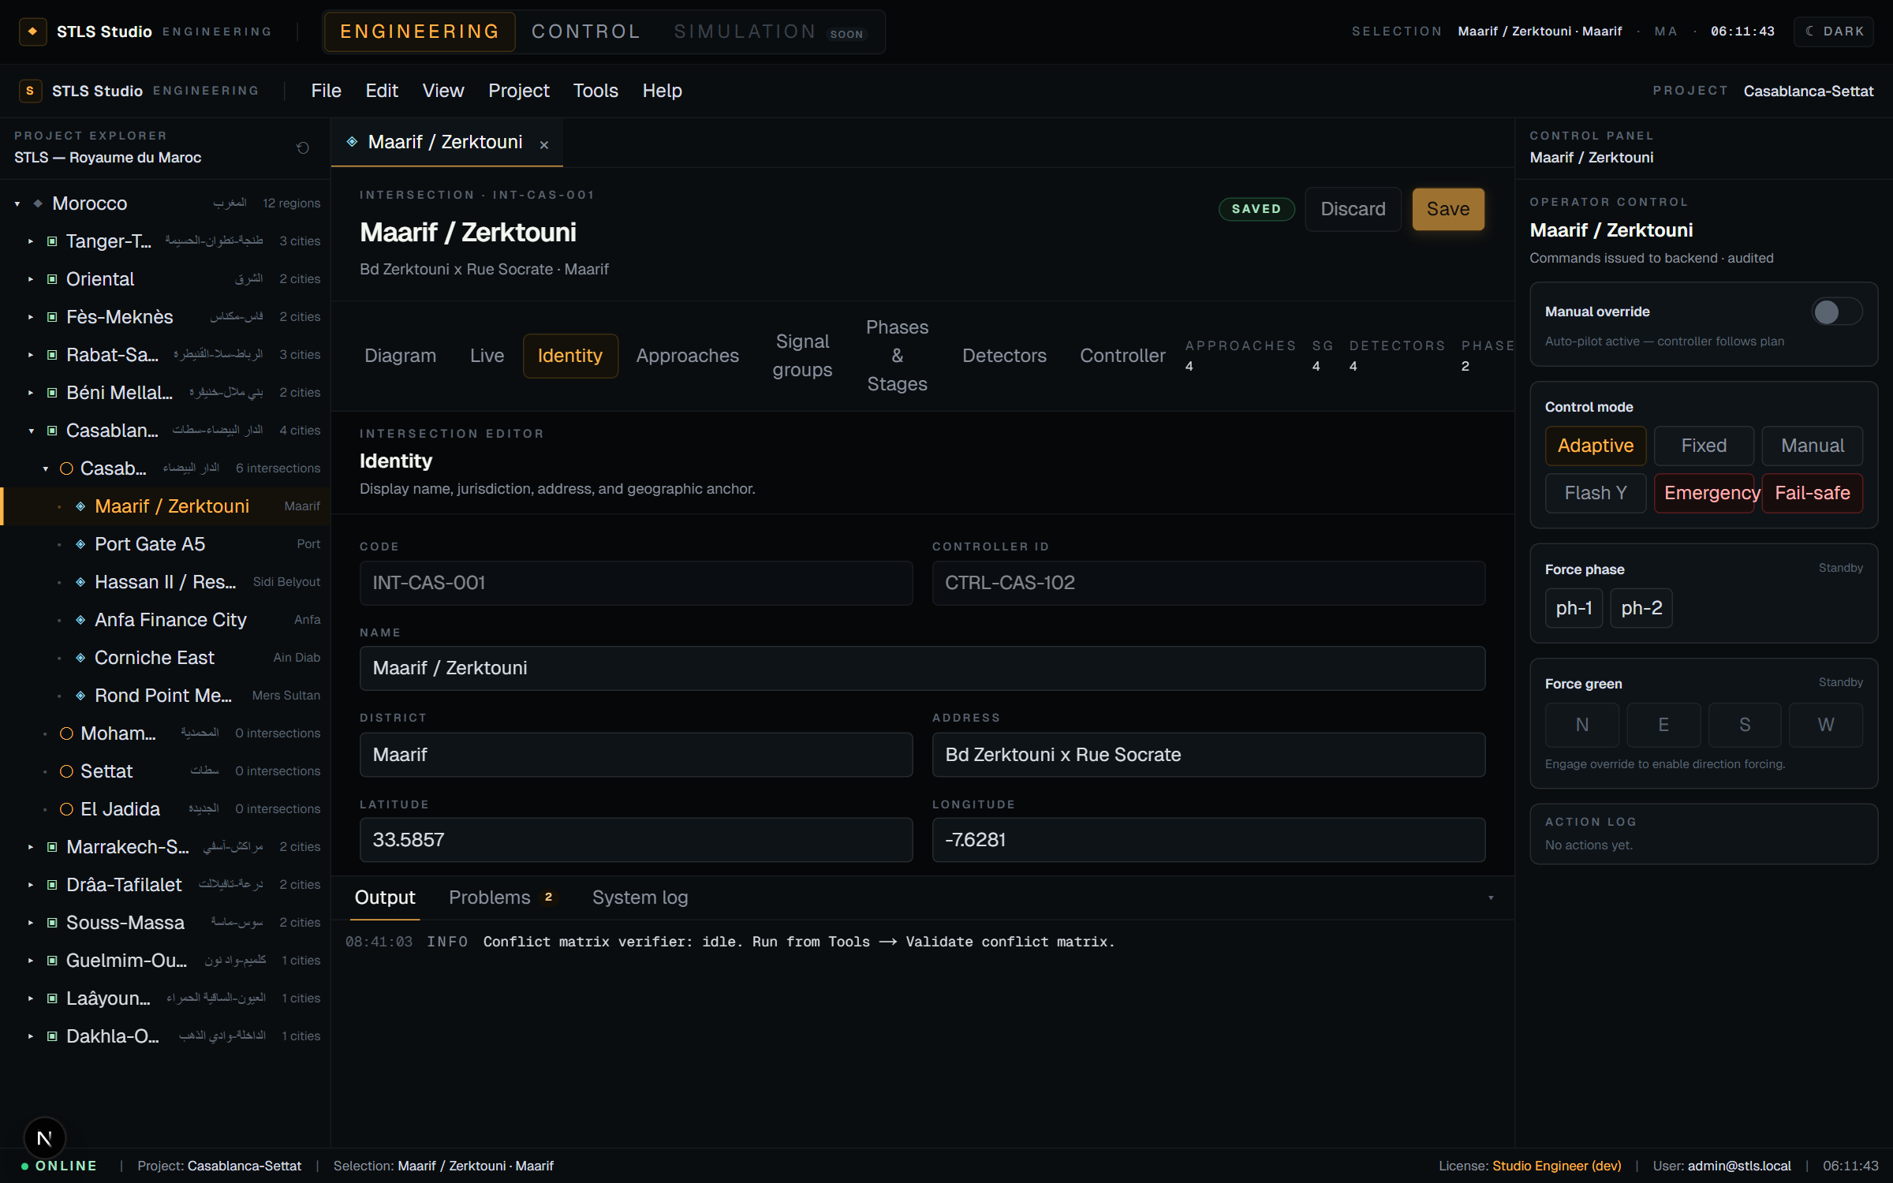
◆
STLS HYBRID
ENGINEERING · IDENTITY
Jurisdiction, address, geometry
▸ Code + controller
Fixed identifiers bound to the field cabinet.
▸ Name & district
Human labels — what operators see.
▸ Geo anchor
Lat / Lng used by the Operations map.
STLS Hybrid · Smart Traffic Light System
08 / 22

Slide 9
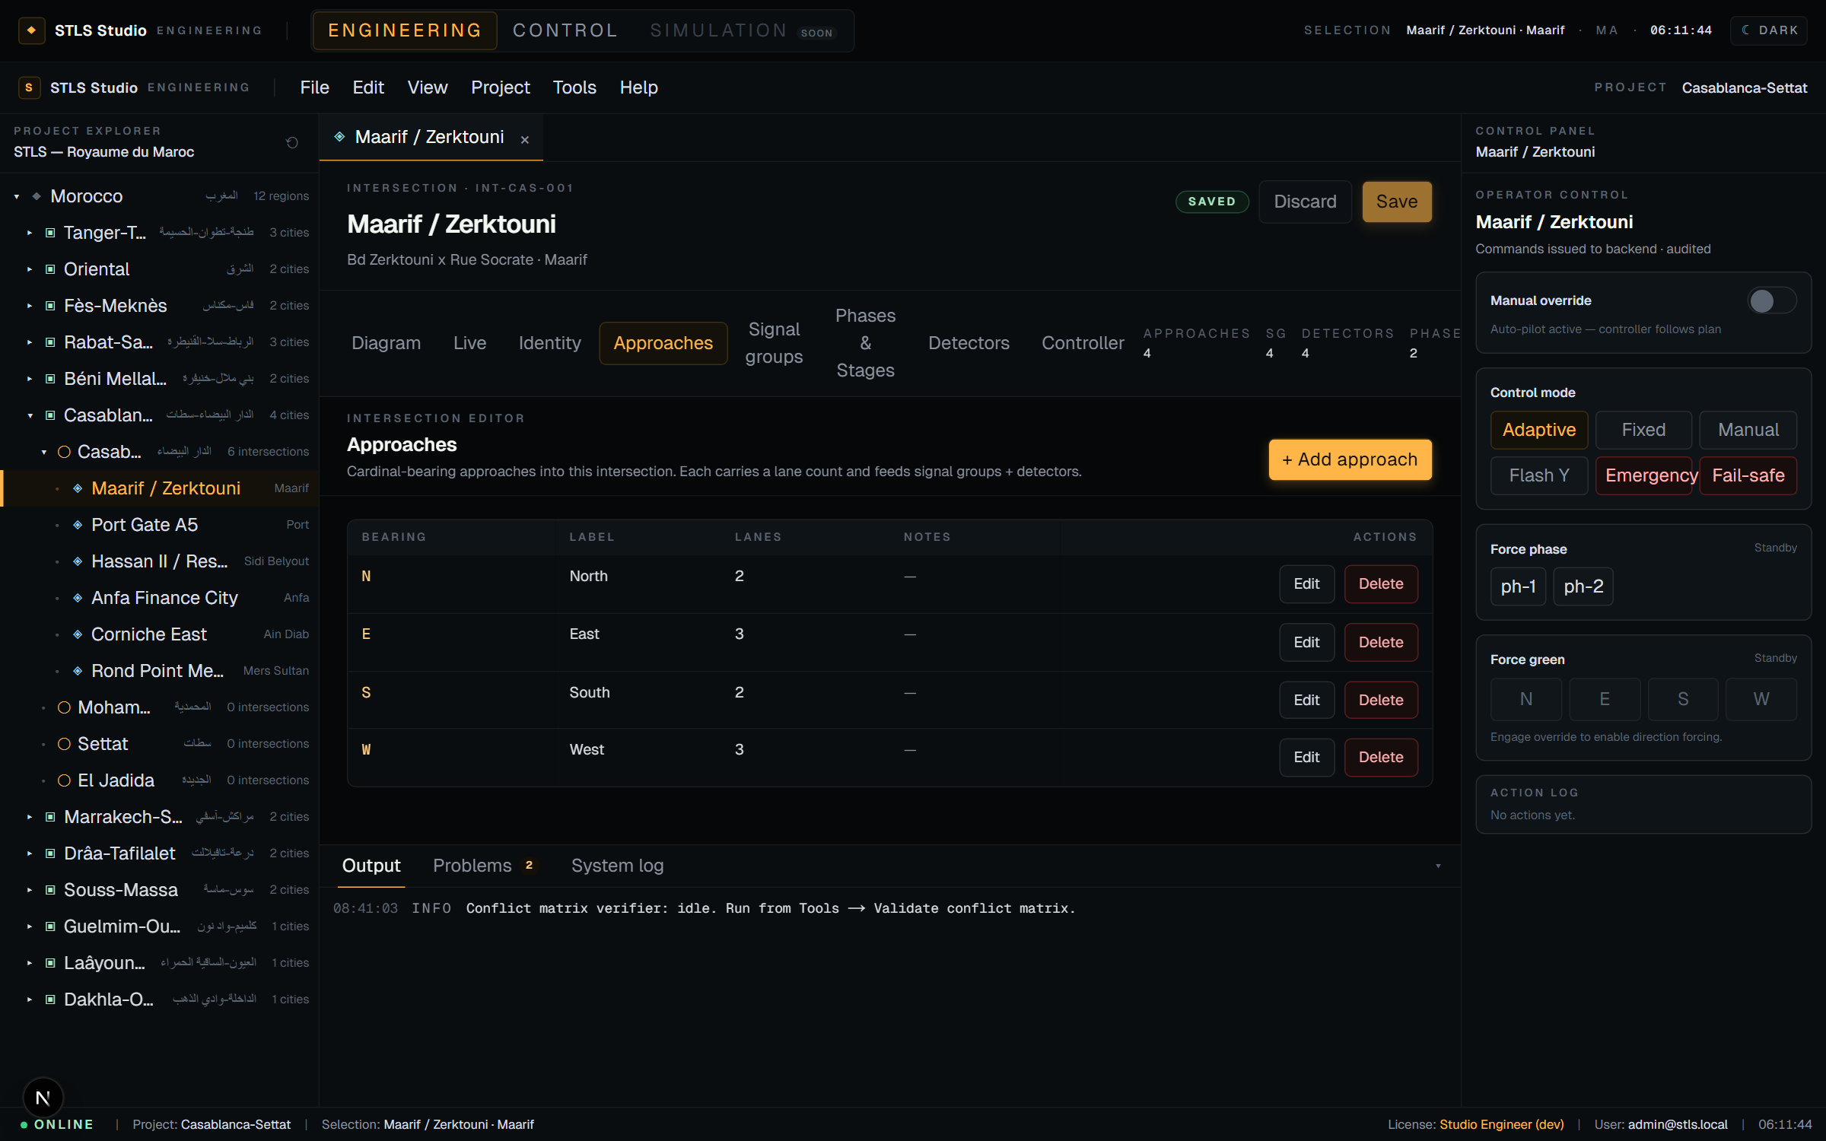
◆
STLS HYBRID
ENGINEERING · APPROACHES
Cardinal approaches and lane counts
▸ Bearing selector
Pick any of the 8 cardinal directions.
▸ Lanes per approach
Drives the road width on the diagram.
▸ Inline editing
Click a row to edit — no modal juggling.
STLS Hybrid · Smart Traffic Light System
09 / 22

Slide 10
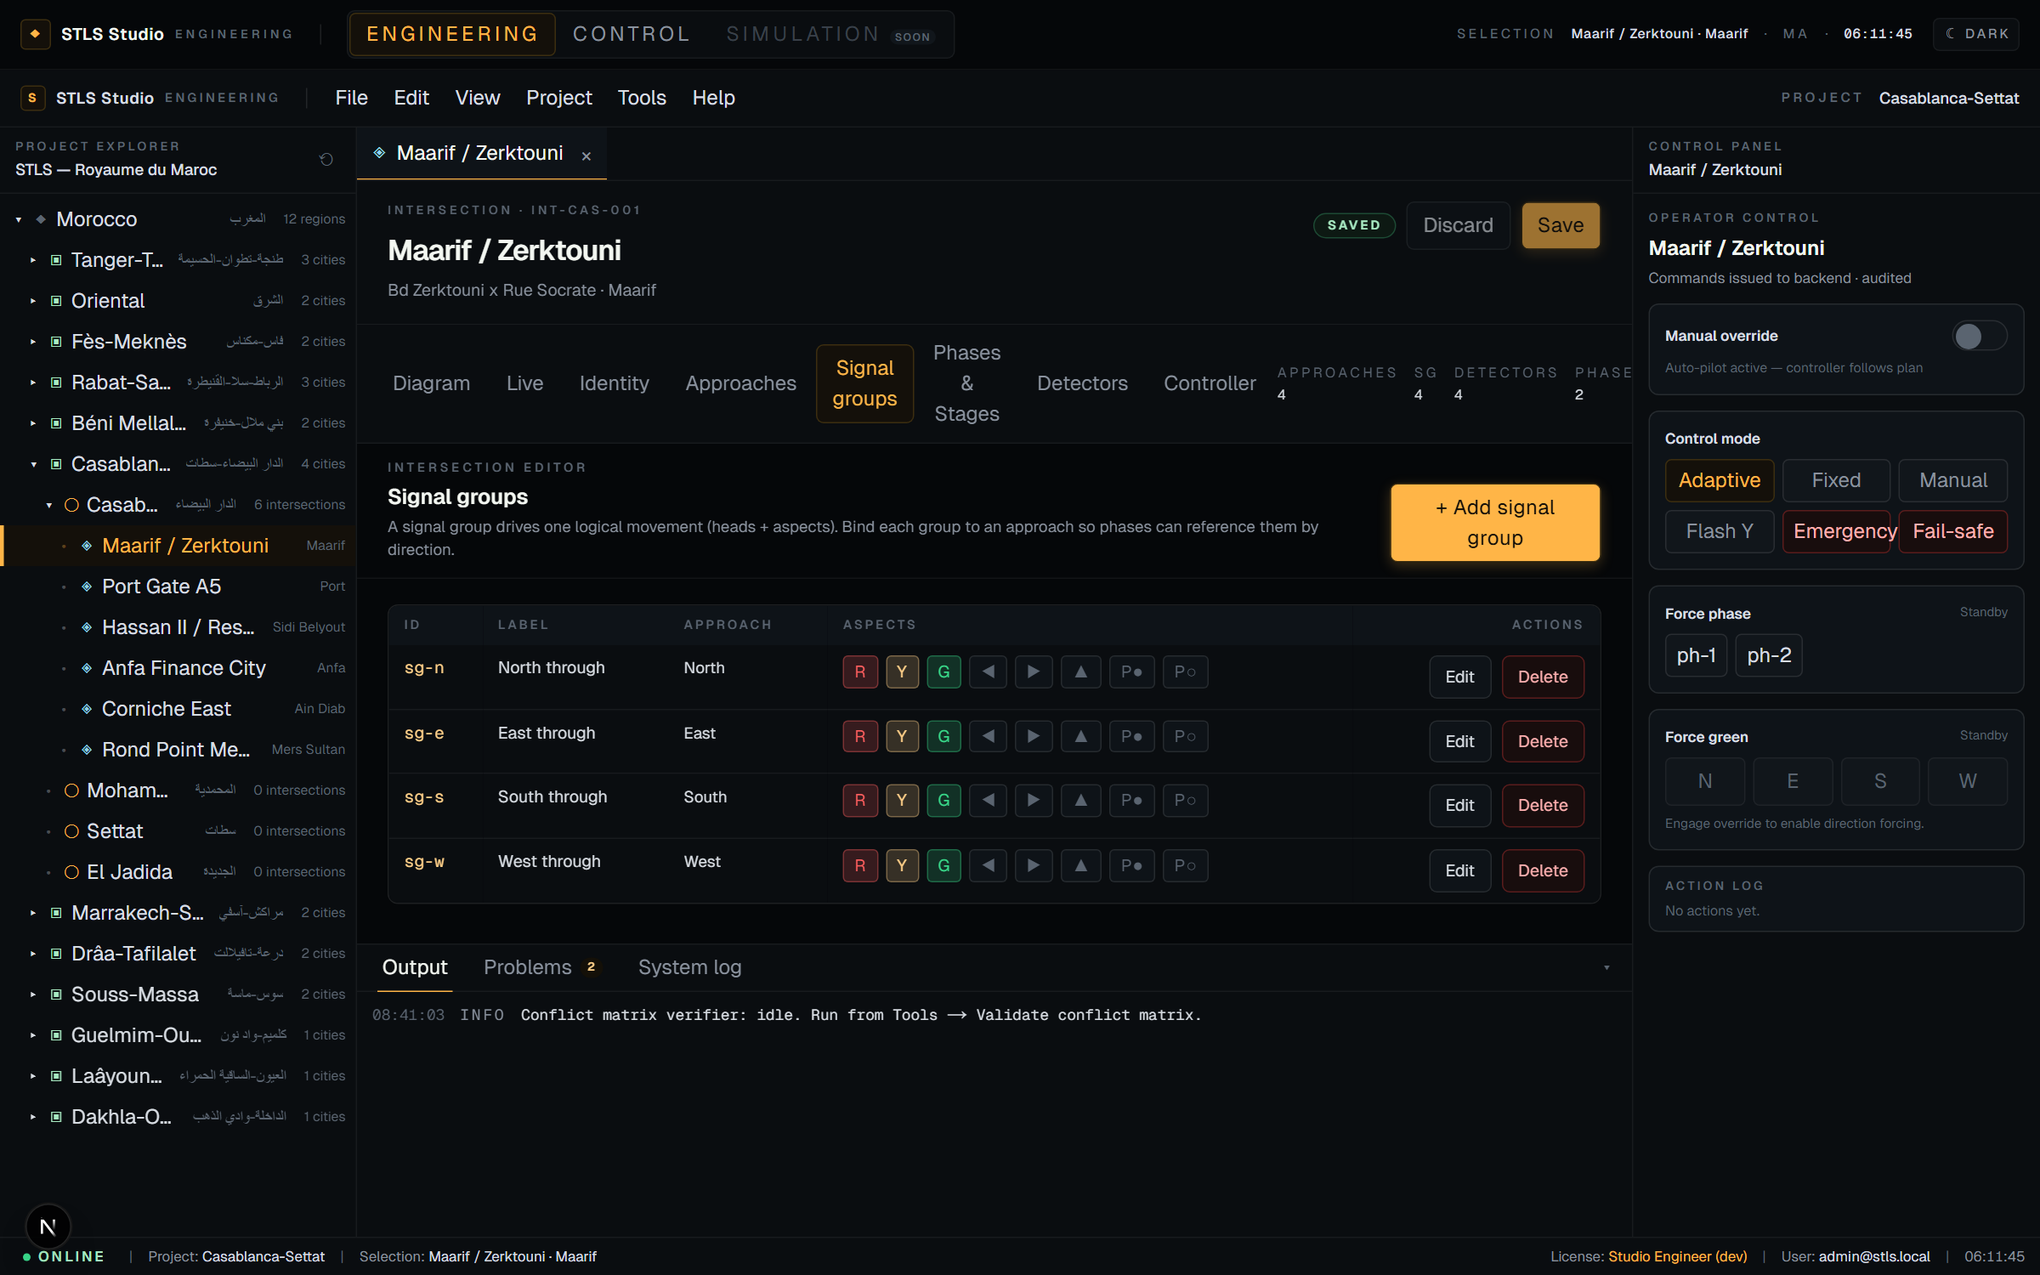
◆
STLS HYBRID
ENGINEERING · SIGNAL GROUPS
Signal groups drive movements
Each group binds to an approach and owns a set of aspects (R / Y / G + arrows + pedestrian).
▸ Approach binding
Needed so phases can reference groups by direction.
▸ Aspect toggles
Coloured chips per supported signal state.
▸ Used in phases
Which groups go green together per phase.
STLS Hybrid · Smart Traffic Light System
10 / 22

Slide 11
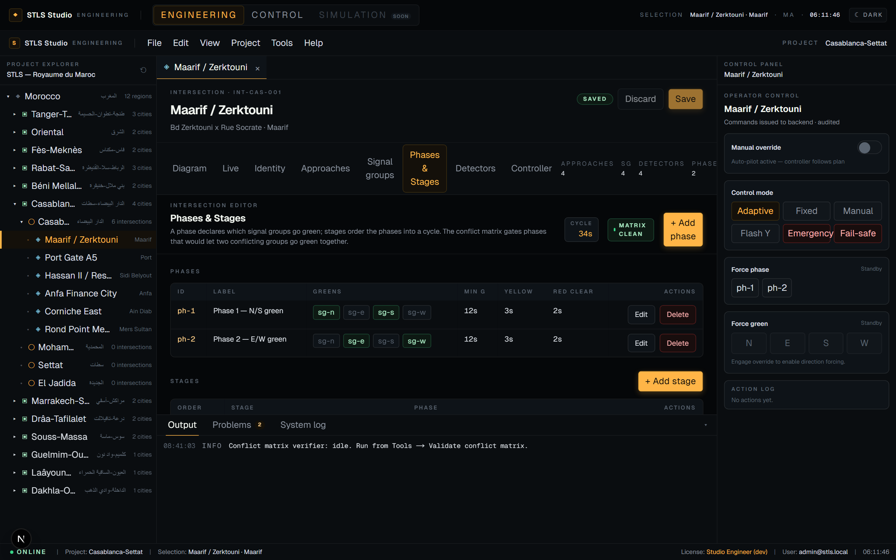
◆
STLS HYBRID
ENGINEERING · PHASES & STAGES
Phases, stages, and the conflict matrix
A phase declares green groups; stages order phases; the matrix prevents dangerous co-greens.
▸ Green selector
Toggle which signal groups go green per phase.
▸ Timings
Min-green / yellow / red-clearance per phase.
▸ Stage ordering
Stages run in order — the cycle.
▸ Matrix guard
Surfaces violations in-page — no silent errors.
STLS Hybrid · Smart Traffic Light System
11 / 22

Slide 12
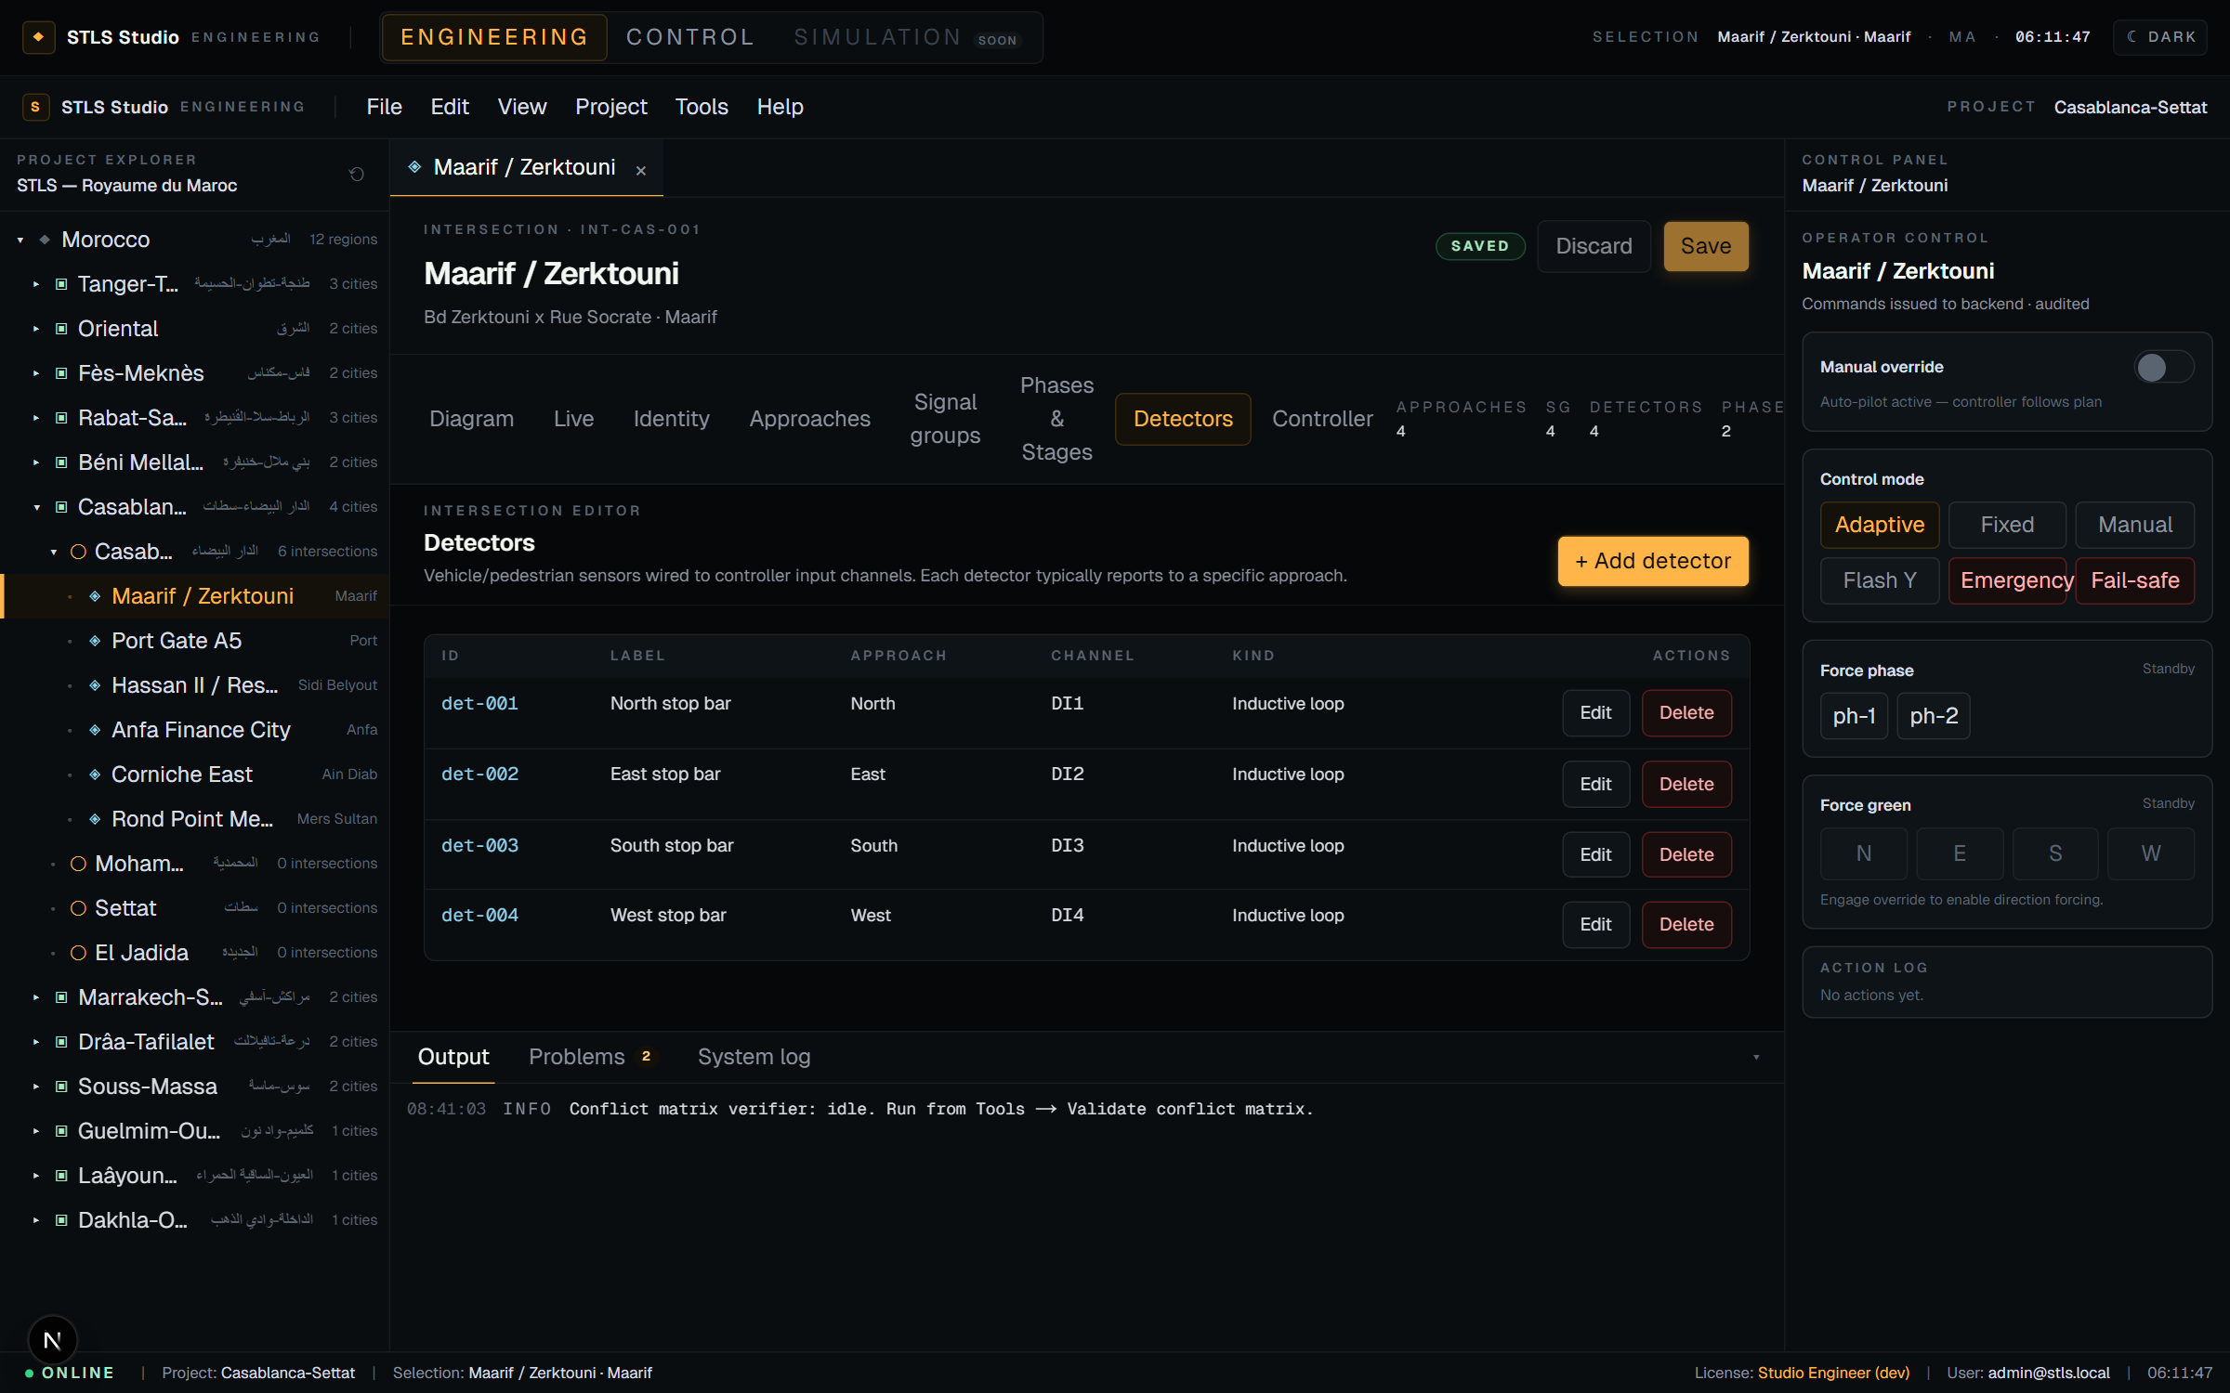
◆
STLS HYBRID
ENGINEERING · DETECTORS
Detectors mapped to controller inputs
▸ Per-approach mapping
Each detector belongs to an approach.
▸ Channel + kind
Loop, radar, video, piezo, magnetometer.
▸ Feeds the runtime
Upstream data for adaptive decisions.
STLS Hybrid · Smart Traffic Light System
12 / 22

Slide 13
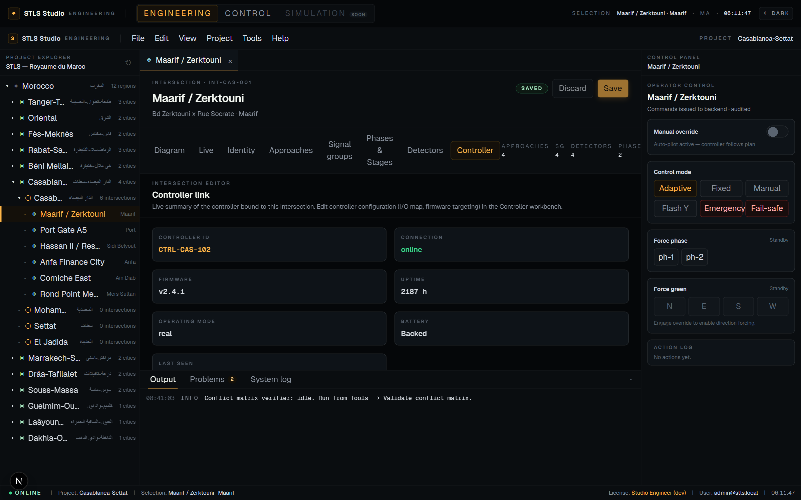
◆
STLS HYBRID
ENGINEERING · CONTROLLER
Controller link summary
Read-only summary bound to the field cabinet.
▸ Link state
Online · degraded · offline, at a glance.
▸ Firmware & uptime
Hardware telemetry from the runtime.
▸ Battery backed
Resilience marker surfaced up-front.
STLS Hybrid · Smart Traffic Light System
13 / 22

Slide 14
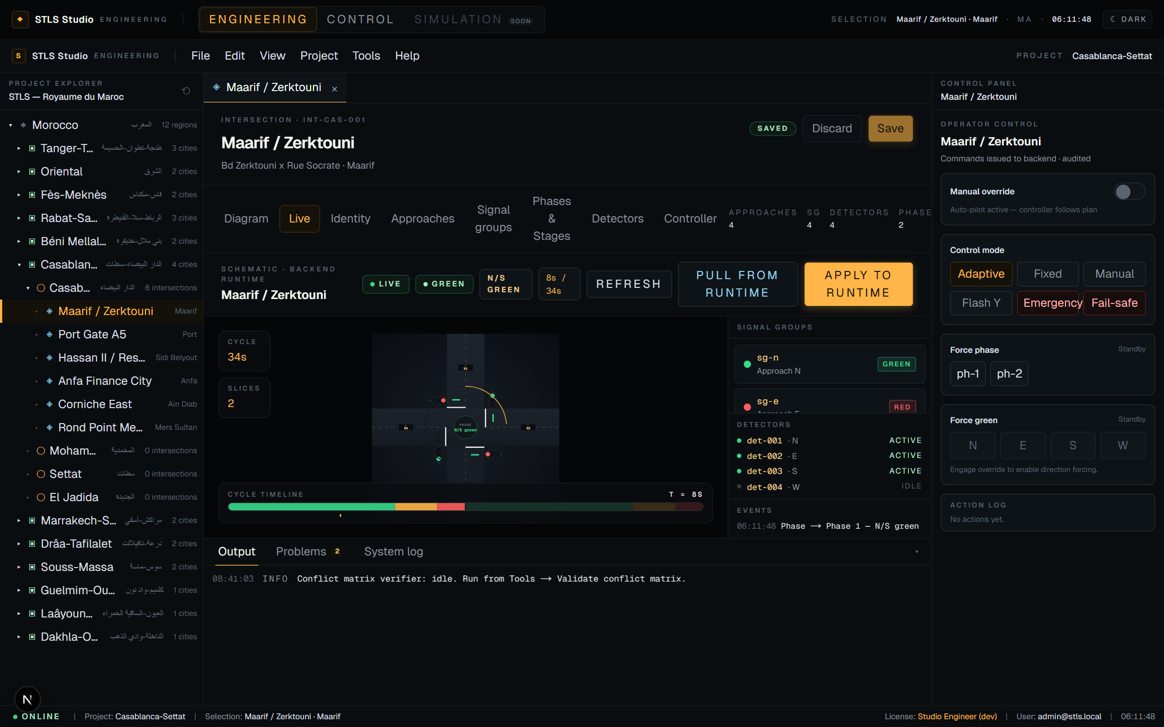
◆
STLS HYBRID
ENGINEERING · LIVE
Apply / Pull · the runtime bridge
Push the Studio config to the runtime — or pull what the runtime actually has. Both are audited.
▸ Apply to runtime
Studio → backend → in-memory simulator.
▸ Pull from runtime
Reload what the controller currently enforces.
▸ Live schematic
Real-time aspect + cycle ring from backend.
▸ Event log
Every transition recorded in the side panel.
STLS Hybrid · Smart Traffic Light System
14 / 22

Slide 15
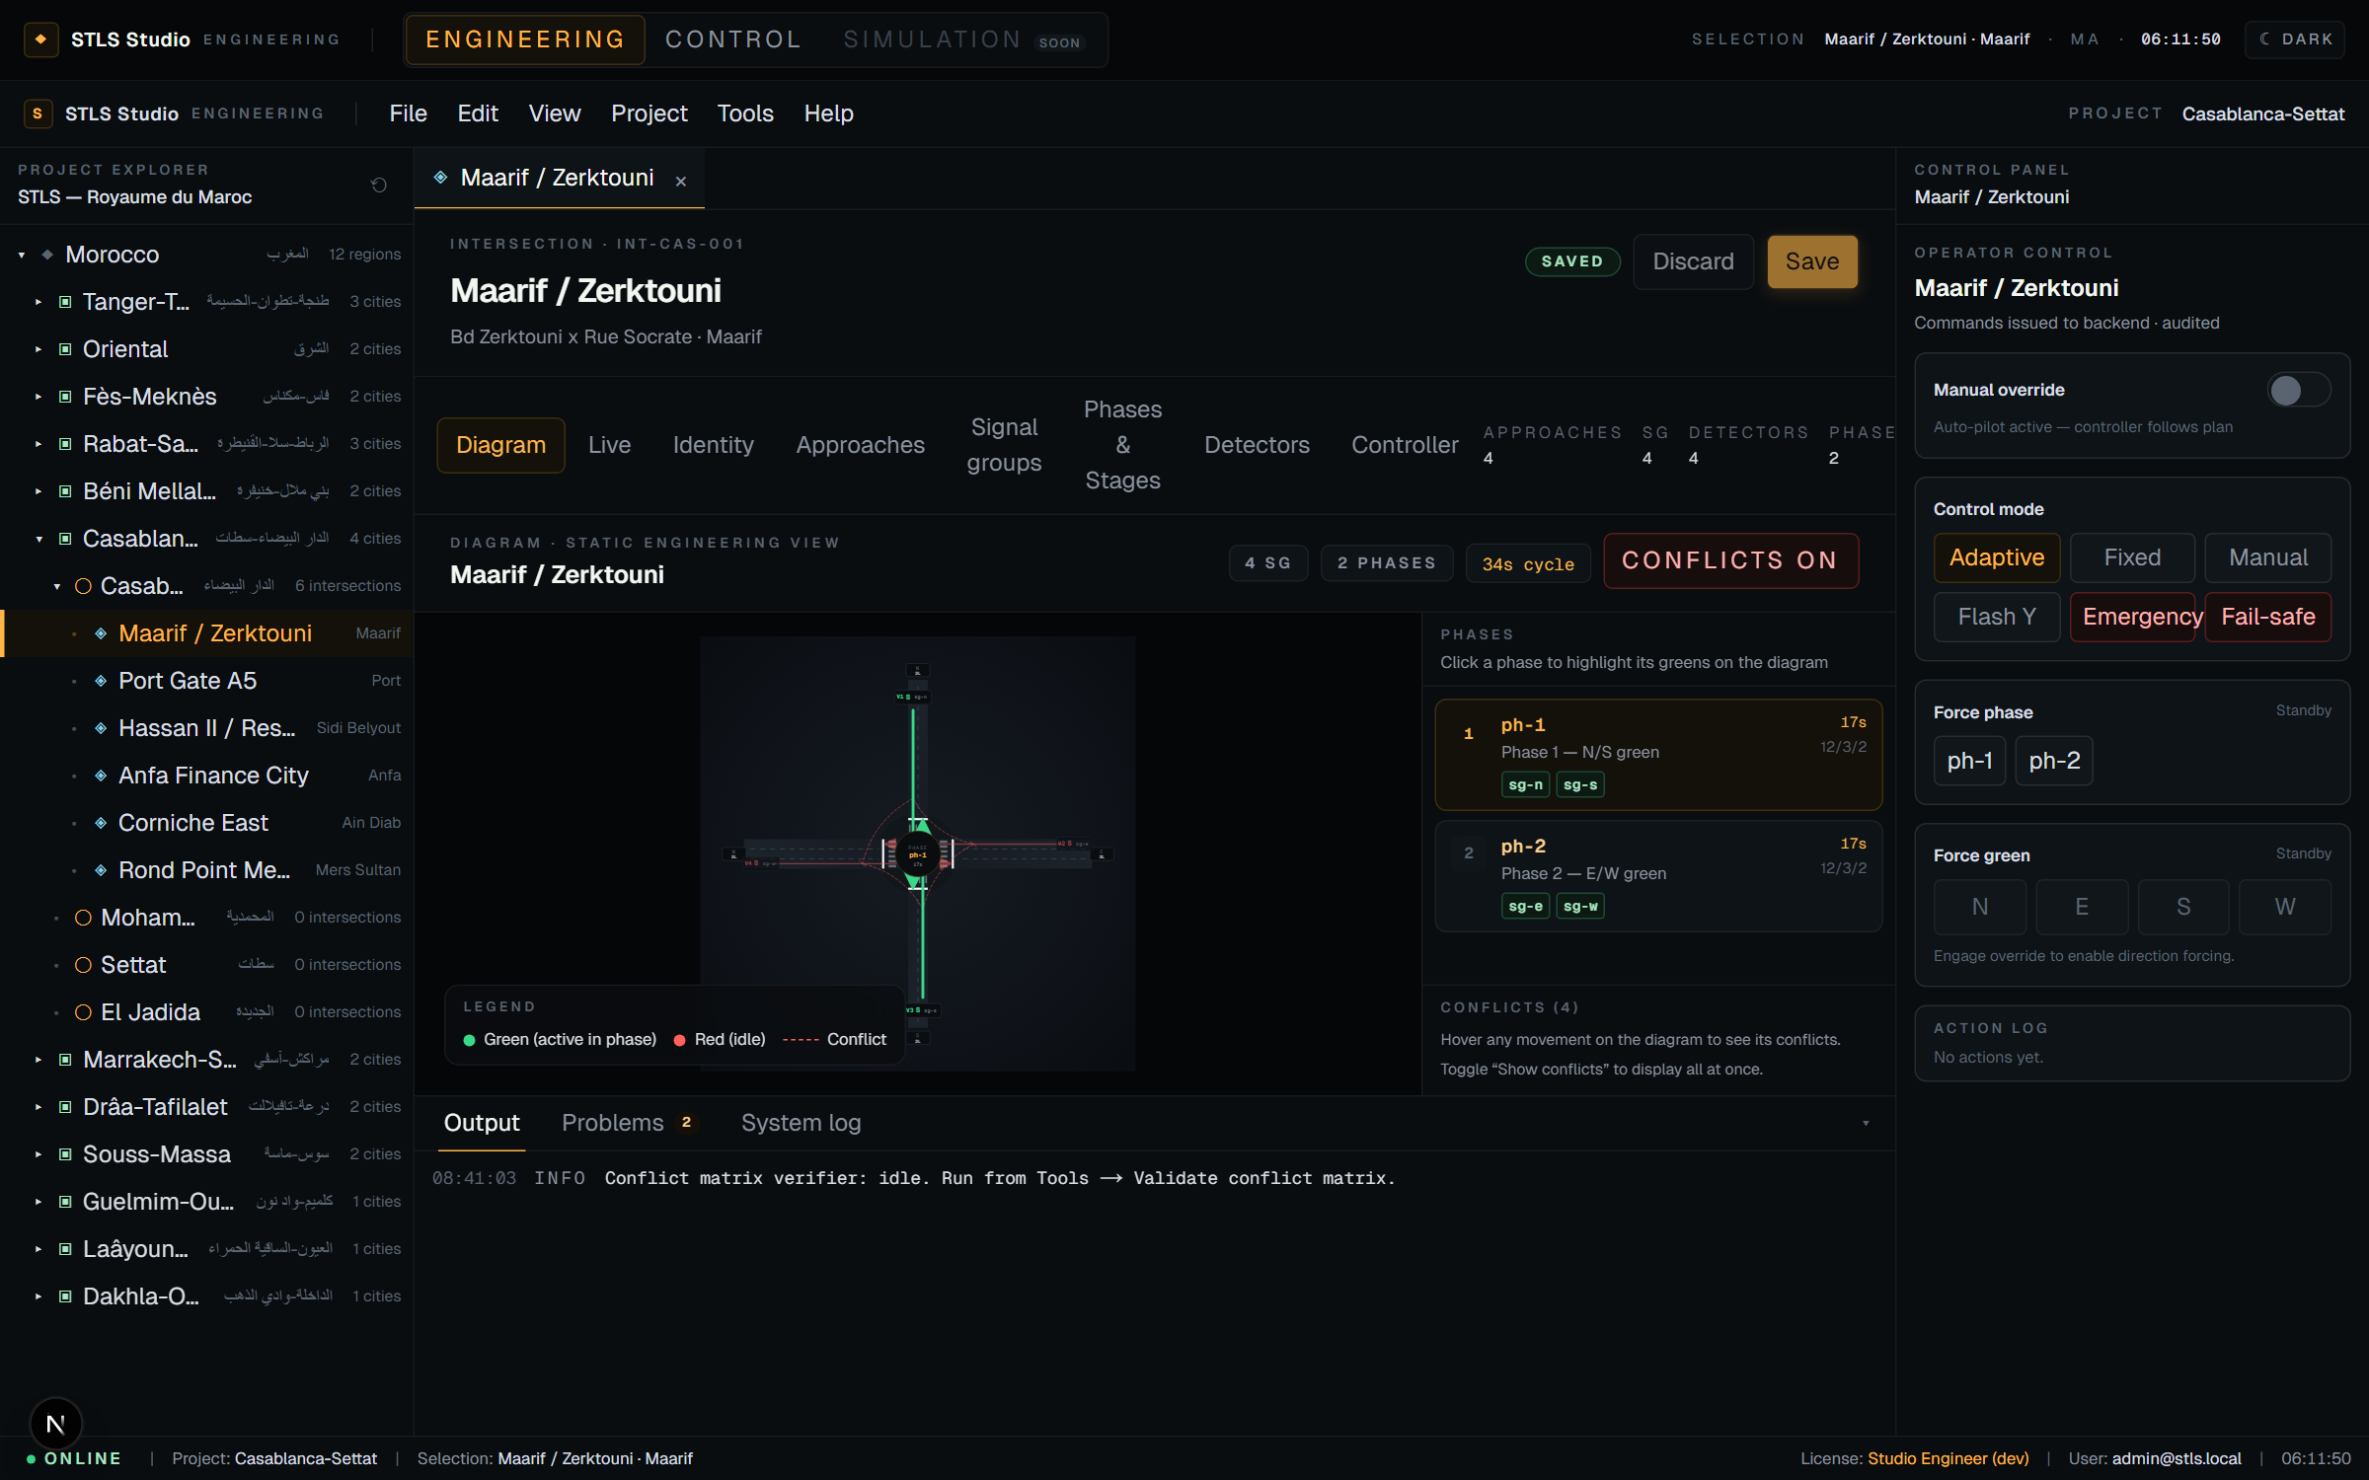
◆
STLS HYBRID
ENGINEERING · CONFLICTS OVERLAY
Every incompatible movement, in one view
▸ All-pairs arcs
Dashed red arcs between conflicting movements.
▸ Hover focus
Hover a single movement to see only its conflicts.
▸ No surprises
Caught at design time, never at runtime.
STLS Hybrid · Smart Traffic Light System
15 / 22

Slide 16
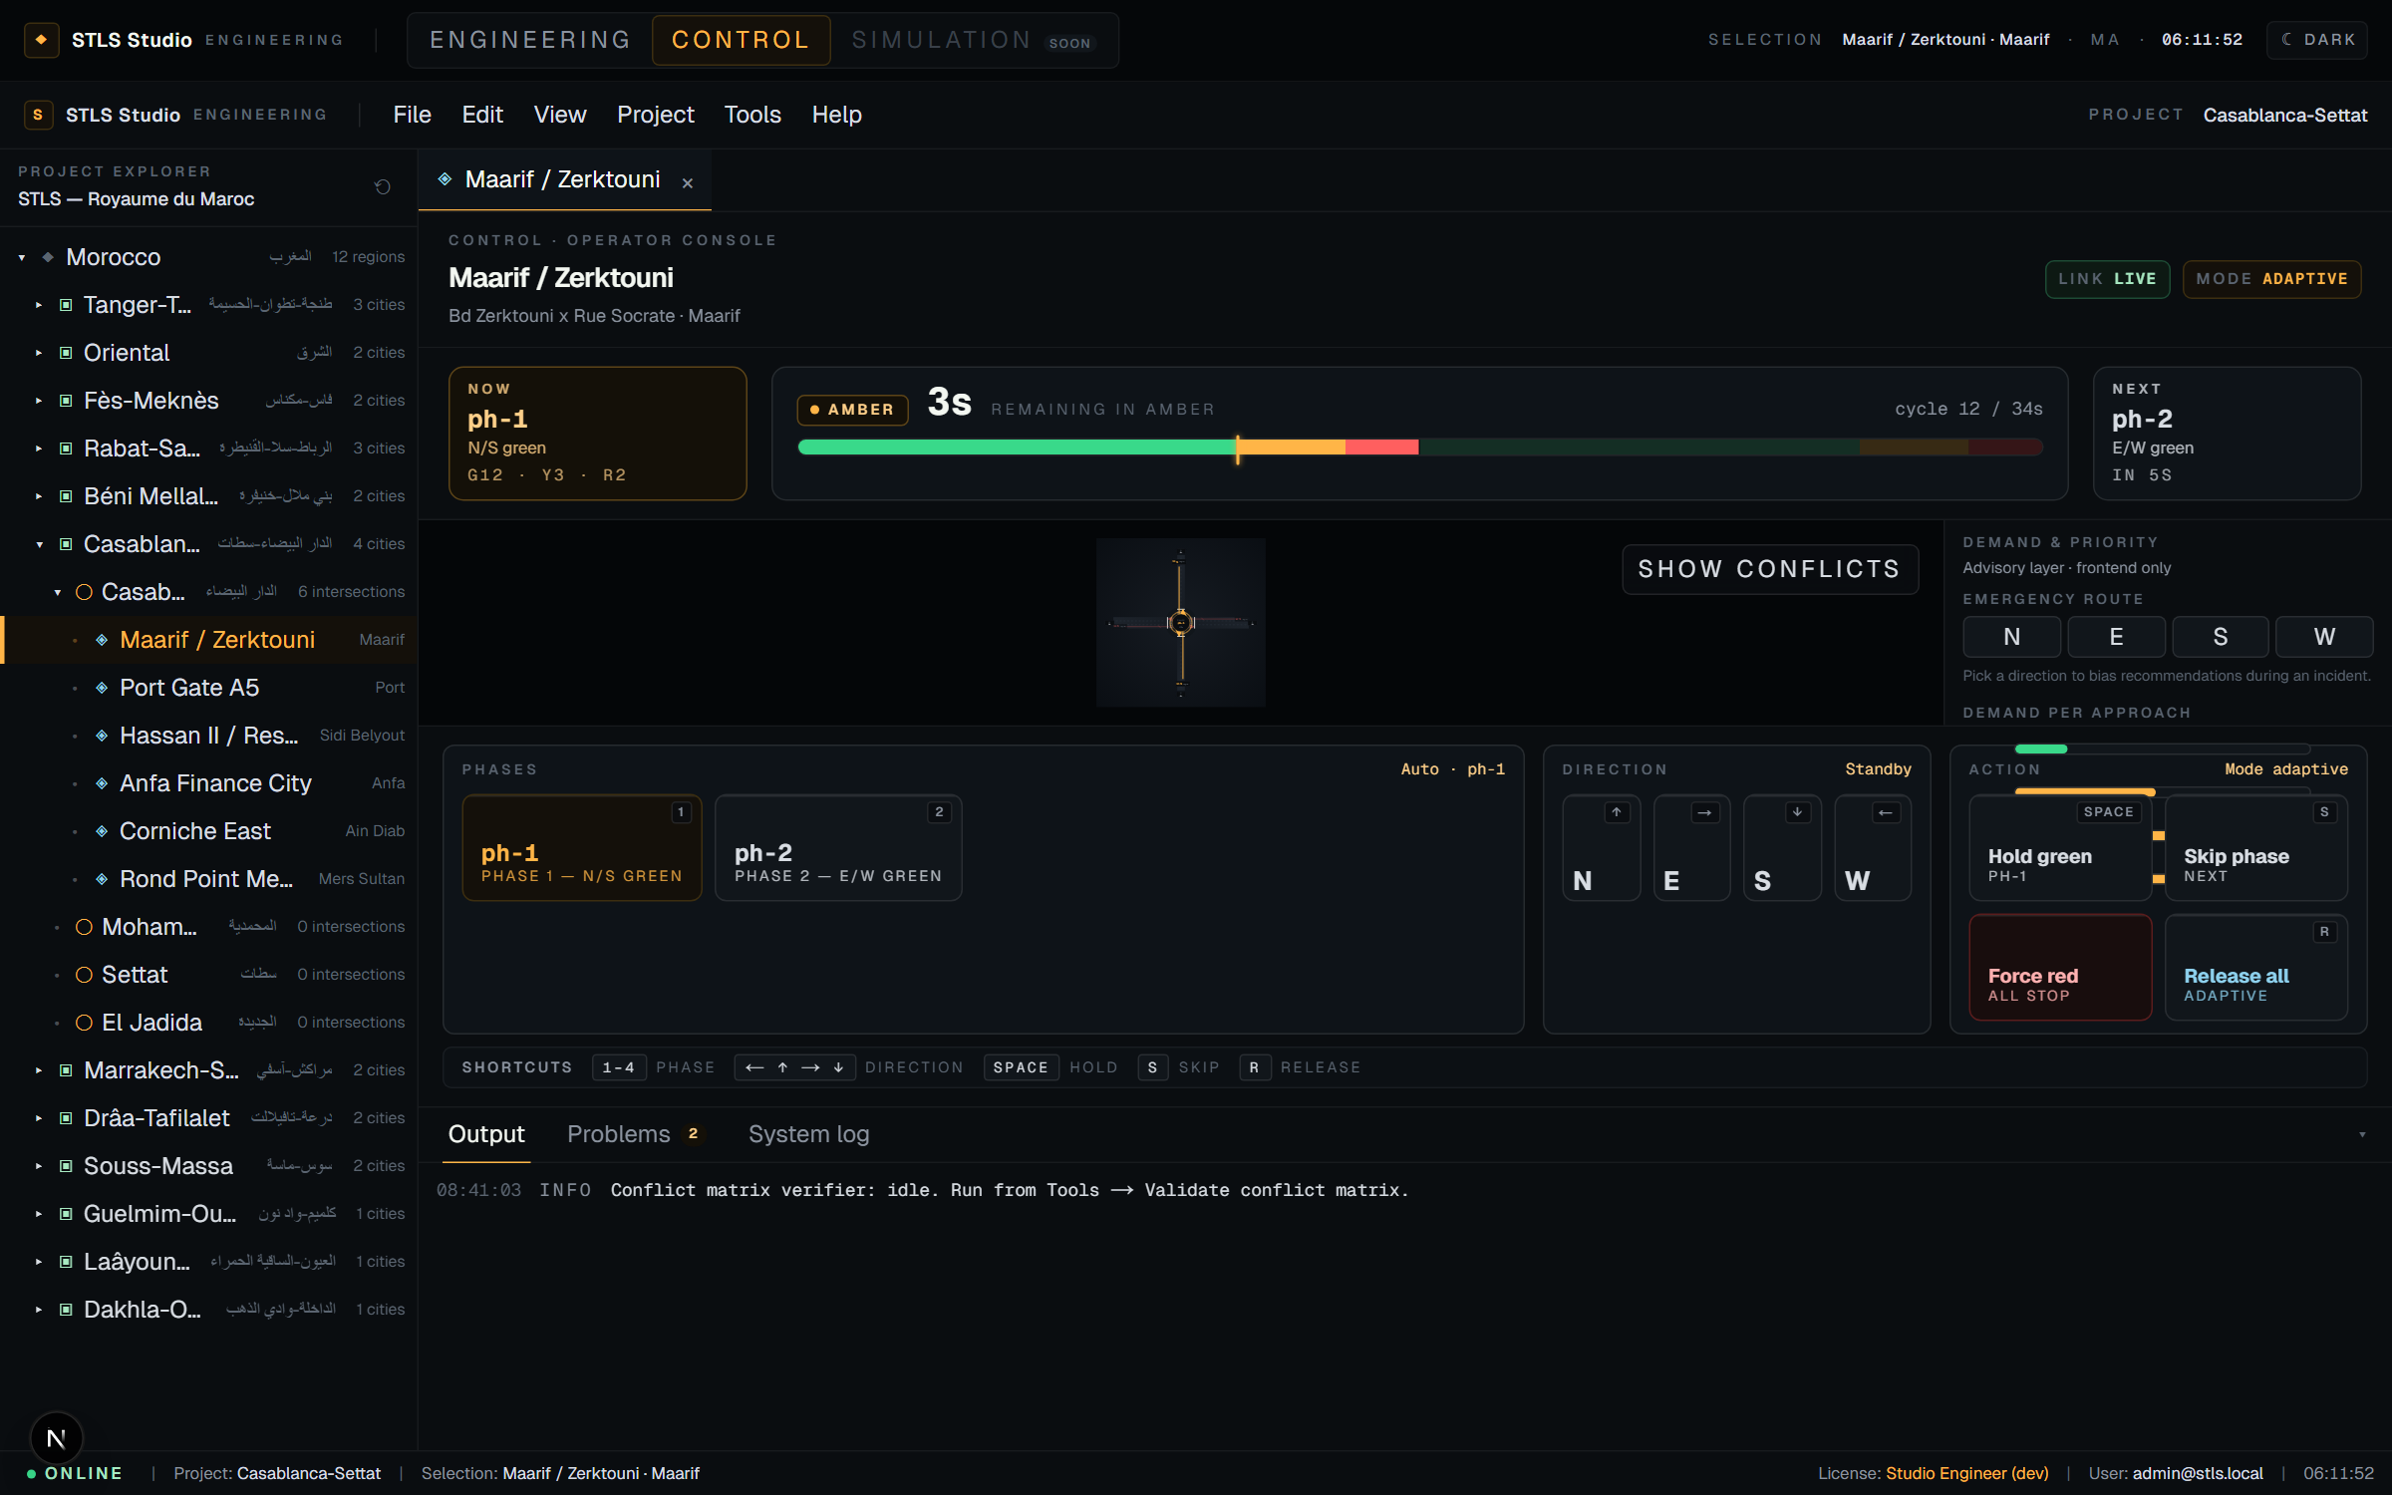
◆
STLS HYBRID
CONTROL MODE · HERO
Play traffic lights like a piano
Live diagram · Timing strip · Emergency banners · Shortcut-driven piano keys.
1
2
3
4
←
↑
→
↓
Space
S
R
STLS Hybrid · Smart Traffic Light System
16 / 22

Slide 17
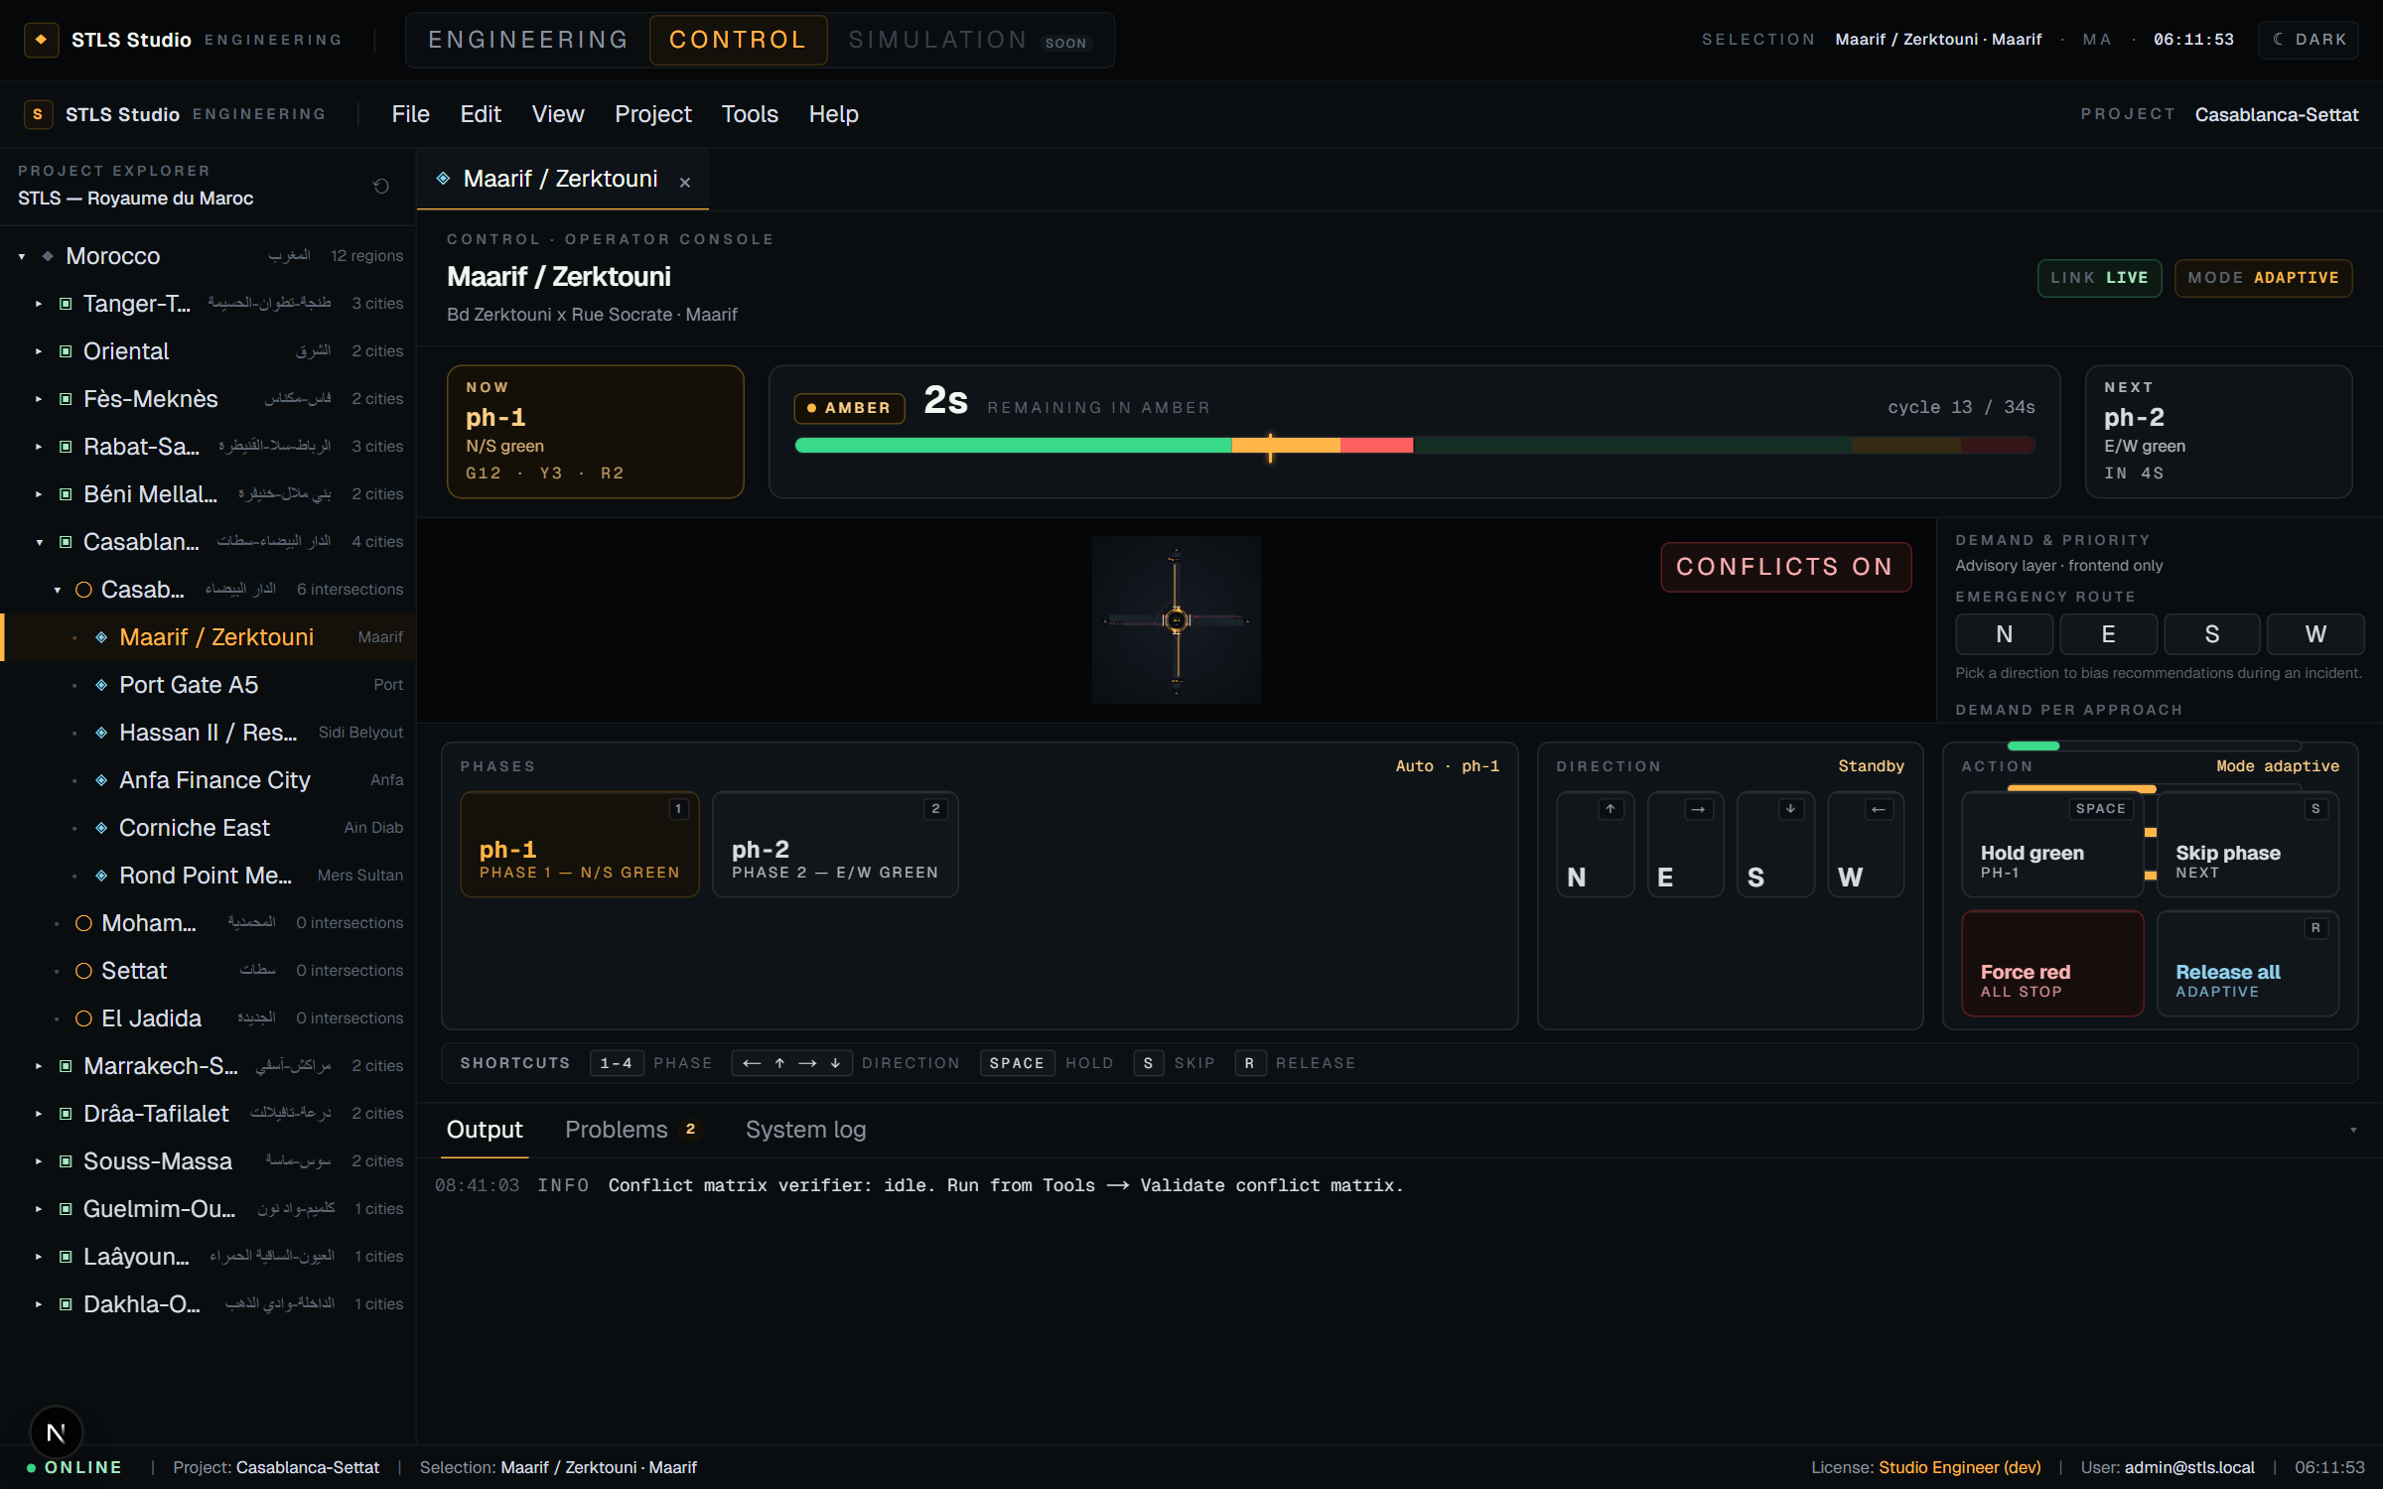
◆
STLS HYBRID
CONTROL MODE · CONFLICTS
Operators can see conflicts live too
Same overlay as Engineering — available as an optional toggle in the operator console.
▸ One-click toggle
Never obstructs the default clean view.
▸ Context when it matters
Verify before forcing a direction or phase.
STLS Hybrid · Smart Traffic Light System
17 / 22

Slide 18
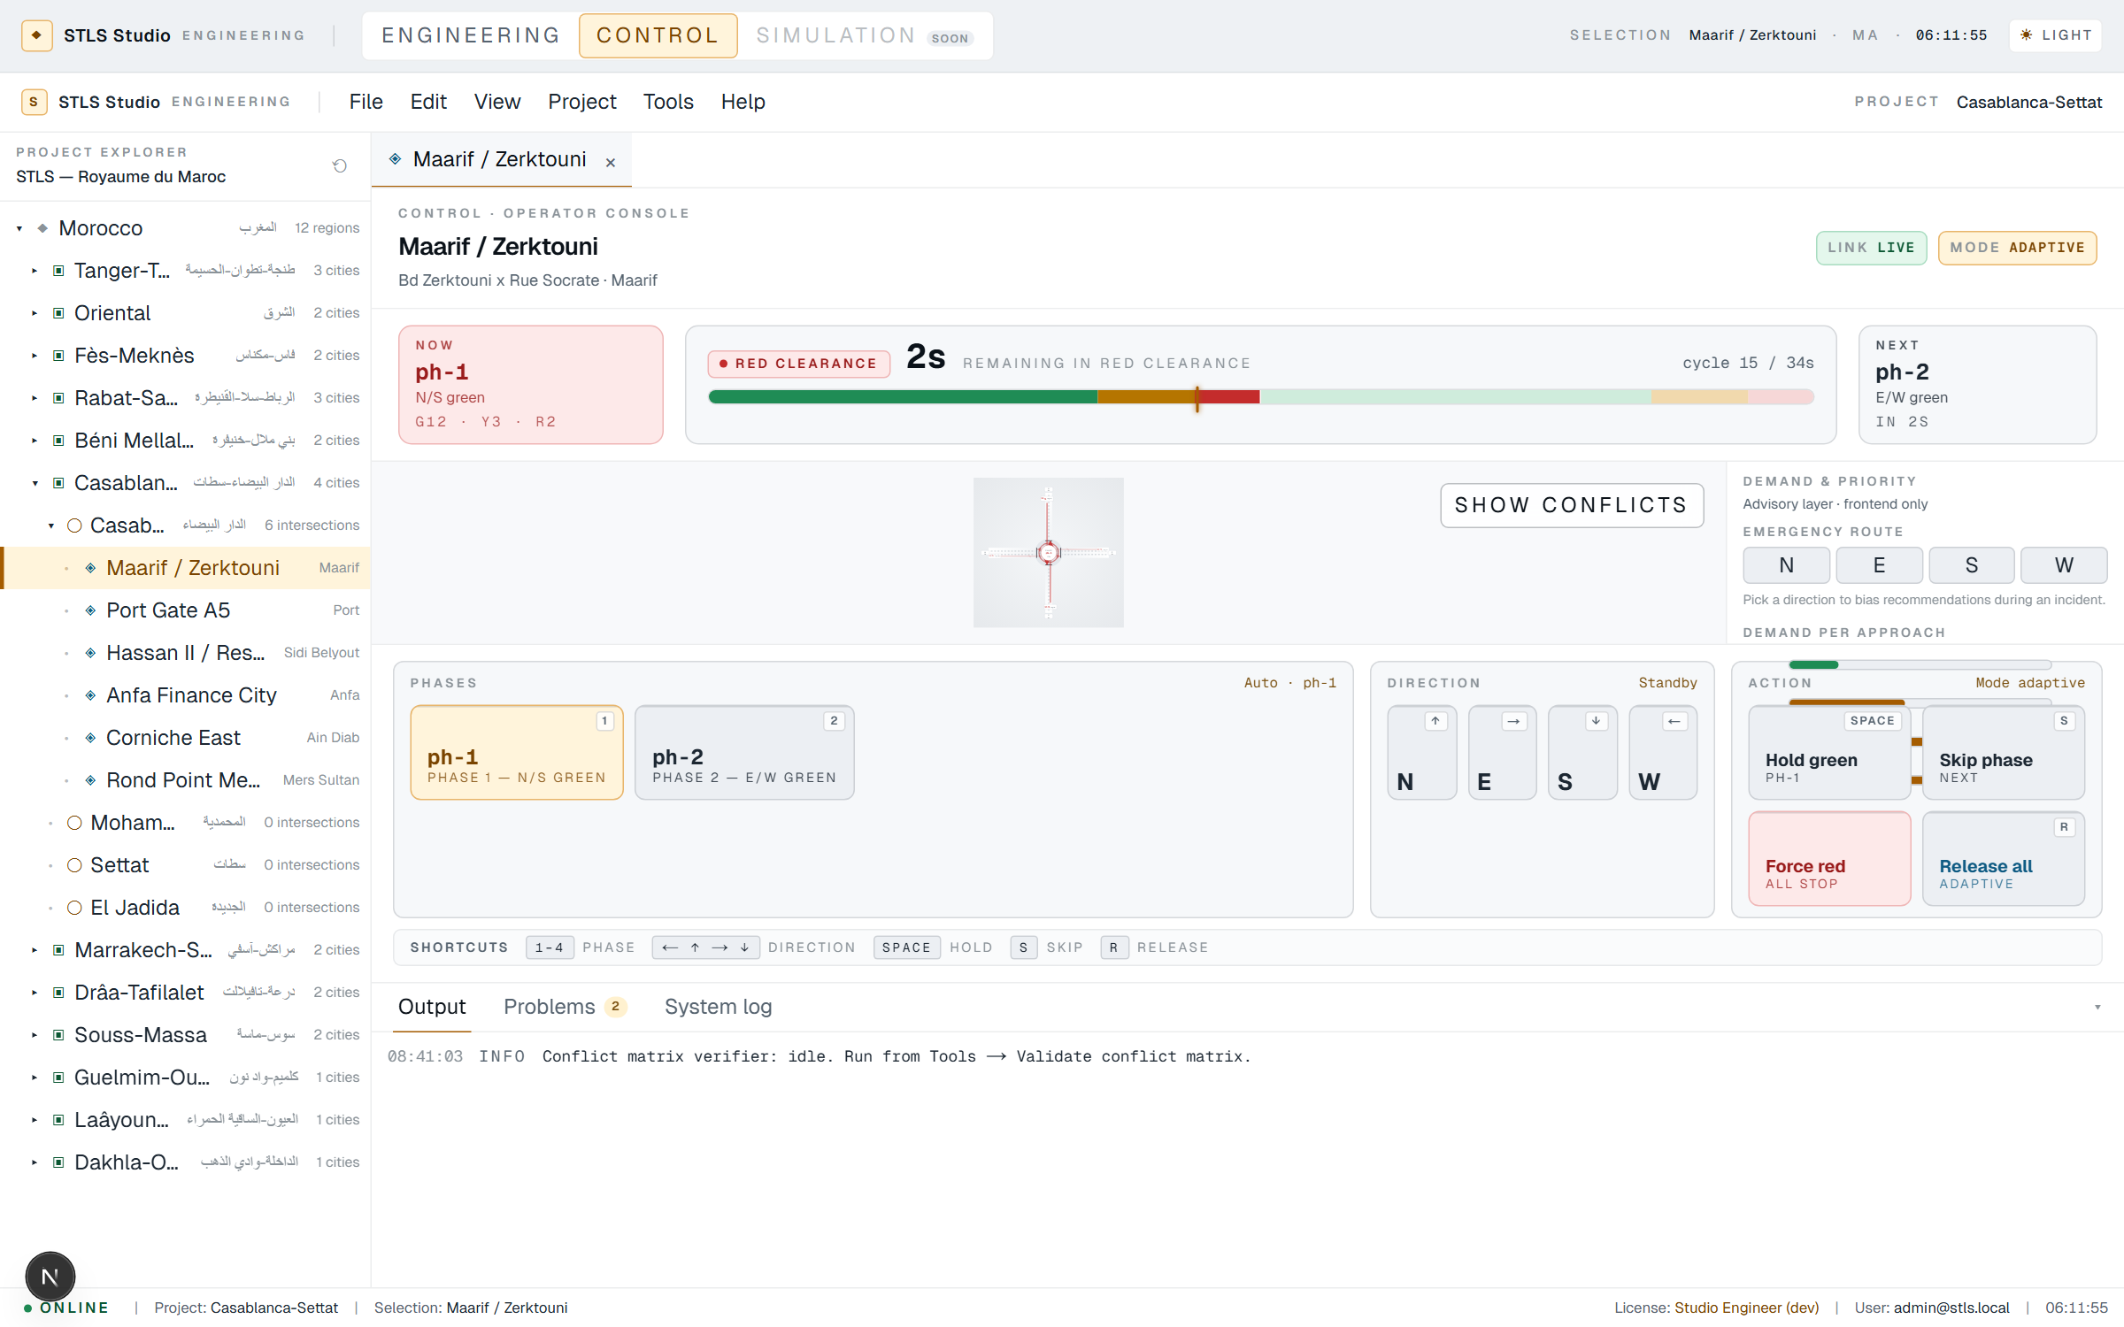
◆
STLS HYBRID
CONTROL MODE · LIGHT THEME
Readable in a bright control room
Engineering-CAD aesthetic — white asphalt, dark lane markings.
▸ Industrial contrast
No candy colours; stays serious.
▸ Same semantics
Every signal colour keeps its meaning.
▸ Persisted preference
Theme is remembered per operator.
STLS Hybrid · Smart Traffic Light System
18 / 22

Slide 19
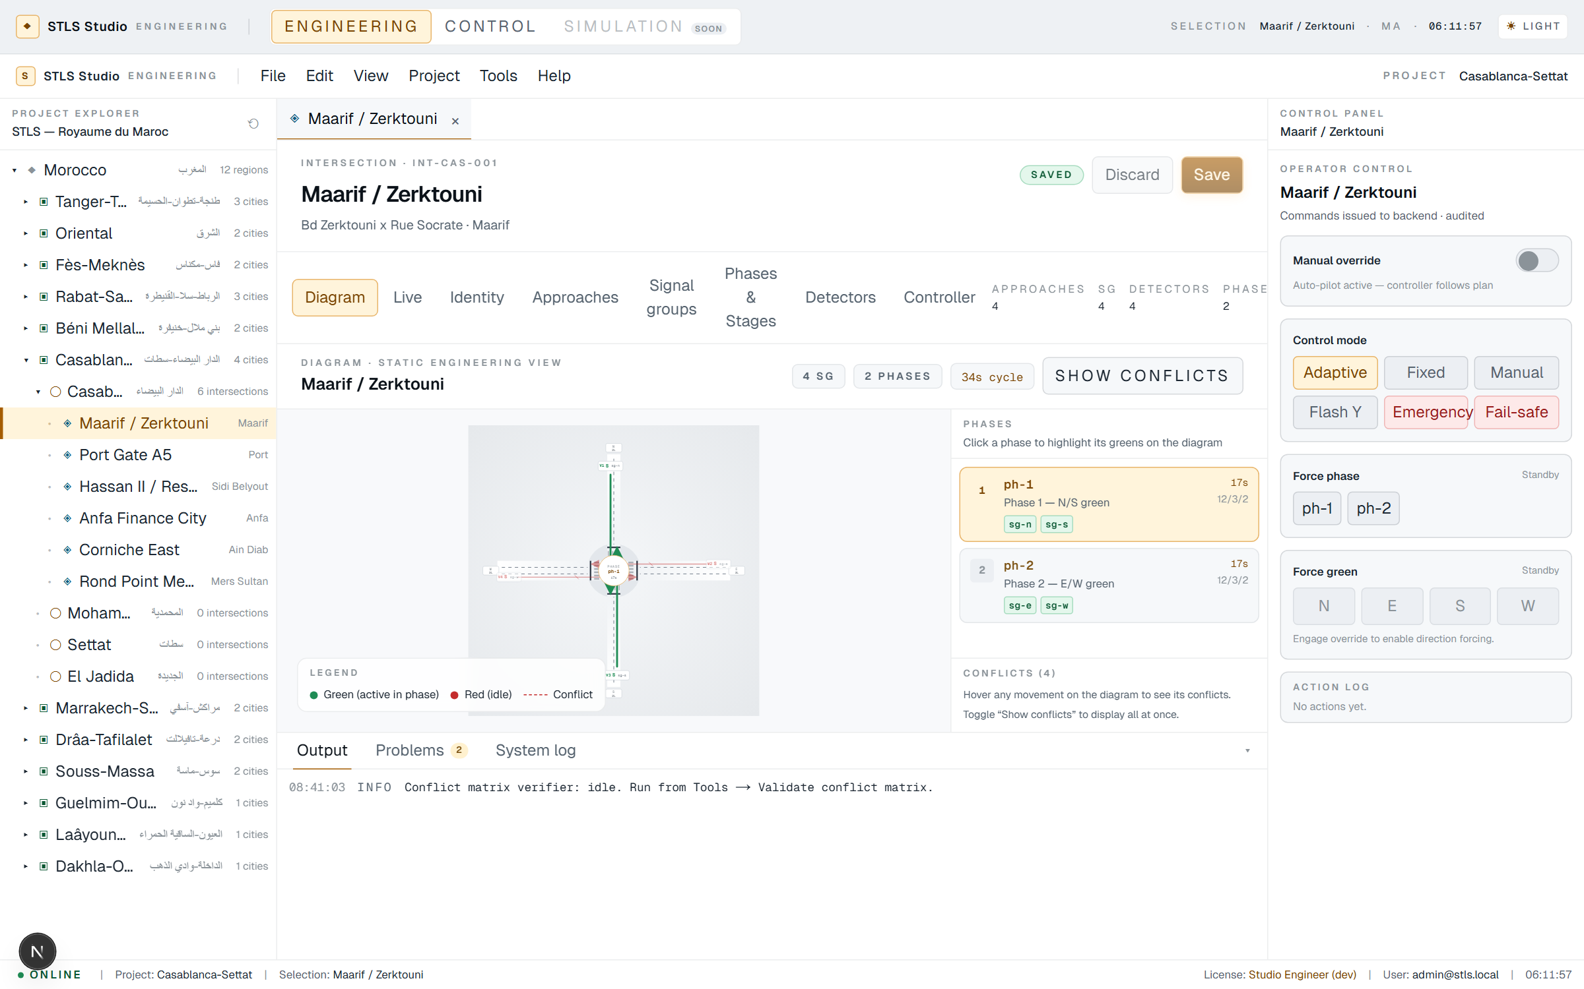
◆
STLS HYBRID
THEME ARCHITECTURE
Dark and light, built on semantic tokens
One palette, two themes — scoped to the Studio so the Operations dashboard stays fixed-dark.
--stls-surface-0
--stls-surface-1
--stls-accent
--stls-sig-green
--stls-sig-red
STLS Hybrid · Smart Traffic Light System
19 / 22

Slide 20
◆
STLS HYBRID
TECHNOLOGY STACK
A pragmatic, typed toolchain
Frontend
Backend
Desktop
Controller runtime
• Next.js 16 (Turbopack)
• React 19 + TypeScript
• Tailwind v4 semantic tokens
• Socket.IO client for live state
• NestJS + TypeORM
• PostgreSQL (JSONB configs)
• Socket.IO gateway
• HMAC-signed command channel
• Electron wrapper
• Loads /studio URL only
• Native-feel menus & status bar
• Persists last-opened intersection
• Standalone Go process
• 1-Hz cycle simulator
• Offline fall-back cache
• Ticks the signal heads
STLS Hybrid · Smart Traffic Light System
20 / 22

Slide 21
◆
STLS HYBRID
STATUS · ROADMAP
Where we are, where we're heading
SHIPPED
IN PROGRESS
NEXT
• Operations dashboard
• Studio engineering mode end-to-end
• Apply / Pull runtime config
• Control mode with piano + shortcuts
• Full dark + light theme
• Coordinated corridors
• Scenario simulator (dry-run)
• Controller offline sync polish
• Conflict-pair import from CAD
• Plan export to field controllers
• Multi-operator audit trail
STLS Hybrid · Smart Traffic Light System
21 / 22

Slide 22
STLS Hybrid
Engineering · Control · Runtime — one coherent product.
Thank you · Questions welcome

