Slide 1
STLS
Smart Traffic Light System
Traffic supervision, engineering and AI assistance platform
Pilot project STLS Pilot — Casablanca
Client Société Région Aménagement
Version 2026-04-24
Contact akarim@tomorrow.ma

Slide 2
AGENDA
12 interfaces · one deck
Each section covers one screen with role, user persona and route
SUPERVISION
ENGINEERING
PROSPECTION
Command Platform
AI Assist panel
Override reason-coded flow
Projects
Studio Landing
Studio Workbench
Controller Workspace
AutoCAD Plan
Dossiers (Régulation / Câblage)
Zone Builder
Proposal Workspace
Engineering Inventory
Controller Inventory

Slide 3
ARCHITECTURE
Stack overview
CLIENTS (Next.js 16 · React 19)
BACKEND (NestJS 11)
Command Platform — real-time operatorStudio — engineering + AutoCAD + dossiers
auth · traffic · intersection-runtime · engineeringcontroller-manager · overrides · projects · audittraffic-intelligence (Gemini + Google Traffic)
PERSISTENCE
EXTERNAL APIS (server-side keys)
PostgreSQL 14 · TypeORM 0.3 (4 migrations)Override audit · projects · deployments · runtime configs
Gemini 1.5 Flash — JSON mode, T=0.2Google Distance Matrix — 4 corridors / zone
CONTROLLER RUNTIME (Go, per cabinet)
HMAC-signed config packagesJWT refresh · offline modeFail-safe flashing amber on comms lossI/O → signal heads · detectors · buttons
AI never commands the field directly — every action goes through the reason-coded override gate.

Slide 4
INTERFACE 1/12
Command Platform
OPERATOR
24/7 operator console — Morocco map, alerts, override controls
Route /
screenshot missing: command-platform.png
Morocco map with regional ADM1 polygons colored by health (green / yellow / red)
Drill-down: country → region → city → district → intersection
KPI hero cards: incidents · nodes · controllers · throughput (vph)
Alerts feed with critical-alert sound toggle
Selected-area panel: operator controls + AI Assist panel
Environment badge · theme toggle · scenario selector (Normal / Peak / Emergency)

Slide 5
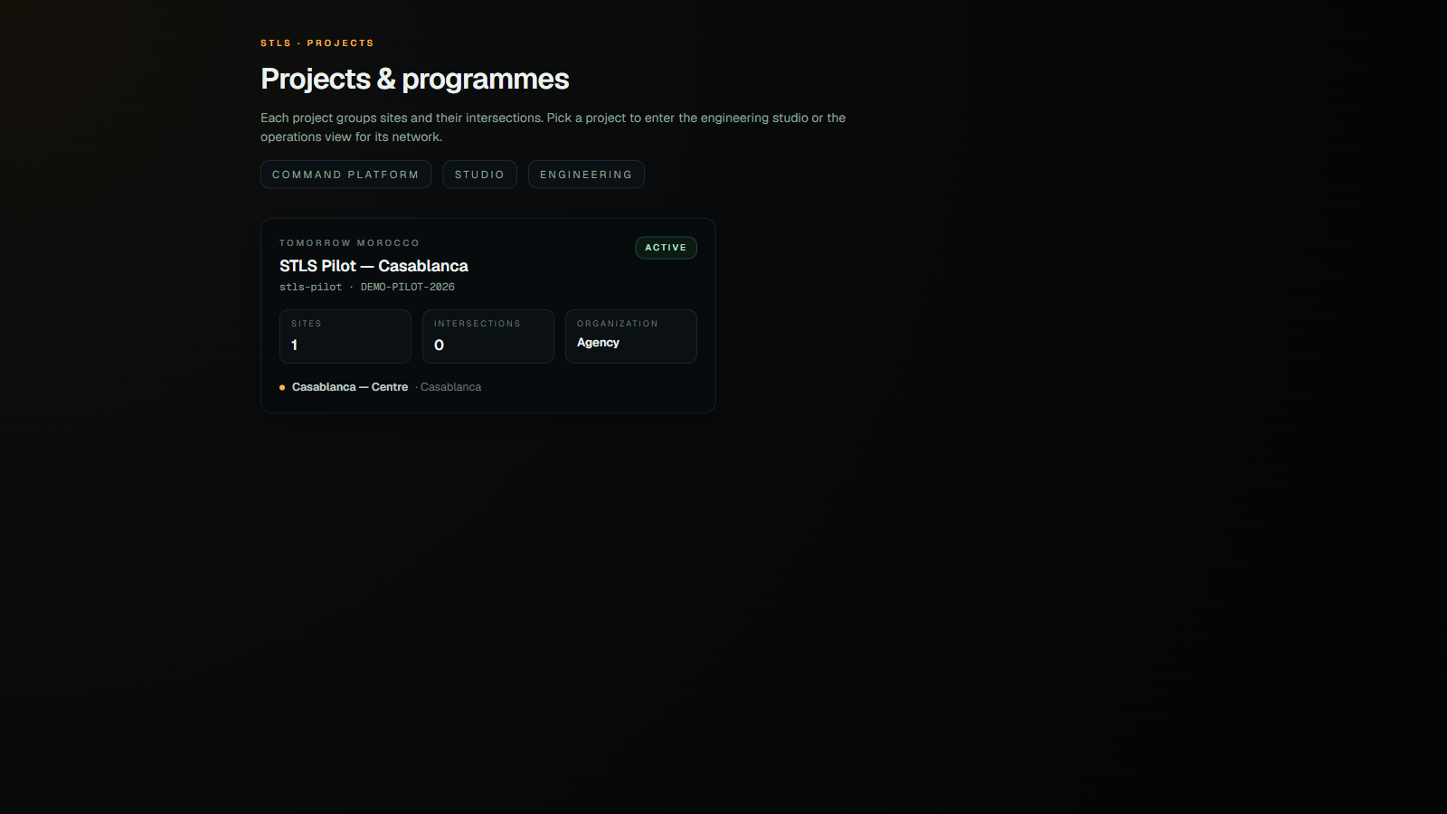
INTERFACE 2/12
Projects
PM / BE
Project catalogue per organization
Route /projects
Hierarchy Organization → Project → Site → Intersection
Seeded: Tomorrow Morocco → STLS Pilot — Casablanca
Each card: client ref · status · sites count · intersection count
Quick navigation to Command / Studio / Engineering

Slide 6
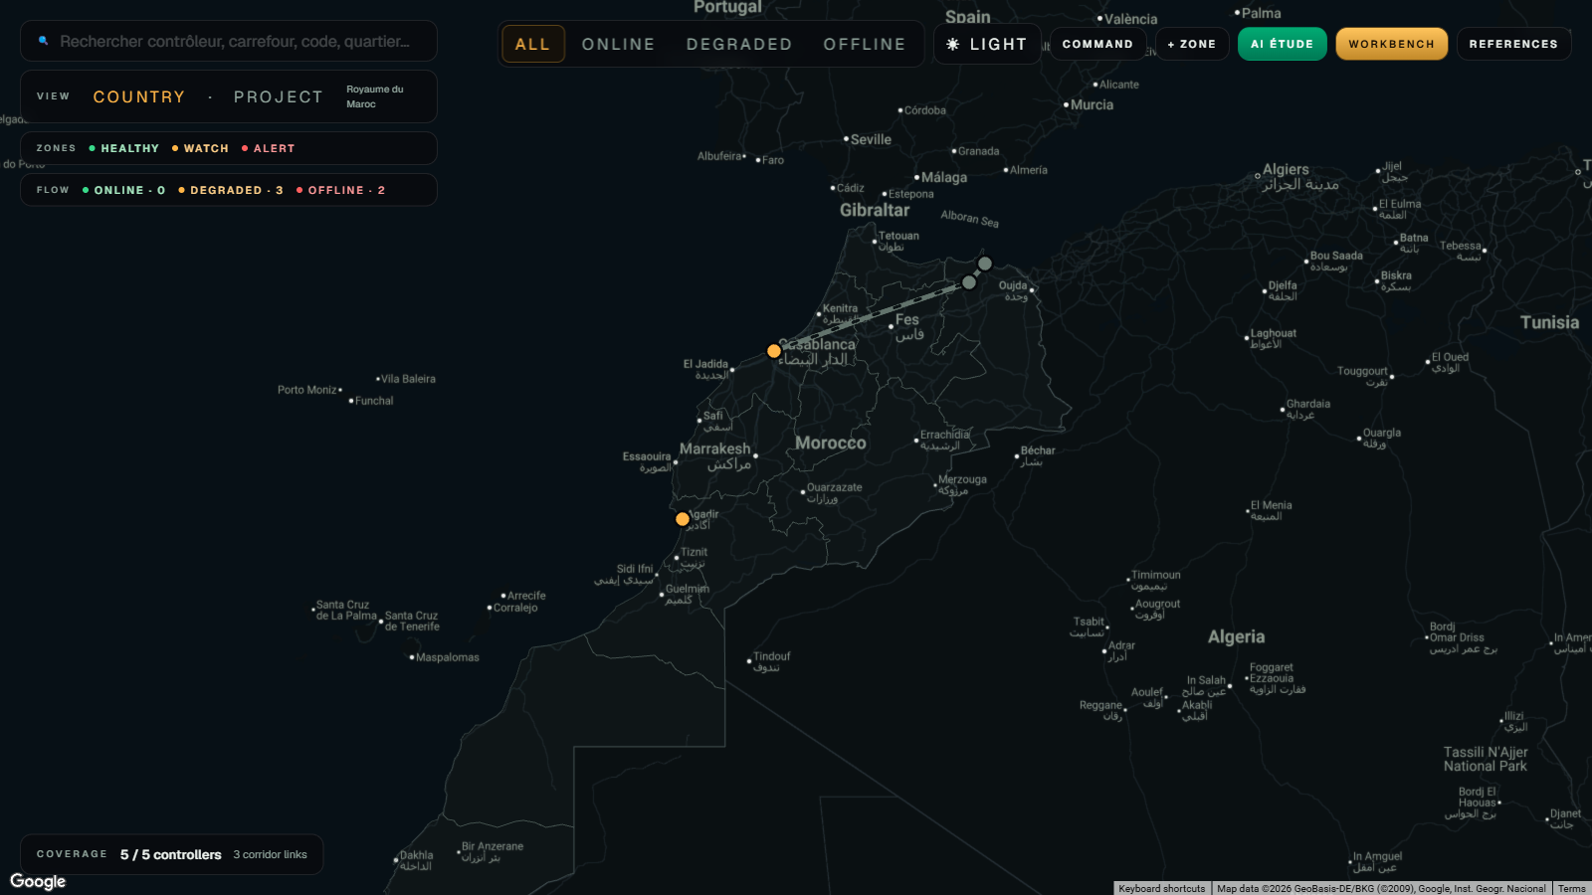
INTERFACE 3/12
Studio Landing
ENGINEER
Google-Maps atlas of every controller in the project
Route /studio
Full-screen Google Map · dark & light themes
Each controller = circular marker colored by connection state
Corridor lines between controllers in the same district
ADM1 polygons covering Morocco's 12 regions
Top-right: health filter · theme · + Zone · Workbench
Legend VIEW / ZONES / FLOW top-left

Slide 7
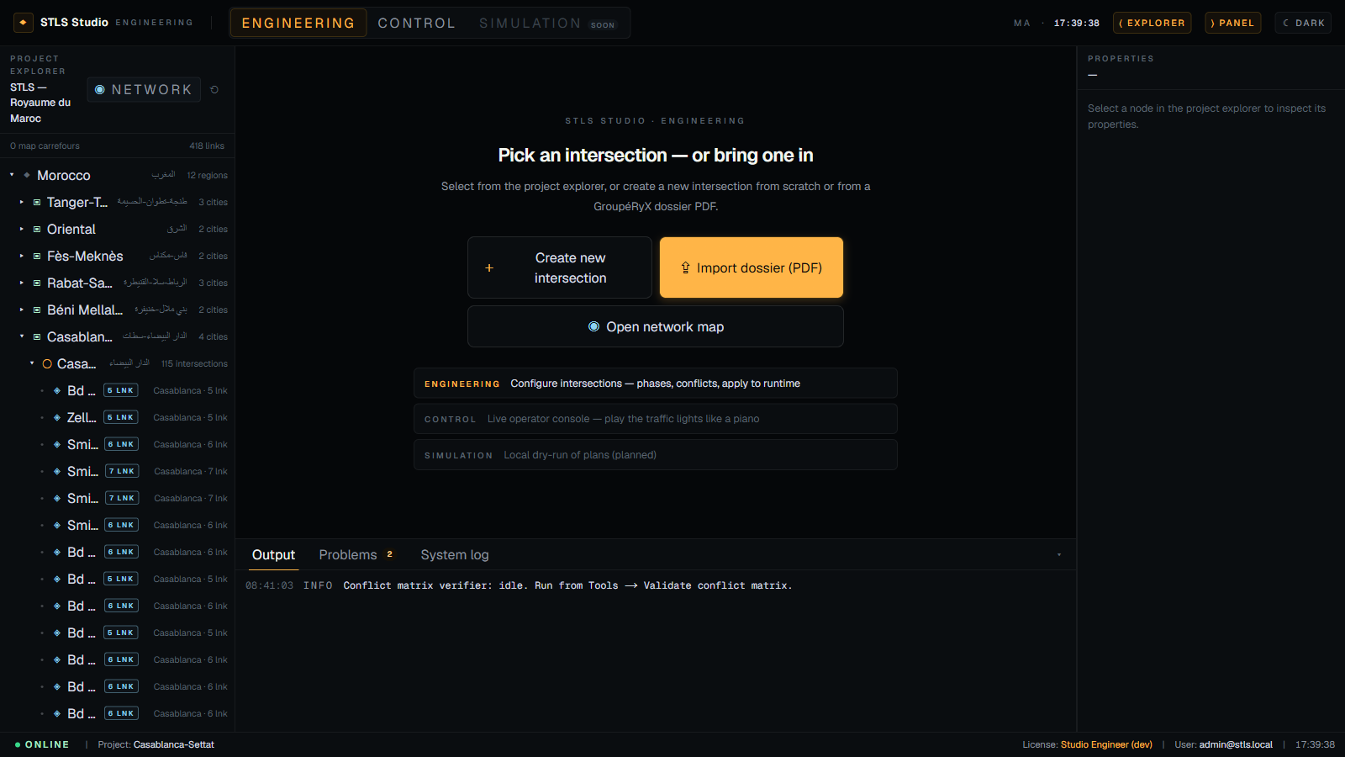
INTERFACE 4/12
Studio Workbench
ENGINEER
Engineering IDE to configure an intersection end-to-end
Route /studio/workbench
3-panel IDE: Project Explorer · Editor Workspace · Control Panel
11 editor tabs: Diagram · Live · Identity · Approaches · Lanes · Signal groups · Movements · Phases & Stages · Detectors · Modes · Controller
Project Explorer shows local proposals under their matched city (Prop tag)
Collapsible side panels via the ⟨ Explorer / ⟩ Panel toggles
Export Régulation / Câblage → PDF via @react-pdf/renderer

Slide 8
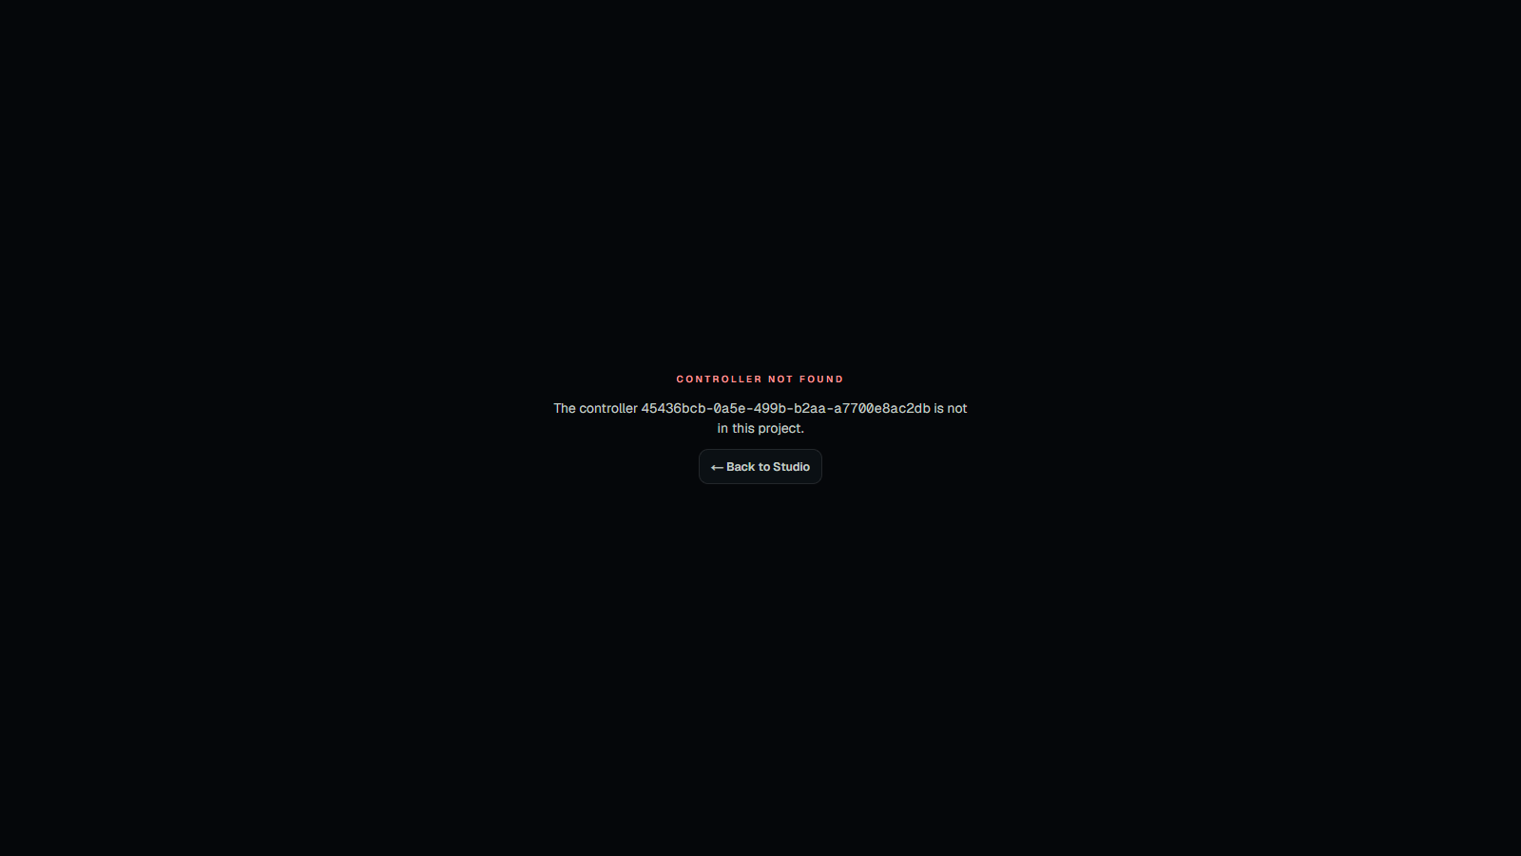
INTERFACE 5/12
Controller Workspace
TECH
Live feed per controller — chip strip + live signal flow
Route /studio/controllers/[id] · /studio/programmer/[id]
Top chip strip: EVERY controller in the project with live state
Controller details: mode · env · runtime · active plan · uptime
Live signal flow: N/E/S/W lights + cycle timeline
Force-phase buttons per phase + Release button
Polls /intersections/:code/state every 1 s

Slide 9
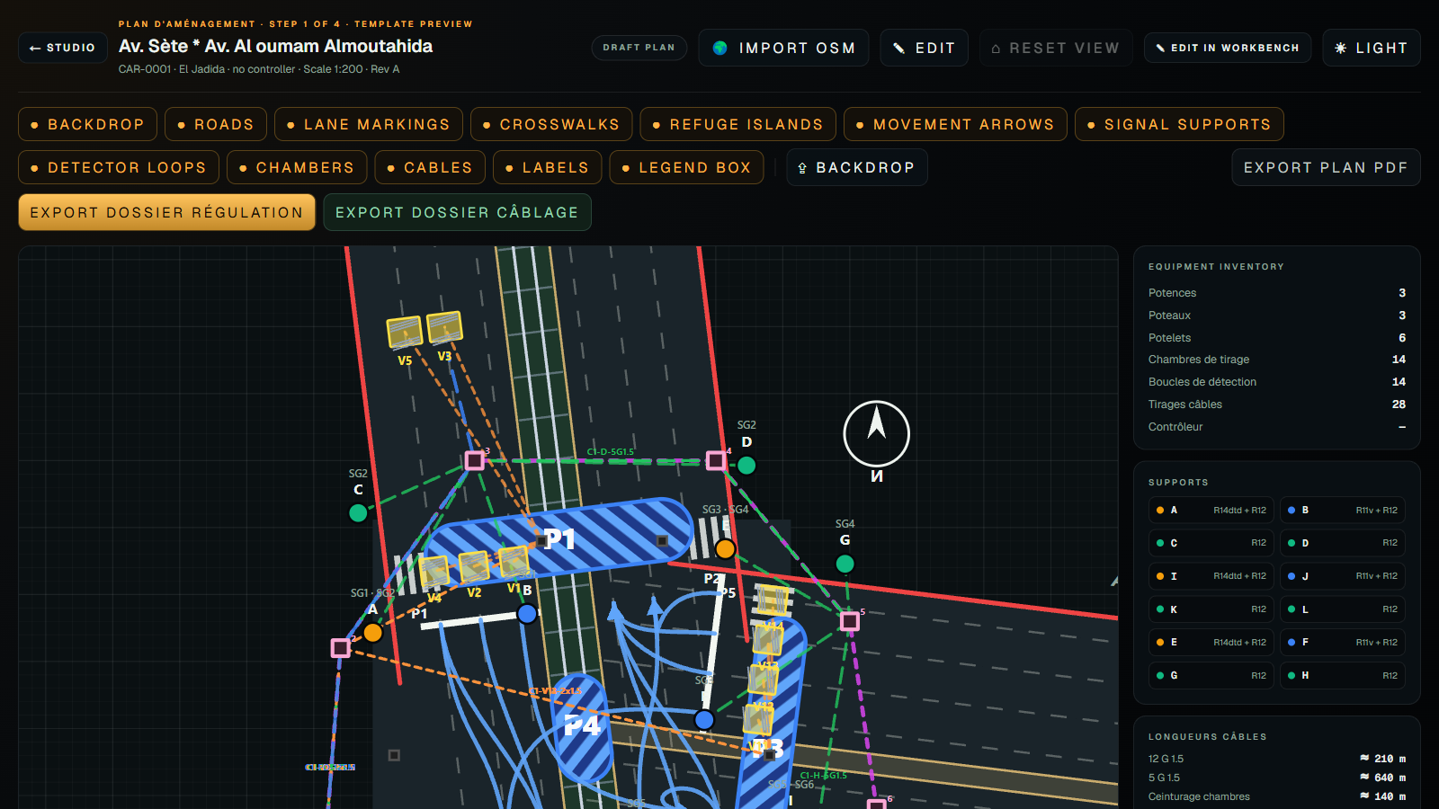
INTERFACE 6/12
AutoCAD Plan
BE TOPO
Vector topographic plan · GroupéRyX style
Route /studio/autocad/[intersectionId]
Full SVG render — no Google tiles in the exported drawing
Data model: CivilPlan · RoadArm · Lane · Crosswalk · SignalSupport · DetectorLoop · CableChamber · CableRun · ControllerCabinet
Sample INT-CAS-006: 16 supports (A-P) · 6 loops · 8 chambers · 22 cable runs · cabinet C04
8 layer toggles: Roads · Lanes · Crosswalks · Supports · Loops · Chambers · Cables · Labels
North arrow · scale bar 0-5-10 m · 1:200 · dark & light
Three export buttons: Plan PDF · Dossier Régulation · Dossier Câblage

Slide 10
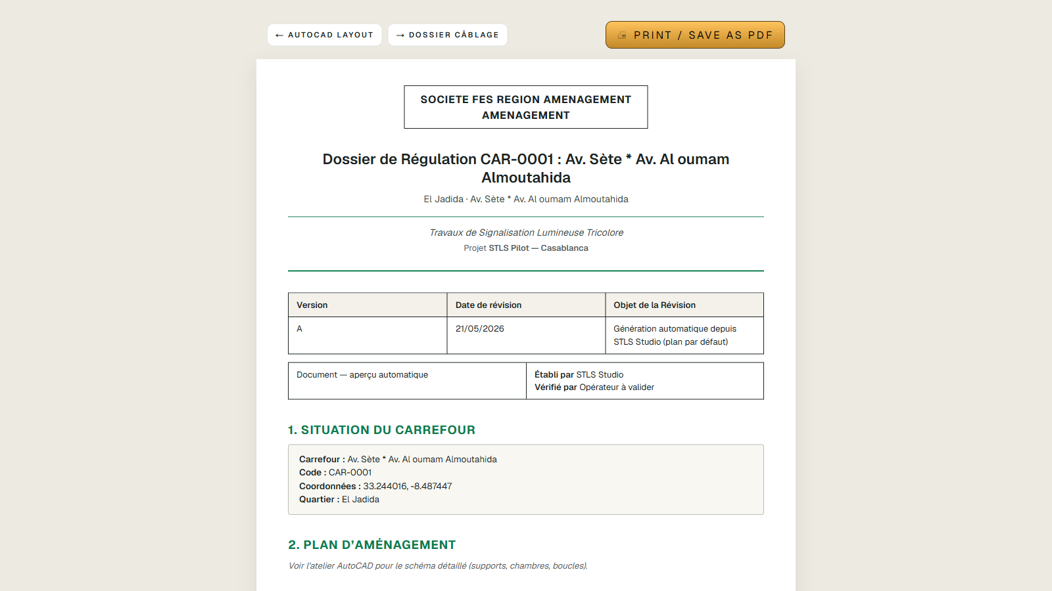
INTERFACE 7/12
Dossier Régulation
DELIVERABLE
Regulation dossier — PDF output matching GroupéRyX format
Route /studio/autocad/[id]/dossier/regulation
Cover page + revision table (préparé / vérifié)
Intersection identity (code, GPS, controller, firmware)
Signal equipment inventory (R11v / R12 / R14 counts, supports)
Controller inputs table
Vector plan d'aménagement (A3 landscape)
Phasing: Min green / Yellow / Red-clearance / Green groups
Signal plans — Code / Name / Status / Cycle / Offset
Observations & assumptions

Slide 11
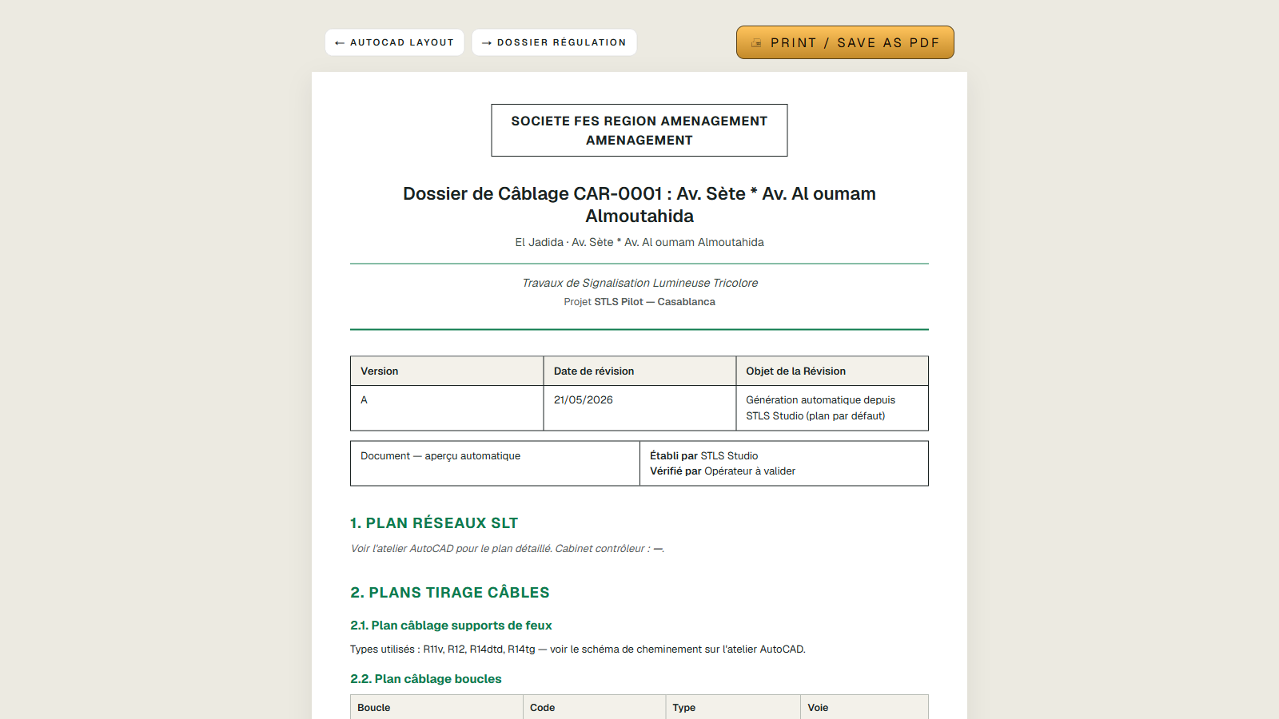
INTERFACE 8/12
Dossier Câblage
DELIVERABLE
Wiring dossier — carnet de câblage + cable schedule
Route /studio/autocad/[id]/dossier/cablage
Cover page + revision table
Vector cabling plan (A3 landscape)
Cabling detail: Departure · Support · Type · Equipment · Cable · Tag · Length · Path
Detection loop wiring
Cable quantity roll-up (U1000 R2v, Blindé LIYCY, Fibre)
Pulling chambers inventory
Controller I/O mapping (Bornier, Mnemonic, Cable ref)

Slide 12
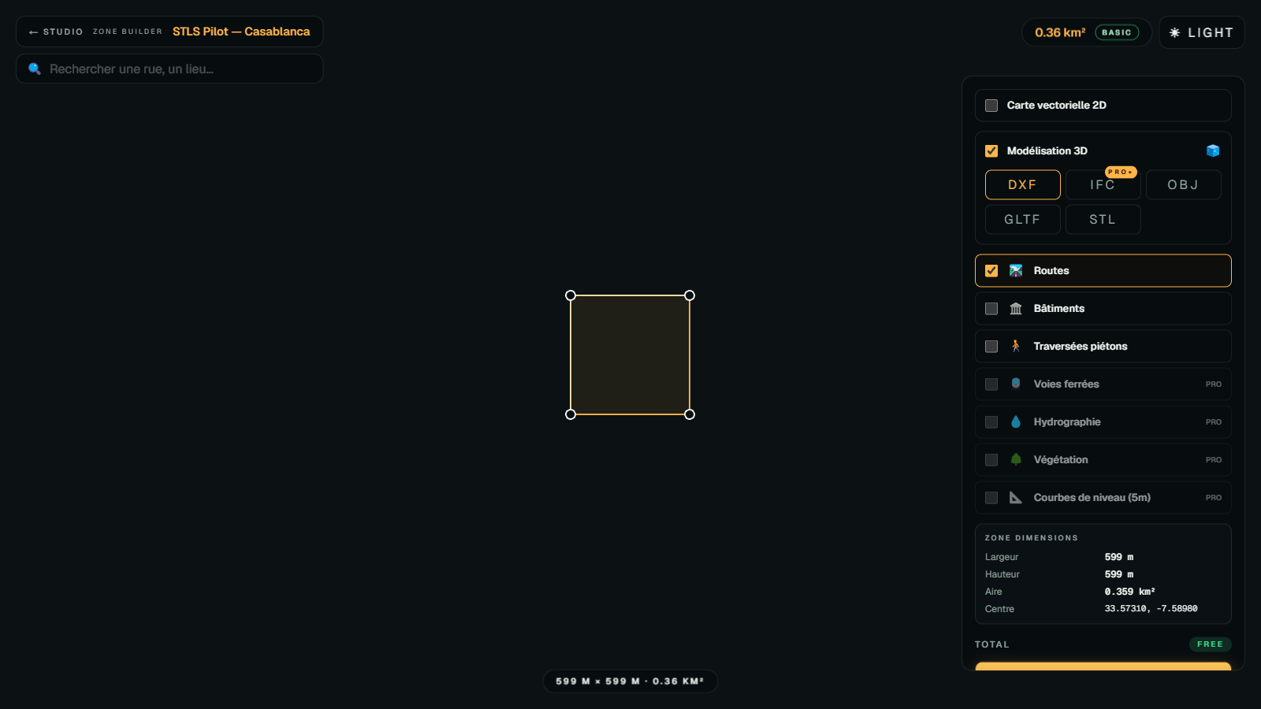
INTERFACE 9/12
Zone Builder
PROSPECTION
Draw a new intersection zone on Google Maps
Route /studio/zones
Draggable rectangle with 4 corner handles on Google Maps
Live dimensions (width × height × km²) via haversine math
TopoExport-style right panel: 3D modeling (DXF / IFC+ / OBJ / glTF / STL) + layers
+ Add controller → auto-fills from Google Maps Geocoder
Intersection name ← route / sublocality · Code ← INT-CITY-STREET
Visualiser: fit-bounds + pulse animation
Saved proposals appear in the Workbench tree under their city

Slide 13
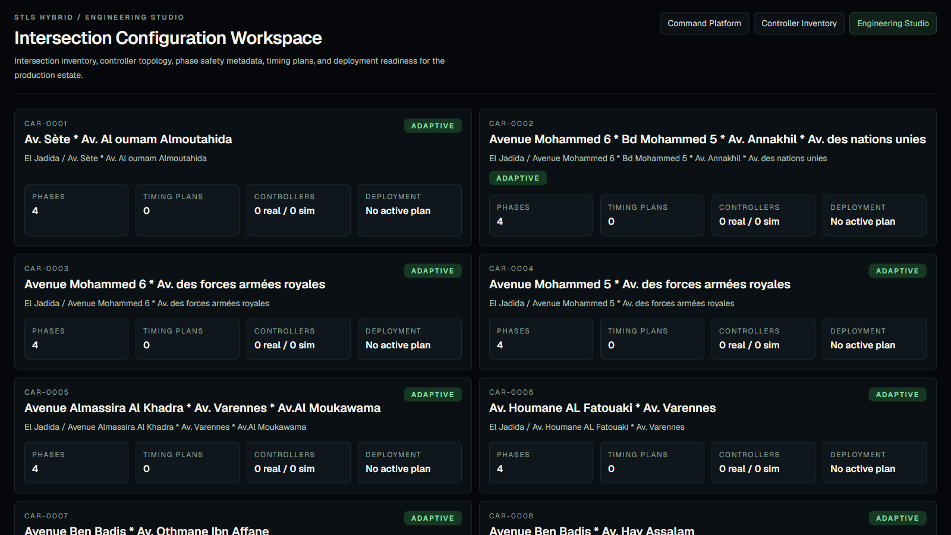
INTERFACE 10/12
Engineering Studio
BE
Engineering inventory of every intersection
Route /engineering
Grid of intersection cards with code · name · district · control mode
Phase count · timing plan count · controllers (real / sim)
Deployment status per intersection
Drill-down to /engineering/intersections/[id] for full details

Slide 14
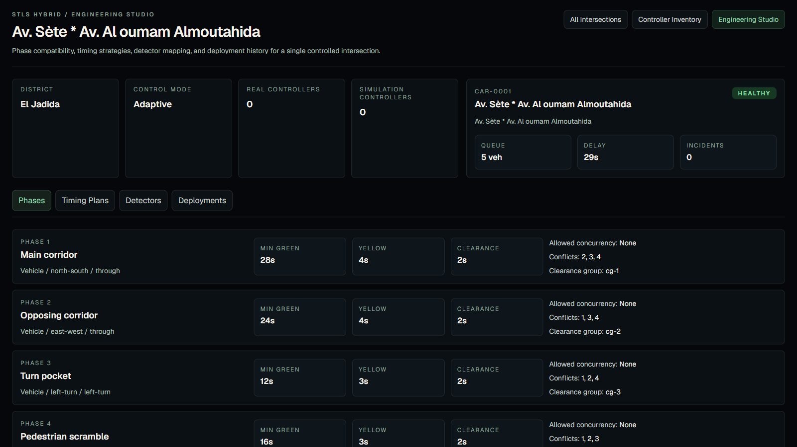
INTERFACE 11/12
Engineering — Intersection detail
BE
Full engineering record of one intersection
Route /engineering/intersections/[id]
Identity, coordinates, control mode, status, queue length
Attached controllers with hardware details
Detection loops + phase sequence table
Timing plans (active / draft / retired)
Deployment history with signed package versions

Slide 15
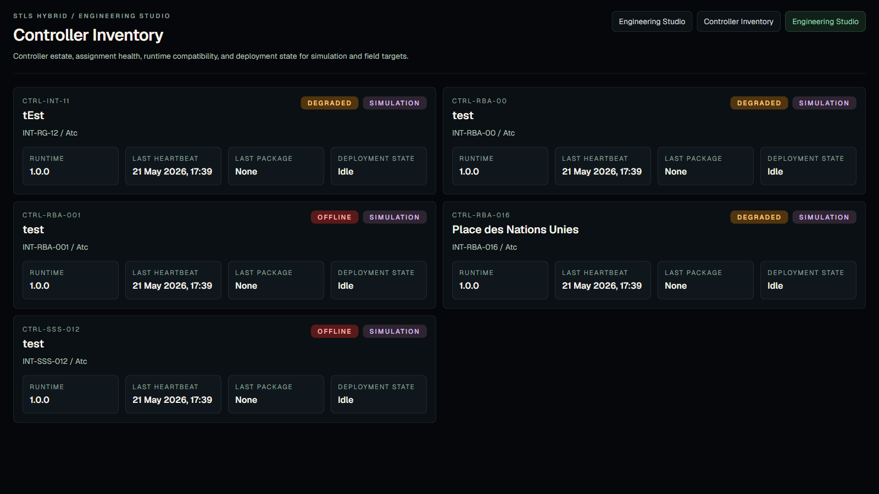
INTERFACE 12/12
Controller Inventory
OPS
Hardware inventory across the fleet
Route /engineering/controllers
Listing: code · controller type · firmware · runtime version
Connection state · environment · battery-backed flag
Detector / signal-group capacity per unit
Last seen · last deployed package · deployment state
Click-through to each controller's detail view

Slide 16
AI ASSIST
Traffic intelligence — advisory, auditable, safe
Backend module traffic-intelligence · 3 services · 15 unit tests
PIPELINE
SAFETY RULES
UX
GoogleTrafficService — Distance Matrix for N/E/S/W corridors
AiRecommendationService — Gemini 1.5 Flash JSON, T=0.2
Fallback: deterministic rule-based if GEMINI_API_KEY is missing
AiSafetyValidatorService — final exit gate
Advisory mode forces requiresHumanApproval=true
Real-mode intersections always need human approval
Operator override (manual / emergency / flash / fail-safe) = no_action
Unknown phase id → no_action
Duration clamped to [minGreen, 60s]
Conflict matrix checked before accepting
3 tabs: Recommendation · Context · History
Chip badges for action · risk · source · approval
Apply via override → reuses reason-coded modal
History keeps last 25 recommendations per intersection

Slide 17
SECURITY
Defence in depth
No command reaches the field without an audit trail
IDENTITY
COMMANDS
AI
JWT required outside dev mode
Fine-grained permissions (read / control / author / approve)
Project-scoped roles
Reason code mandatory on every override
Operator · IP · timestamp persisted
Triple validation: UI · AI safety · runtime service
Advisory only (AI_CONTROL_MODE env)
Real-mode = human approval always
Any operator override suppresses AI suggestion

Slide 18
STACK
Technologies in use
FRONTEND
BACKEND
FIELD RUNTIME
Next.js 16 · React 19
Tailwind v4 · TypeScript 5
@react-google-maps/api
@react-pdf/renderer
NestJS 11 · TypeORM 0.3
PostgreSQL 14
Passport JWT
Gemini 1.5 · Google Distance Matrix
Go runtime per cabinet
HMAC package signing
JWT refresh + offline mode
Fail-safe flashing amber

Slide 19
ROADMAP
Done · in progress · next
SPRINT 1 — DONE
SPRINT 2 — DONE
SPRINT 3 — IN PROGRESS
NEXT
Projects / sites / intersections
Reason-coded override
Environment badge · audit logs
Frontend route groups
AutoCAD SVG plan
PDF dossiers (régulation + câblage)
Zone builder + Google geocoder
AI Assist advisory + safety
Gemini + fallback rules
Override audit integration
POST /engineering/intersections
Conflict matrix editor UI
Simulation dry-run
SSO / LDAP in production
Fleet rollout with OTA HMAC

Slide 20
Thank you
Questions · live demo · code walkthrough
akarim@tomorrow.ma

