Slide 1
“TIC” or “ITC” (Information and Communication Technologies) and the technologies related to its
Sabrine Boumechhour
Mehdi zouheir charif
Ayoub elyes kafif
Abdi islem
Sarah hamedi
28.12.2023

Slide 2

“TIC” or “ITC”

Slide 3
Plan
Introduction to “TIC/ITC”
Google services
Emerging Technologies in “TIC /ITC”
Case Studies
Futur of “TIC/ITC”
Conclusion

Slide 4
Plan
Introduction to “TIC/ITC”
Google services
Emerging Technologies in “TIC /ITC”
Case Studies
Futur of “TIC/ITC”
Conclusion

Slide 5
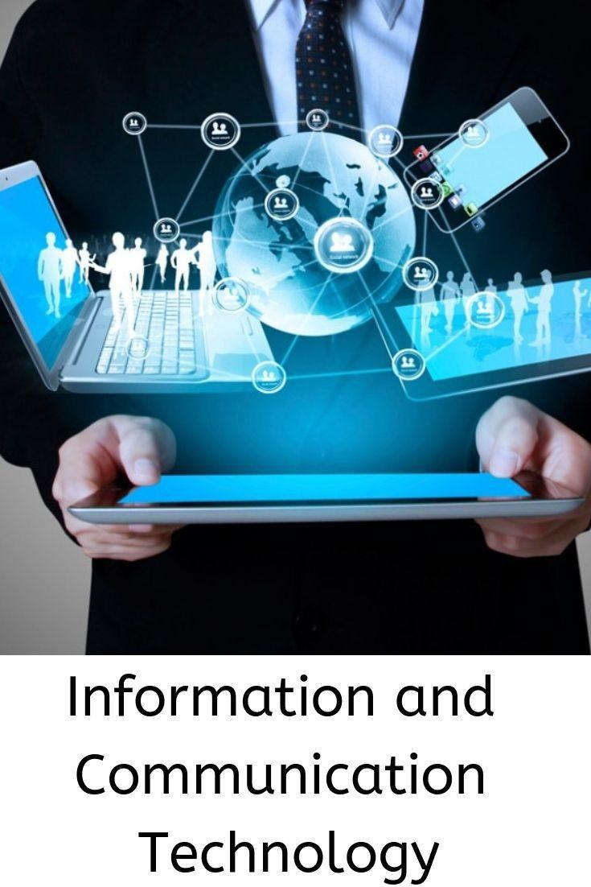

Introduction to “tic” or “itc”
What are Information and Communication Technologies (TIC/ITC) ?
Information and Communication Technologies refer to a broad range of technologies that are used to transmit, process, store, and retrieve information .
Importance of TIC
TIC has revolutionized various aspects of our lives, including communication, education, business, healthcare, and entertainment. Here are some key reasons why TIC is important:
Improved Communication: TIC enables instant communication across geographical boundaries, connecting people from different parts of the world.

Slide 6
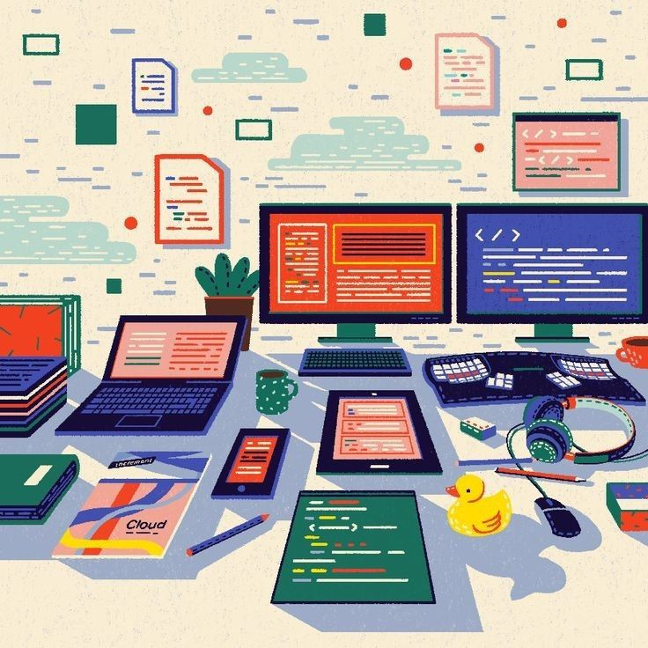
Efficient Data Management: TIC allows for efficient storage, processing, and retrieval of large volumes of data, enabling organizations to make informed decisions.
Enhanced Access to Information: TIC provides easy access to a vast amount of information, empowering individuals and organizations to acquire knowledge and stay updated.
Increased Efficiency and Productivity: TIC automates tasks, streamlines processes, and improves productivity, saving time and resources.
Innovation and Economic Growth: TIC drives innovation and economic growth by enabling the development of new products, services, and business models.

Slide 7
Plan
Introduction to “TIC/ITC”
Google services
Emerging Technologies in “TIC /ITC”
Case Studies
Future of “TIC/ITC”
Conclusion

Slide 8
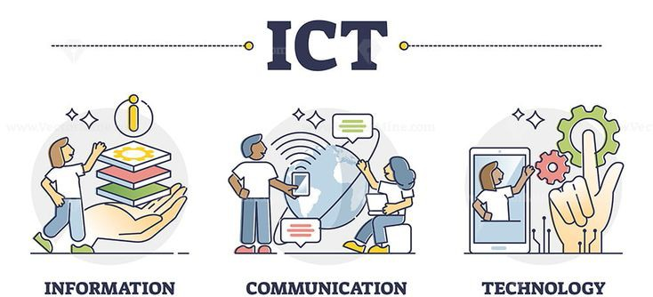
Google services
Google offers a wide range of services that play a significant role in the field of Information and Communication Technologies (TIC). These services have revolutionized the way we access and share information, communicate with others, and collaborate on projects.

Slide 9
SERVICE | DESCRIPTION | ROLE IN “TIC” / “ITC”
Google Search | A web search engine that provides relevant search results based on user queries . | Enables users to access vast amounts of information and plays a crucial role in information retrieval in “TIC/ITC” .
Gmail | A free email service that allows users to send and receive emails. | Facilitates communication and collaboration through email, an essential component of “TIC/ITC” .
Google Drive | A cloud storage and file sharing service that allows users to store and access files from anywhere. | Enables seamless files sharing and collaboration , enhancing productivity and efficiency in “TIC/ITC” .
Google Docs | A web-based word processing application that allows users to create and edit documents collaboratively . | Promotes real-time collaboration and document sharing , facilitating teamwork and project management in “TIC/ITC” .
Google Maps | A web mapping service that provides detailed maps and satellite imagery . | Facilitates navigation , location-based services, and geospatial analysis, playing a vital role in various “TIC/ITC” applications .
Google Meet | A video conferencing platform that enables virtual meetings and collaboration . | Supports remote communication and collaboration , allowing individuals and teams to connect and work together in “TIC/ITC” .

Slide 10
Plan
Introduction to “TIC/ITC”
Google services
Emerging Technologies in “TIC /ITC”
Case Studies
Future of “TIC/ITC”
Conclusion

Slide 11

Emerging Technologies in “TIC /itc”
Artificial Intelligence
Artificial Intelligence (AI) is revolutionizing the TIC industry by enabling improved automation and decision-making processes.
Internet of Things
The Internet of Things (IoT) is transforming the TIC industry by enabling enhanced connectivity and data collection.
Blockchain
Blockchain technology is bringing increased security and transparency to transactions in the TIC industry.
Virtual Reality
Virtual Reality (VR) is enabling immersive training and simulation experiences in the TIC industry.

Slide 12
Plan
Introduction to “TIC/ITC”
Google services
Emerging Technologies in “TIC /ITC”
Case Studies
Future of “TIC/ITC”
Conclusion

Slide 13
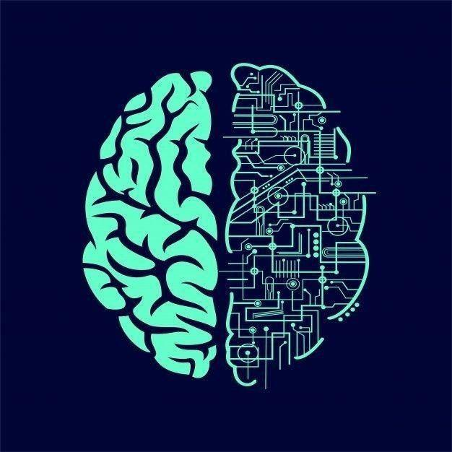

Case Studies
Smart City Infrastructure
Our TIC solutions have been implemented in smart city projects, enabling efficient management of resources, improved public safety, and enhanced quality of life for residents.
Connected Healthcare System
Our TIC technologies have revolutionized the healthcare industry, enabling seamless communication and data exchange between healthcare providers, improving patient care and outcomes.

Slide 14
Plan
Introduction to “TIC/ITC”
Google services
Emerging Technologies in “TIC /ITC”
Case Studies
Future of “TIC/ITC”
Conclusion

Slide 15
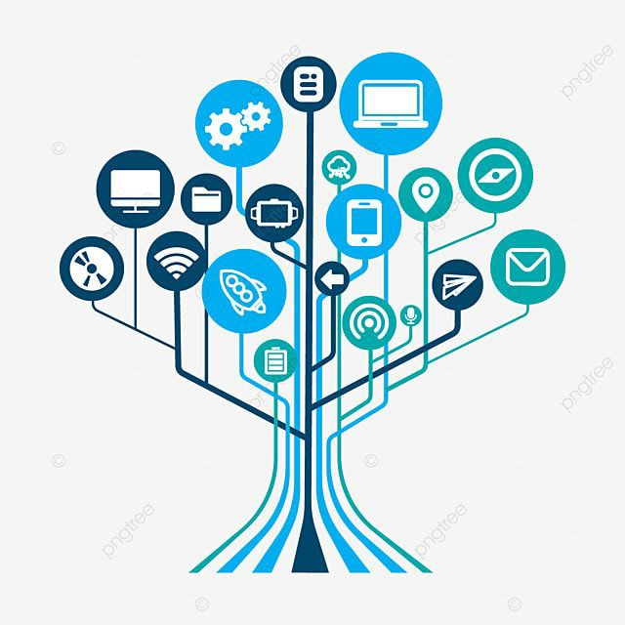
Future of TIC :
Advancements in the Field
The future of TIC holds exciting possibilities for advancements in technology and communication.
With the rapid pace of innovation, we can expect to see:
  Increased connectivity and internet speeds, enabling faster and more reliable communication.
  Advancements in artificial intelligence and machine learning, enhancing automation and data analysis capabilities.
  Improved cybersecurity measures to protect against evolving threats and vulnerabilities.
  Integration of TIC with emerging technologies such as Internet of Things (IoT) and 5G networks.

Slide 16
Plan
Introduction to “TIC/ITC”
Google services
Emerging Technologies in “TIC /ITC”
Case Studies
Future of “TIC/ITC”
Conclusion

Slide 17

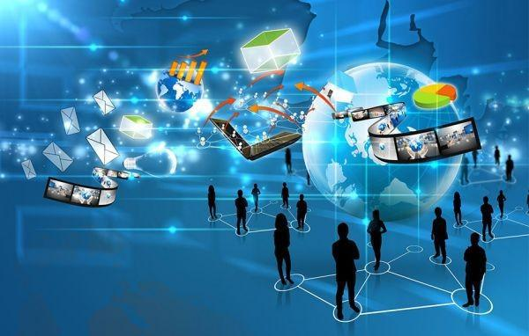
Conclusion
Key Findings
  Information and Communication Technologies (ICT) have revolutionized the way we communicate, work, and access information.
  Emerging technologies such as Artificial Intelligence (AI), Internet of Things (IoT), and Blockchain are driving innovation and transforming industries.
  ICT has enabled remote work and digital collaboration, leading to increased productivity and flexibility.
Insights
  The adoption of ICT is crucial for businesses to stay competitive and adapt to changing market dynamics.
  Investments in emerging technologies can lead to improved efficiency, cost savings, and new revenue streams.

