Slide 1

Netflix TV Shows Dataset Analysis
Uncovering strategic insights from 50 popular TV shows to guide content acquisition and production decisions.

Slide 2
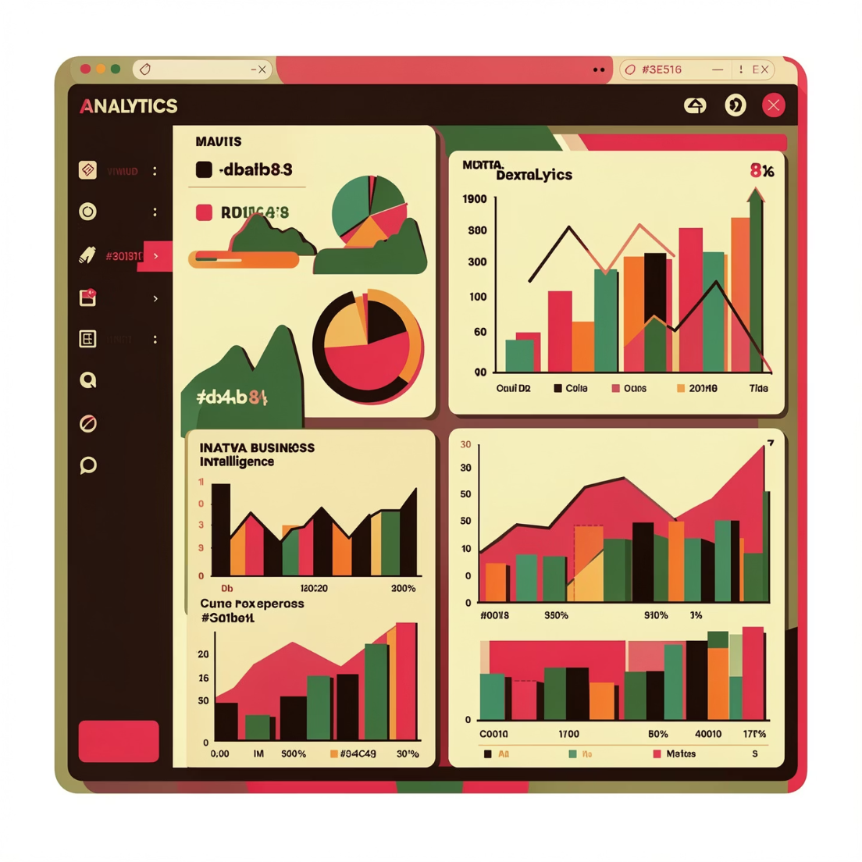
Project Overview
Objective
Analyze Netflix TV shows using transactional data to uncover trends in content quality, audience targeting, and performance metrics.
Key Attributes
Release year and era classification
Age rating and audience classification
IMDb ratings and popularity scores
Netflix availability status

Slide 3
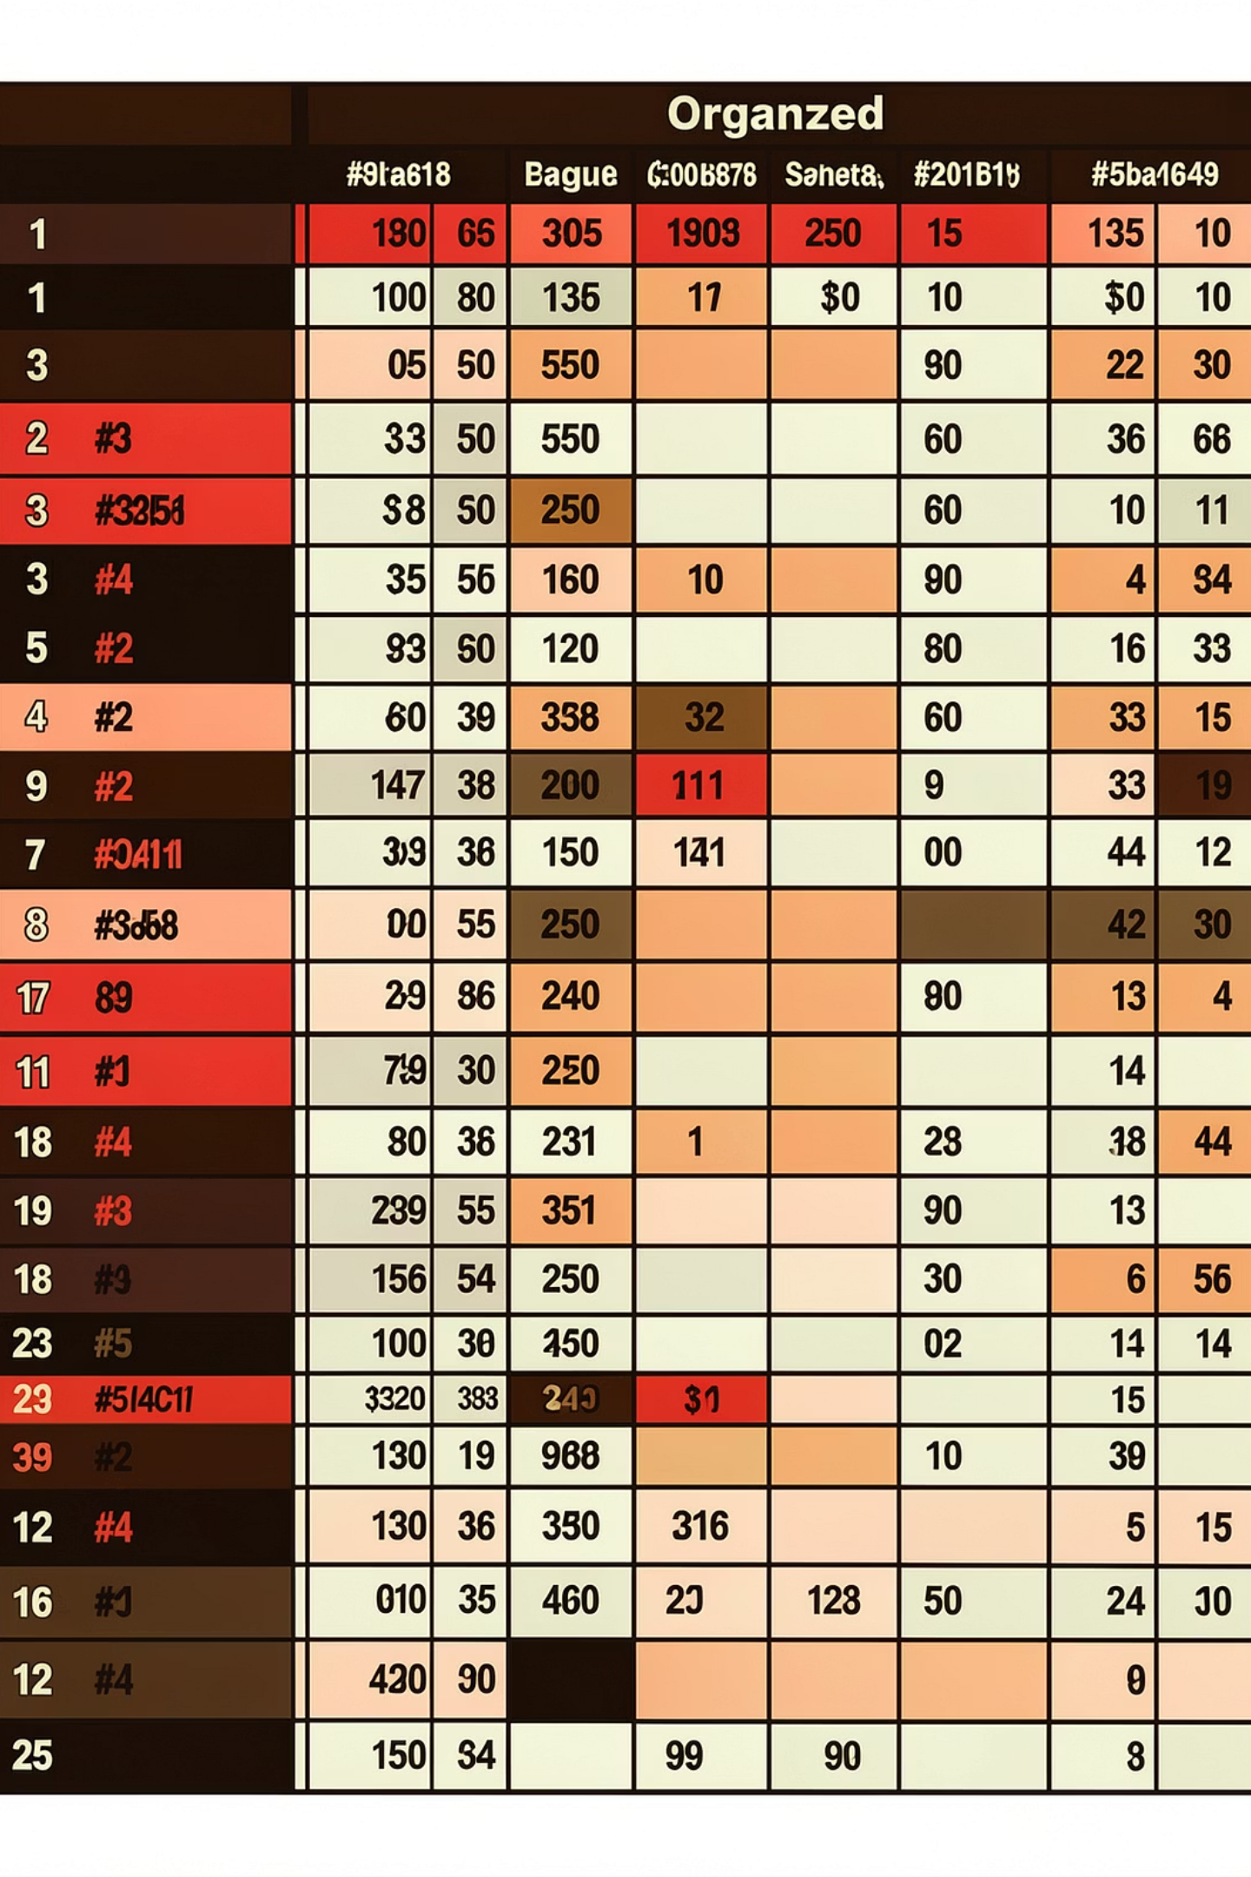
Dataset Summary
50
5
TV Shows
Key Features
Curated list of highly rated and popular series
Release year, age rating, IMDb scores, availability
0
Missing Values
Clean dataset ready for analysis

Slide 4




Data Preparation Process
Data Loading
Initial Exploration
Imported dataset using pandas for analysis
Checked structure with df.info() and summary statistics
Quality Check
Database Integration
Verified no missing data in the dataset
Loaded cleaned data into PostgreSQL for SQL analysis

Slide 5

Feature Engineering
Age Rating Tier
Release Era
Created tier classifications by mapping age ratings to standardized categories for easier analysis.
Binned release years into era categories to identify temporal trends in content performance.

Slide 6

SQL Analysis: Key Findings
Netflix vs Non-Netflix
Top Release Era
Top 2 TV Shows
Compared total TV shows available versus not available on Netflix platform
Ranked eras by average IMDb rating with total shows in each era category
Identified highest-rated shows and their age rating tier classifications

Slide 7
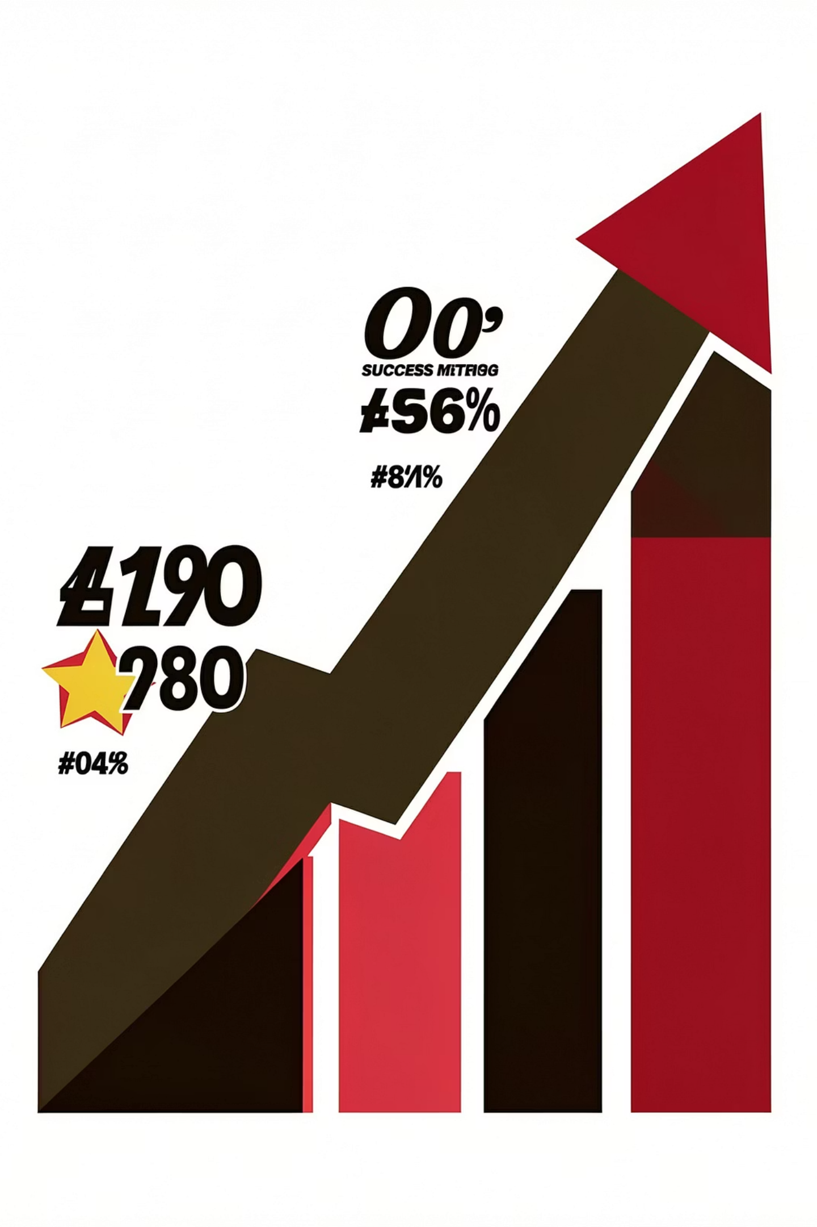
Performance Insights
Age Tier Performance
Ranked age tiers by highest average IMDb rating to identify best-performing audience segments
Combined Analysis
Analyzed age tier and era combinations with most Netflix available shows
High-Performing Gaps
Identified shows with IMDb >8.5 not available on Netflix for acquisition opportunities

Slide 8

Power BI Dashboard
Interactive Visualization
Built comprehensive dashboard to present insights visually with interactive filters and drill-down capabilities.
Enabled stakeholders to explore data from multiple dimensions including era, age tier, and rating performance.

Slide 9
Business Recommendations
01
02
License High-Rated Shows
Focus on Modern Era
Acquire IMDb 8.5+ titles not currently on Netflix—proven hits waiting to be licensed
Prioritize productions from modern era, which score highest in audience ratings
03
04
Expand Family Content
Fill Content Gaps
Develop more family-friendly shows—strong ratings drive household subscriptions
Address high-demand age group and era combinations currently underrepresented

Slide 10

Strategic Next Steps
Personalize Marketing
Tailor campaigns by audience tier—different age groups respond to different content strategies
Enhance Recommendations
Implement quality score combining IMDb ratings, era, and age tier to predict viewer preferences
Optimize Content Mix
Balanced portfolio of licensed hits and original productions targeting underserved segments

