Slide 1

Networking checkpoint
By Hergli Sabrine

Slide 2
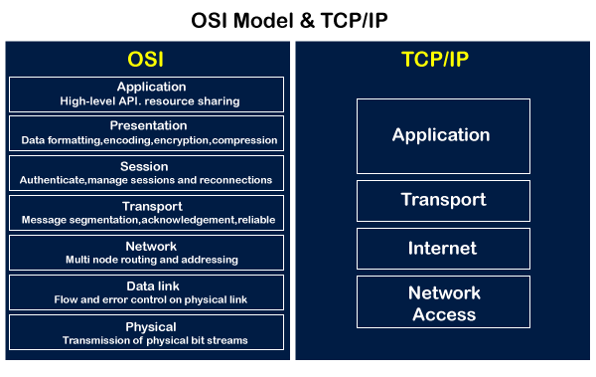
OSI model vs TCP/IP model:
OSI model is a generic model that is based upon functionalities of each layer. TCP/IP model is a protocol-oriented standard.
OSI model distinguishes the three concepts, namely, services, interfaces, and protocols. TCP/IP does not have a clear distinction between these three.
OSI model gives guidelines on how communication needs to be done, while TCP/IP protocols layout standards on which the Internet was developed. So, TCP/IP is a more practical model.
In OSI, the model was developed first and then the protocols in each layer were developed. In the TCP/IP suite, the protocols were developed first and then the model was developed.
The OSI has seven layers while the TCP/IP has four layers.

Slide 3
OSI model vs TCP/IP model:
OSI | TCP/IP
OSI represents Open System Interconnection. | TCP/IP model represents the Transmission Control Protocol / Internet Protocol.
OSI is a generic, protocol independent standard. It is acting as an interaction gateway between the network and the final-user. | TCP/IP model depends on standard protocols about which the computer network has created. It is a connection protocol that assigns the network of hosts over the internet.
The OSI model was developed first, and then protocols were created to fit the network architecture’s needs. | The protocols were created first and then built the TCP/IP model.
It provides quality services. | It does not provide quality services.
The OSI model represents defines administration, interfaces and conventions. It describes clearly which layer provides services. | It does not mention the services, interfaces, and protocols.
The protocols of the OSI model are better unseen and can be returned with another appropriate protocol quickly. | The TCP/IP model protocols are not hidden, and we cannot fit a new protocol stack in it.
It is difficult as distinguished to TCP/IP. | It is simpler than OSI.
It provides both connection and connectionless oriented transmission in the network layer; however, only connection-oriented transmission in the transport layer. | It provides connectionless transmission in the network layer and supports connecting and connectionless-oriented transmission in the transport layer.
It uses a horizontal approach. | It uses a vertical approach.
The smallest size of the OSI header is 5 bytes. | The smallest size of the TCP/IP header is 20 bytes.
Protocols are unknown in the OSI model and are returned while the technology modifies. | In TCP/IP, returning protocol is not difficult.

Slide 4
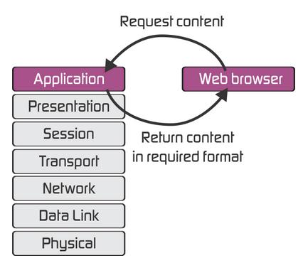
The application layer :
The application layer in the OSI model generally acts only like the interface which is responsible for communicating with host-based and user-facing applications. This is in contrast with TCP/IP protocol, wherein the layers below the application layer, which is Session Layer and Presentation layer, are clubbed together and form a simple single layer which is responsible for performing the functions, which includes controlling the dialogues between computers, establishing as well as maintaining as well as ending a particular session, providing data compression and data encryption and so on.
At first, client sends a command t server and when server receives that command, it allocates port number to client. Thereafter, the client sends an initiation connection request to server and when server receives request, it gives acknowledgement (ACK) to client through client has successfully established a connection with the server and, therefore, now client has access to server through which it may either ask server to send any types of files or other documents or it may upload some files or documents on server itself.

Slide 5
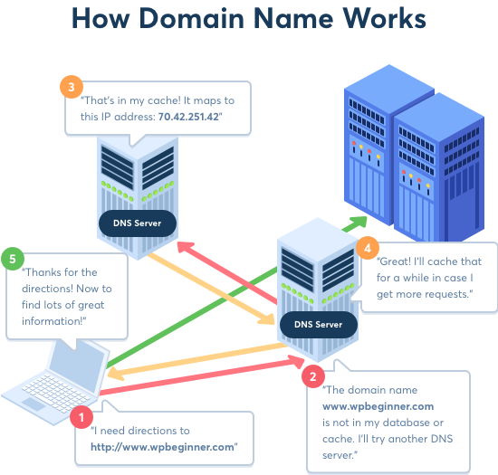
Domain name and IP address :
A domain name is a unique, easy-to-remember address used to access websites, such as ‘google.com’, and ‘facebook.com’. Users can connect to websites using domain names thanks to the DNS system.
The actual address of a website is a complex numerical IP address (e.g. 103.21.244.0), but thanks to DNS, users are able to enter human-friendly domain names and be routed to the websites they are looking for. This process is known as a DNS lookup.
The Domain Name System (DNS) is the phonebook of the Internet. Humans access information online through domain names, like nytimes.com or espn.com. Web browsers interact through Internet Protocol (IP) addresses. DNS translates domain names to IP addresses so browsers can load Internet resources.
Each device connected to the Internet has a unique IP address which other machines use to find the device. DNS servers eliminate the need for humans to memorize IP addresses such as 192.168.1.1 (in IPv4), or more complex newer alphanumeric IP addresses such as 2400:cb00:2048:1::c629:d7a2 (in IPv6).

Slide 6
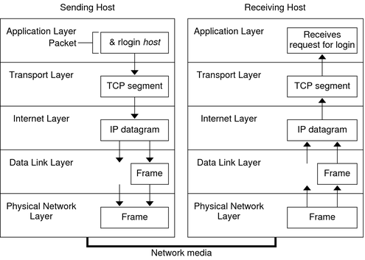
TCP interconnection between local host and the server:
Because network communication is always a little bit unreliable, TCP is built to withstand failure. It sends data in separate individually labelled packets that the destination computer puts back together again in order to read.
When a user issues a command that uses a TCP/IP application layer protocol, a series of events is initiated. The user's command or message passes through the TCP/IP protocol stack on the local system. Then, the command or message passes across the network media to the protocols on the remote system. The protocols at each layer on the sending host add information to the original data.
Protocols on each layer of the sending host also interact with their peers on the receiving host.
A packet consists of a header with the sending and receiving systems' addresses, and a body, or payload, with the data to be transferred travels through the TCP/IP protocol stack, the protocols at each layer either add or remove fields from the basic header. When a protocol on the sending system adds data to the packet header, the process is called data encapsulation. Moreover, each layer has a different term for the altered packet.

Slide 7
How data transfer over internet (TCP Packet):
The Internet works by chopping data into chunks called packets. Each packet then moves through the network in a series of hops.
Entering the network: Each packet hops to a local Internet service provider (ISP), a company that offers access to the network -- usually for a fee.
The next hop delivers the packet to a long-haul provider, one of the airlines of cyberspace that quickly carrying data across the world.
BGP: These providers use the Border Gateway Protocol to find a route across the many individual networks that together form the Internet.
Finding a route: This journey often takes several more hops, which are plotted out one by one as the data packet moves across the Internet.
Bad information: For the system to work properly, the BGP information shared among routers cannot contain lies or errors that might cause a packet to go off track – or get lost altogether.
Arrival: The final hop takes a packet to the recipient, which reassembles all of the packets into a coherent message. A separate message goes back through the network confirming successful delivery.

Slide 8


