Slide 1
FRAUD DETECTION
An End-to-End Machine Learning Pipeline for Detecting
Fraudulent Financial Transactions
MySQL → Python (Scikit-learn) → Streamlit
Presented by: LENOVO Project Team

Slide 2
AGENDA
Objective.
Data Overview.
Exploratory Data Analysis.
Project Workflow.
Model Building .
Model Evaluation.
Data Leakage Investigation.
Deployment.
Key Insights & Conclusion.

Slide 3
Objective
Develop an end-to-end machine learning pipeline that extracts transaction data from a SQL database, analyzes and engineers features, trains multiple classifiers, and deploys the strongest model as an interactive fraud-screening tool.
WHY IT MATTERS
10.25%
of transactions in this dataset are fraudulent — far above real-world rates, making reliable detection essential.
✓
Improve Security
Flag suspicious transactions before losses occur
✓
Reduce Financial Loss
A single missed fraud case can cost far more than the cost of a false alarm — recall on the fraud class is the metric that matters most.
Catch fraud patterns human review would miss
✓
Real-Time Ready
Model usable with only pre-transaction data
5

Slide 4
Data Overview
Source: MySQL 'fraud_analysis' database — transactions table, loaded into pandas
11,142
10
10.25%
5
Total Transactions
Raw Columns
Fraud Rate
Transaction Types
Transaction types: PAYMENT, CASH_IN, CASH_OUT, TRANSFER and DEBIT.
Numerical fields include amount and sender/receiver balances before and after the transaction.
Identifier fields include nameOrig and nameDest; these are not directly used as numeric predictors.
No missing values were found in the supplied dataset.
Fraud represents approximately 10.25% of records, making class imbalance an important modeling consideration.
2

Slide 5
Project Workflow
A seven-stage pipeline from raw SQL data to a deployed prediction app
1
→
2
→
3
→
4
→
5
→
6
→
7
Load Data
from MySQL
Exploratory
Data Analysis
Feature
Engineering
Preprocessing
(Encode & Scale)
Train Models
(LR / RF / XGB)
Evaluate &
Compare
Deploy
(Streamlit)
EDA & Visualization
Feature Engineering
Preprocessing
Correlation heatmaps to understand which features relate to fraud
Tested engineered balance-change features; later removed after leakage check
One-hot encoding for 'type', StandardScaler for numeric columns
FRAUD DETECTION ML PIPELINE
6

Slide 6
Exploratory Data Analysis
Understanding class balance and transaction volume before modeling
Class Distribution
Transactions by Type
10.25%
fraud rate
3

Slide 7
EDA: Where Fraud Concentrates
Fraud rate by transaction type — the key relationship driving model performance
EDA FINDINGS
•
Fraud appears only in TRANSFER and CASH_OUT transactions — never in CASH_IN, PAYMENT, or DEBIT
•
TRANSFER carries the highest fraud concentration at roughly 4 in 10 transactions
•
Fraudulent transfers tend to involve larger amounts and often empty the origin balance
4

Slide 8
Models Compared
Three classifiers trained and evaluated on the same train/test split
BASELINE
SELECTED
STRONG ALT.
Logistic Regression
Random Forest
XGBoost
Simple linear baseline model. Fast to train and easy to interpret, but limited when patterns are non-linear.
Ensemble of decision trees. Captures non-linear patterns, ranks feature importance, and handles imbalance via class weighting.
Gradient-boosted trees. Handles class imbalance and often leads on complex tabular data.
FRAUD DETECTION ML PIPELINE
7

Slide 9
Train-Test Split
80/20 split, stratified to preserve the 10.25% fraud ratio in both sets
11,142 Total Transactions
WHY STRATIFY?
TRAIN · 80%
TEST
20%
8,913 rows
✓
Fraud is rare
2,229
Only 10.25% of transactions are fraud — a random split could easily over- or under-represent it in the test set
Fraud Ratio Preserved in Both Sets
✓
Reliable evaluation
Split
Not Fraud
Fraud
Fraud %
Stratifying keeps the fraud ratio nearly identical in train (10.25%) and test (10.23%)
Training Set
7,999
914
10.25%
✓
Fair comparison
Test Set
2,001
228
10.23%
All three models were scored against the exact same class balance, making metrics directly comparable
✓
random_state=42
train_test_split(X, y, test_size=0.2, random_state=42, stratify=y)
Fixes the split so results are reproducible every time the notebook is re-run
FRAUD DETECTION ML PIPELINE
8

Slide 10
Model Performance
Precision, recall, and F1-score on the fraud class (class 1), test set
KEY TAKEAWAY
Highest Fraud Detection: Random Forest captures the most fraud with a top recall of 0.98.
Fewer False Alarms: XGBoost delivers better precision (0.94) and a superior F1-score (0.96).
.Deployment Choice: Random Forest remains preferred for maximum coverage, while XGBoost is ideal if minimizing false positives is the priority.
FRAUD DETECTION ML PIPELINE
9

Slide 11
Data Leakage Investigation
Near-perfect scores prompted a check for features that leak the answer
!
The Concern
✓
The Test & Result
1. newbalanceOrig / newbalanceDest are known only after the transaction.
2. orgin_balance_change / dest_balance_change were built from those balances, so they leak too (fraud drains the account, so change ≈ amount).
3. step: every transaction after step 7 is fraud. This comes from how the dataset was sampled, not from real fraud behaviour.
Retrained Random Forest three ways: all features, without post-transaction balances, and without balances and step. The final model uses only pre-transaction data.
Precision 1.00 → 0.90 | Recall 0.97 → 0.98
Scores dropped slightly, as expected. The final model still catches about 98% of fraud, with about 25 false alarms out of 2,001 normal transactions
FRAUD DETECTION ML PIPELINE
12

Slide 12
Why Random Forest?
chosen on practicality and validated stability
Deployment Practicality
Factor
Random Forest
XGBoost
Train accuracy 0.989 vs. test 0.986, a gap of only ~0.3%.
Leakage found and removed.
Post-transaction balances and step removed; only pre-transaction features used.
Imbalance handled.
class_weight='balanced' used; judged on precision, recall, F1 and PR-AUC.
Extra dependency
Built into scikit-learn
Separate xgboost package
Hyperparameter tuning
Simpler, fewer knobs
More sensitive to tune
Overfitting risk
Lower (trees averaged)
Higher if untuned
Production maintenance
Fewer moving parts
One more library to track
Random Forest matched the top-performing model while being simpler to tune, deploy, and maintain in production.
FRAUD DETECTION ML PIPELINE
10

Slide 13
Confusion Matrix
Random Forest — final model, test set (2,229 transactions)
ACTUAL
PREDICTED
Not Fraud
Fraud
What It Means
Not Fraud
1973
28
224 fraud cases caught
Correctly identified out of 228 actual fraud cases in the test set
True Negative
False Positive
Fraud
4 fraud cases missed
4
224
False negatives — fraud that slipped through undetected
False Negative
True Positive
28 false alarms
FRAUD DETECTION ML PIPELINE
11

Slide 14
Final Model: Random Forest
Trained only on realistic, pre-transaction features
0.90
0.98
0.94
0.99
Precision (Fraud)
Recall (Fraud)
F1-Score (Fraud)
Overall Accuracy
Final Feature Set
step
type (one-hot)
amount
oldbalanceOrg
oldbalanceDest
Removed: step, nameOrig, nameDest, newbalanceOrig, newbalanceDest — IDs and post-transaction fields unavailable (or irrelevant) at prediction time.
13

Slide 15
Random Forest — Training & Testing Performance
Random Forest achieved very high performance on both training and testing data.
Accuracy: 98.65% → Almost all test transactions were classified correctly.
Precision: 89.9% → The model raised about 25 false alarms among 2,001 normal transactions.
Recall: 97.8% → The model detected about 97 out of every 100 actual fraud transactions.
F1 Score: 93.7% → Shows a strong balance between precision and recall.
The Random Forest model showed strong performance on the test set, particularly in detecting fraudulent transactions, with 97.8% recall and 93.7% F1-score.
Metric | Training | Testing
Accuracy | 99.05% | 98.65%
Precision | 91.7% | 89.9%
Recall | 99.8% | 97.8%
F1 Score | 95.5% | 93.7%

Slide 16
Key Insights
What the data, the models, and the validation checks revealed
DATA
MODELING
•
Fraud is rare but severe — only 10.25% of transactions
•
Linear model underperforms — Logistic Regression: 0.87 recall
•
Concentrated entirely in TRANSFER & CASH_OUT types
•
Random Forest & XGBoost all most same at 0.96–0.97 recall
•
Fraud pattern: large amounts that drain the origin account
•
Stratified split kept fraud ratio fair across train/test
VALIDATION
DEPLOYMENT
•
No overfitting
•
Model uses only pre-transaction, real-time-available data
•
leakage found and removed risky features
•
25 false alarms; only 4 of 228 frauds missed in testing
•
Random Forest: best balance of accuracy and simplicity
FRAUD DETECTION ML PIPELINE
15

Slide 17
Deployment Architecture
Training and inference are two separate, independent phases
PHASE 1 · TRAINING
PHASE 2 · INFERENCE
Spyder / Jupyter Notebook
Streamlit Web App
1
MySQL database → SQLAlchemy + PyMySQL
1
Load model.pkl, scaler.pkl, columns.pkl
2
Clean columns, drop IDs & leaky features
2
User enters one new transaction
3
One-hot encode, scale, train/test split
3
Encode & scale to match training format
4
Fit RandomForestClassifier
4
model.predict() + predict_proba()
5
Save model.pkl, scaler.pkl, columns.pkl
5
Display Fraud / Not-Fraud with confidence
No SQL connection at runtime — the trained model is self-contained; the app needs only the .pkl files.
FRAUD DETECTION ML PIPELINE
14

Slide 18
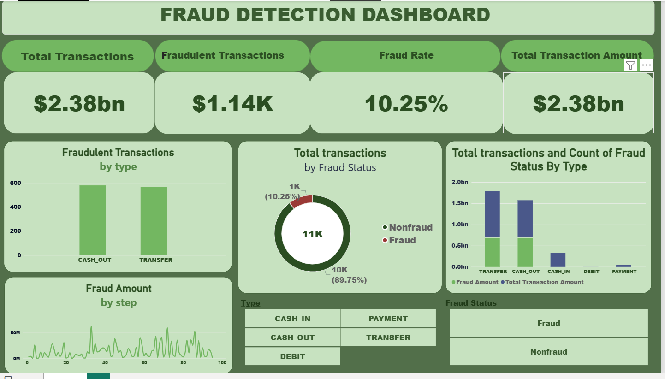
DASHBOARD ON POWER BI

Slide 19
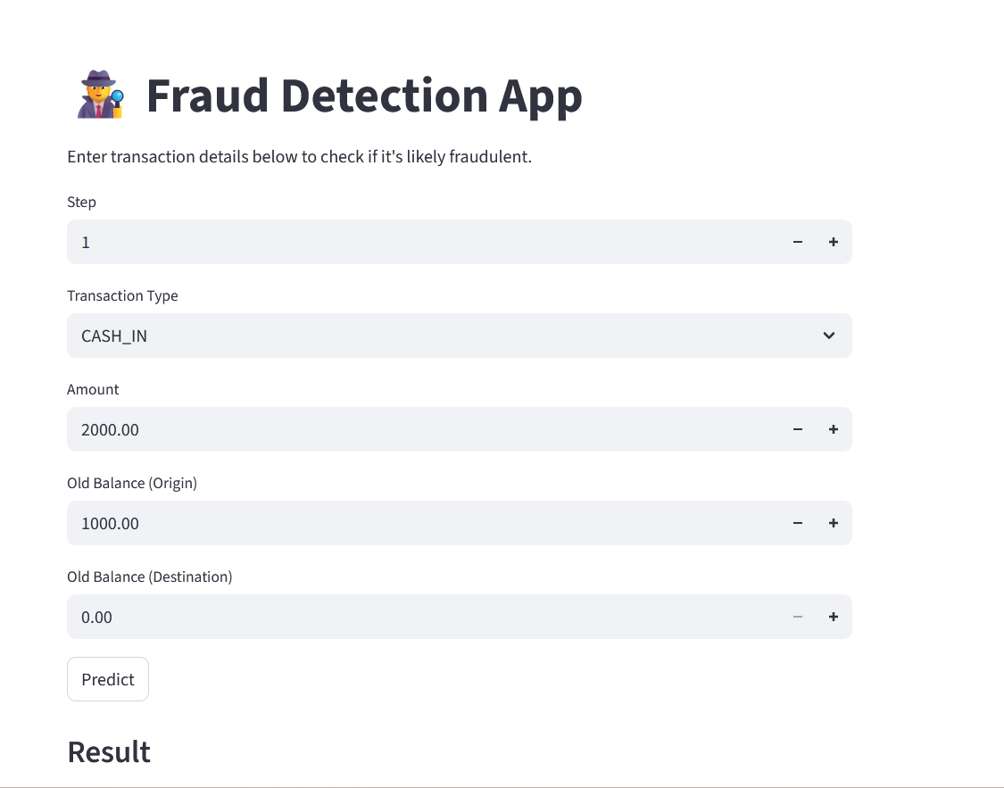
STREAMLIT APPLICATION

Slide 20
Conclusion
A Random Forest model, validated against overfitting and data leakage, and is deployed as a live Streamlit application.
project developed an end-to-end fraud detection system using SQL, Python, Machine Learning, and Power BI. Through EDA and feature engineering, we identified useful transaction patterns and trained three ML models. Random Forest was selected for deployment based on the evaluation results. The Power BI dashboard provides an easy way to monitor and analyze fraudulent transactions.
Thank you
FRAUD DETECTION ML PIPELINE
16

