Slide 1
Logistic Regression
Classification: Credit Worth of Applicants

Slide 2
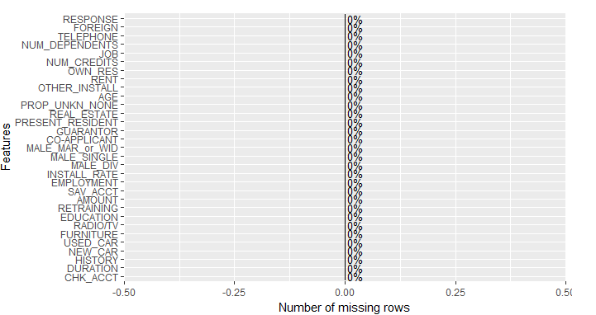
1. Dataset Examination:
A] Check missingness:
None found

Slide 3
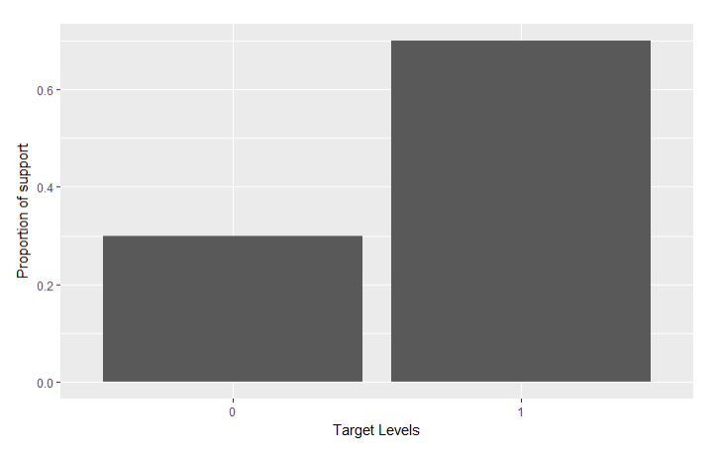
1. Dataset Examination:
B] Check support of response levels/imbalance of responses:
Imbalance found – Response 1 – weight 70% Response 0 – weight 30%

Slide 4
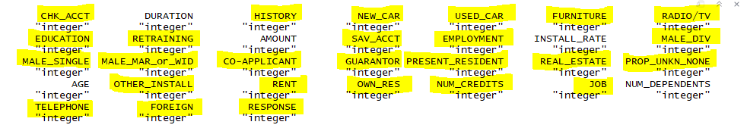
1. Dataset Examination:
C] Check variable typing:
Numeric typing for categories found
Highlighted variables are categorical in nature and need to be typed as factors to avoid domain interpretation inconsistencies.

Slide 5

2. Dataset Split
Dataset was randomly split into
A] Train – 50% of records
B] Validate – 30% of records
C] Test – 20% of records

Slide 6
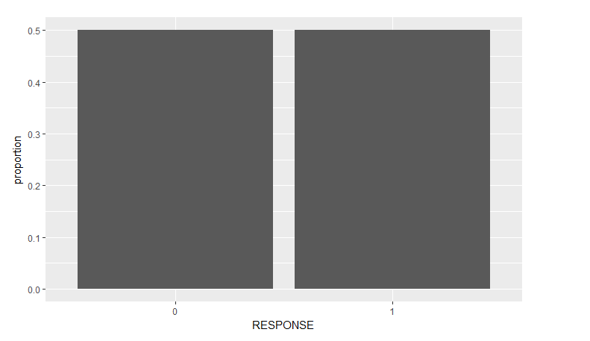
3. Dataset Rectification
A] No missing data so no need to impute
B] Class Imbalance – SMOTE used on train dataset
undersampling Class 1 200%
oversampling Class 0 100%

Slide 7
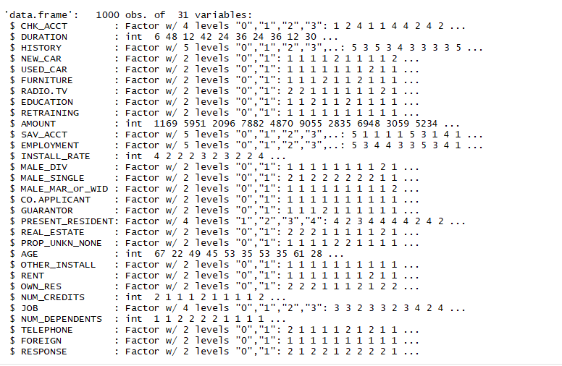
3. Dataset Rectification
C] Typing: Post Typing, dataset was as below:

Slide 8
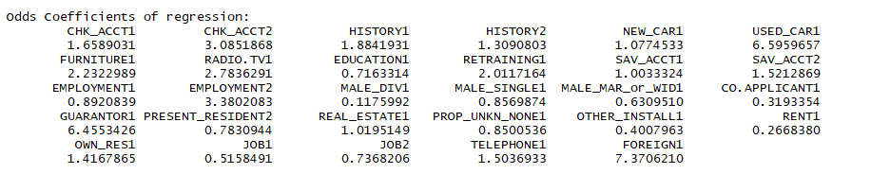
4. Model Building
Full model regression and odds scores:
Some interesting inferences from the full model:
Applicants with a Guarantor have 6 times higher odds of being credit worthy compared to those without.
Divorced Males have low odds of being credit worthy.
Credit/Loan applications for purchase of used cars, furniture, radio and purpose of retraining have higher odds of being credit worthy than those for new cars and purpose of education.

Slide 9
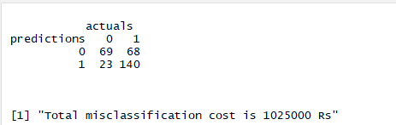
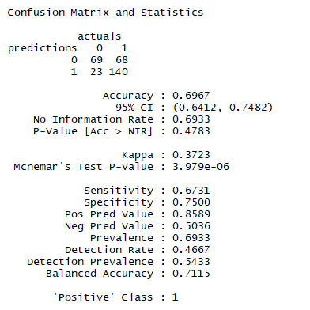
4. Model Building
Full model performance statistics on validation set:
The full model consists of
all 31 variables.

Slide 10
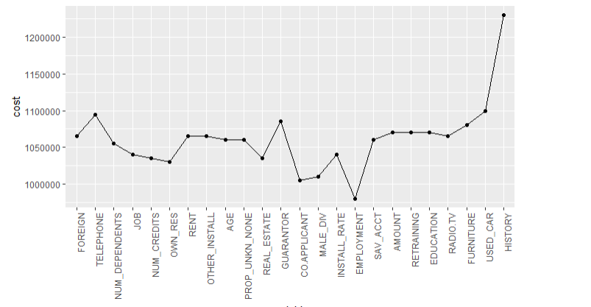
4. Model Building
Cost Function Optimization:
A simulation was run to verify according to variable importance, the increase or decrease of misclassification cost on variable exclusion. Part of the simulation is plotted below. This chunk needs to be rerun several times for proper visualization.

Slide 11
4. Model Building
Cost Function Optimization (contd):
Global minimum reached on eliminating variables up to EMPLOYMENT. Post removal of EMPLOYMENT, the cost is seen to only rise.
However from the initial model summary, we see that factors like RENT, OTHER_INSTALL, GUARANTOR, MALE_DIV are all significant variables in model, except for CO.APPLICANT.
Also, post removal of OWN_RES, the behavior of the cost function is highly unstable post PROP_UNKN_NONE.
Thus as a compromise to preserving information and minimizing cost, I chose removal up to OWN_RES. Below are results of this reduced model on the test set. Note that this is not the end and further pruning is also done subsequently.

Slide 12
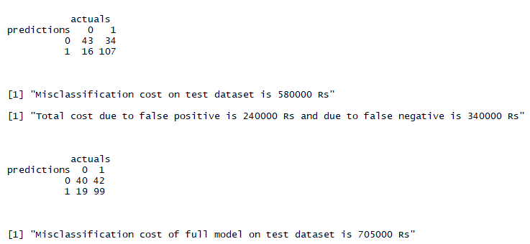
4. Model Building
Cost Function Optimization (contd):
Model statistics (upper part of image) on cost optimization based pruning vs full model statistics (lower part of image) on test dataset

Slide 13
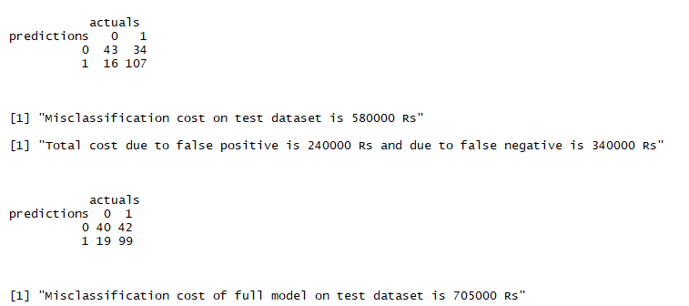
4. Model Building
Further pruning for leaner model:
REAL_ESTATE, PROP_UNKN_NONE, EDUCATION and RETRAINING were
found to be insignificant variables and hence are excluded from the model at this point. Post their exclusion, below are the pruned final model statistics vs full model statistics on test dataset. As can be seen, even with a leaner model, we achieve the same classification efficacy.

Slide 14
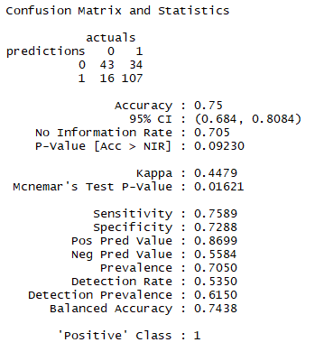
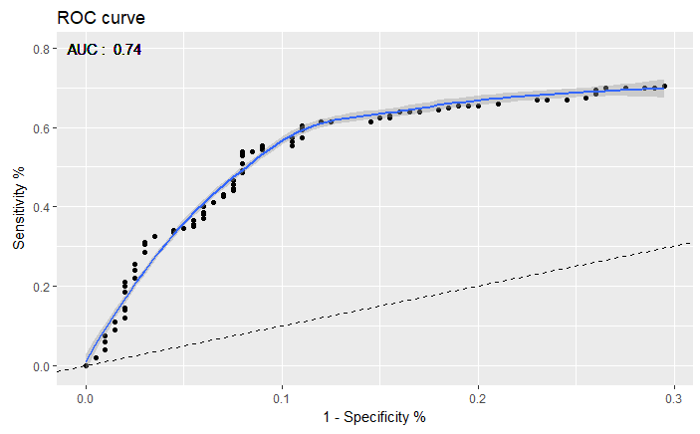

4. Model Building
Final Model performance statistics and form:

Slide 15
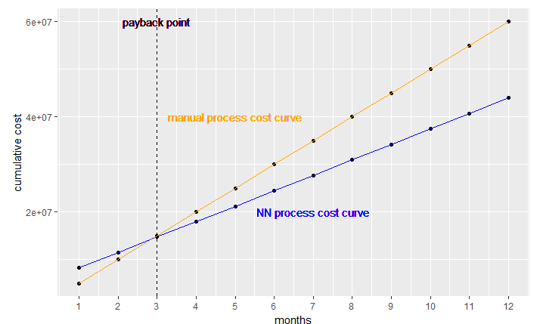
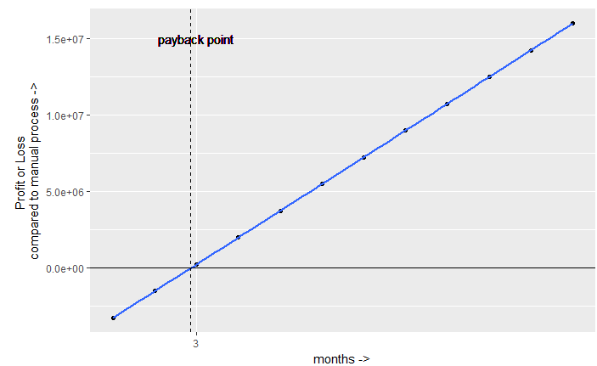
5. Additional Exercise
A simulation to estimate payback point was run. Its output is as below:
The simulation involved calculation and solving of two functions shaped as 5000000 + ( 1000000 + proportion_false_positives*25000*1000 + proportion_false_negatives*10000*1000) * x) and 5000*1000*x, where,
x: month proportion_false_positives: 100/(0.4*5000) = 0.05 proportion_false_negatives: 200/(0.4*5000) = 0.1
and their difference function (plotted right). The payback period is rounded to nearest integer and as such ~ 2.8 months

Slide 16

5. Additional Exercise
ROI = monthly_savings_due_to_NN_model / initial_investment %
where,
monthly_savings_due_to_NN_model =
expense_montly_due_to_manual_process –
expense_monthly_due_to_NN_process
<also equal to difference between y(i+1) and y(i) in the previous plot on the right>

