Slide 1


MONITORING & EVALUATION FRAMEWORK FOR LTA ON-DEMAND BUS ROUTING SERVICE
Aishwarya Bose | (A0178277M)
Ankita Avadhani | (A0178495J)
Bhabesh Senapati | (A0178349M)
Misha Singh | (A0178309W)
Sabrish Gopalakrishnan | (A0178314A)

Slide 2
INTRODUCTION
LTA is implementing On-demand bus service
Trial for 6 months from Dec 2018 in Punggol, Joo Koon, Marina Way and Shenton way during Off Peak Hours.
Based on the initial tender of $460,000 for Algorithm development in Feb 2018- VIA and SWAT were chosen.
Tender for trial of value $2.26 million for running the bus service.
SWAT by Ministry of movement is a local Singapore based company running service in Singapore and Malaysia.
VIA is running a similar on demand bus service in Chicago and New York.

Slide 3
WHY ON-DEMAND?
Currently Singapore has fixed buses for fixed routes on fixed frequency.
Some areas have high demand and overcrowding during peak hours and very low demand during non-peak hours.
On-demand service will provide services where the customer needs it and when they need it. They will use the Dynamic routing algorithm to chose the route and the waiting time is promised to be below 15 mins.
Use of Mobile app to book a seat in the bus.
BUSINESS OBJECTIVE
LTA is in the process of implementing the trial phase of on-demand bus service in Singapore. In order to understand the impact of their on-demand bus service, a monitoring and evaluation framework needs to be built for LTA.
Scope: Joo Koon region is considered in this case study for evaluating the problem.

Slide 4
GOAL - QUALITY- METRIC (GQM)

Slide 5
GQM FOR COMMUTERS
Sl. No | Goals | Questions | Metrics
1 | Decrease waiting time | How long commuter must wait for bus to arrive ? | Average waiting minutes.
2 | Decrease travelling time | How much is the usual time travel different from the optimised ? | Average time for usual route and optimised route
3 | Increase bus availability | What is the coverage? How much time commuter needs to wait for the next bus if he misses the one he booked? | Density of stop points in the specific stops Frequency
4 | Decrease cost | What is the dynamic pricing and how much is the % increase compared to the actual one? | Calculated through an algorithm
5 | Increase comfort | How comfortable is the commuter using on-demand service? | Analysing the survey via App
6 | Increase UI simplicity | Is the user app simple and user-friendly? | Analysing the survey via App
 | Waiting Time | Travelling Time | Bus Availability | Cost | Comfort | UI
Waiting Time |  | W₃ | W₃ | W₂ | W₃ | U₂
Travelling Time |  |  | A₂ | T₃ | T₃ | T₃
Availability |  |  |  | A₂ | A₂ | A₂
Cost |  |  |  |  | Cs₃ | Cs₃
Comfort |  |  |  |  |  | UI₃
UI
Paired Comparison Analysis used to create priority list
Prioritising the Commuter's Goal
Goals | Score
Waiting Time | 11
Travelling time | 9
Availability | 8
Cost | 6
UI | 3
Comfort | 0

Slide 6
GQM FOR LTA
Sl. No | Goals | Questions | Metrics
1 | Decrease operating and maintenance cost | 1)How much the occupancy rate has decreased? 2) What is the number of buses per service? 3)What is the earning to spend ratio? | Calculated through an Algorithm
2 | Increase User base | What is the increase in number of new users installing the app | Percentage increase in new users over past 1 month
3 | Increase booking | What is the number of requested pick-ups / drop-offs for each location | Number of requests made in last 1 hour
4 | Decrease no-shows | How many customers not opting after booking the ride? | Difference between schedule pickups and actual swipe- ins.
5 | Increase resource utilisation | 1) How many buses allocated for the service 2) Number of drivers | Number of buses used
6 | Increase customer satisfaction | How well are the customers satisfied with the on-demand service? | Survey feedback from App
 | O & M Cost | User Base | Bookings | No shows | Resource | Satisfaction
O & M Cost |  | C₂ | B₃ | C₂ | C₂ | S₂
User Base |  |  | B₂ | N₃ | R₃ | S₃
Bookings |  |  |  | N₃ | R₃ | S₃
No shows |  |  |  |  | R₃ | N₃
Resource |  |  |  |  |  | R₂
Satisfaction
Paired Comparison Analysis used to create priority list
Prioritising the LTA's Goal
Goals | Score
Resource | 11
No-shows | 9
Satisfaction | 8
O & M Cost | 6
Bookings | 5
User Base | 0

Slide 7
MONITORING AND EVALUATION FRAMEWORK
Identification Phase:
Initial assessment of the service implemented during the trial period
Identify the KPI’s as well as the policies for their evaluation
Problem Identification and planning for resources
Follow-up from Evaluation:
Review and respond to the disparities between expectations and actual deliverables
Fine tune it further for the next trial
Design Phase:
Identify expected results at the end of trial period
Define policies and expected service standards
Plan the layout of the monitoring system and assign different roles and responsibilities to different departments
Monitoring & Evaluation Phase:
Measure progress against the identified KPI’s
Regular review of the data collected to monitor any unusual activities and identify the causes for the same
Implementation Phase:
Implement the monitoring system with the required infrastructure
Collect the required data from various portals such as from the App or from the LTA DB that captures data like the tap-in & tap-out information of commuters

Slide 8
MONITORING AND EVALUATION FRAMEWORK
Goals | DEFINITION | BASELINE | TARGET | DATA SOURCE | FREQUENCY | RISK | RECOMMENDATIONS
 | How is it calculated? | What is the current value? | What is the target value? | From where will it be measured? | How often will it be measured? | What might go wrong/challenge? | How it needs to tune it further?
Reduce Waiting and Travelling Time | 1) WT- Ratio of Distance to the nearest location of the bus to the speed of the bus 2) TT - Ratio of optimized distance from origin- destination to the speed of the bus | WT- 10-20 mins TT - N/A | WT- 5-15 mins TT - 25% less than the current value On-demand bus service won't stop at all bus stops | App LTA DB | Every booking | Multiple requests from the same location but different destination via different routes, hence different buses will be allocated for different routes although from the same location. | Shorter routes with On-Demand bus services to serve short distances with high demand using Dynamic Matching and Routing algorithm
Maximize resource utilization | Calculated using Minimum Cost Flow Analysis | Approximately 1 bus every 15 minutes | Deploy the buses only at demand locations | LTA DB | Daily | Bus bunching | Accurate and timely communication between bus captains and Bus managing portal
Reduce Cost of on-demand commute for customer | Calculated based on the distance travelled and at what time of the day | Adult- $2.80 to $9.00(Grab Shuttle Plus on-demand service) | Taking into consideration competitor's rate, service will be offered in a range of $1.50 to $4.00 per ride. | Will be measured based on the distance and time of day by the App | Revised Quarterly | Commuters may find regular bus services, competitor bus and shared-cab services as well as bicycle services more pocket-friendly | Set prices for the ride with the constraint that the cost of travel will never exceed the competitor price or 1.5* regular bus ride cost
App UI usability | Time taken to open the App and book a ride, general user-friendliness of the App, Different UI for the bus drivers to accept the bookings. | N/A | 1) Easy App interation 2) Run-time updates on the App 3) Multi-Language support 4) Flexible vehicle options 5) Automated E-receipt | App: User experience with App feedback | Every booking | 1) Commuters may not find the App to be user-friendly 2) Commuters may not give ratings at the end of trip | Identify the problem areas based on the feedback received and improve further
Reduce No-shows | Difference between schedule pickups and actual swipe- ins. | 5% of total booking/day | Reduce the No-shows to the minimum | LTA DB | Weekly | Increase in the number of No-shows would lead to loss of both capital and time | Penalise the commuter on the next trip if they cancel a ride more than once in a week
Increase Bookings | Calculate occupancy rate | N/A | Weekdays- Increase by 20% Weekends- Increase by 10% | From 3rd party App | Weekly | Competition from MyBusSG, Grabshuttle and Grabshuttle plus & other private players which already operate | By strictly serving and complying with the assured facilities and services
Increase Customer Satisfaction | Calculate using Net Promoter Scale (NPS) | N/A | Excellent(4-5/5) | From 3rd party App | Weekly | Commuter might not give ratings at the end of trip | Improve the service and cater to commuter's individual issues based on their feedback
Decrease Operations & Maintenance Cost | Calculated via algorithm | N/A | Minimizing it by 10% | LTA DB | Monthly | Over usage of bus deployments might lead to wear-out of the buses causing shortage of supply sometimes. | Needs planned calculation and execution
Operational Performance | Keep track of breakdowns, performance incidents, fuel consumptions and earn-to-spend ratio | N/A | Keep the number of incidents and the maintenance time for every breakdown/repair to minimum | Based on the call logs from the bus captains maintained by company's DB | Weekly | Too many buses off road due to breakdown incidents causing incovenience to commuters, Loss of revenue due to inability to serve demand | Ensure incident maintenance time is less than 2 hours. Maintain a few extra buses in case of breakdowns as well to handle peak-demand areas.
Data Collection | Collect and maintain vital data from all the sources | Current LTA Data | Maintain detailed data obtained from App as well as LTA DB | 3rd party App and LTA DB | Hourly(as per the demand) | Data loss, DB connection issues etc. | Archiving/Backing up the data at regular intervals(daily)

Slide 9
PROOF OF CONCEPT-SIMULATION

Slide 10
DEMAND FORECASTING
Passenger Volume by bus stops data - the Tap In/Tap Out data obtained from LTA DataMall website.
API calls and Data Extraction - Postman and Python respectively.
Forecasting - Generalized Linear Model with Negative Binomial distribution
For simulation purposes, we assume
average passenger demand per bus at 2 pm
the number of buses arriving per hour at each bus stop is 5.
approximately 3 passengers ask for on-demand service per minute at all the bus stops along the route of Bus Number 255.

Slide 11
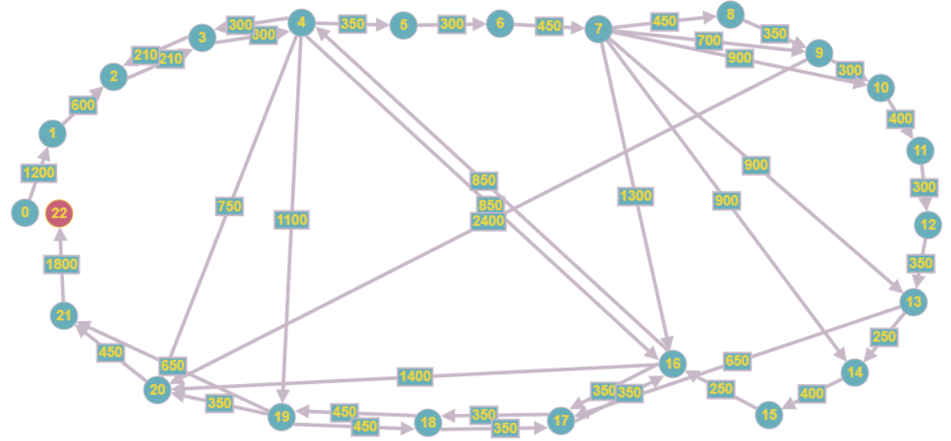
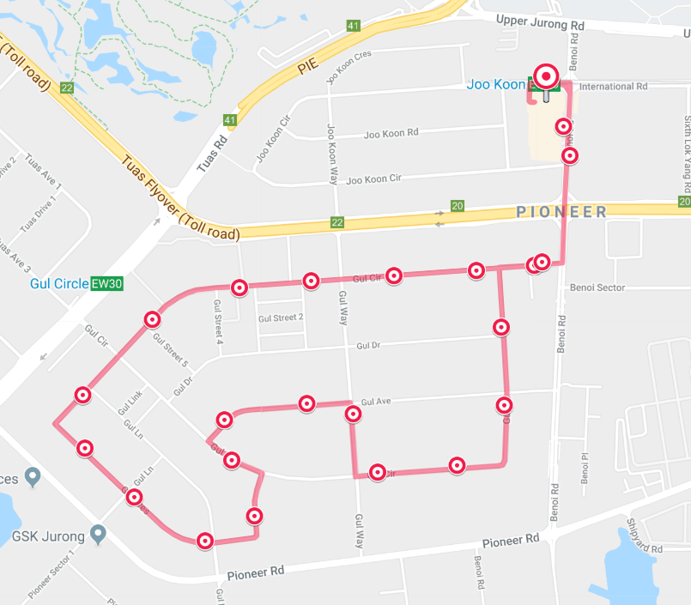
ROUTE OPTIMISATION
Each simulation iteration consists of:
Setting up the demand (source-sink vector).
Supplying the graph.
Solving the resulting graph – demand optimization problem of minimum cost flow

Slide 12
ROUTE OPTIMISATION
For measuring the KPI of distance covered via Dynamic Routing Service, we need to first lay down a Geofence and then calculate the total distance covered by all the bus services via dynamic routing in that Geofence.
This measurement of distance travelled by a bus within a pre-designated Geofence can be easily accomplished by several GIS plugins within the GPS systems that will be employed to guide the driver on the route he/she needs to follow.
Travel Distance due to service : 6.1 km
Default travel distance : 10.21 km
Number of buses deployed to satisfy service : 5
Number of via travels : 2

Slide 13
BUS ROUTE 1 & 2

Slide 14
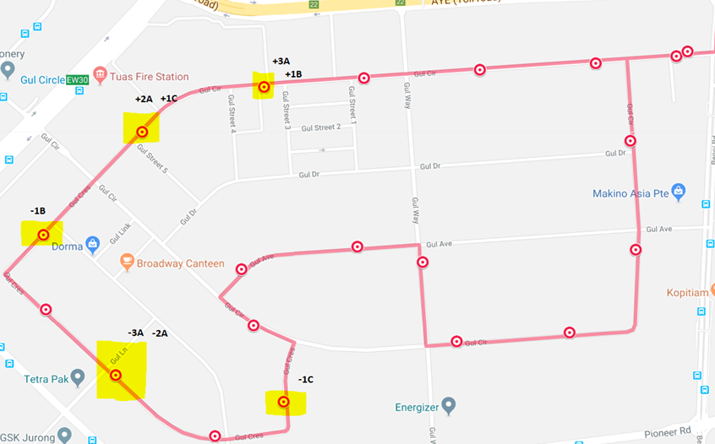
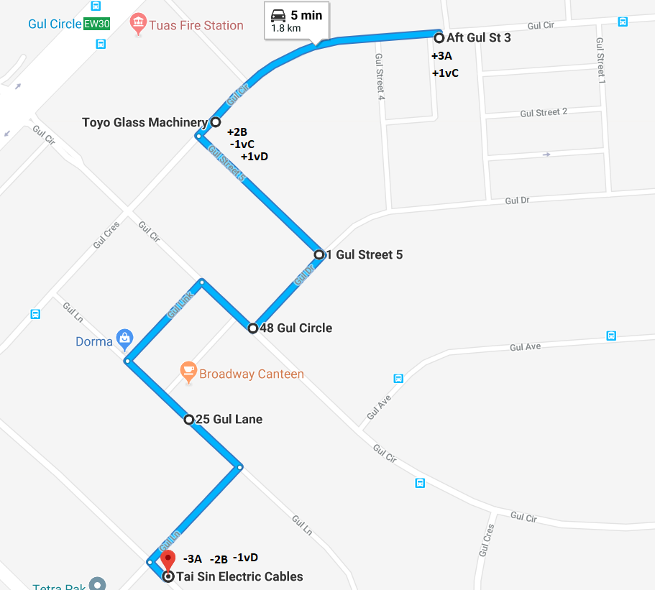
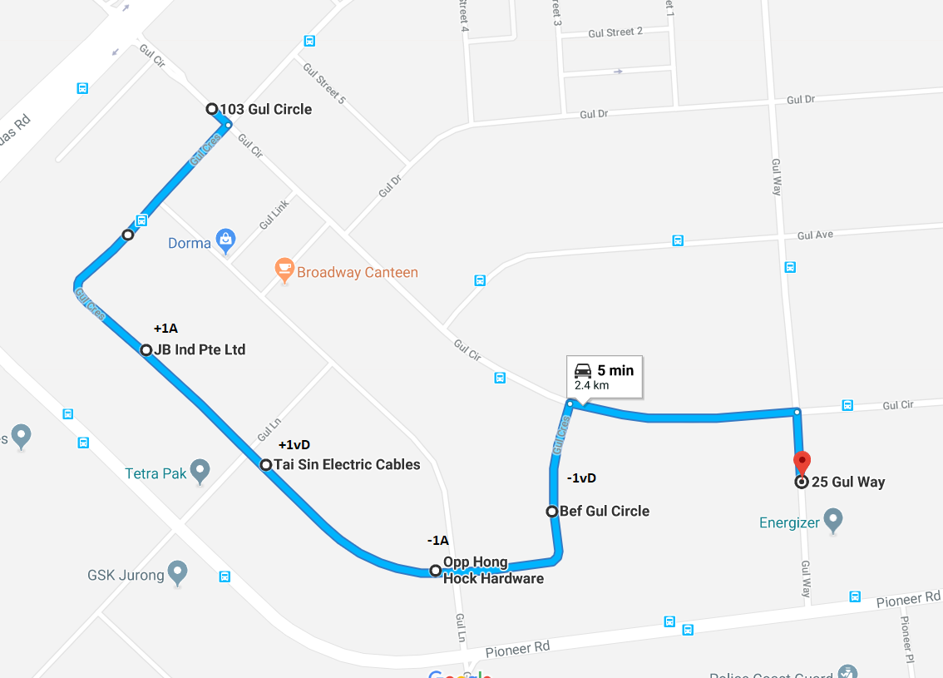
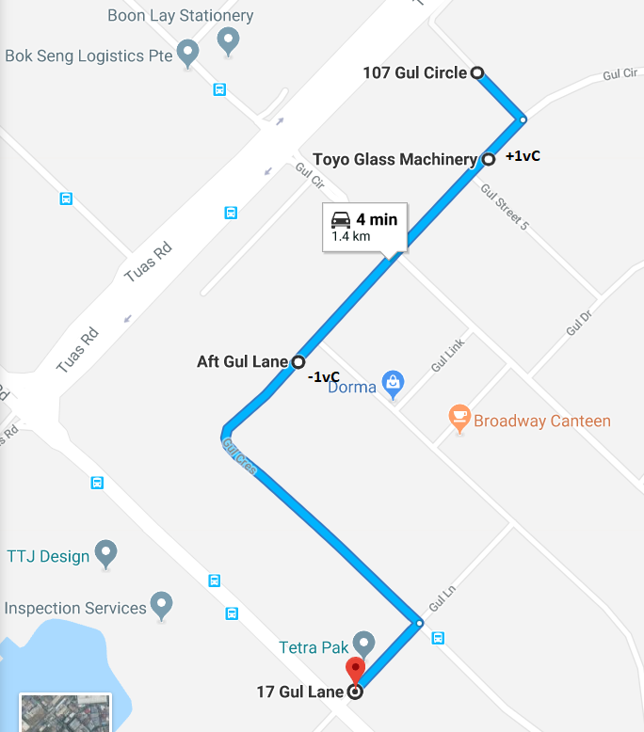
BUS ROUTE 3, 4 & 5

Slide 15
WAITING TIME AND NO SHOW
Waiting time - time between the booking of a travel request via the mobile app and person’s verification at the time of boarding the bus.
No Show → No. of verified boarders < No. of assigned demands
Demand at Bus stop 24009 (Joo Koon Int) during weekends at 14:00 hrs. → demand per minute is 3 (obtained via demand forecasting).
Service policy for on-demand bus waiting time is 5-15 mins.
We have compared the same with the regular bus arrival at 14:00 hrs.
If Patience > Bus Arrival : Customer boards the bus, then waiting time is calculated.
If Patience < Bus Arrival : Customer Reneges or is lost to Grab. Waiting time is then the time customer waited or Patience level.

Slide 16
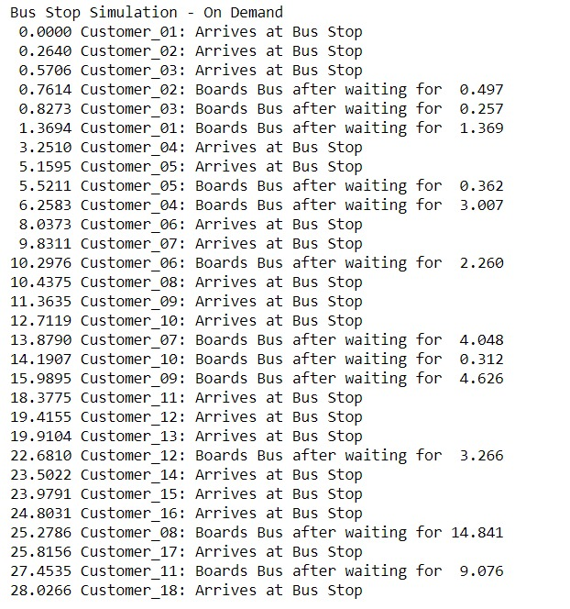
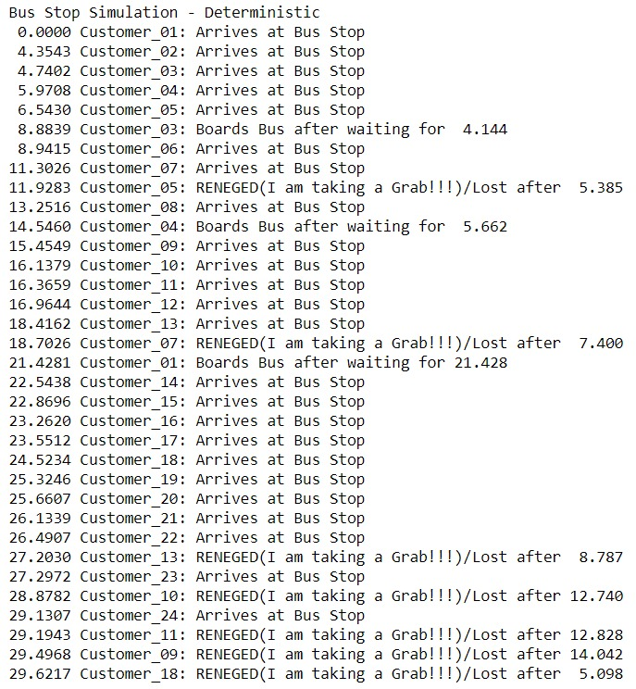
OUTPUT FOR WAITING TIME
CASE 1: As per the on-demand routing service:
CASE 2: As per the Regular fixed service:

Slide 17
WAITING TIME AND NO SHOW
After running over 15 simulations, below are the results:
Avg. waiting time is lesser in case of on-demand service compared to the regular service (4.323 mins vs 8.193 mins).
Number of customers that renege is lesser in case of on-demand service compared to the regular service (2 vs 6).
As proved by the simulation, we can effectively use these KPIs to measure the achievement of these specific goals of our service.

Slide 18

SERVICE QUALITY METRICS
Access
Door to Door transportation
Aesthetics
The Buses need to be in good condition and bus captains responsible
Comfort
Company to ensure bus captains drive safely and maintain good quality buses
Commitment
Maintain the promised time lines e.g. waiting time less than 15 mins
Attentiveness/ Helpfulness
Bus Captains performance based on empathy towards commuters
Communication
User friendly app and accurate information in sync with the bus captain app
Competence/Courtesy
Professional bus captains hired and groomed to service the customers the best way and the companies to also provide training for the same
Functionality/Flexibility
Commute distance minimized using the Dynamic routing algorithms and the routes optimised as per the request received
Integrity
The customers fare, the waiting time and the travel time will be given at the time of booking
Reliability
The KPI as set will be maintained 95% of the time such as the buses will arrive at the time promised etc.
Security
The security of the customers will be ensured . Eg. for the children and senior citizens.

Slide 19
CUSTOMER SURVEY SIMULATION
Based on the GQM, customer surveys were simulated.
From Commuter’s POV
Rating the comfort level of the passengers
Rating the simplicity of the user app
From LTA’s POV
Rating the customer satisfaction
Designed a question for each of the three categories and simulated the responses.
We took a sample size of 1000 passengers and used rbinom() in R to simulate the responses.
Survey Method → Net Promoter Score (NPS) method → Scoring scale is from 1 to 5.

Slide 20
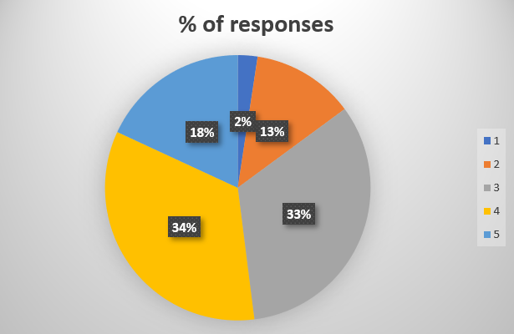
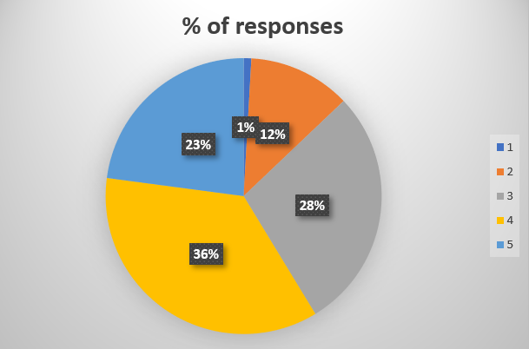
CUSTOMER SURVEY SIMULATION-COMMUTER POV
Simulation 1 – Rating the comfort level of the passengers:
How Comfortable are you with in using the on demand services?
Simulation 2 – Rating the simplicity of the user app:
Is the on-demand service user app simple and user-friendly?
Extremely Uncomfortable | Uncomfortable | Neutral | Comfortable | Extremely Comfortable
1 | 2 | 3 | 4 | 5
Strongly Disagree | Disagree | Neutral | Agree | Strongly Agree
1 | 2 | 3 | 4 | 5

Slide 21
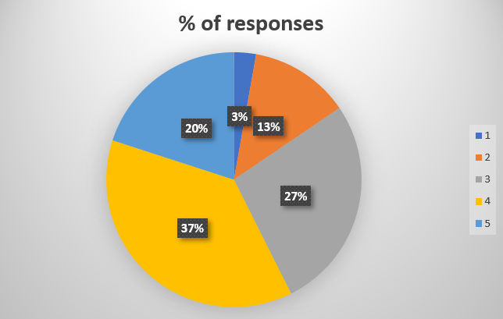
CUSTOMER SURVEY SIMULATION- LTA POV
Simulation 3 – Rating the customer satisfaction of the service:
How satisfied are you with the on-demand service?
Strongly Disagree | Disagree | Neutral | Agree | Strongly Agree
1 | 2 | 3 | 4 | 5
57% of passengers are completely satisfied with the on-demand services and around 15% of the passengers are not completely satisfied with the services.

Slide 22
COST BASED EVALUATION
Fuel Cost: As per Mercedes Benz Citaro mileage of 2.5 km per diesel liter and diesel price of 1.85 SGD.
Manpower Cost: As per article $SGD 8 per hour → converted to $SGD 0.2 per min → calculated for all buses and average of 5 minutes per bus in above simulation.
Operating Cost: Assuming this to be half of the fuel cost i.e. 0.9 per km.

Slide 23
CONCLUSION
Parameters | Current System | Proposed System | Up/Down
Bus Stop | Fixed | Dynamic
No Shows | 6 | 2
Avg. Distance travelled/ Customer | ~5 Km | 2.16 Km
Fuel Cost | S$8 | S$5
Operating Cost | S$9 | S$6
Manpower Cost | S$6 | S$5
Waiting Time | 8.193 min | 4.323 min
Bus Frequency | 6 buses/hour | As per the location of commuter’s demand

Slide 24
OUTPUT
10 -> 11 2 / 96 400
11 -> 12 1 / 96 300
12 -> 13 0 / 96 0
13 -> 17 3 / 96 650
13 -> 14 2 / 96 250
14 -> 15 1 / 96 400
15 -> 16 3 / 96 250
4 -> 16 0 / 96 0
16 -> 4 0 / 96 0
16 -> 17 0 / 96 0
17 -> 16 0 / 96 0
17 -> 18 4 / 96 350
18 -> 17 0 / 96 0
16 -> 20 0 / 96 0
18 -> 19 5 / 96 450
19 -> 18 0 / 96 0
19 -> 20 3 / 96 350
20 -> 21 0 / 96 0
19 -> 21 1 / 96 600
21 -> 22 0 / 96 0
4 -> 19 0 / 96 0
4 -> 20 0 / 96 0
9 -> 20 0 / 96 0
22 -> 0 0 / 96 0
Optimal Distance travelled for service: 6100 meters
This demand is better served with dynamic routing
Demand: [0, 0, 0, 0, 0, 0, 4, 3, -1, 1, -5, -1, -1, 5, -1, 2, -3, 1, 1, -1, -3, -1, 0]
Arc Flow / Capacity Distance
0 -> 1 0 / 96 0
1 -> 2 0 / 96 0
2 -> 3 0 / 96 0
3 -> 2 0 / 96 0
3 -> 4 0 / 96 0
4 -> 3 0 / 96 0
4 -> 5 0 / 96 0
5 -> 6 0 / 96 0
6 -> 7 4 / 96 450
7 -> 13 0 / 96 0
7 -> 14 0 / 96 0
7 -> 16 0 / 96 0
7 -> 9 0 / 96 0
7 -> 10 6 / 96 900
7 -> 8 1 / 96 450
8 -> 9 0 / 96 0
9 -> 10 1 / 96 300
From the calculation shown, it is observed that the running cost for dynamic routing is less than the regular running cost even after deploying 5 buses.

