Slide 1
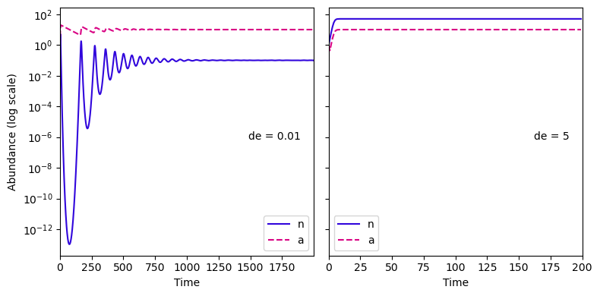
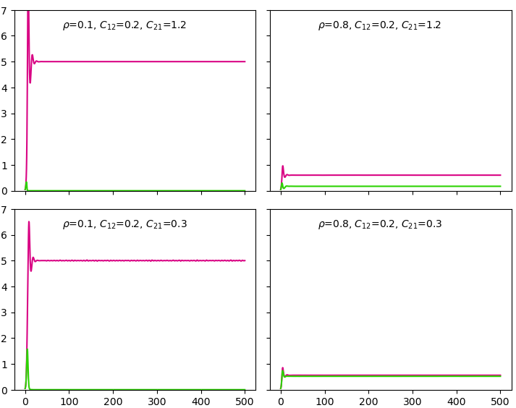
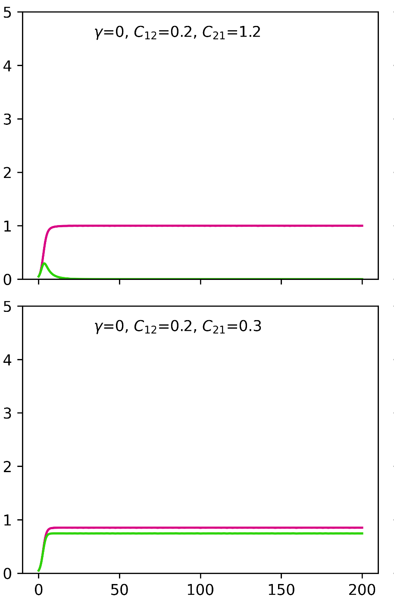


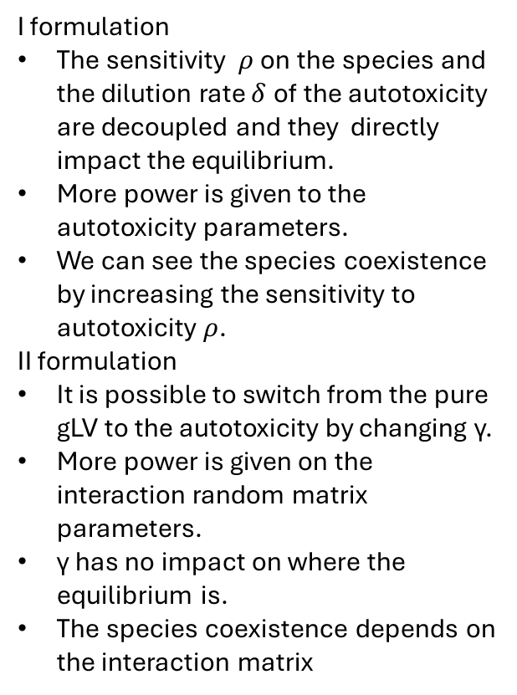




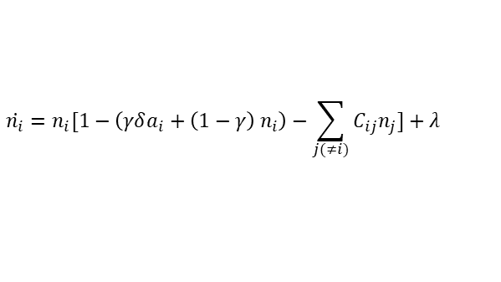

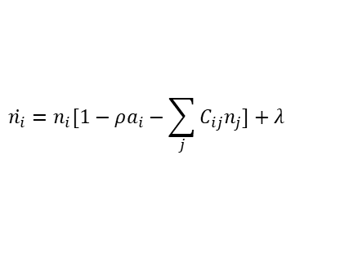




SABRINA: Comparison between gLV and autotoxicity model
First version of the model
Non-dimensionalised version
I formulation
The sensitivity $ρ$on the species and the dilution rate $δ$of the autotoxicity are decoupled and they directly impact the equilibrium.
More power is given to the autotoxicity parameters.
We can see the species coexistence by increasing the sensitivity to autotoxicity $ρ$.
II formulation
It is possible to switch from the pure gLV to the autotoxicity by changing γ.
More power is given on the interaction random matrix parameters.
γ has no impact on where the equilibrium is.
The species coexistence depends on the interaction matrix
$$\dot{n_{i}}=n_{i}[1−ρa_{i}−\sum_{j}{C_{ij}n_{j}]+λ}$$
$$\dot{n_{i}}=n_{i}[1−\left(γδa_{i}+\left(1−γ\right) n_{i}\right)−\sum_{j(≠i)}{C_{ij}n_{j}]+λ}$$
$$\dot{a_{i}}=n_{i}−δa_{i}$$
$$\dot{a_{i}}=n_{i}−δa_{i}$$
One species
One species
Abundances
δ=0.01
δ=5
γ=0
γ=1
Two species
Two species
$$ρ=0.1;C_{12}=0.2;C_{21}=1.2$$
$$ρ=0.8;C_{12}=0.2;C_{21}=1.2$$
$$γ=0;C_{12}=0.2;C_{21}=1.2$$
$$γ=1;C_{12}=0.2;C_{21}=1.2$$
δ=0.1
δ=0.1
δ=0.01
δ=0.01
Abundances
$$ρ=0.1;C_{12}=0.2;C_{21}=0.3$$
$$ρ=0.8;C_{12}=0.2;C_{21}=0.3$$
$$γ=0;C_{12}=0.2;C_{21}=0.3$$
$$γ=1;C_{12}=0.2;C_{21}=0.3$$
δ=0.1
δ=0.1
δ=0.01
δ=0.01
Time
Time

