Slide 1
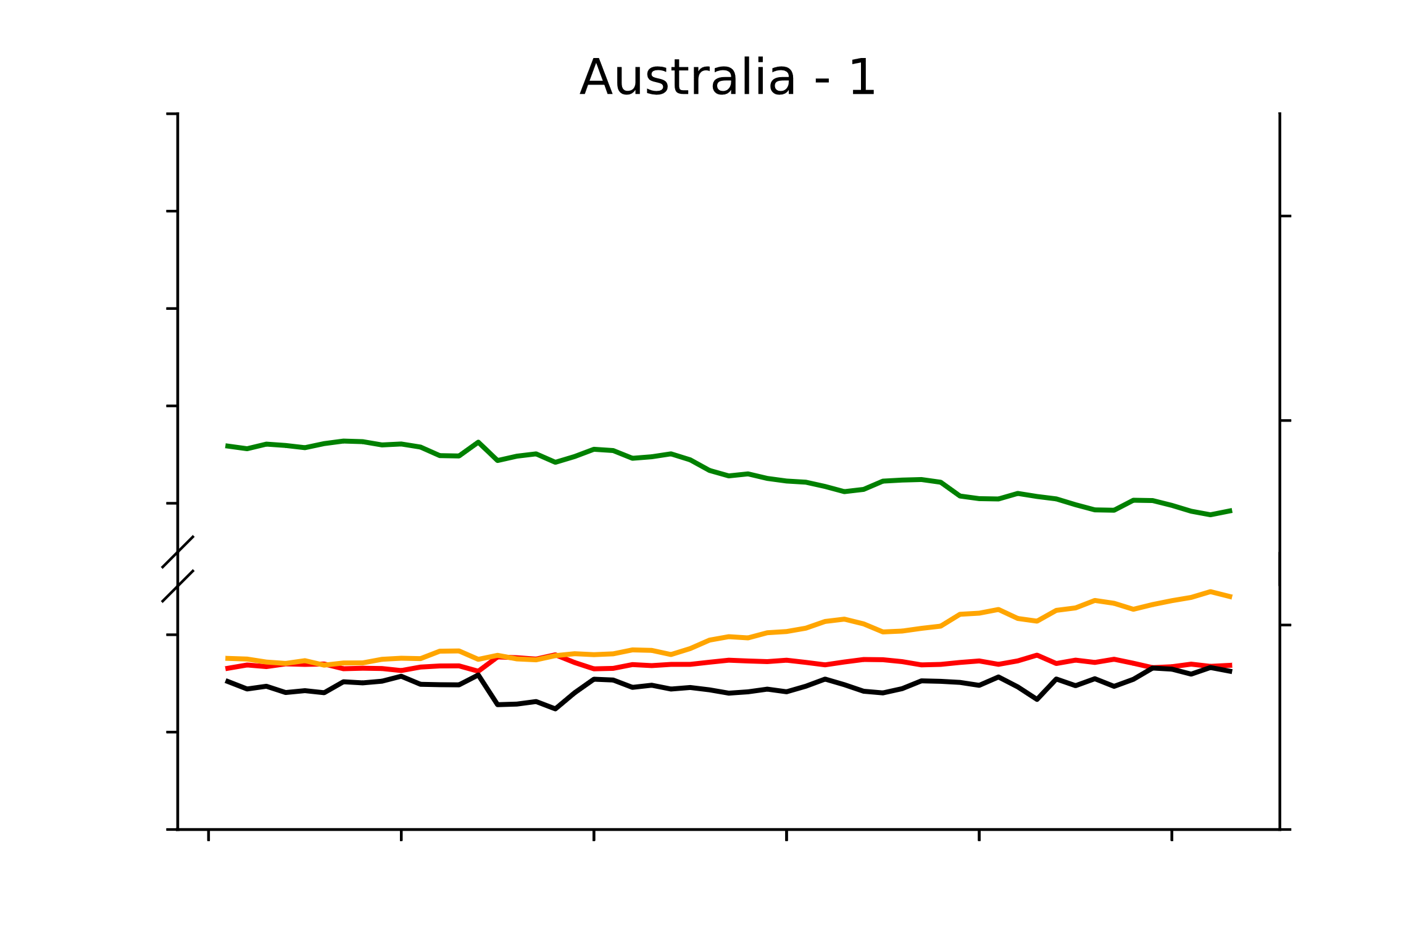
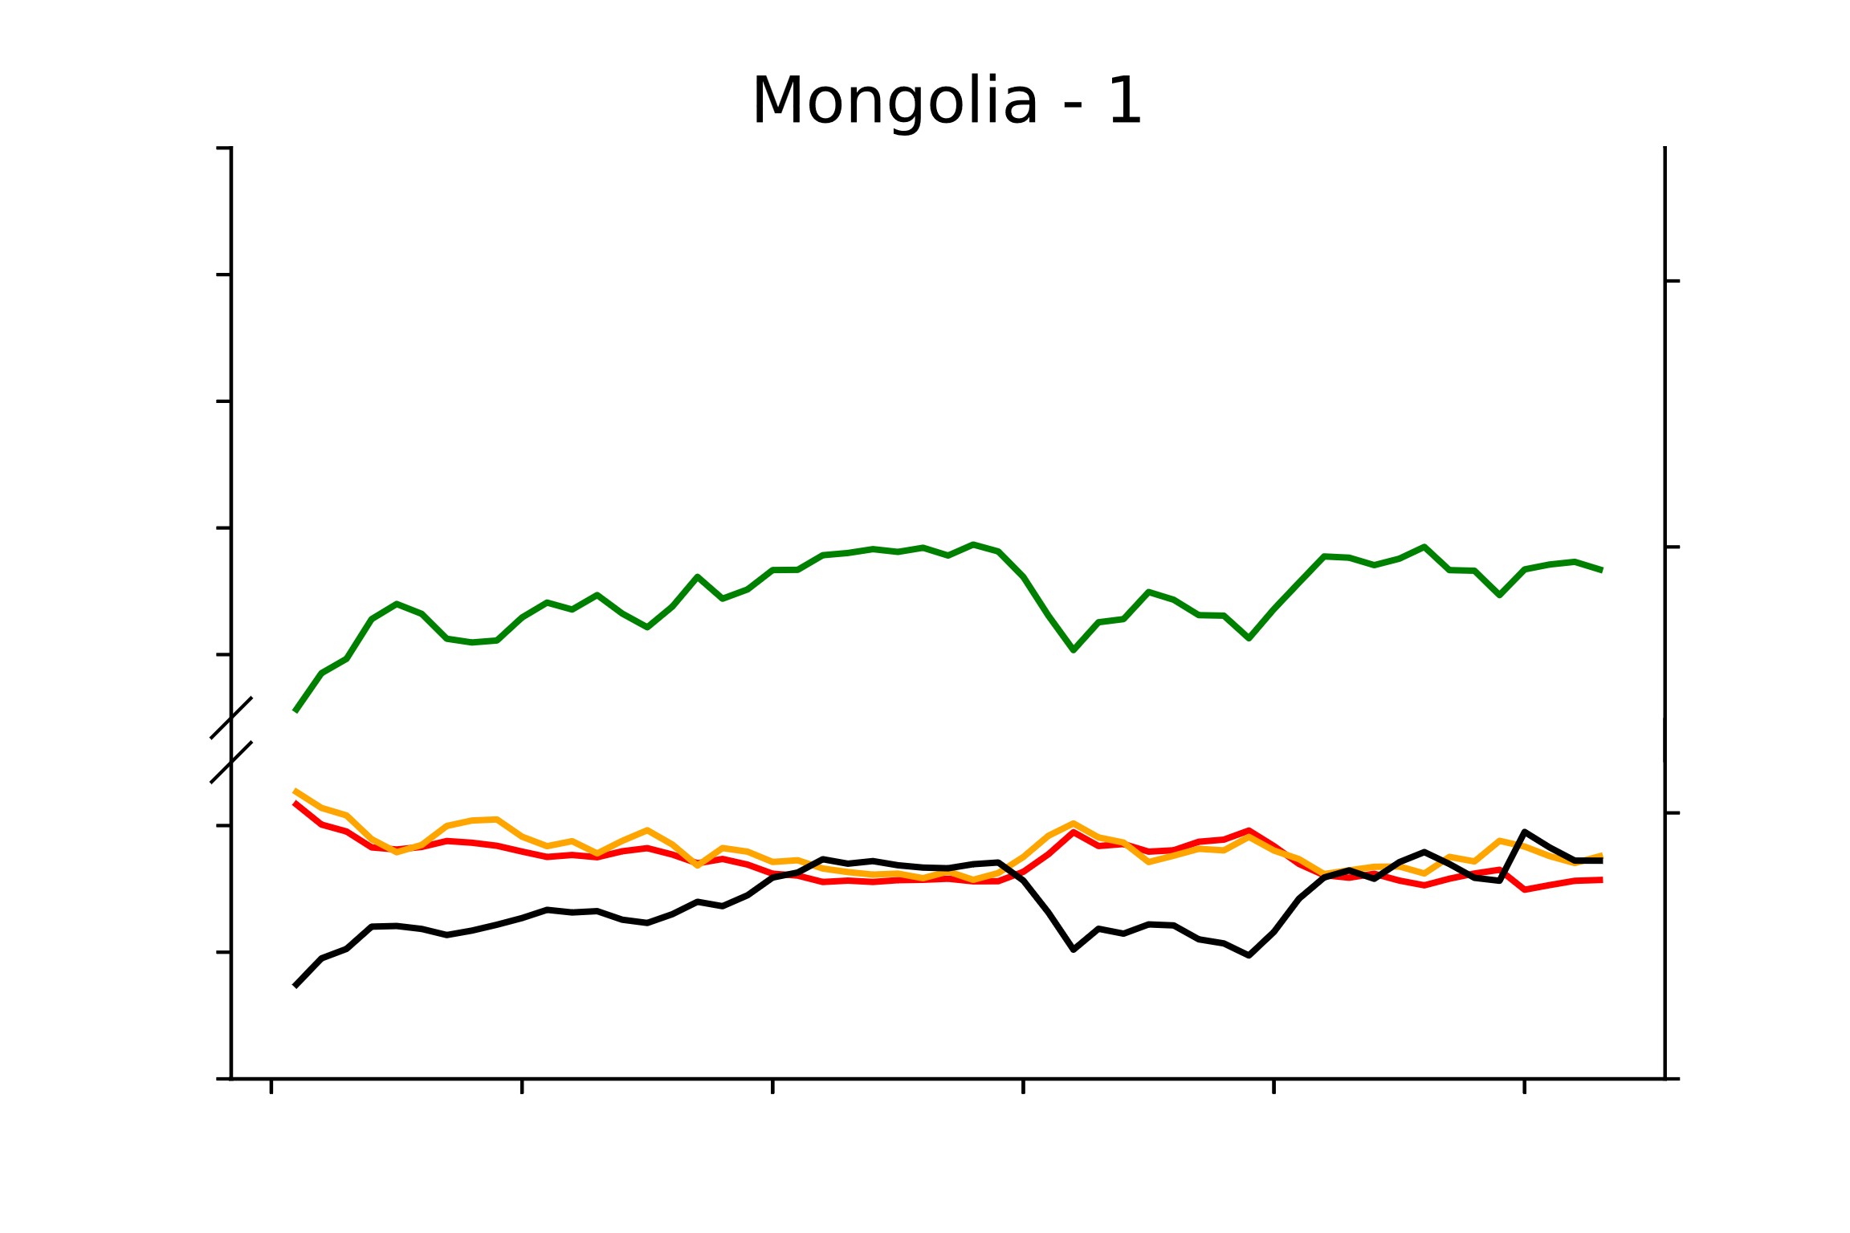
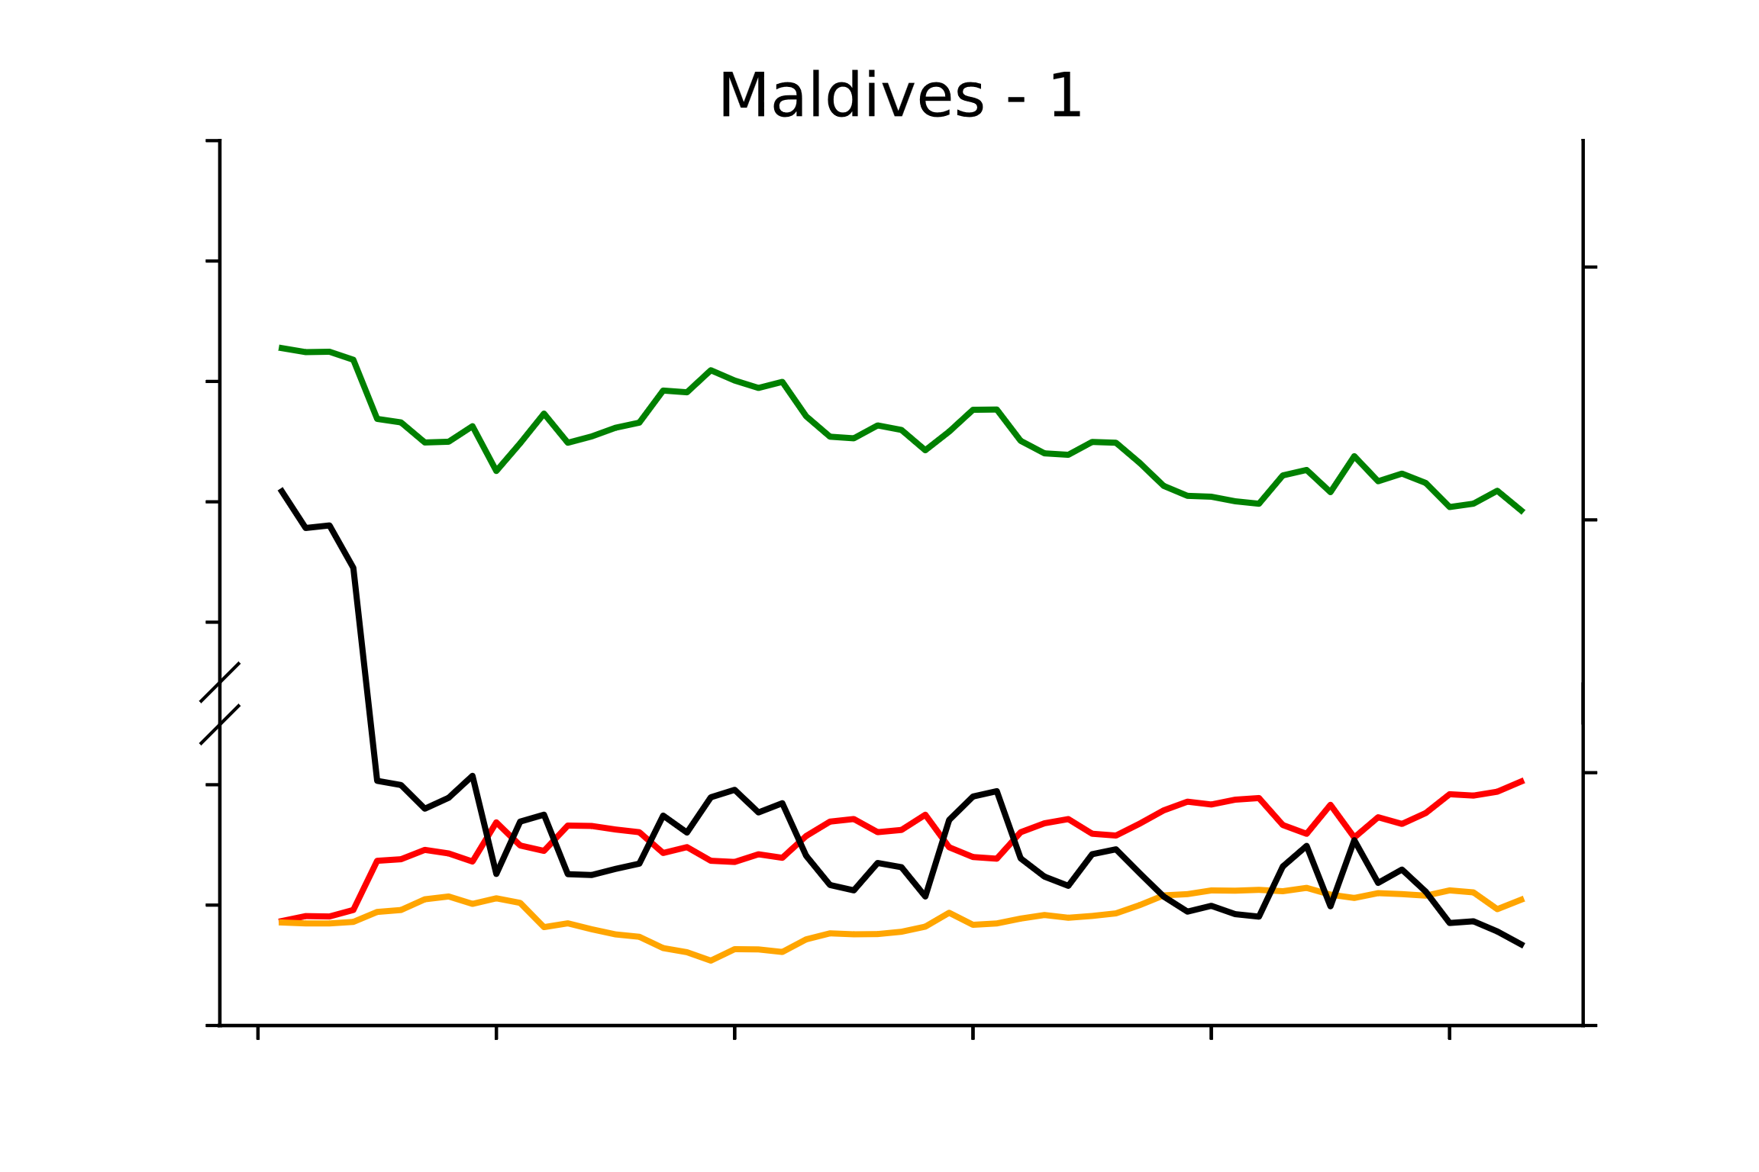
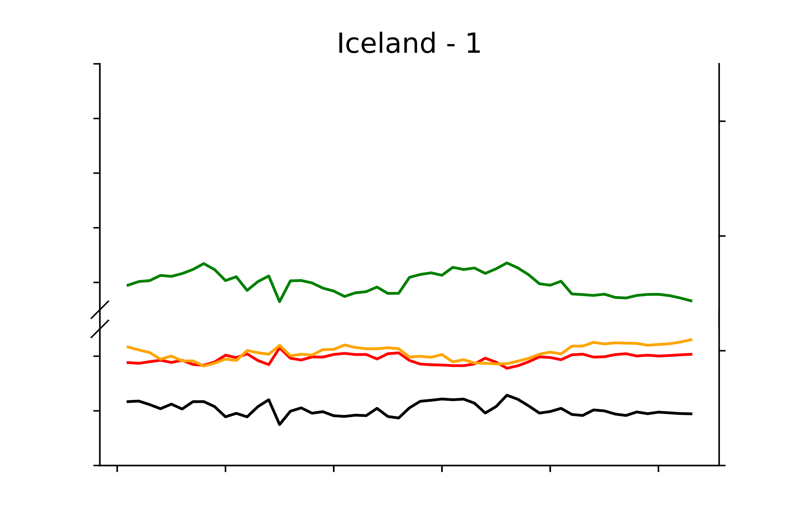
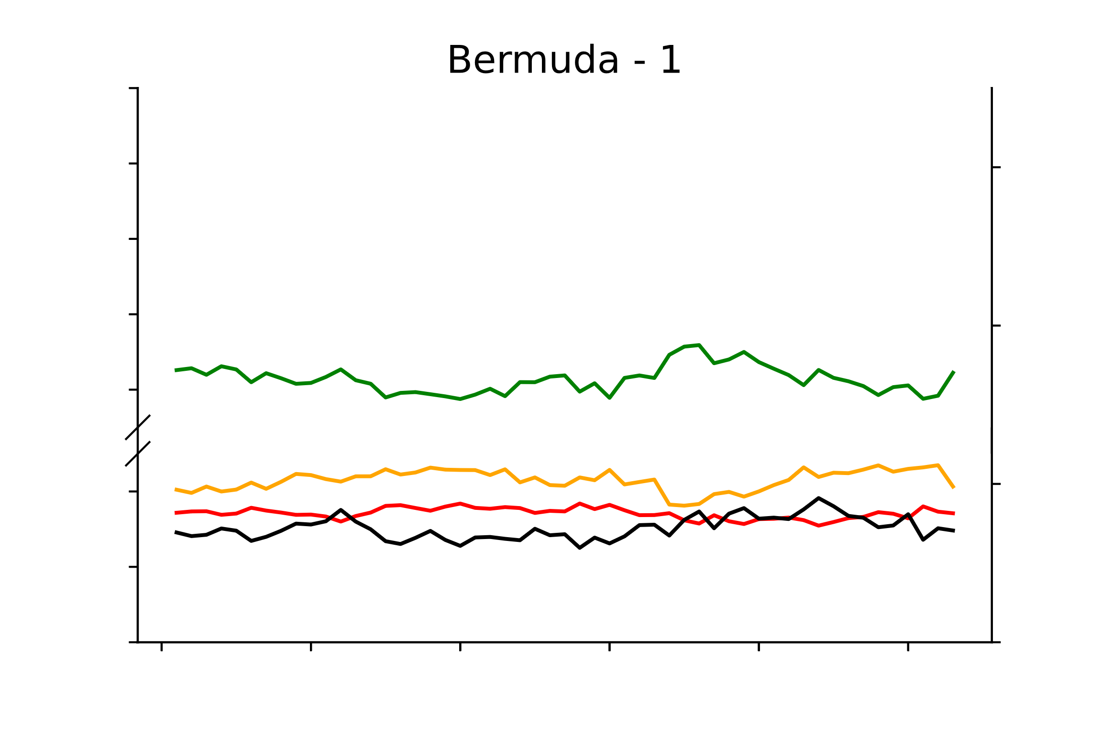
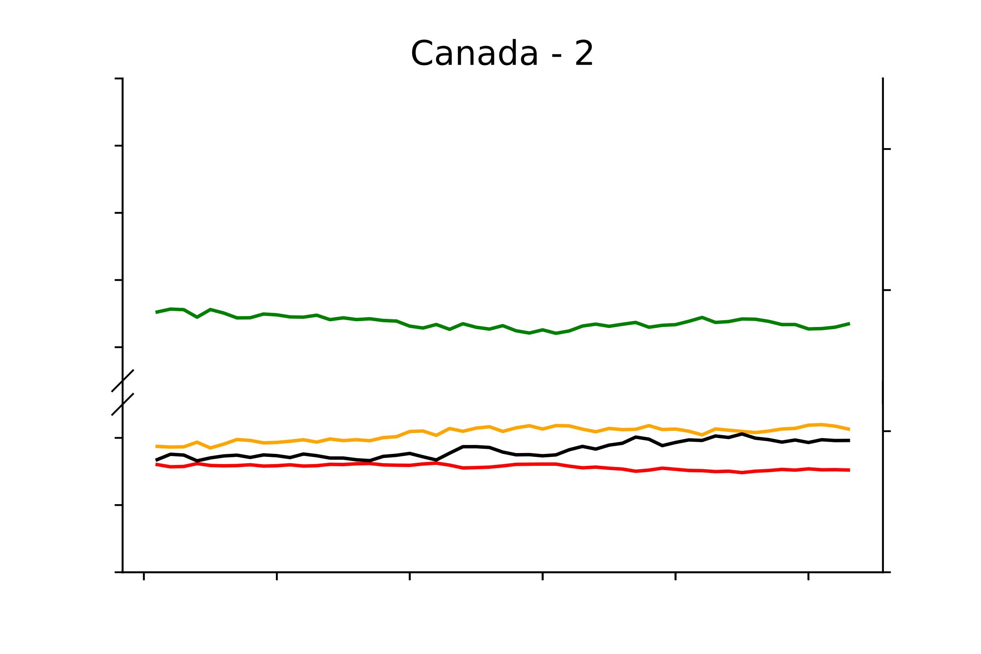
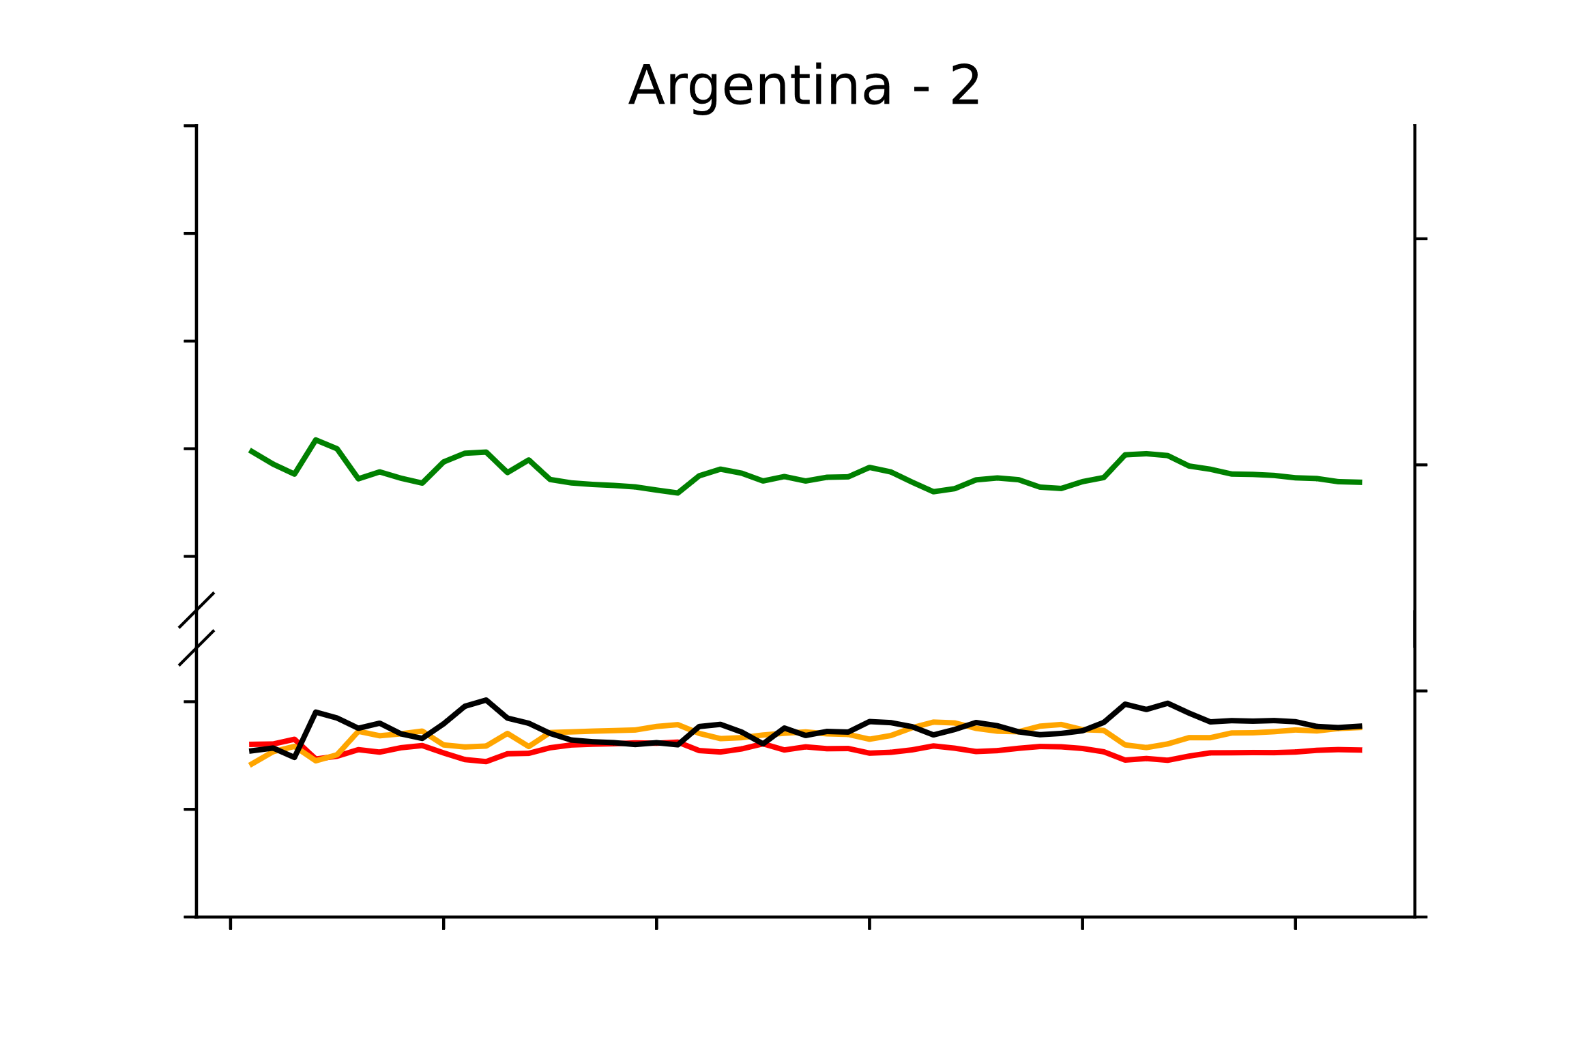
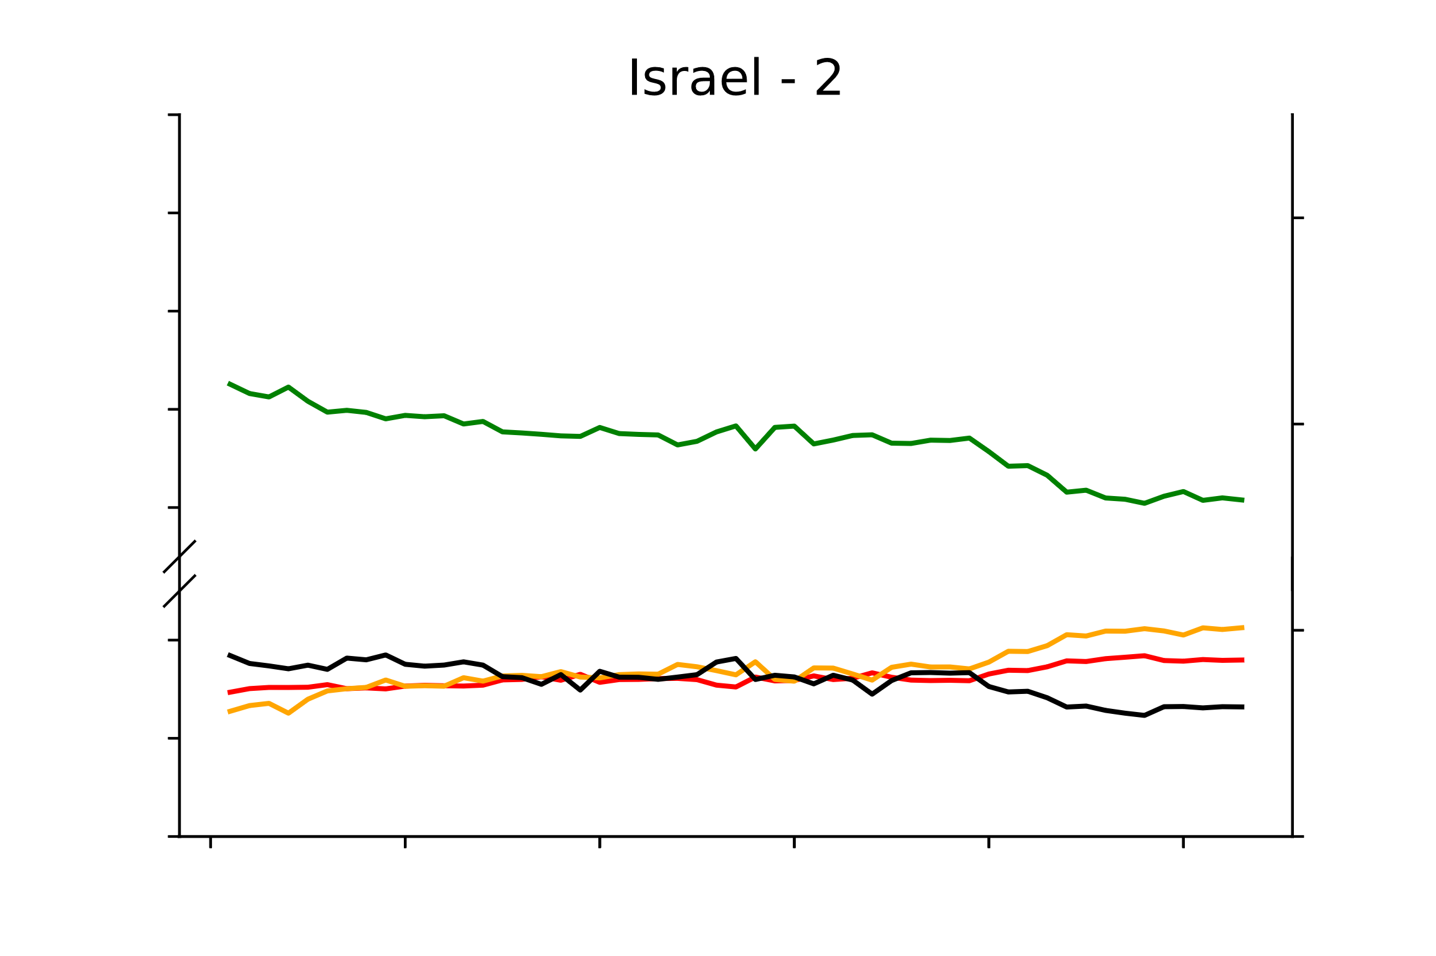
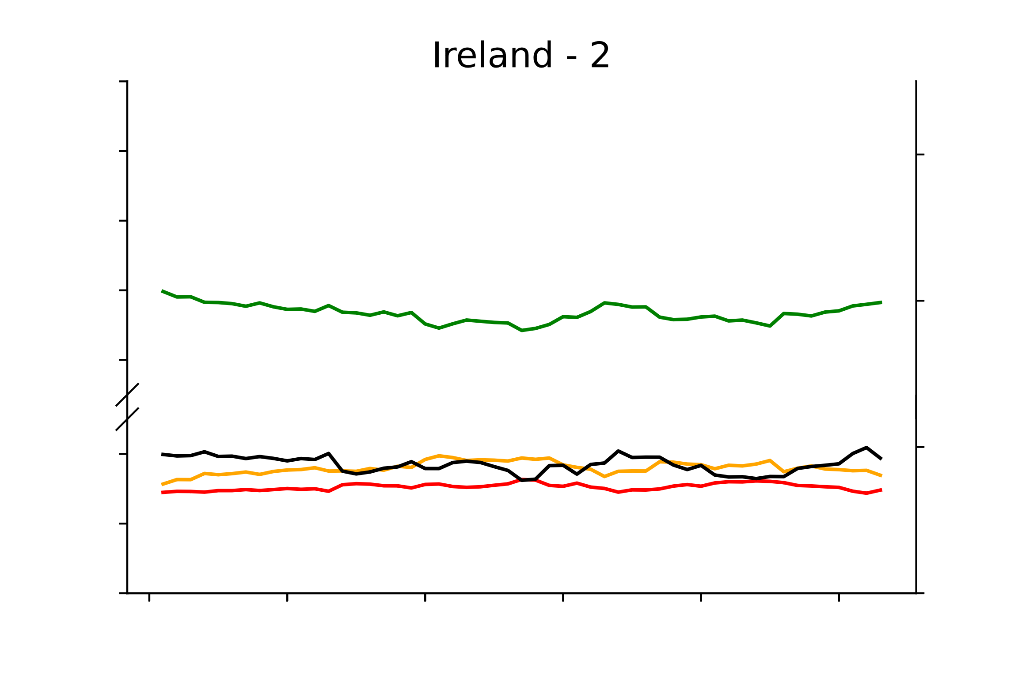
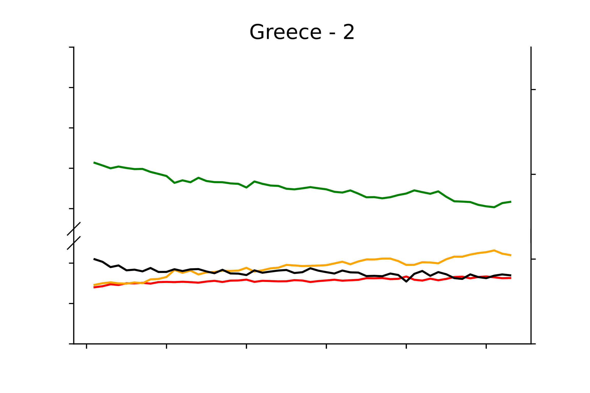
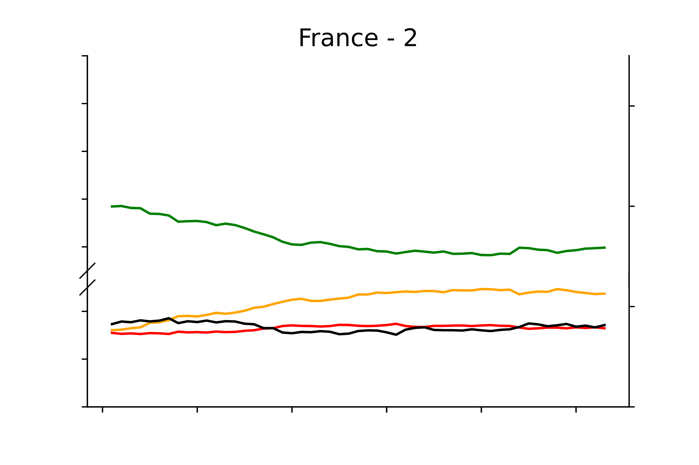
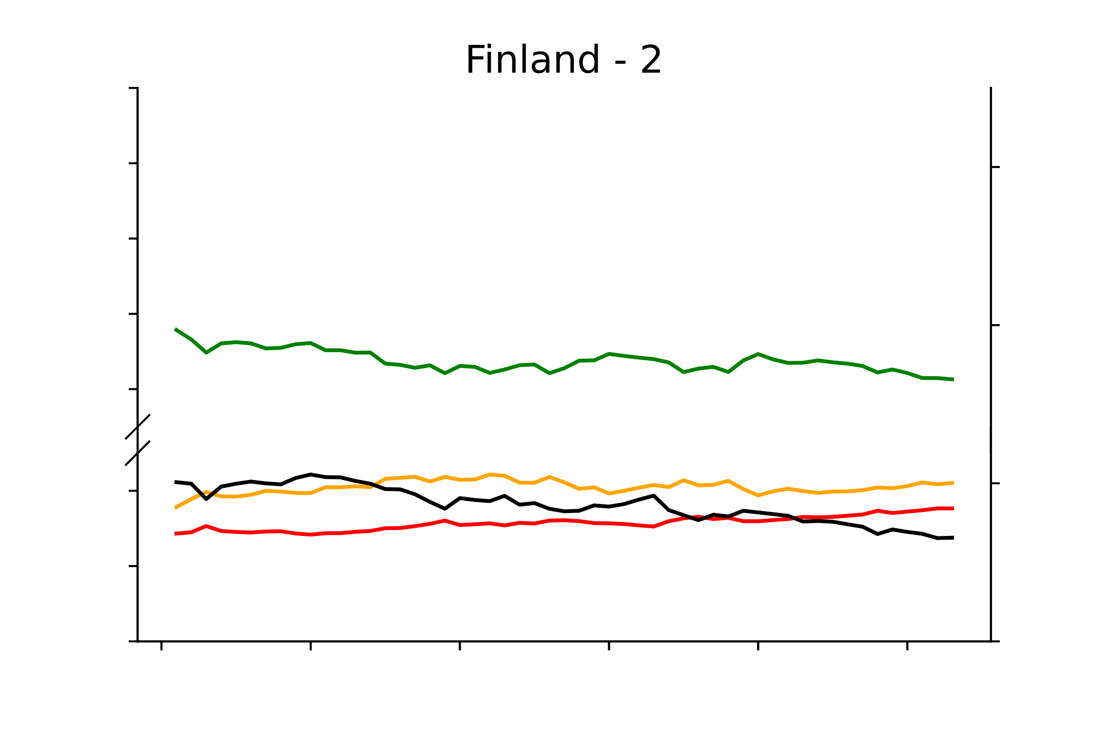
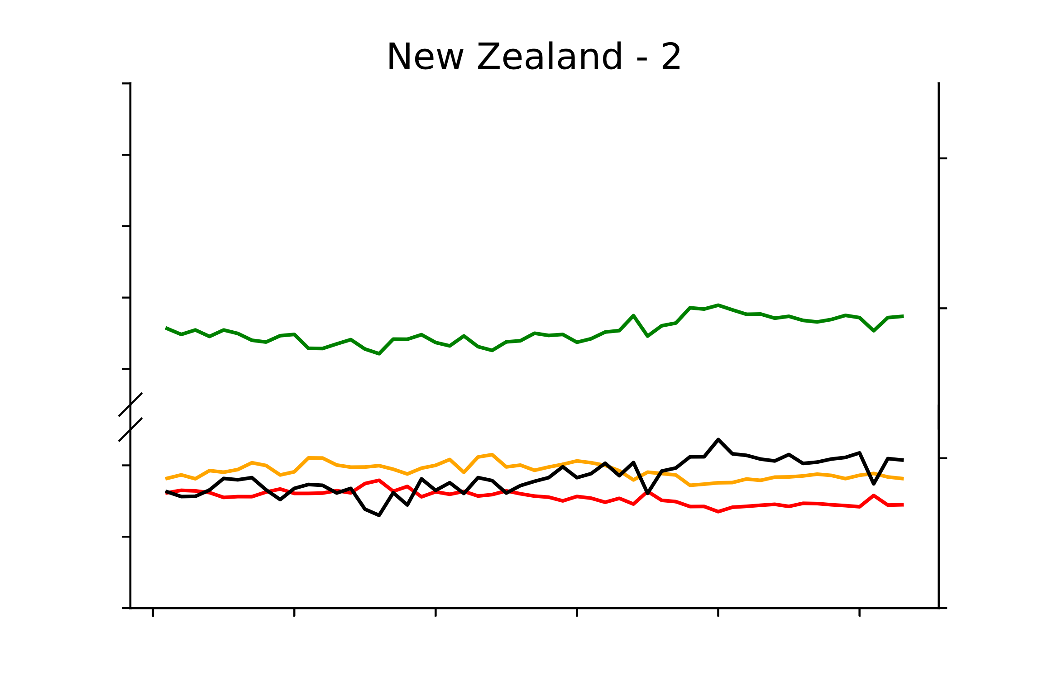
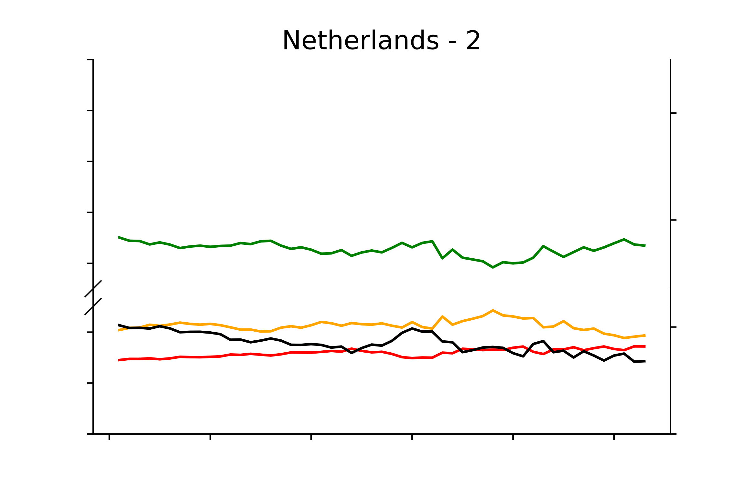
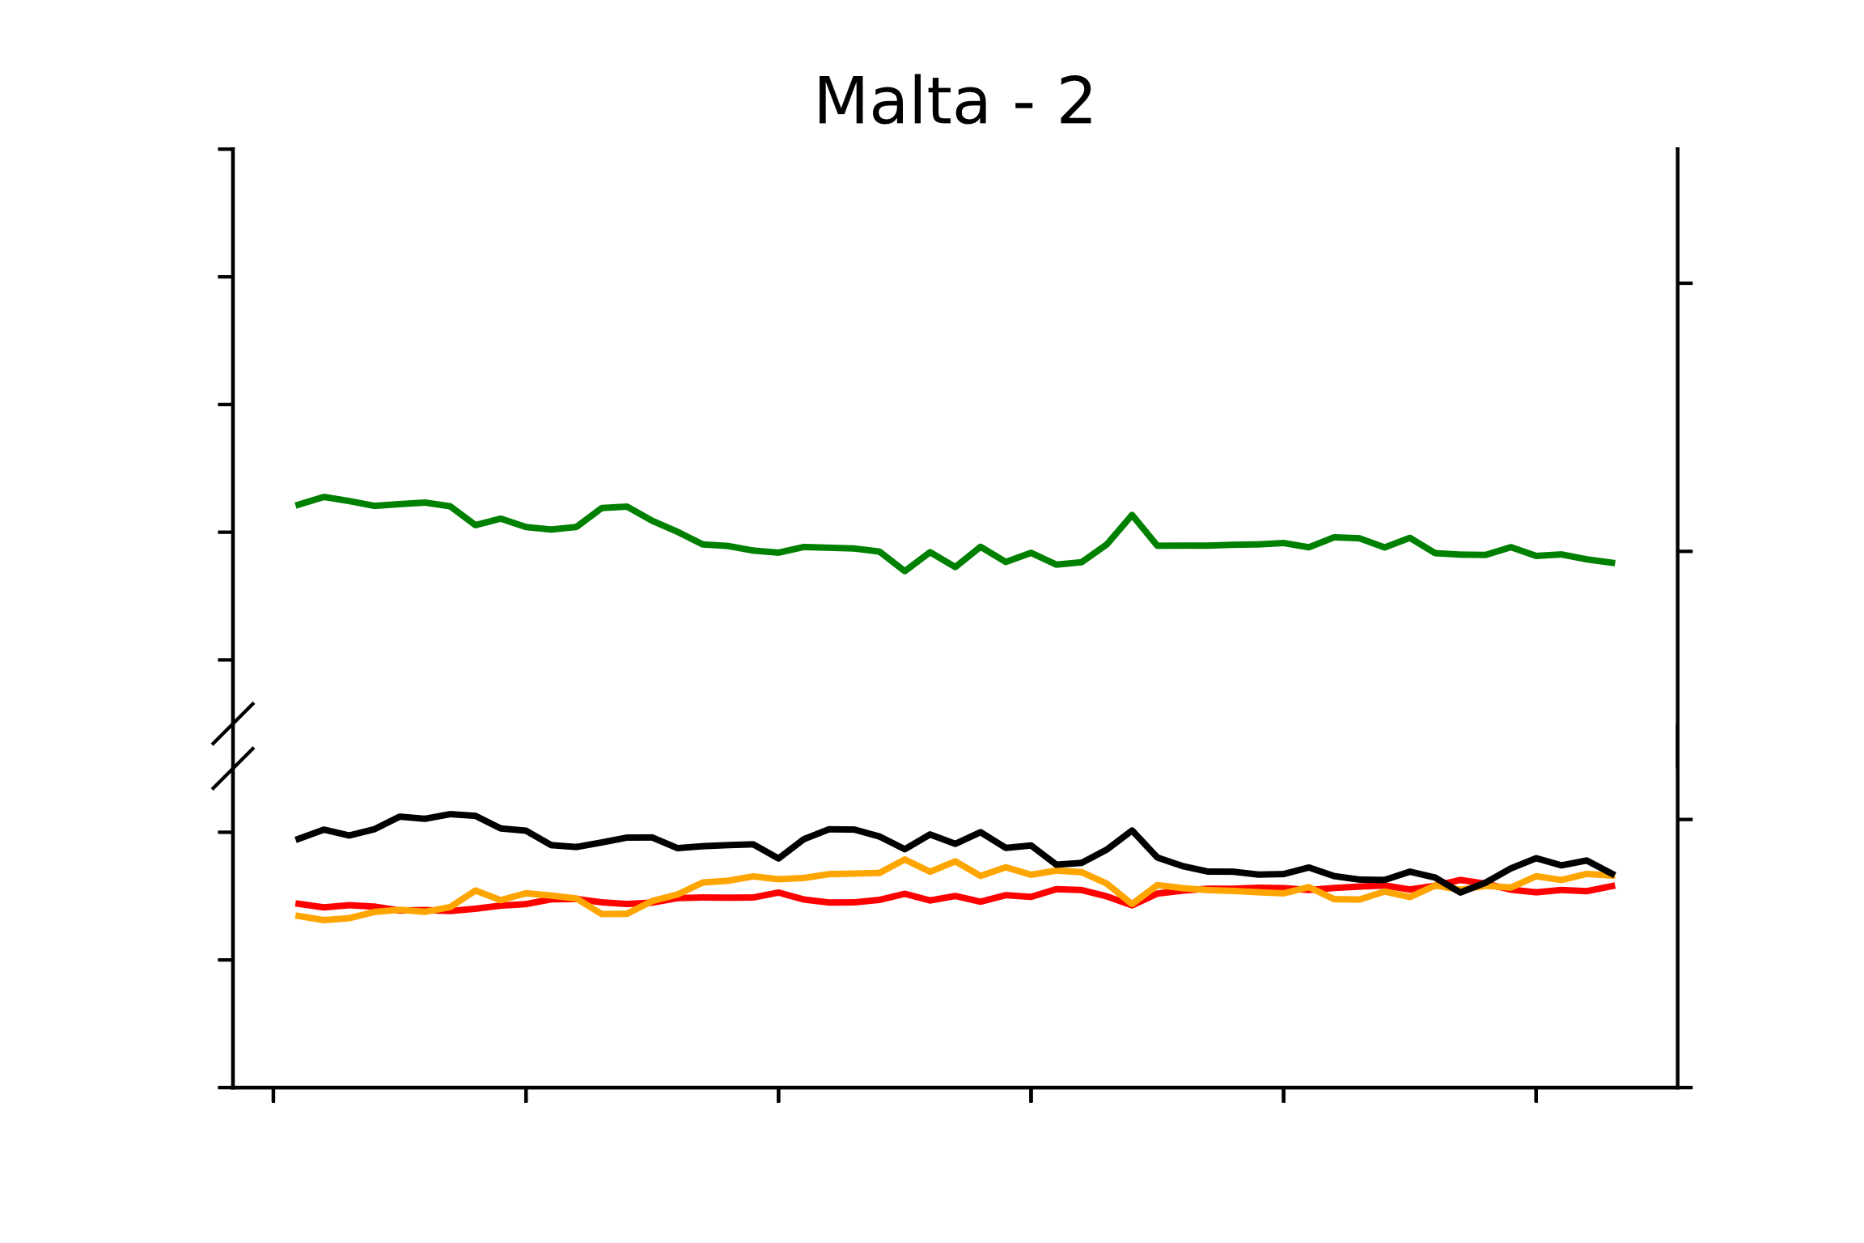
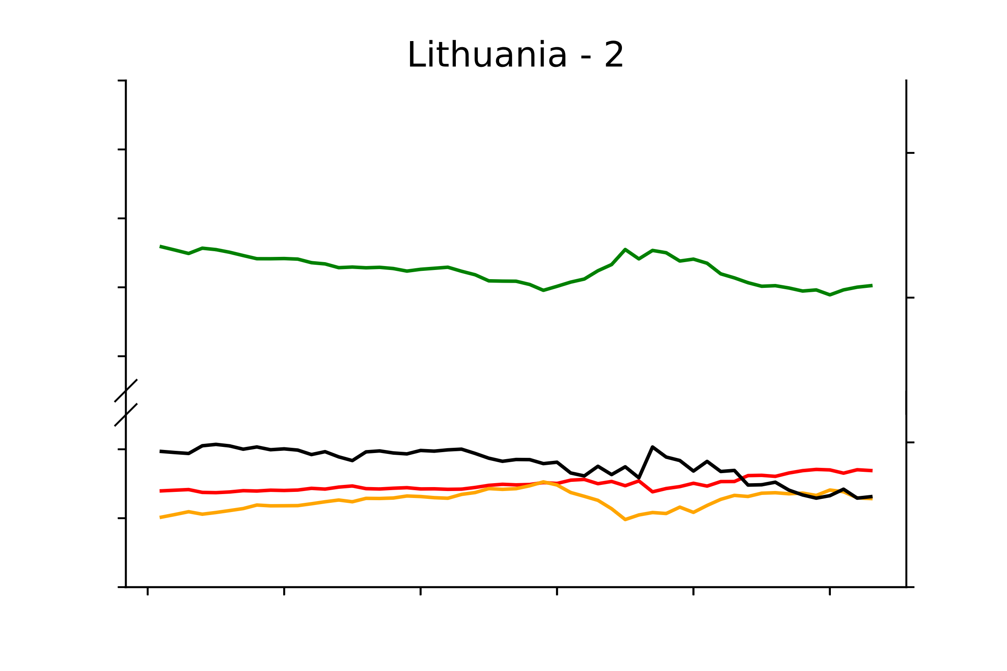
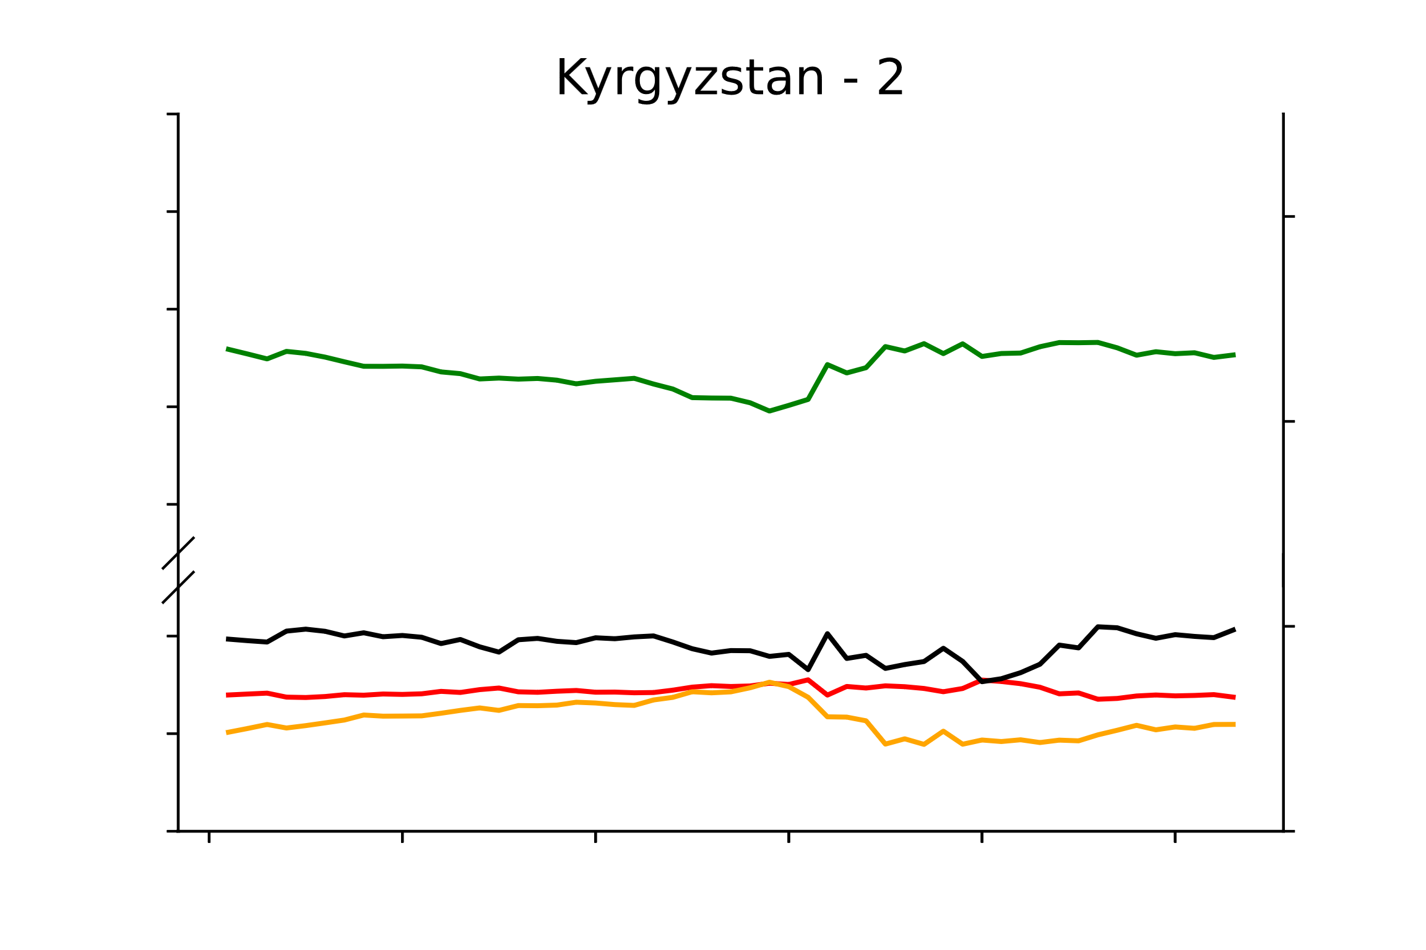
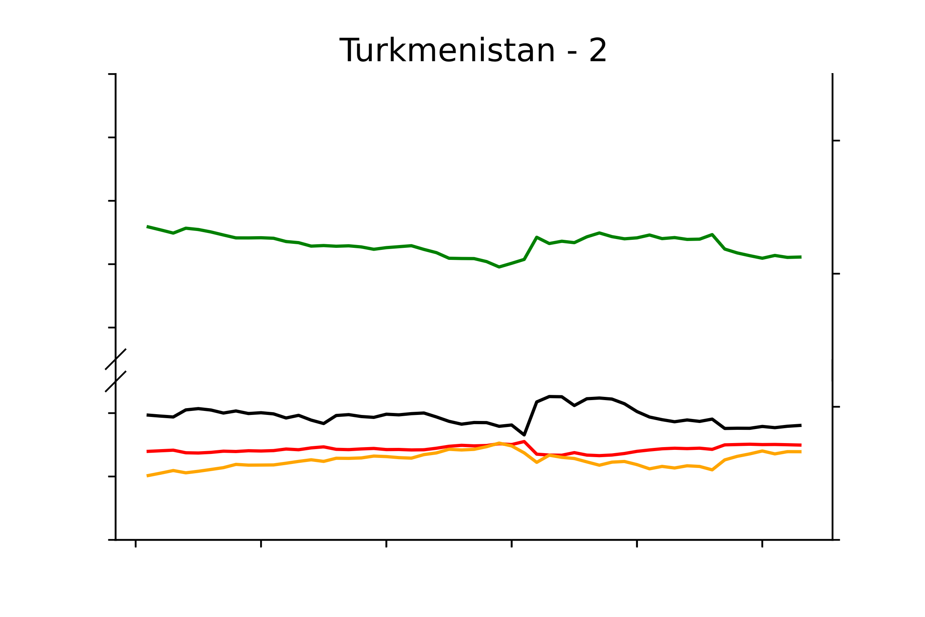
Diet composition and stoichiometry trends in 162 countries
100
90
40
80
70
30
60
20
20
10
0
10
100
90
40
80
70
30
60
20
20
10
10
0
100
40
90
80
30
70
60
20
20
10
10
0
Macronutrient composition (%)
Human diet C/N
100
40
90
80
70
30
60
20
20
10
10
0
100
40
90
80
70
30
60
20
20
10
10
0
100
40
90
80
30
70
60
20
20
10
10
0
1961
1971
1981
1991
2001
2010
1961
1971
1981
1991
2001
2010
1961
1971
1981
1991
2001
2010
Time (years)

Slide 2
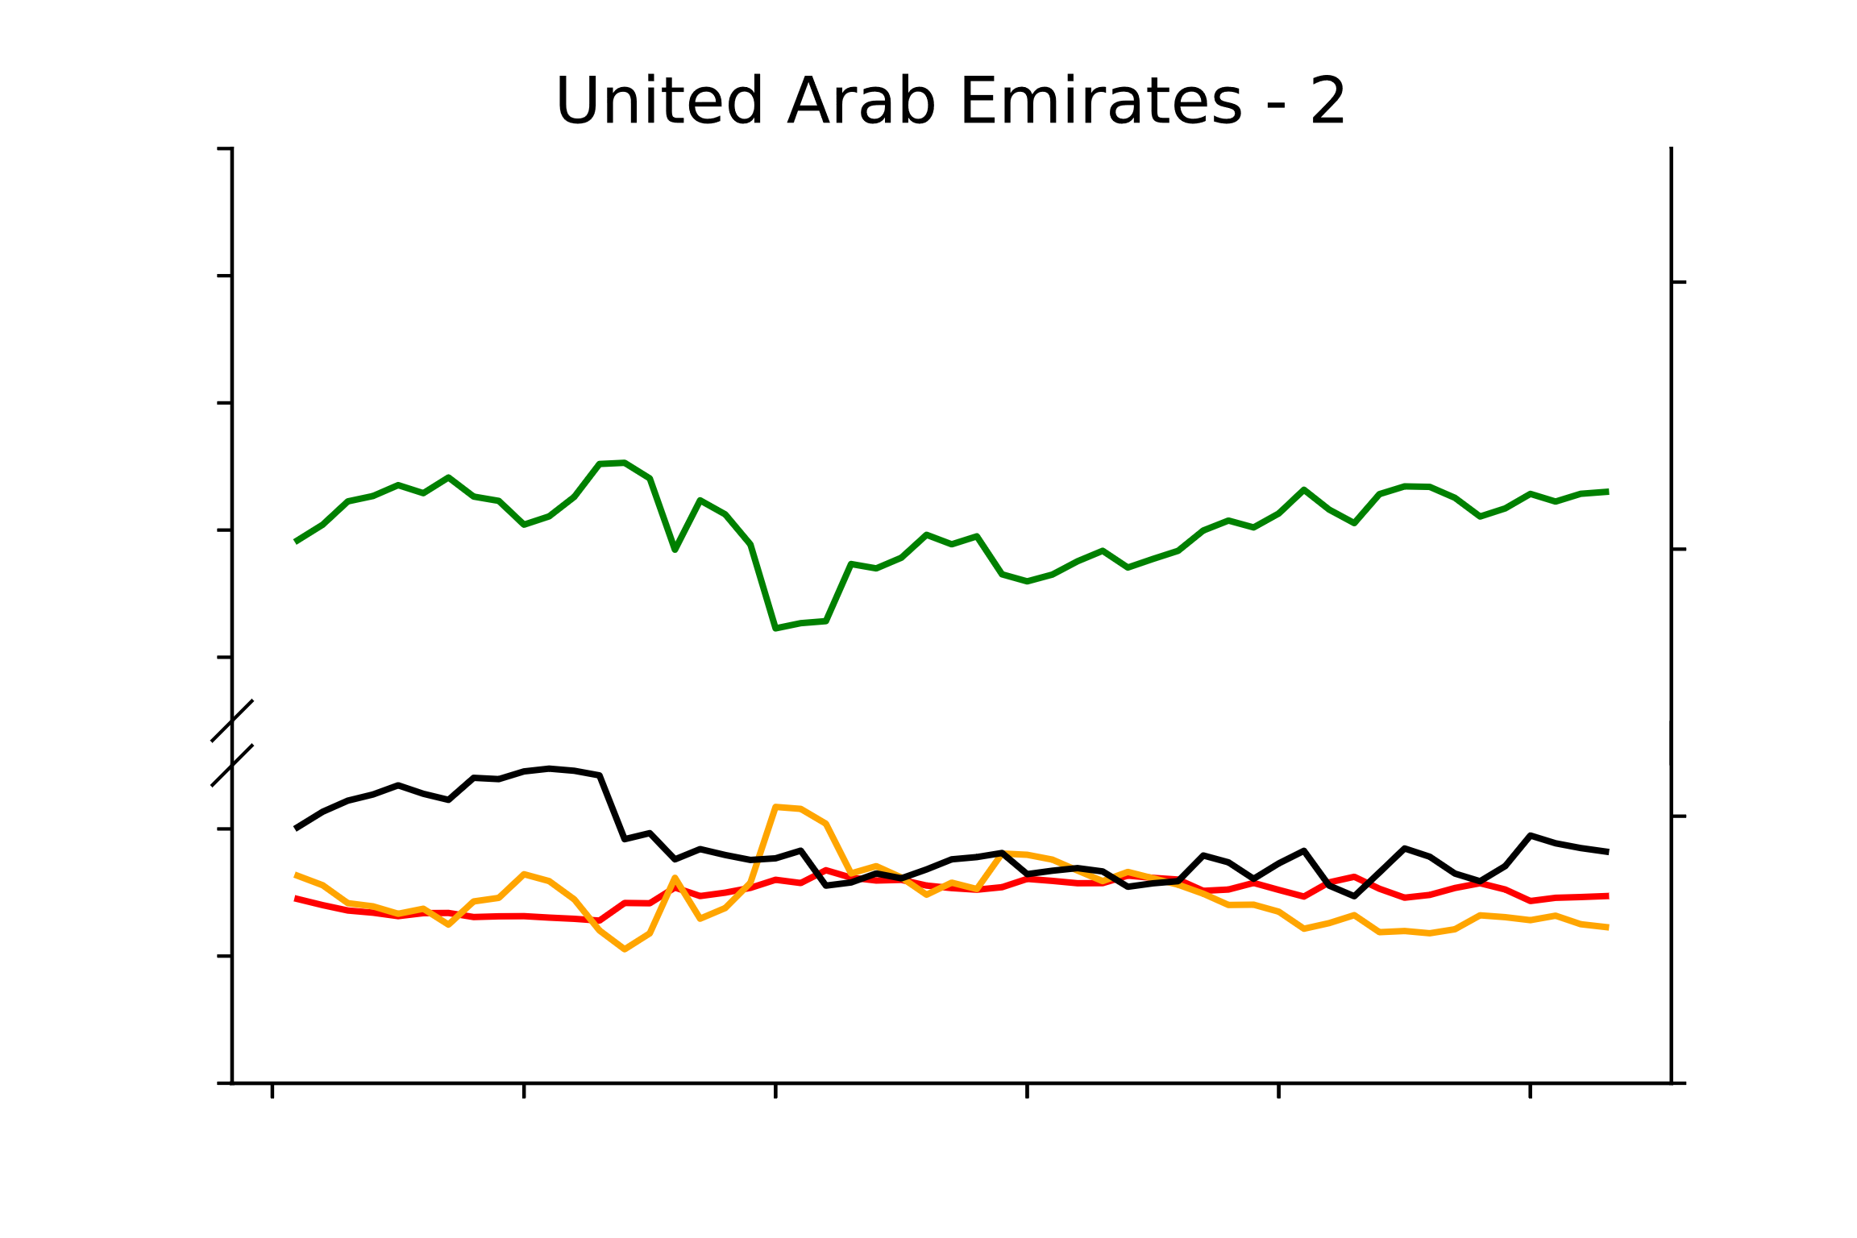
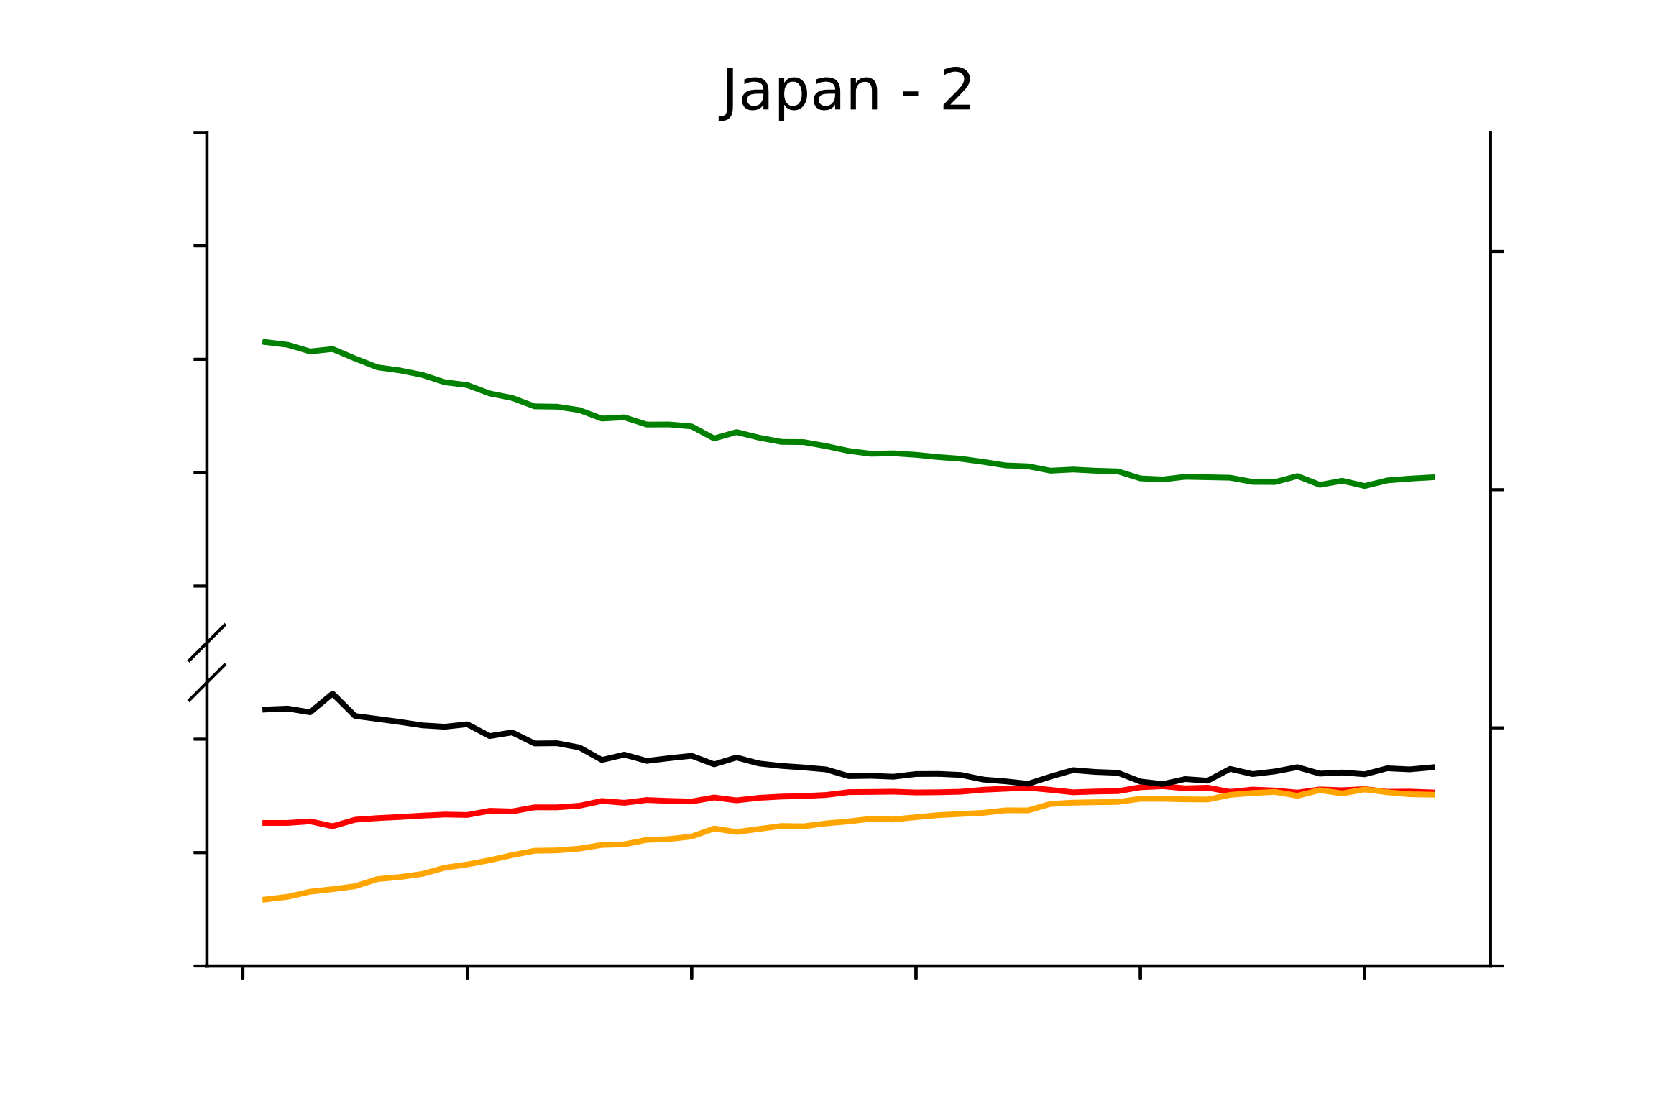
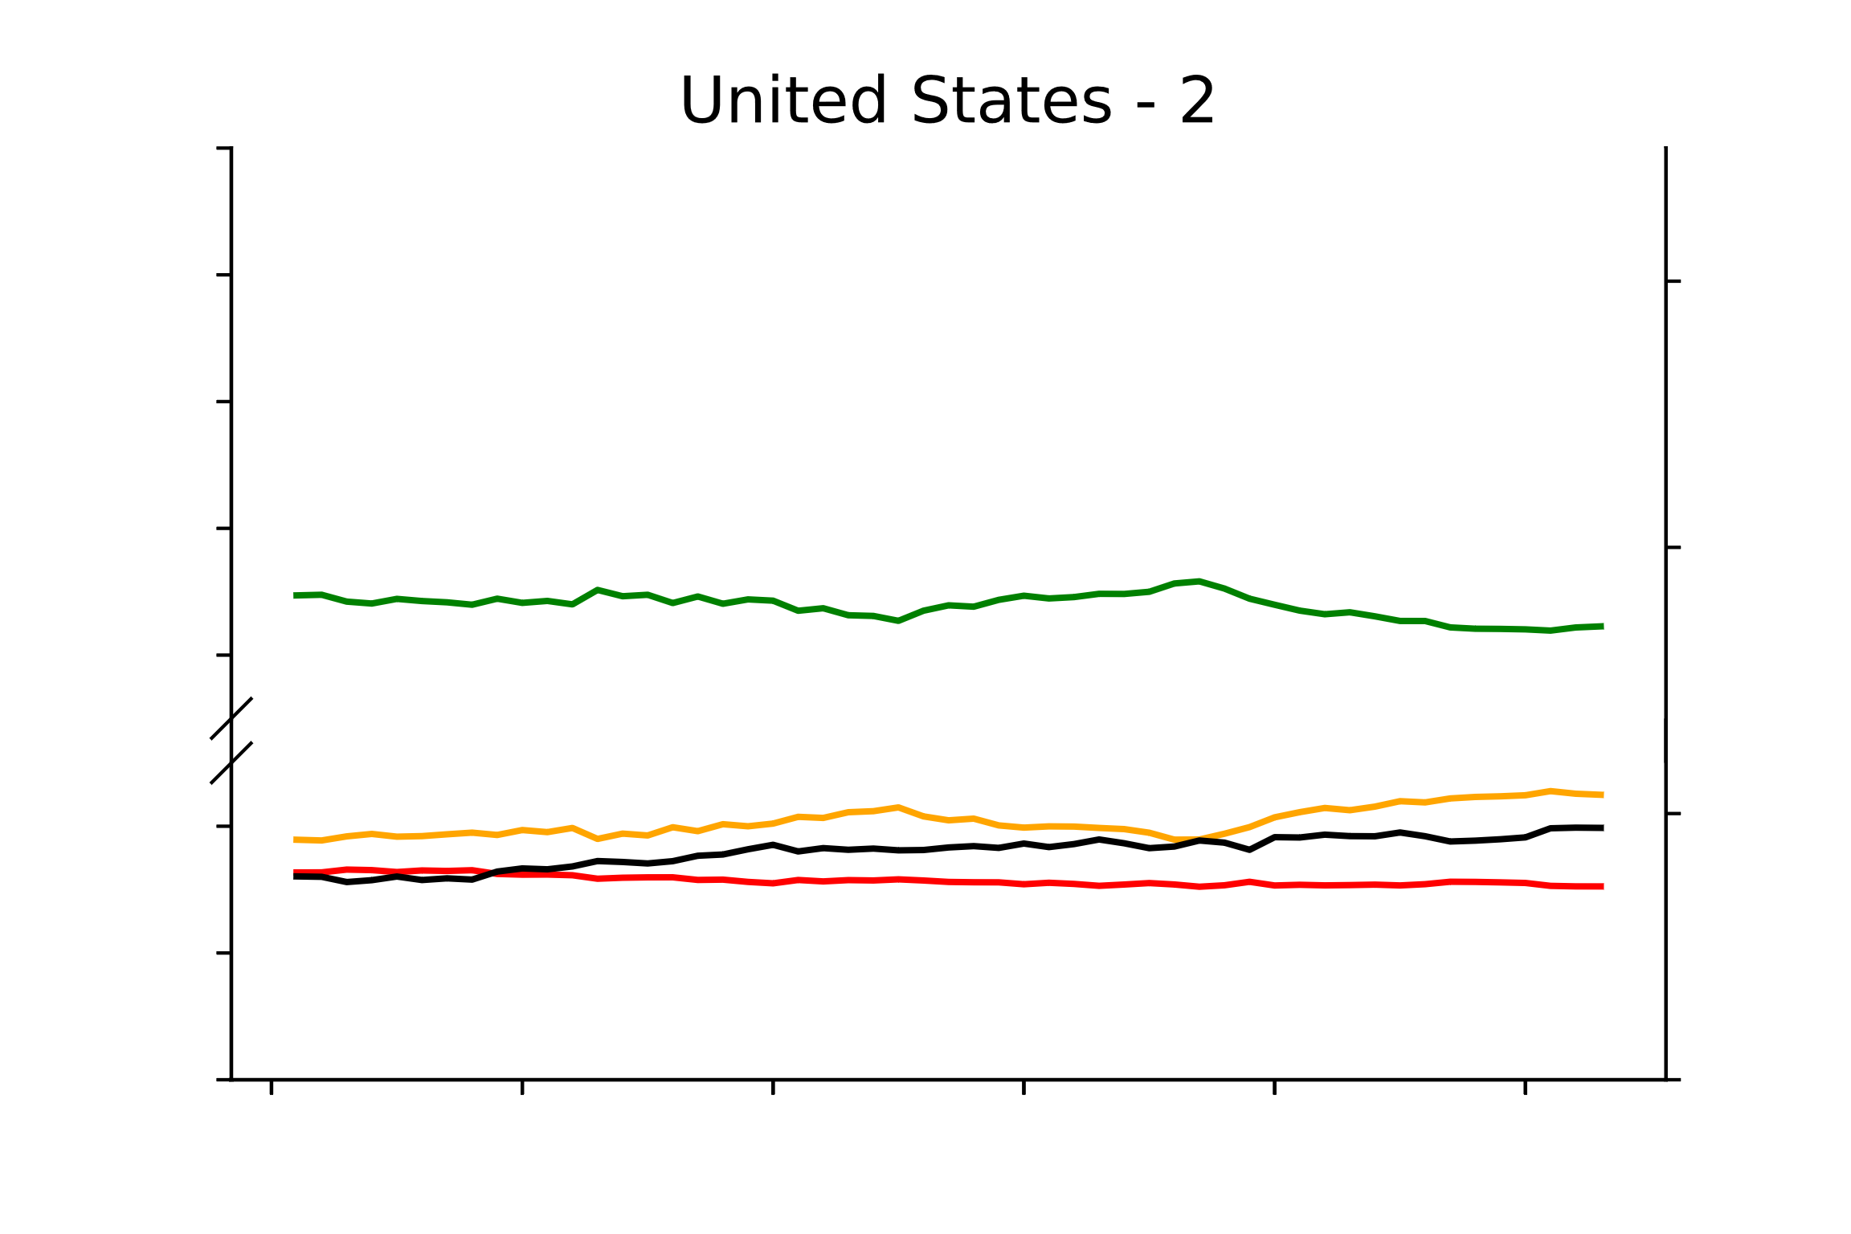
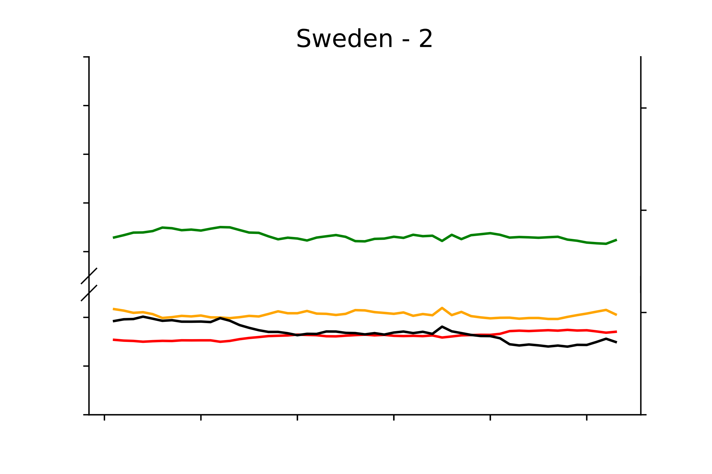
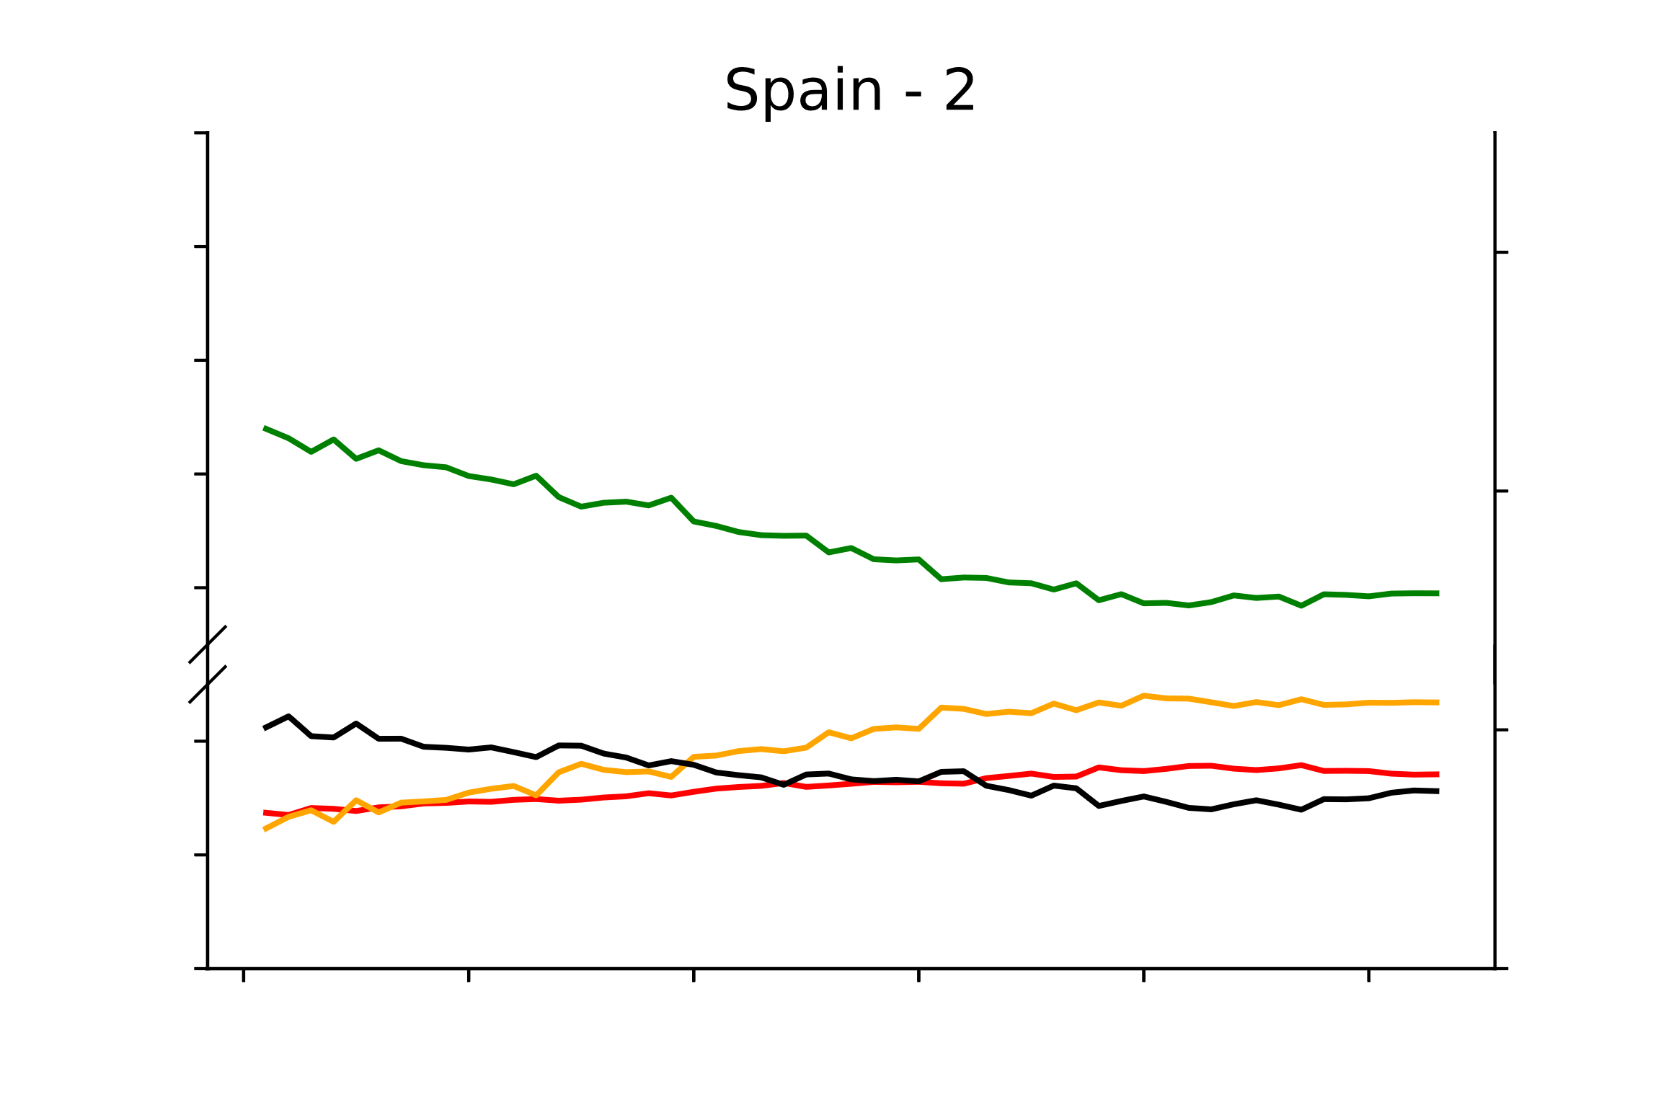
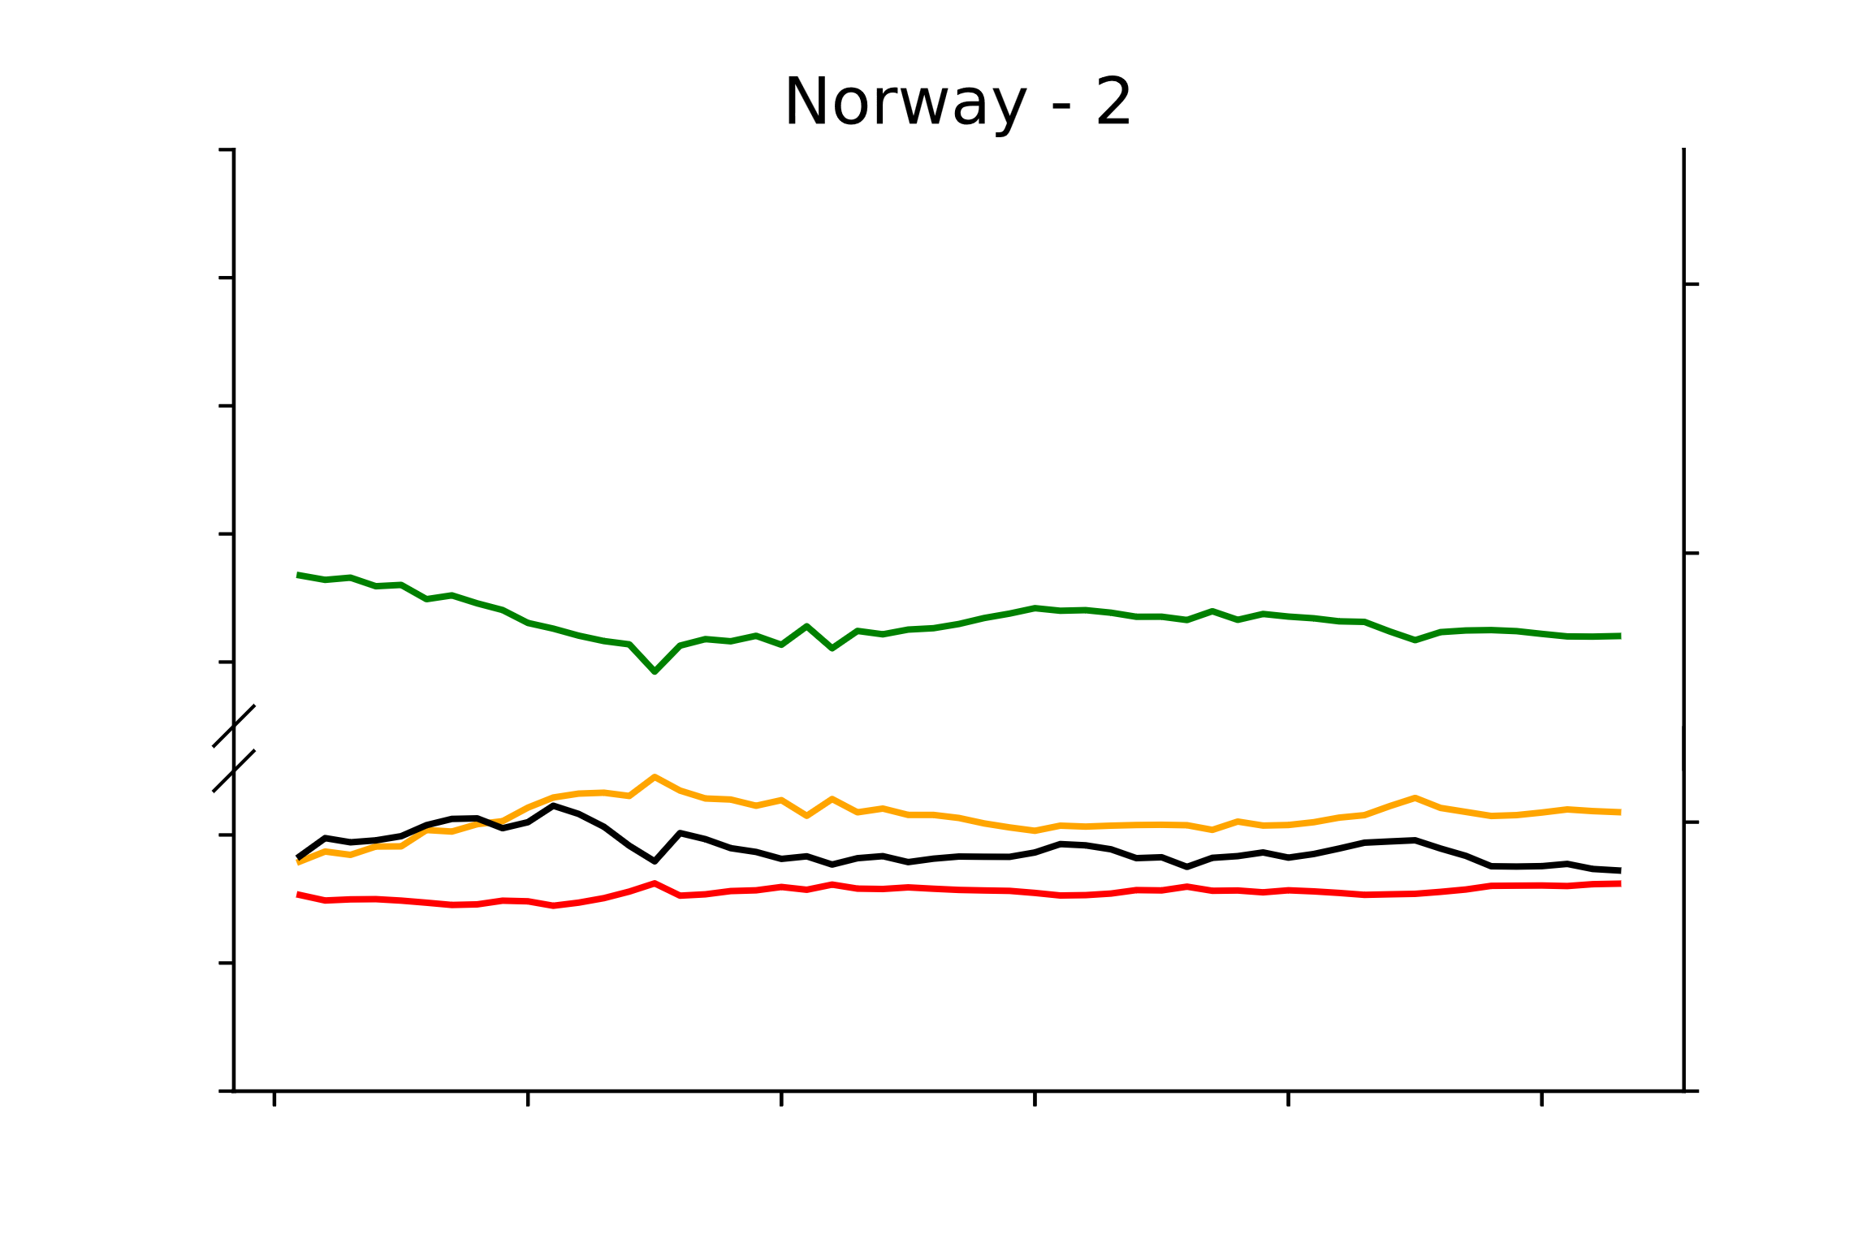
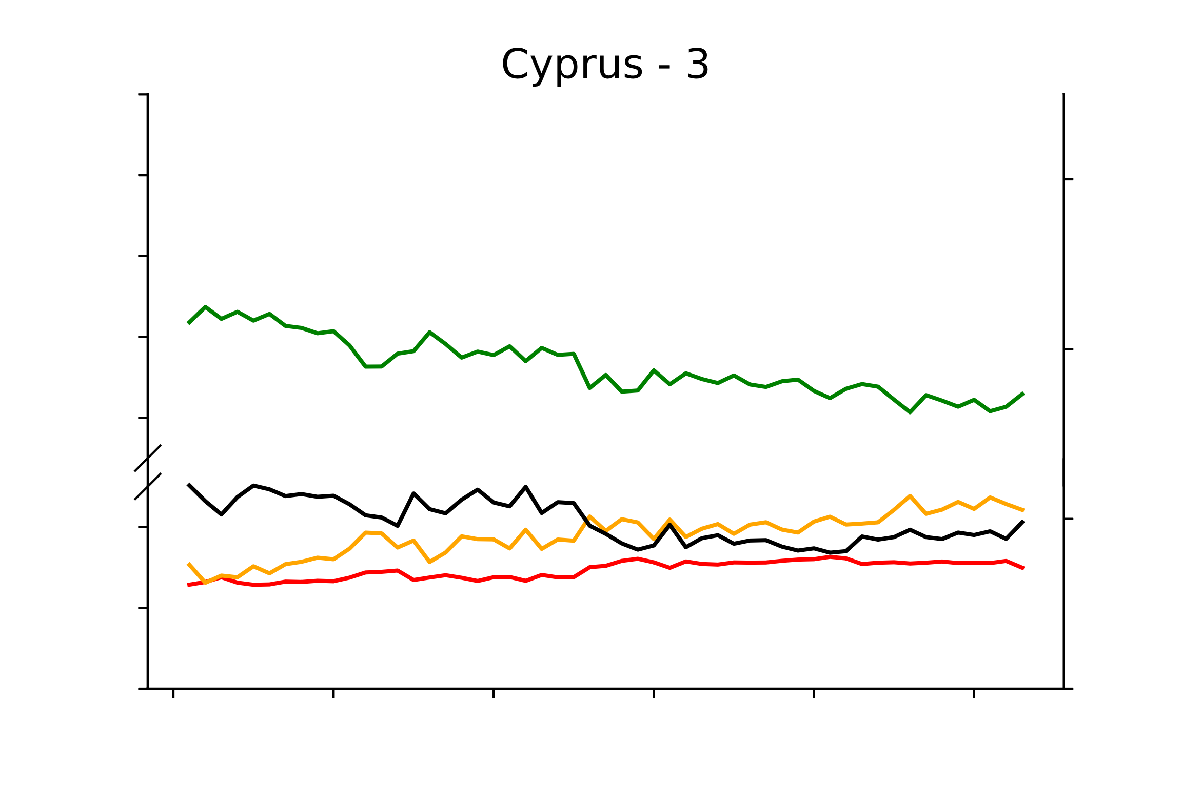
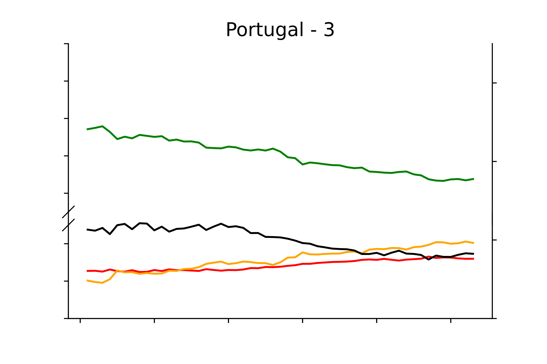
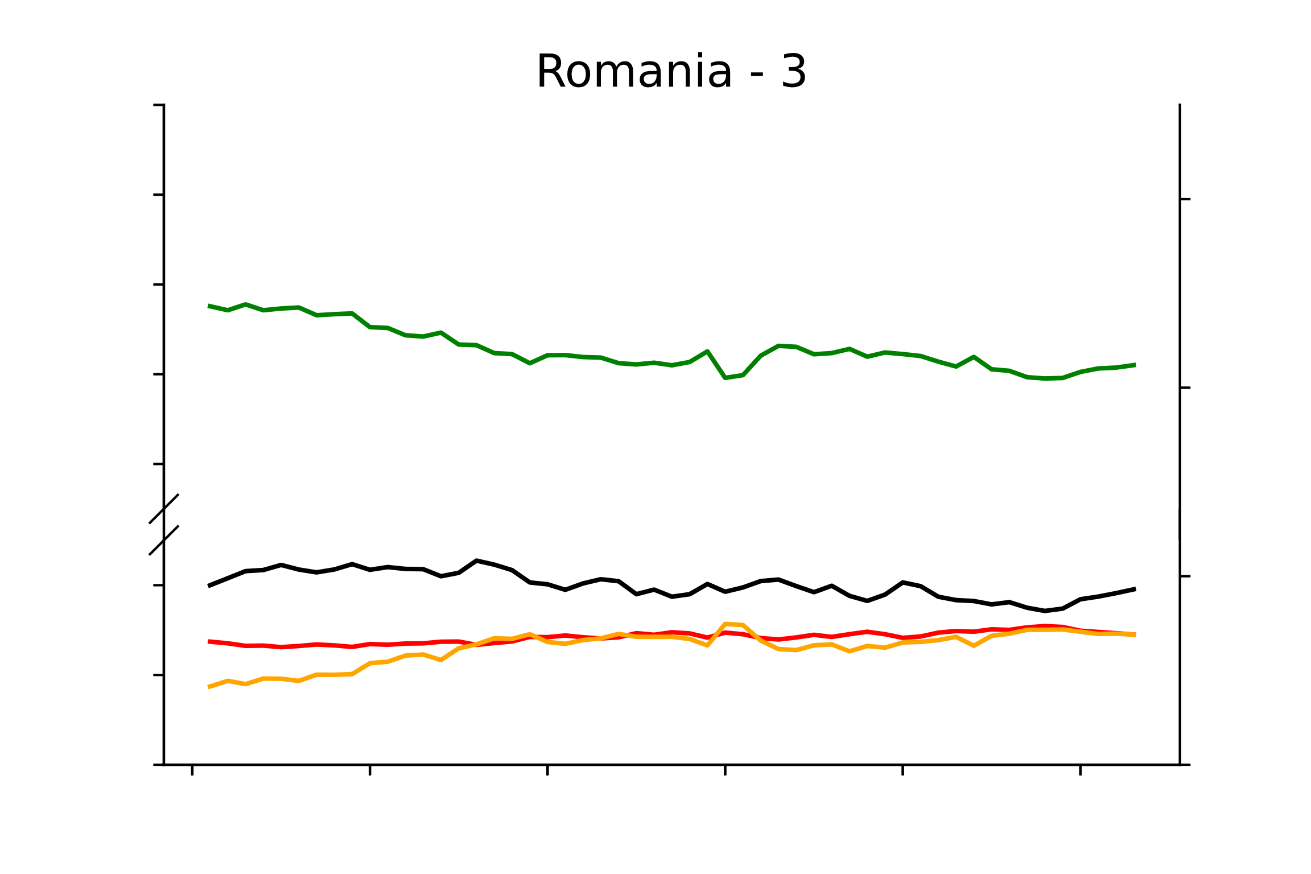
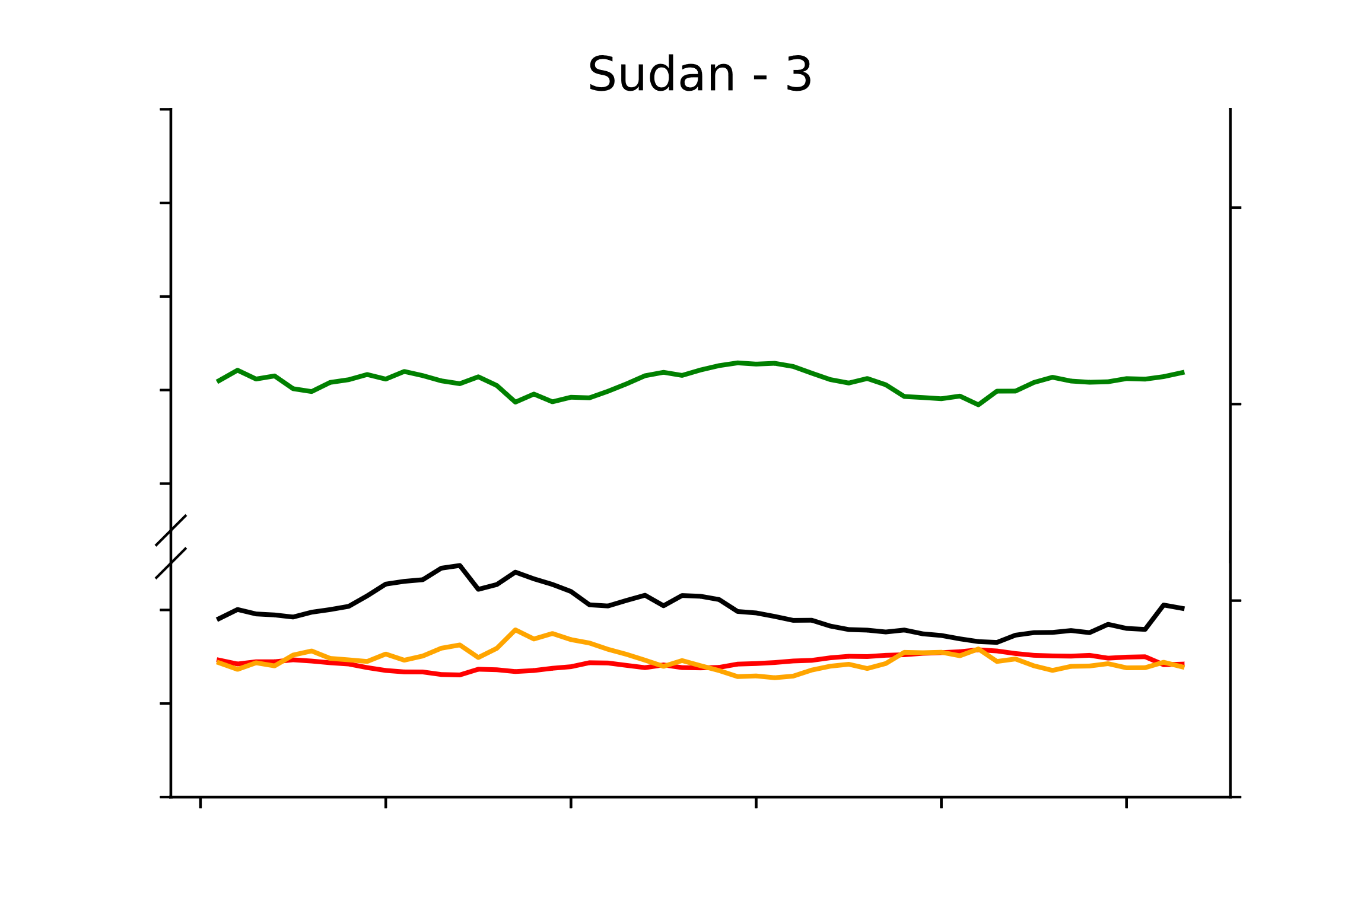
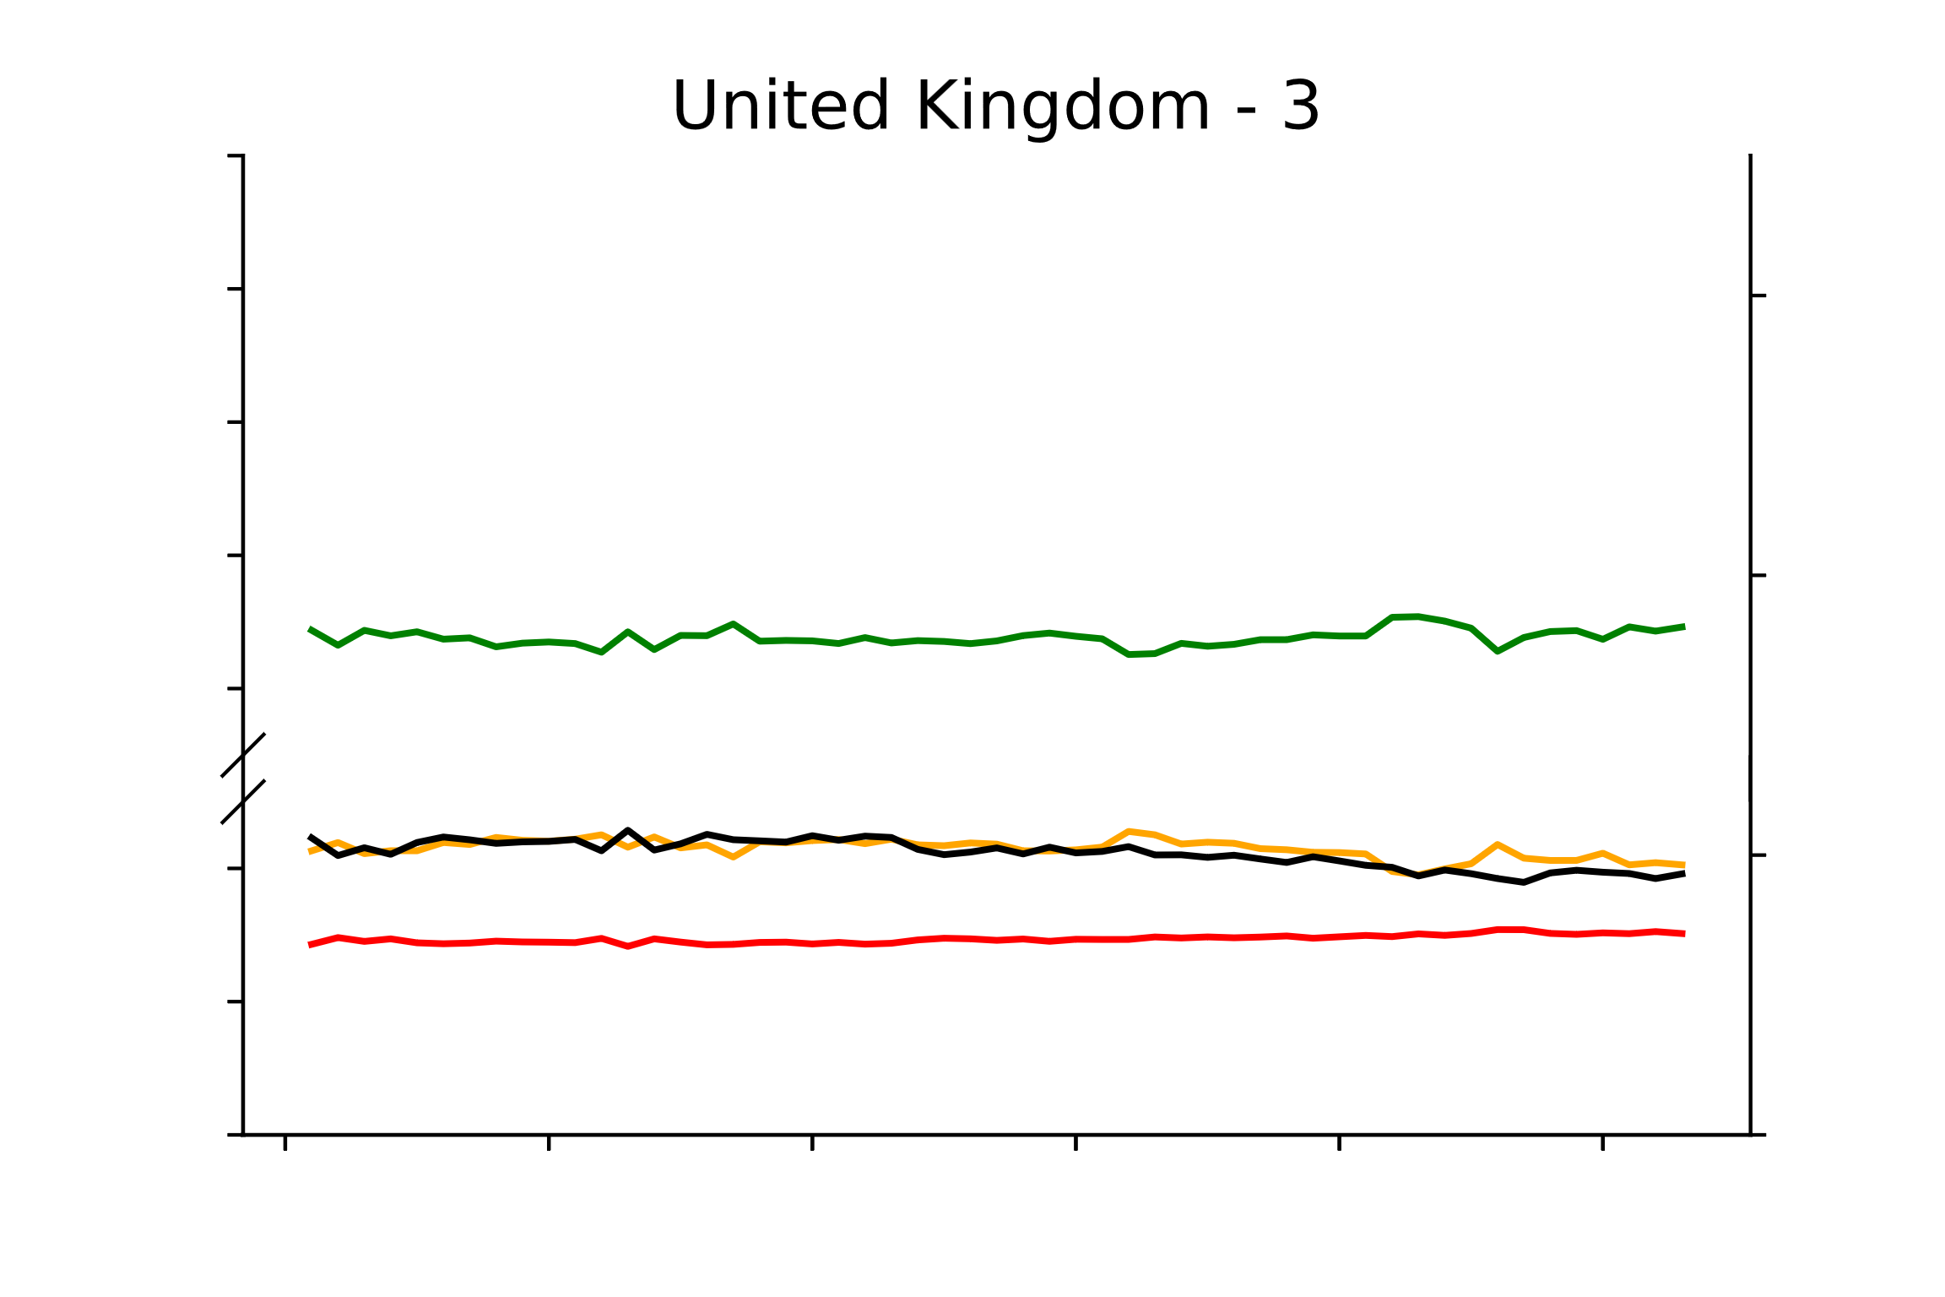
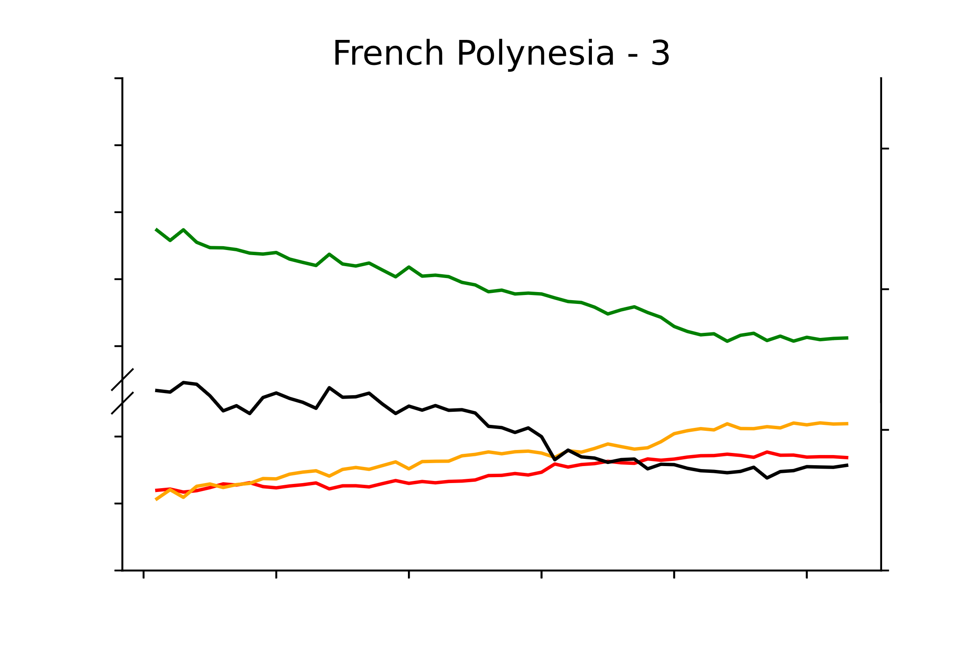
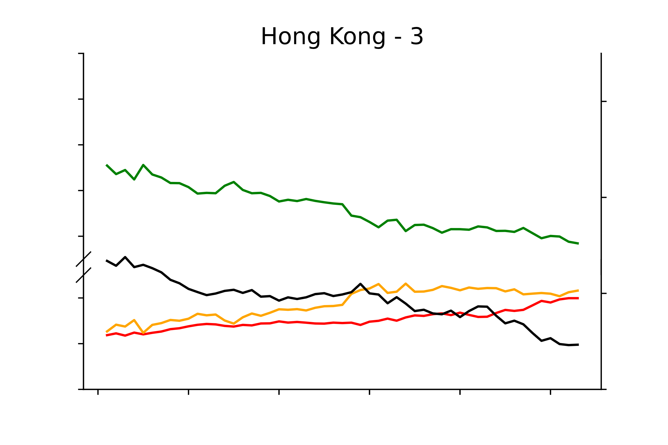
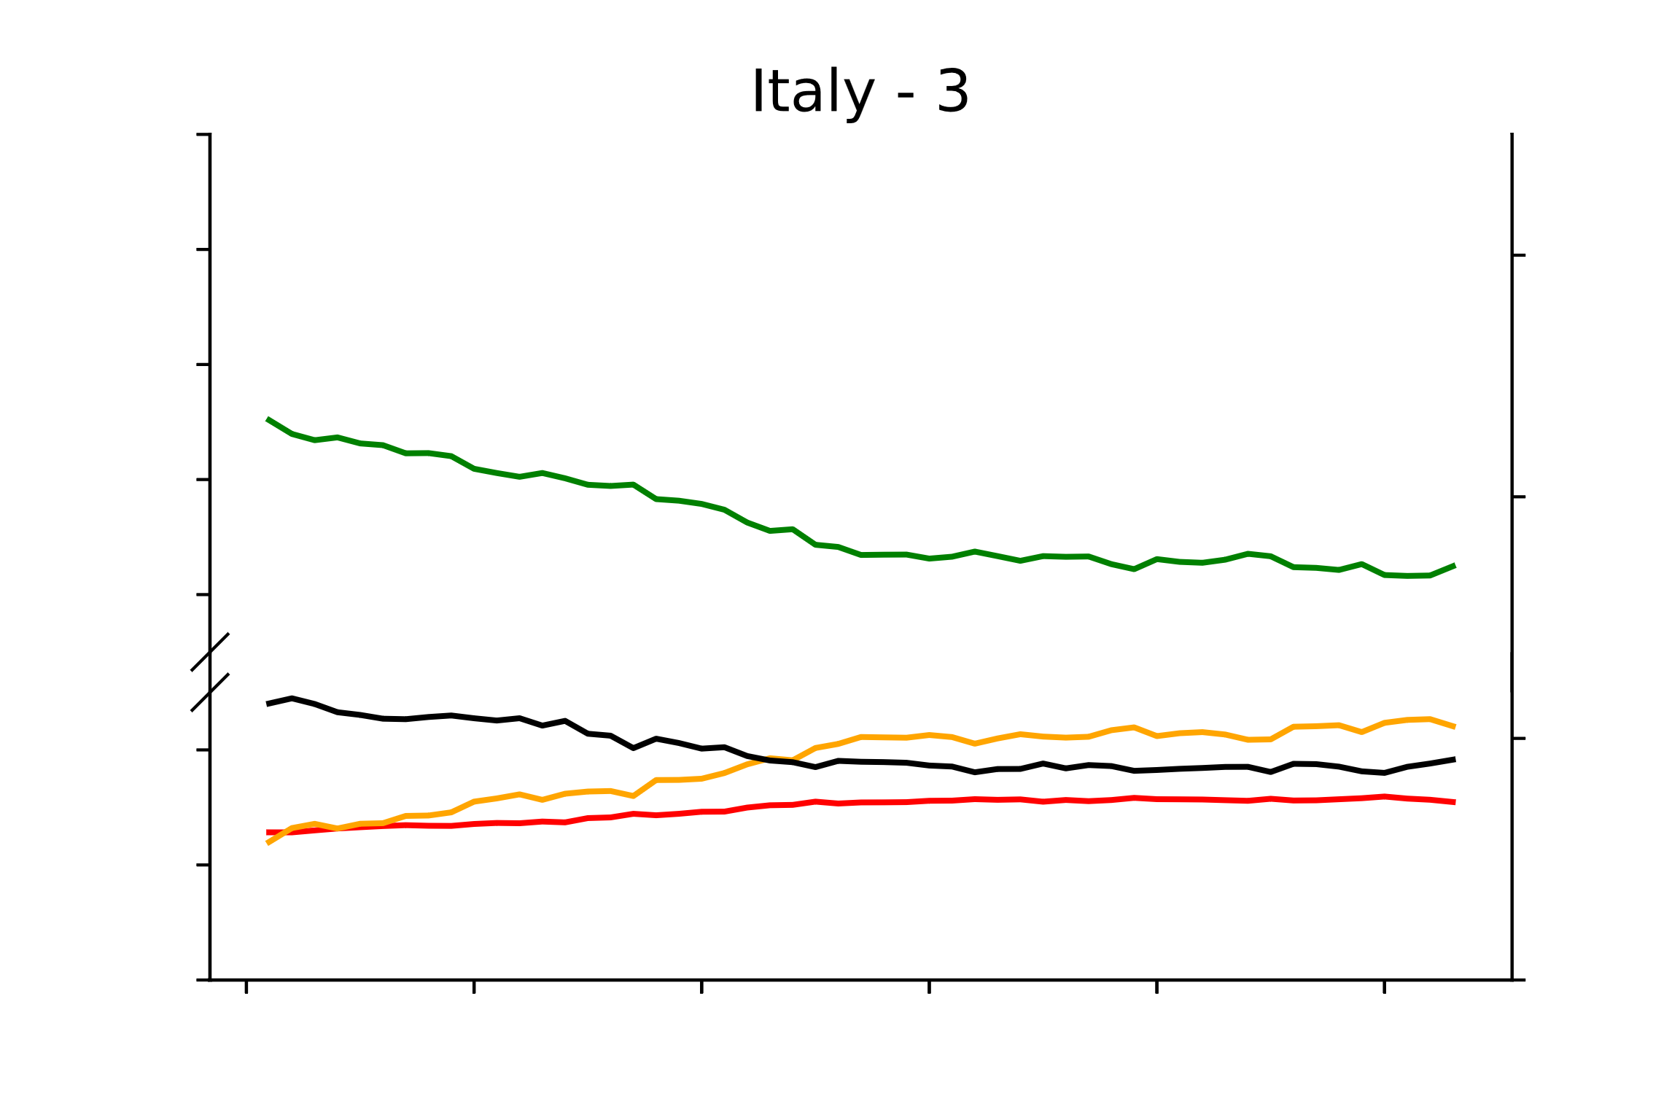
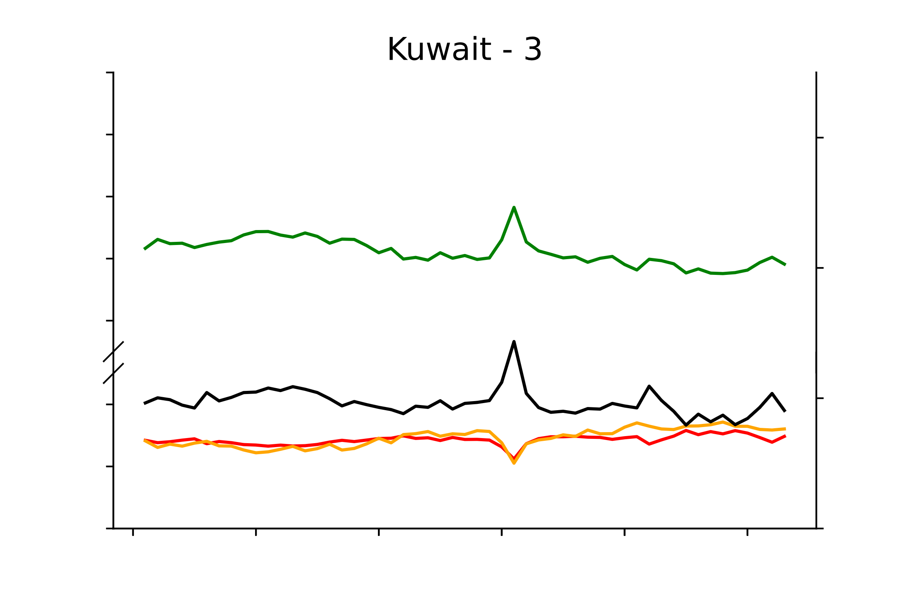
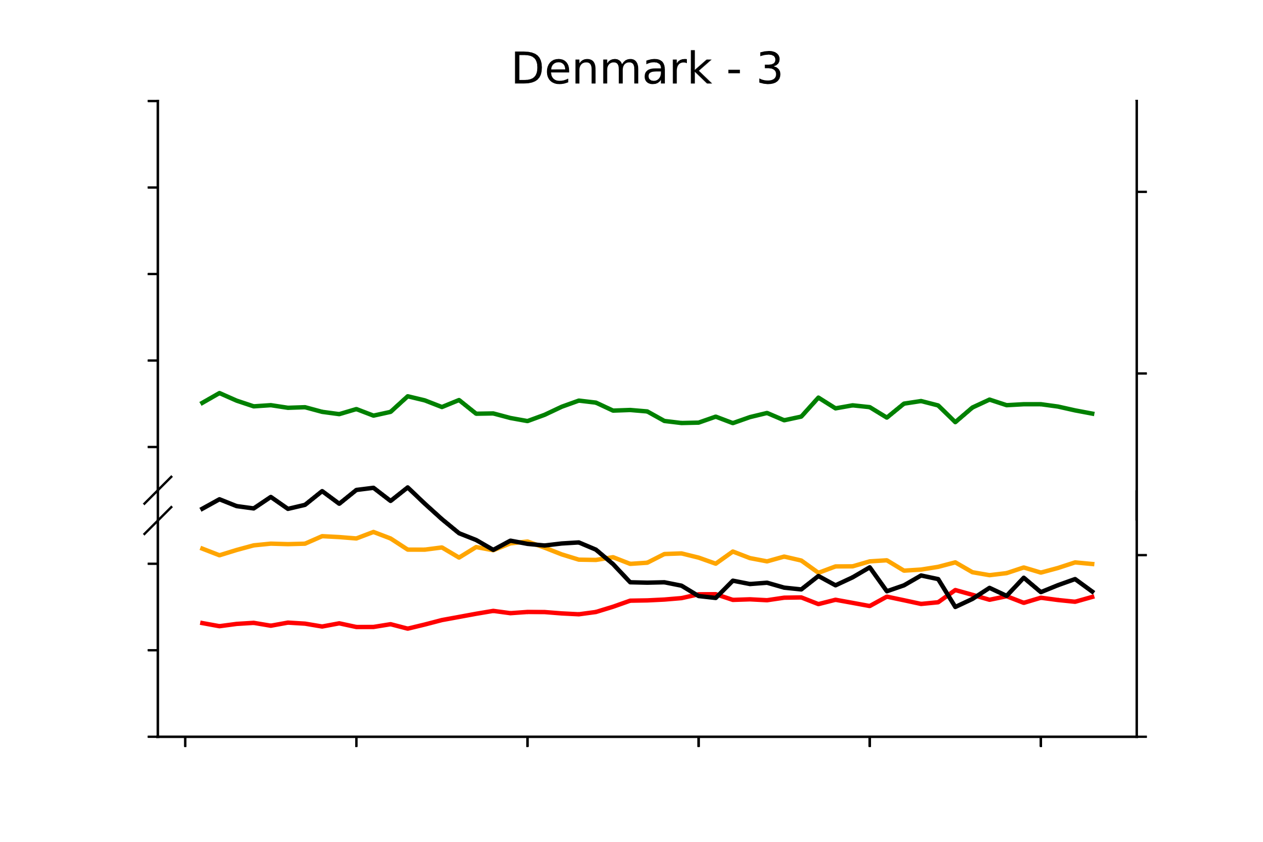
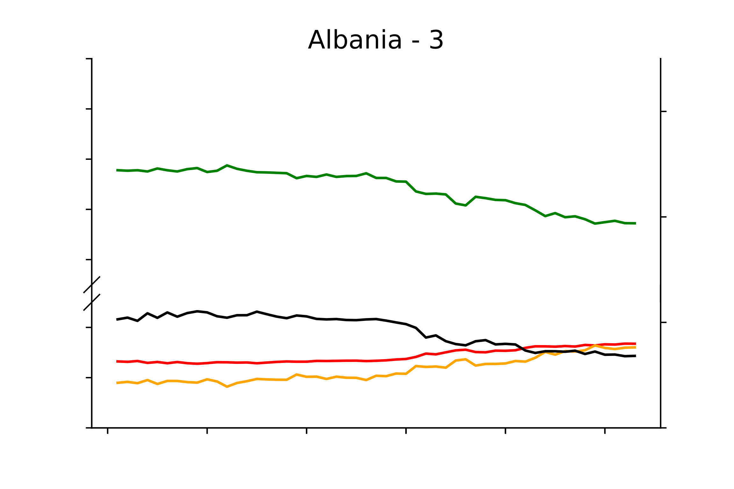
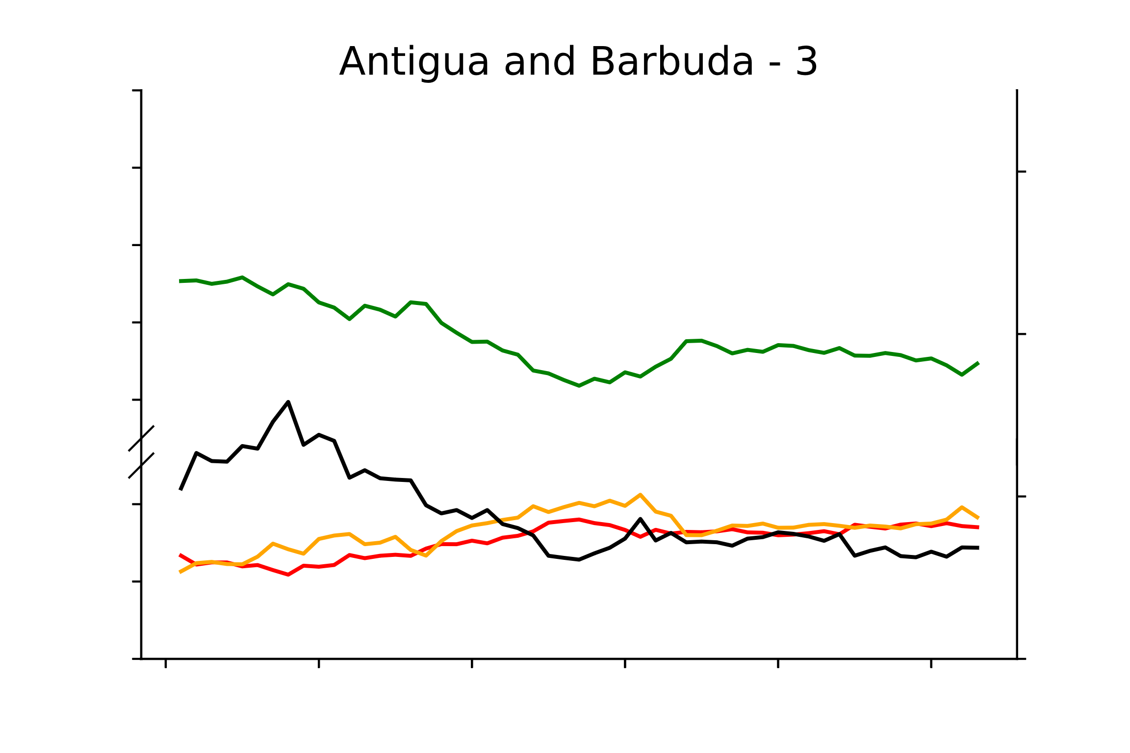
Continued: Diet composition and stoichiometry trends in 162 countries
100
40
90
80
70
30
60
20
20
10
10
0
100
40
90
80
70
30
60
20
20
10
10
0
100
40
90
80
30
70
60
20
20
10
10
0
Macronutrient composition (%)
Human diet C/N
100
40
90
80
70
30
60
20
20
10
10
0
100
90
40
80
70
30
60
20
20
10
10
0
100
40
90
80
70
30
60
20
20
10
10
0
1961
1971
1981
1991
2001
2010
1961
1971
1981
1991
2001
2010
1961
1971
1981
1991
2001
2010
Time (years)

Slide 3
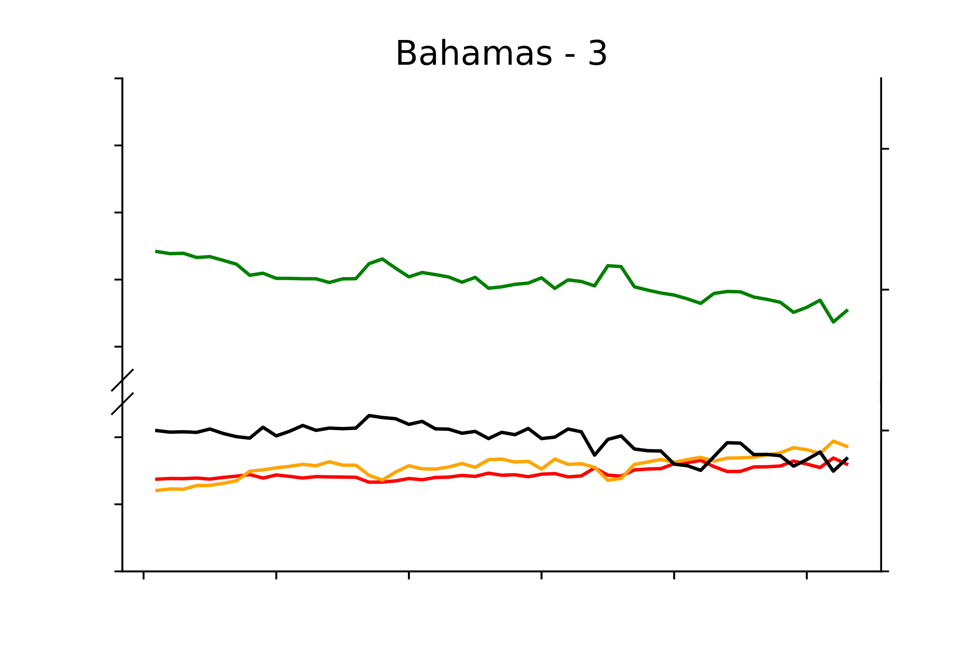
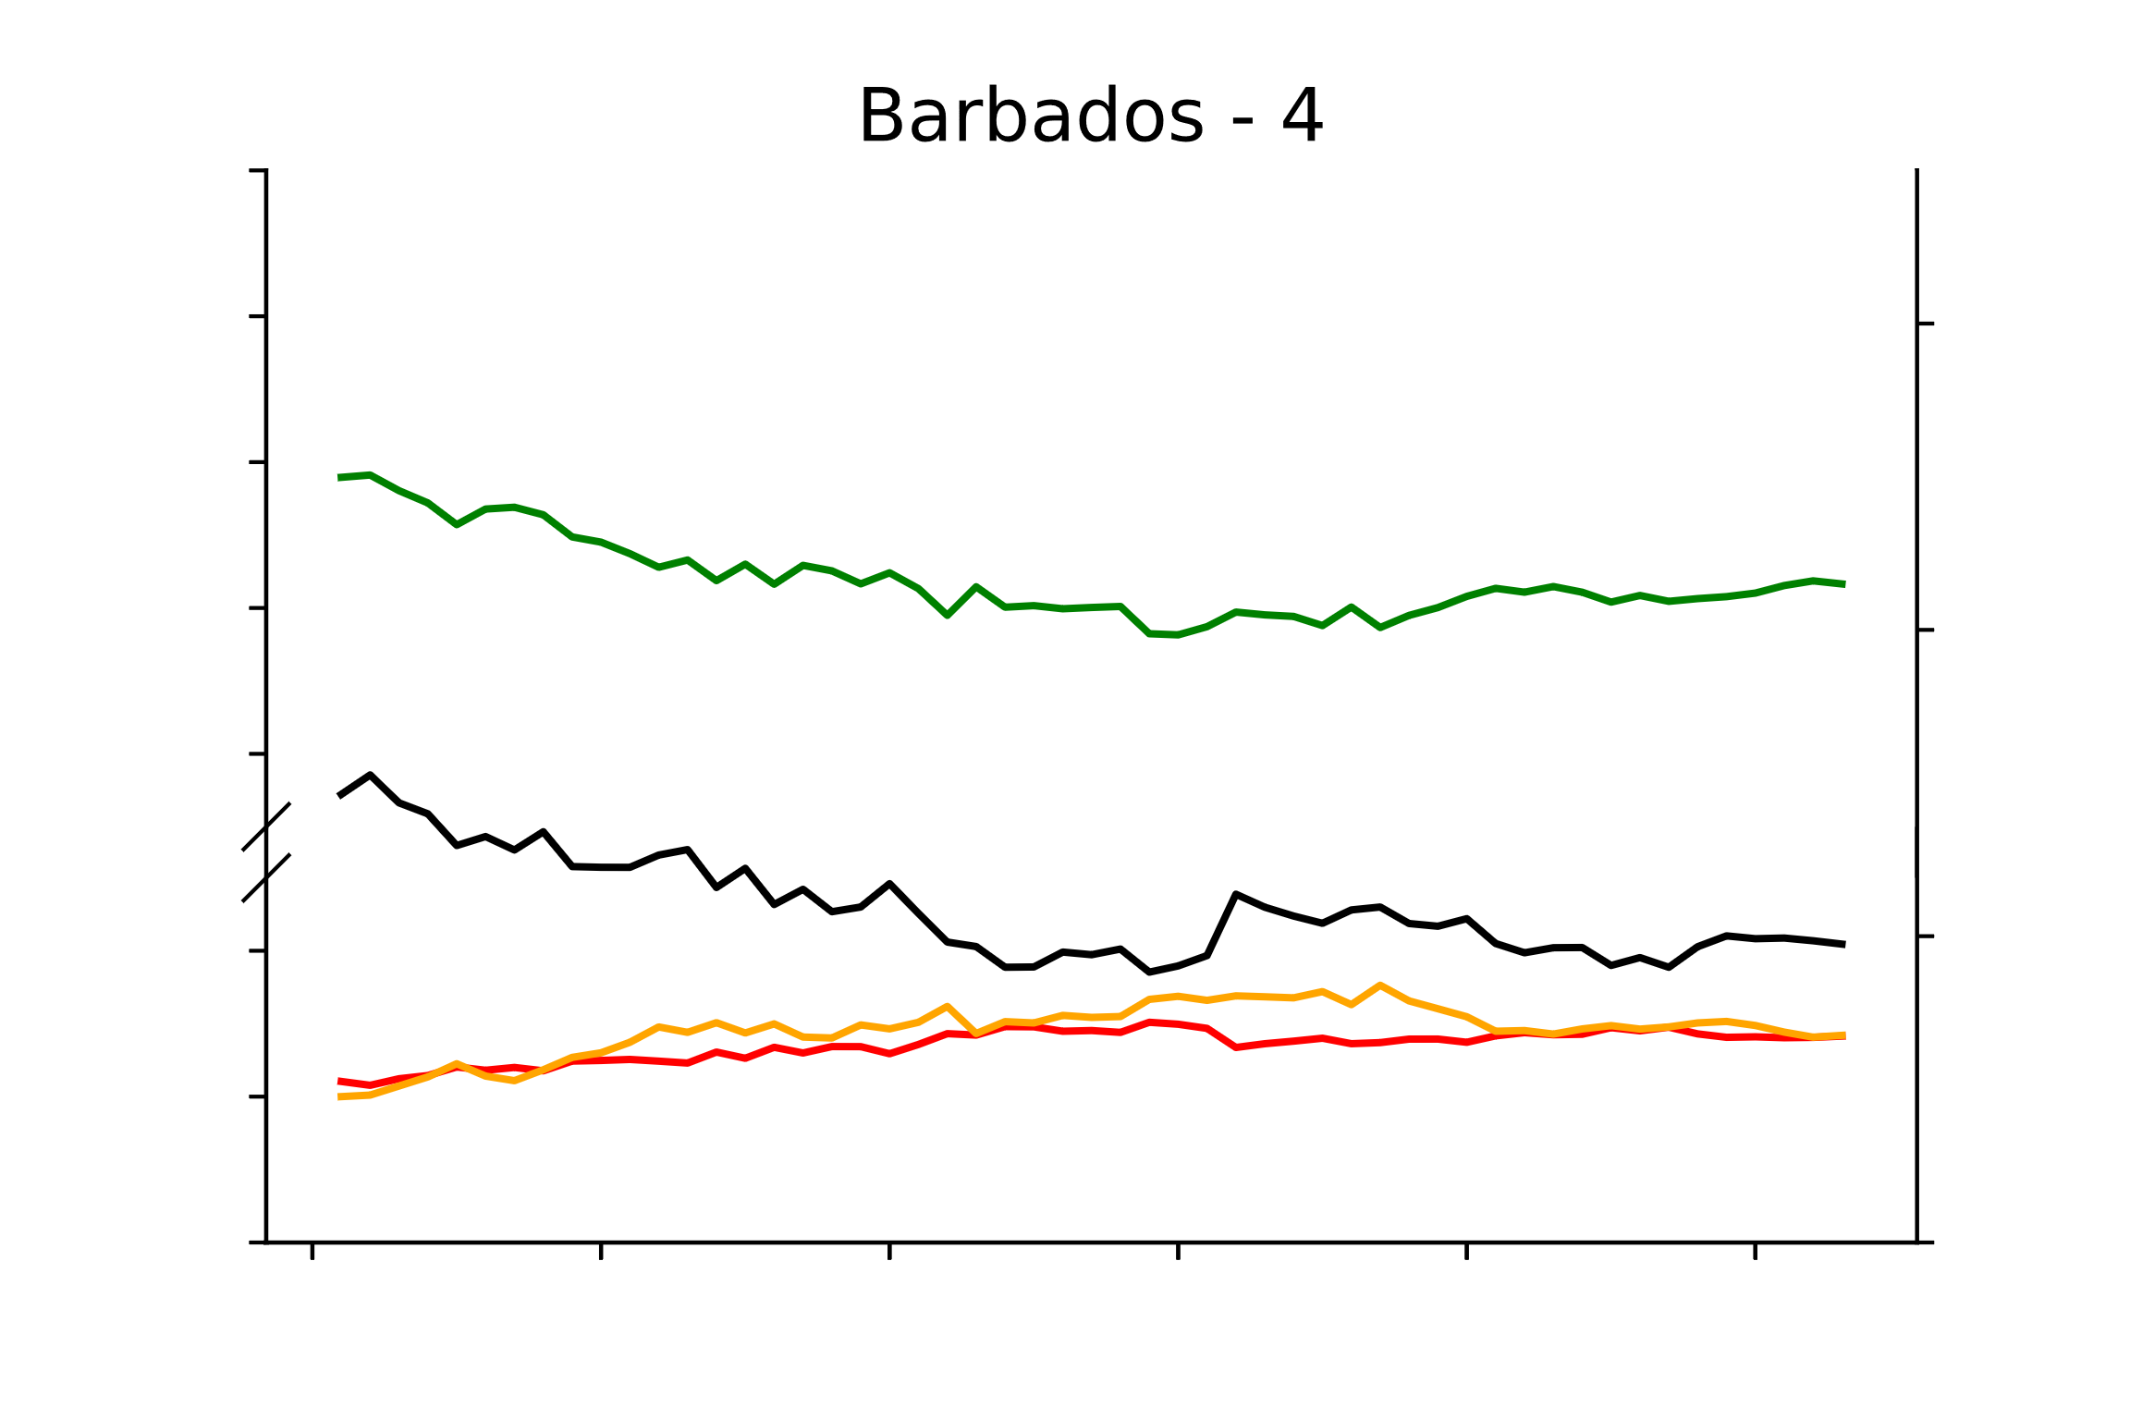
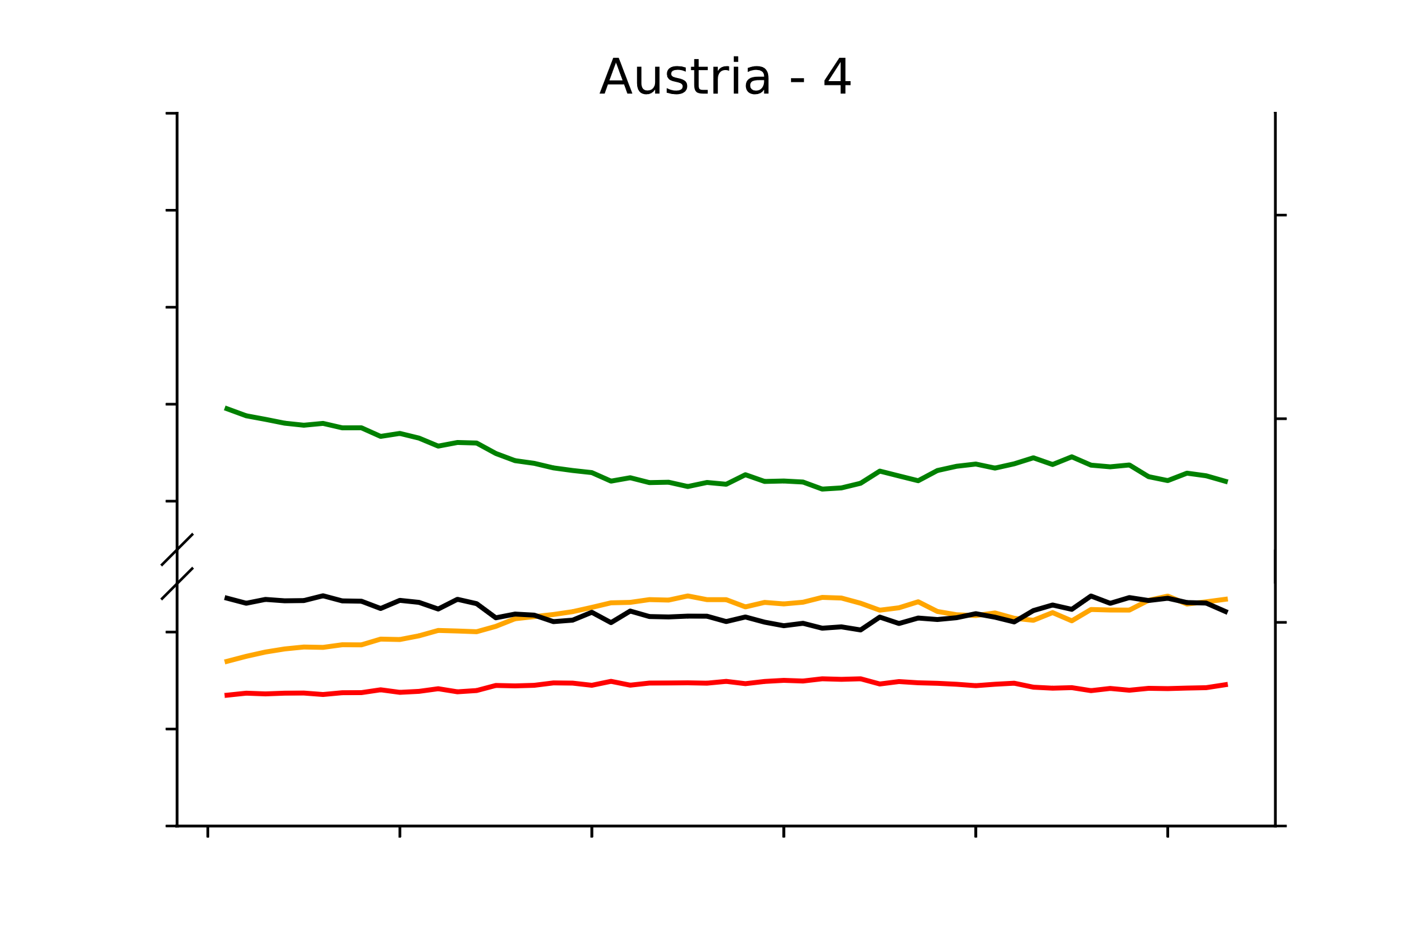
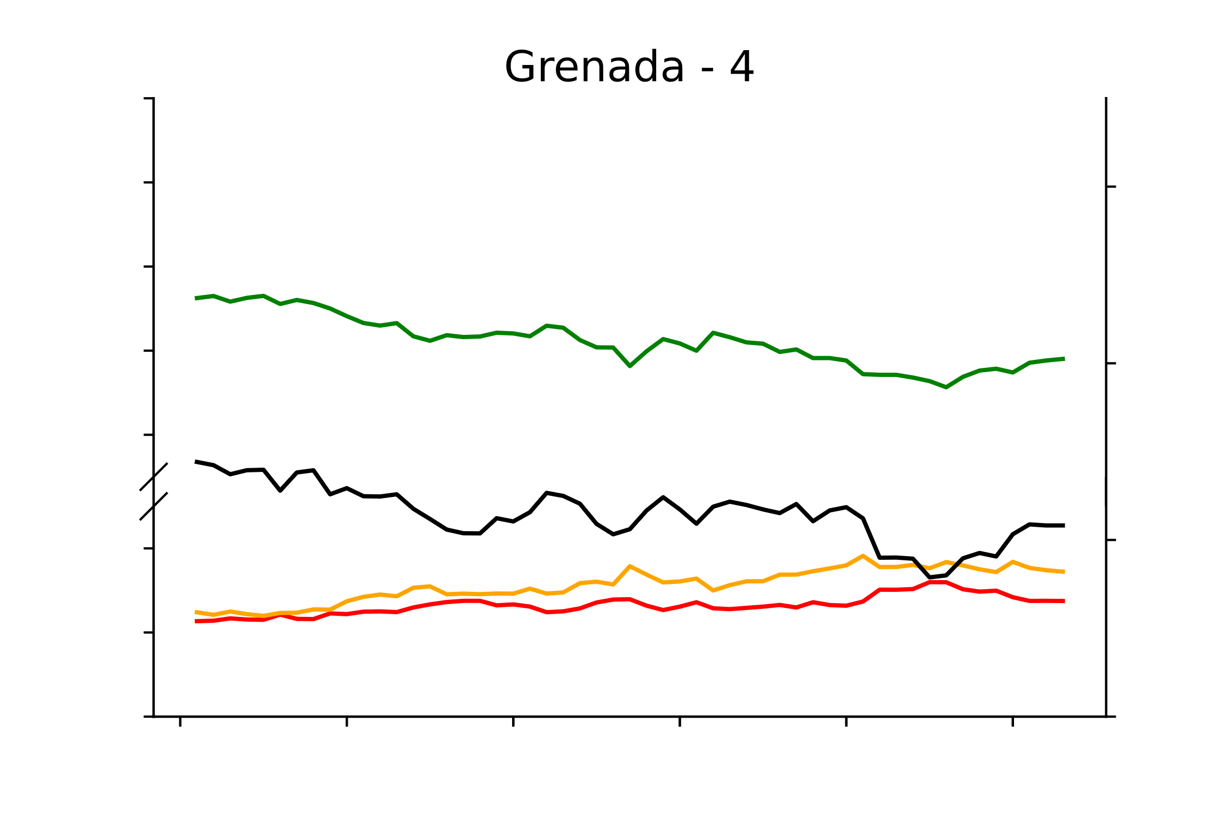
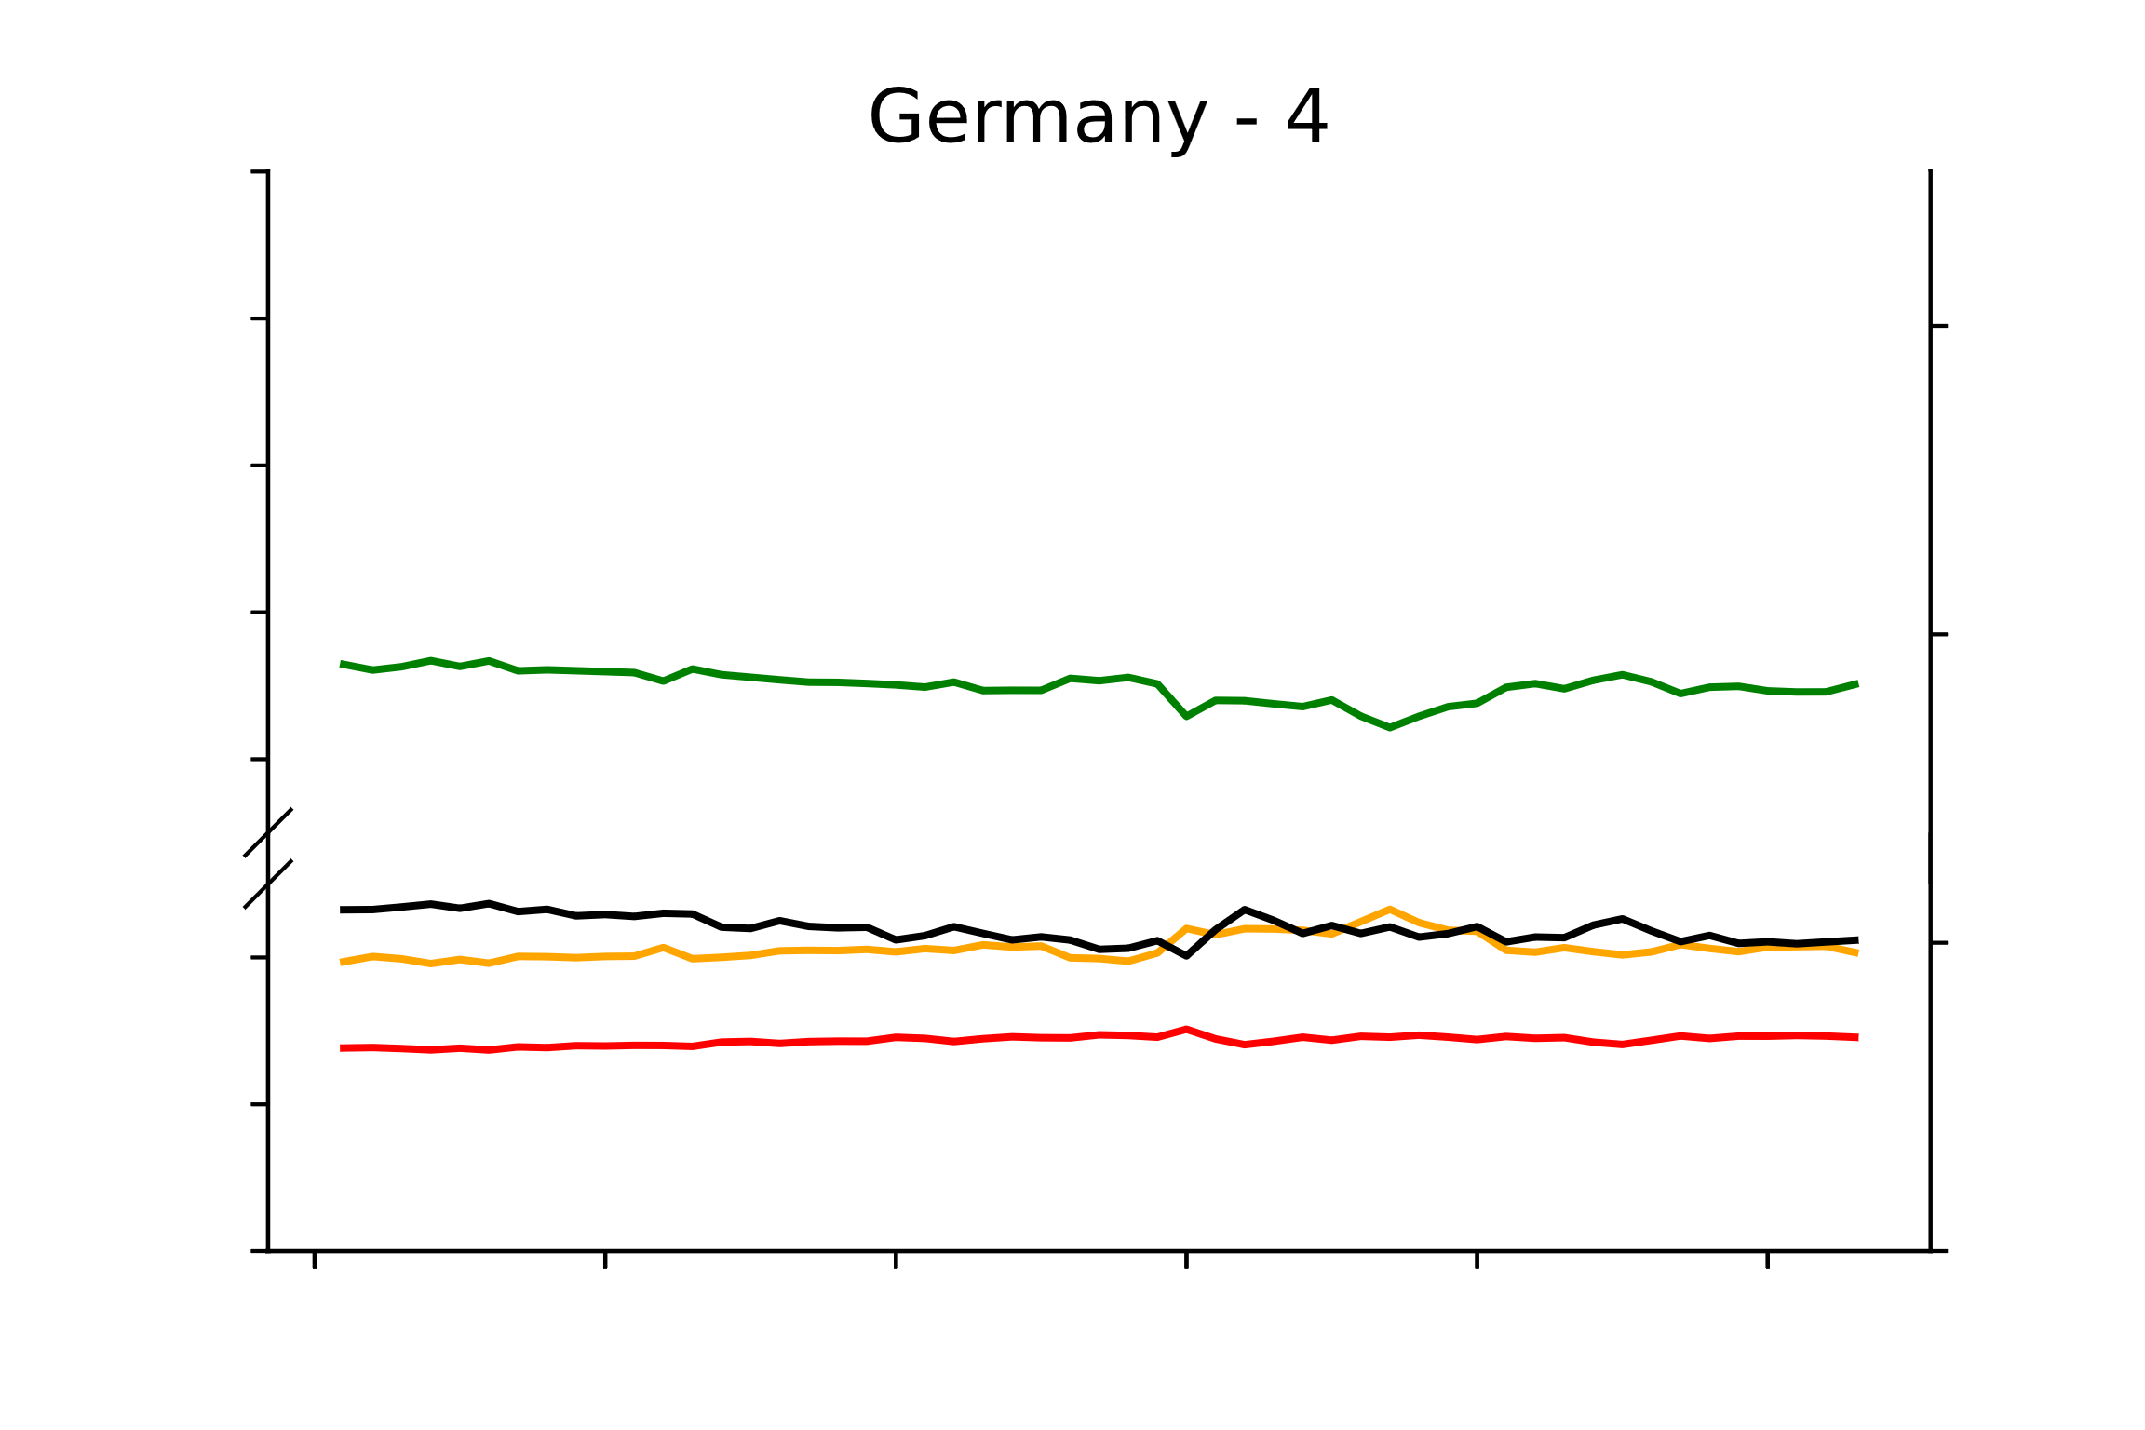
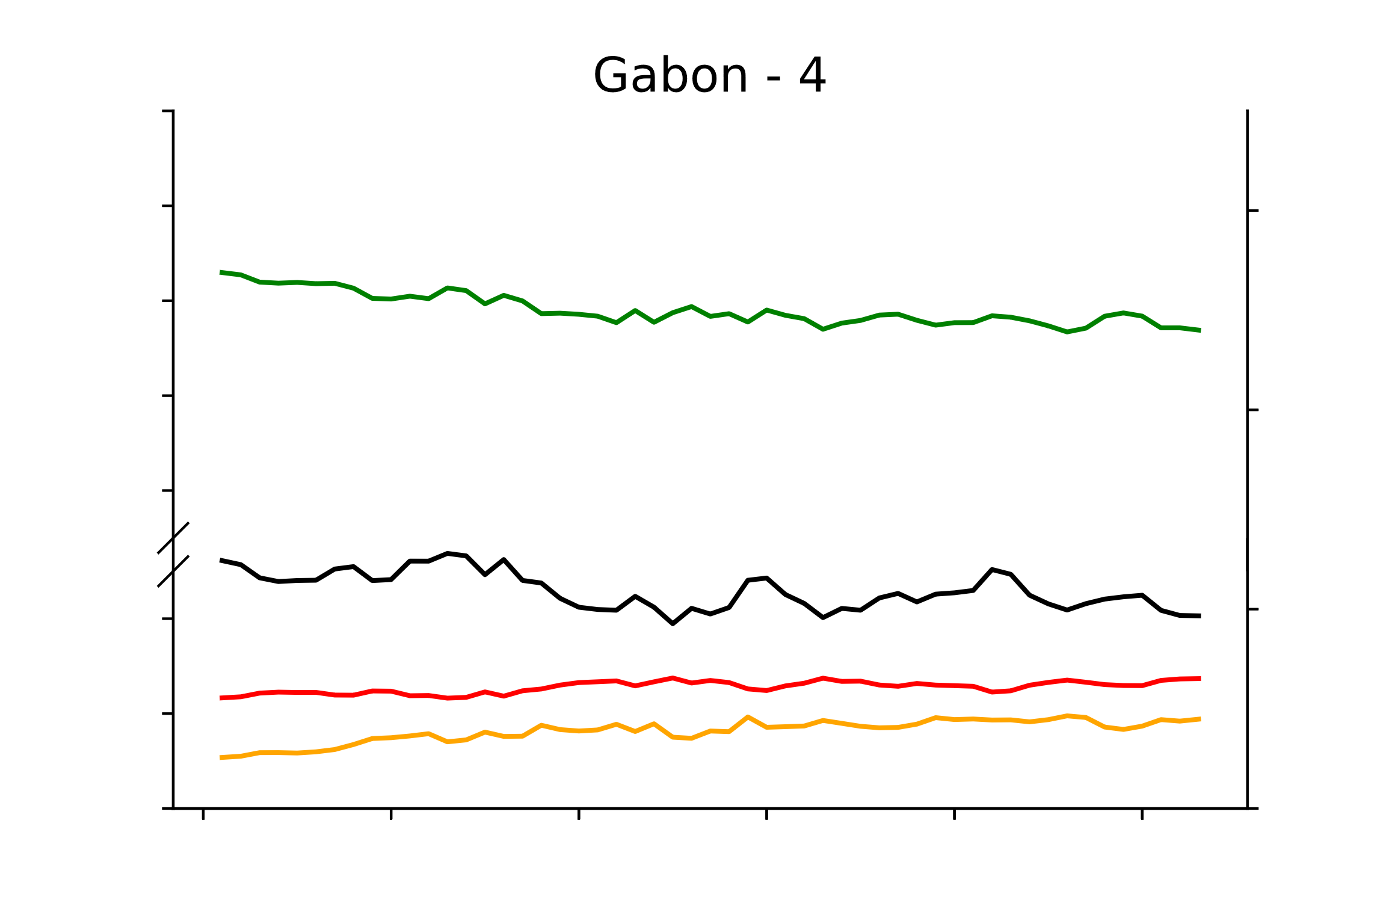
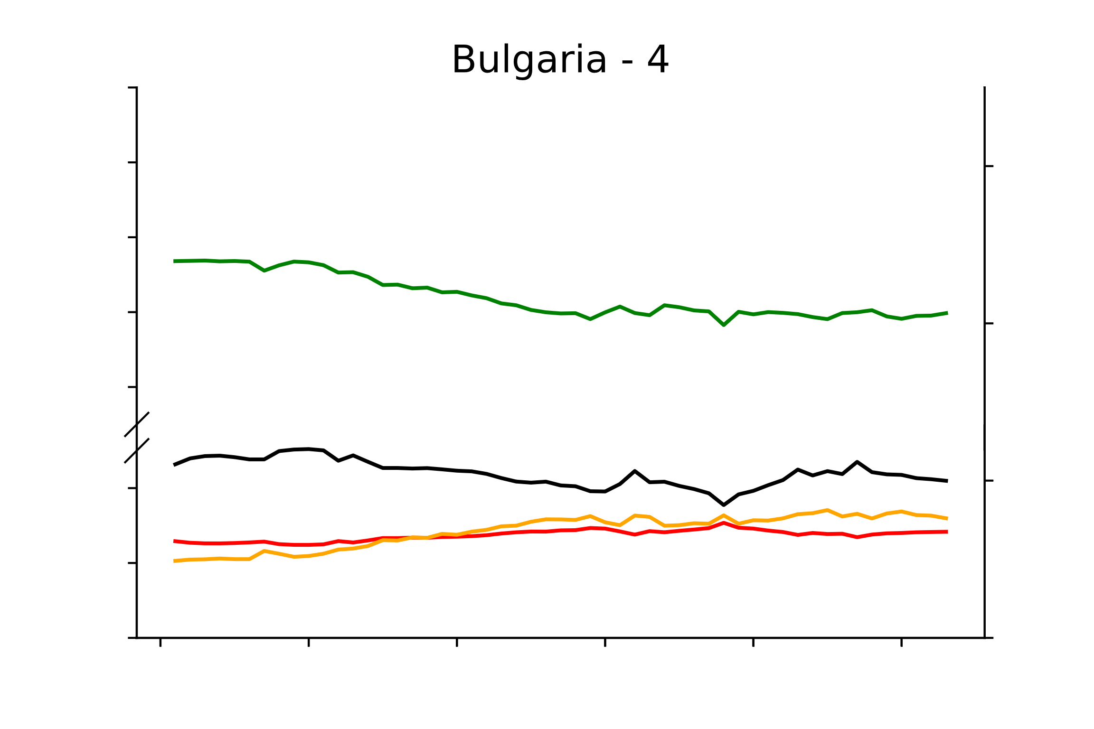
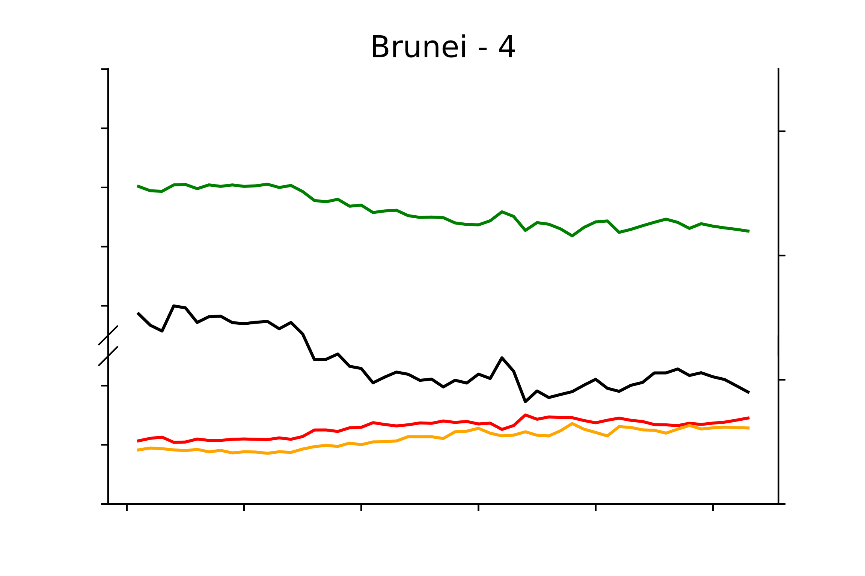
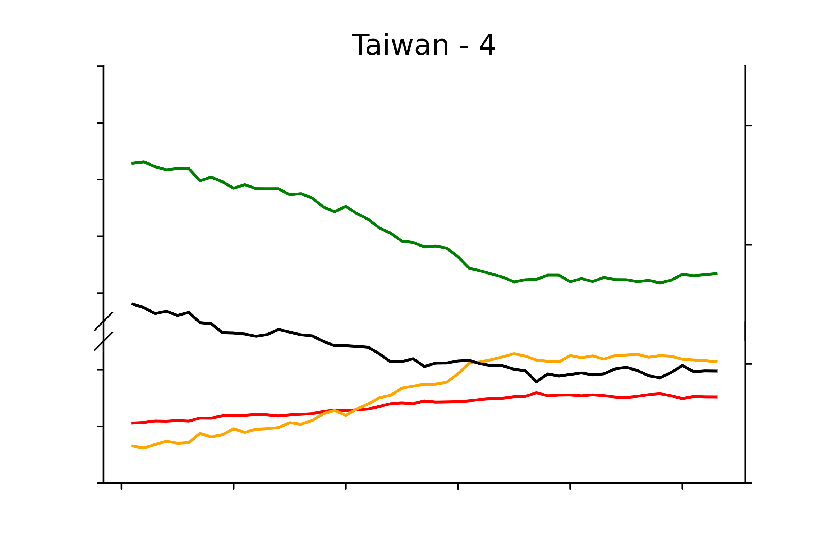
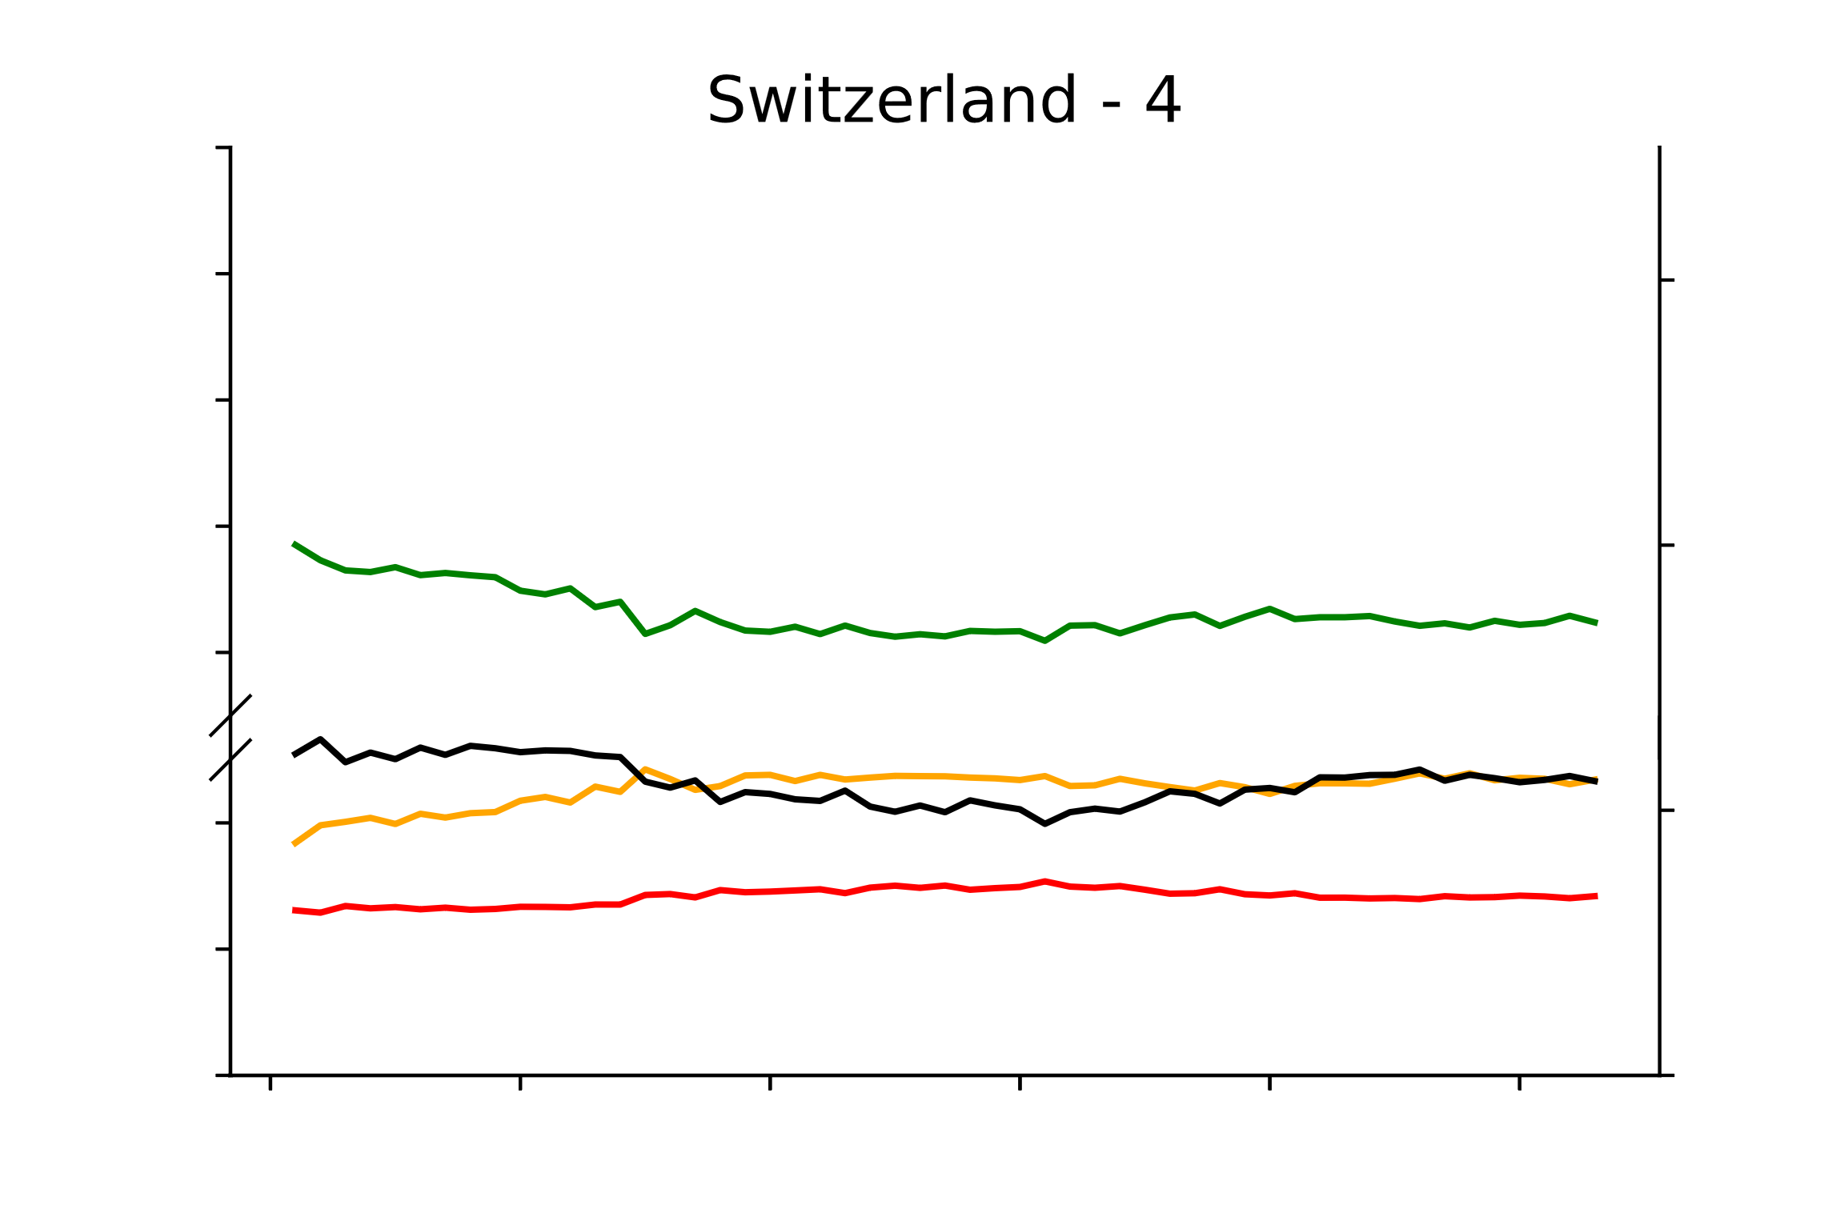
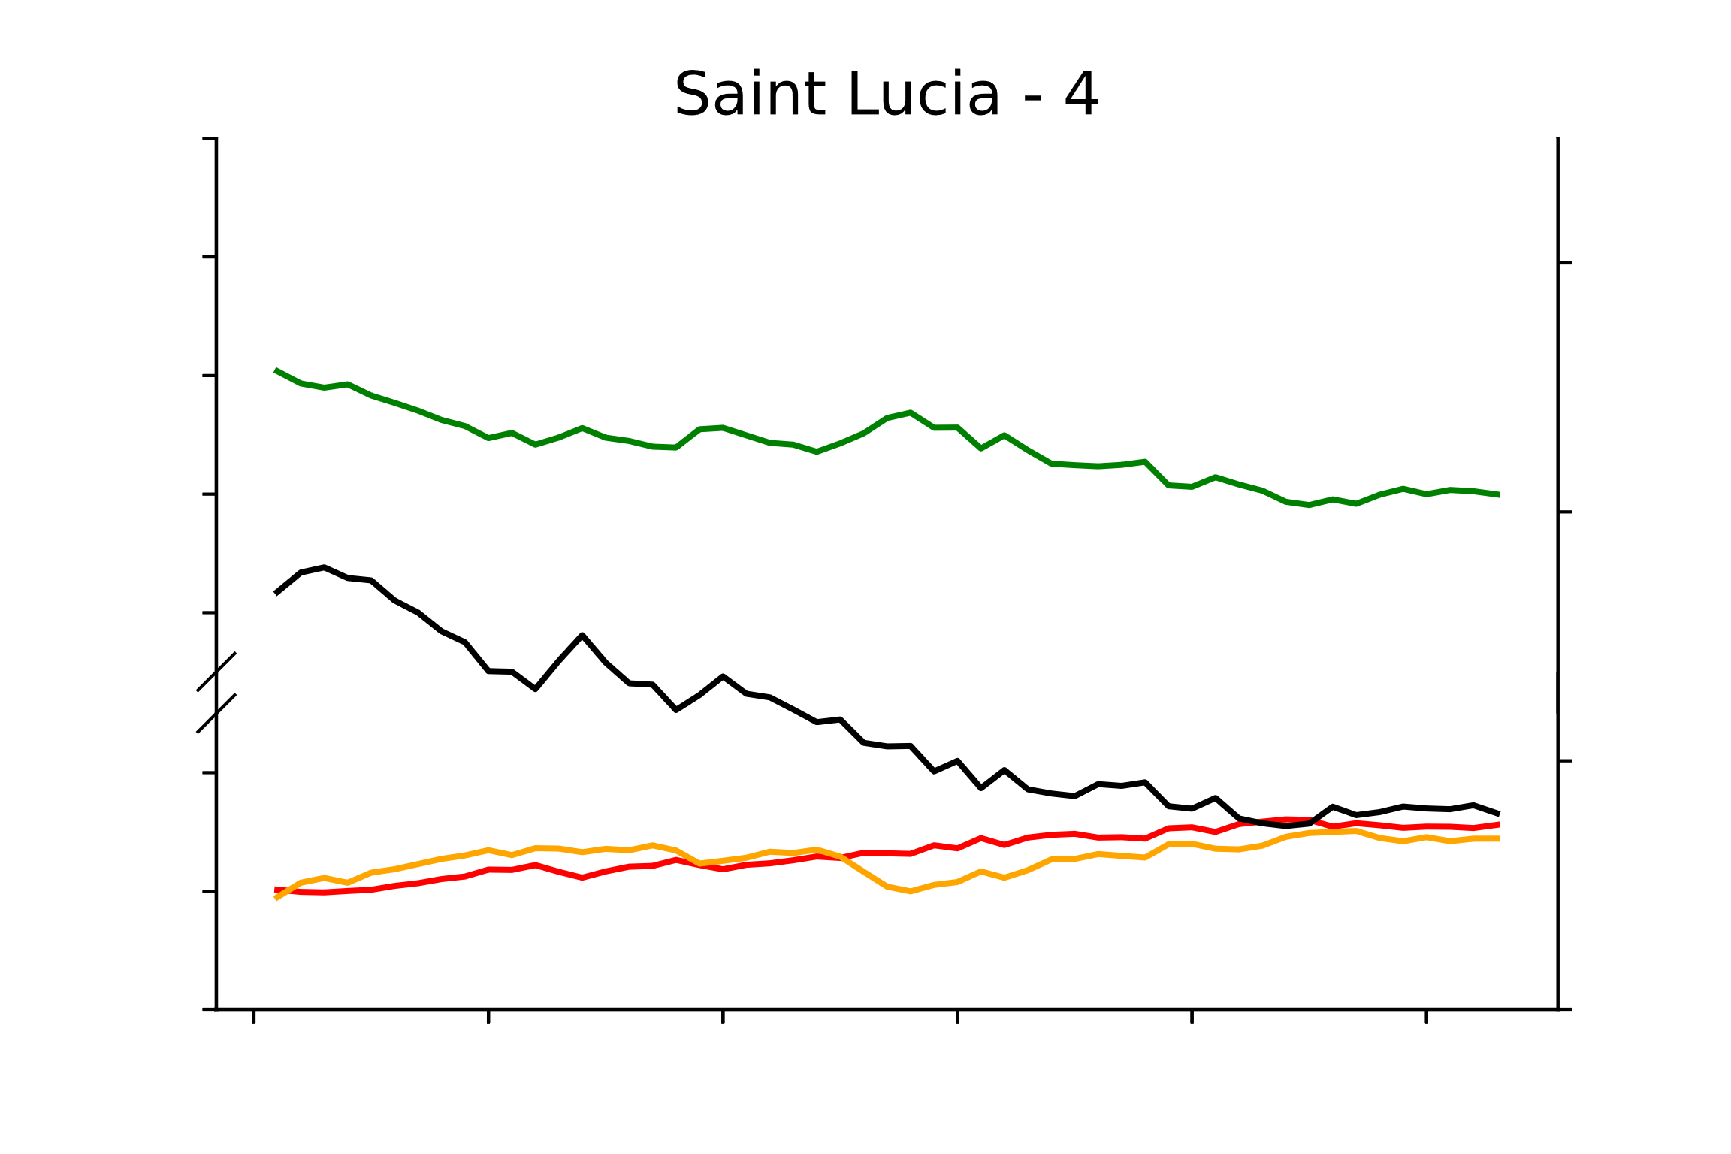
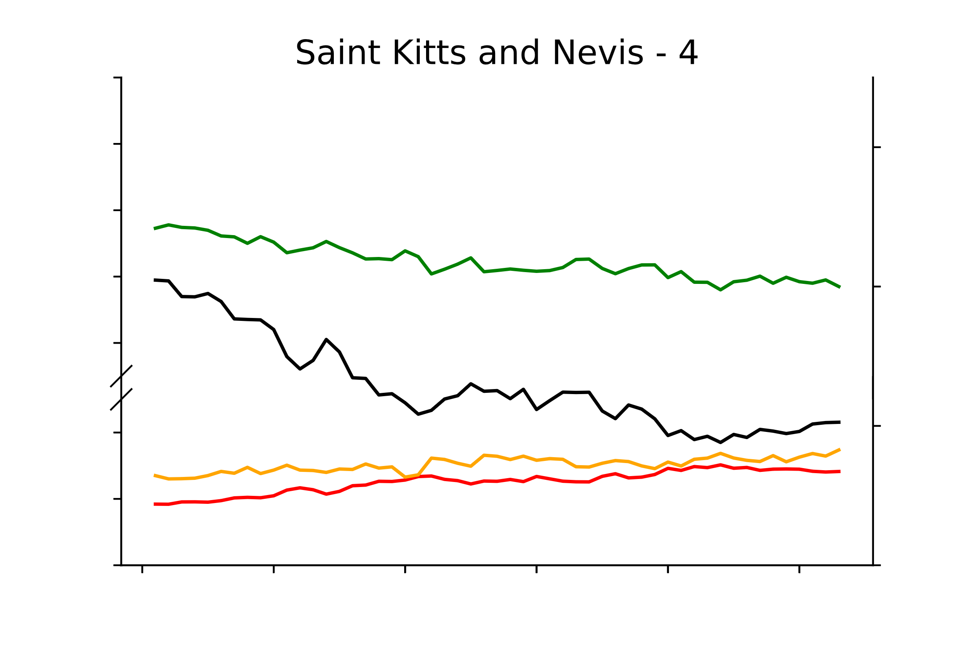
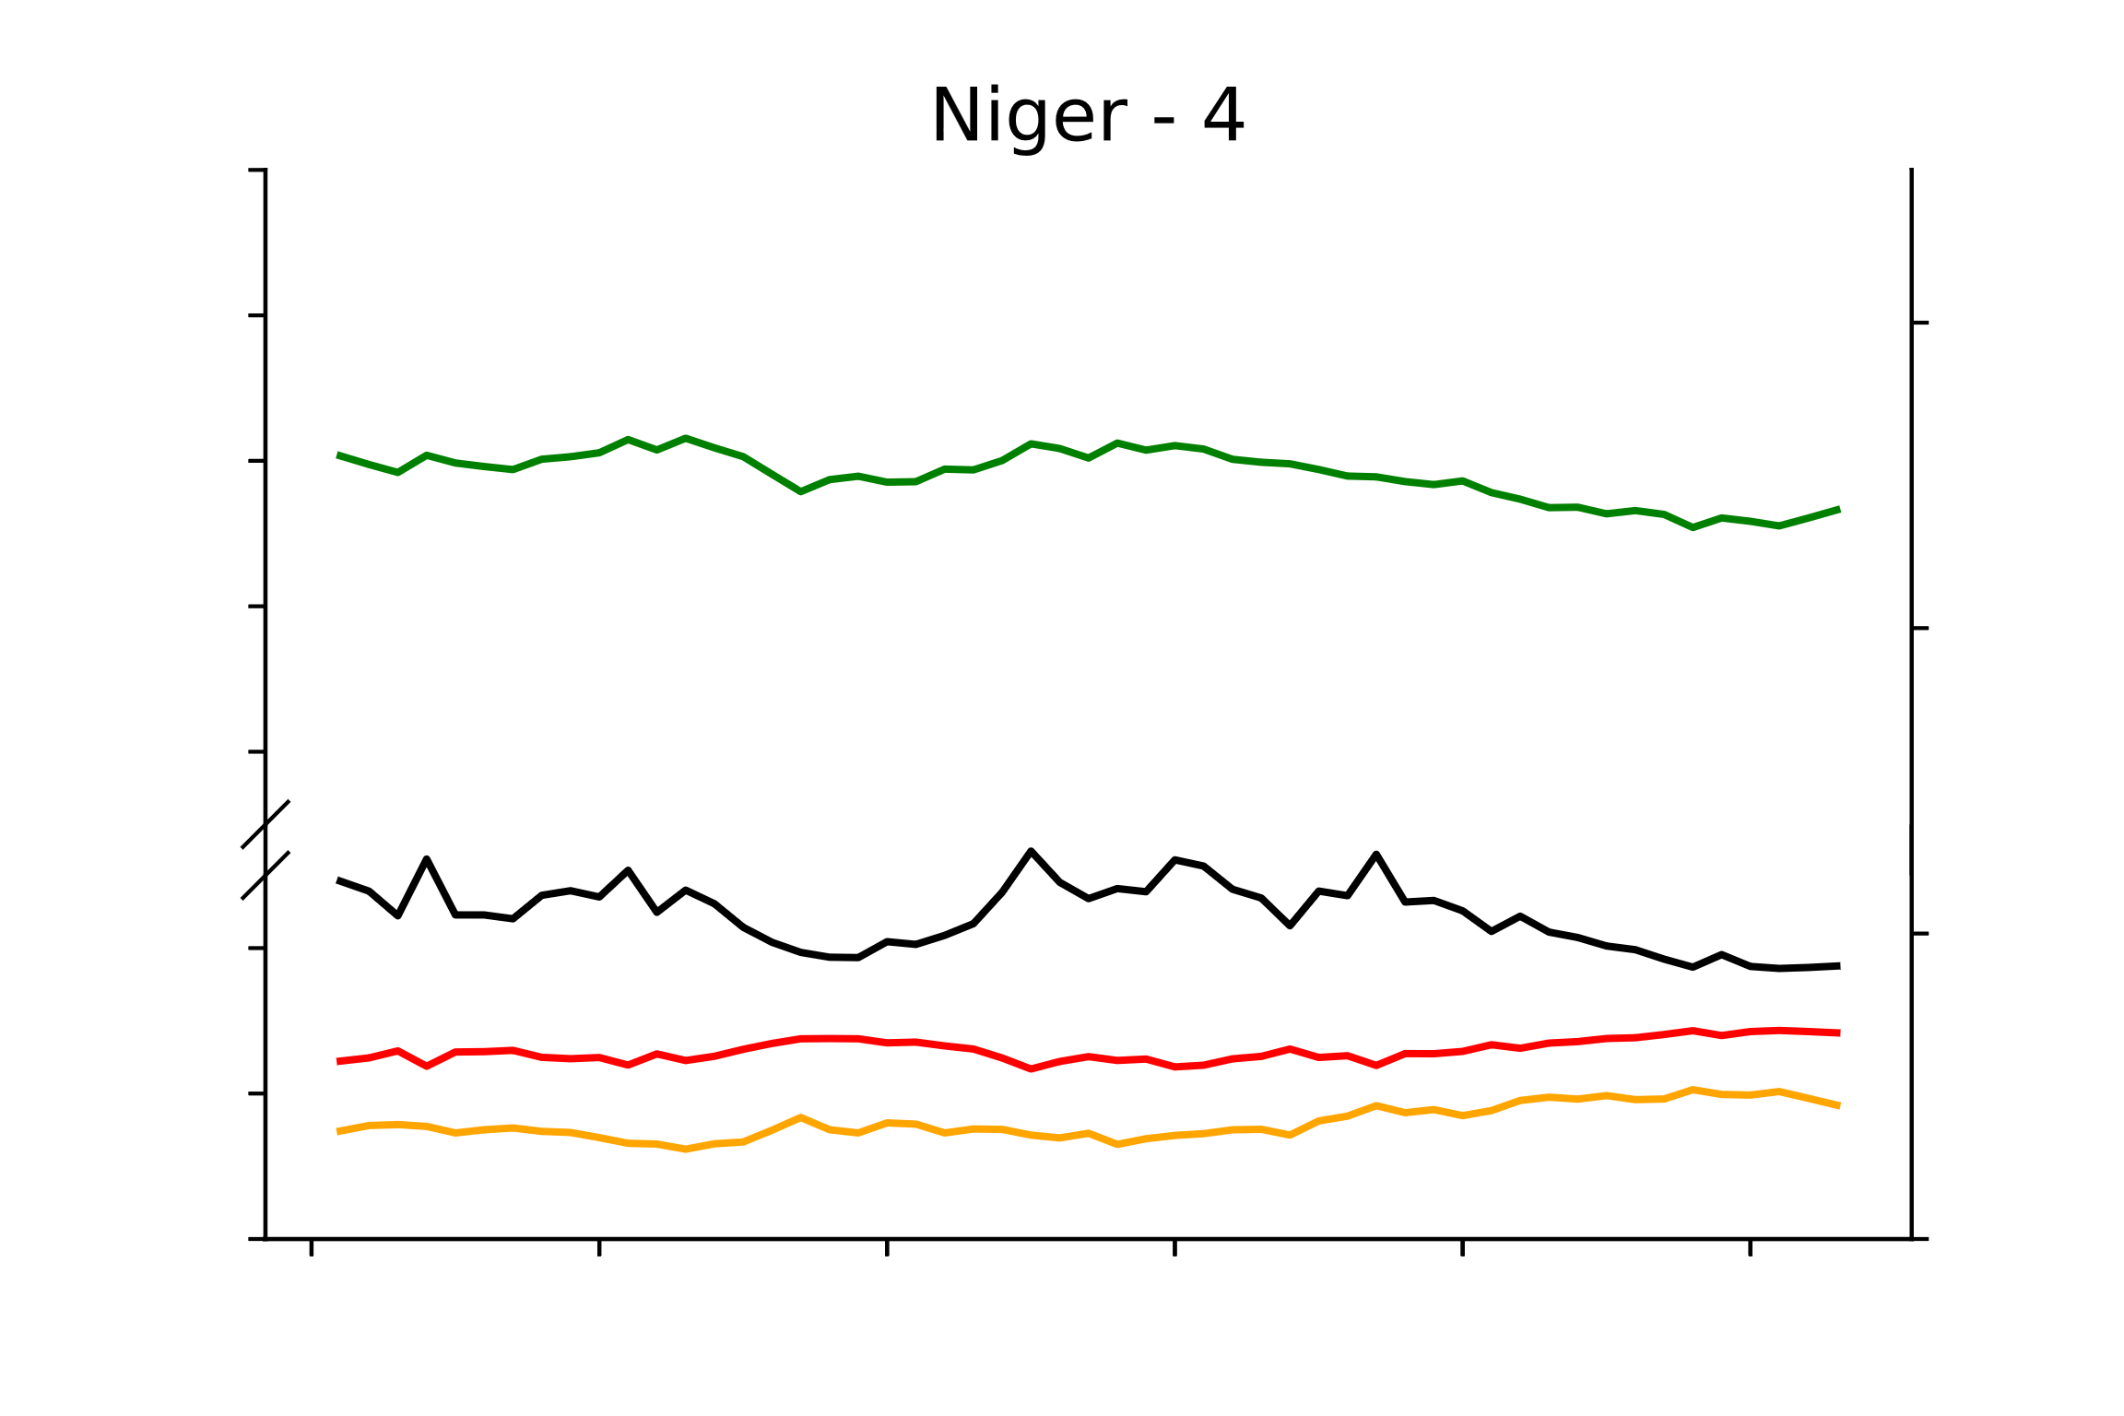
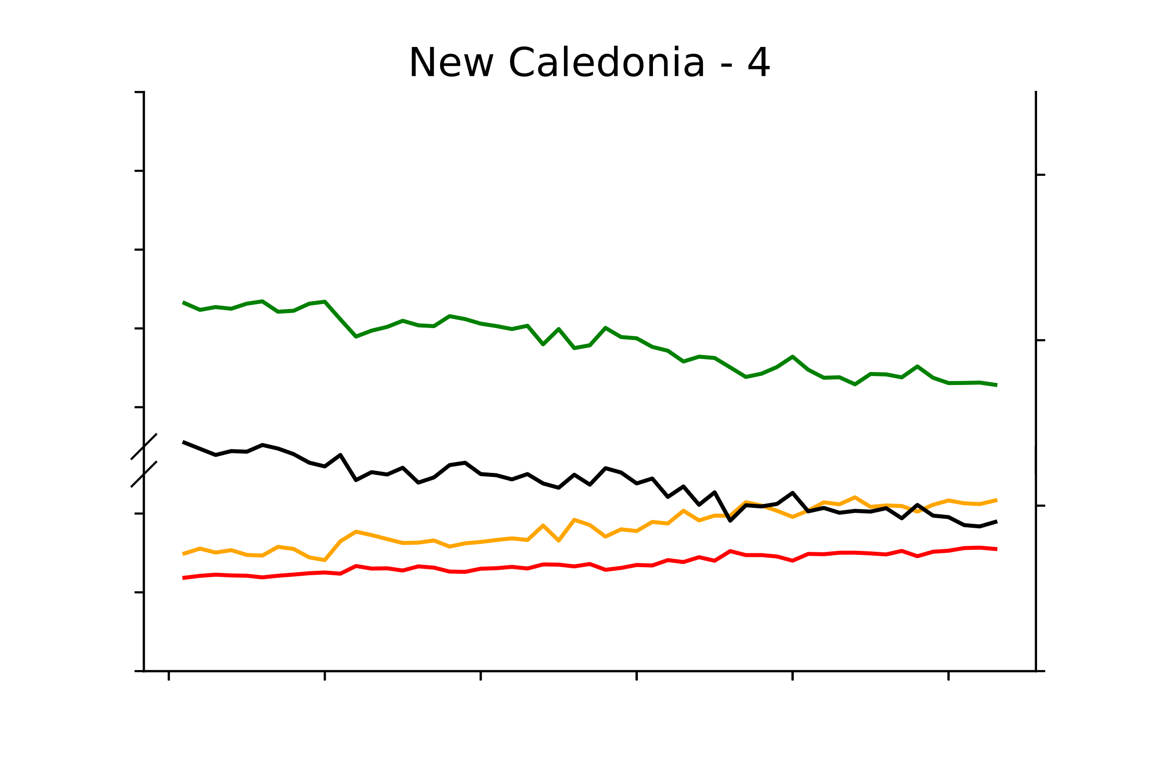




Continued: Diet composition and stoichiometry trends in 162 countries
100
90
40
80
70
30
60
20
20
10
10
0
100
90
40
80
70
30
60
20
20
10
0
10
100
90
40
80
70
30
60
20
20
10
0
10
Macronutrient composition (%)
Human diet C/N
100
40
90
80
70
30
60
20
20
10
10
0
100
90
40
80
70
30
60
20
20
10
0
10
100
90
40
80
70
30
60
20
20
10
0
10
1961
1971
1981
1991
2001
2010
1961
1971
1981
1991
2001
2010
1961
1971
1981
1991
2001
2010
Time (years)

Slide 4


















Continued: Diet composition and stoichiometry trends in 162 countries
100
40
90
80
30
70
60
20
20
10
10
0
100
40
90
80
70
30
60
20
20
10
10
0
100
90
40
80
70
30
60
20
20
10
0
10
Macronutrient composition (%)
Human diet C/N
100
40
90
80
30
70
60
20
20
10
10
0
100
90
40
80
70
30
60
20
20
10
0
10
100
90
40
80
70
30
60
20
20
10
0
10
1961
1971
1981
1991
2001
2010
1961
1971
1981
1991
2001
2010
1961
1971
1981
1991
2001
2010
Time (years)

Slide 5


















Continued: Diet composition and stoichiometry trends in 162 countries
100
40
90
80
70
30
60
20
20
10
10
0
100
90
40
80
70
30
60
20
20
10
0
10
100
90
40
80
70
30
60
20
20
10
10
0
Macronutrient composition (%)
Human diet C/N
100
90
40
80
70
30
60
20
20
10
10
0
100
40
90
80
70
30
60
20
20
10
10
0
100
90
40
80
70
30
60
20
20
10
0
10
1961
1971
1981
1991
2001
2010
1961
1971
1981
1991
2001
2010
1961
1971
1981
1991
2001
2010
Time (years)

Slide 6


















Continued: Diet composition and stoichiometry trends in 162 countries
100
90
40
80
70
30
60
20
20
10
10
0
100
90
40
80
70
30
60
20
20
10
0
10
100
40
90
80
30
70
60
20
20
10
10
0
Macronutrient composition (%)
Human diet C/N
100
90
40
80
70
30
60
20
20
10
0
10
100
90
40
80
70
60
30
20
20
10
0
10
100
40
90
80
30
70
60
20
20
10
10
0
1961
1971
1981
1991
2001
2010
1961
1971
1981
1991
2001
2010
1961
1971
1981
1991
2001
2010
Time (years)

Slide 7


















Continued: Diet composition and stoichiometry trends in 162 countries
100
90
40
80
70
30
60
20
20
10
0
10
100
90
40
80
70
30
60
20
20
10
0
10
100
40
90
80
70
30
60
20
20
10
10
0
Macronutrient composition (%)
100
Human diet C/N
90
40
80
70
30
60
20
20
10
10
0
100
40
90
80
30
70
60
20
20
10
10
0
100
40
90
80
70
30
60
20
20
10
10
0
1961
1971
1981
1991
2001
2010
1961
1971
1981
1991
2001
2010
1961
1971
1981
1991
2001
2010
Time (years)

Slide 8


















Continued: Diet composition and stoichiometry trends in 162 countries
100
40
90
80
70
30
60
20
20
10
10
0
100
40
90
80
30
70
60
20
20
10
10
0
100
90
40
80
70
30
60
20
20
10
10
0
Macronutrient composition (%)
100
Human diet C/N
90
40
80
70
30
60
20
20
10
10
0
100
90
40
80
70
30
60
20
20
10
0
10
100
90
40
80
70
30
60
20
20
10
0
10
1961
1971
1981
1991
2001
2010
1961
1971
1981
1991
2001
2010
1961
1971
1981
1991
2001
2010
Time (years)

Slide 9


















Continued: Diet composition and stoichiometry trends in 162 countries
100
40
90
80
70
30
60
20
20
10
10
0
100
40
90
80
70
30
60
20
20
10
10
0
100
90
40
80
70
30
60
20
20
10
0
10
Macronutrient composition (%)
100
Human diet C/N
90
40
80
30
70
60
20
20
10
10
0
100
40
90
80
30
70
60
20
20
10
10
0
100
40
90
80
30
70
60
20
20
10
10
0
1961
1971
1981
1991
2001
2010
1961
1971
1981
1991
2001
2010
1961
1971
1981
1991
2001
2010
Time (years)
Fig. S2: The macronutrients and the human diet C/N pattern in each country from 1961 to 2013. Carbohydrates (green line), Fats (yellow line), Proteins (red line) and C/N (black line).

