Slide 1

Autonomous car
Sabry Mohamed Sabry
Kareem Mohamed Anwer
Mahmoud Mohamed Abdallah
Ahmed Mohamed Abdelaziz
Abdelrahman Emad Ibraim

Slide 2
Firstly… The car initially moves forward in case the car detect an obstacle by Ultrasonic Sensor: 1- The servo motor moves left subsequently the ultrasonic measures the distance at the left side of the car. the servo motor moves right subsequently the ultrasonic measures the distance at the right of the car. The car compares the two measured distances. 2- in case the left distance is greater than right distance: the car moves left and then forward [the direction will be displayed on the LCD]. in case the right distance is greater than left distance: the car moves right and then forward [the direction will be displayed on the LCD]. in case both direction are less than 20 the car moves back and then measures right and left distances.

Slide 3
Components:
1. Ultrasonic HC- SR04.
2. Servo motor.
3. L293D.
4. 4 Wheeled RC CAR
5. DC motors
6. chassis

Slide 4
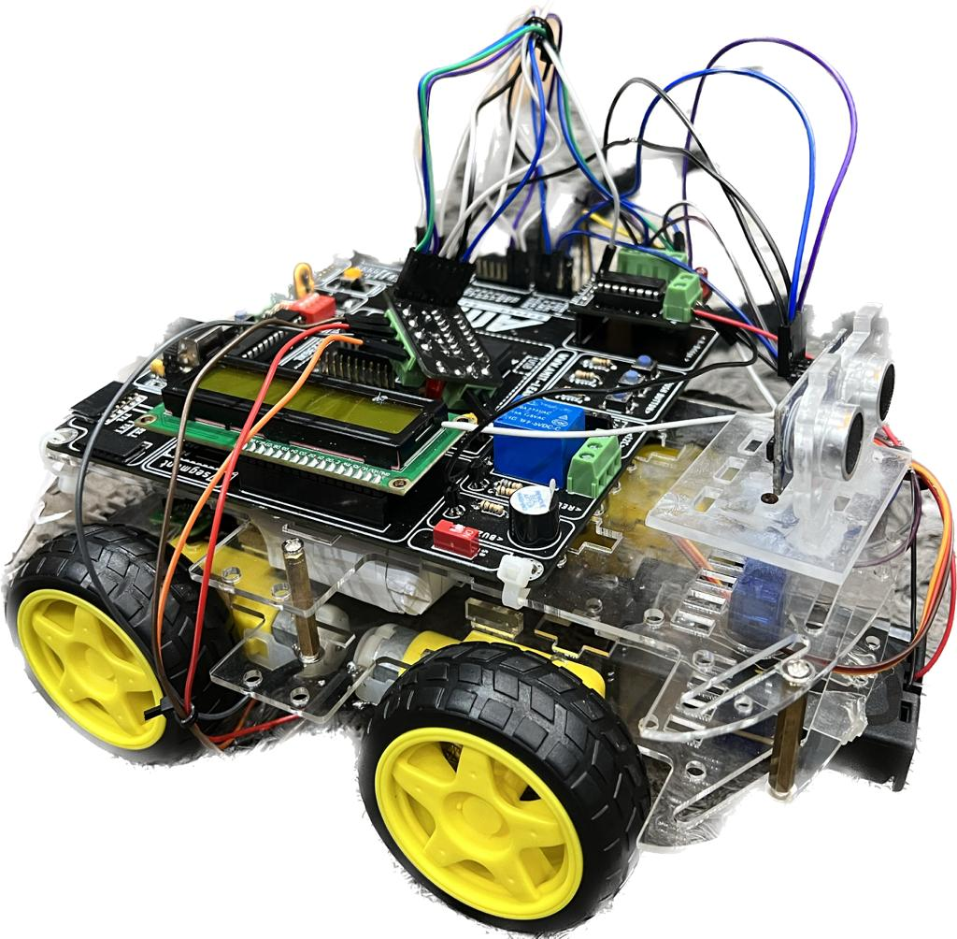
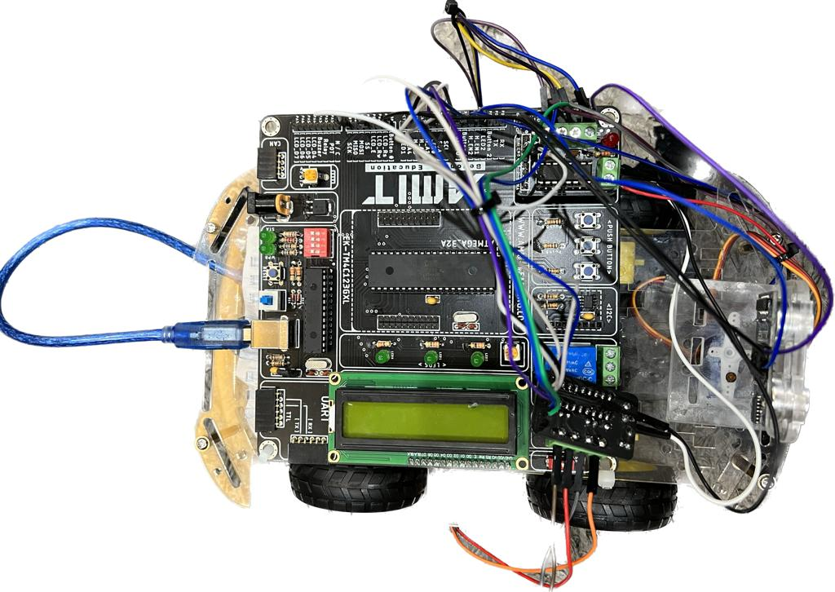
Here is the photos of the car after the hardware assembly using ATmega32A kit …

Slide 5
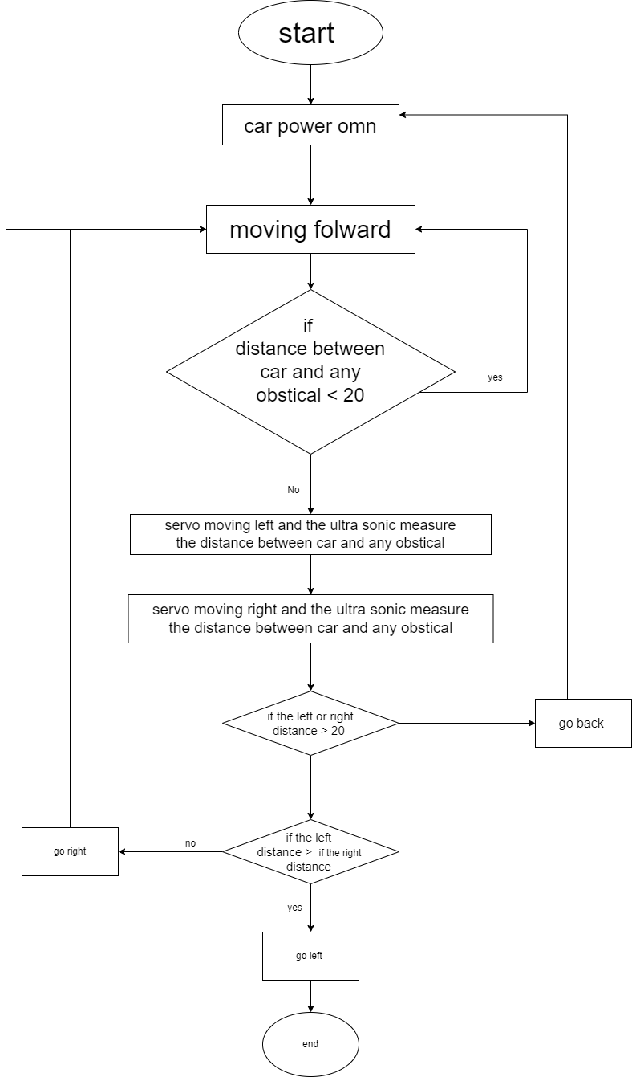
Flow chart

Slide 6
Github Link of the Project :
https://github.com/sabry112002/Autonomous-car
NOTE : There is an attached video of the car while moving through different situations

