Slide 1
Cleaning Operations Workflow Demo
Odoo 19 Field Service + Portal Cleaner Execution Flow

Slide 2
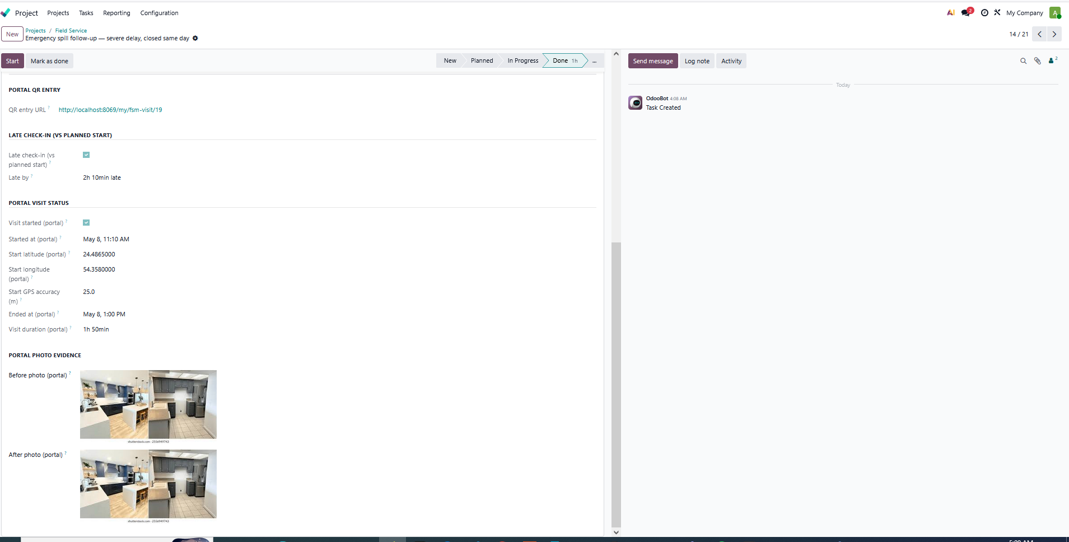
Scene 1 — Manager-side operational evidence overview
Single-task visibility of QR entry, late check-in, timestamps, GPS, duration, and photo evidence.

Slide 3
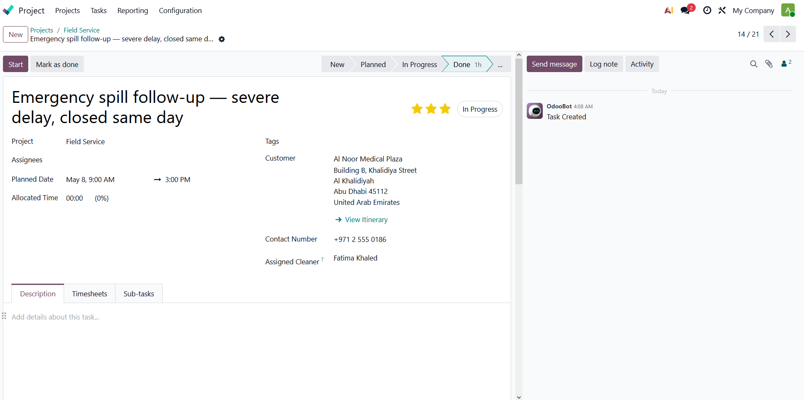
Scene 2 — Assignment, site, and planned visit overview
Manager can see the visit title, customer site, planned window, and assigned cleaner.

Slide 4
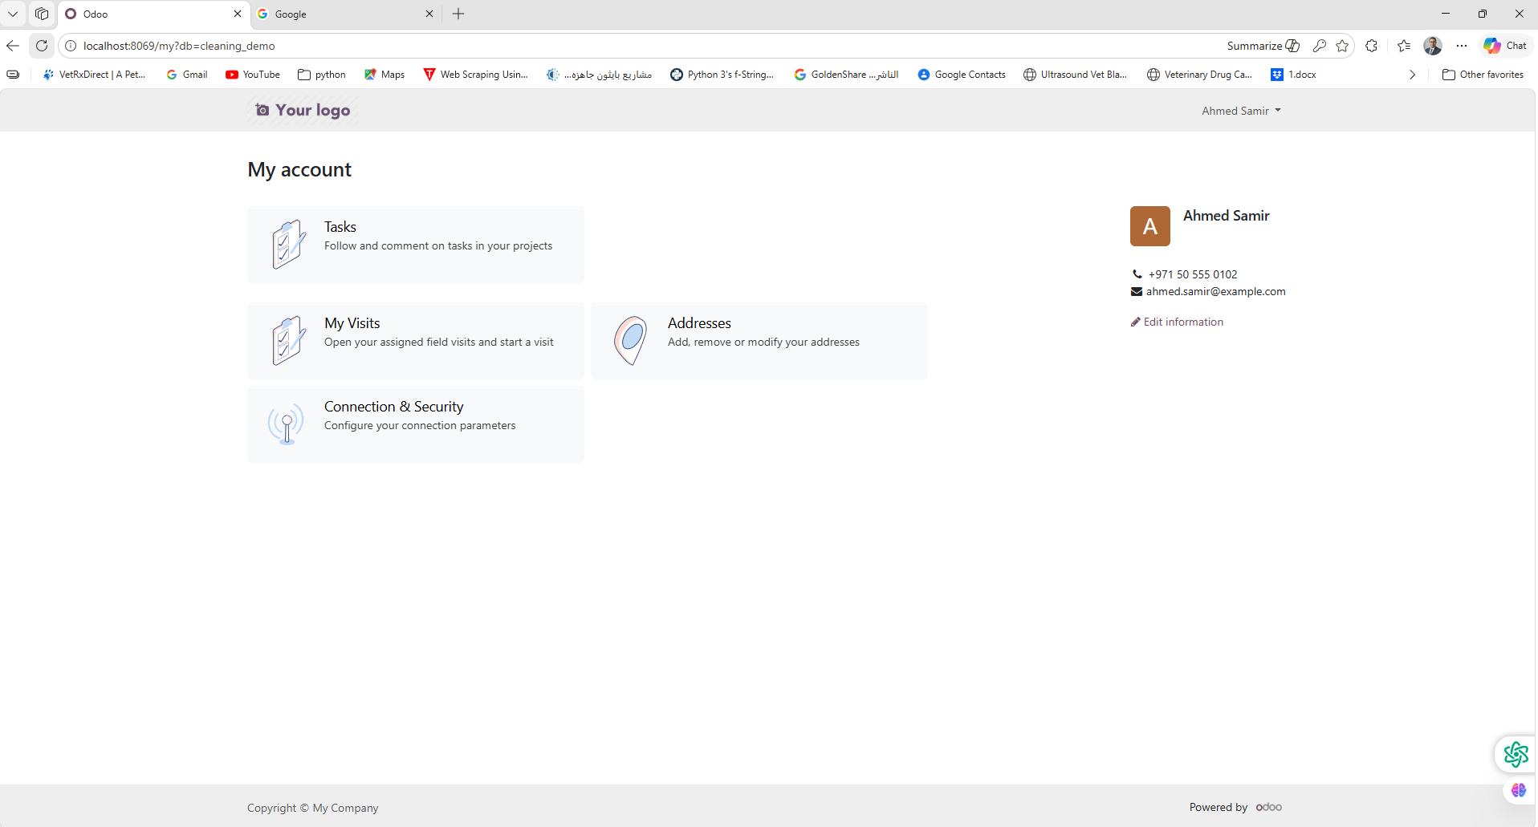
Scene 3 — Cleaner portal homepage and entry point
Cleaner accesses the workflow from a simple portal homepage through My Visits.

Slide 5
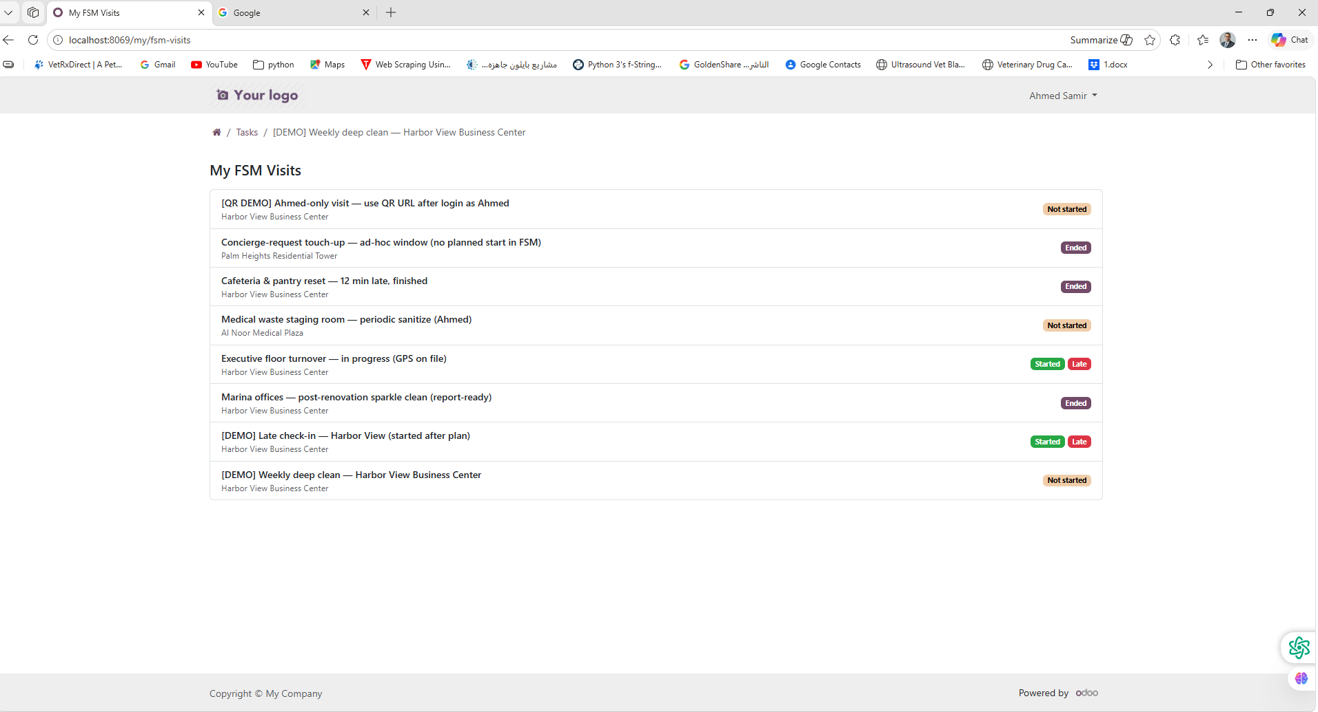
Scene 4 — Cleaner work queue / My Visits list
Cleaner sees only assigned visits with clear operational statuses.

Slide 6
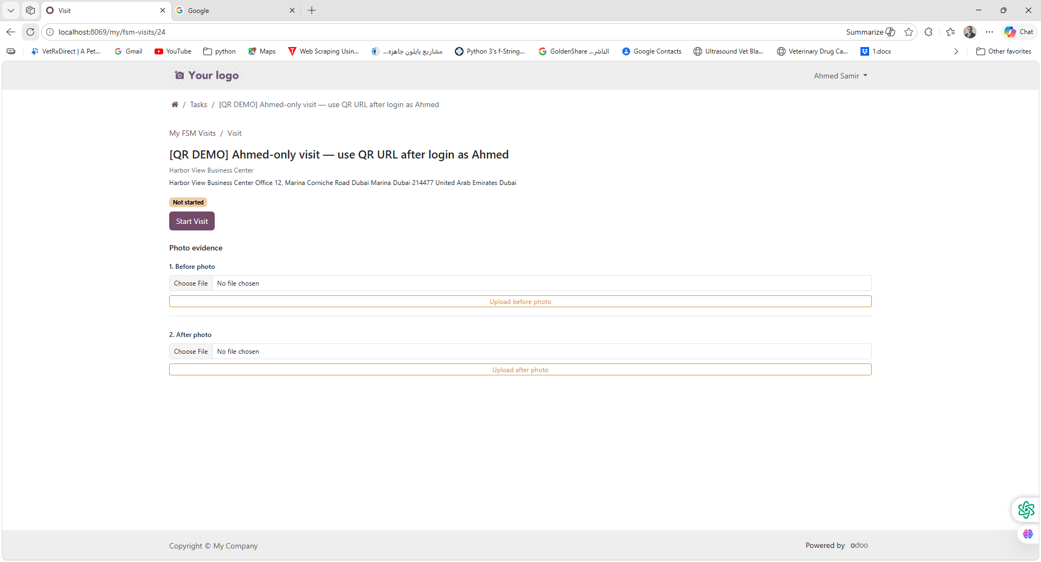
Scene 5 — Visit detail before starting execution
Visit starts from a simple portal page with Start Visit and photo evidence sections.

Slide 7
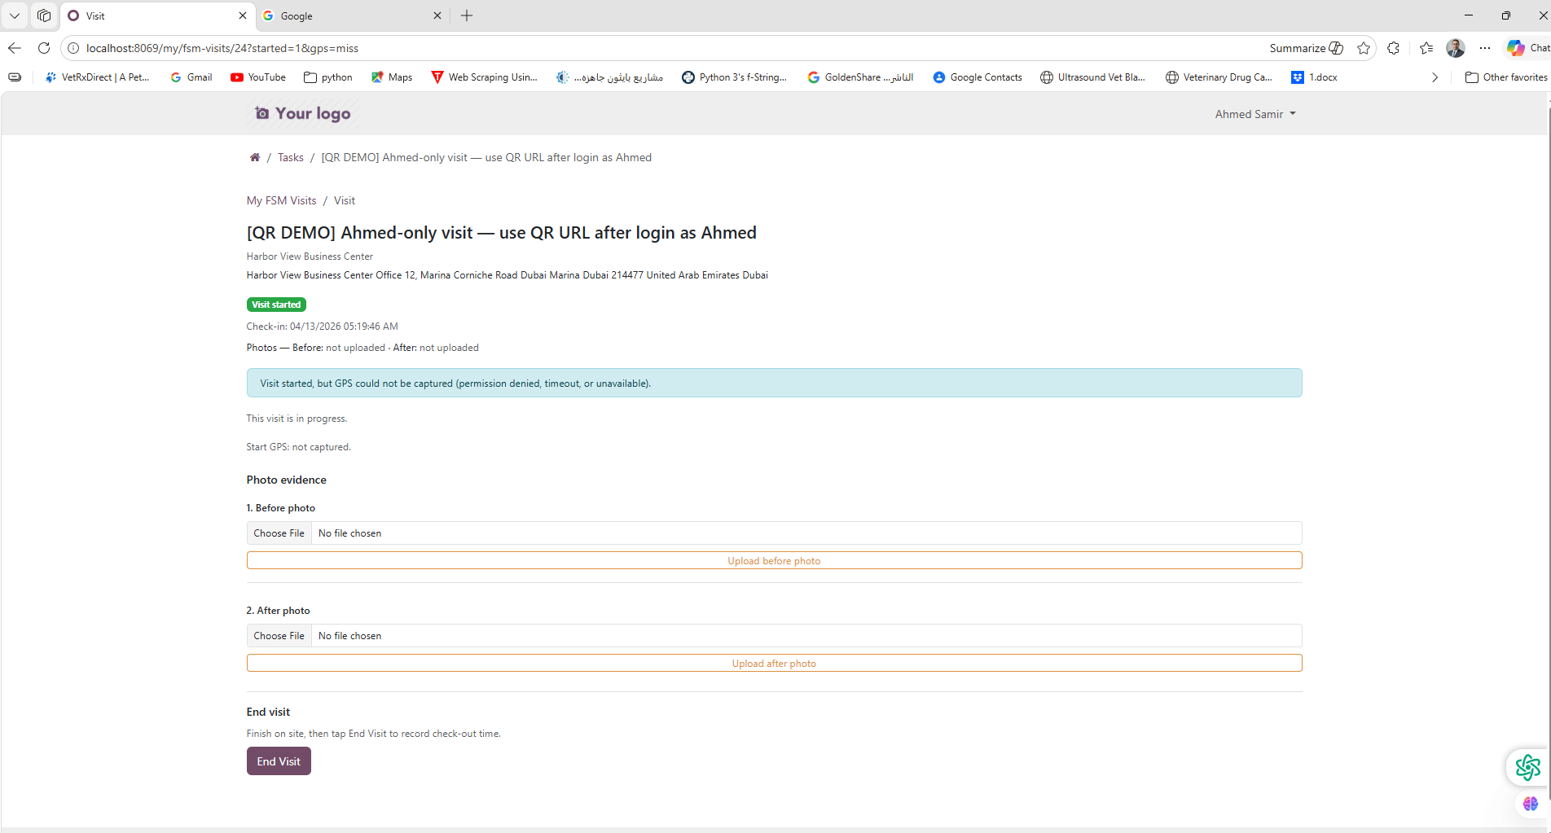
Scene 6 — Visit started with graceful GPS fallback
Check-in is recorded even when GPS cannot be captured.

Slide 8
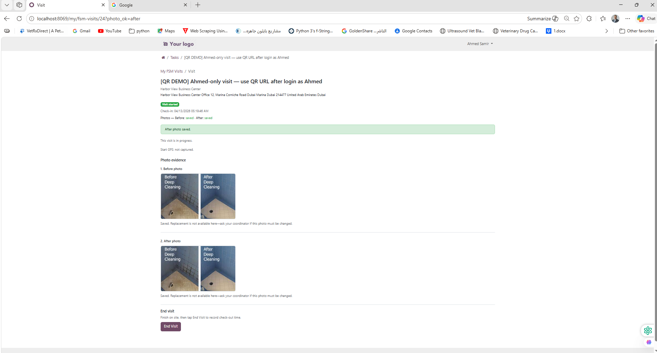
Scene 7 — Before and after photo evidence captured
Cleaner uploads visual evidence directly from the portal.

Slide 9
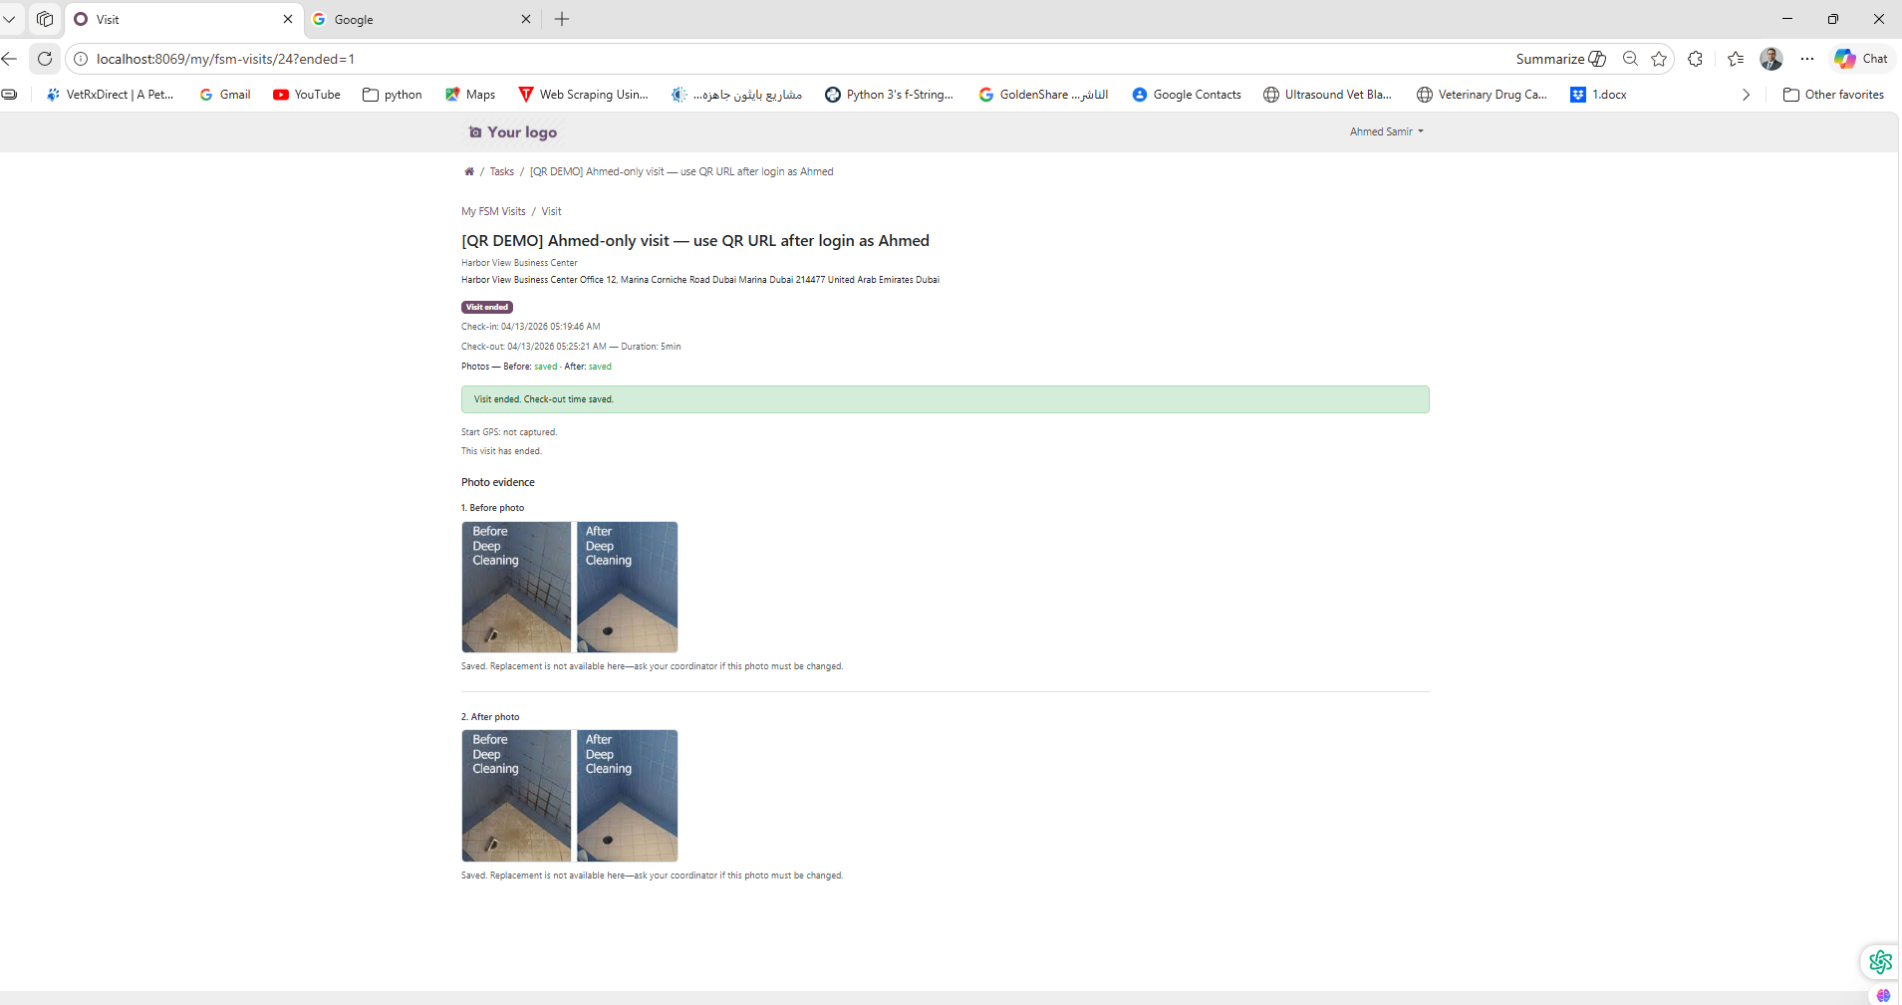
Scene 8 — Visit completed with check-out and duration
System records check-out and computes total visit duration.

Slide 10
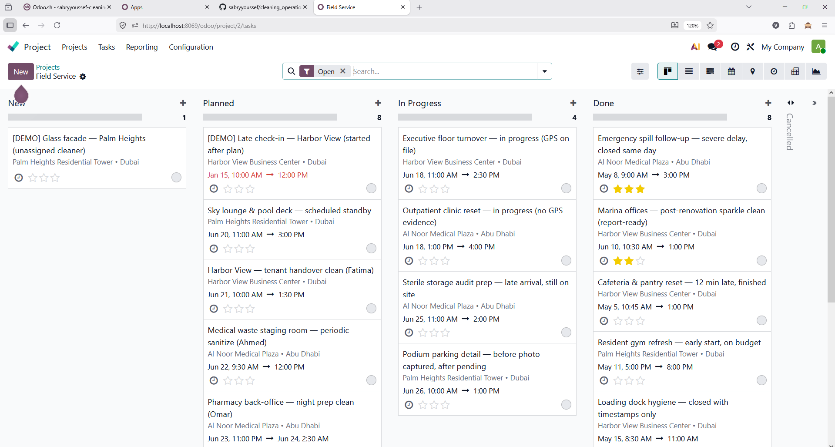
Scene 9 — Late check-in visibility for the manager
Manager can clearly identify delayed visit starts versus the planned schedule.

Slide 11
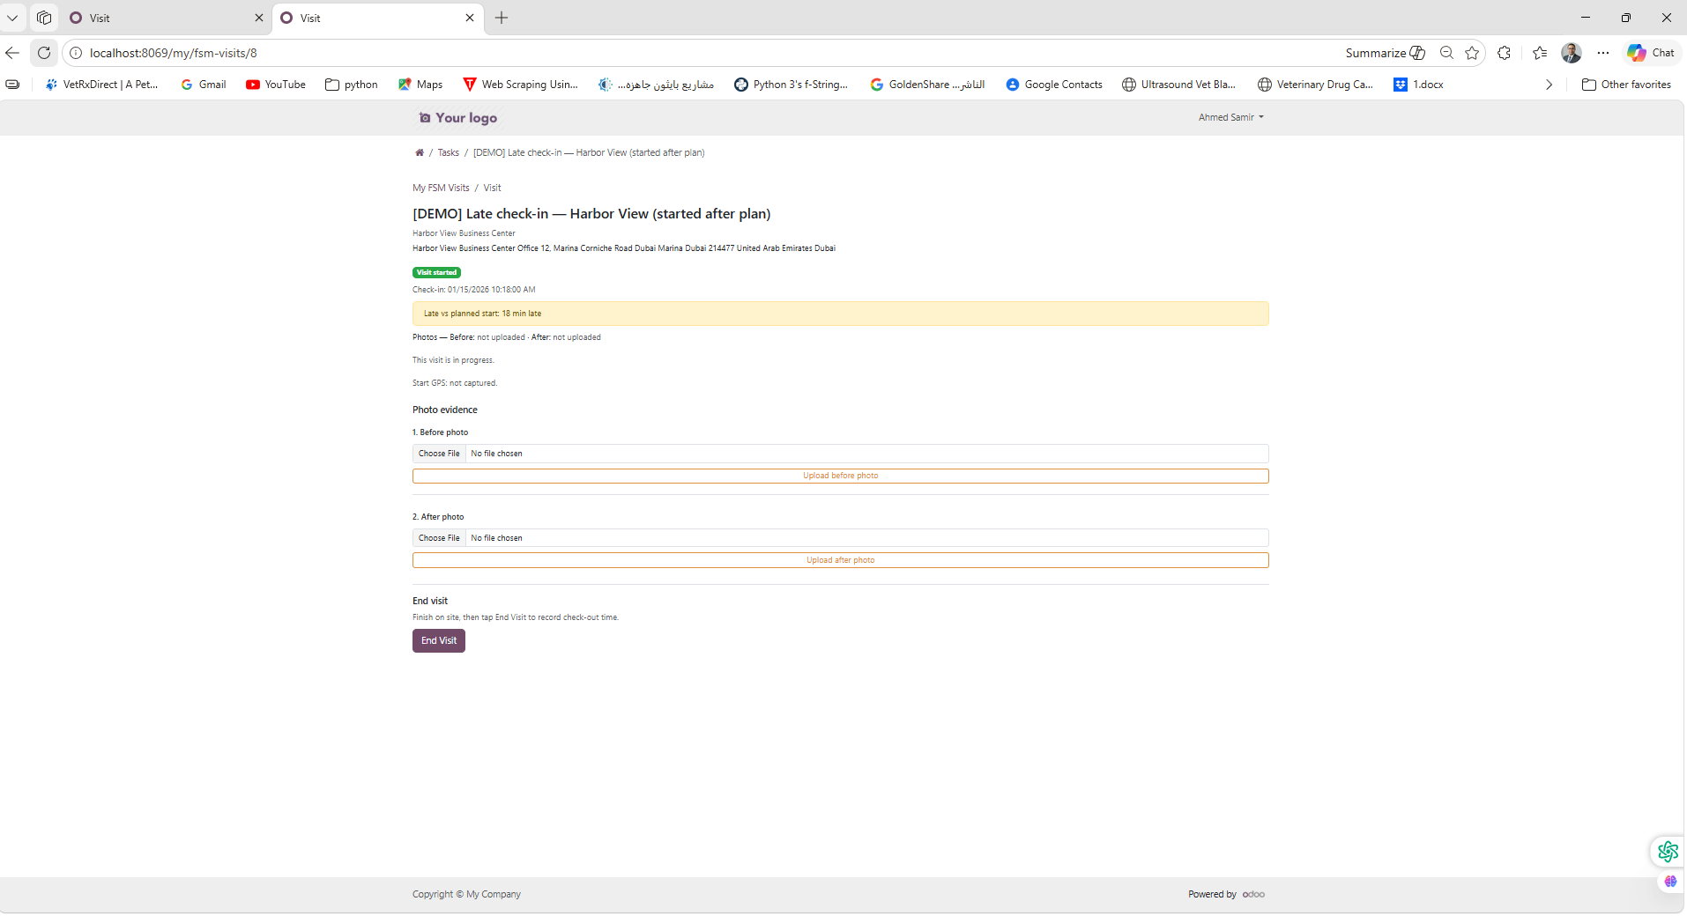
Scene 10 — QR-based entry URL for the visit
Each visit can be opened through a lightweight URL-based QR entry flow.

Slide 12
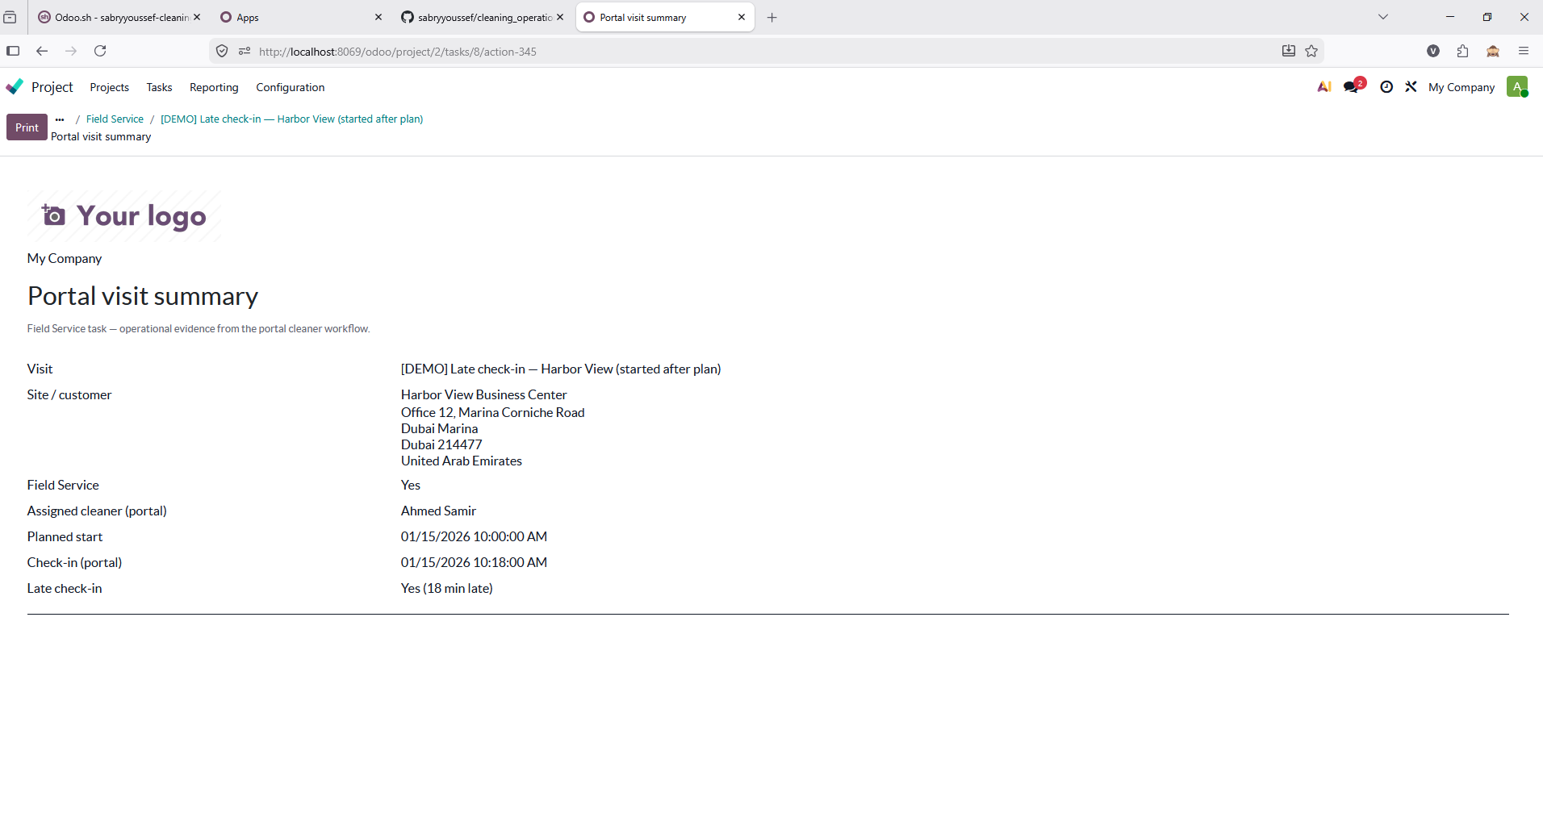
Scene 11 — Printable portal visit summary report
Manager can export a clean single-visit summary for review and presentation.

Slide 13
Summary
Manager-side visit assignment and oversight
Cleaner portal execution flow
Start and end timestamps
Optional GPS at check-in with graceful fallback
Before and after photo evidence
Late check-in visibility
QR-based visit entry
Printable visit summary report

